Slide 1
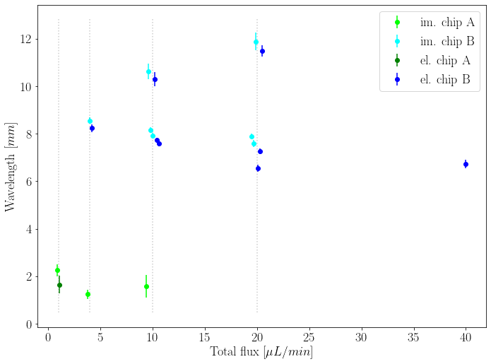











$$q_{w}=7.0$$
$$q_{o}=3.0$$
$$q_{w}=15.0$$
$$q_{o}=5.0$$
$$q_{w}=2.0$$
$$q_{o}=2.0$$
$$q_{w}=5.0$$
$$q_{o}=5.0$$
$$q_{w}=10.0$$
$$q_{o}=10.0$$
$$q_{w}=3.0$$
$$q_{o}=7.0$$
$$q_{w}=5.0$$
$$q_{o}=15.0$$
$$q_{w}=10.0$$
$$q_{o}=30.0$$
$$q_{w}=0.5$$
$$q_{o}=0.5$$
$$q_{w}=5.0$$
$$q_{o}=5.0$$
$$q_{w}=2.0$$
$$q_{o}=2.0$$

