Slide 1
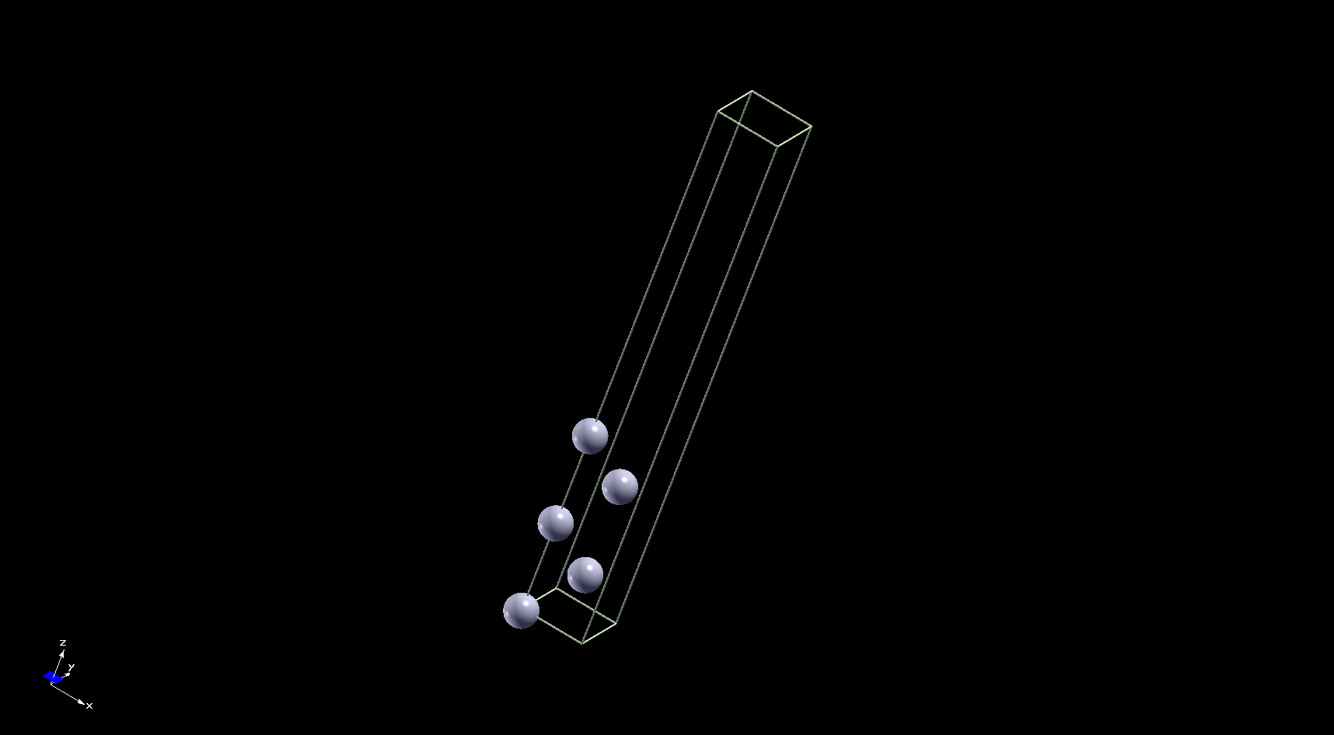





$$t_{v}$$
$${(n}_{layers}−1)\frac{a_{0}}{2}$$
$$n_{layers}\frac{a_{0}}{2}$$
$${a_{0}}/{\sqrt{2}}$$
$${a_{0}}/{\sqrt{2}}$$

