Slide 1


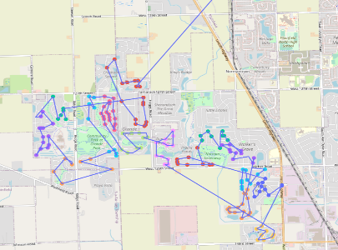
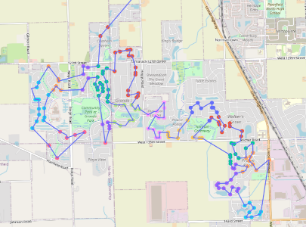
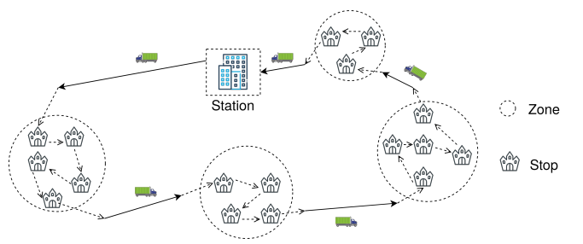
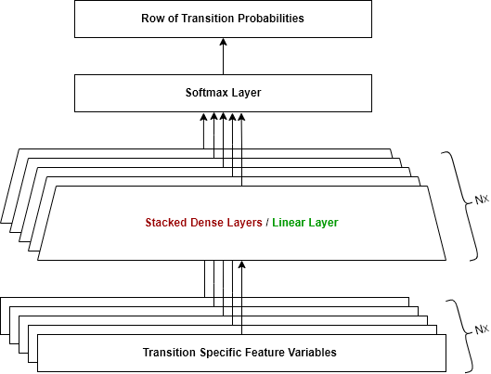
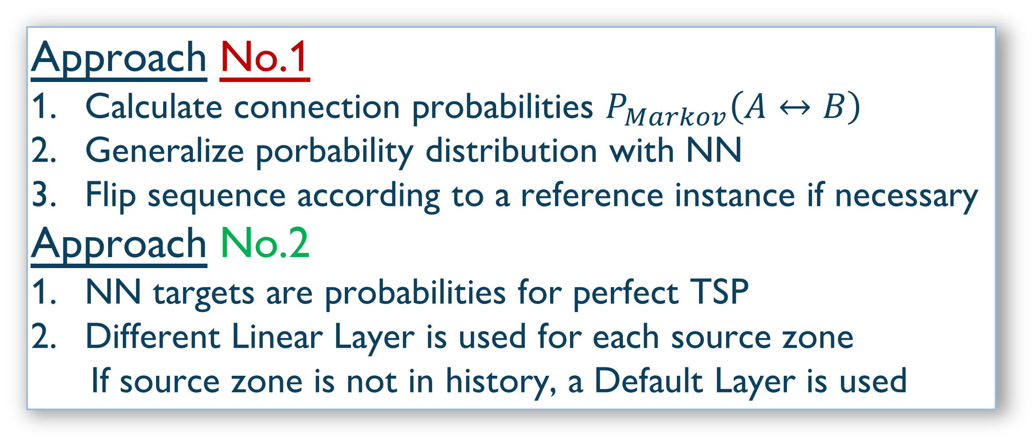
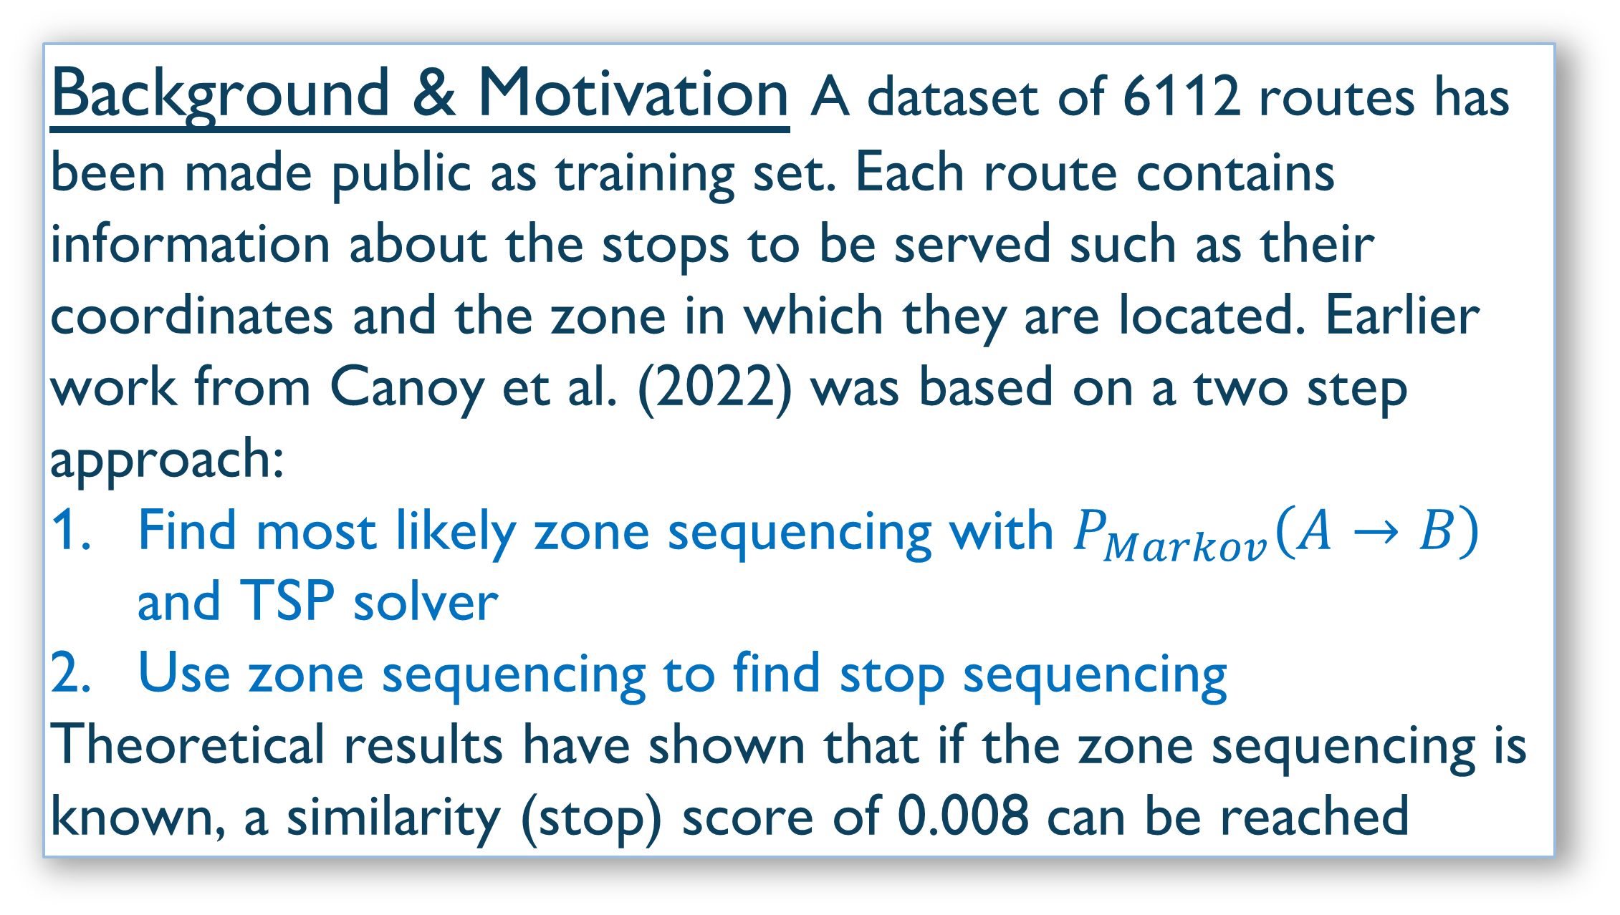
New approaches for the Amazon Last Mile Routing Challenge
Alessandro Marchese
About the Challenge A research challenge organized by Amazon’s Last Mile research team and MIT. The goal is to make use of AI and other non-conventional methods to generate better delivery routes in terms of quality and computational cost using a set of historical routes.
Routes performed by delivery drivers are not necessarily the best in terms of time or distance. How can they be predicted?
Background & Motivation A dataset of 6112 routes has been made public as training set. Each route contains information about the stops to be served such as their coordinates and the zone in which they are located. Earlier work from Canoy et al. (2022) was based on a two step approach:
Find most likely zone sequencing with $P_{Markov}\left(A→B\right)$ and TSP solver
Use zone sequencing to find stop sequencing
Theoretical results have shown that if the zone sequencing is known, a similarity (stop) score of 0.008 can be reached
Approach No.1
  Calculate connection probabilities $P_{Markov}\left(A↔B\right)$
  Generalize porbability distribution with NN
  Flip sequence according to a reference instance if necessary
Approach No.2
NN targets are probabilities for perfect TSP
Different Linear Layer is used for each source zone
If source zone is not in history, a Default Layer is used
Table of results | zone score | AD | Flipped AD
Approach No.1
Connection Probabilities | 0.0372 | 58.6 | 29.70
Neural Net | 0.0270 | 59.2 | 20.18
Neural Net with distances | 0.0270 | 59.4 | 19.80
Approach No.2 (sym.)
Neural Net | 0.0388 | 76.3 | 33.17
Neural Net with distances | 0.0356 | 76.0 | 29.48
Approach No.2 (asym.)
Neural Net | 0.0456 | 31.8 | 41.15
Neural Net with distances | 0.0409 | 30.6 | 38.21
Conluding Remarks & Future Work
Targetting symmetrical probabilities and adjusting directions by flipping sequences seems to be a reliable method for both approaches
Linear Layers from approach No.2 performed worse than expected. They should be trained individually with their corresponding data and not collectively
Approach | No.1 | No.2 (sym.) | No.2 (asym.)
stop score | 0.0257 | 0.0326 | 0.0418

