Slide 1

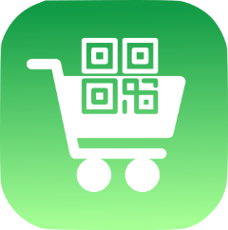
CLup: Customers Line-up
Advisor: Prof. Matteo Giovanni Rossi
Students: Alessandro Nocentini
Alberto Valentini
Fausto Luca Pichierri
M.Sc. Automation and Control Engineering
Software Engineering (for Automation)
Academic year 2021/2022

Slide 2

Clup: scope
regulate the influx of the people in a store
Avoid the creation of hazard gatherings outside the stores and crowds inside it
save time booking tickets from home

Slide 3
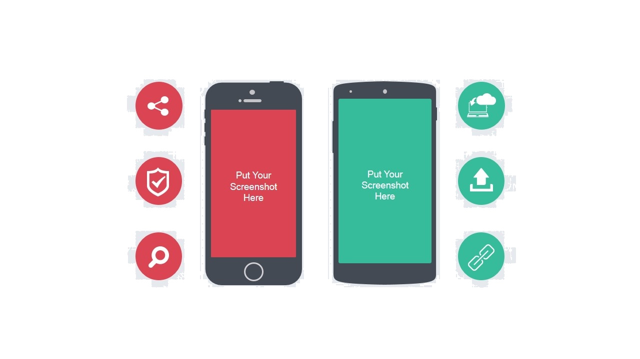
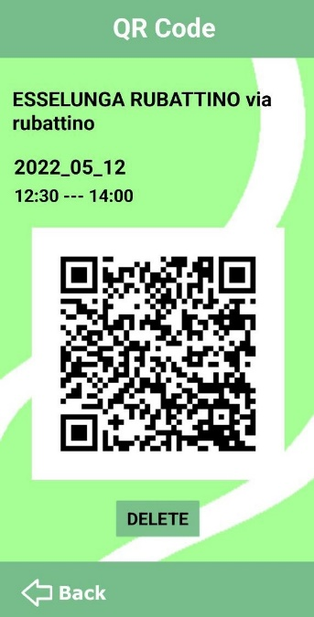
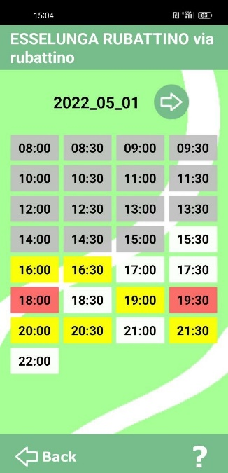
CLUP: FUNCTIONALITY
1
3
CHOOSE A SUPERMARKET
USE THE QR CODE
2
4
CHOOSE THE TIME SLOTS
GO SHOPPING

Slide 4
SOFTWARE LIFECYCLE
D1
D2
D3
D4
RASD
DESIGN DOCUMENT
IMPLEMENTATION
TESTING
Document containing a description of the requirements and the features of the app
Document which provide a functional description of the main architectural components of the system
It is presented a possible way to implement a prototype of the mobile phone application “Customers Line-up“ using App_inventor
Verification and validation of the application

Slide 5
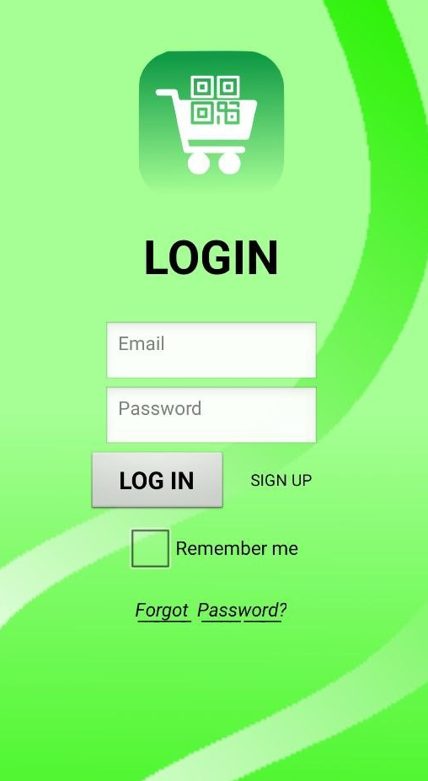
CLUP: HOME PAGE
LOG IN PAGE
Once the application has been open, the home page is shown. The user can log-in by uploading the correct credentials.
He can check the "remember me" box so as not to repeat these steps if the application is closed.
By pushing the “Forgot Password" button, the user will receive an email with the lost credentials.
If the user is new, he must first sign up

Slide 6
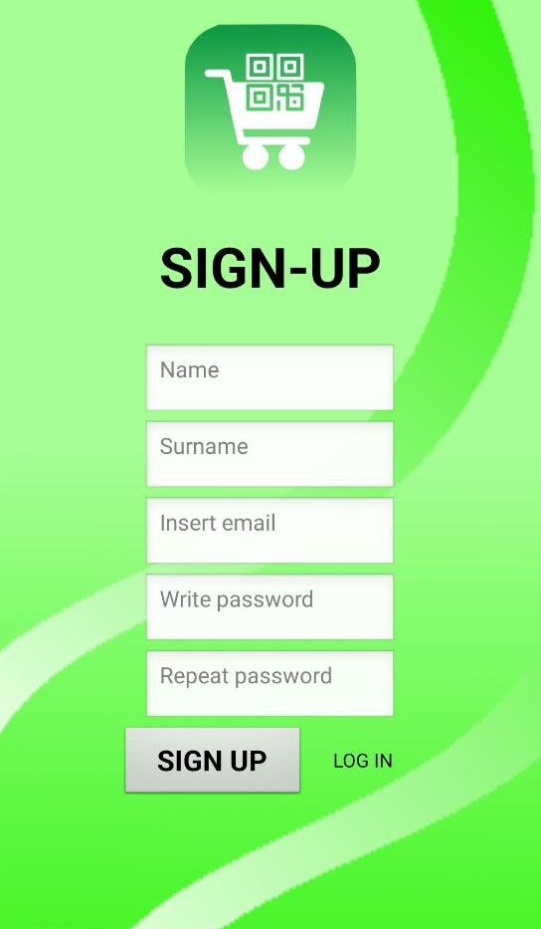
CLUP: REGISTRATION
SIGN UP PAGE
When the customer want to register to use the services of the app,
he must compile the sign-up form.
If the entered data are correct and if the user is not already registered, the process will be successful, and a confirmation email will be sent.
Then, he can log-in.

Slide 7
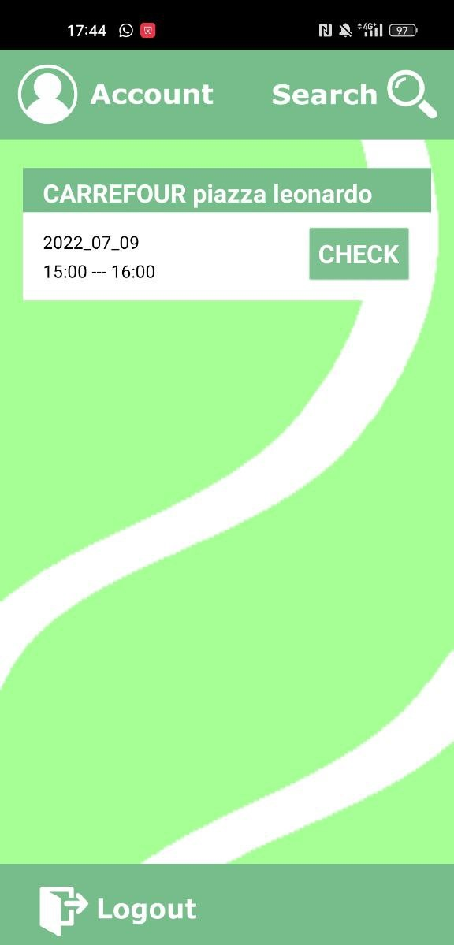
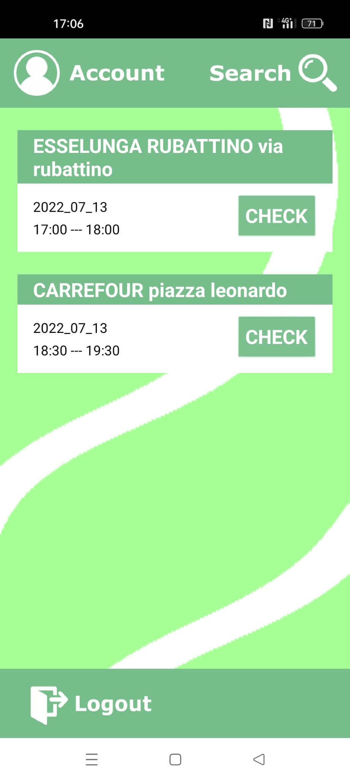
CLUP: SERVICES
MAIN PAGE
The logged-in user can take advantages of the app functions. He can check the current tickets or create a new one by pushing the “Search” button.
From the main page he can also open the User section by clicking on “Account”.
Once the user has finished the desired operations, he can log out.

Slide 8
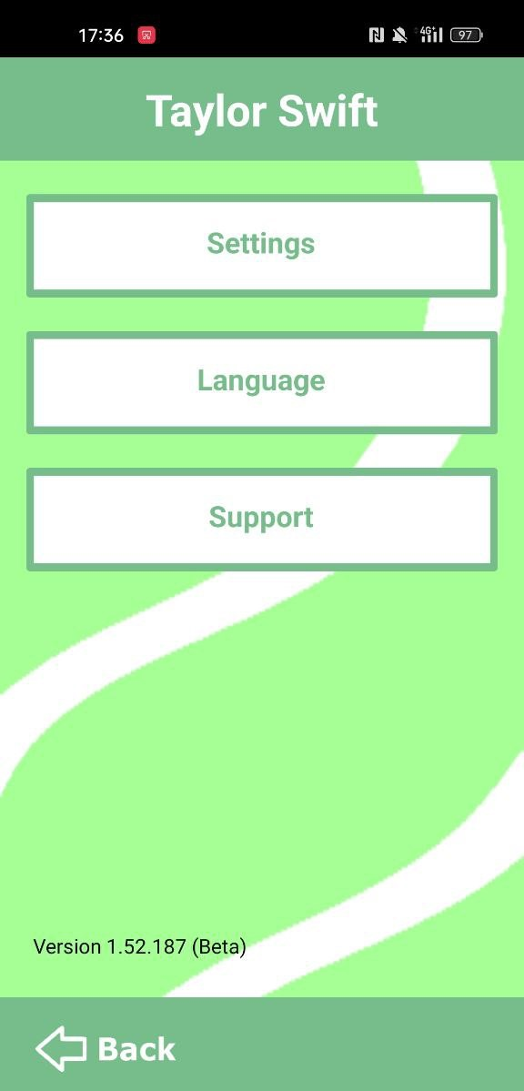
CLUP: SERVICES
USER PAGE
In the User page, the guest can update his personal credentials in the setting section or contact the Support.
In future developments, the user will be able to change the Language.
Once the operation are done, the user can come back to the Main page.

Slide 9
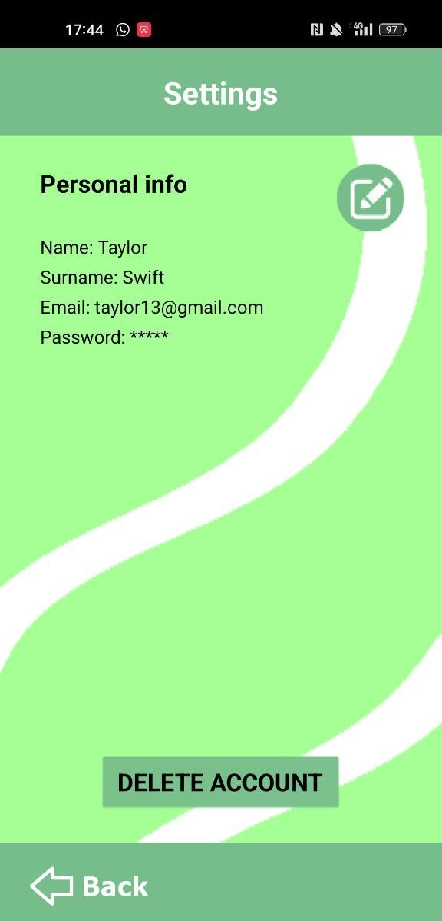
CLUP: SERVICES
SETTINGS PAGE
The User has the possibility to change the registered credentials or delete his account at any time.
To change the credentials, he must press the button at the top right.
Finally, he can come back to the User page.

Slide 10
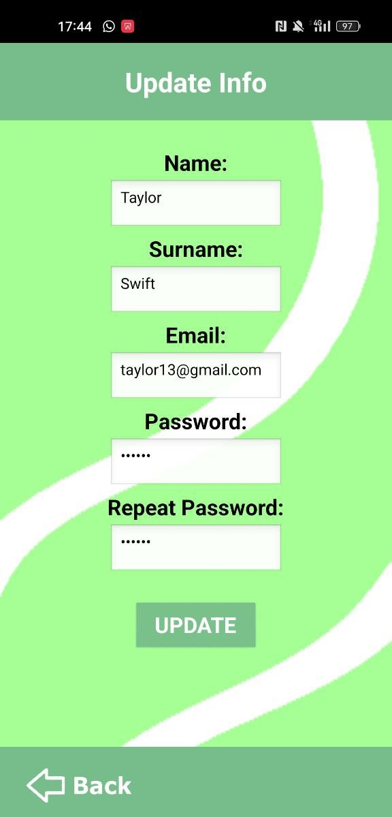
CLUP: SERVICES
UPDATE INFO PAGE
Here, the User, has the possibility to change Name, Surname, email or password.
The changed information will be saved once the key “update” is selected.
Once the operation is done, he push the “Back” button.

Slide 11
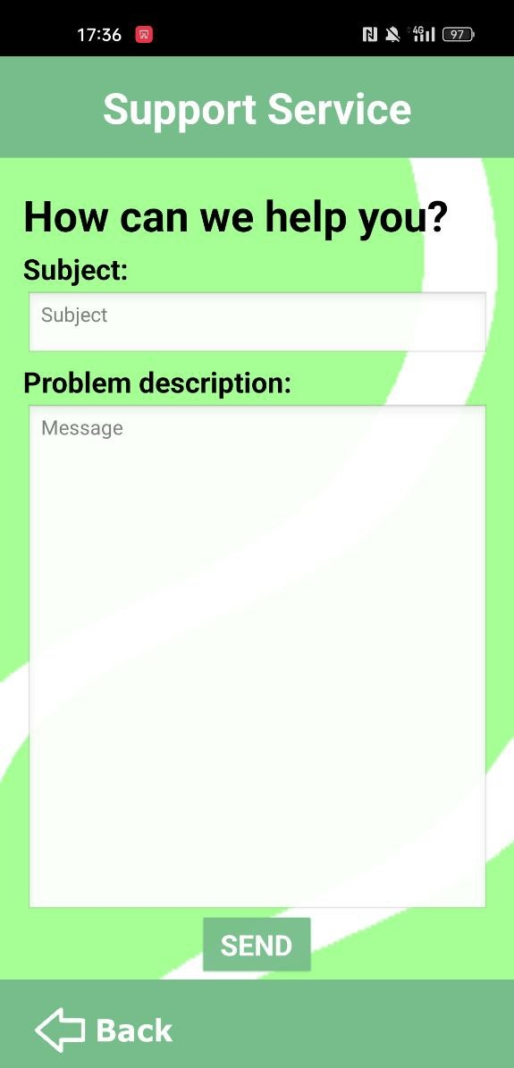
CLUP: SERVICES
SUPPORT SERVICE PAGE
In case of problems, the user can report an error.
By pressing the “send" button, the developers will receive an email with the specified problem description.
With the “Back” key, he returns to the User page.

Slide 12
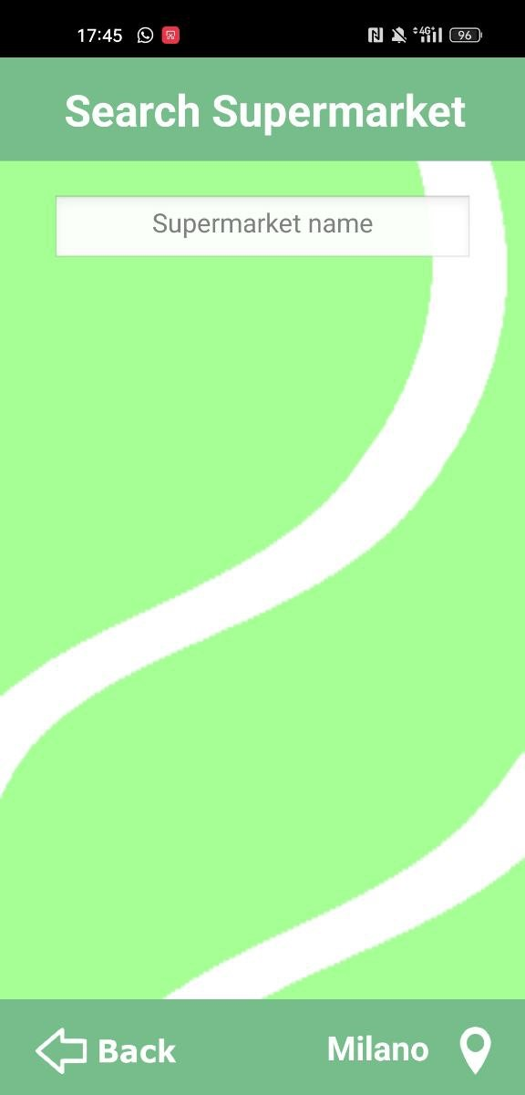
CLUP: BOOKING
SEARCH SUPERMARKET PAGE
Once the Search page is opened from the Main page, the following screen is shown.
The user is automatically directed to the preferred city, but he can change it in any time thanks to the button located at the bottom right.
By pressing on "Supermarket name", a list of supermarkets appears;
at the same time, the user can digit to search for the desired market and the relative timetable.
With “Back”, the Main page appears.

Slide 13
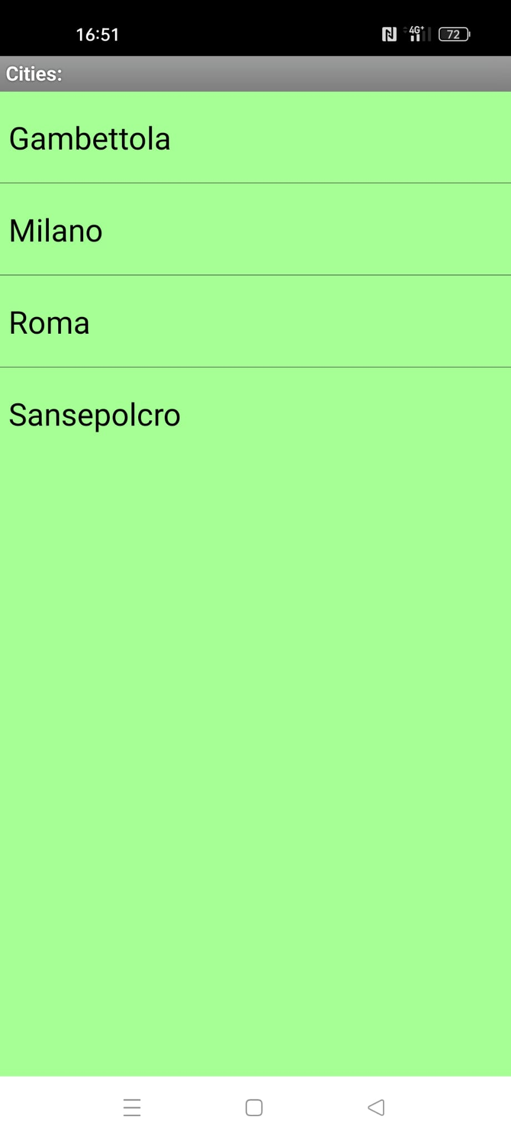
CLUP: BOOKING
SEARCH CITY PAGE
The user can select a new city from a given list.

Slide 14
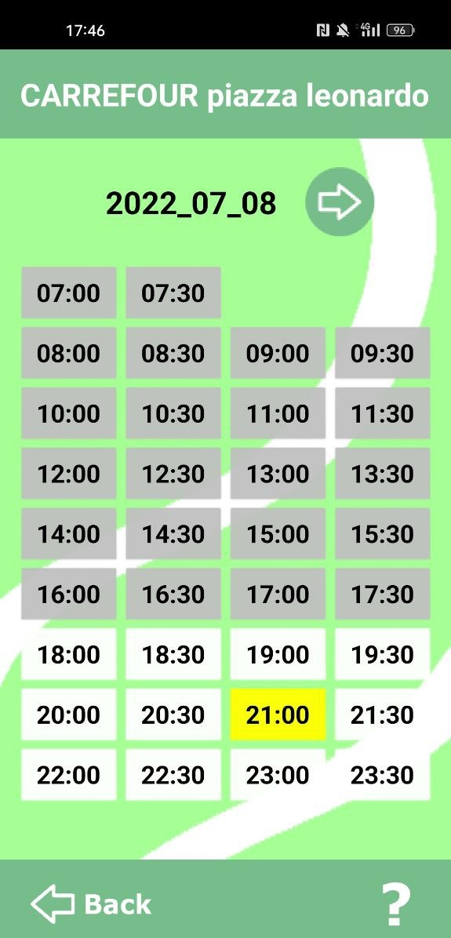
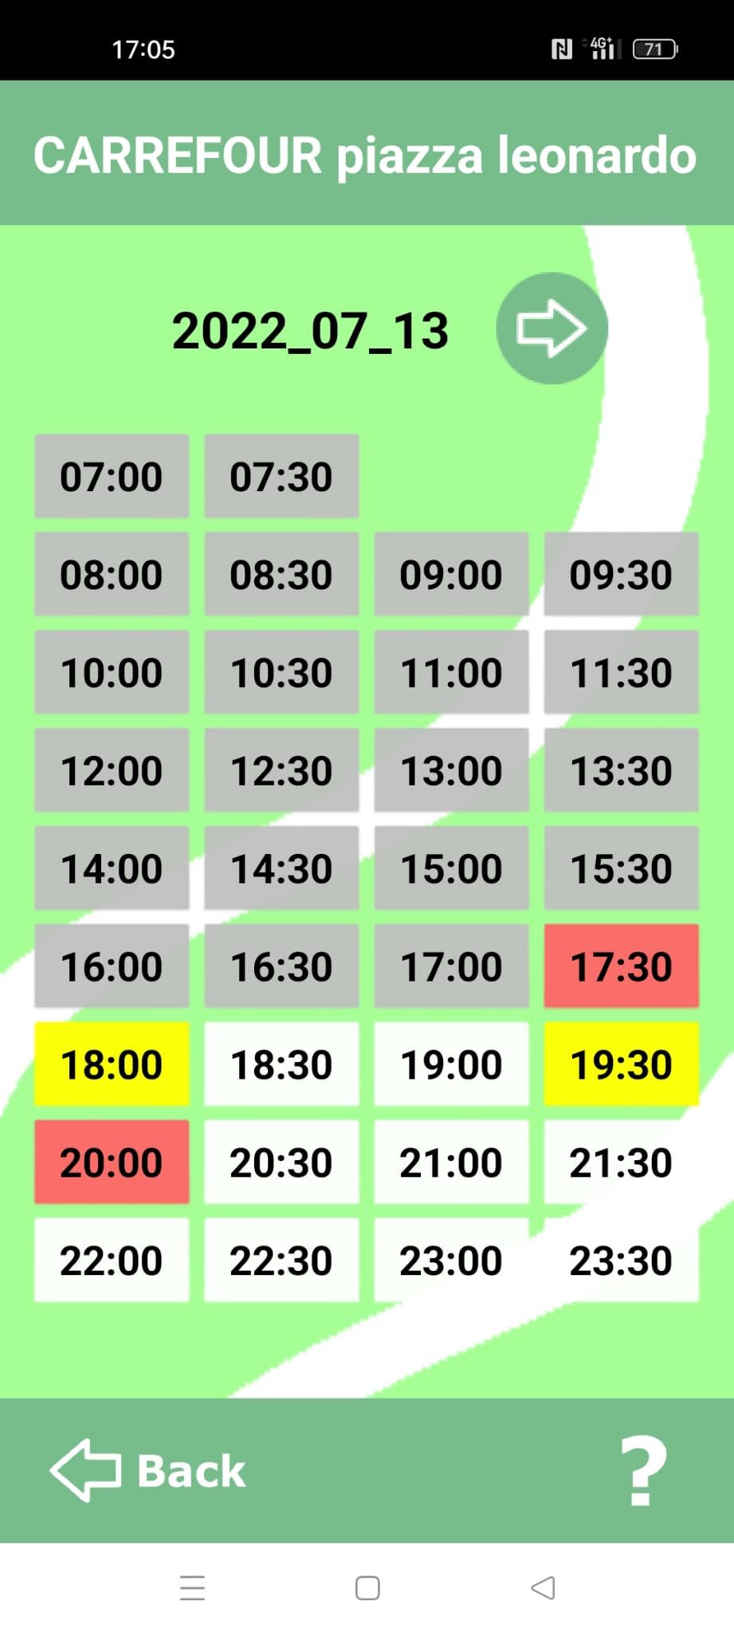
CLUP: BOOKING
MARKET PAGE
When the market is selected, the timetable is shown.
Here, the User can select the day and the time slots.
The User can also consult a legend by pressing on “?“.
He can also go Back to the Search supermarket page

Slide 15
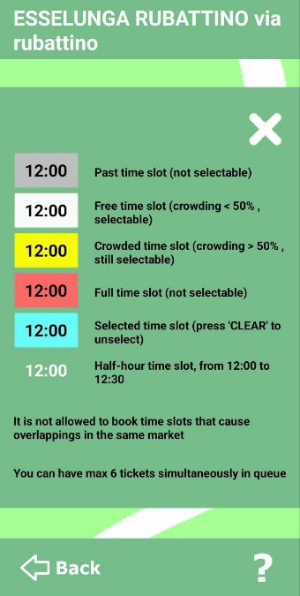
CLUP: BOOKING
MARKET PAGE - legend
If the user is confused and cannot understand the meaning of the colors, he can consult the following legend.
This description can be closed with the button “X”.

Slide 16
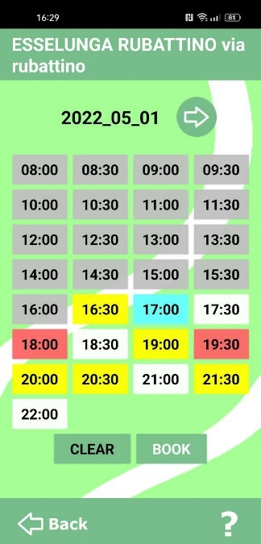
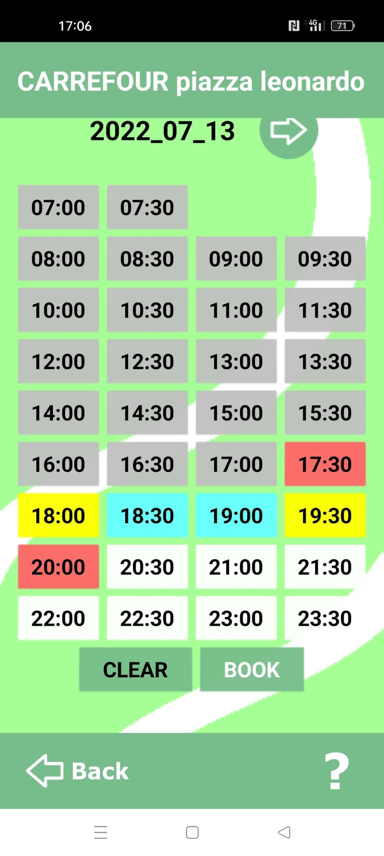
CLUP: BOOKING
MARKET PAGE – slot selection
Once the slots have been chosen, two new buttons appear.
With “Clear”, the current selection is canceled.
With “Book”, the user is routed to the Booking confirmation.

Slide 17
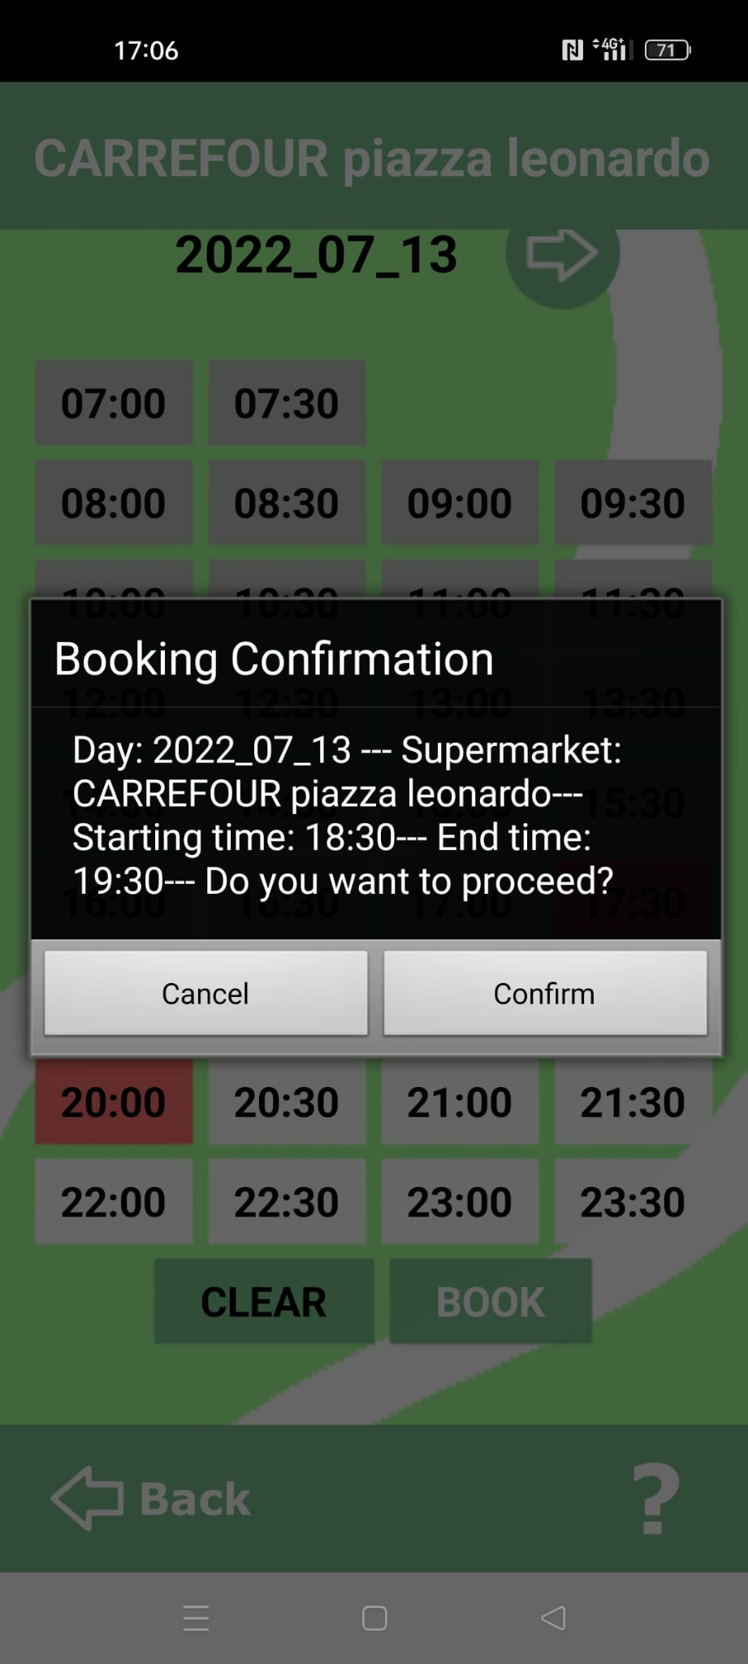
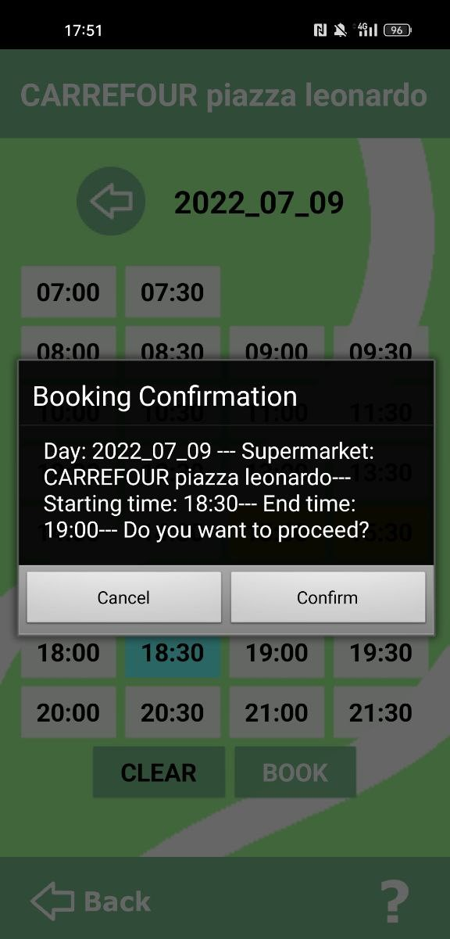
CLUP: BOOKING
BOOKING CONFIRMATION PAGE
If the user is satisfied with the choices made, he can press “confirm”. in this case a new ticket is created and shown.
Else, by pushing “cancel”, the user comes back to the Market page with the selected slots.

Slide 18
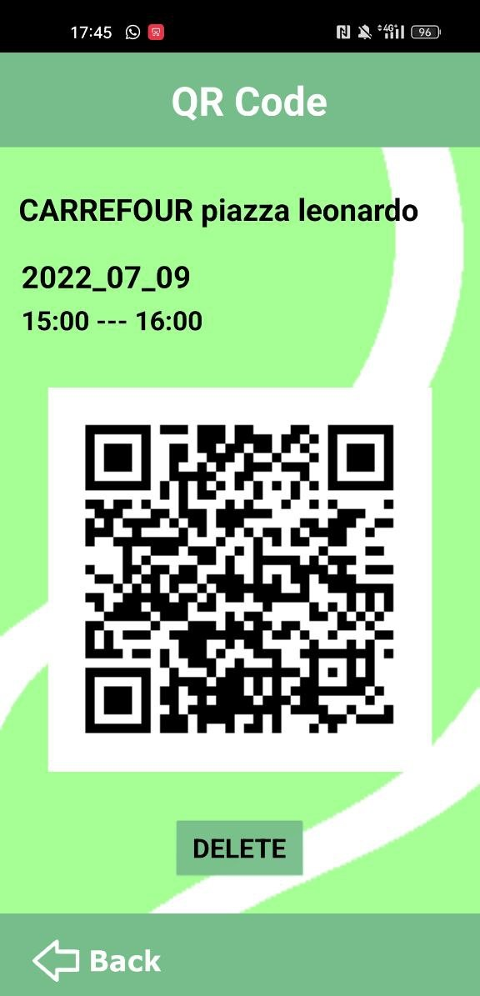
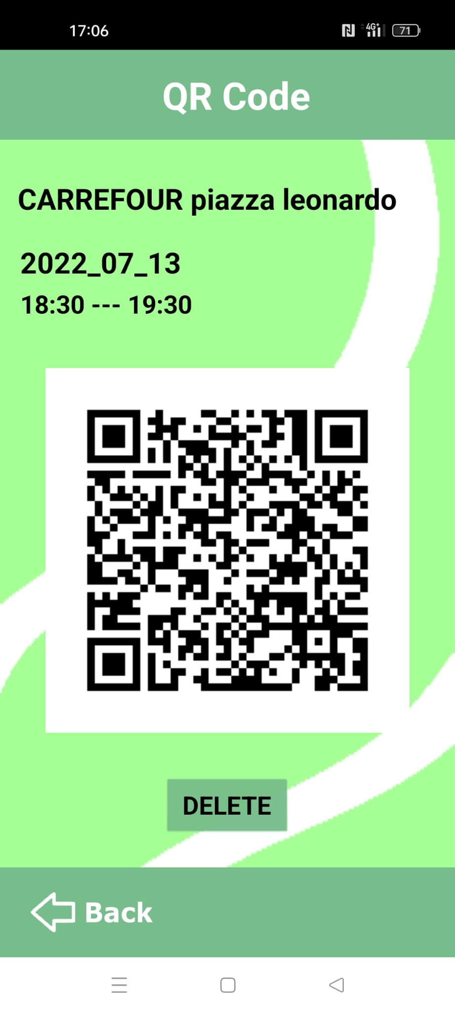
CLUP: BOOKING
QR CODE
The QR code of a given ticket is shown in two cases, when the ticket has been created, or when the ticket has been selected.
Depending on the previous cases, the button “Back” can show the Market page or the Main page.
The user can also delete an existing ticket.

