Slide 1

Differential gene expression analysis of muscle cells from patients with and without type 2 diabetes
Network Based Data Analysis project
7th September 2023
Alessandro Pilli

Slide 2
Introduction
Type 2 diabetes (T2D) is a serious and common chronic disease resulting from a complex inheritance-environment interaction along with other risk factors such as obesity and a sedentary lifestyle.
Its presence often leads to a decline in the differentiation capacity of myoblasts and progressive loss of muscle mass, which in turn results in the deterioration of skeletal muscle function.
In this study differences between muscle samples from healthy and affected subjects are going to be investigated.

Slide 3
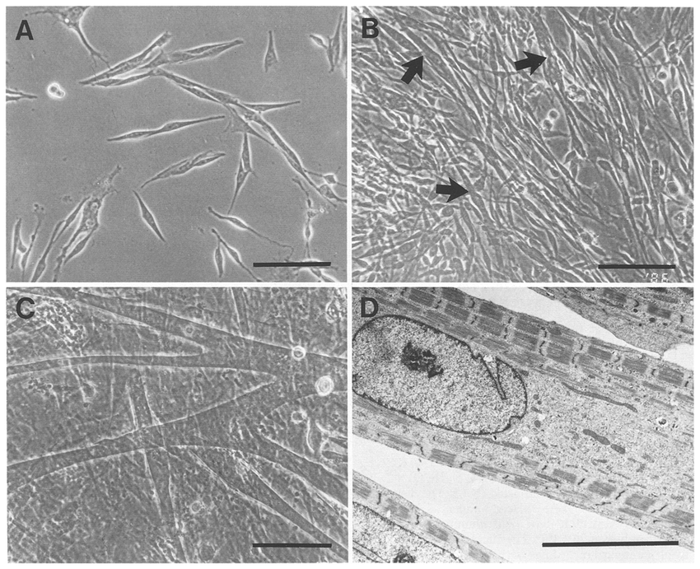
The dataset
52 samples divided into 2 main groups.
26 healthy subjects (normal glucose tolerant)→ NGT
26 individuals affected by type 2 diabetes → T2D
Muscle stem cells were isolated from human vastus lateralis muscle biopsies. To induce differentiation, cells were incubated in a differentiation medium until cells were fully differentiated, as determined by visual confirmation of myotube formation.
The data matrix (coming from GEO: accession GSE166502) contains 17011 probes x 52 samples. Values have been acquired via oligonucleotide microarray according to the platform Illumina HumanHT-12 V4.0 expression beadchip.

Slide 4

Methods
Exploratory analysis via unsupervised methods:
PCA
feature reduction
Clustering
K means
Classification based on machine learning techniques via supervised methods:
Random Forest
Ridge and Lasso regression (Ridge → best method)
Linear discriminant analysis (LDA)
rSCUDO
over representation analysis:
gProfiler
network based analysis:
pathfindR
STRING

Slide 5
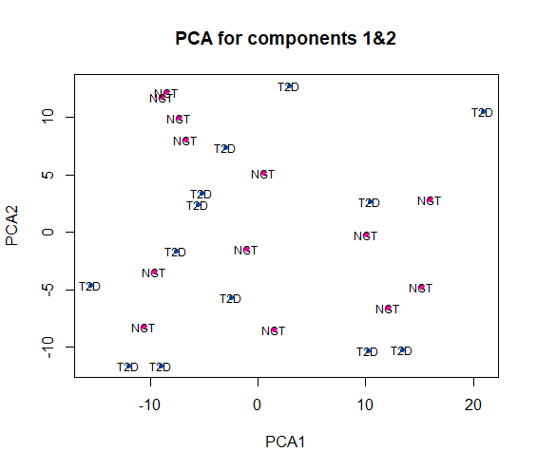
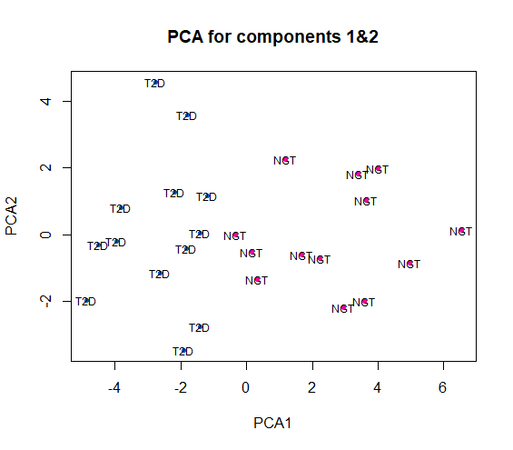

Results – PCA (myoblast) unfiltered data → poor results filtered data → good separation
52 samples 17010 probes row t-test with α =0.05 52 samples 1678 probes

Slide 6
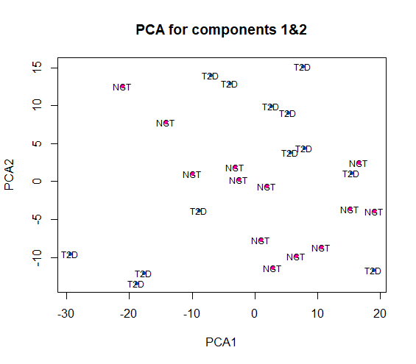
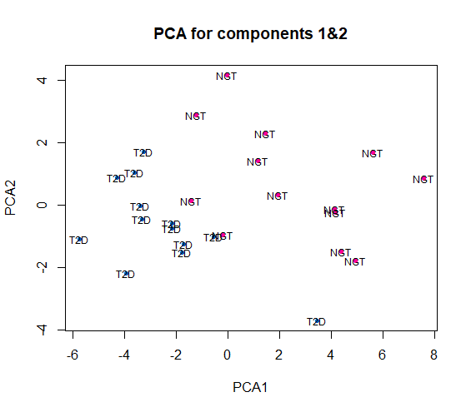
Results – PCA (myotube) unfiltered data → poor results filtered data → good separation
52 samples 17010 probes row t-test with α =0.05 52 samples 1028 probes

Slide 7
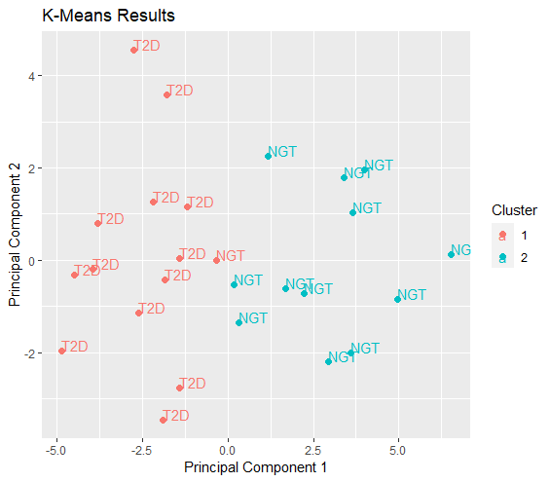
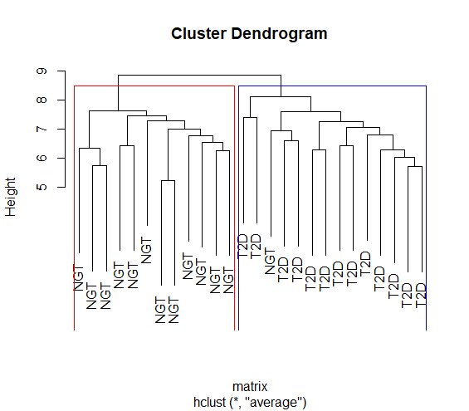
Results – clustering (myoblast) - only 1 misclassification - correct clustering

Slide 8
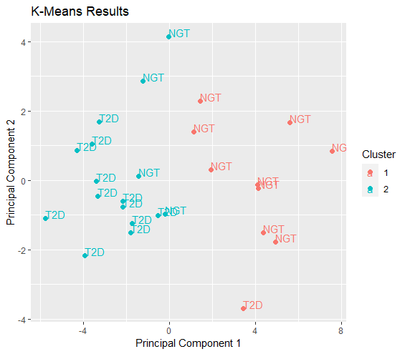
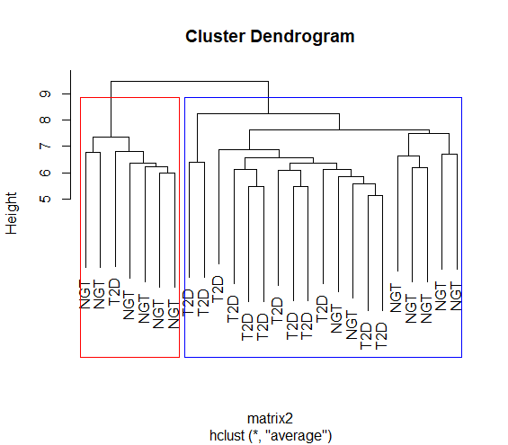
Results – clustering (myotube) - misclassification of 5 samples - wrong clustering

Slide 9
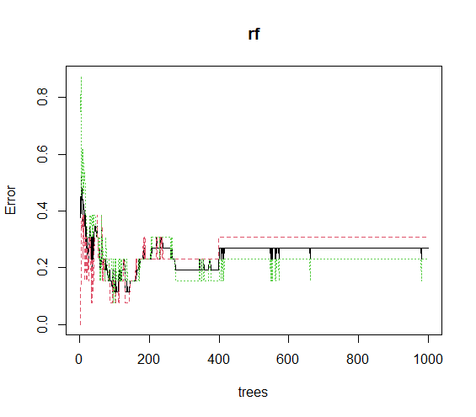
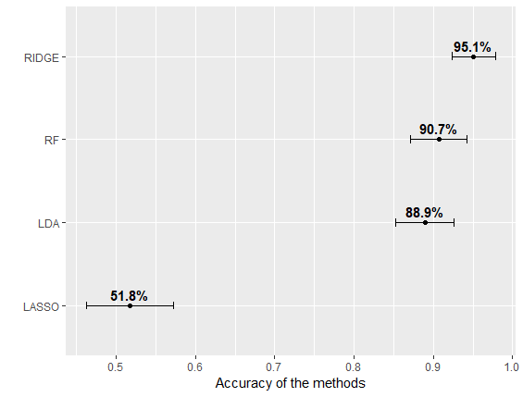
Results – classification method (myoblast) Ridge regression is the best model for group separation with the highest accuracy

Slide 10
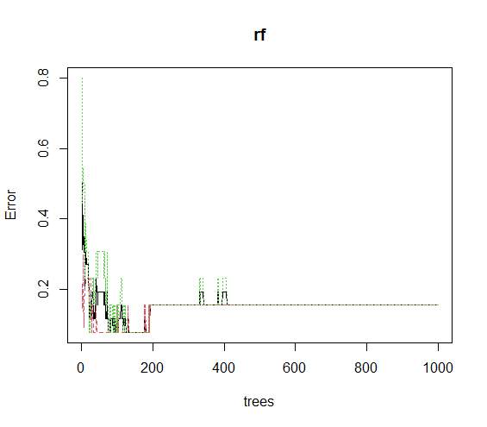
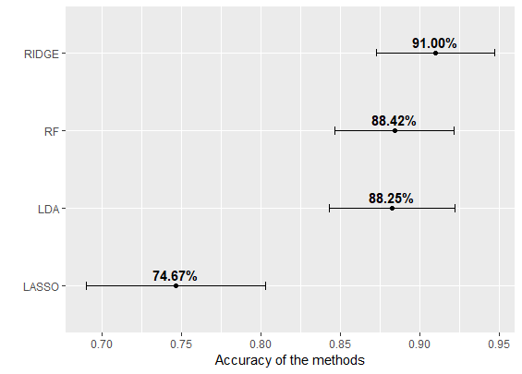
Results – classification methods (myotube) Ridge regression is the best model for group separation with the highest accuracy

Slide 11
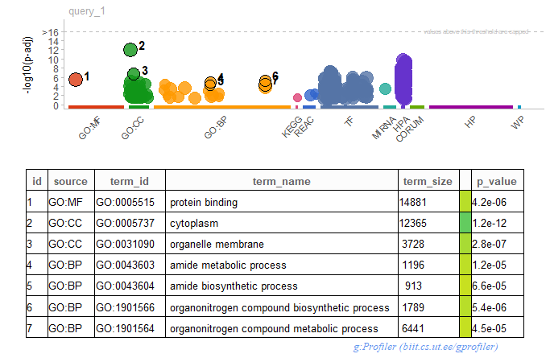
Results – functional enrichment analysis (gprofiler) identification of the main processes
Myoblast
GO:MF main term→ protein bindign
GO:BP main terms→ organitrogen and amide
GO:CC main term→ cytoplasm

Slide 12
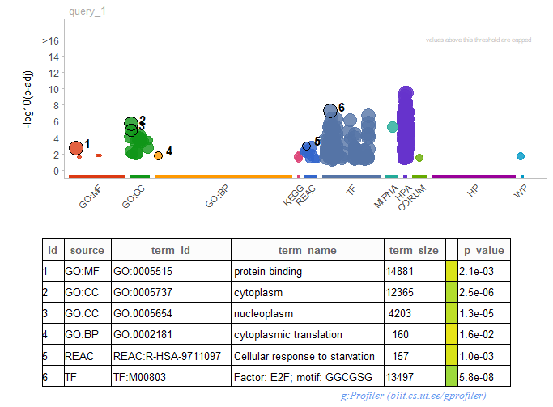
Results – functional enrichment analysis (gprofiler) identification of the main processes
Myotube
GO:MF main term→ protein bindign
GO:BP main term→ cytoplasmic translation
TF main term → factor E2F
GO:CC main term→ cytoplasm

Slide 13
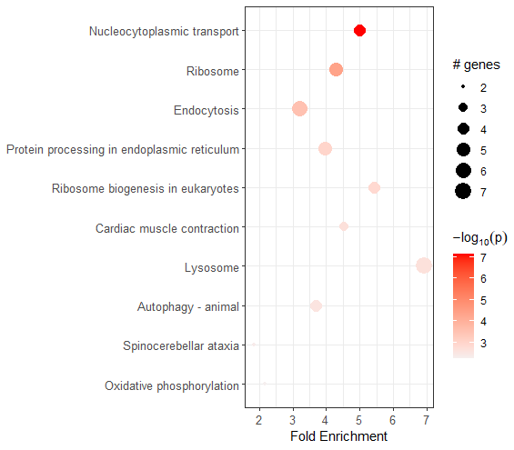
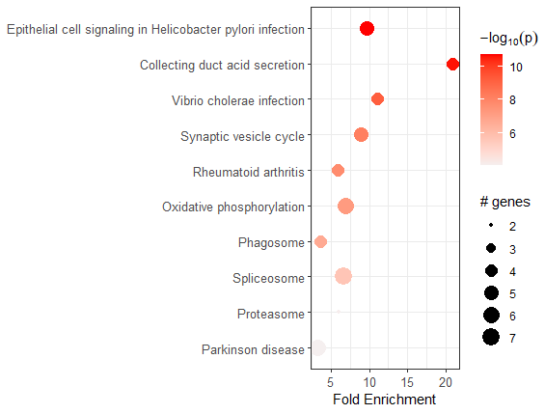
Results – NBA (pathfindR) identification of enriched pathways
Myoblast
Myotube

Slide 14
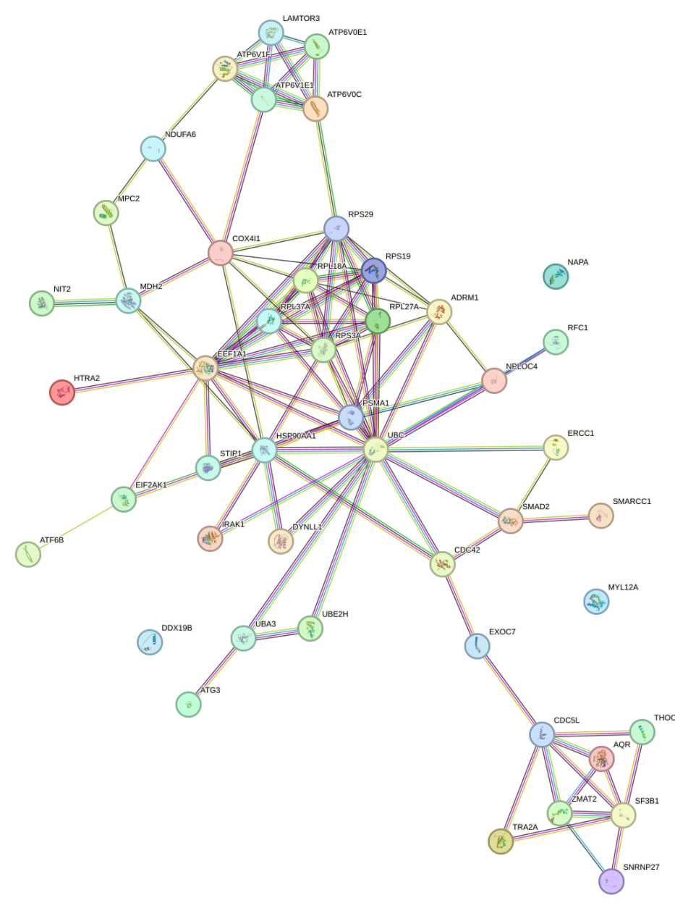
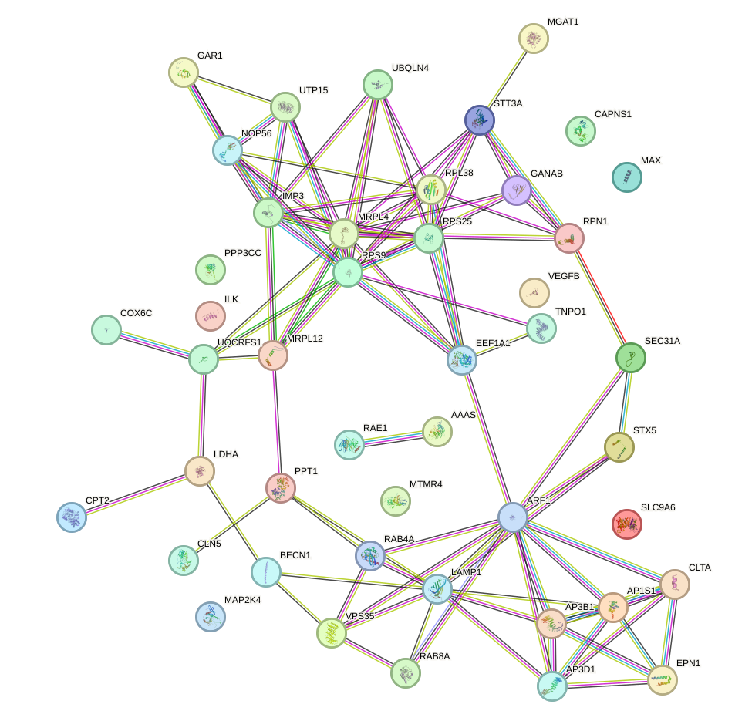
Results –NBA (STRING) identification of protein-protein interactions
Myoblast
Myotube
ATP6
COX4I1
HSP90AA1
AQR
VPS35
CLTA
RAB8A

Slide 15
Results –Specific genes (literature)
Myoblast:
VPS35: high glucose regulates the Golgi apparatus stress through NLRP3/VPS35/Golph3/Vimentin pathway.
RAB8A: identified in Gestational Diabetes Mellitus, is relevant because it regulates lipid uptake and storage in skeletal muscle.
CLTA: gene polymorphisms of CTLA, including CTLA-4+49A/G and CTLA4-318C/T, are important predictors of type 2 diabetes mellitus.
Myotube:
ATP6: mutation of this gene was found in patients with type 2 diabetes, identifying it as a possible genetic marker
HSP90AA1: is an already known molecular target of type 2 diabetes when associated with SARS-COV-2.
COX4I1: association between COX expression, obesity, and type 2 diabetes. COX4I1 depression is related to insulin resistance, and it may be a useful diagnostic biomarker.
AQR: previously demonstrated AQR as a susceptibility gene for type 2 diabetes, AQR/PLAU is a critical signaling axis in the modulation of endothelial cell senescence, revealing a link between hyperglycemia and vascular dysfunction.

Slide 16
Conclusions
Regarding the statistical methodologies employed, it can be observed that supervised techniques yield superior results. Notably, Ridge regression stands out as the method demonstrating the highest accuracy.
Regarding the specific processes we can say that a probable reaction to the metabolic dysfunctions associated with diabetes, can be the overexpression of ribosomes and ATP-producing processes to sustain the myotube in response to the lack of nutrients. This may also lead to events that will lead to deterioration of the muscle and, later, skeletal structure.
Particular genes both in myoblast and myotubes have been retrieved and identified as up-regulated by pathfindR.
As a final note, all the genes found in our analysis are not reported in the published article from which the original dataset was derived, this could be due to the different statistical approaches and tools.

Slide 17
Thanks for your attention

