Slide 1
Coronavirus’ Study
L’Aquila 07/07/2021
BioInformatics Project
Members:
Nome | Cognome | Matricola
Alessandro | Pio | 261764
Lorenzo | Tucceri Cimini | 259039
Lorenzo | Negro | 261144

Slide 2
Introduction
Coronaviruses are a large family of single-stranded RNA respiratory viruses.
In humans, the common Coronaviruses cause respiratory infections, often of mild magnitude such as the common cold, but in some cases they can cause non-serious viral pneumonia, and rarely they can also cause Severe Acute Respiratory Syndrome (SARS).
In case of mutations, the disease’s severity depends on the fact that, if the virus is new, our immune system does not recognize it because it has never come into contact with it before, it does not know how to defend itself and undergoes the attack that becomes particularly violent and dangerous in immunologically weak or immunosuppressed subjects.
We’ve decided to choose this project because it is about a subject that we are experiencing firsthand and an IT approach to it could be of help for future studies.

Slide 3
We have followed the steps below for both our projects:
Sequences selection on the NCBI site
Sequences alignment by the tool ClustalΩ

Slide 4
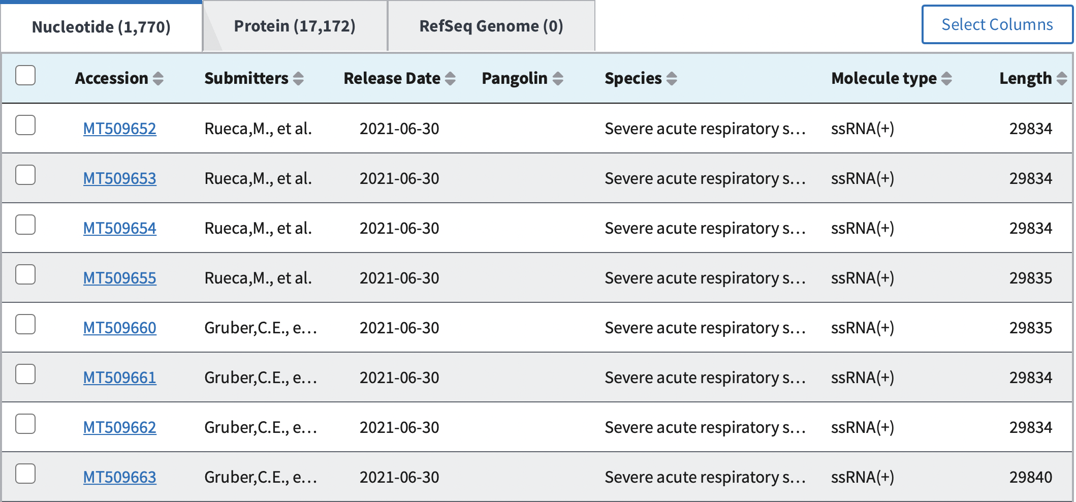
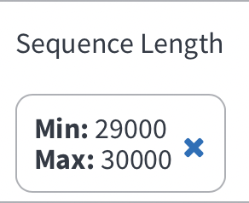

Sequences selection on the NCBI site
We have selected sequences from 2 geographic regions: India and Italy.
Our sequences length’s range is between a min value of 29000 and a max value of 30000, in order to minimize the gap among them.
We have selected sequences with a 3-months interval, to increase accuracy.
NCBI SITE

Slide 5
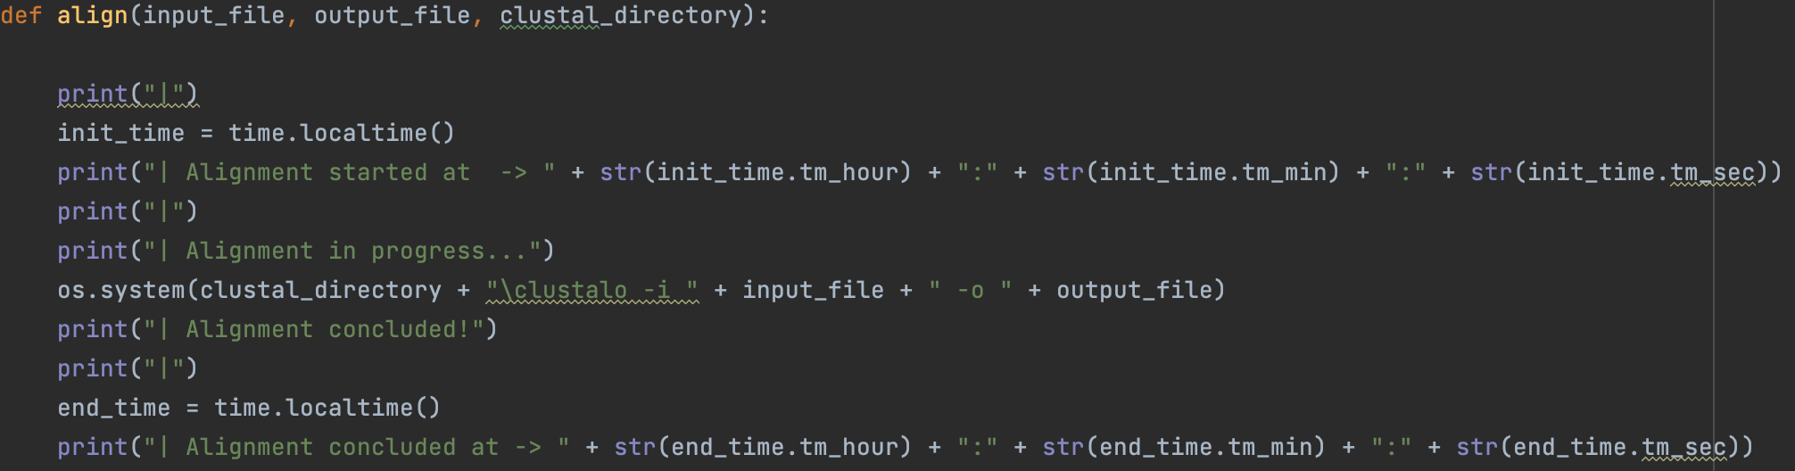
Multiple Sequence Alignment
Multiple Sequence Alignment (MSA) is generally the alignment of three or more biological sequences (protein or nucleic acid) of similar length. From the output, homology can be inferred and the evolutionary relationships between the sequences studied.
We have use the tool ClustalΩ to perform our analysis.
‘http://www.clustal.org/omega/#Download’
Tale tool è necessario per l’utilizzo di questo software.

Slide 6
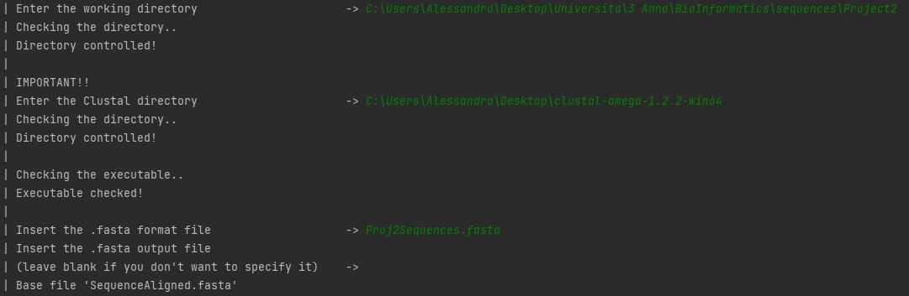
A very intuitive console
The tool is equipped with a very intuitive console/terminal, where all the options are listed. The user runs the tool by sending commands from this console.

Slide 7
Mutations Project
Software that makes a comparison between two different human strains to understand if the two types of infections are different. Identify common regions or mutations among the two considered strains.

Slide 8
Pipeline
Sequences selection on the NCBI site
Sequences alignment using the tool ClustalΩ
Sequences comparison and mutations count

Slide 9
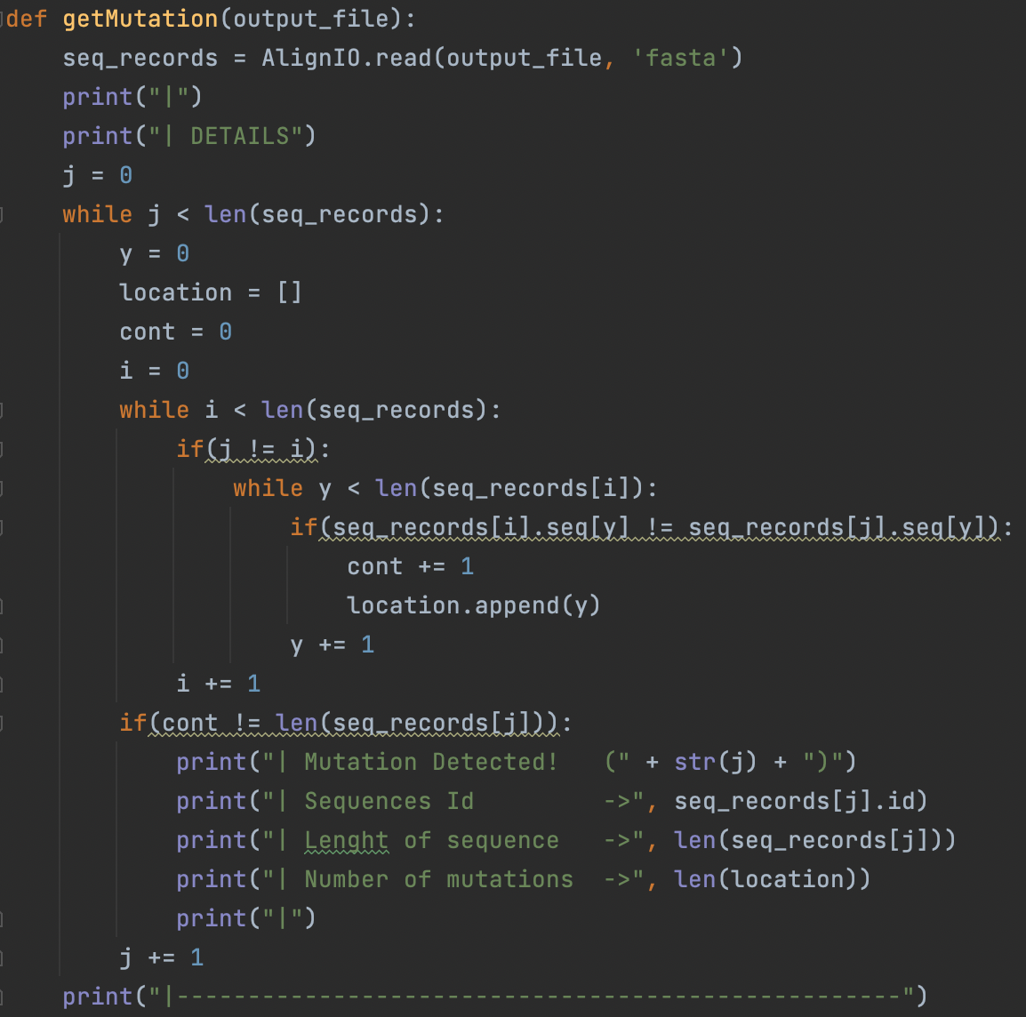

Detect Mutations
We have chosen to analyze mutations in our sequences rather than identifying regions of similarity.
To achieve this goal, we have created an algorithm that compares the analysis of each sequence with the analysis of each and every other sequence, looking for nitrogenous bases variations.
The output provides the following data:
Id sequence;
Length’s sequence;
Eventual number of mutations.

Slide 10
Phylogenic Analysis Project
Implement a pipeline or a software that makes a phylogenetic analysis considering the sar-cov-2 genome of the bat with two human strains.

Slide 11
Pipeline
Sequences selection on the NCBI site
Sequences alignment using the tool ClustalΩ
NJTree construction
UPGMATree construction

Slide 12
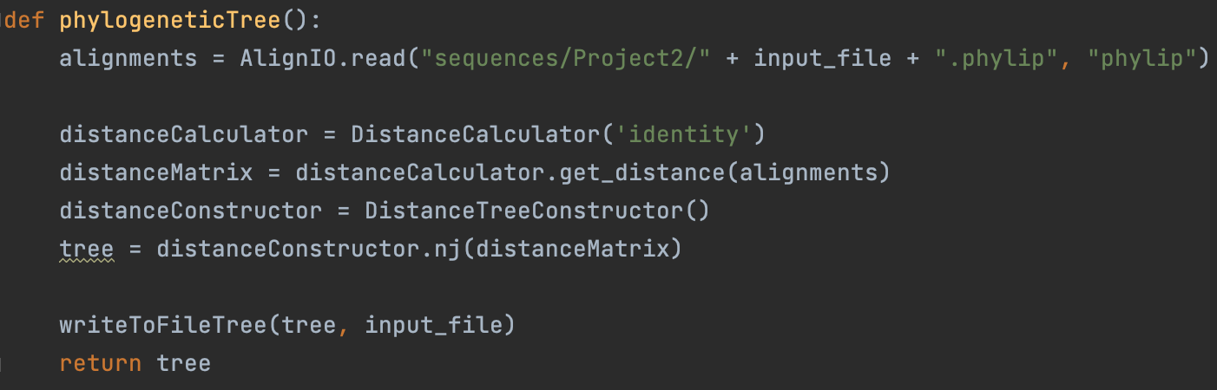
Phylogenetic tree construction
The method has an input of aligned sequences. Using the class DistanceCalculator, it generates an identity matrix, which is used for building a Neighbor Joining (nj) tree.

Slide 13
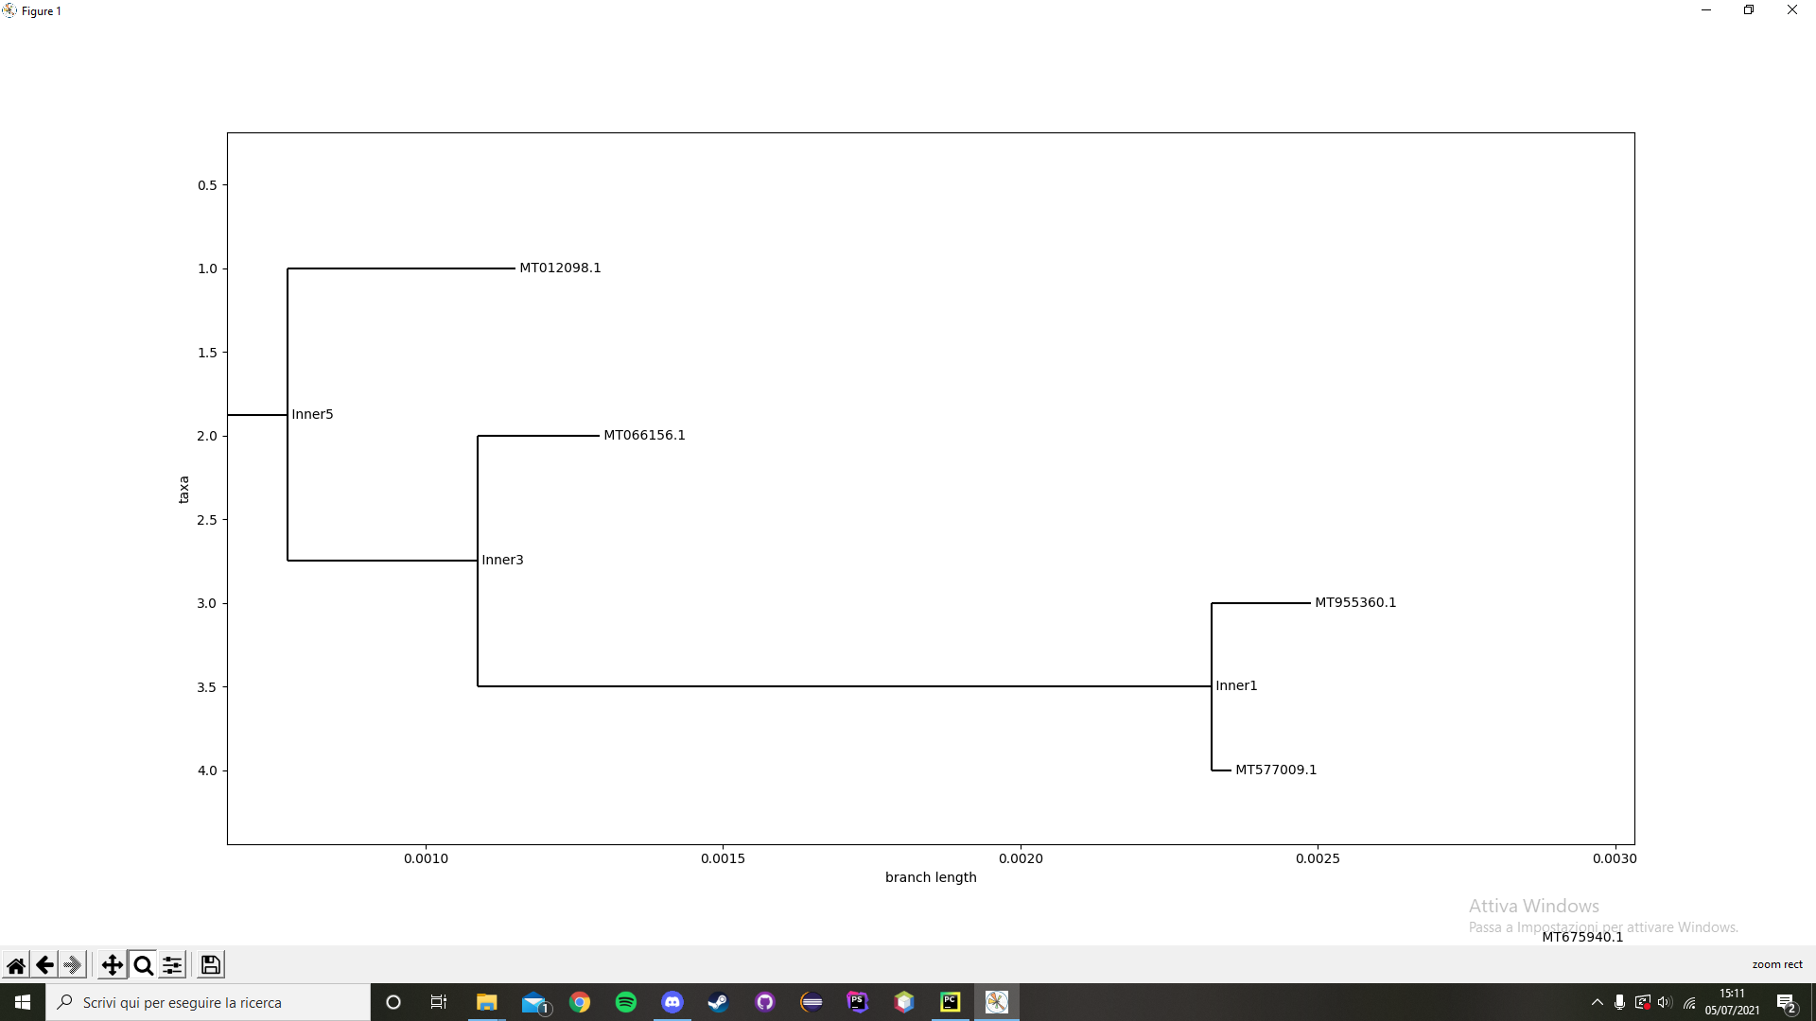
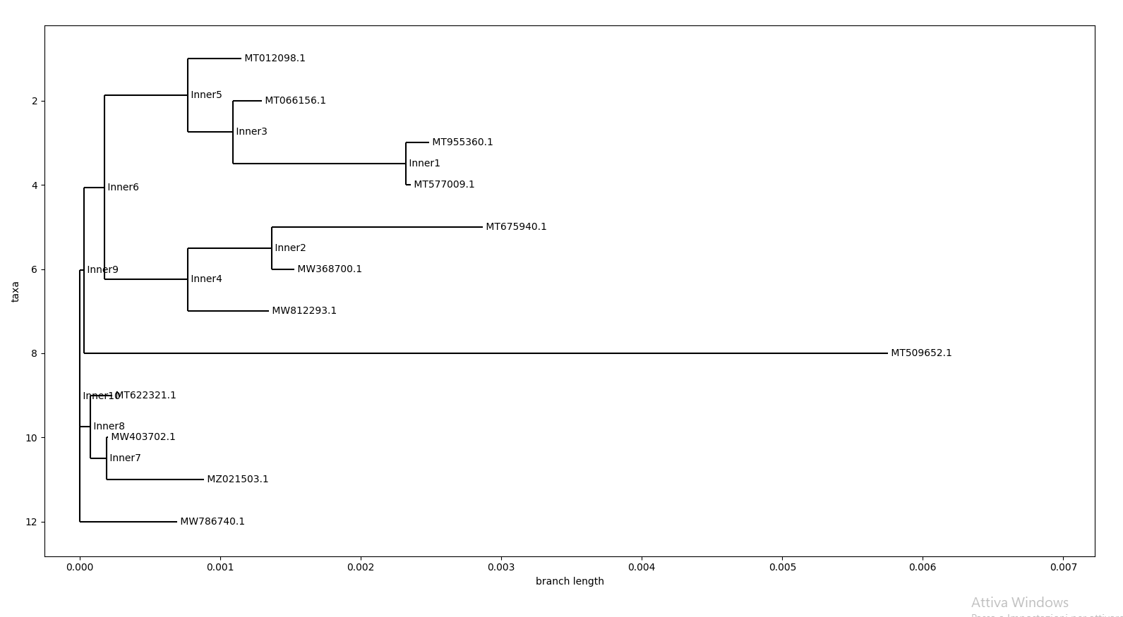
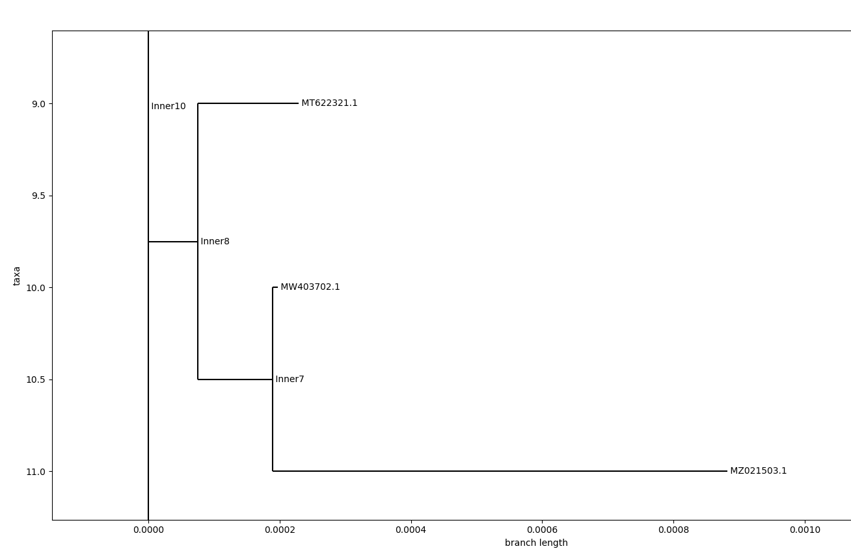
NJ Tree
The neighbor join is a clustering bottom-up method for building phylogenetic trees. It’s used for trees based on DNA sequences or on protein sequences.
The algorithm needs to know the distance between each taxa (species or sequences) pair in order to build the tree.

Slide 14
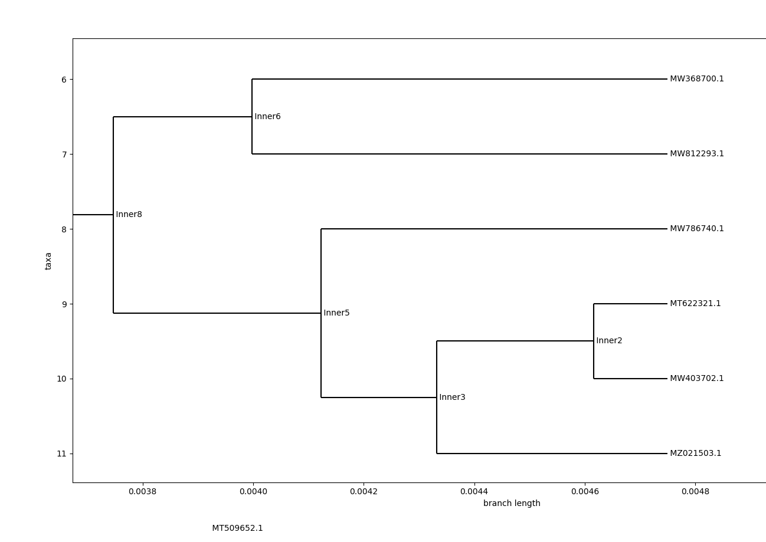
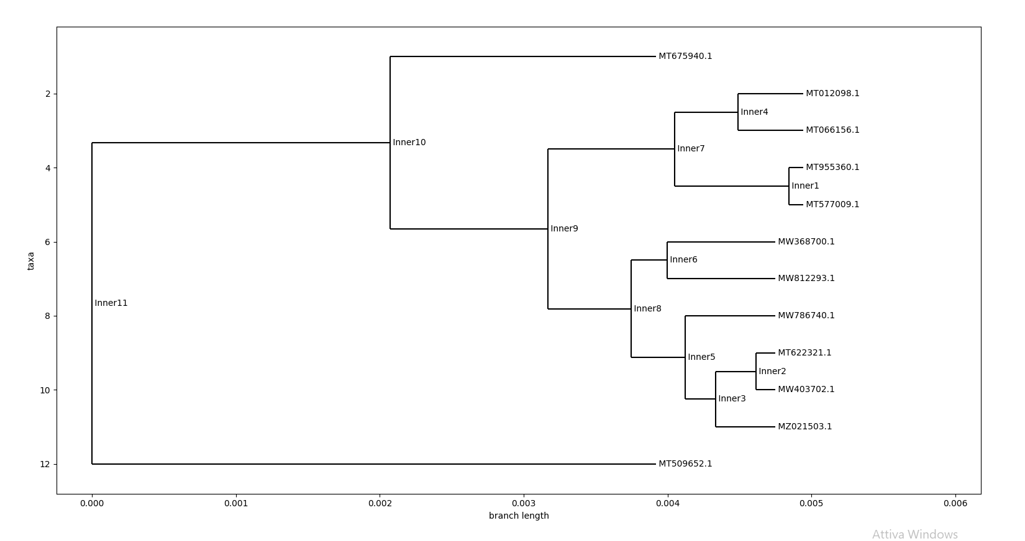
UPGMA Tree
The UPGMA method assumes that the speed of evolution of the sequences is constant along all branches of the tree.

Slide 15
Conclusions
The two projects on Covid19, allow us to trace the mutations and ancestry of the various strains that are selected and inserted as inputs to the software.
With a larger number of sequences we are able to see the evolution of the most common clusters for each viral strain, we may also be able to highlight the extraordinary strength of SARS-CoV-2 for its rapid geographical spread.
Developing this software has been very interesting. We’ve realized how much the software can be useful in biology and how important this can be for the development of activities and research for the scientific community.

