Slide 1
Building calendars for daily seasonal adjustment:
lessons from electronic invoicing and electricity demand
PARIS, December 2026
COSA MEETING #5
ALESSANDRO PIOVANI | alessandro.piovani@istat.it
Istat | Directorate For Methodology and Statistical Process Design

Slide 2
Why the calendar matters in daily data
Monthly data average special days out; daily data expose every special day: holidays, month end, payment deadlines
Effects are large and differ by day of the week
Keep outliers and calendar effects apart: an outlier on a holiday or a nearby day (e.g. a bridge) signals a misspecified calendar, not an unusual event
Check the adjusted series, not only the coefficients: a significant coefficient can still leave a residual pattern
×8.6
Last day of the month, weekday
×69
Last day of the month, Sunday
E-invoicing, 2019-2025: effect relative to a normal day of the same type

Slide 3
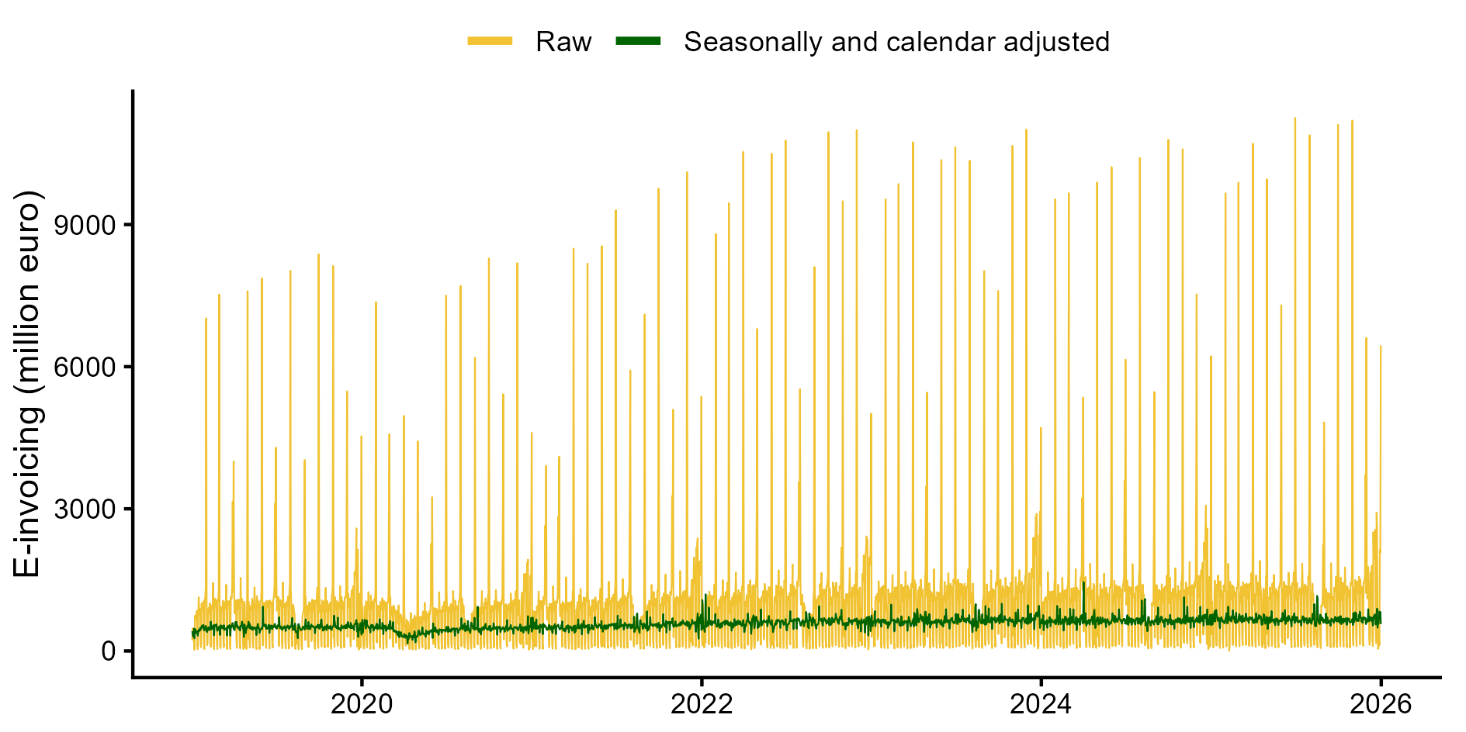
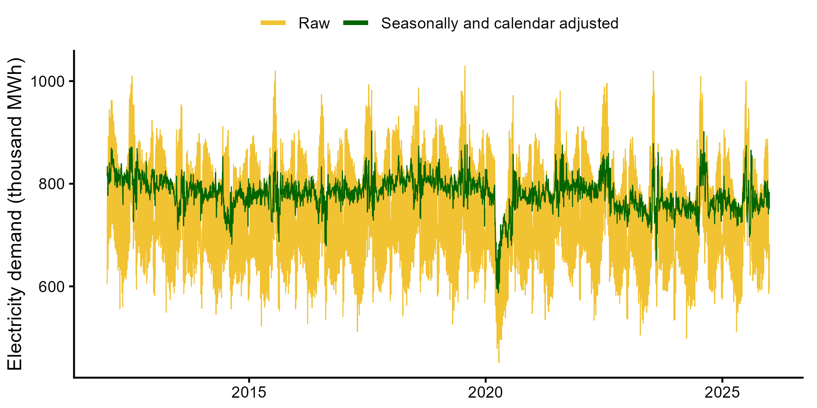
Two daily series, two decompositions
E-invoicing 2019–2025, daily taxable amount
Electricity demand 2012–2025, daily MWh
Multiplicative model (logs)
Additive model (levels)
Raw = trend × seasonal × calendar × irregular: the adjustment divides.
Raw = trend + seasonal + calendar + irregular: the adjustment subtracts.
Raw (yellow) and seasonally and calendar adjusted series (green), final calendar. Sequential AMB: weekly, then annual seasonality; logs or levels chosen by AICc.

Slide 4
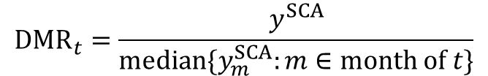
The Day-to-Month Ratio (DMR)
$y^{SCA}$: seasonally and calendar adjusted series
$${DMR}_{t}=\frac{y^{SCA}}{median\{y_{m}^{SCA}:m∈month of t\}}$$
= 1
> 1
< 1
No residual calendar effect
Day still above its month
Day still below its month
Median DMR for each group of days, over the whole sample
Tolerance: groups within ±5% of 1 are considered adjusted
Medians, not means: robust to outliers and to unusual months
Above or below 1: over- or under-correction, depending on the sign of the calendar effect

Slide 5
Which DMR charts? The mechanism decides
1
2
3
4
Find candidate days
Group by mechanism
Split for interactions
Check, then model
Domain knowledge and the raw data: deadlines, month end, holidays.
Fixed dates by day of the month, month end by days to the end, holidays by distance from the holiday. Groups outside ±5% are critical.
Split critical days by day type (weekday, Saturday, Sunday): a median close to 1 can hide opposite errors.
Test each hypothesis with a dedicated chart before adding a regressor; after each change, redo all charts.
Raw data
Slides 6–10
Slide 11
Slide 12
The denominator is always the monthly median: only the grouping of days changes.

Slide 6
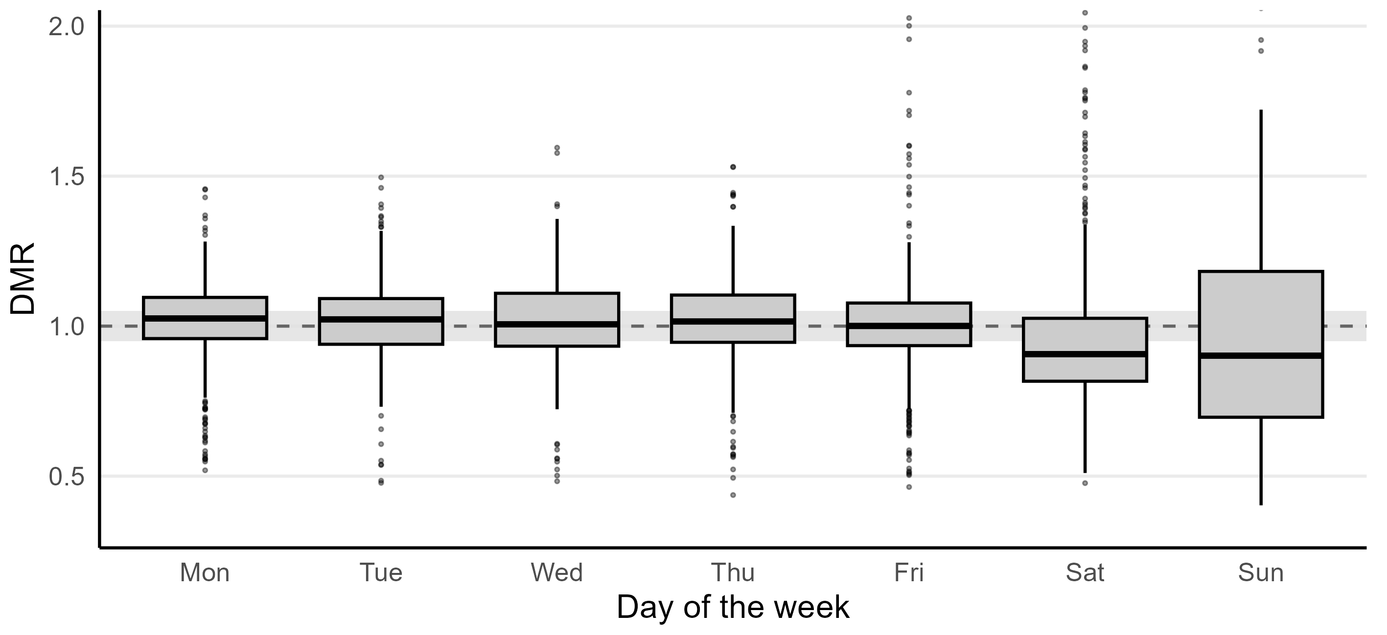
Day of the week: weekends stand out
Step 2 · Basic calendar. Median DMR about 1.0 on weekdays, about 0.9 on Saturdays and Sundays, with a much wider spread at weekends

Slide 7
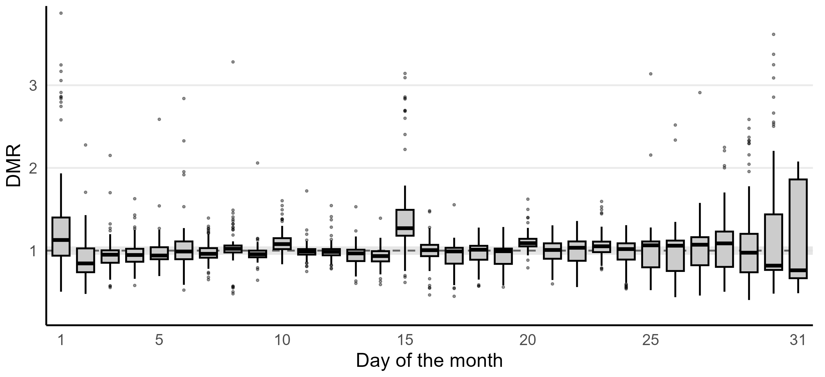
Day of the month: peaks on 1, 15 and 20
Step 2 · Basic calendar. Median DMR: day 1 = 1.13, day 15 = 1.27, day 20 = 1.09; days 30 and 31 = 0.82 and 0.76

Slide 8
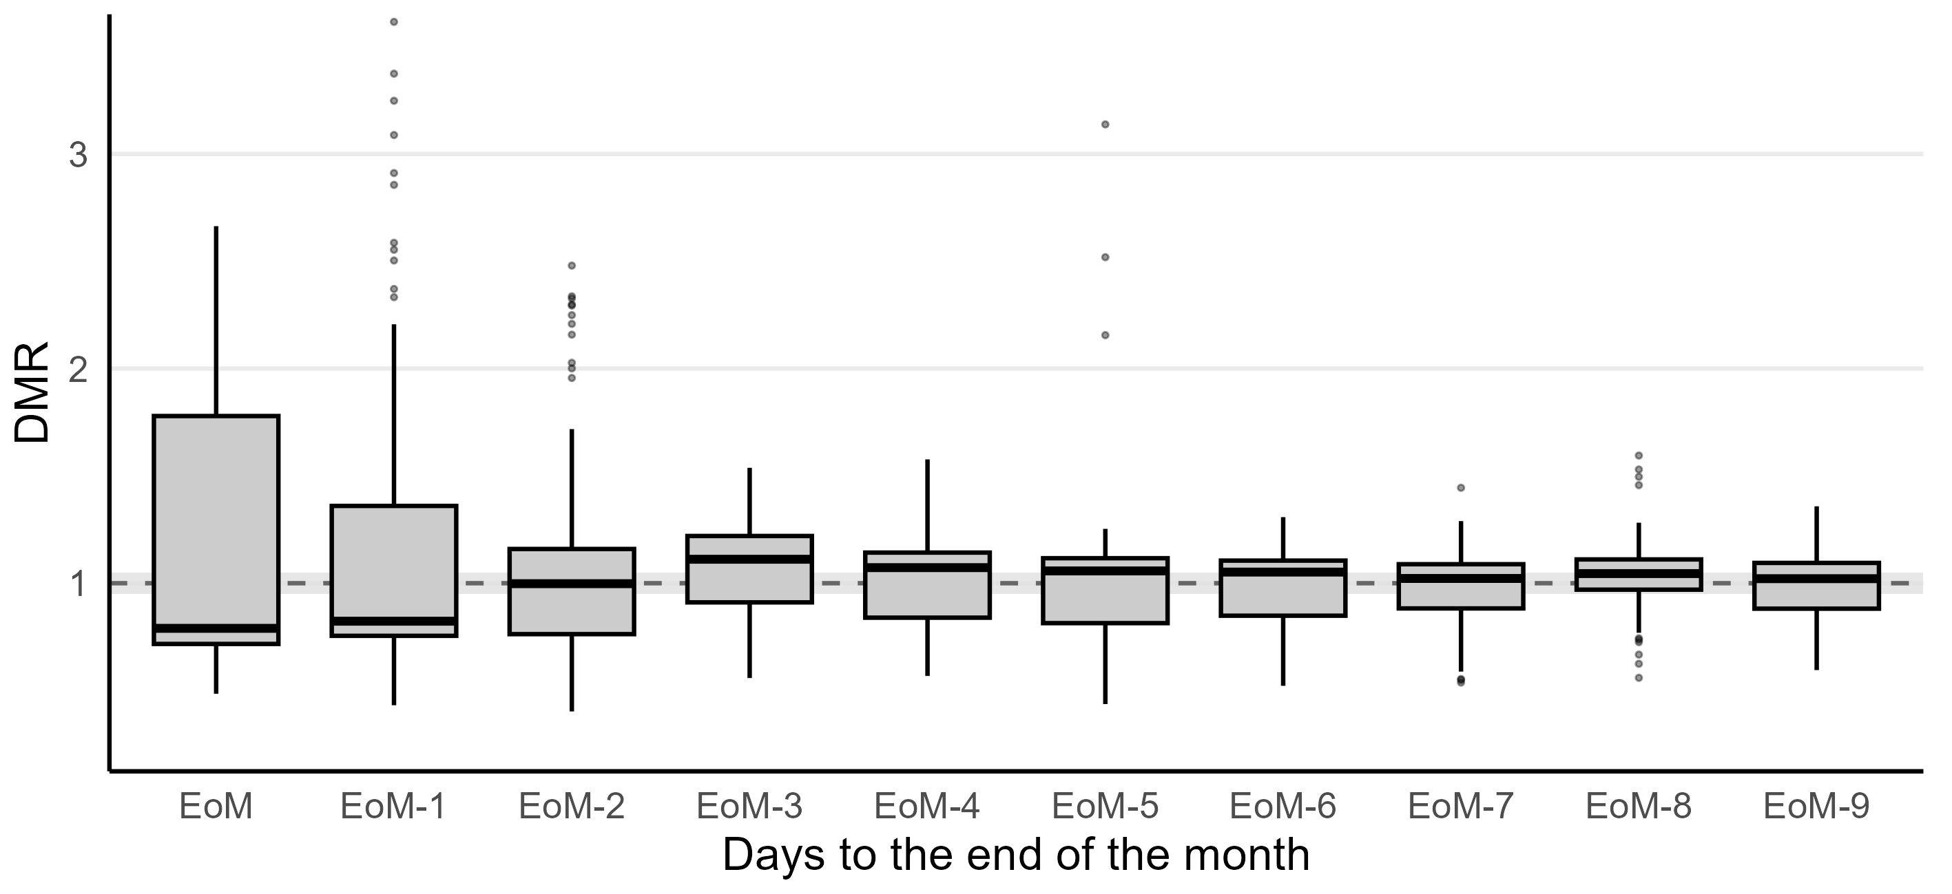
Month end: a dip at the end, a ramp before
Step 2 · Basic calendar. Median DMR: last day 0.79, one day before 0.82, three to five days before 1.06–1.11. Wide boxes on the last days mix different weekdays

Slide 9
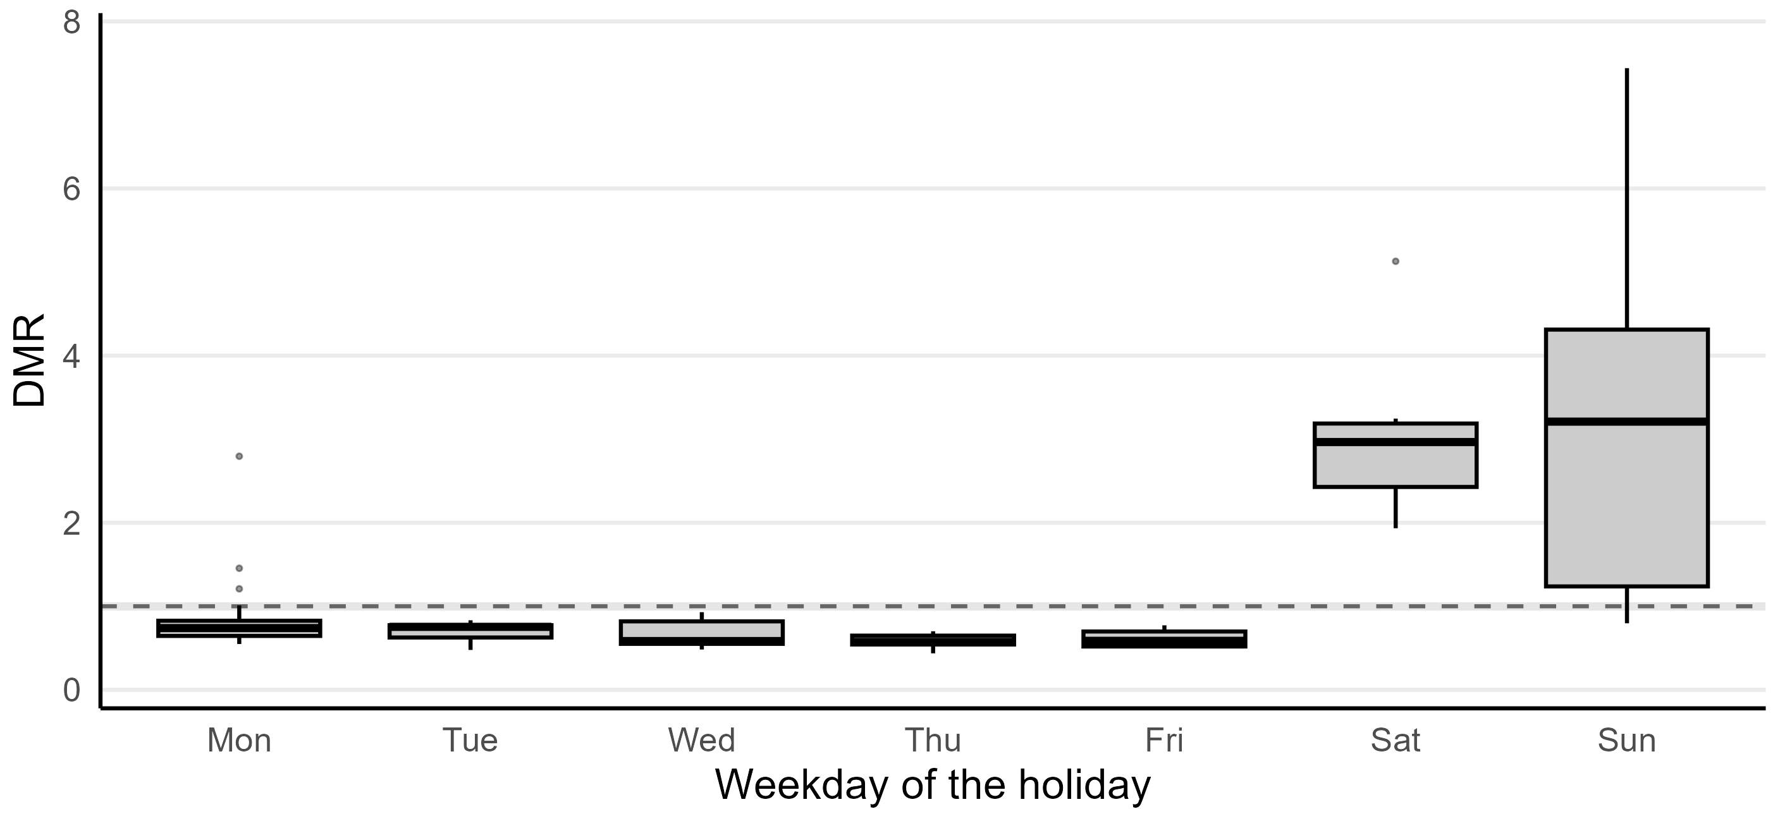
Holidays: one dummy fails on weekends
Step 2 · Basic calendar, holidays active on every day. Median DMR: holidays on weekdays 0.6–0.7, holidays on Saturdays and Sundays about 3

Slide 10
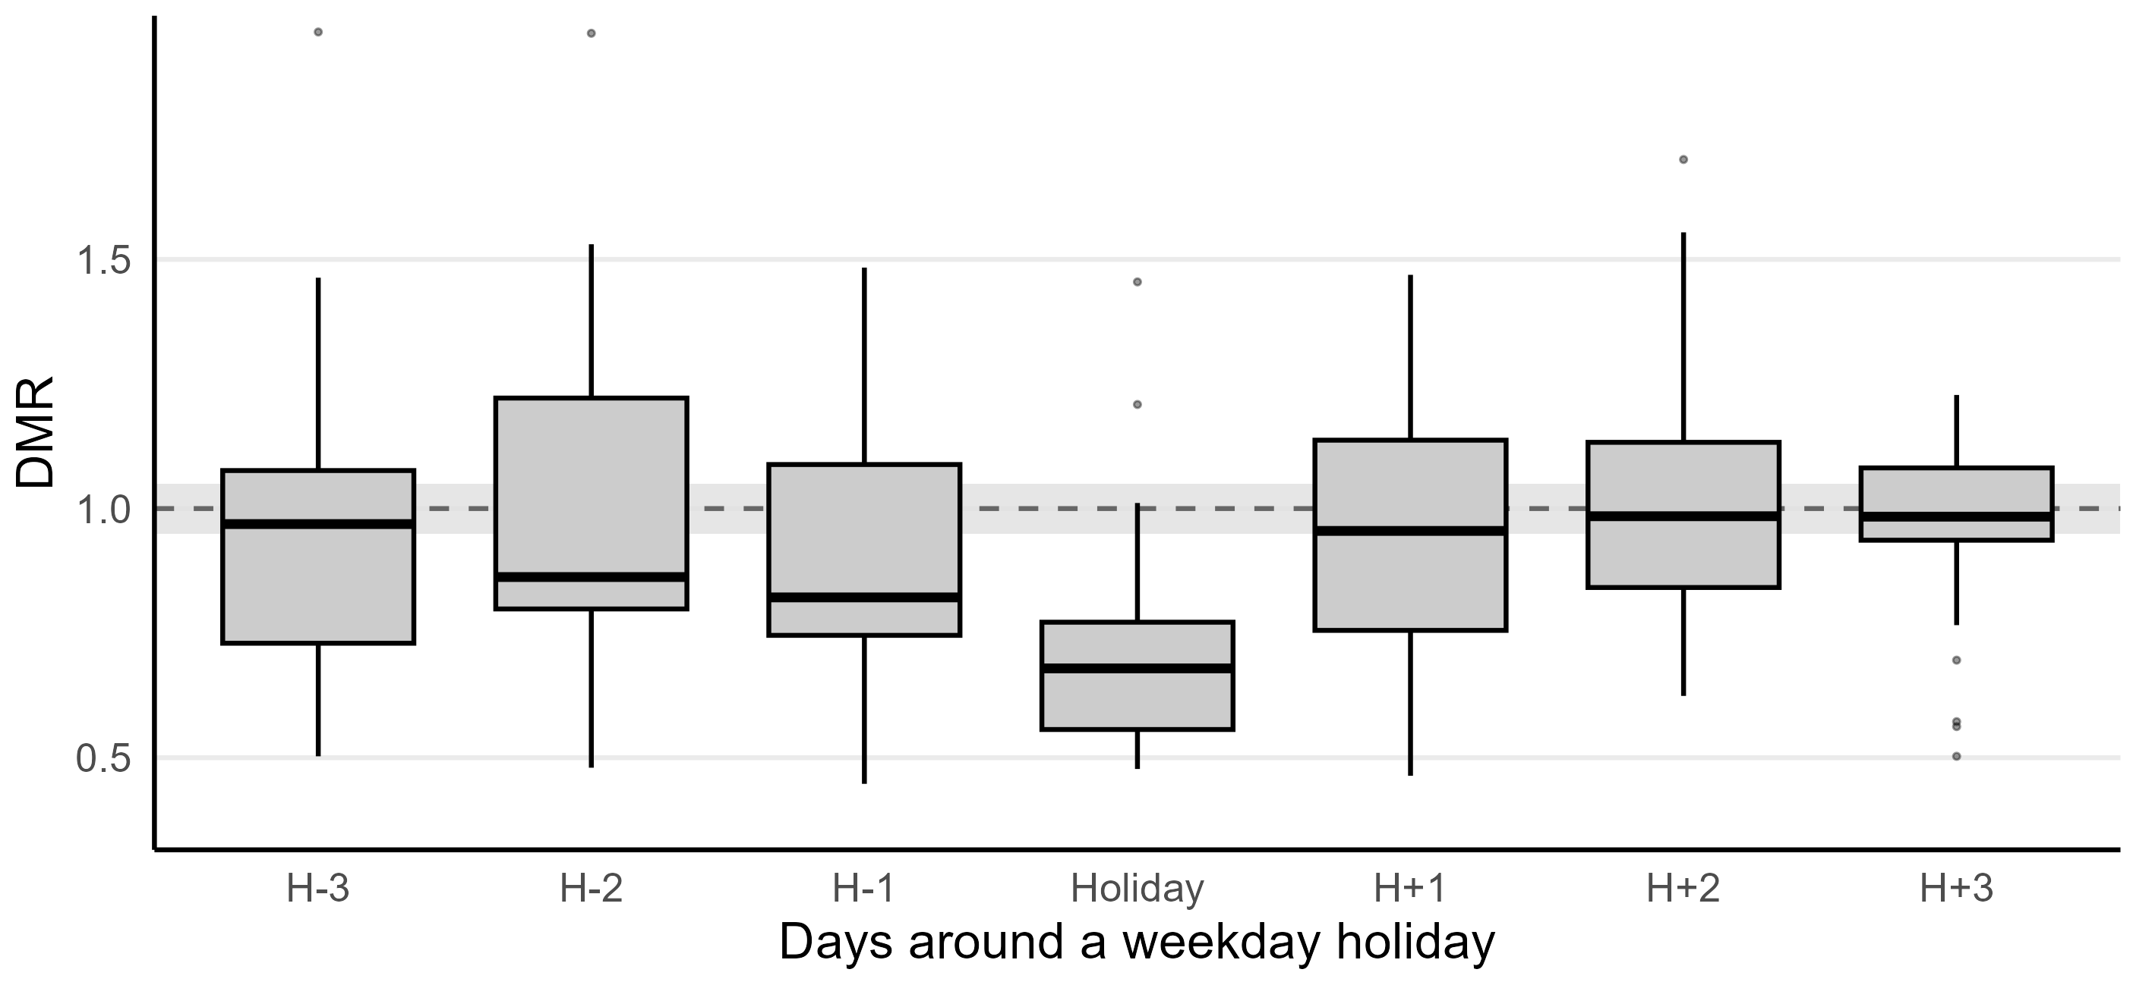
Around holidays: the dip spreads earlier
Step 2 · Basic calendar, weekday holidays, Christmas period excluded. Median DMR: holiday 0.68, the two days before 0.82–0.86, back to about 1 from the day after

Slide 11
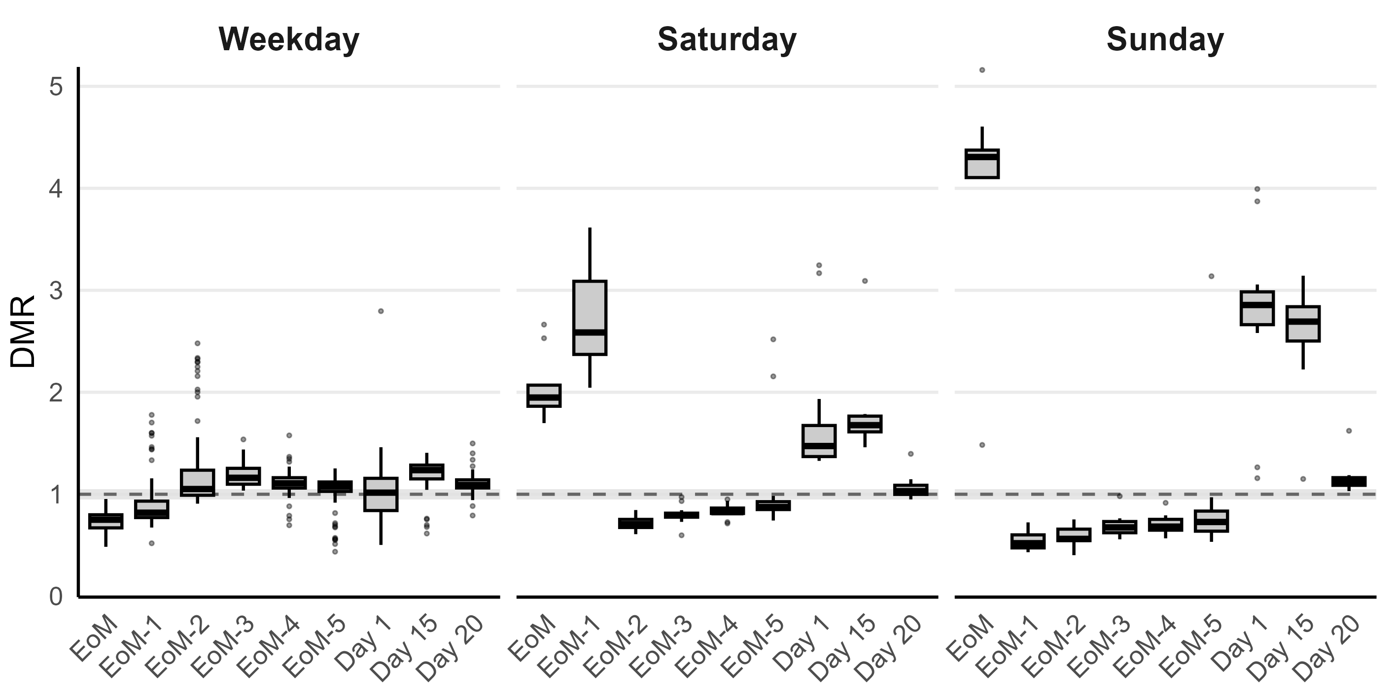
Split by day type: errors of opposite sign
EoM = End of Month
Step 3 · Basic calendar. Last day of the month: median DMR 0.73 on weekdays, 1.96 on Saturdays, 4.3 on Sundays. One coefficient cannot fit all three

Slide 12
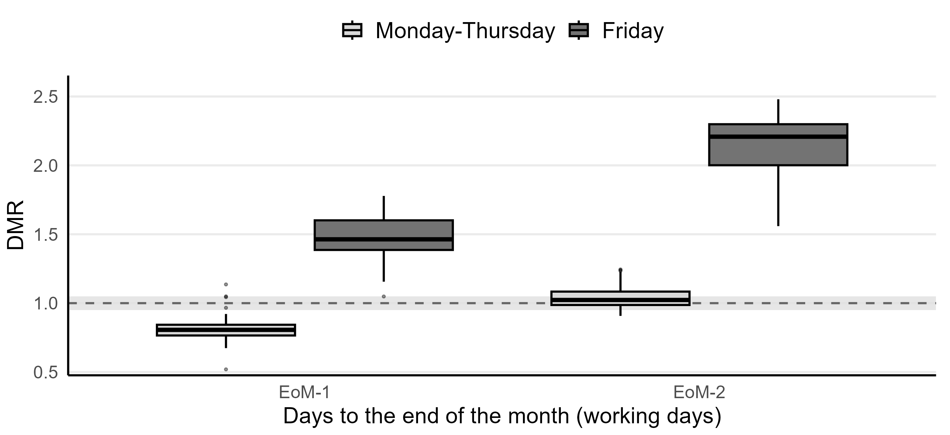
Weekend month end: Friday takes the billing
Step 4 · Basic calendar, working days only. Median DMR on Fridays 1.46 and 2.2, on Monday–Thursday 0.81 and 1.03: a regressor for the last working day

Slide 13
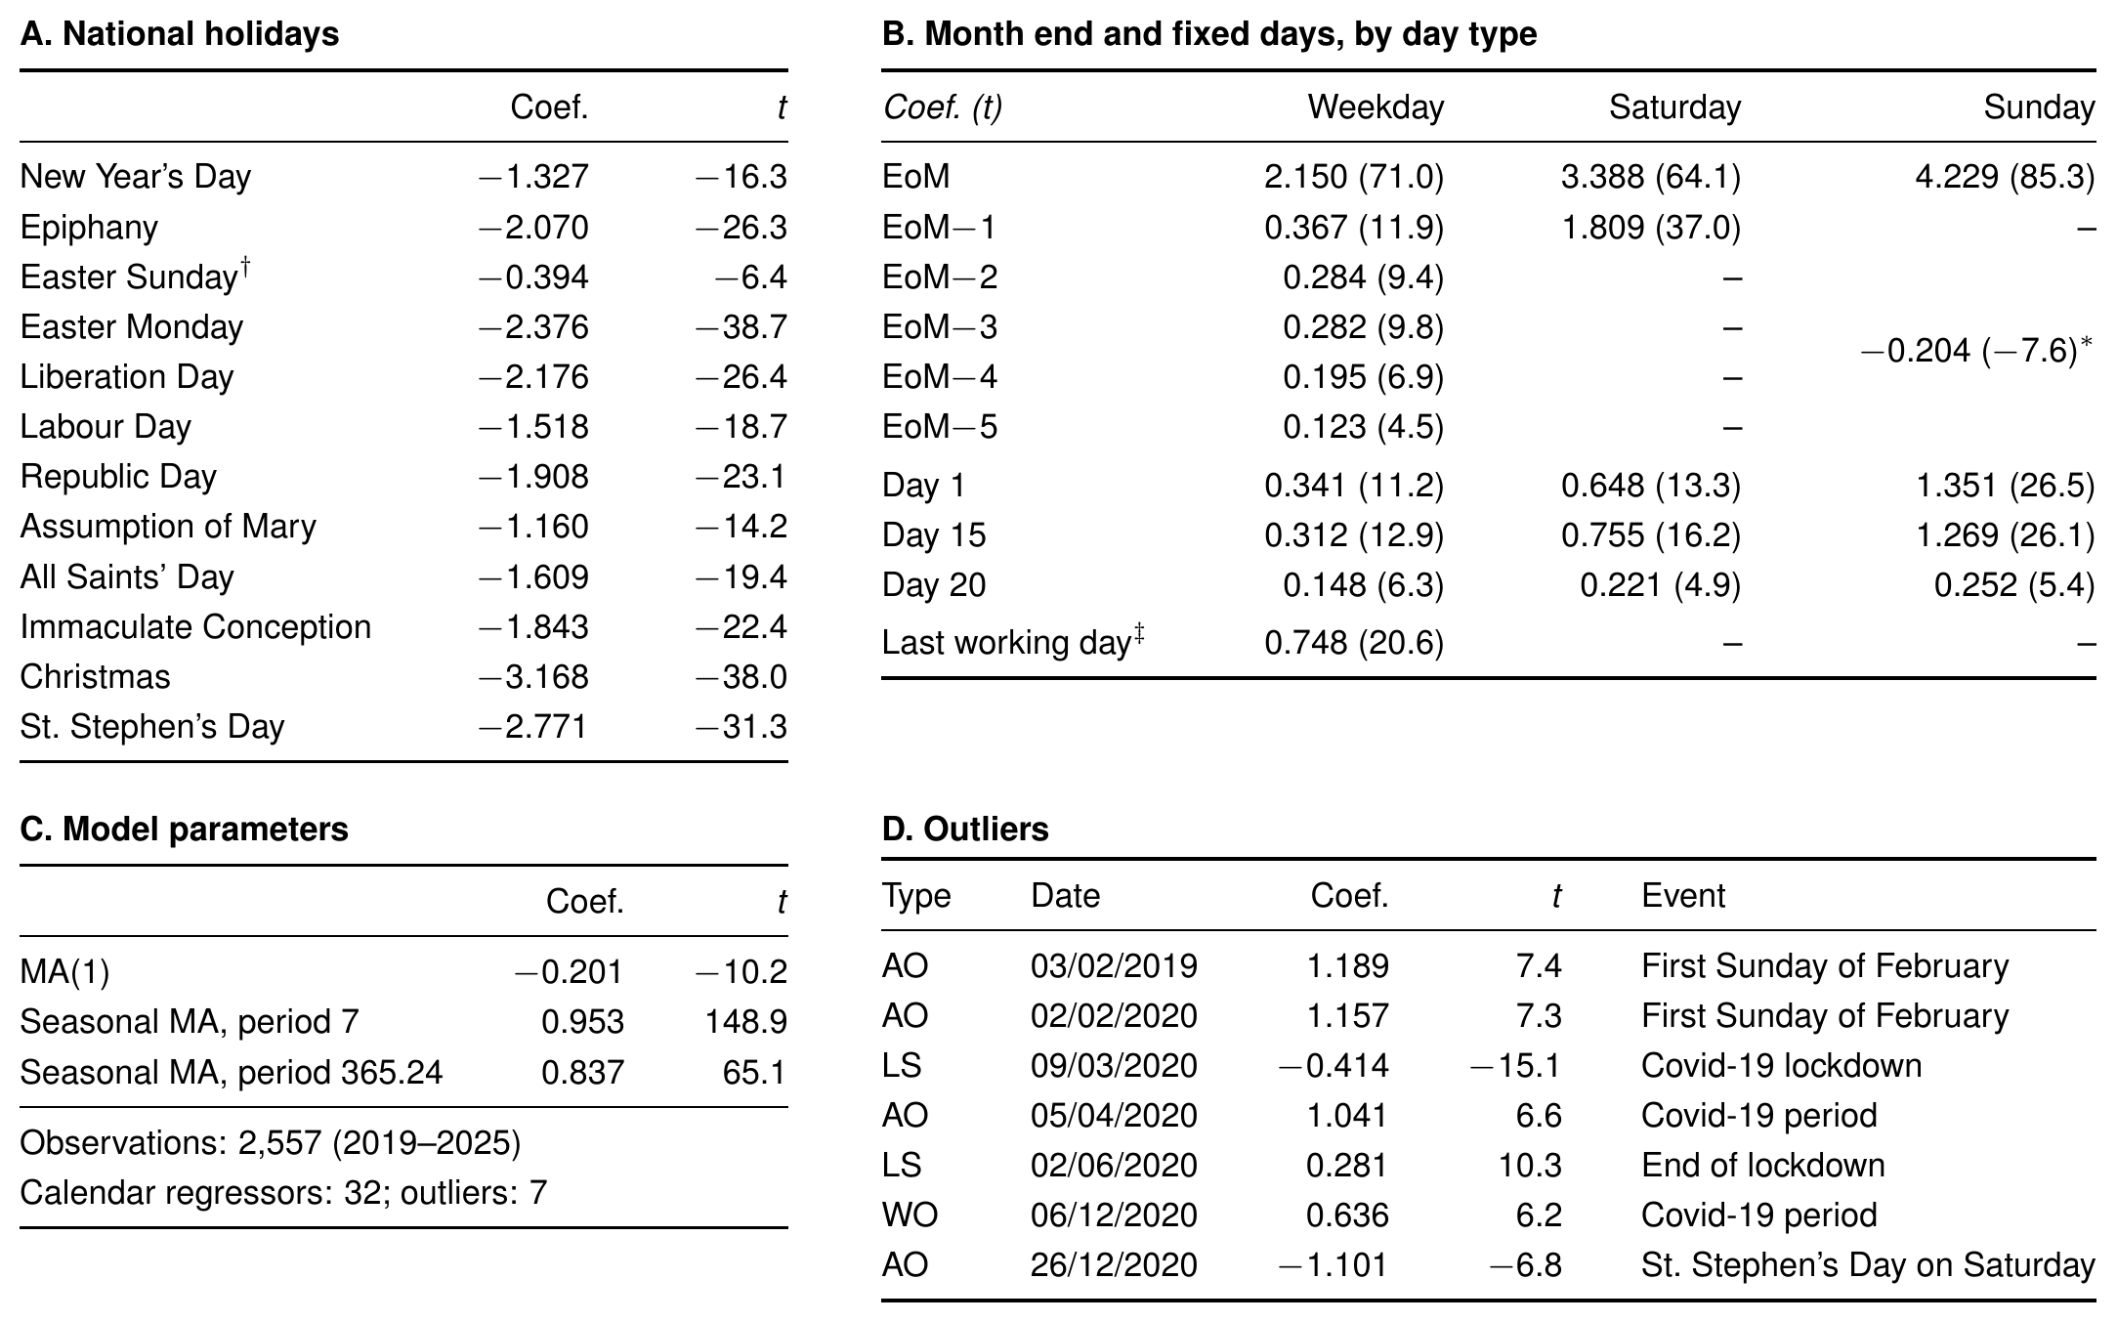
The final model: 32 calendar regressors
32
calendar regressors, all significant (|t| > 4)
×69
last day of the month on a Sunday (×8.6 on weekdays, ×30 on Saturdays)
7
outliers, four of them in the Covid-19 period
Pre-treatment estimates on the log scale; t-statistics in parentheses in panel B.

Slide 14
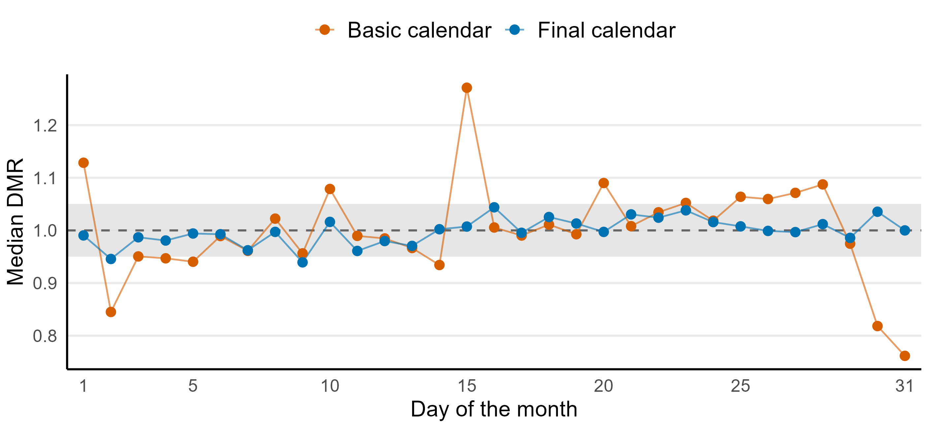
Final calendar: a flat day-of-month profile
Result · Basic vs final calendar. Final calendar (32 regressors): every day within ±5% except days 2 and 9 (0.95 and 0.94)

Slide 15
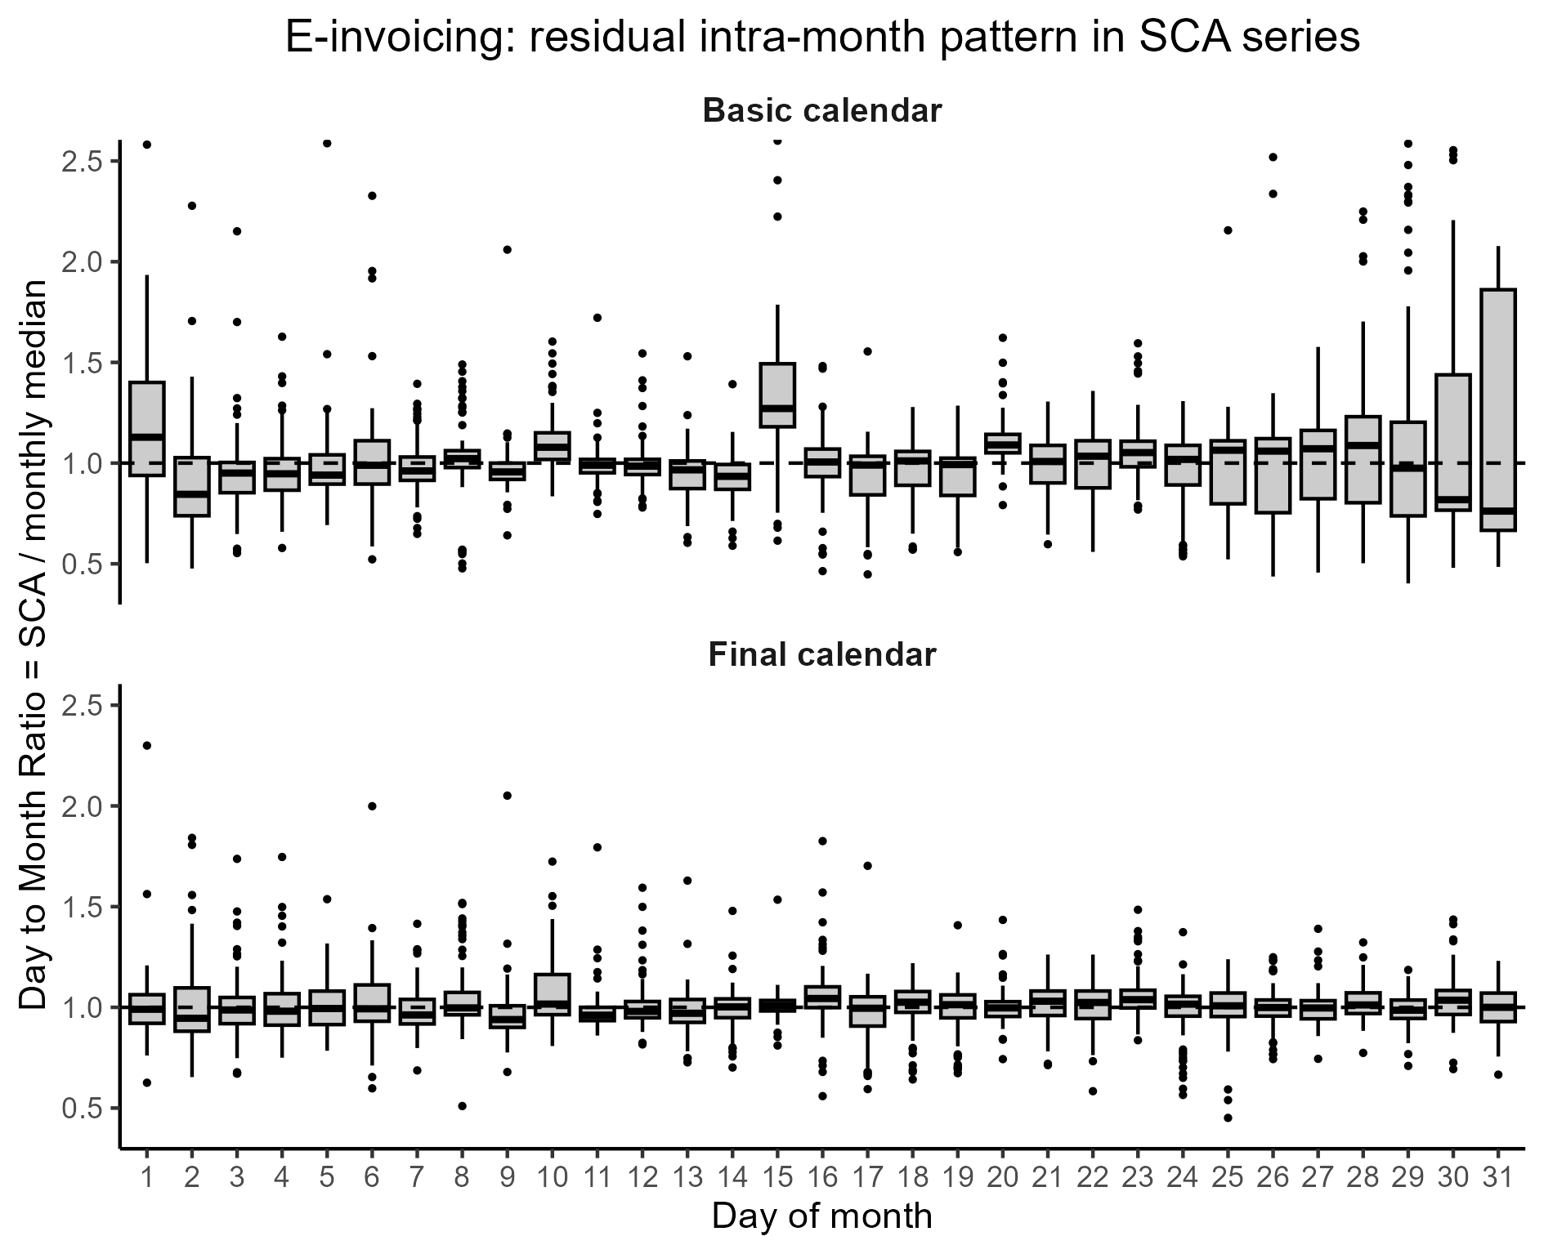
Day by day: the residual pattern disappears
Median DMR basic → final
Day 1
1.13 → 0.99
Day 15
1.27 → 1.01
Day 31
0.76 → 1.00
The boxes also shrink: at the end of the month the spread falls the most.
Result · Basic vs final calendar. Same scale in both panels.

Slide 16
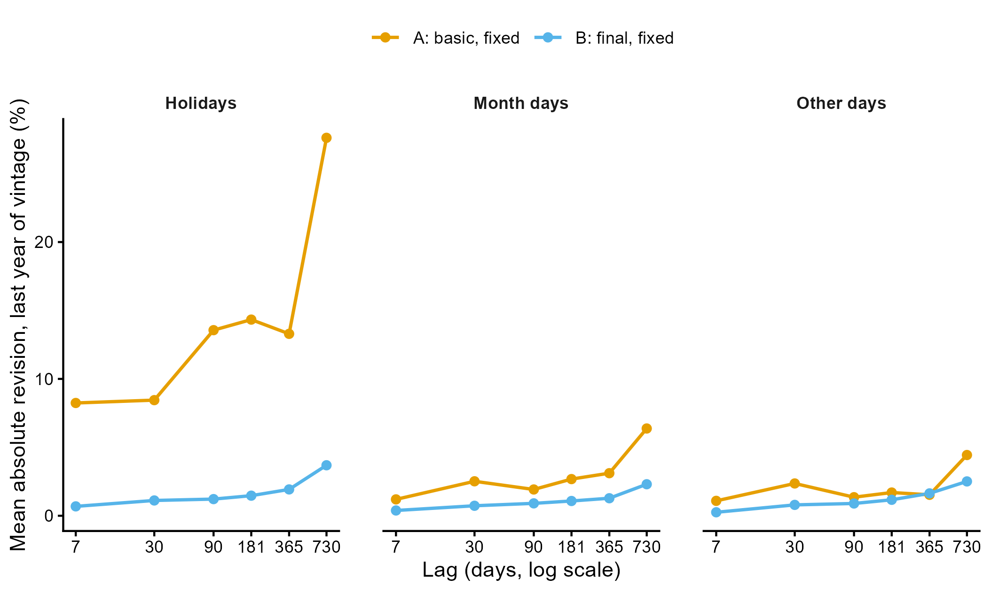
Revisions: fewer on every group of days
Last year basic → final
Holidays
14.2% → 1.7% −88%
Month days
3.0% → 1.1% −62%
Other days
2.1% → 1.2% −42%
Historical sample: 3.0% → 0.9% (−71%). Basic calendar: weekend-holiday outliers come and go, one day revised by over 400%; no lockdown level shift detected.
Result · Revisions, e-invoicing. Fixed coefficients. Full sample vs six vintages ending 7 to 730 days earlier; mean absolute revision (%) over the last year of each vintage.

Slide 17
Electricity demand: a production calendar
Same procedure as for e-invoicing: DMR charts grouped by mechanism, split by day type, a regressor only when a chart supports it.
E-invoicing: administrative
Electricity: production
Driver
Billing rules and fiscal deadlines
Plant activity and closures
Model
Multiplicative (log)
Additive (MWh)
Within the month
Strong: month end, days 1, 15 and 20
None: flat DMR profiles
Holidays
Monday to Friday only: set to zero on weekends
Monday to Friday only (zero on weekends), plus Saturday and midweek effects
Other days
Last working day before a weekend month end
Bridges, 24 and 31 Dec, Christmas–Epiphany working days, 14 and 16 Aug, Easter window
Coefficients
Fixed, 32 regressors
Time-varying, 23 regressors
E-invoicing 2019–2025, electricity demand 2012–2025. Time-varying coefficients: random walks with a common variance, estimated before the outlier search (two steps).

Slide 18

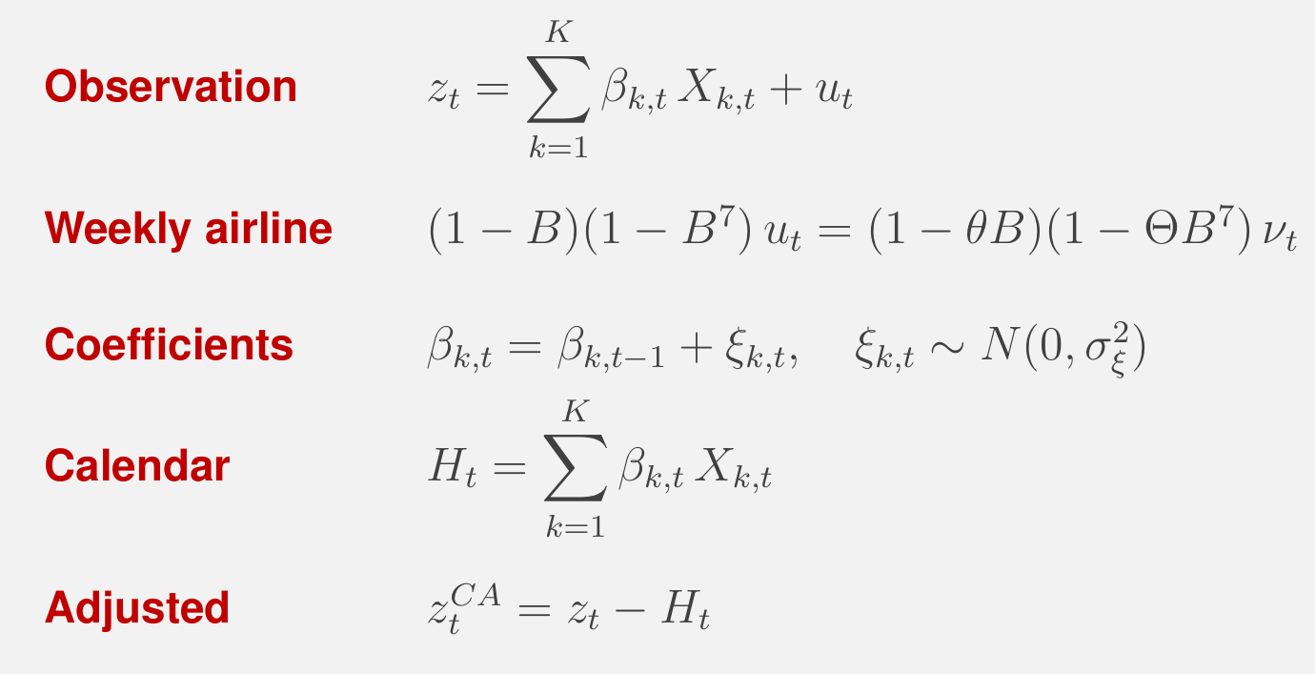
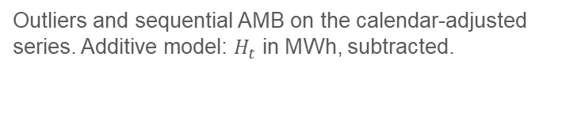
Electricity: time-varying calendar effects
Why not fixed coefficients
Holiday effects fall by 10–18% between 2012 and 2025. Fixed coefficients would apply the 14-year average to every year.
Estimation
Kalman filter and smoother, maximum likelihood. One common variance σ²ξ for the 23 coefficients; σ²ξ = 0 gives fixed coefficients.
Then
Outliers and sequential AMB on the calendar-adjusted series. Additive model: $H_{t}$ in MWh, subtracted.
X_k,t: 23 binary regressors. Holidays falling on Saturday or Sunday are set to zero (Easter Sunday and one Holiday_Sat regressor aside): otherwise the coefficients drift for no real reason. The annual pattern is left to the AMB step.

Slide 19
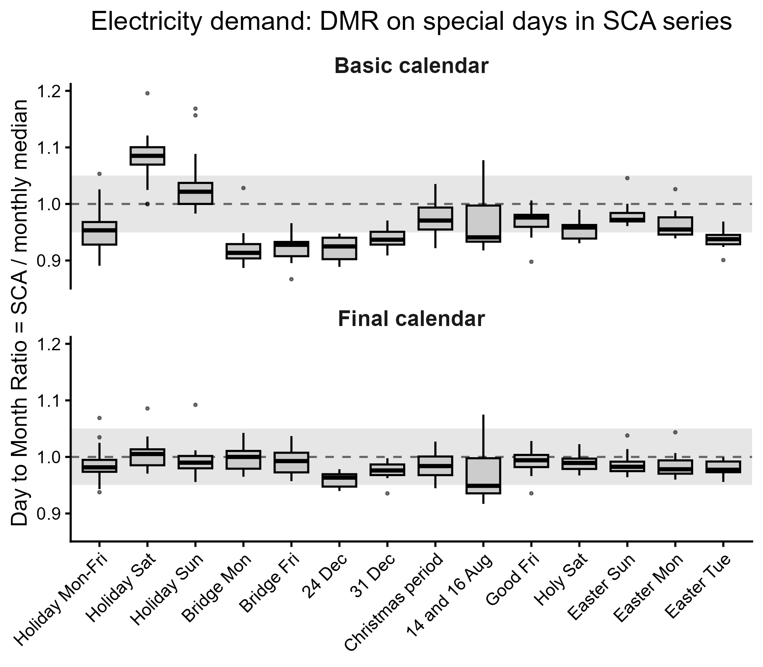
Special days back within the ±5% band
Median DMR basic → final
Holiday on Saturday
1.09 → 1.01
Monday bridge
0.91 → 1.00
Easter Tuesday
0.94 → 0.98
Groups outside ±5%: 7 of 14 → 1 (14 and 16 August, 0.949)
Result · Basic vs final calendar. Basic: 12 holidays on every day, fixed coefficients. Final: production calendar, 23 time-varying regressors.

Slide 20
What remains: two known limits
Holidays: slightly under-corrected
August: a weaker weekly pattern
0.98 median DMR, final calendar
1.03–1.07 weekends
0.94–0.97 weekdays
Inside the ±5% band, but below 1 on every weekday and in the Easter window (0.98–0.99).
Cause: in the two-step estimation the calendar is fitted with a weekly airline only. Its local level absorbs part of the drop, so the coefficients come out a little too small.
Over the whole month, and the same with the basic calendar: not a calendar error.
Cause: with plants closed, weekdays and weekends get closer, but the estimated weekly seasonality is the same all year. This also explains 14 and 16 August at 0.949.
Open points: temperature (cooling and heating degree days) and a weekly pattern that changes within the year.

Slide 21
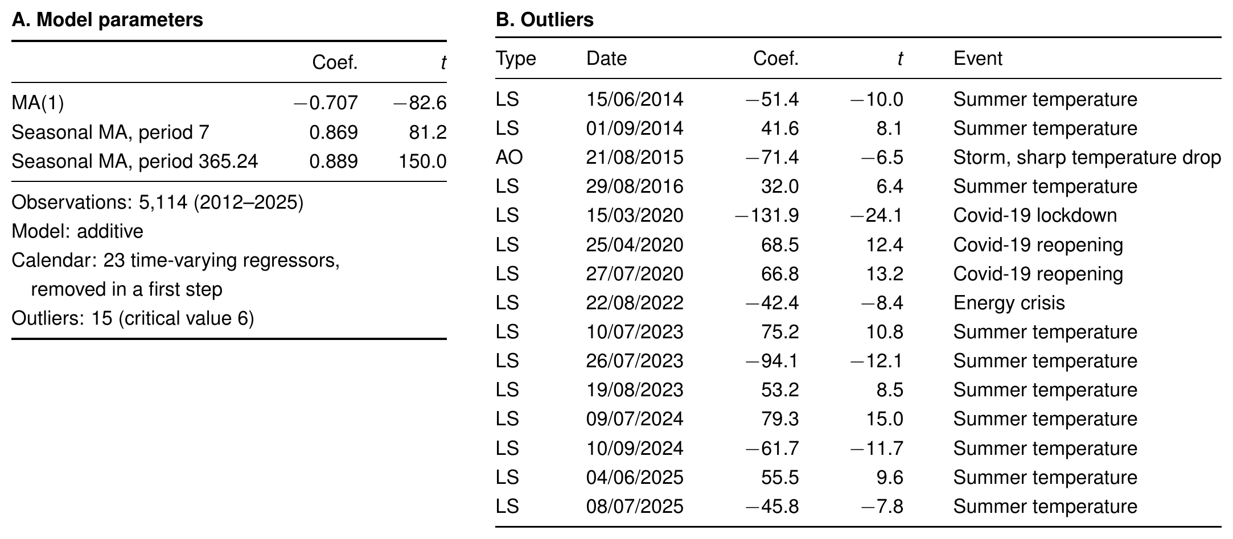
Pre-treatment: outliers show what is missing
10
summer level shifts, mostly in pairs of opposite sign: temperature is not modelled
4
Covid-19 (lockdown, reopenings) and the 2022 energy crisis
1
additive outlier (21/08/2015): a storm with a sharp temperature drop
Pre-treatment of the calendar-adjusted series (additive model); outlier coefficients in thousand MWh. LS: level shift; AO: additive outlier.

Slide 22
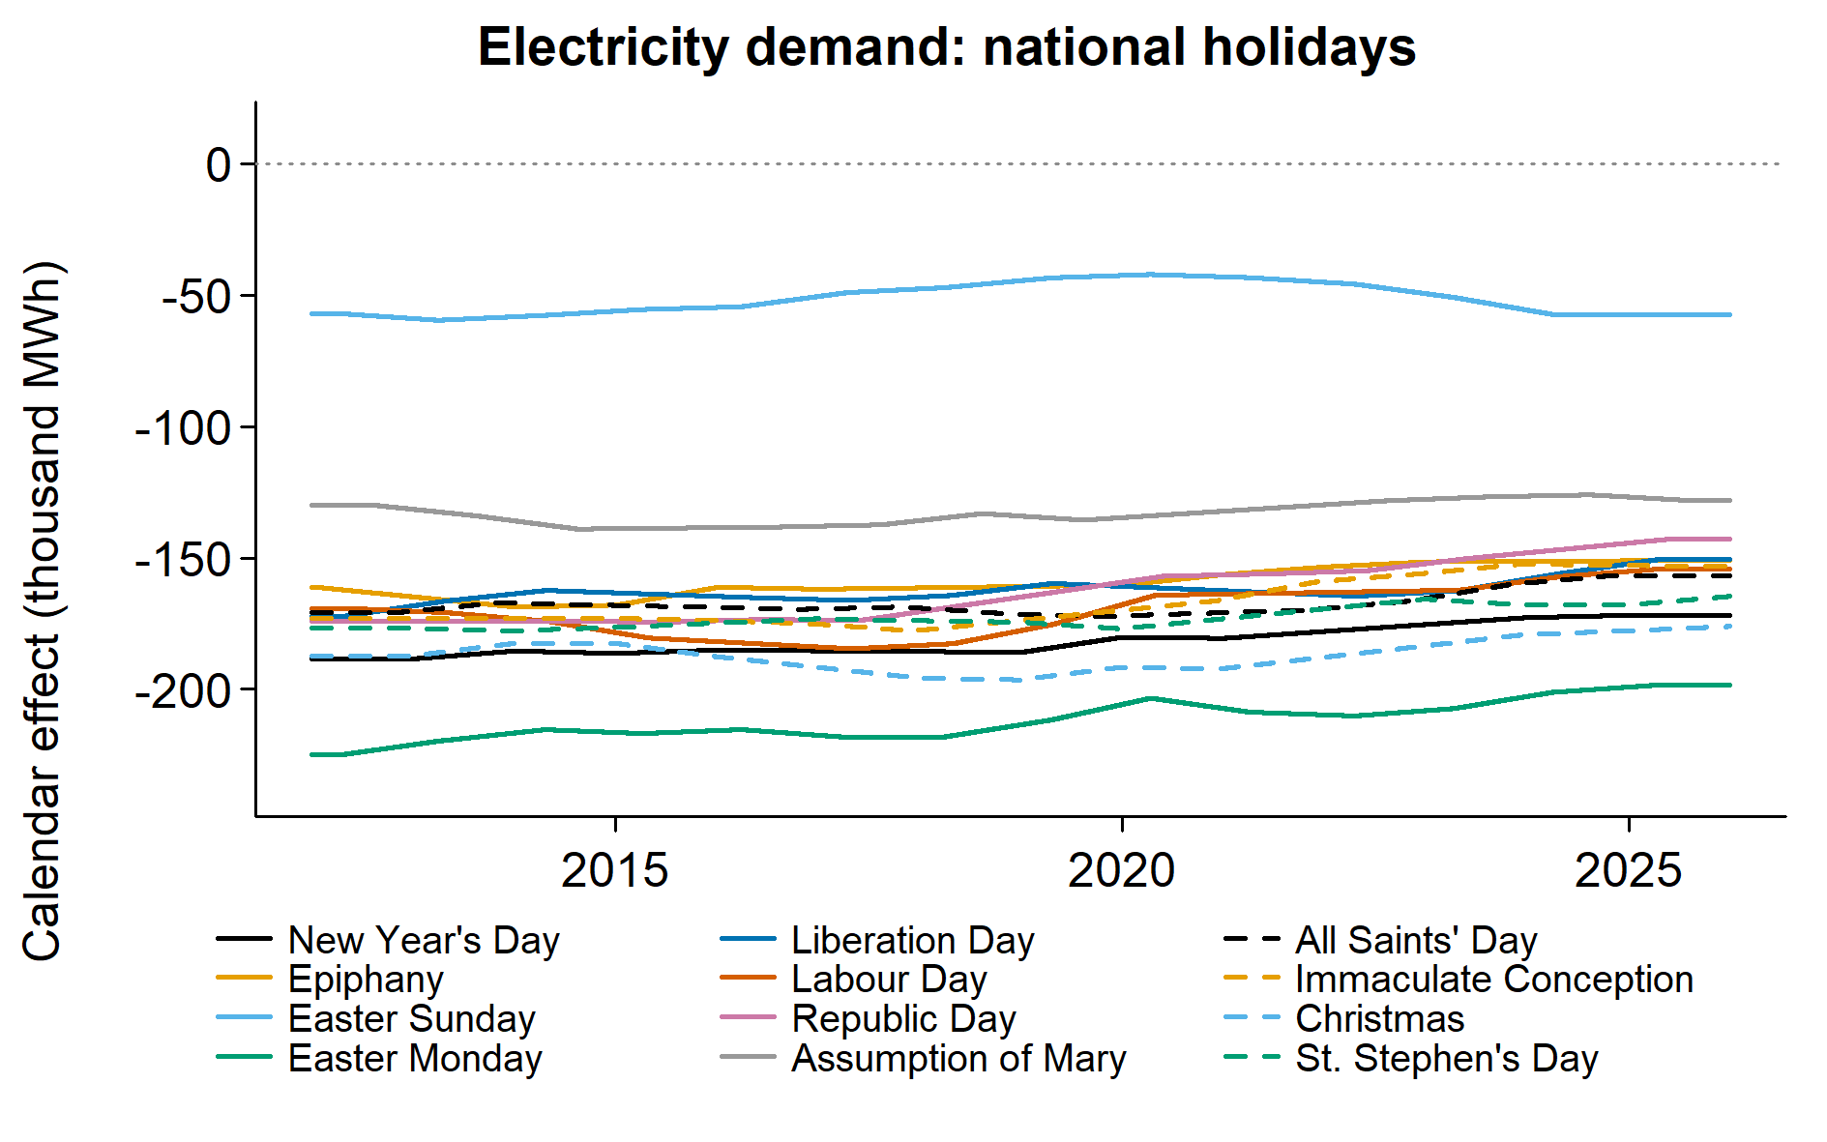
National holidays: the effects fade
2012 → 2025 thousand MWh
Republic Day
−174 → −143
Easter Monday
−221 → −198
All holidays move together, by 10–18%, mostly after 2018. Only the Assumption is stable (−132 → −128).
Result · Time-varying coefficients. Thousand MWh; values at the end of 2012 and of 2025.

Slide 23
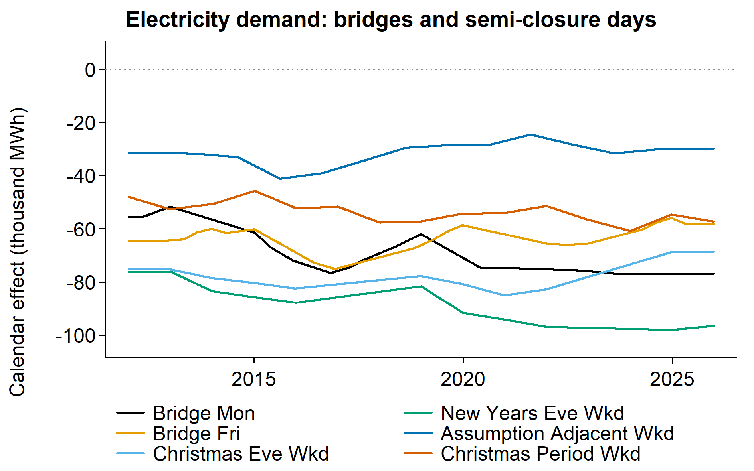
Bridges and semi-closures: no fading
2012 → 2025 thousand MWh
Monday bridge
−52 → −77
New Year's Eve
−76 → −97
Unlike holidays, these days do not fade: some deepen. Days next to the Assumption stay at about −30.
Result · Time-varying coefficients. Thousand MWh; values at the end of 2012 and of 2025.

Slide 24
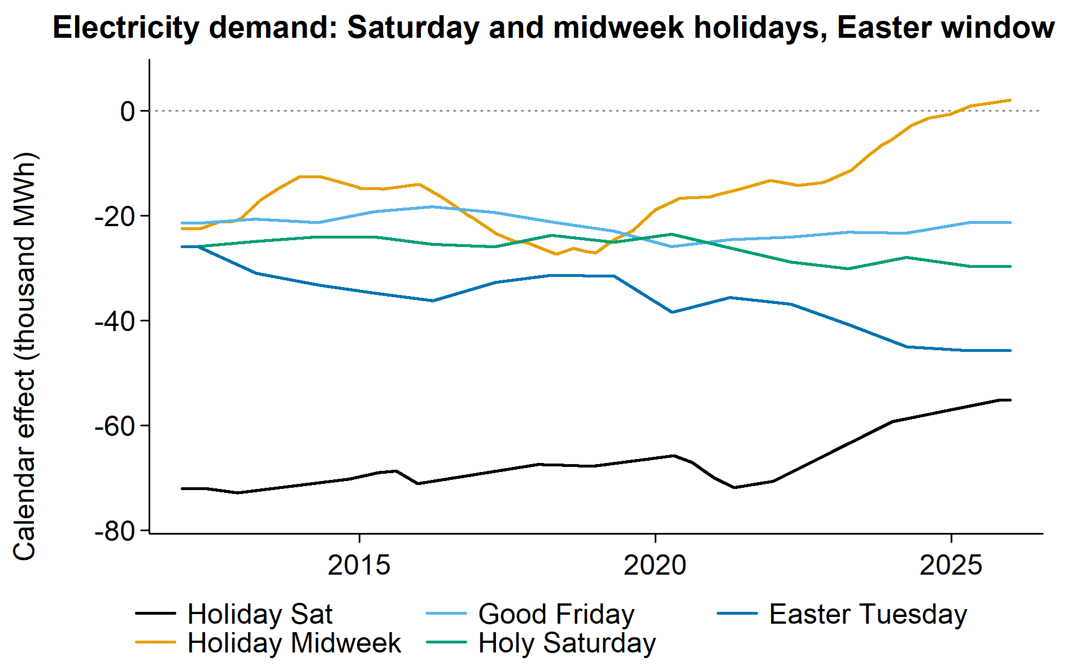
Saturday fades, Easter Tuesday deepens
2012 → 2025 thousand MWh
Holiday on Saturday
−73 → −55
Easter Tuesday
−30 → −46
The midweek effect (−21 → +2) overlaps with the single holidays: read it together with them.
Result · Time-varying coefficients. Thousand MWh; values at the end of 2012 and of 2025.

Slide 25
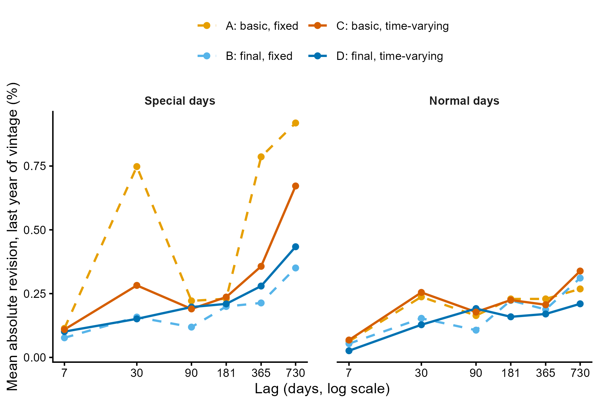
Revisions: special days need the calendar
Special days basic → final
Fixed coefficients (A → B)
0.50% → 0.19% −63%
Time-varying (C → D)
0.31% → 0.23% −26%
Other days: similar for all versions. Final calendar with time-varying coefficients: smallest revisions overall (0.15%).
Result · Revisions, electricity. Full sample vs six vintages ending 7 to 730 days earlier; mean absolute revision (%) over the last year of each vintage; about 24 special days per year.

Slide 26
A good calendar also stabilises the outliers
A
Basic, fixed
B
Final, fixed
23 of 28 outliers on weekend holidays, and they come and go: All Saints' Day 2025, New Year's Days 2017 and 2023; Epiphany 2024 changes type and date.
Weather outliers unstable: the 2015 storm and the 2023 summer level shifts appear only in some vintages. One day revised by 65 thousand MWh.
C
Basic, time-varying
D
Final, time-varying (adopted)
No outlier on holidays, but the error is still there: the coefficients move to absorb it, and are revised as data arrive. A switch outlier sits next to the 2016 All Saints' bridge.
The same outliers in all estimates, or all but one; on holidays only the Covid reopening of April 2020, a real event. Largest single-day revision below 10 thousand MWh.
A well-specified calendar makes the whole model more stable, not only the calendar days.

Slide 27
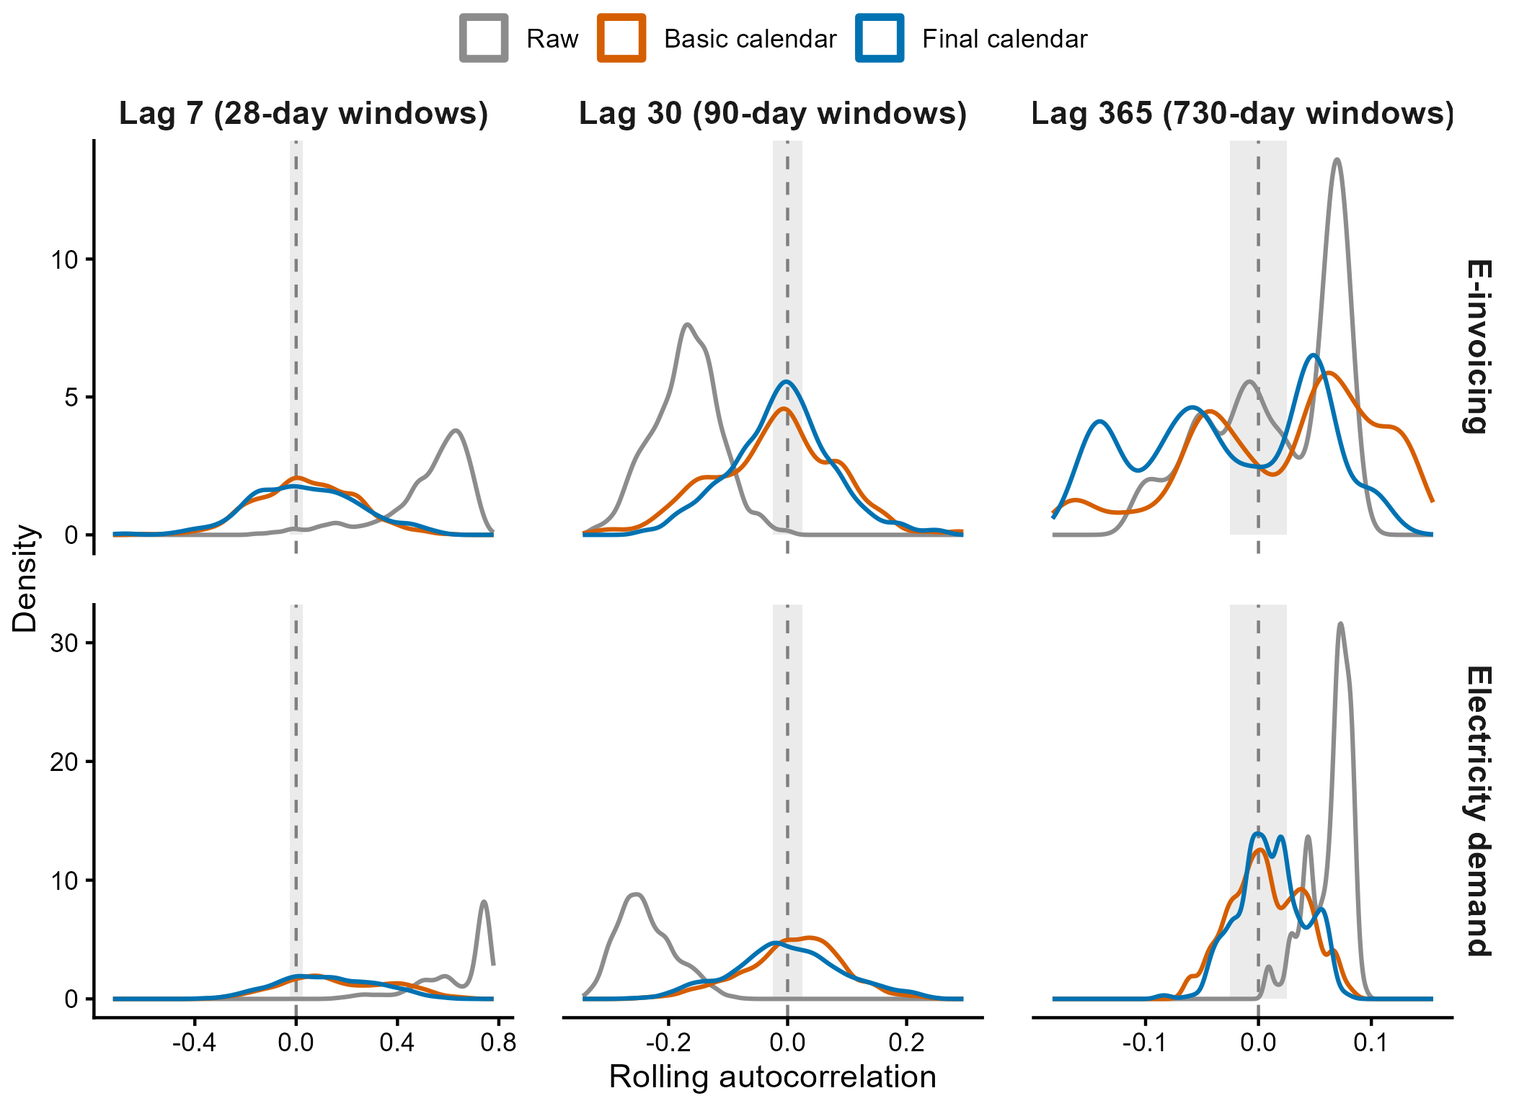
Standard diagnostics barely see the calendar
Seasonality: removed
The raw series is far from 0 at every lag; after adjustment all densities are centred around 0.
Calendar: hardly visible
Only at lag 30 for e-invoicing is the final calendar a little narrower than the basic one. Elsewhere the curves overlap.
Why
Special days are a few per year and get lost in rolling windows over all days. The DMR groups them by mechanism, so it sees them.
Rolling autocorrelations of first differences (of logs for e-invoicing), windows of 28, 90 and 730 days; grey band ±0.025.

Slide 28
Why the calendar deserves the effort
1
Special days are key days
2
Calendar effects are information
3
Daily errors do not average out
Month ends, holidays and bridges are the days users look at. A wrong calendar distorts exactly them: e-invoicing DMR from 0.76 to 1.27 with the basic calendar.
They can be read on their own: a month end worth almost nine weekdays of invoicing; holiday effects on electricity down 10–18% since 2012.
A monthly total hides them; a daily series shows each one as a false movement, or as an outlier that should have been a calendar effect.
A good calendar is more stable
Each series needs its own calendar
Build the calendar from the evidence of each series, and check it on the adjusted series, day by day.
4
5
Fewer revisions, above all on holidays: −88% for e-invoicing, up to −63% on electricity special days. Outliers describe real events and stay put across vintages.
Same diagnostic, different calendars: administrative for e-invoicing, production for electricity. Standard diagnostics barely see the difference; the DMR does.

Slide 29
Thanks for your attention!
ALESSANDRO PIOVANI
alessandro.piovani@istat.it

