Slide 1
An Experimental Testbed for Resource Misuse Detection in Microservices Environments
Master Thesis in Cyber Security
Academic Year 2023/2024
Relatori
Ch.mo Prof. Roberto Natella
Ch.mo Prof. Pietro Liguori
Correlatrice
Ing. Simona de Vivo
Candidato
Alessandro Riccitiello
Matr. M63001354

Slide 2

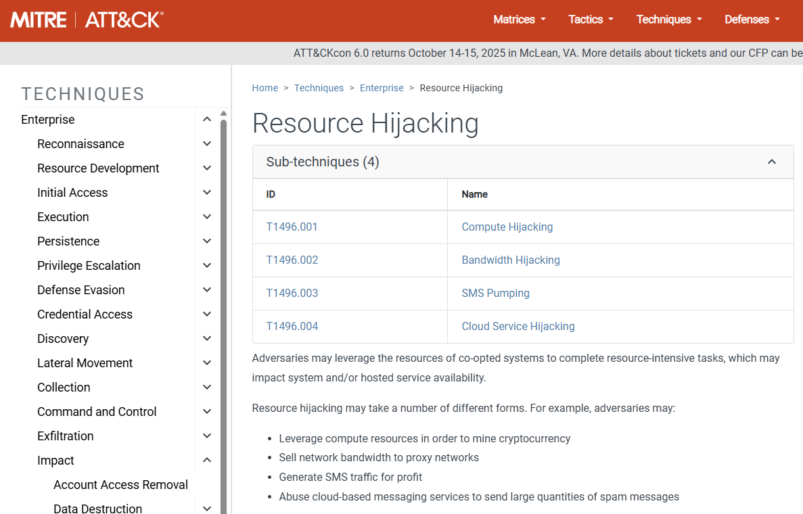
Context
Detecting resources hijacking in dynamic environments
Key difficulties:
High variability in workload patterns;
Real-time detection and response needs;
Lack of benchmarks and public dataset;
Interoperability and explainability issues.

Slide 3
Thesis Contributions
Deployment of a microservice-based testbed in a Local Kubernetes cluster.
Utilizing the Train-Ticket application and Minikube.
Creation of a labeled dataset through monitoring and attack simulation.
Workload generated using Locust; monitoring stack includes Grafana, Prometheus and cAdvisor;
Simulated resource hijacking attacks: cryptojacking, botnet, and reflection/amplification.
Training of an AI-based model for anomaly detection.
Leveraging collected metrics to identify malicious activity.

Slide 4
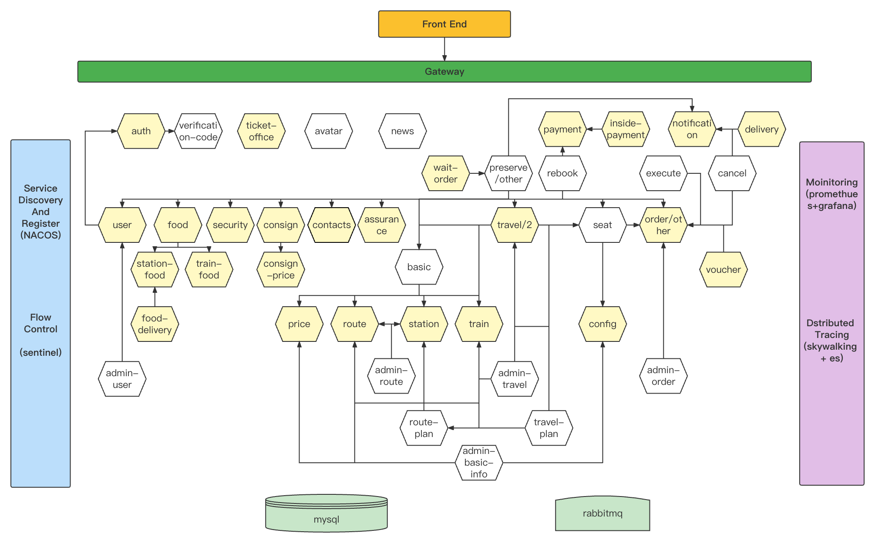
Train-Ticket Architecture

Slide 5
Cluster Architecture

Slide 6
Workload Generation and Metric Selection
Locust was used to simulate realistic system load with dynamic scaling.
The load gradually increased and decreased to approximate real-word operational stress.
To effectively monitor the system, key metrics were selected to analyze performance and resource utilization:
Container CPU Usage;
Container Memory Usage;
Container Network I/O;
Container Resource Limits;
Container CPU Throttling.

Slide 7
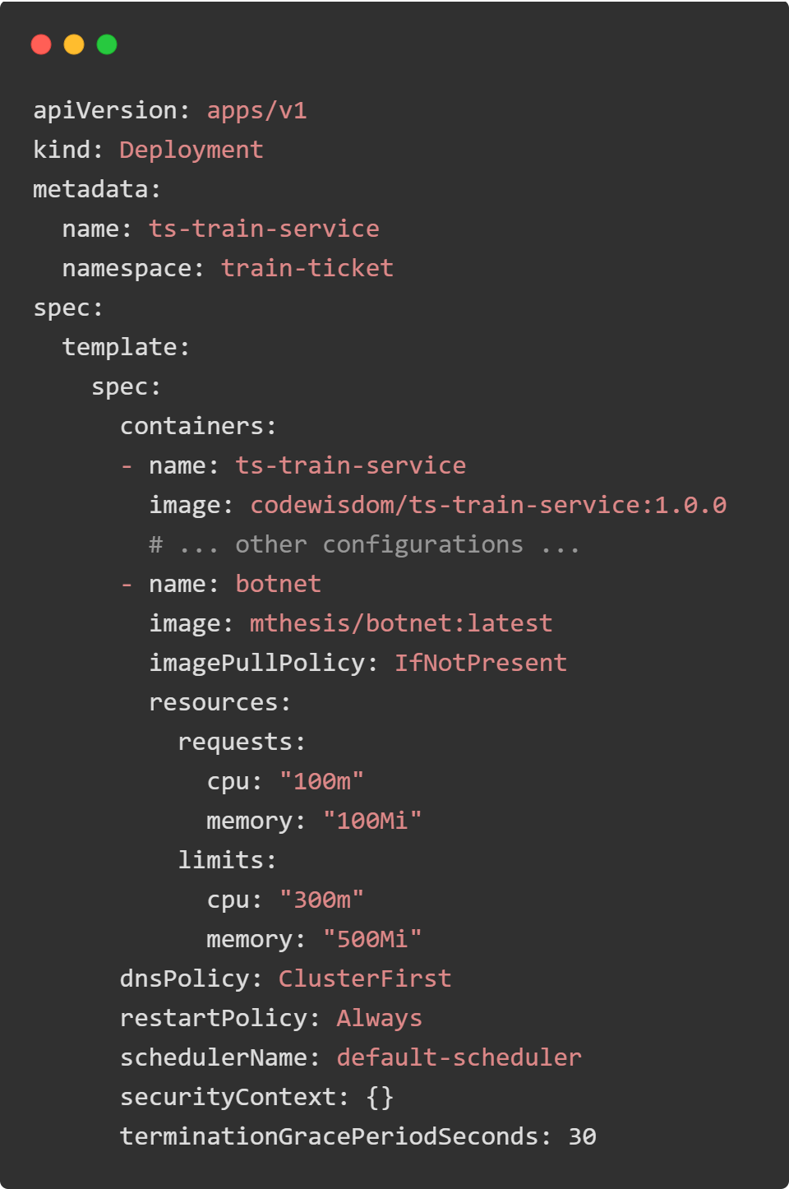
Threat Identification
For our analysis, multiple attacks were selected:
Crypto mining;
Botnet;
Reflection/Amplification.
The attacker exploits privilege escalation to gain control of the Kubernetes cluster and inject malicious containers.

Slide 8
Experimental Plan
Scenario | Repetitions | Modified Variables | Duration per Experiment | Data Collection Frequency | Total Samples per Experiment
No attack | 8 | Number of users in the system | 30 minutes | Every 10 seconds | 180 samples
Botnet | 2 | Number of users, compromised pod | 30 minutes | Every 10 seconds | 180 samples
Cryptojacking | 2 | Number of users, compromised pod | 30 minutes | Every 10 seconds | 180 samples
Reflection Amplification | 2 | Number of users, compromised pod | 30 minutes | Every 10 seconds | 180 samples

Slide 9
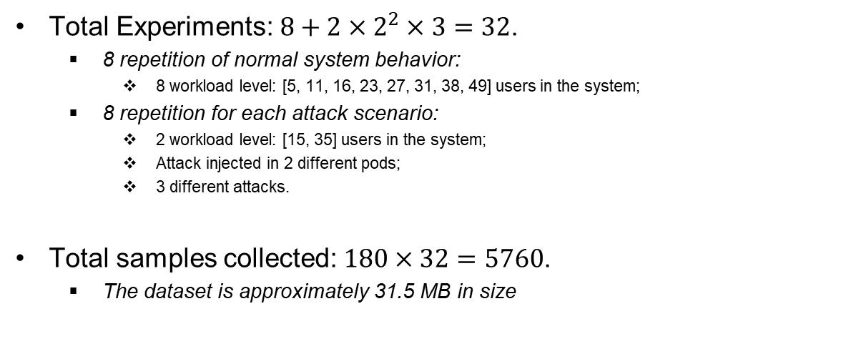
Dataset Overview
Total Experiments: $8+2×2^{2}×3=32$.
8 repetition of normal system behavior:
8 workload level: [5, 11, 16, 23, 27, 31, 38, 49] users in the system;
8 repetition for each attack scenario:
2 workload level: [15, 35] users in the system;
Attack injected in 2 different pods;
3 different attacks.
Total samples collected: $180×32=5760$.
The dataset is approximately 31.5 MB in size

Slide 10
Model Selection
Three models were tested:
Support Vector Machine;
Random Forest;
Convolutional Neural Networks.
CNN offers a better generalization compared to SVM and RFC.
Improves detection of attacks.

Slide 11
Convolutional Neural Networks
Hyperparametrs:.
Learning Rate = 0.008;
Batch size = 32;
90 Epoches of training;
Adam Optmizer.
Tuning the hyperparameters has achieved the following:
Accuracy | Loss | Precision | Recall | F1-score
80.26% | 0.4516 | 0.8175 | 0.7614 | 0.7884

Slide 12
Conclusion
Objective:
Developed a testbed to detect resource hijacking attacks in Kubernetes microservices environments.
Methodology:
Testbed & Monitoring: Train-ticket on Minikube with Grafana, Prometheus and cAdvisor.
Experiments: 32 test, varying user load and compromised pod.
Dataset & AI Models: 5.760 samples analyzed using SVM, RFC and CNN
Key Finding:
SVM and RFC have poor generalization, the CNN performed better.
Future works: Refining AI models, improving dataset diversity.

Slide 13
Thank you
for your attention

Slide 14
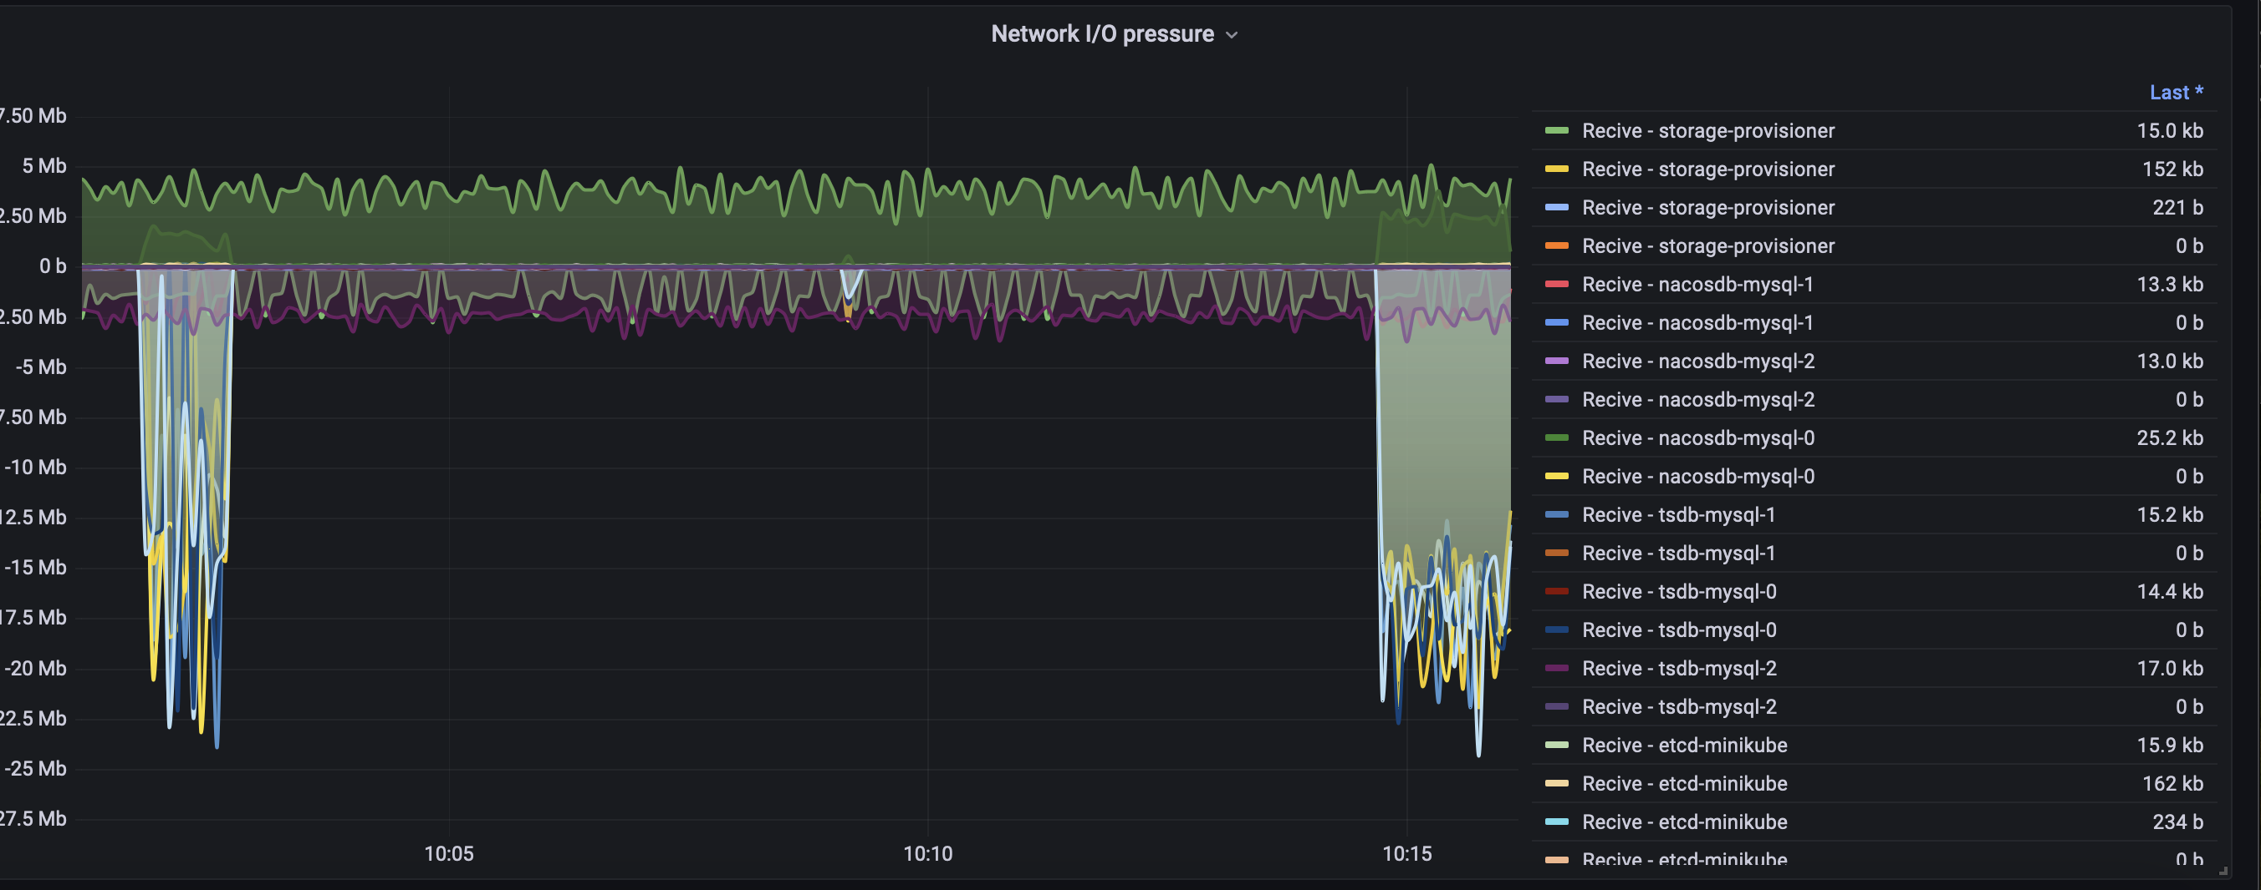
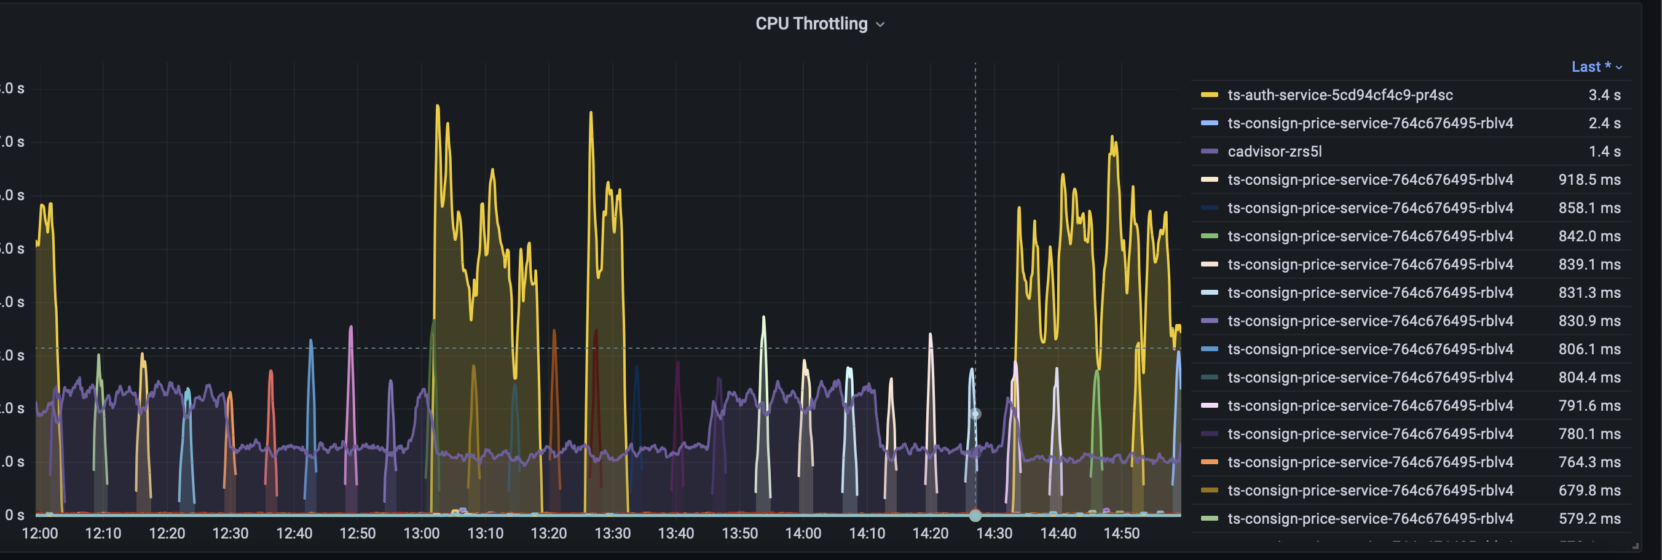
Data Collection
Metrics were collected using Prometheus and cAdvisor and visualized through Granafa.
The metrics are exported in a CSV time-series file.
Datas were aggregated in a single DataFrame for analysis.
The DataFrame is cleaned by handling missing or null values.
Data were normalized applying MinMaxScaler.

