Slide 1
Project Harvest
Preliminary valuation materials: Demo Target Co. (synthetic)
September 2026 | Draft, illustrative and for discussion purposes only
Built on SYNTHETIC DEMO DATA: set DATA_MODE = 'live' for real market data

Slide 2
Executive summary
SYNTHETIC DEMO DATA
Demo Target Co. (synthetic) (TGT.DEMO)
■ Demo Target Co. (synthetic) trades at $20.00 per share: market cap $17,069mm and EV $22,789mm, or 10.9x LTM EBITDA vs a peer median of 10.6x.
■ Preliminary reference range of $17.28–$22.08 per share (-14% to +10% vs current), the median of trading comps, transaction and DCF ranges.
■ DCF at a 7.1% WACC: $24.33 (perpetuity growth 2.5%) and $19.64 (exit multiple 10.6x); terminal value is 80% of EV.
■ A financial sponsor at 5.0x leverage could pay up to $13.13 per share (-34%) for a 20% IRR, which sets a floor for a competitive process.
■ 1 of 5 strategic buyers screened could fund an all-cash deal at the mid-point premium within 4.0x pro forma leverage.
Source: SYNTHETIC DEMO DATA. Illustrative analysis for educational purposes.
2

Slide 3
Company overview
SYNTHETIC DEMO DATA
Consumer Defensive | Packaged Foods (synthetic)
Key market data | Value
Share price | $20.00
52-week range | $17.57 – $22.30
Market cap ($mm) | 17,069
Net debt ($mm) | 5,720
Enterprise value ($mm) | 22,789
LTM revenue ($mm) | 11,834
LTM EBITDA ($mm) | 2,084
EBITDA margin | 17.6%
EV / LTM EBITDA | 10.9x
P / NTM EPS | 15.9x
Synthetic company generated for offline demonstration. Switch DATA_MODE to 'live' for real data.
Source: SYNTHETIC DEMO DATA. Illustrative analysis for educational purposes.
3

Slide 4
Trading comparables
SYNTHETIC DEMO DATA
Peers valued on LTM and NTM multiples
Company | Mkt cap ($mm) | EV ($mm) | EBITDA margin | EV / Revenue | EV / EBITDA | P/E LTM | P/E NTM | Net debt / EBITDA
PEER-A.DEMO | 30,922 | 41,239 | 19.7% | 2.1x | 10.6x | 15.3x | 14.8x | 2.7x
PEER-B.DEMO | 14,910 | 19,933 | 18.3% | 2.0x | 11.2x | 16.6x | 15.9x | 2.8x
PEER-C.DEMO | 11,231 | 17,325 | 20.9% | 2.0x | 9.6x | 12.3x | 12.0x | 3.4x
PEER-D.DEMO | 13,281 | 14,527 | 12.1% | 1.2x | 10.1x | 18.4x | 18.0x | 0.9x
PEER-E.DEMO | 36,950 | 56,766 | 24.1% | 2.2x | 9.0x | 11.1x | 10.9x | 3.2x
PEER-F.DEMO | 17,830 | 21,146 | 20.6% | 3.1x | 15.0x | 23.4x | 22.4x | 2.3x
PEER-G.DEMO | 10,235 | 16,543 | 18.1% | 2.0x | 11.1x | 15.5x | 14.8x | 4.3x
Mean |  |  |  | 2.1x | 10.9x | 16.1x | 15.5x
Median |  |  |  | 2.0x | 10.6x | 15.5x | 14.8x
25th pct |  |  |  | 2.0x | 9.8x | 13.8x | 13.4x
75th pct |  |  |  | 2.1x | 11.2x | 17.5x | 17.0x
TGT.DEMO (target) | 17,069 | 22,789 | 17.6% | 1.9x | 10.9x | 16.3x | 15.9x | 2.7x
Implied value per share (25th–75th percentile): EV/LTM EBITDA $17.28 – $20.56 | P/NTM EPS $16.84 – $21.38
Source: SYNTHETIC DEMO DATA. Illustrative analysis for educational purposes.
4

Slide 5
Precedent transactions and premiums paid
SYNTHETIC DEMO DATA
Control value benchmarks
Date | Acquirer | Target | EV / LTM EBITDA
2025-03 | Buyer One (demo) | Snack Co (demo) | 13.8x
2024-11 | Buyer Two (demo) | Sauce Co (demo) | 12.1x
2024-06 | Sponsor Three (demo) | Frozen Co (demo) | 10.4x
2023-09 | Buyer Four (demo) | Cereal Co (demo) | 14.6x
2023-02 | Buyer Five (demo) | Spice Co (demo) | 16.2x
2022-07 | Sponsor Six (demo) | Bakery Co (demo) | 11.3x
Median EV / LTM EBITDA: 12.9x
Interquartile range: 11.5x – 14.4x
Implied value per share: $21.37 – $28.45
Premiums paid analysis
Premium | Price
Unaffected (current) | $20.00
20% premium | $24.00
30% premium | $26.00
40% premium | $28.00
Source: SYNTHETIC DEMO DATA. Illustrative analysis for educational purposes.
5

Slide 6
Weighted average cost of capital
SYNTHETIC DEMO DATA
WACC of 7.10%
Component | Value
Risk-free rate (10y UST) | 4.2%
Equity risk premium | 4.5%
Raw beta: 2y weekly / 5y monthly | 0.68 / 0.71
Peer median unlevered beta | 0.69
Target D/E (market) | 36.3%
Relevered beta | 0.89
Cost of equity | 8.2%
Synthetic rating (coverage) | A (5.3x)
Pre-tax cost of debt | 5.3%
Tax rate | 23.0%
Equity / total capital | 73.4%
WACC | 7.10%
Peer | Raw beta | Adj. beta | D/E | Unlevered
PEER-A.DEMO | 0.83 | 0.89 | 35.9% | 0.69
PEER-B.DEMO | 0.86 | 0.91 | 36.2% | 0.71
PEER-C.DEMO | 0.71 | 0.80 | 57.3% | 0.56
PEER-D.DEMO | 0.76 | 0.84 | 13.0% | 0.77
PEER-E.DEMO | 0.68 | 0.79 | 56.5% | 0.55
PEER-F.DEMO | 0.93 | 0.95 | 20.1% | 0.83
PEER-G.DEMO | 1.03 | 1.02 | 64.7% | 0.68
Median |  |  |  | 0.69
Betas are Blume-adjusted (0.67 × raw + 0.33) and unlevered with Hamada: βu = βl / (1 + (1 − t) × D/E).
Cost of debt uses Damodaran's interest-coverage synthetic rating table.
Source: SYNTHETIC DEMO DATA. Illustrative analysis for educational purposes.
6

Slide 7
Discounted cash flow analysis
SYNTHETIC DEMO DATA
Unlevered free cash flow projections ($mm)
$mm | FY2025A | FY2026E | FY2027E | FY2028E | FY2029E | FY2030E
Revenue | 11,717 | 11,972 | 12,243 | 12,530 | 12,833 | 13,154
Revenue growth |  | 2.2% | 2.3% | 2.3% | 2.4% | 2.5%
EBITDA | 2,063 | 2,066 | 2,112 | 2,162 | 2,214 | 2,270
EBITDA margin | 17.6% | 17.3% | 17.3% | 17.3% | 17.3% | 17.3%
D&A | 410 | 419 | 429 | 439 | 449 | 460
EBIT | 1,653 | 1,647 | 1,684 | 1,723 | 1,765 | 1,809
Taxes | – | 379 | 387 | 396 | 406 | 416
Capex | 434 | 443 | 453 | 464 | 475 | 487
Change in NWC | 8 | 26 | 27 | 29 | 30 | 32
Unlevered FCF | – | 1,218 | 1,245 | 1,273 | 1,303 | 1,335
Valuation | Perpetuity | Exit multiple
WACC | 7.1% | 7.1%
g / exit multiple | 2.5% | 10.6x
PV of FCF | 5,378 | 5,378
PV of terminal value | 21,107 | 17,105
Enterprise value | 26,485 | 22,483
(–) Net debt & minority | -5,720 | -5,720
Value per share | $24.33 | $19.64
TV % of EV | 79.7% | 76.1%
Implied exit multiple from perpetuity method: 13.1x | Implied perpetuity growth from exit method: 1.48%
Mid-year convention; terminal value discounted from the end of the final projection year.
Source: SYNTHETIC DEMO DATA. Illustrative analysis for educational purposes.
7

Slide 8
DCF sensitivity analysis
SYNTHETIC DEMO DATA
Value per share
WACC vs terminal growth
WACC vs exit multiple (EV / EBITDA)
WACC \ g | 1.5% | 2.0% | 2.5% | 3.0% | 3.5%
6.1% | $25.41 | $28.68 | $32.86 | $38.39 | $46.04
6.6% | $22.28 | $24.86 | $28.07 | $32.18 | $37.60
7.1% | $19.71 | $21.80 | $24.33 | $27.48 | $31.51
7.6% | $17.57 | $19.28 | $21.32 | $23.81 | $26.90
8.1% | $15.75 | $17.18 | $18.85 | $20.86 | $23.30
WACC \ exit | 8.6x | 9.6x | 10.6x | 11.6x | 12.6x
6.1% | $16.75 | $18.73 | $20.71 | $22.69 | $24.66
6.6% | $16.28 | $18.22 | $20.15 | $22.08 | $24.01
7.1% | $15.83 | $17.72 | $19.60 | $21.49 | $23.38
7.6% | $15.39 | $17.23 | $19.07 | $20.92 | $22.76
8.1% | $14.95 | $16.75 | $18.56 | $20.36 | $22.16
Current share price: $20.00. Highlighted row = base-case WACC.
Source: SYNTHETIC DEMO DATA. Illustrative analysis for educational purposes.
8

Slide 9
LBO analysis: financial sponsor ability to pay
SYNTHETIC DEMO DATA
Max price at 20% IRR and 5.0x leverage: $13.13 per share
$mm | FY2026E | FY2027E | FY2028E | FY2029E | FY2030E
EBITDA | 2,066 | 2,112 | 2,162 | 2,214 | 2,270
Interest | 886 | 840 | 789 | 733 | 670
Taxes | 175 | 194 | 215 | 237 | 262
Levered FCF | 537 | 598 | 666 | 739 | 819
Debt repayment | 537 | 598 | 666 | 739 | 819
Debt (end) | 9,882 | 9,283 | 8,618 | 7,879 | 7,060
Cash (end) | 0 | 0 | 0 | 0 | 0
Net debt / EBITDA | 4.8x | 4.4x | 4.0x | 3.6x | 3.1x
Max price per share
IRR \ leverage | 4.0x | 4.5x | 5.0x | 5.5x | 6.0x
25.0% | $10.36 | $11.02 | $11.68 | $12.34 | $13.00
22.5% | $11.16 | $11.76 | $12.36 | $12.96 | $13.56
20.0% | $12.06 | $12.60 | $13.13 | $13.67 | $14.21
17.5% | $13.08 | $13.54 | $14.01 | $14.47 | $14.93
15.0% | $14.24 | $14.62 | $15.00 | $15.38 | $15.76
Entry EV $16,929mm (8.1x LTM EBITDA), sponsor equity $6,849mm (40% of total funding), MOIC 2.49x over 5 years.
Assumes 8.5% blended cost of debt, 100% cash sweep, 2% fees and exit at 10.6x EBITDA (peer median).
Source: SYNTHETIC DEMO DATA. Illustrative analysis for educational purposes.
9

Slide 10
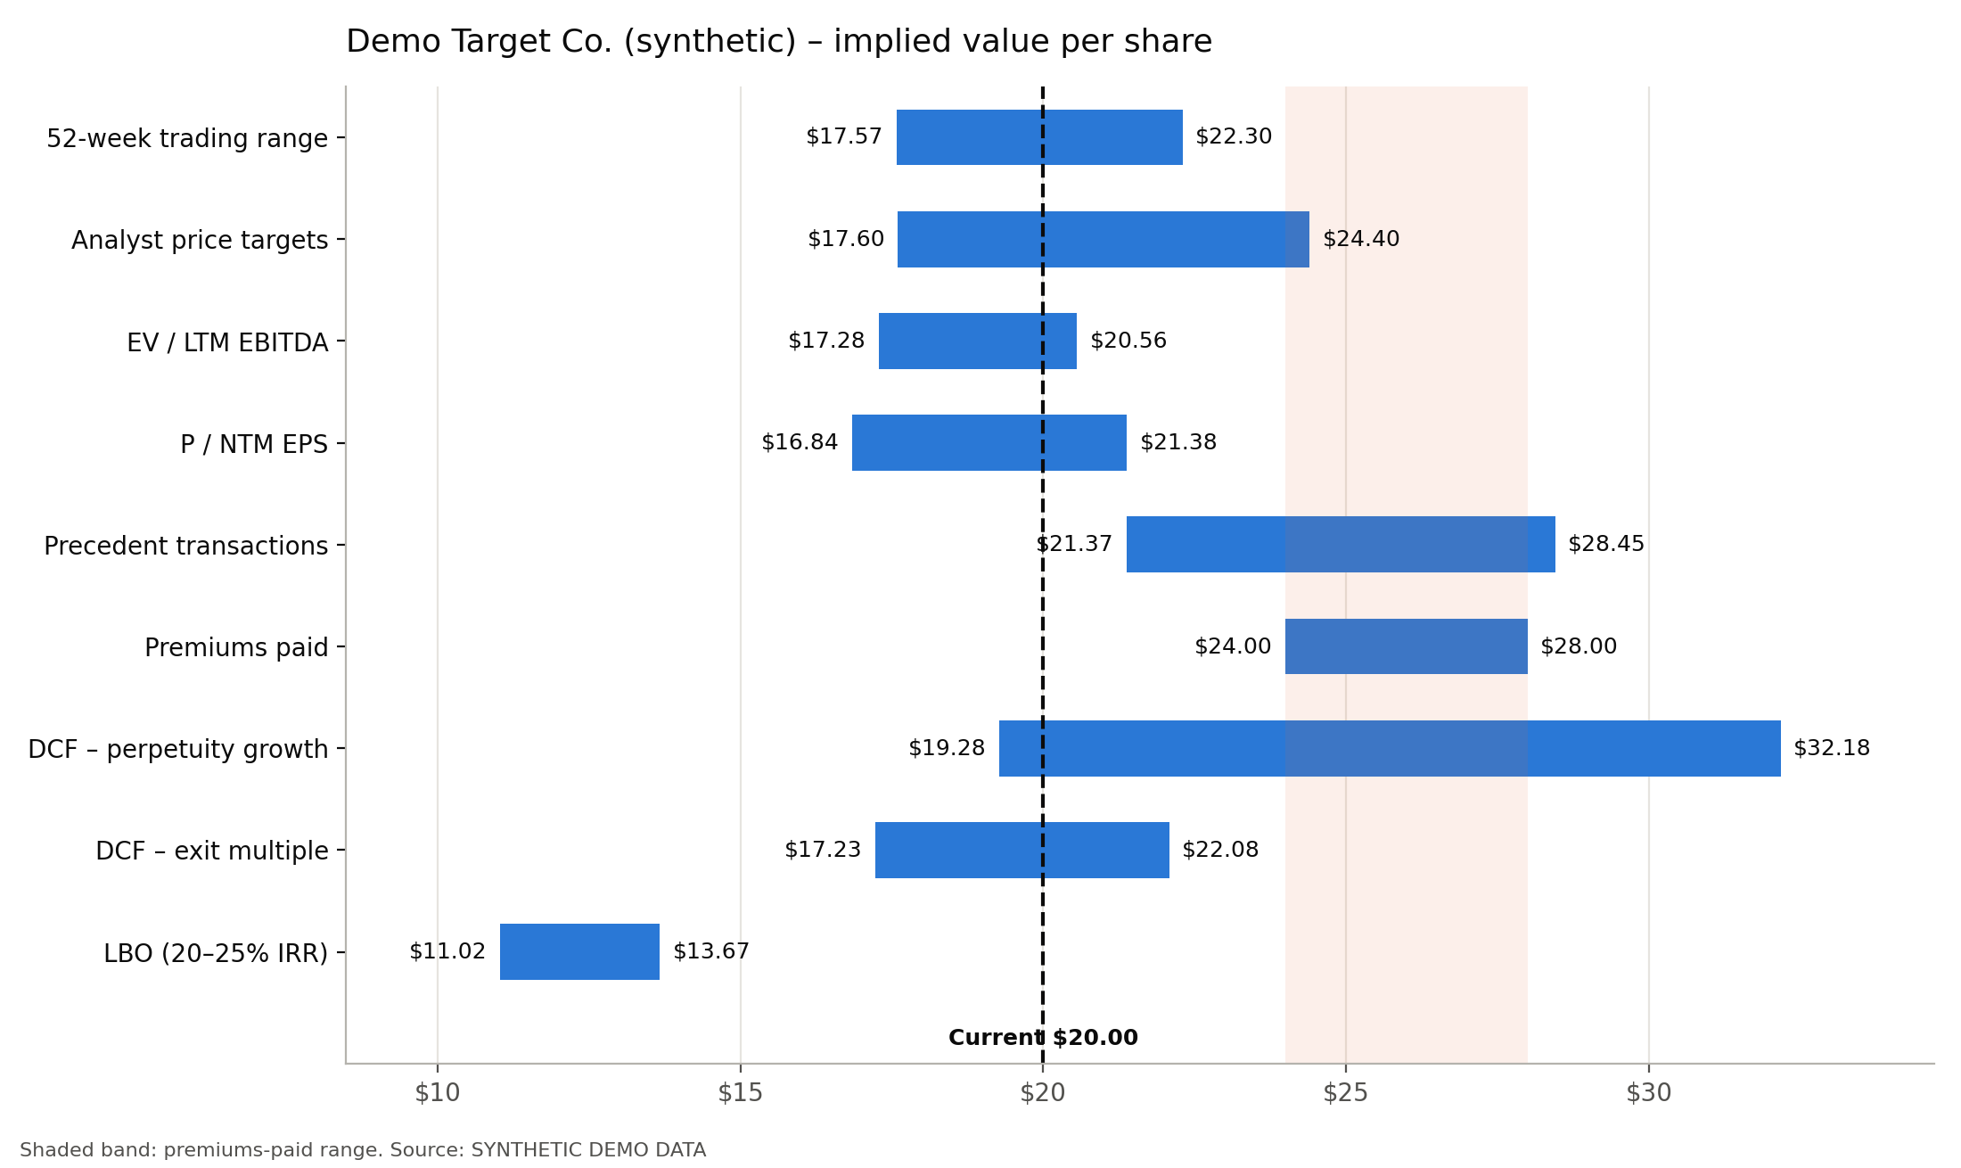
Valuation summary
SYNTHETIC DEMO DATA
Preliminary reference range $17.28 – $22.08 per share
Source: SYNTHETIC DEMO DATA. Illustrative analysis for educational purposes.
10

Slide 11
Potential strategic acquirers
SYNTHETIC DEMO DATA
Screened at $26.00 per share (30% premium)
Ticker | Company | Mkt cap ($mm) | Net debt / EBITDA | Deal / mkt cap | PF leverage (all-debt) | Buyer P/E NTM | All-cash feasible | All-stock EPS
BUY-B.DEMO | Buy-B Corp. (synthetic) | 176,320 | 1.8x | 15.8% | 3.0x | 18.0x | Yes | Dilutive
BUY-A.DEMO | Buy-A Corp. (synthetic) | 88,683 | 1.9x | 31.5% | 4.2x | 18.8x | Stretch | Dilutive
BUY-D.DEMO | Buy-D Corp. (synthetic) | 72,901 | 2.7x | 38.3% | 4.8x | 16.7x | Stretch | Dilutive
BUY-C.DEMO | Buy-C Corp. (synthetic) | 37,265 | 1.4x | 74.9% | 6.3x | 19.8x | Stretch | Dilutive
PEER-A.DEMO | Peer-A Corp. (synthetic) | 30,922 | 2.7x | 90.3% | 6.4x | 14.8x | Stretch | Dilutive
Offer P/E NTM at the mid-point premium: 20.6x. An all-stock deal is accretive before synergies when the buyer's P/E is higher.
All-cash feasible = pro forma net debt / EBITDA ≤ 4.0x assuming 100% debt funding. Strategic fit and antitrust overlap need qualitative review.
Source: SYNTHETIC DEMO DATA. Illustrative analysis for educational purposes.
11

Slide 12
Methodology and key assumptions
SYNTHETIC DEMO DATA
■ Trading comparables: LTM multiples from Yahoo Finance; multiples above 100x or with negative denominators excluded; 25th–75th percentile applied.
■ Premiums paid: one-day premium range applied to the current (unaffected) share price; refine with a deal-specific precedent set.
■ DCF: 5-year driver-based projections, mid-year convention, perpetuity growth 2.5% and exit multiple 10.6x (peer median).
■ WACC: CAPM with peer-derived relevered beta; cost of debt from interest-coverage synthetic rating.
■ LBO: max entry price solved by bisection at the target IRR, with exit at 10.6x EBITDA (peer median).
■ Limitations: data vendor figures are not reconciled to filings; no stub-period adjustment; share count excludes dilution from options/RSUs.
Source: SYNTHETIC DEMO DATA. Illustrative analysis for educational purposes.
12

