Slide 1


PREDICTING RISK CATEGORY FROM RESTAURANT INSPECTION DATA
Final Project - Big Data For Official Statistics, MSc Data Science
Alessandro Taglieri, 1890945

Slide 2
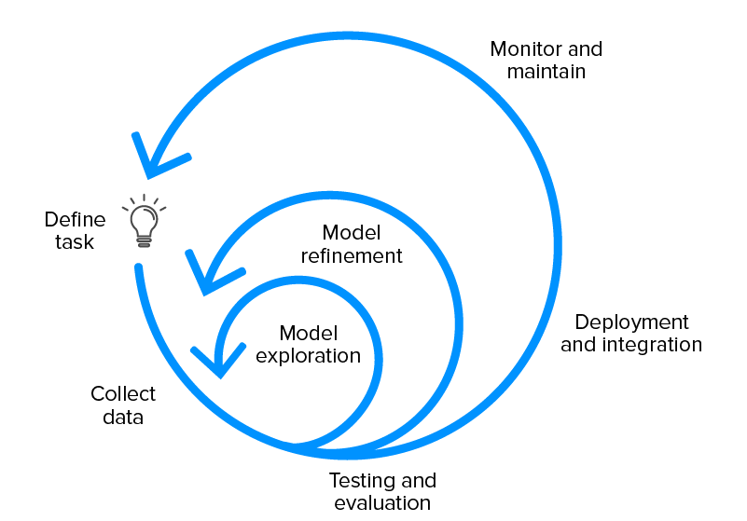

Problem: Predict risk category from an inspection
Steps to reach the goal:
Overview on the dataset
Preprocessing data
EDA
Training models
Evaluation and comparison
Dashboard
Alessandro Taglieri, 1890945

Slide 3

Overview on the dataset
Dataset name: San Francisco Restaurant Scores - LIVES Standard
Dataset source: DataSF website, https://data.sfgov.org/Health-and-Social-Services/Restaurant-Scores-LIVES-Standard/pyih-qa8i?rowindex=0=
Data from inspections on San Francisco Restaurant. It contains all info about inspections and relative restaurants
Dataset comprimes of 17 columns and 53.7 K rows
Alessandro Taglieri, 1890945

Slide 4
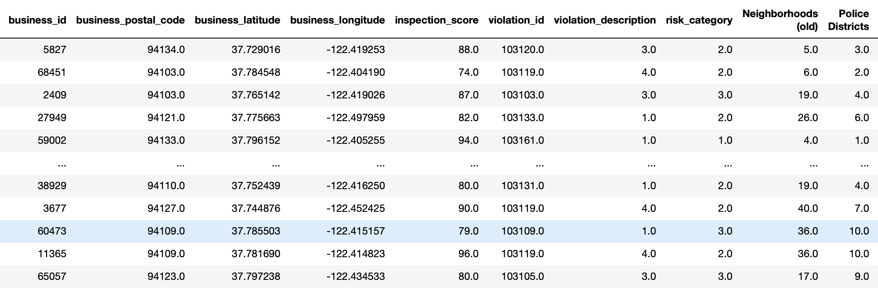
PREPROCESSING DATA
Understanding the dataset
Identifiy and handling missing values
Encoding the categorical data
Data reduction
Split dataset
Alessandro Taglieri, 1890945

Slide 5
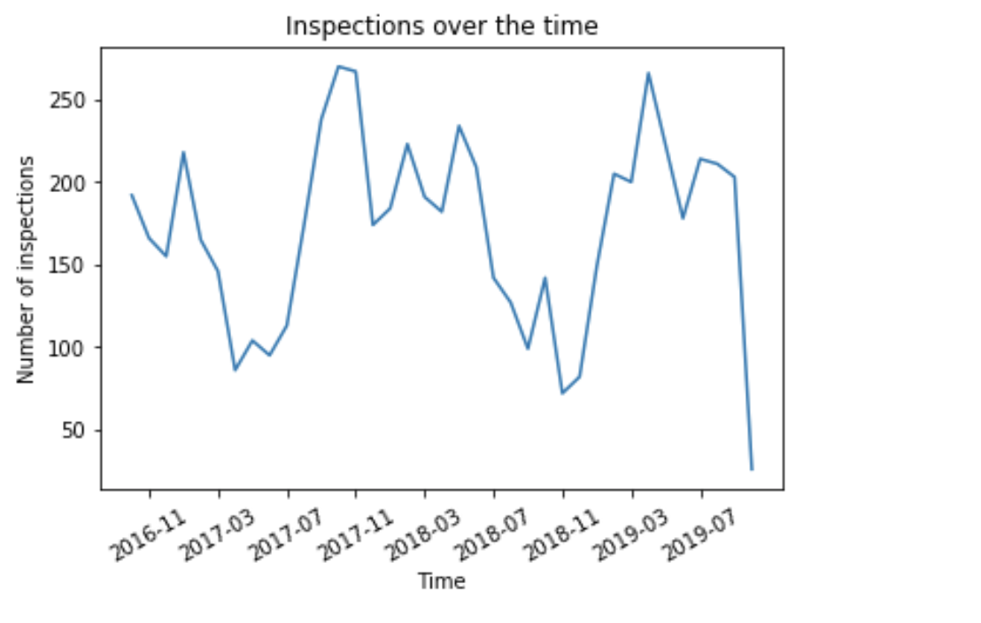
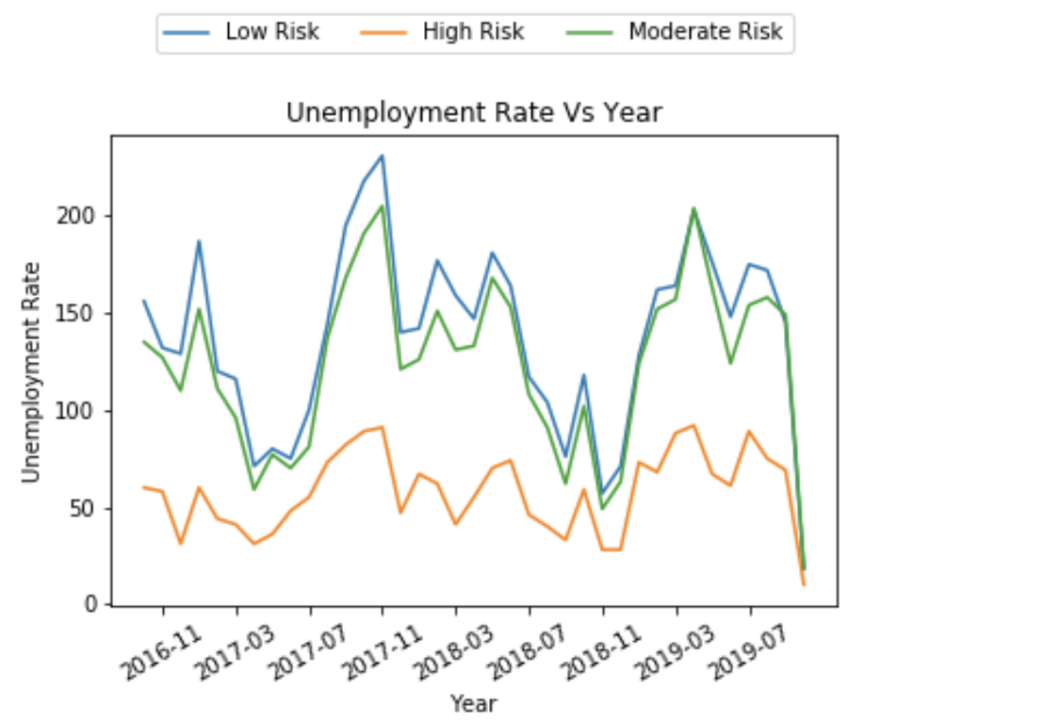
EXPLORATORY DATA ANALYSIS (EDA)
Insepctions over the time/years:
Alessandro Taglieri, 1890945

Slide 6
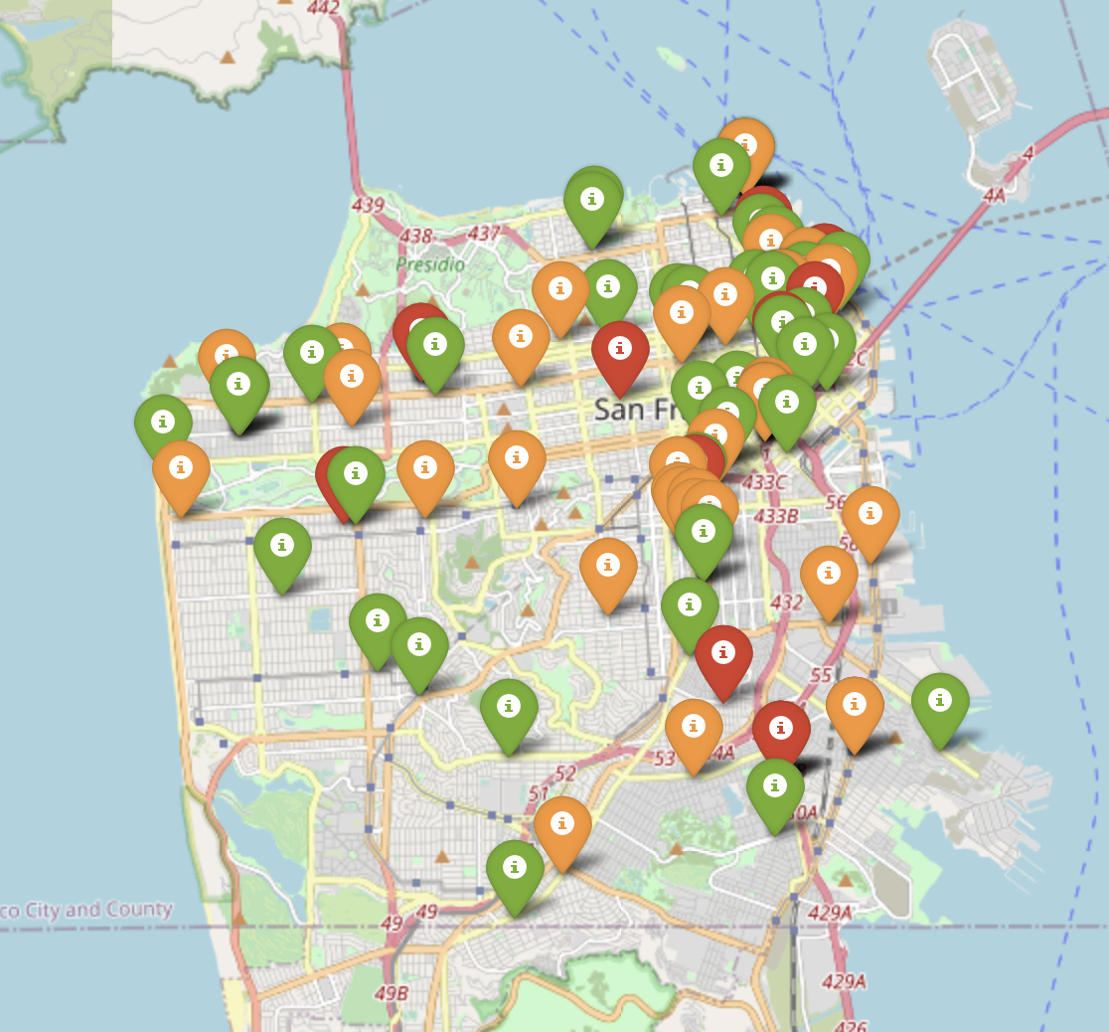
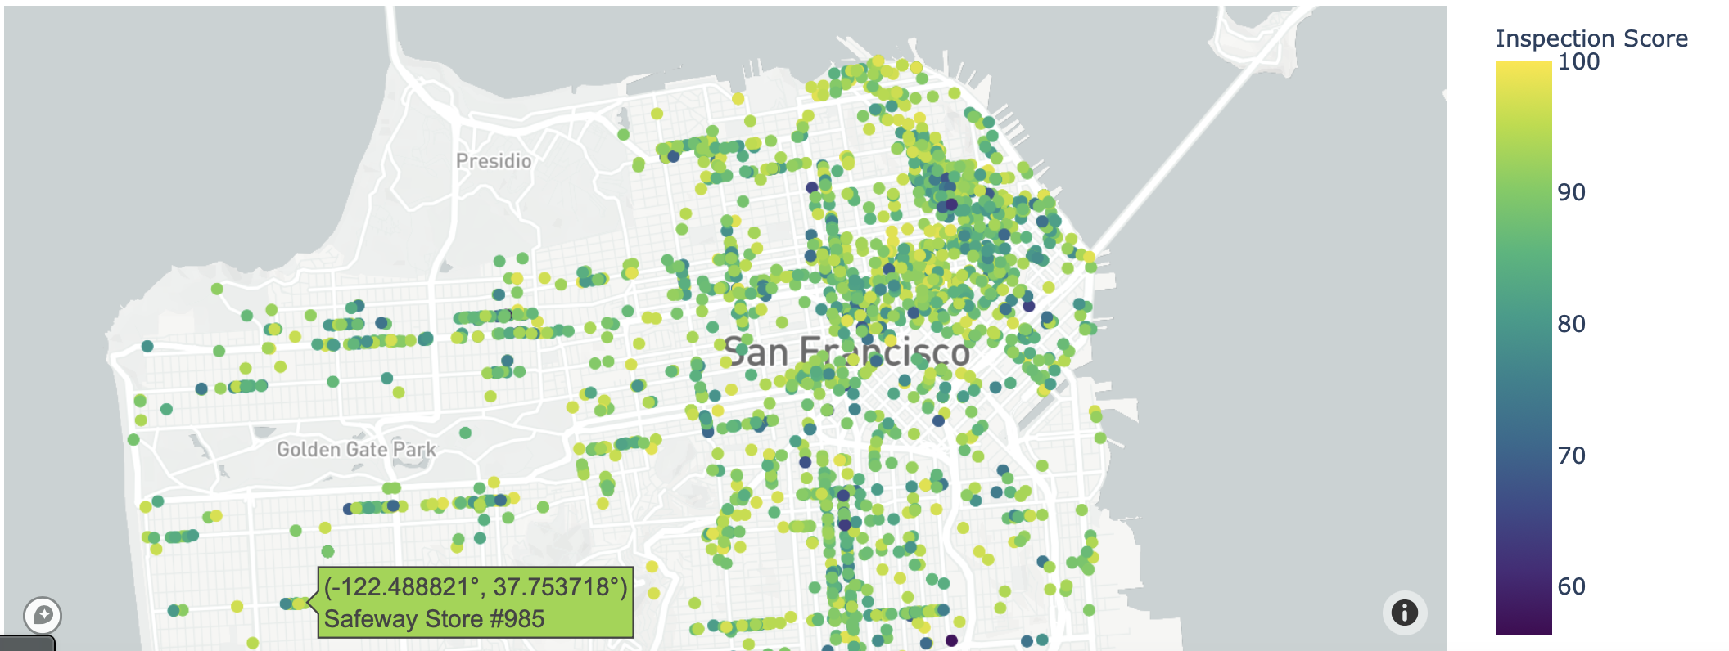
EXPLORATORY DATA ANALYSIS (EDA)
Inspections over the maps:
Alessandro Taglieri, 1890945

Slide 7
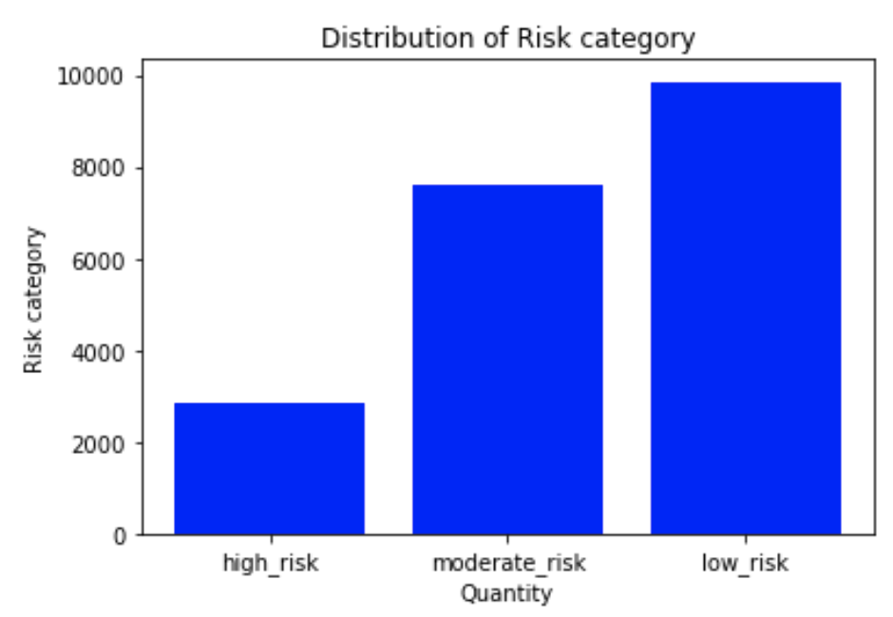
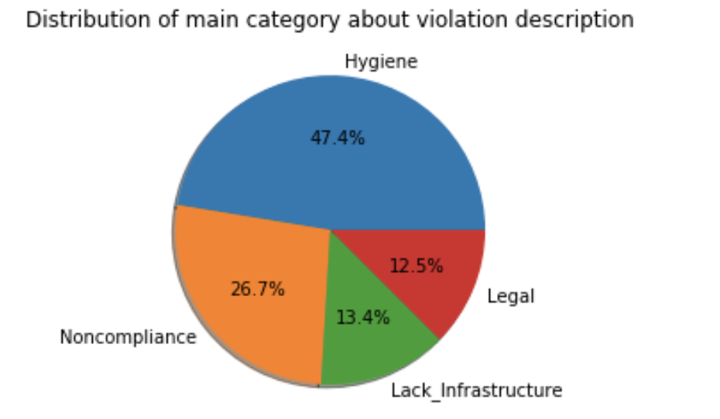
EXPLORATORY DATA ANALYSIS (EDA)
Dsitribution about inspection:
Alessandro Taglieri, 1890945

Slide 8
TRAINING MODELS
Different Models:
Ridge Classifier
Random Forest
SGD Classifier
K Nearest Neighbors
Gaussian NB Classifier
Performance analysis:
Accuracy
Precision
Recall
F1-Score
Hyperparameter optimization:
GridSearch
Alessandro Taglieri, 1890945

Slide 9
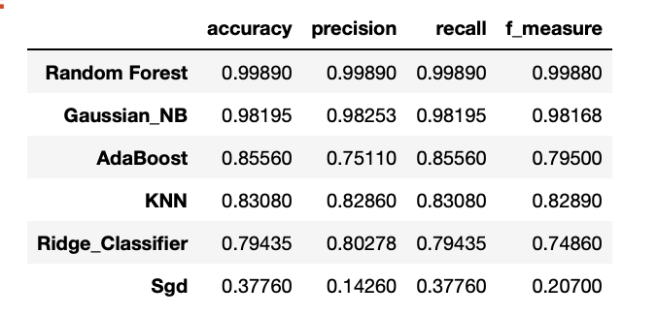
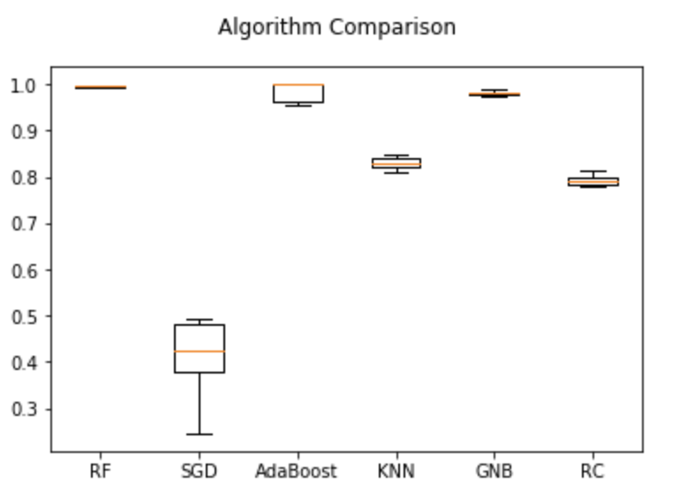
Model evaluation and model comparison
Performance comparison:
Accuracy comparison:
Alessandro Taglieri, 1890945

Slide 10

DASHBOARD
Framework: Streamlit
Deployed on Heroku Cloud Platform
Available on the following link: https://bdos-project.herokuapp.com
Sections:
Introduction on the data
Maps over inspection
Data over the time
Predict your violation description
Alessandro Taglieri, 1890945

Slide 11
Problem 2: PREDICT VIOLATION DESCRIPTION
GOAL: Predict risk category, given the violation description
Steps to reach the goal:
Preprocessing text
Build Model
Evaluate Model
Alessandro Taglieri, 1890945

Slide 12
PREPROCESSING TEXT
Input: violation description
Text cleaning
(remove stop words)
Tokenization
TfIdf vectorization
Output: TfIdf Vectors
Alessandro Taglieri, 1890945

Slide 13
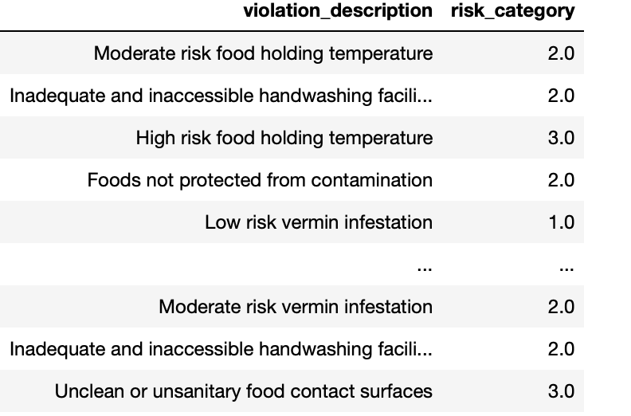
Model and evaluation
Model: Multinomial Naive Bayes
Accuracy obtained: 98%
Implementation on the dashboard
Alessandro Taglieri, 1890945

Slide 14
THANK YOU FOR YOUR ATTENTION!!
Alessandro Taglieri, 1890945

