Slide 1
FPGA-based accelerator for LSTM
ALESSANDRO VARALDI – POLITECNICO DI TORINO

Slide 2
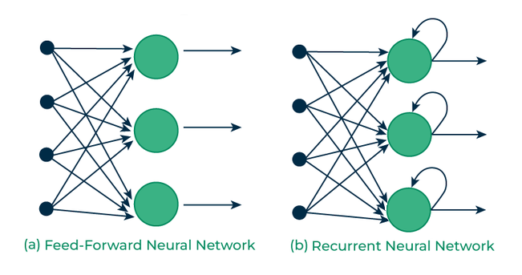
RNN: Recurrent Neural Network
bi-directional artificial neural network
infinite impulse response

Slide 3
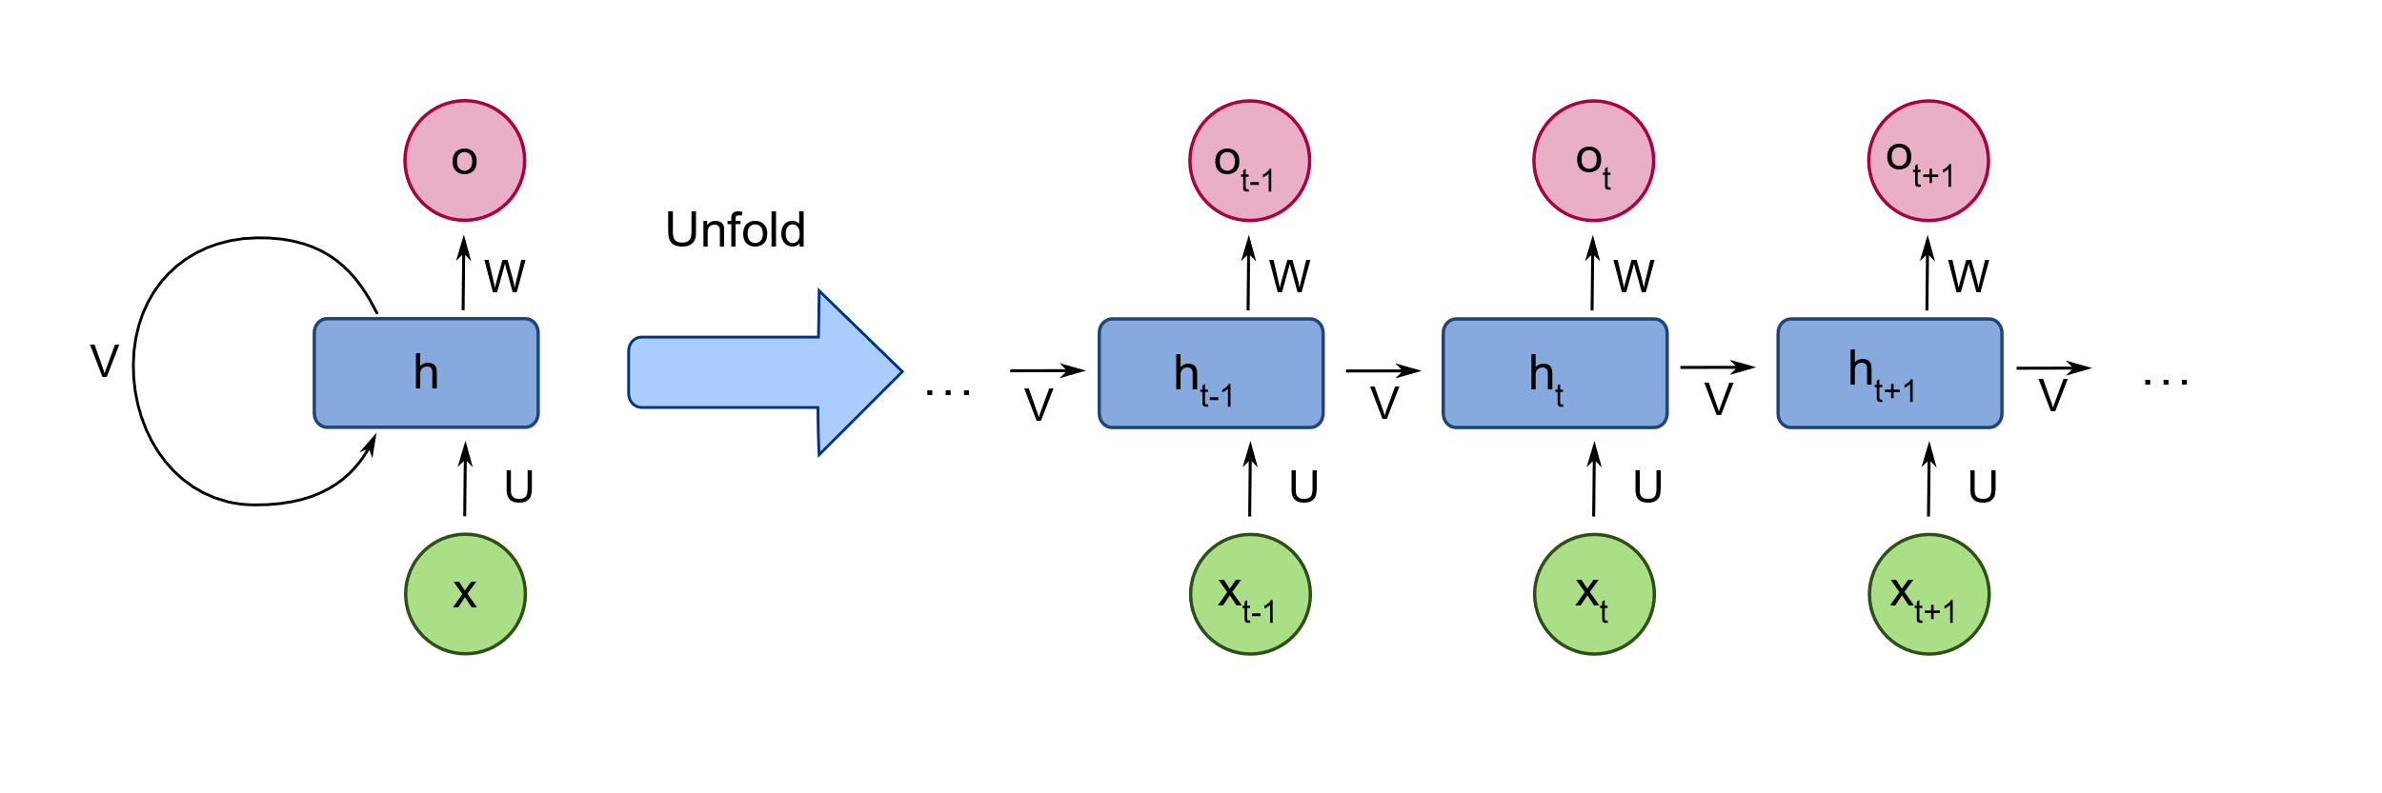
Architecture
Loop unfolding

Slide 4
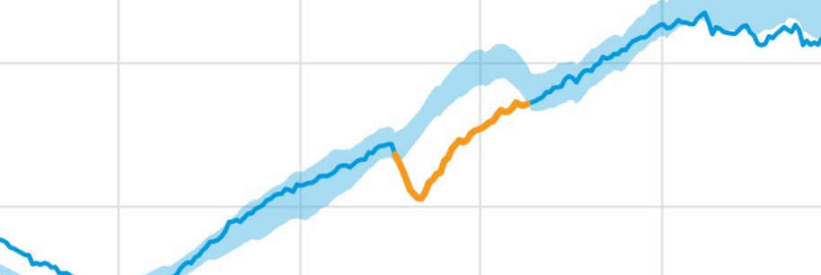
Applications
Natural Language Processing
DNA sequences modelling
Time series prediction & anomaly detection

Slide 5
Challenges
BPTT requires recursive gradients
Effective training is impossible

Slide 6
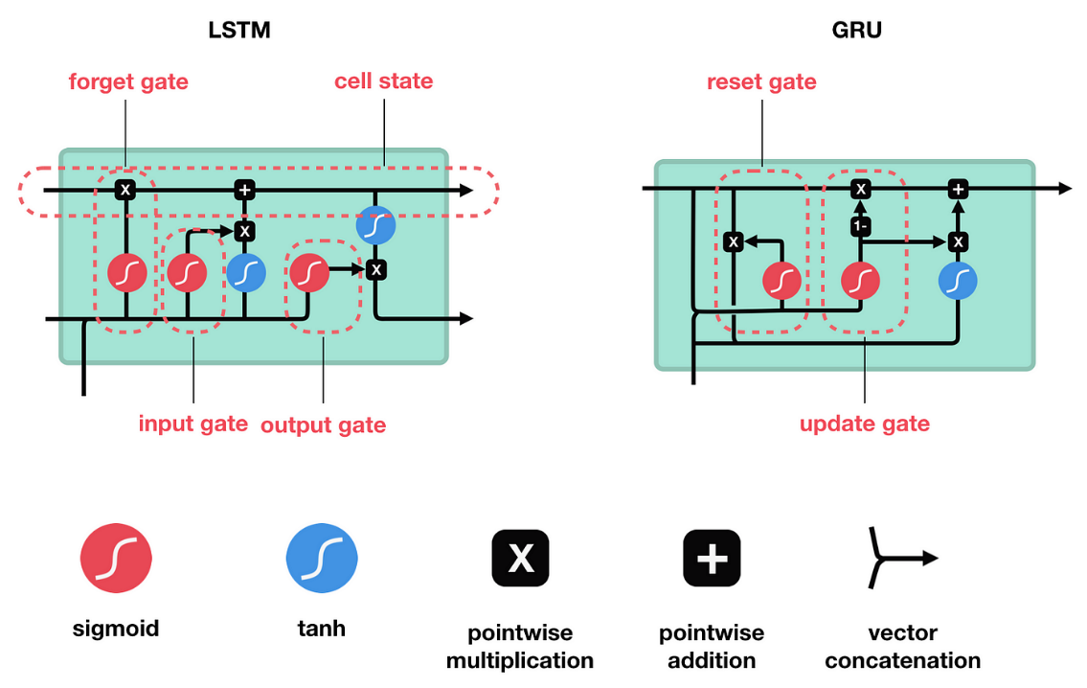
Gradient stabilization
Gated structure
Each gate performs a specific task
Training is possible and very effective

Slide 7
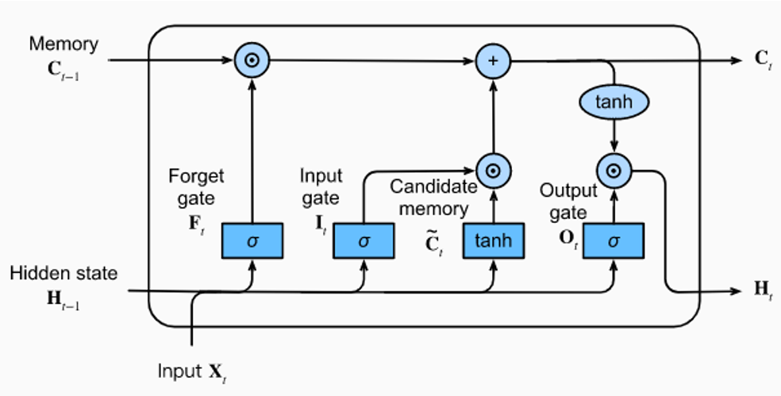

Long Short- Term Memory
$\tanh\left(x\right)=\frac{e^{x}−e^{−x}}{e^{x}+e^{−x}}$
$sigm\left(x\right)=\frac{1}{1+e^{−x}}$
Cell memory state is propagated
Forget gate: how much memory state to keep
Input gate: how much input to add to the memory state
Output gate: how much input should affect the output

Slide 8


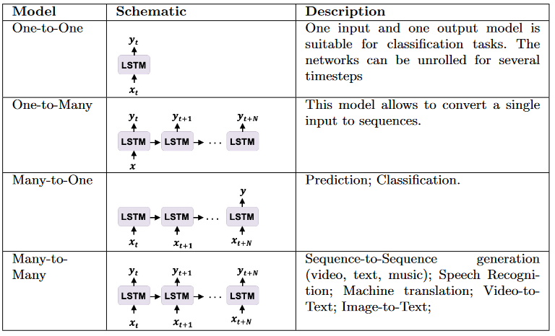


LSTM networks

Slide 9

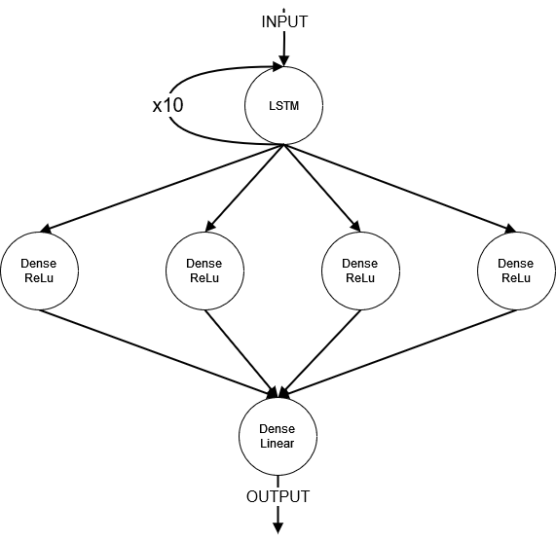
Case study: temperature forecast
Goal: given a training dataset, predict the average temperature recorded at the city of Jena, Germany
LSTM neurons: 1
LSTM iterations: 10
Training epochs: 50
Dataset: https://www.kaggle.com/datasets/mnassrib/jena-climate

Slide 10
Results: MSE = 0.026740

Slide 11
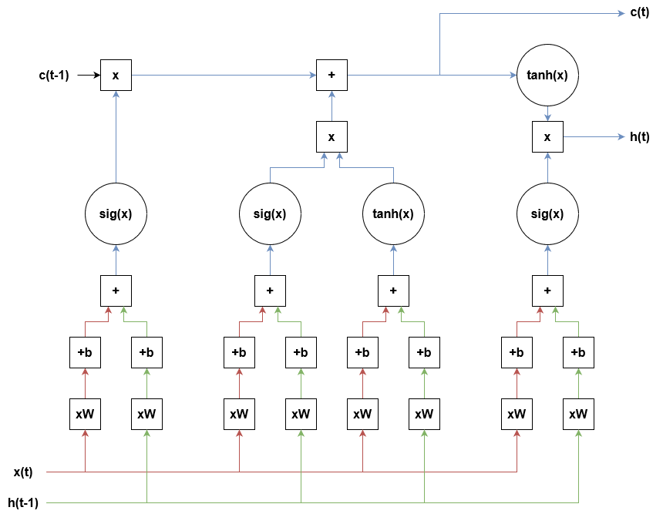

Slide 12
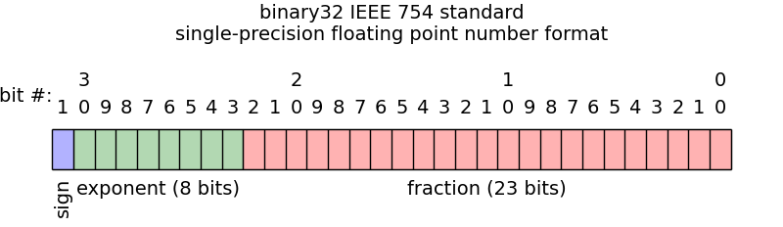
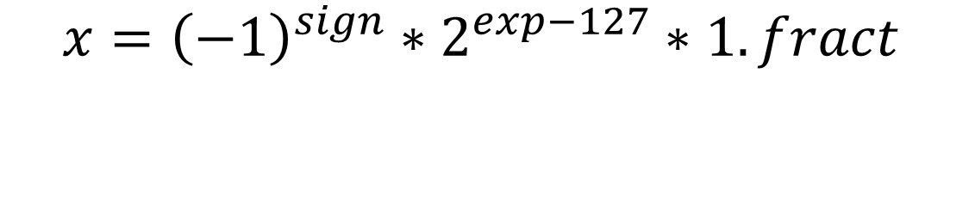
Single- precision floating point format
$$x={\left(−1\right)}^{sign}∗2^{exp−127}∗1.fract$$

Slide 13

Floating-Point Unit
https://github.com/taneroksuz/fpu-sp
3 clock cycles to perform FMA (Fused Multiply-Add): a x b + c
Pipelined and conform to IEEE 754-2008
Example:
$$x_{1}={\left(−1\right)}^{sign_{1}}∗2^{\exp_{1}−127}∗1.fract_{1}$$
$$x_{2}={\left(−1\right)}^{sign_{2}}∗2^{\exp_{2}−127}∗1.fract_{2}$$
$$x_{1}∗x_{2}={\left(−1\right)}^{sign_{1} xor sign_{2}}∗2^{\exp_{1}+\exp_{2}−127} ∗1.({fract}_{1}∗{fract}_{2})$$

Slide 14
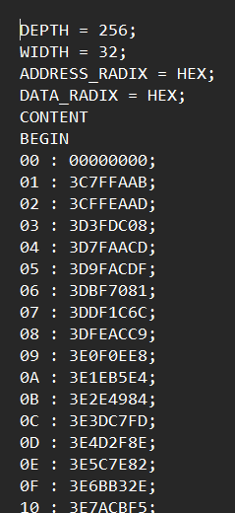

Look-Up Table
Read-Only Memory (access time: 2 clock cycles)
$\tanh\left(x\right)$linearly spaced in [0,4) (256 points)
$\tanh\left(x\right) ≈1$for x > 4
$\tanh\left(−x\right)=−\tanh\left(x\right)$
$sigm\left(x\right)=\frac{1}{2}+\frac{1}{2}tanh⁡( \frac{x}{2} )$
Approximation to nearest int through shift and mask operations, and modification of weights and biases

Slide 15
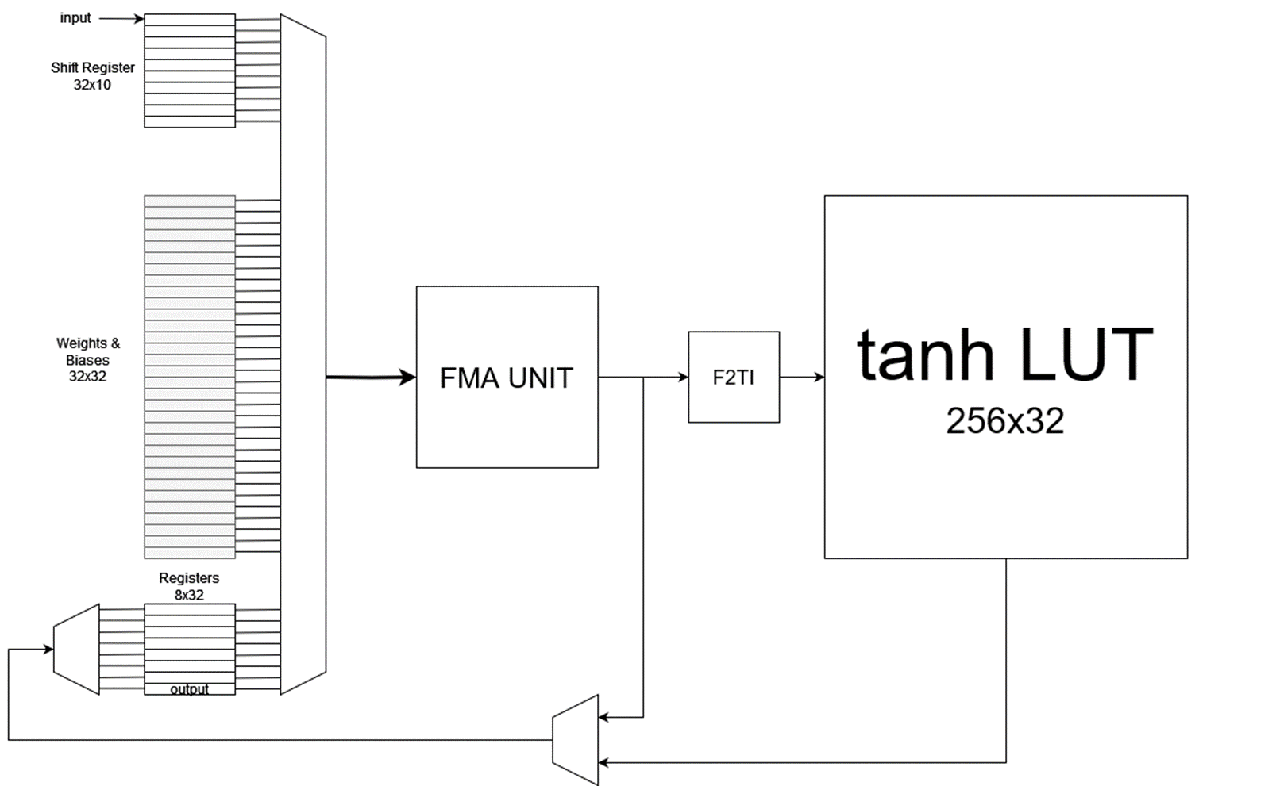
STATIC CONTROL ALGORITHM

Slide 16
Compilation report and simulation
Device: Cyclone 10 LP 10CL010YM164C6G
Logic elements: 4,322 / 10,320 ( 42 % )
Memory Bits: 7,936 / 423,936 ( 2 % )
9-bit multipliers: 7 / 46 ( 15 % )
Clock fmax: 38.51 MHz
Working fmax: ~100 kHz

Slide 17
Results: MSE = 0.027883

Slide 18
Difference in MSE = 0.001144 (4%)

Slide 19
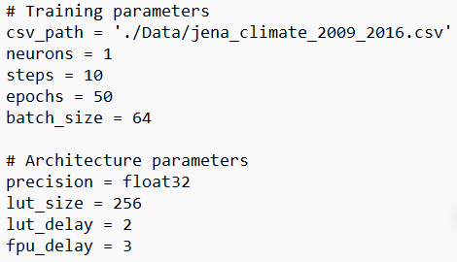
Research space
Parametrization and automation
Mixed precision
Pruning and quantization
Matrix sparsification

