Slide 2
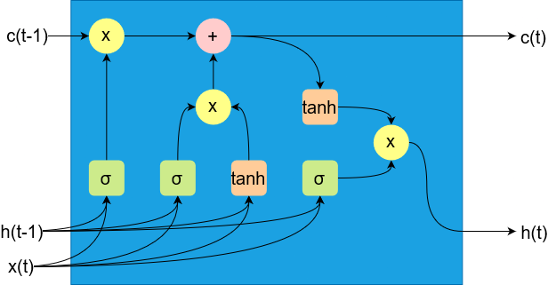

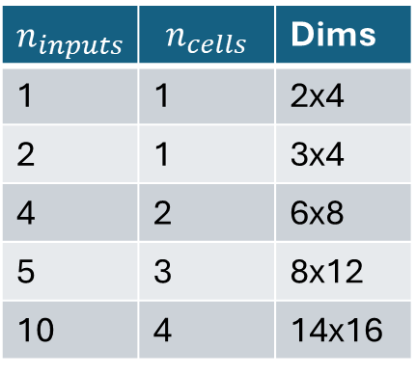
$n_{cells}≈ \log_{2}{(n_{inputs})}$
Weight matrix dimension:
$\left(n_{inputs}+ n_{cells}\right) x (4 ∗ n_{cells})$
$$n_{inputs}$$ | $$n_{cells}$$ | Dims
1 | 1 | 2x4
2 | 1 | 3x4
4 | 2 | 6x8
5 | 3 | 8x12
10 | 4 | 14x16

Slide 3
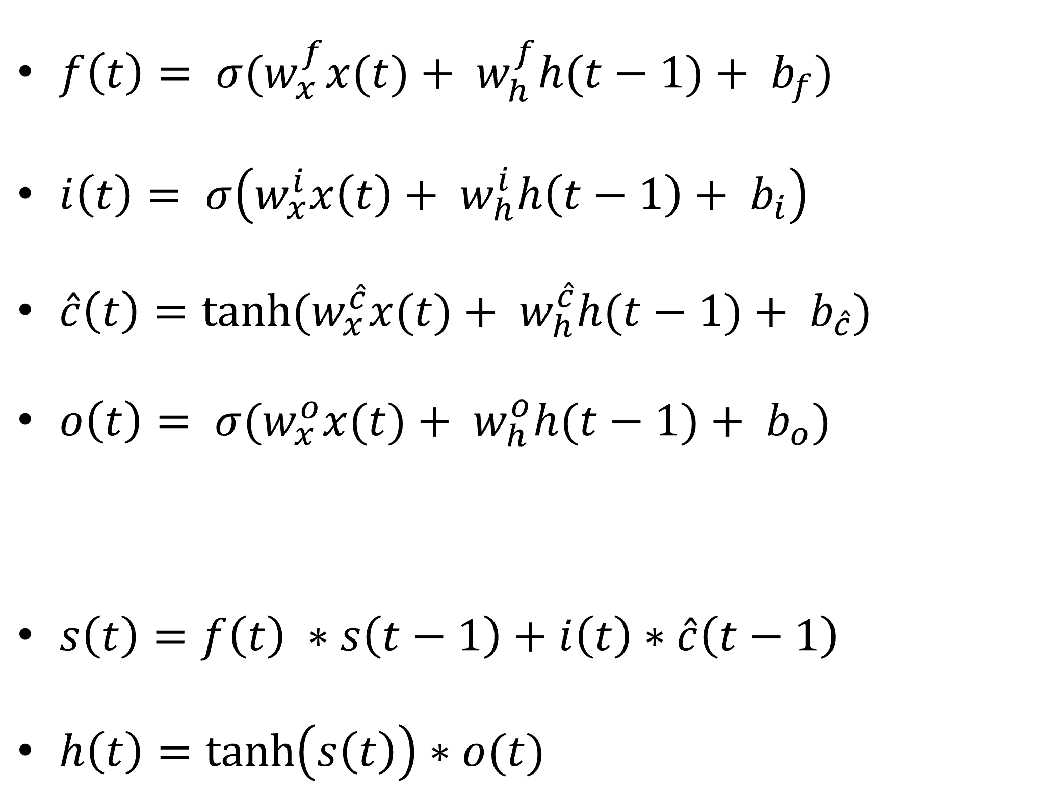
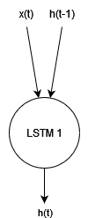

Slide 4
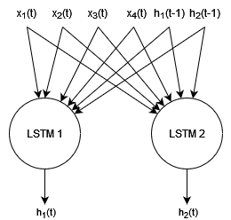
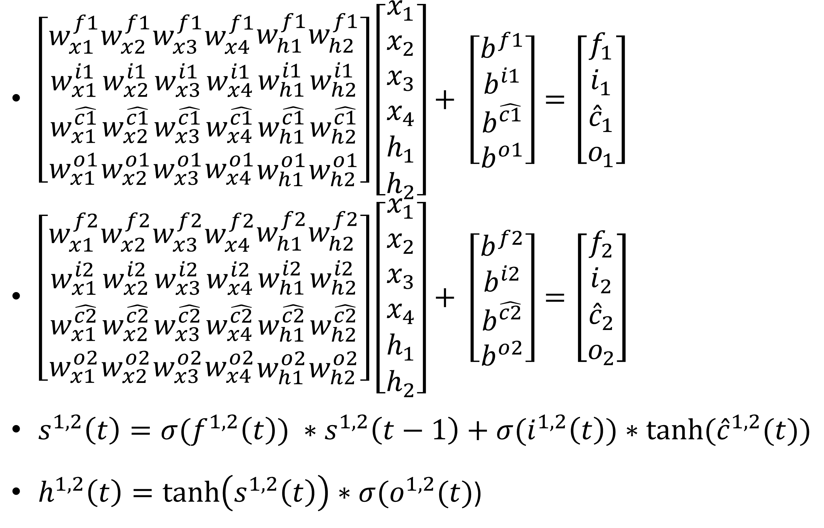

Slide 5
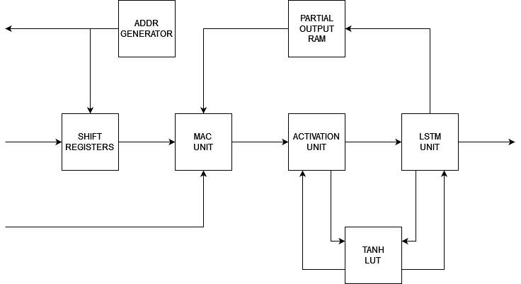
Architecture
Parameters:
Data precision
n° of inputs
n° of cells

Slide 6
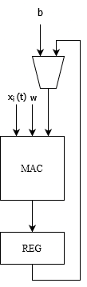
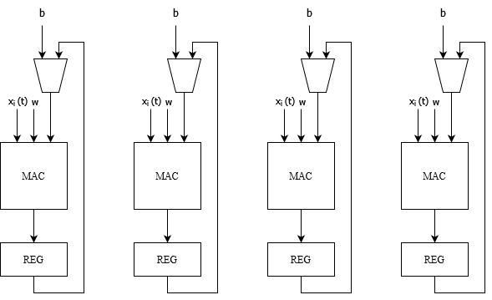
MAC Unit
Single MAC processing inputs in sequence
Smaller, slower
Parallel MACs processing inputs in parallel
Bigger, faster

Slide 7
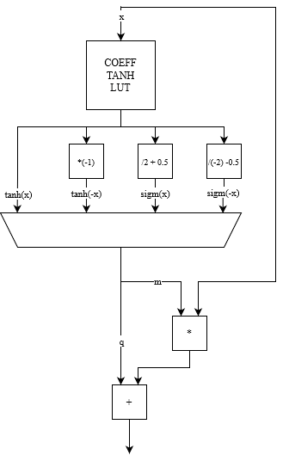
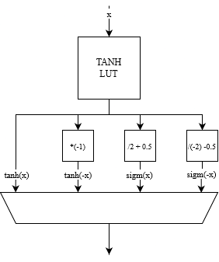
Activation Unit
Look-Up-Table containing coefficients for tanh function
piecewise linearization
Smaller Look-Up-Table, bigger logic, slower
Look-Up-Table containing tanh function
Bigger Look-Up-Table, smaller logic, faster

Slide 8
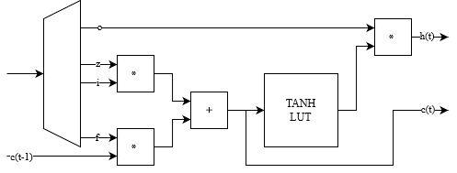
LSTM unit

Slide 9
Data format
1 bit: valid
3 bit: gate identifier
n bit: data (32-bit fixed-point, single-precision floating point, etc.)

Slide 10
Roadmap
MAC unit: generic operators (november)
PWL LUT (november)
Results gathering and analysis (november/december)
Writing paper (november/december)
Ideas & Motion period (january-july)
Abroad period (2026)

