Slide 1
Parameterizable Dataflow Accelerator for LSTM DNNs
ALESSANDRO VARALDI

Slide 2
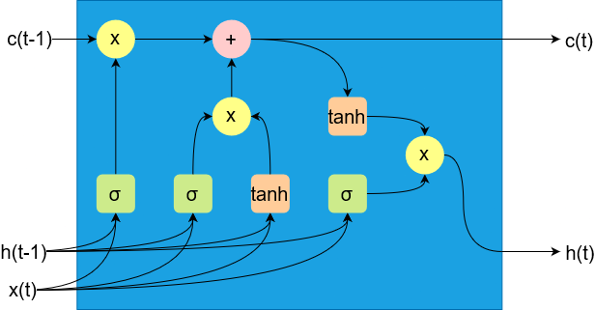
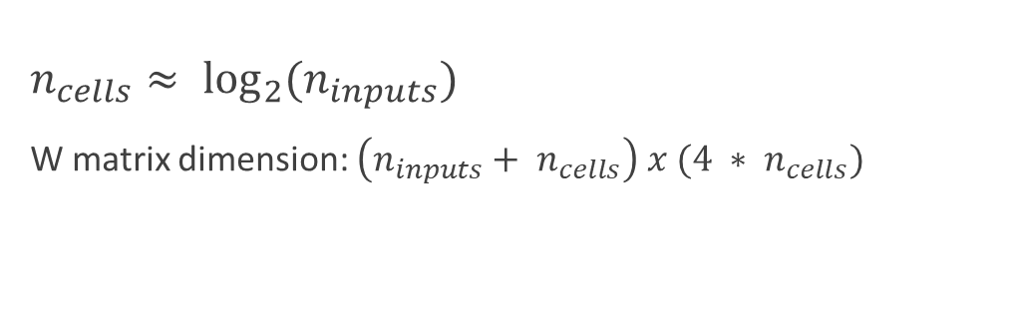
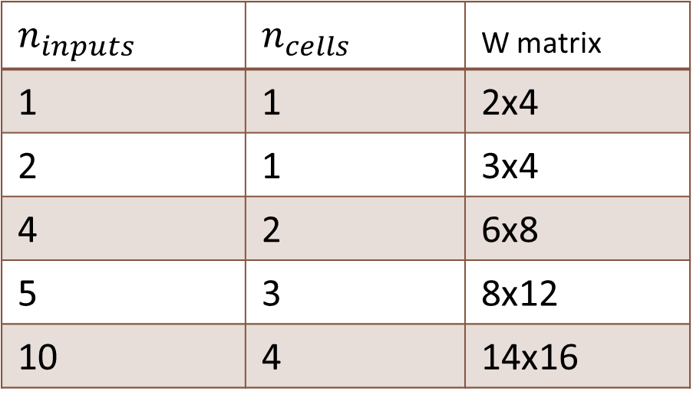
LSTM networks
$n_{cells}≈ \log_{2}{(n_{inputs})}$
W matrix dimension: $\left(n_{inputs}+ n_{cells}\right) x (4 ∗ n_{cells})$
$$n_{inputs}$$ | $$n_{cells}$$ | W matrix
1 | 1 | 2x4
2 | 1 | 3x4
4 | 2 | 6x8
5 | 3 | 8x12
10 | 4 | 14x16

Slide 3
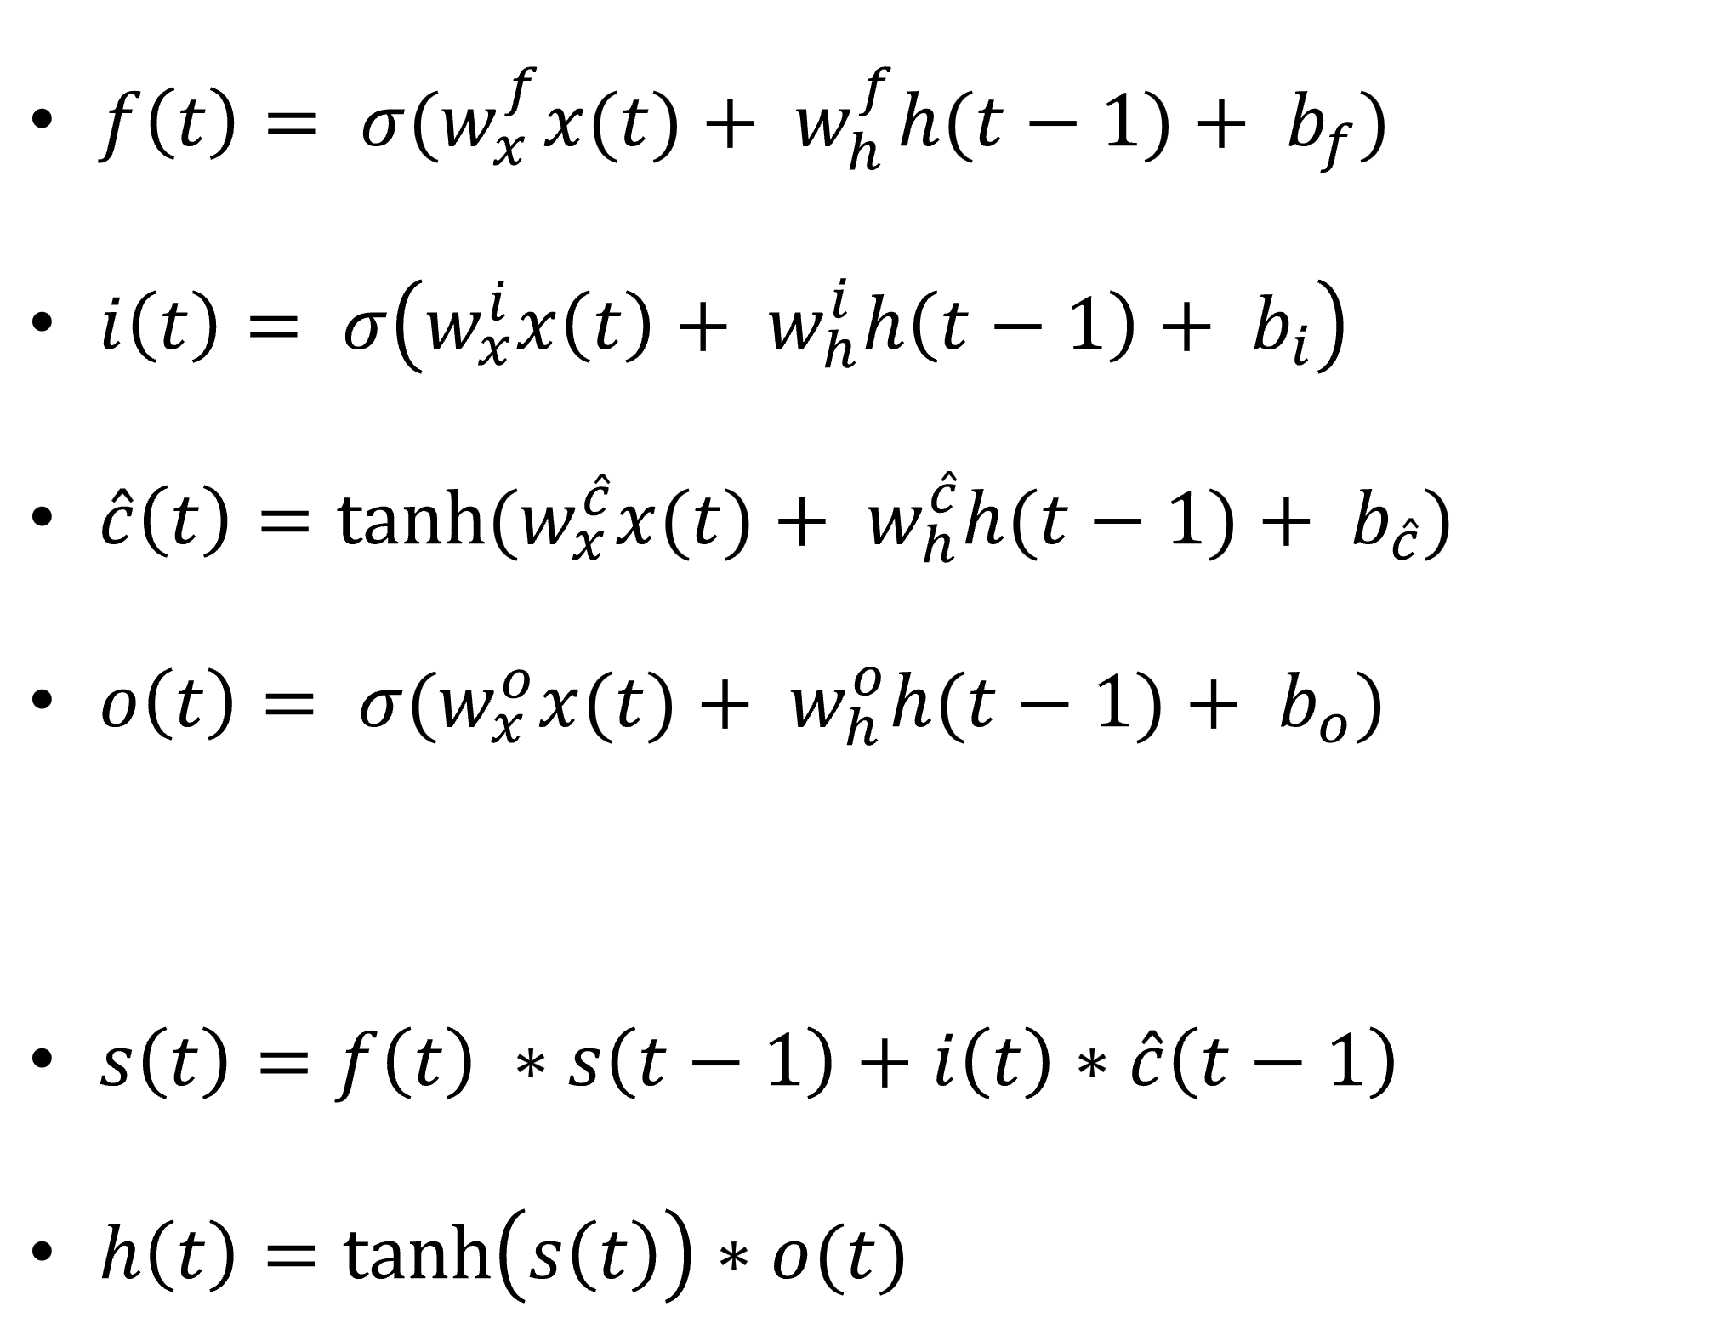
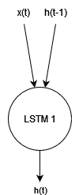
LSTM equations for single input

Slide 4
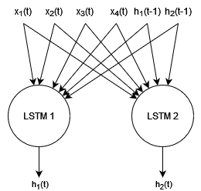
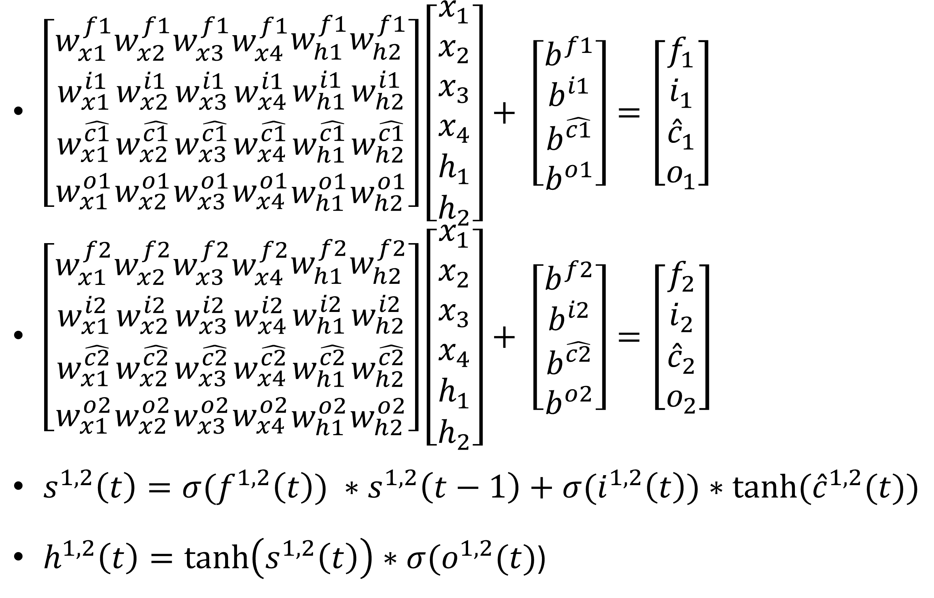
LSTM equations for multiple inputs

Slide 5
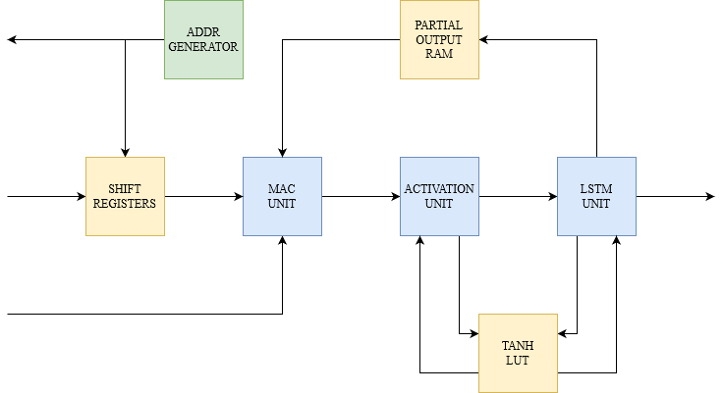
Architecture
Parameters:
Data precision:
int32
int16
float32
float16
etc.
n° of inputs
n° of cells
→ Dataflow →

Slide 6
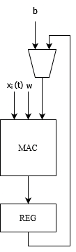
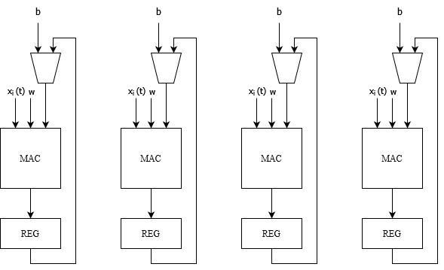
MAC Unit
Single MAC processing inputs in sequence
Parallel MACs processing inputs in parallel

Slide 7
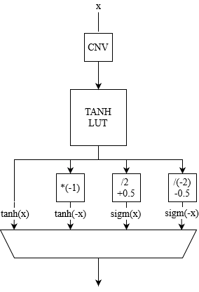
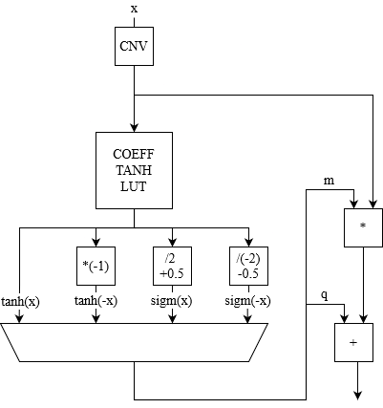
Activation Unit
Look-Up-Table containing tanh function
Look-Up-Table containing coefficients for PWL tanh function

Slide 8
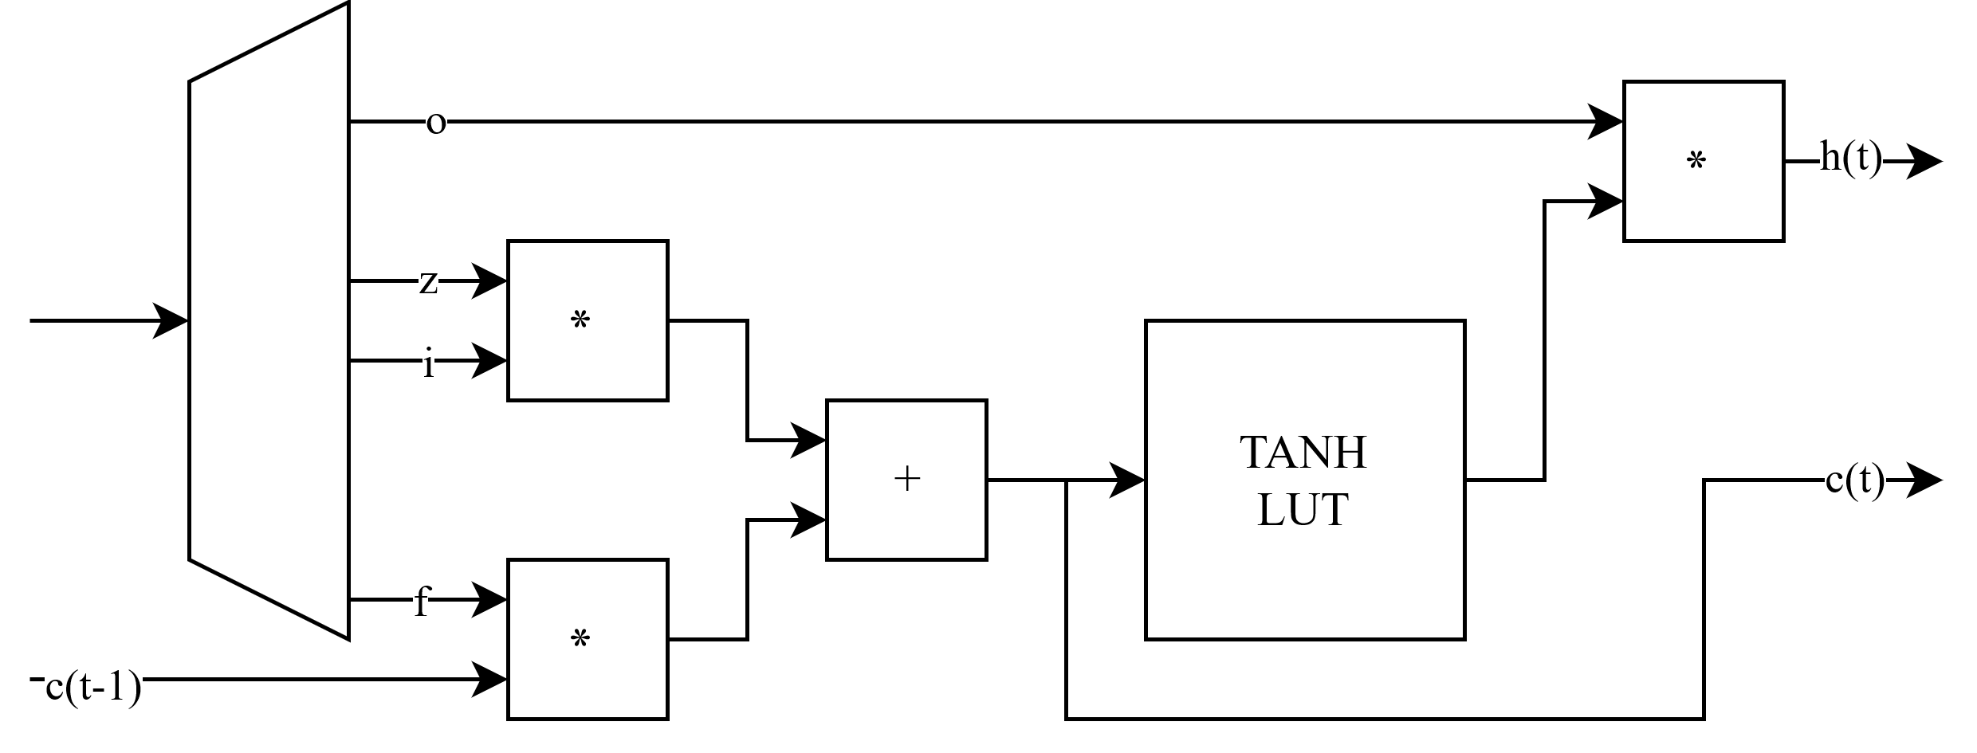
LSTM unit

Slide 9
Supported data formats
Example for float32 :
(1 + 3 + 32) bit: Valid, Gate, Data (Sign, Exponent, Mantissa)
Example for int16:
(1 + 3 + 16) bit: Valid, Gate, Data (Integer, Fraction)

Slide 10
PhD Roadmap
November 2024: Design finalization (Parametric MAC unit and PWL Activation unit)
November/December 2024: Results gathering, analysis, and writing the paper
January/September 2025: Period in company
February/October? 2025: Master’s thesis
January/June 2026: Abroad period

Slide 11
Possible future works
Mixed precision
Interfacing and SoC integration
Approximate computing
Address generator optimization

