Slide 1

HolA: Holistic and Autonomous Attestation for IoT Networks
Alessandro Visintin¹, Flavio Toffalini^{2,3}, Eleonora Losiouk¹
Mauro Conti¹, Jianying Zhou²
¹ University of Padua, Padua IT
² SUTD, Singapore SG
³ EPFL, Lausanne CH
June, 23th 2022 - Rome
AIoTS Workshop @ ACNS 2022

Slide 2
The activity of making a claim about
properties of a prover by supplying
evidence to a verifier.
Attestation.
June, 23th 2022 - Rome
AIoTS Workshop @ ACNS 2022

Slide 3
The activity of making a claim about
properties of a prover by supplying
evidence to a REMOTE verifier.
Remote attestation.
June, 23th 2022 - Rome
AIoTS Workshop @ ACNS 2022

Slide 4
SANA - Ambrosin, et al. (2016) Sana: Secure and scalable aggregate network attestation
SCAPI - Kohnhauser, et al. (2017) Scapi: A scalable attestation protocol to detect software and physical attacks
PASTA - Kohnhauser, et al. (2019) A practical attestation protocol for autonomous embedded systems
Collective Remote attestation (CRA).
June, 23th 2022 - Rome
AIoTS Workshop @ ACNS 2022

Slide 5
Mesh-like networks enables only physical neighbours to communicate with each other.
Mesh-like networks do not consider intermediate machinery (e.g., switches, routers)
CRA operates on mesh networks.
June, 23th 2022 - Rome
AIoTS Workshop @ ACNS 2022

Slide 6
Current CRA do not consider Internet-like networks.
6LoWPAN - Shelby, et al. (2011) 6LoWPAN: The wireless embedded Internet
Thread - Group, T.: Thread, https://www.threadgroup.org/
June, 23th 2022 - Rome
AIoTS Workshop @ ACNS 2022

Slide 7
Neighbourhood attestation - how do you define logical neighbours?
Absence detection - how do you detect physical attackers?
Network obfuscation - how do you hide the topology and operations of the network?
Introducing HolA
June, 23th 2022 - Rome
AIoTS Workshop @ ACNS 2022

Slide 8
Stoica, et al (2003) Chord: a scalable peer-to-peer lookup protocol for internet applications
Zave, P. (2012). Using lightweight modeling to understand Chord
Chord protocol
June, 23th 2022 - Rome
AIoTS Workshop @ ACNS 2022

Slide 9
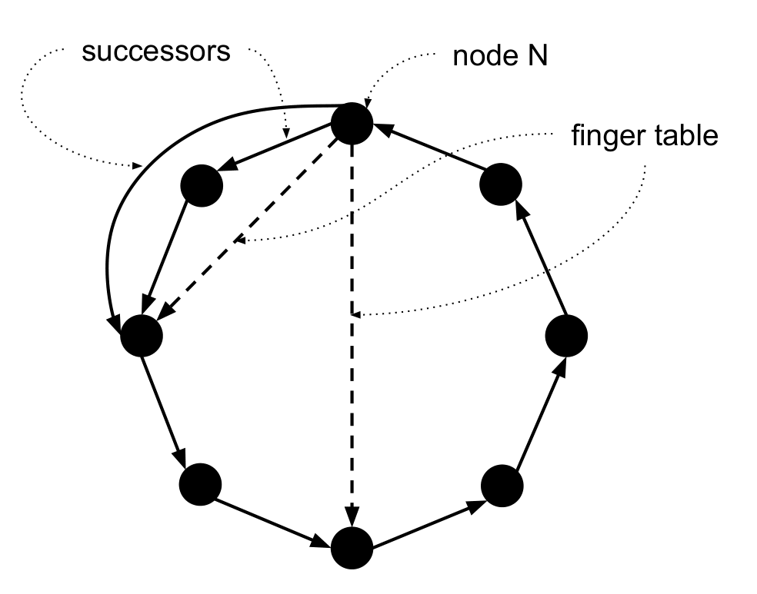
Chord protocol
June, 23th 2022 - Rome
AIoTS Workshop @ ACNS 2022

Slide 10
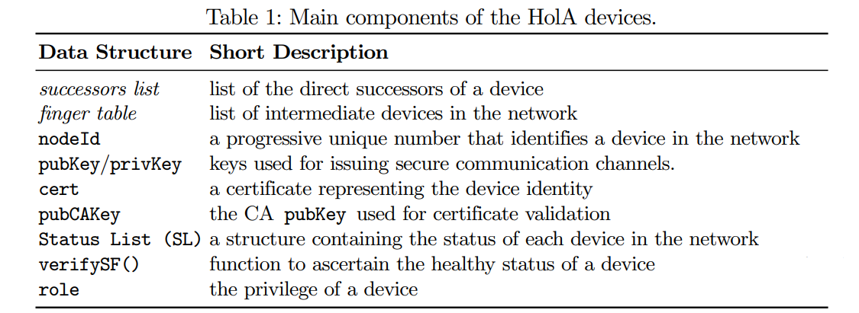
June, 23th 2022 - Rome
AIoTS Workshop @ ACNS 2022

Slide 11
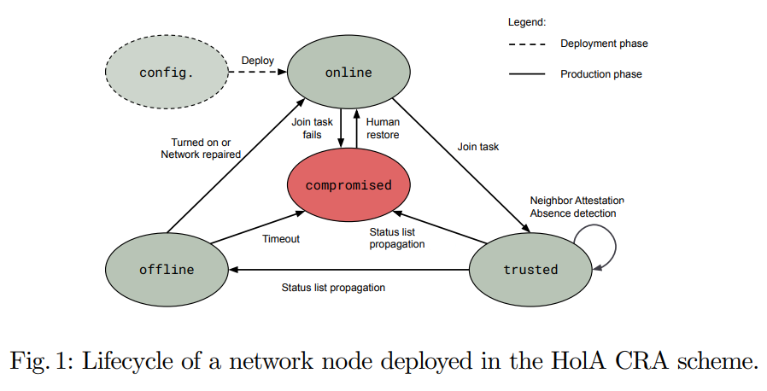
June, 23th 2022 - Rome
AIoTS Workshop @ ACNS 2022

Slide 12
Raspberry Pi 0 - estimate the cost of cryptographic operations.
Raspberry Pi 3 - feasibility assessment with a network of 5 devices.
Network simulation - evaluate the performances in large networks.
Experimental setup
June, 23th 2022 - Rome
AIoTS Workshop @ ACNS 2022

Slide 13
Theorem 1 - Neighbourhood attestation guarantees continuous check of nodes.
Theorem 2 - Absence detection guarantees the detection of offline nodes.
Theorem 3 - Status list propagation reaches all online devices.
Security properties
June, 23th 2022 - Rome
AIoTS Workshop @ ACNS 2022

Slide 14
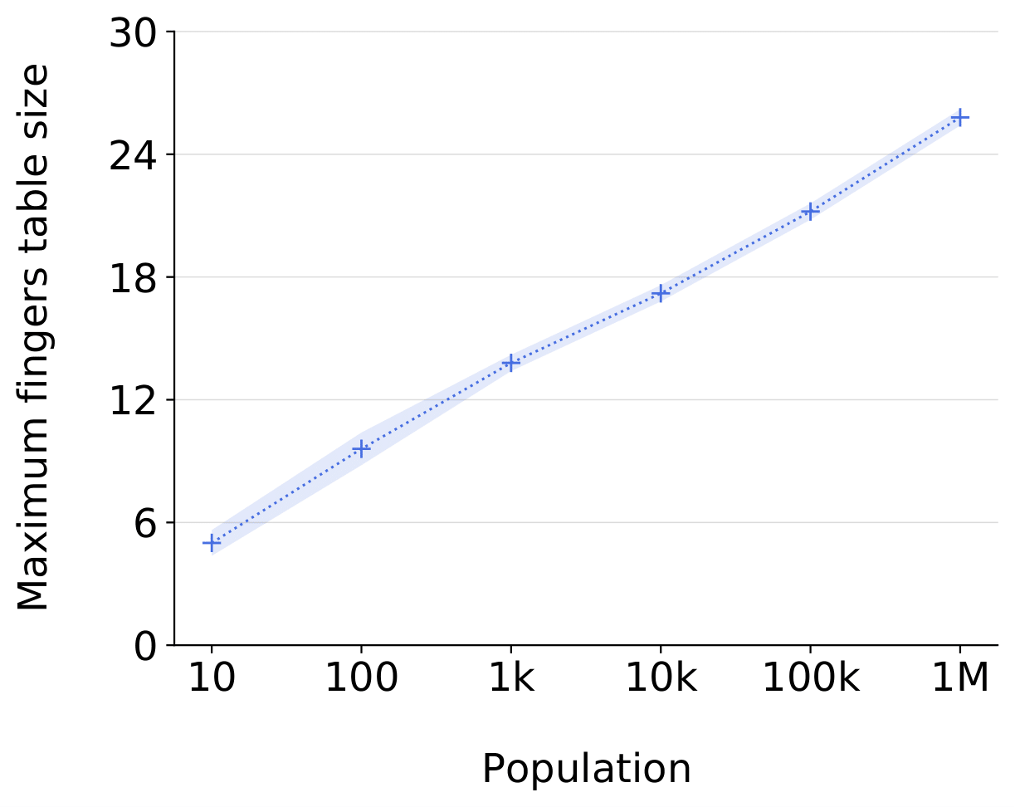
Finger table size
June, 23th 2022 - Rome
AIoTS Workshop @ ACNS 2022

Slide 15
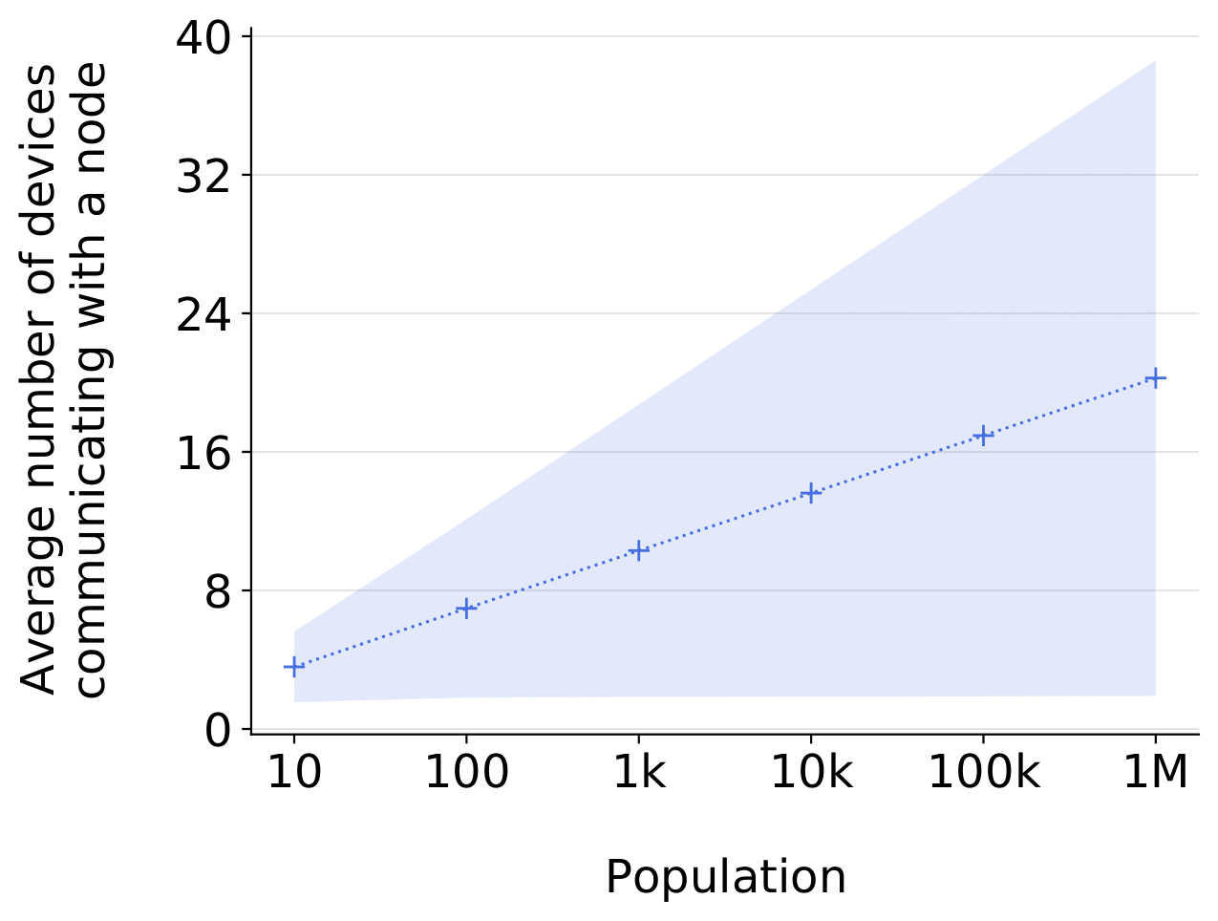
Communicating nodes
June, 23th 2022 - Rome
AIoTS Workshop @ ACNS 2022

Slide 16
successor list - (132 x SLEN) B
finger table - (132 x log₂(N)) B
Status list - (10 x N) B
cache (opt.) - (130 x log₂(N)) B
Node memory usage
Comparing against PASTA (10k nodes), HolA is seven times lighter (105kB vs 700kB).
June, 23th 2022 - Rome
AIoTS Workshop @ ACNS 2022

Slide 17
operational messages - 264 × (SLEN +1) B
Communication
overhead
In a network of 10k nodes, HolA operational messages are 3960 B. This is the same order of magnitude of PASTA and SCAPI (1341 B).
June, 23th 2022 - Rome
AIoTS Workshop @ ACNS 2022

Slide 18
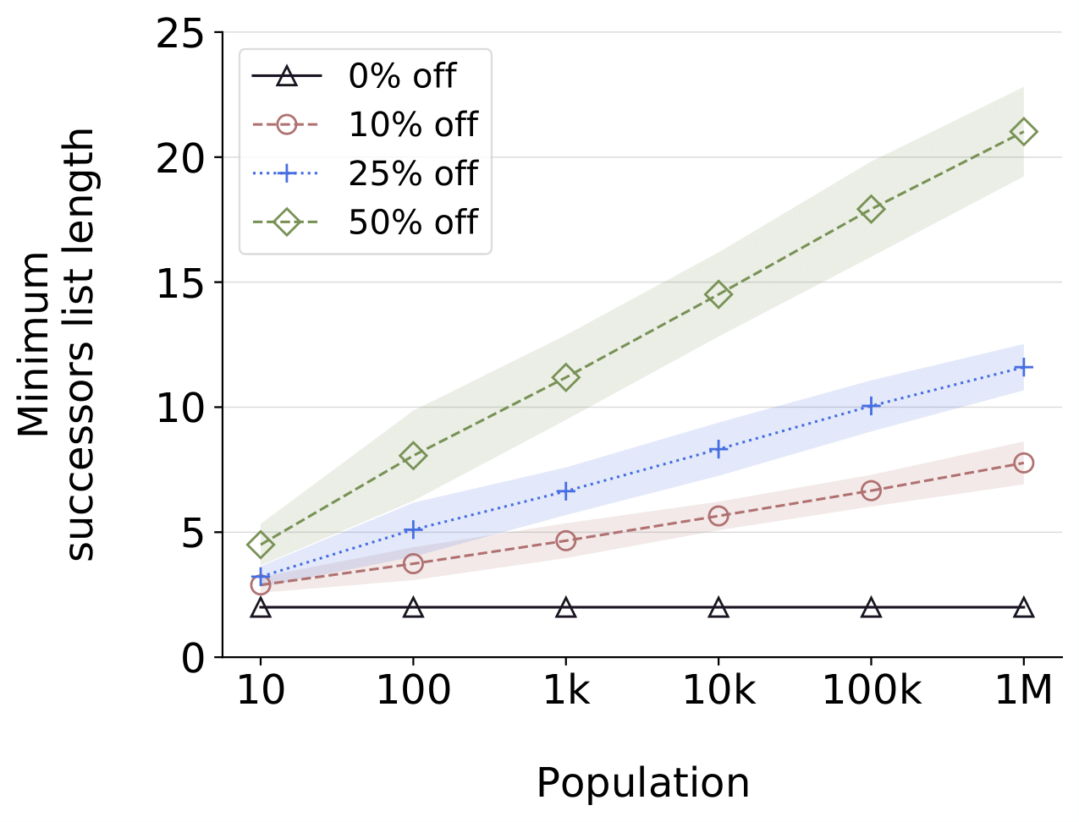
Resiliency
June, 23th 2022 - Rome
AIoTS Workshop @ ACNS 2022

Slide 19
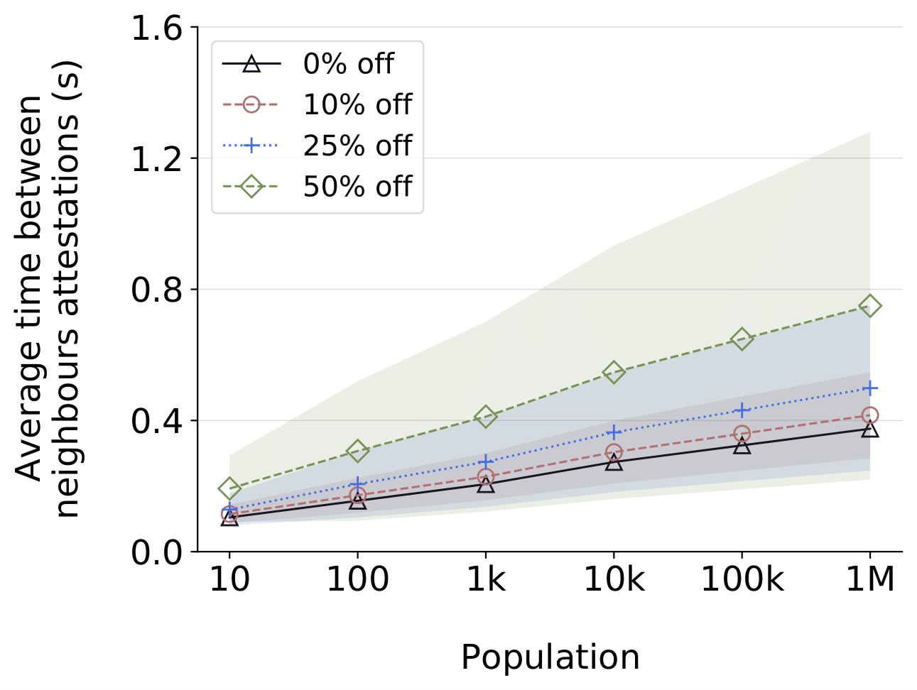
Time Delay for Neighbourhood Attestation
June, 23th 2022 - Rome
AIoTS Workshop @ ACNS 2022

Slide 20
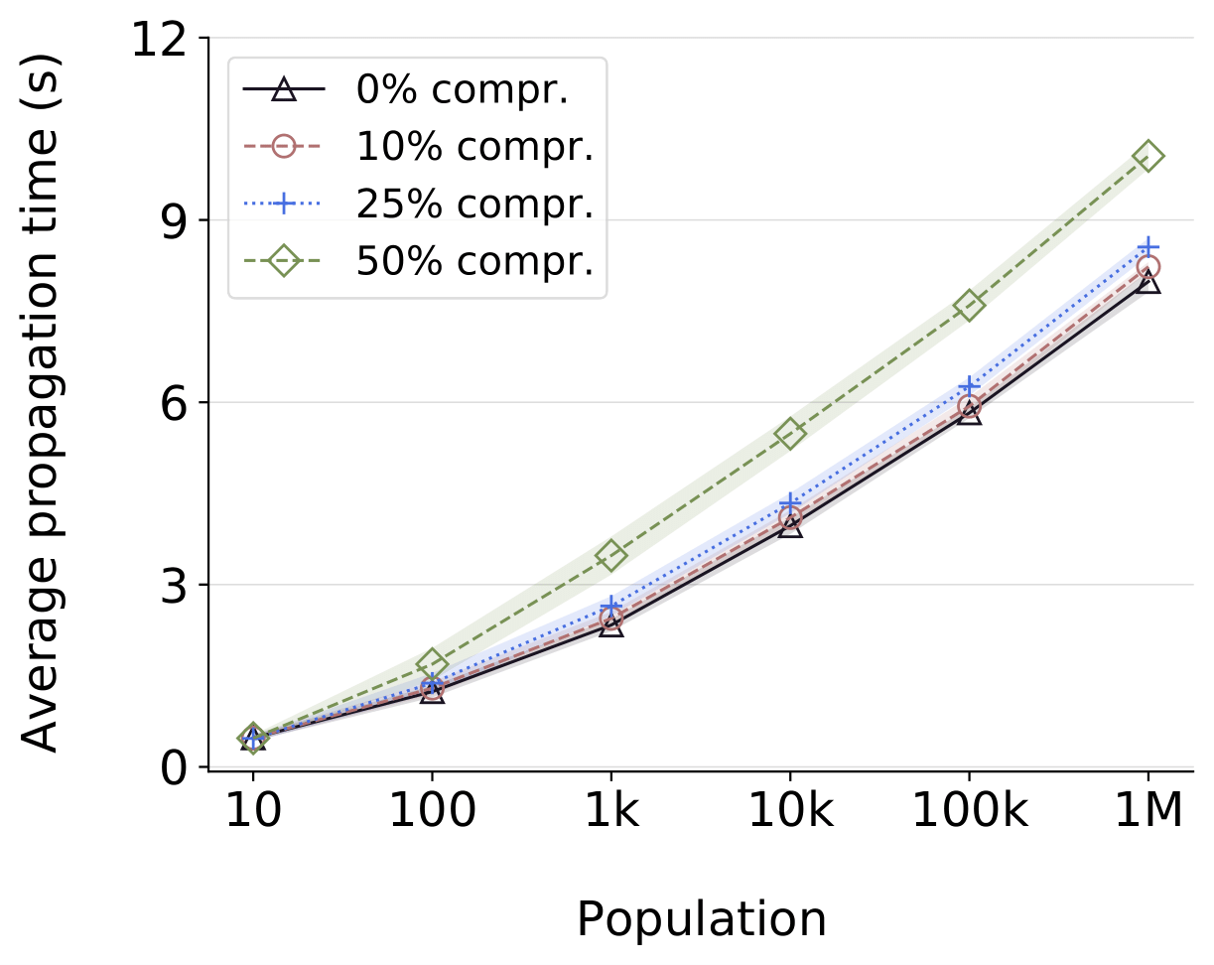
Status list
propagation
June, 23th 2022 - Rome
AIoTS Workshop @ ACNS 2022

Slide 21
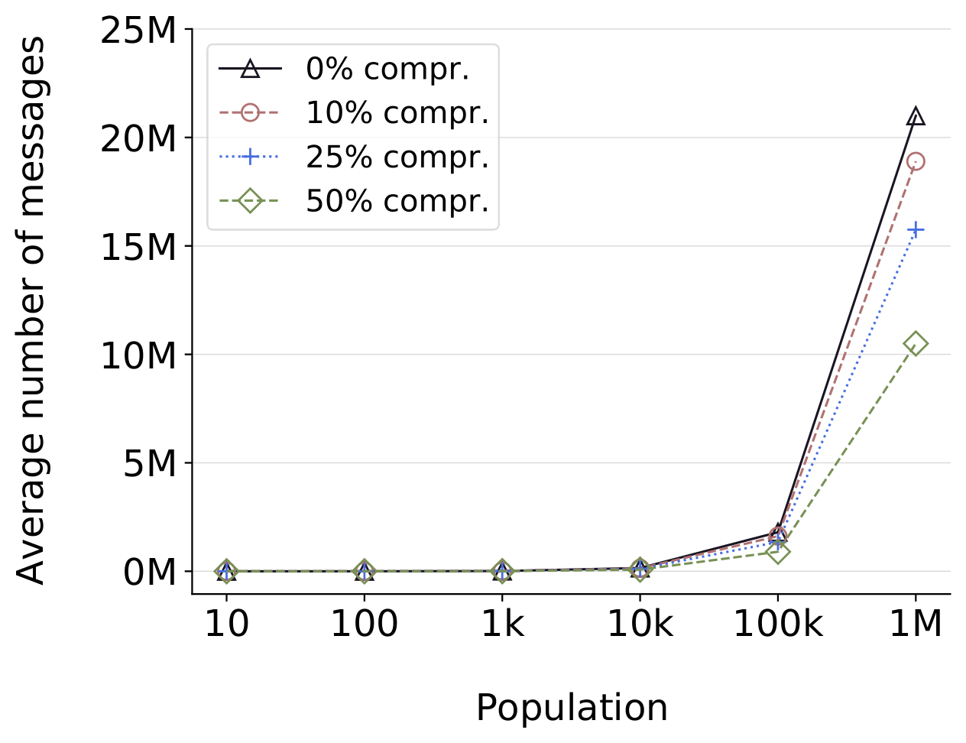
Status list
propagation
June, 23th 2022 - Rome
AIoTS Workshop @ ACNS 2022

Slide 22
Certificate revocation/expiration - trade-off between precise and probabilistic solutions
False positive - management through Admin nodes.
Devices loosely synchronized - common problem to distributed schemes. Further research needed.
Discussion
June, 23th 2022 - Rome
AIoTS Workshop @ ACNS 2022

Slide 23
HolA: Holistic and Autonomous Attestation for IoT Networks
Alessandro Visintin¹, Flavio Toffalini^{2,3}, Eleonora Losiouk¹
Mauro Conti¹, Jianying Zhou²
¹ University of Padua, Padua IT
² SUTD, Singapore SG
³ EPFL, Lausanne CH
June, 23th 2022 - Rome
AIoTS Workshop @ ACNS 2022

