Slide 1
Synthetic Hystological Samples for Segmentation Training
A virtual slicing method on a hystological-like 3D model for generation of image – label pairs for training of segmentation oriented Neural Network.
Alessandro d'Agostino - Master in Applied Physics UniBo - a.y. 2019/20
Alessandro d'Agostino - Master in Applied Physics UniBo - a.y. 2019/20
Notes:
2020/5/11

Slide 2
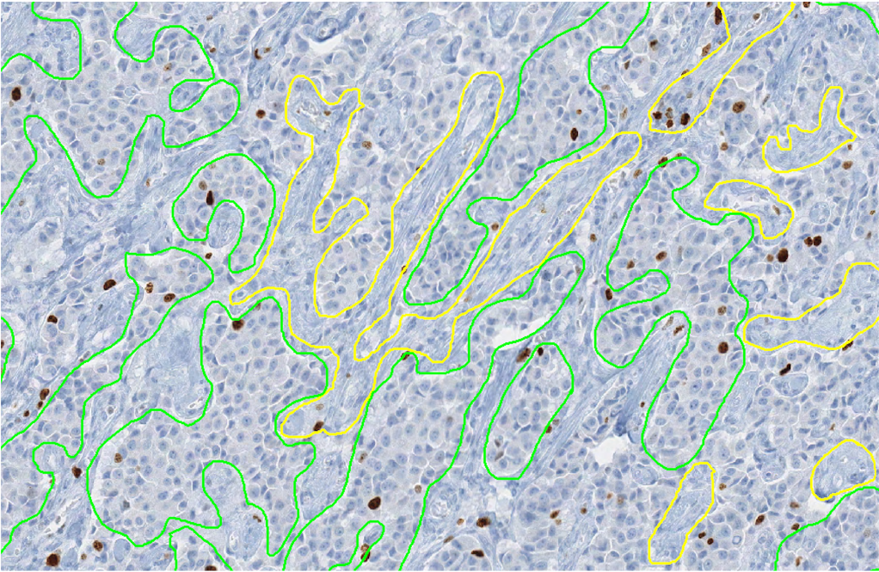
The problem
Hysto-Pathological images segmentation is a difficult operation.
It requires a labeled dataset for training or testing that it’s commonly reached only through time expensive intervention by qualified experts.
This shortage of data hinders the development of new algorithms and the possibility to test existing ones.
Segmentation of health and tumoral region in a pancreatic tissue sample made by a cGAN. [Link to bibliography]
Alessandro d'Agostino - Master in Applied Physics UniBo - a.y. 2019/20
Alessandro d'Agostino - Master in Applied Physics UniBo - a.y. 2019/20
Notes:
2020/5/11

Slide 3
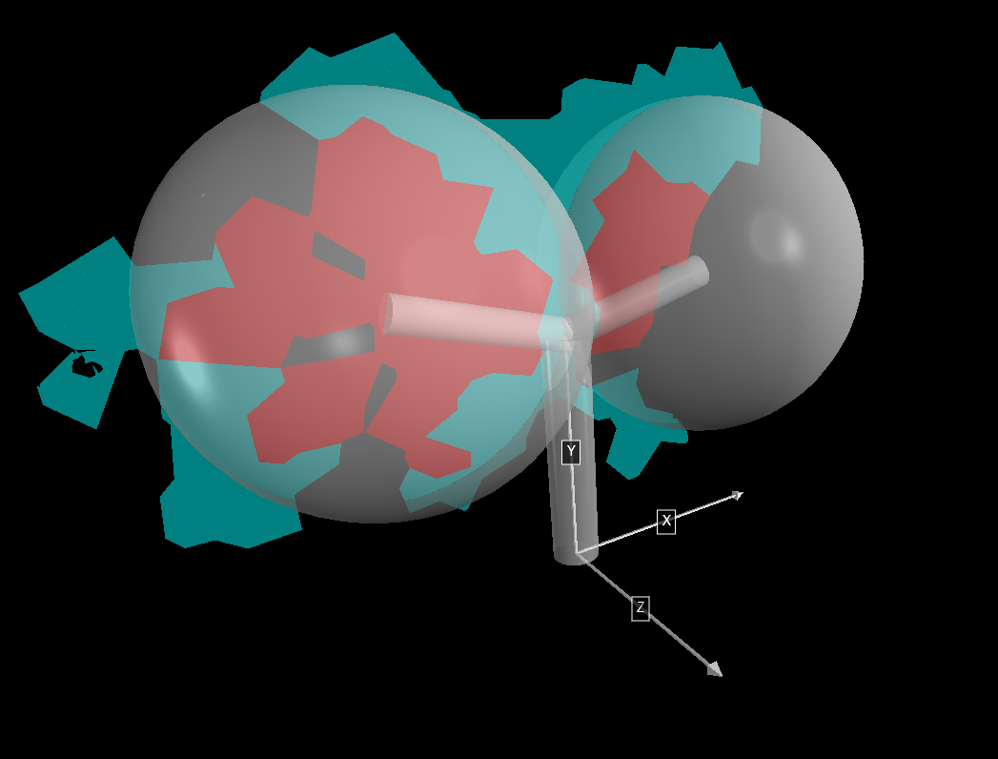
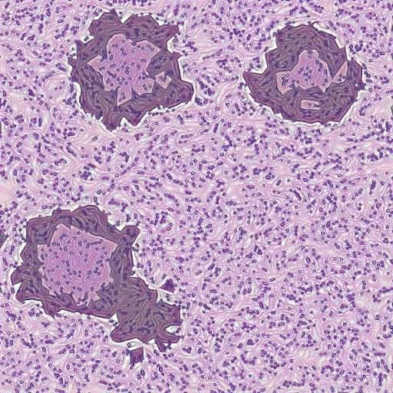
Artificial Slices Generator
Artificial generation of realistic samples could help to overcoming this problem, providing arbitrary wide datasets of images with related ground truth.
The idea is to perform virtual slicing on a 3D tissue model and recreate the slicing process.
Processing
Alessandro d'Agostino - Master in Applied Physics UniBo - a.y. 2019/20
Alessandro d'Agostino - Master in Applied Physics UniBo - a.y. 2019/20
Notes:
2020/5/11

Slide 4
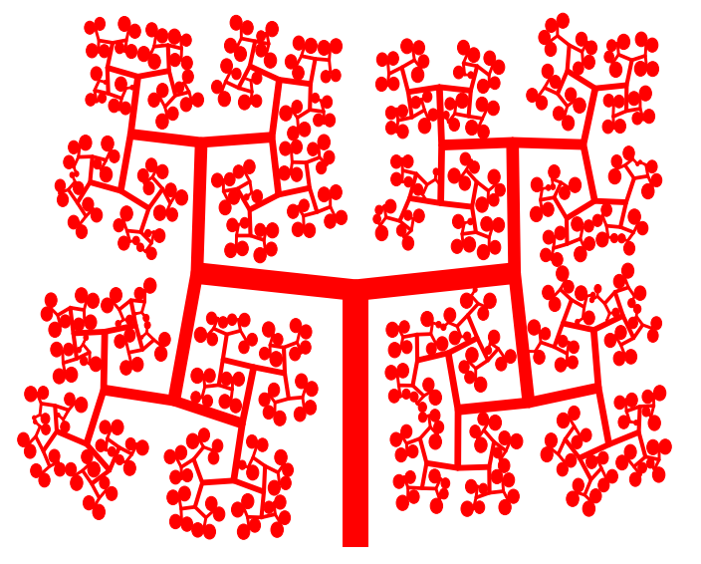
Space-Filling Iterative Structure 2D
Pancreatic tissue may be represented in first stance by a space filling iterative structure.
The succeding ramifications schematized blood vassels in glandular tissues.
Spheres at free ends stand for glandural grapes.
Alessandro d'Agostino - Master in Applied Physics UniBo - a.y. 2019/20
Alessandro d'Agostino - Master in Applied Physics UniBo - a.y. 2019/20
Notes:
2020/5/11

Slide 5
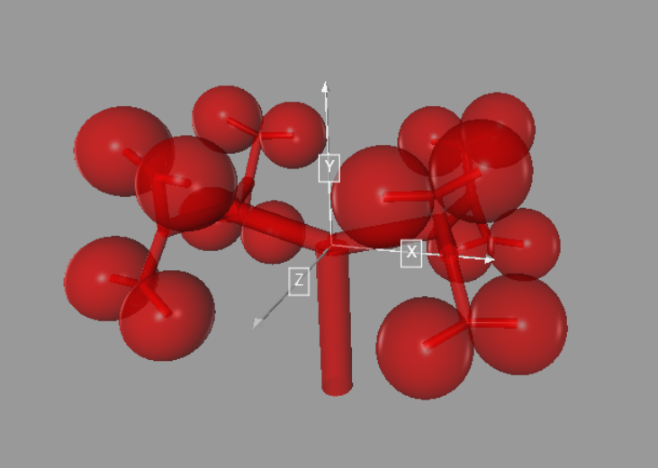
Expansion to 3D Structure
Extending the geometry in 3D results in a structure representing the spatial distribution of glandural grapes in the tissue.
Quaternions were exploited for ease 3D relative orientation.
Alessandro d'Agostino - Master in Applied Physics UniBo - a.y. 2019/20
Alessandro d'Agostino - Master in Applied Physics UniBo - a.y. 2019/20
Notes:
2020/5/11

Slide 6
Quaternions
Quaternions are a number system that expands complex numbers in 4 dimensions:
q = a + bi + cj + dk
i² = j² = k² = ijk = -1
A particular subspace made of those quaternion with vanishing real part ( a = 0 ) have a useful correspondence with rotations in 3D space. With this system the rotation q of any vector v is:
v’ = q v q⁻¹
While the sequence of rotations q and p on a vector v is simply given by:
v’ = pq v (pq)⁻¹
Quaternions are widely used in Computer Graphic for their ease of use, respect other methods involving Euler angles or other reference system.
Alessandro d'Agostino - Master in Applied Physics UniBo - a.y. 2019/20
Notes:
2020/5/11

Slide 7
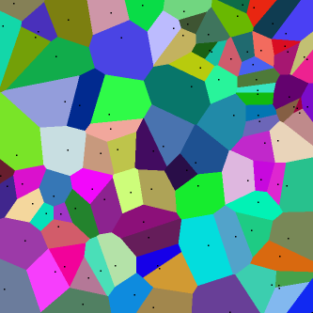
Voronoi Tassells as Cells
Cells need to be convex, with similar shape, space filling and slightly different.
A non-regular 3D Voronoi tessellation is what best suits the task.
In a Voronoi tessellation the N-space is partitioned in subregions respect the proximity to the seeding points.
Quasi-random algorithms with low discrepancy give seeding grid for a Voronoi tessellation with the desired features.
Alessandro d'Agostino - Master in Applied Physics UniBo - a.y. 2019/20
Notes:
2020/5/11

Slide 8
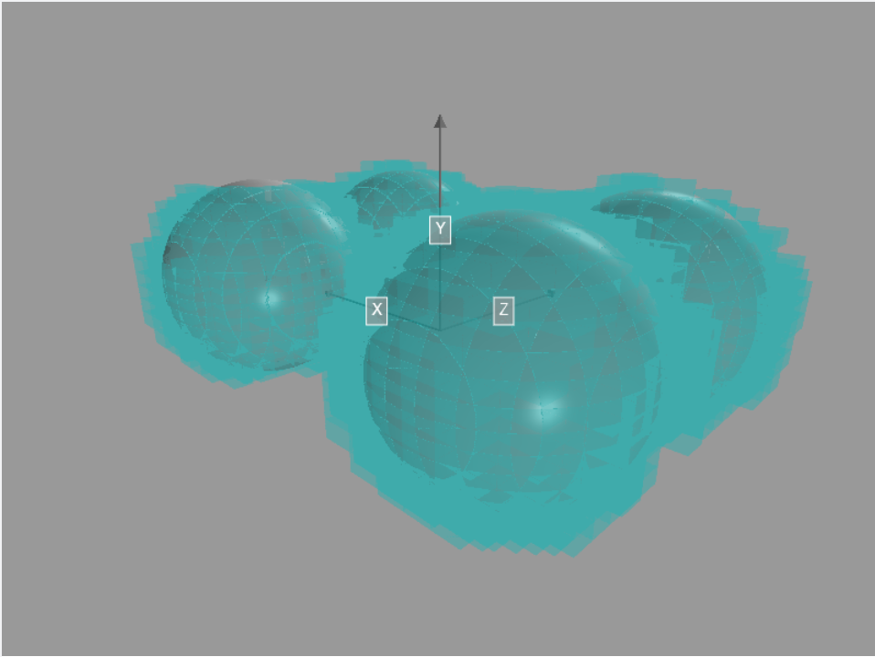
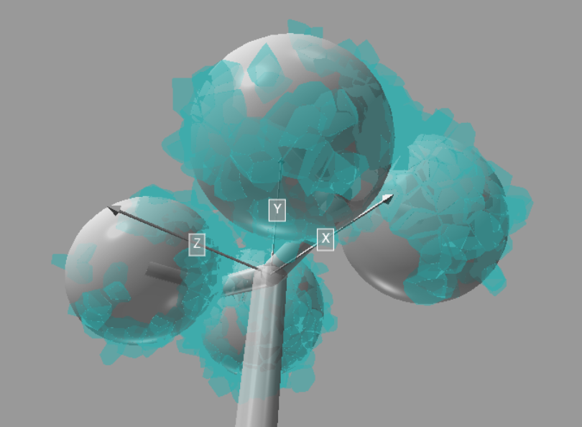
3D Voronoi Tassells as Cells
Different quasi random number generator have been tested and the best results were given by the Saltelli Algorithm (an improved version of the Sobol sequence).
Comparison between 3D cells produced by Voronoi based on a regular grid and a quasi-random one.
Alessandro d'Agostino - Master in Applied Physics UniBo - a.y. 2019/20
Alessandro d'Agostino - Master in Applied Physics UniBo - a.y. 2019/20
Notes:
2020/5/11

Slide 9
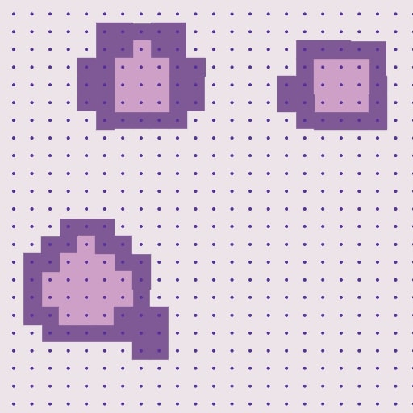
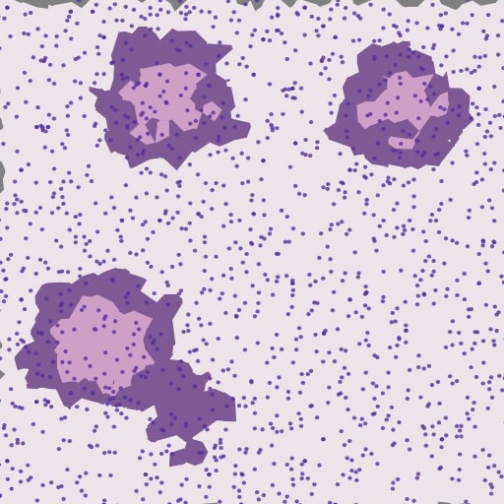
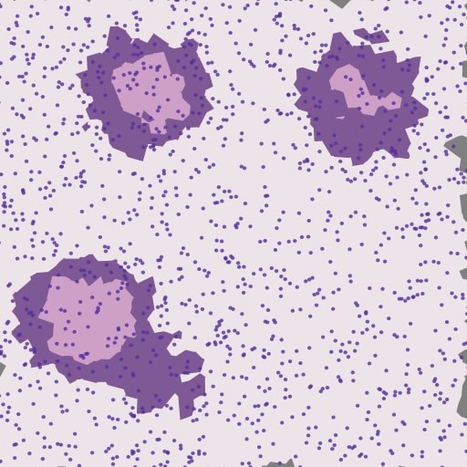
Voronoi Comparison
This is a graphical comparison of three slices made on Voronoi tessellation based respectively on a regular grid, a quasi random sampled grid and a full random sampled grid.
Alessandro d'Agostino - Master in Applied Physics UniBo - a.y. 2019/20
Notes:
2020/5/11

Slide 10
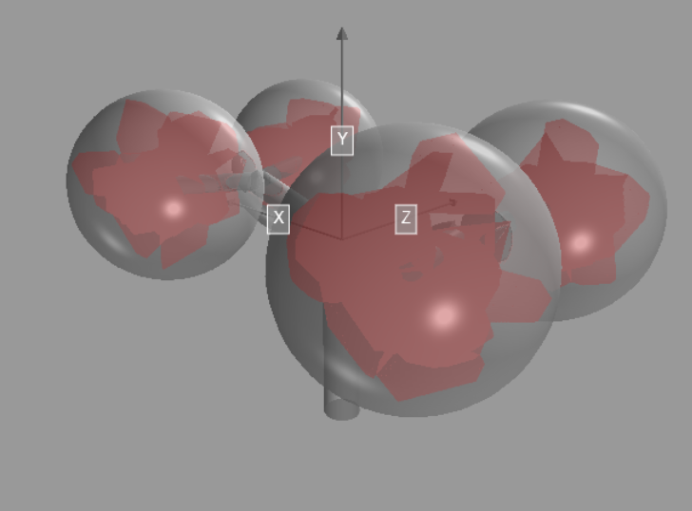
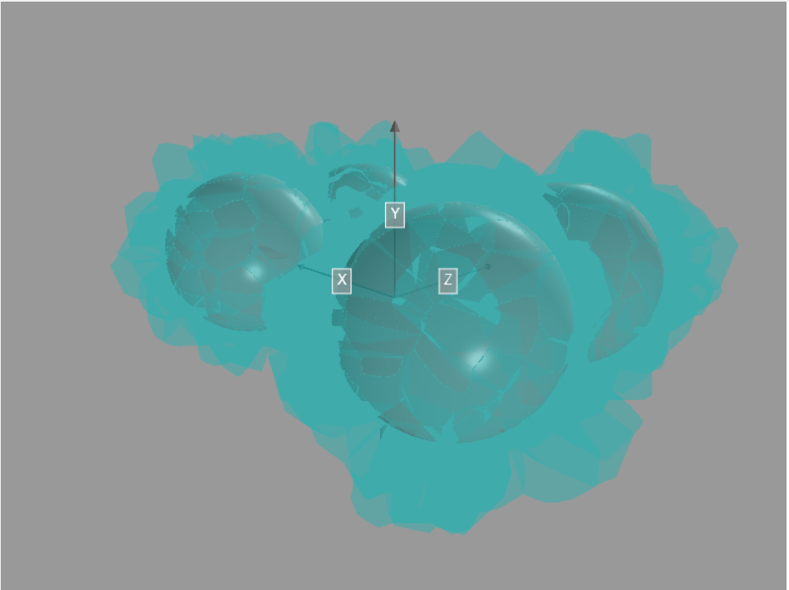
Cells Identity
The categorization is made upon the distance of every tassel’s vertex from each free end sphere.
The division is made between internal, external and boundary tassels.
Given the amount of points to evaluate KD-Tree based algorithm were exploited for better performance.
Alessandro d'Agostino - Master in Applied Physics UniBo - a.y. 2019/20
Alessandro d'Agostino - Master in Applied Physics UniBo - a.y. 2019/20
Notes:
2020/5/11

Slide 11
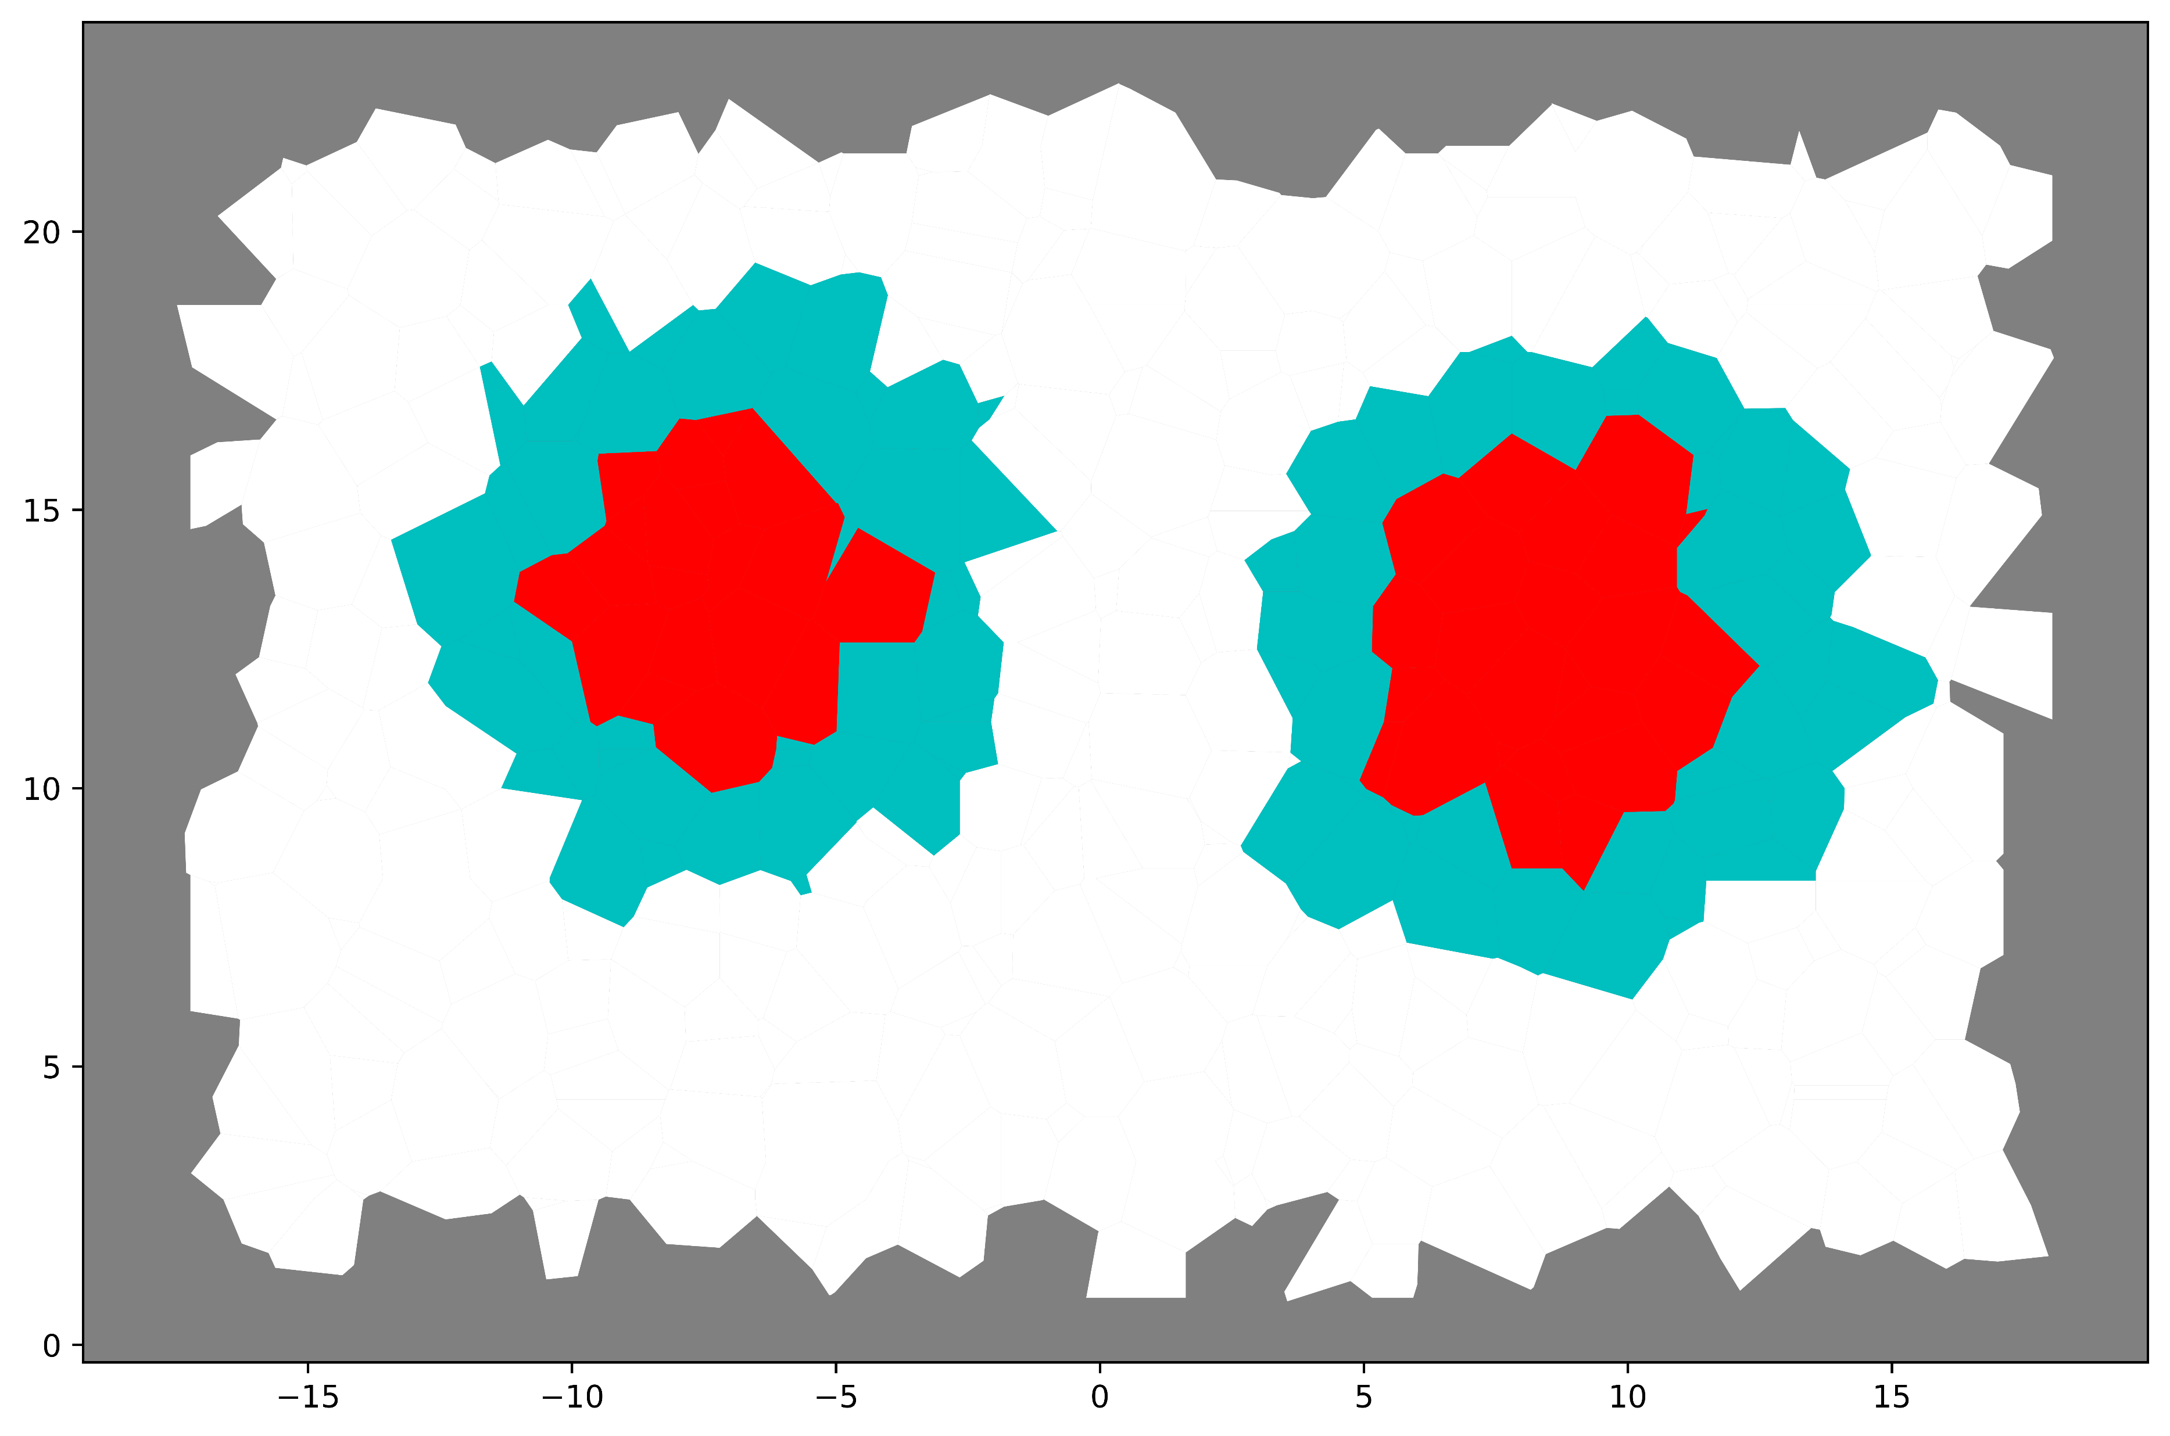
Planar Section of Polyhedrons
There is no general rule to perform the section of an arbitrary convex polyhedron, so I devised an algorithm to face the task.
Colours represent the identity: colours on the section should match the colours in the 3D structure.
Virtual slicing
Alessandro d'Agostino - Master in Applied Physics UniBo - a.y. 2019/20
Alessandro d'Agostino - Master in Applied Physics UniBo - a.y. 2019/20
Notes:
2020/5/11

Slide 12
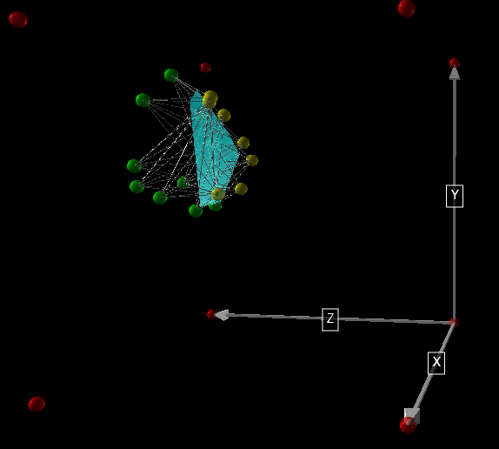
Slicing Method
Given a convex polyhedron and the slicing plane:
  Divide the vertex that lies to the left and the right of the plane
  Draw any possible line that cross two points from different class
  Make the intersections between the sectioning plane and all the lines
  Compute the convex hull of the intersection points
Alessandro d'Agostino - Master in Applied Physics UniBo - a.y. 2019/20
Alessandro d'Agostino - Master in Applied Physics UniBo - a.y. 2019/20
Notes:
2020/5/11

Slide 13
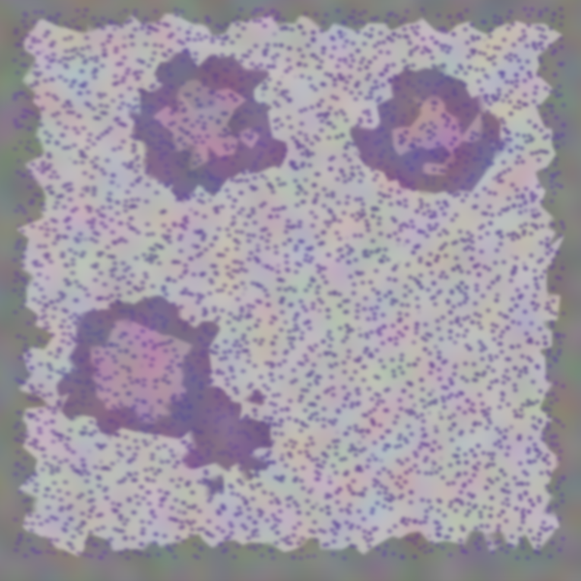
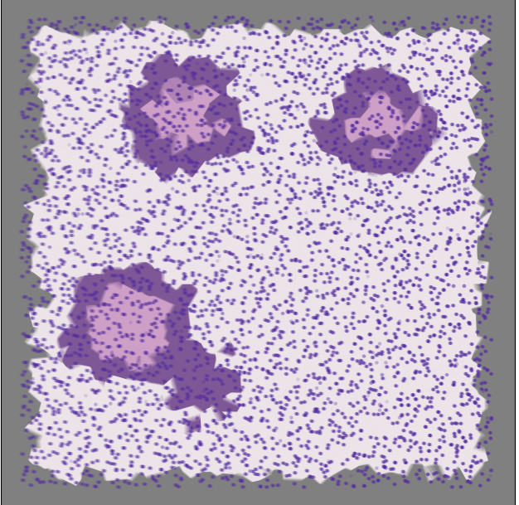
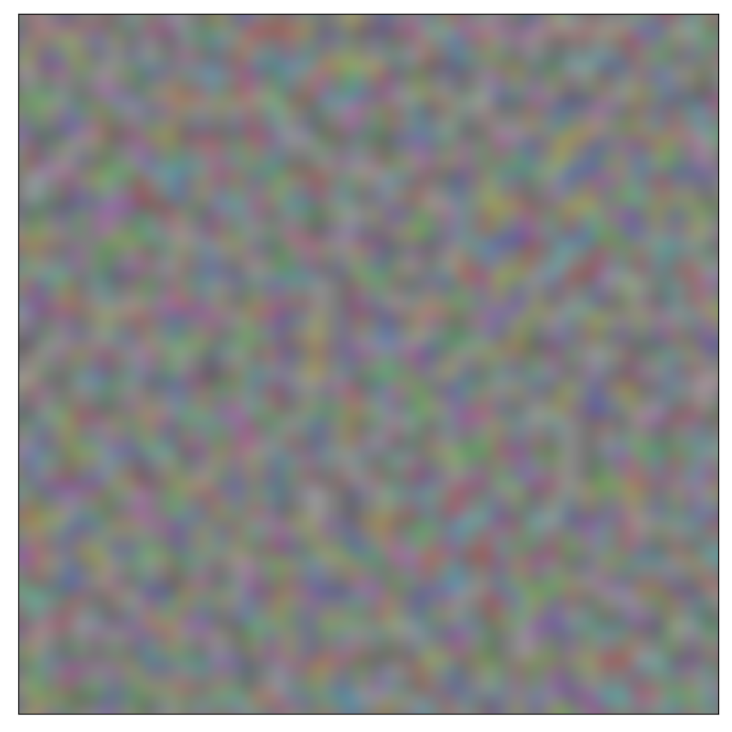
Intentional Aesthetic Refinements
Choice of a more matching colour palette
Addittion of projections of cells’ nuclei
Averaging on more succeeding slices
Application of a Perlin RGB noise
Computation Time of ~ 20 s on CPU
Alessandro d'Agostino - Master in Applied Physics UniBo - a.y. 2019/20
Alessandro d'Agostino - Master in Applied Physics UniBo - a.y. 2019/20
Notes:
2020/5/11

Slide 14
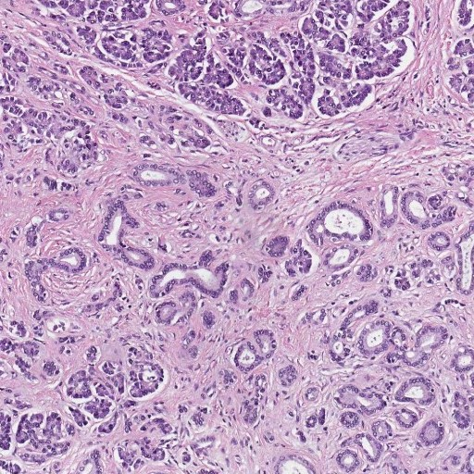
Style Transfer Net
Alternatively to adding a Perlin noise a style transfer NN should be exploited to give some texture to the image.
Transfering style from a real pancreas specimen.
Computation Time of ~ 7 min on GPU
Alessandro d'Agostino - Master in Applied Physics UniBo - a.y. 2019/20
Alessandro d'Agostino - Master in Applied Physics UniBo - a.y. 2019/20
Notes:
2020/5/11

Slide 15
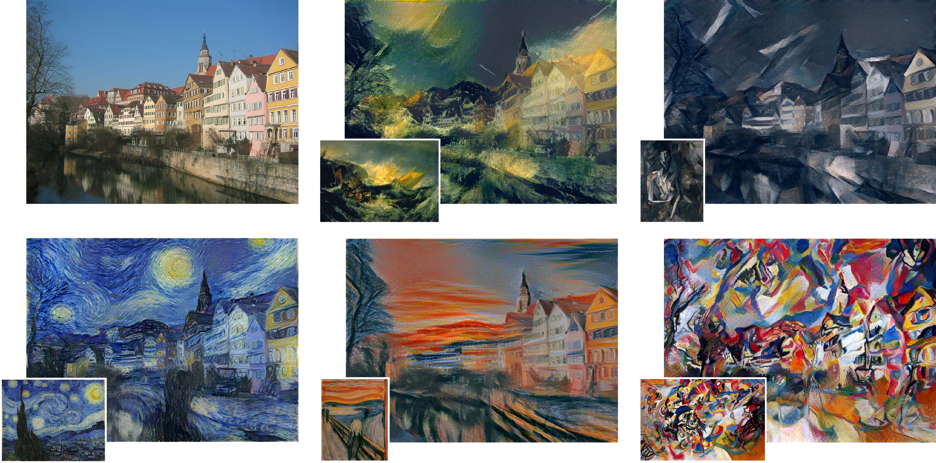
Style Transfer Neural Network
Style transfer NN are able to create hybrid images, conserving the content of an image whilst implanting the visual style from another image. This type of Deep Learning instruments find interesting and funny applications in the artistic world.
Alessandro d'Agostino - Master in Applied Physics UniBo - a.y. 2019/20
Alessandro d'Agostino - Master in Applied Physics UniBo - a.y. 2019/20
Notes:
2020/5/11

Slide 16
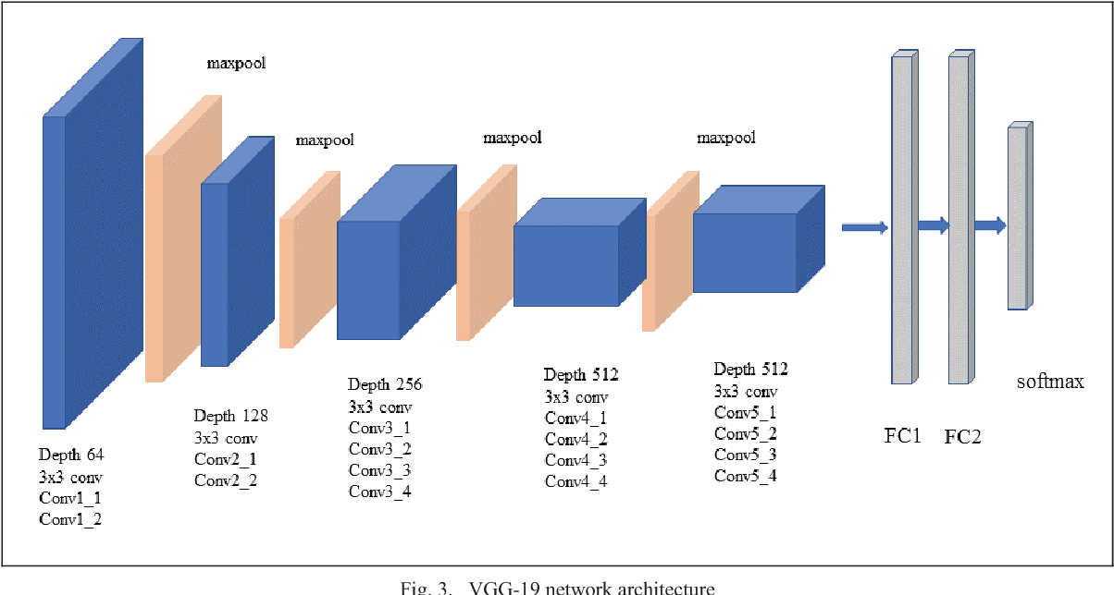
Style Transfer Net informations
I used a custom version of the VGG19 network provided in a tutorial of the pytorch library. The structure is still the same, with a sequence con convolutional layers followed by a couple of fully-connected Layers.
https://pytorch.org/tutorials/advanced/neural_style_tutorial.html
Alessandro d'Agostino - Master in Applied Physics UniBo - a.y. 2019/20
Alessandro d'Agostino - Master in Applied Physics UniBo - a.y. 2019/20
Notes:
2020/5/11

Slide 17
Image and Label Pair
A complete run on the pipeline results in a pair Image – Label.
This procedure may be repeated many times, providing a training dataset of arbitrary dimension.
The randomness in the slicing direction provides every time different pairs.
FOUR DIFFERENT PAIRS OF IMAGES AND RELATIVE LABELS
Alessandro d'Agostino - Master in Applied Physics UniBo - a.y. 2019/20
Notes:
2020/5/11

Slide 18
Next Steps
Try applications on new types of tissues.
Starting from a completely different geometric structure to embed in the 3D tassellation.
Try to train a model on this data set.
It could help detecting problematic in the images and way to improve the generation.
Deepen the comprehension of the style transfer NN.
The fine tuning of the network’s parameters could help in the generation
Alessandro d'Agostino - Master in Applied Physics UniBo - a.y. 2019/20
Alessandro d'Agostino - Master in Applied Physics UniBo - a.y. 2019/20
Notes:
2020/5/11

Slide 19
Alessandro d'Agostino - Master in Applied Physics UniBo - a.y. 2019/20
Alessandro d'Agostino - Master in Applied Physics UniBo - a.y. 2019/20
Notes:
2020/5/11

Slide 20
Bibliography
Segmentation Article
More realistic images
Saltelli algorithm
cGAN NN
Alessandro d'Agostino - Master in Applied Physics UniBo - a.y. 2019/20
Notes:
2020/5/11

