Slide 1


Embedded Systems - project report
Testbench group:
Alessia Guzzo Chiara Muscari Tomajoli Matteo Cattaneo

Slide 2


Slide 3

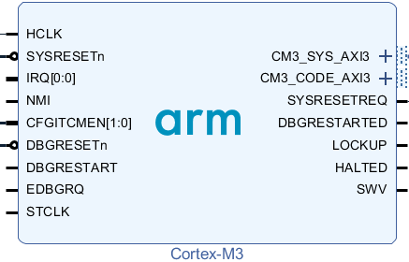
The idea behind our work
We wanted to have a closer look on when and how the instructions are executed by the processor.

Slide 4
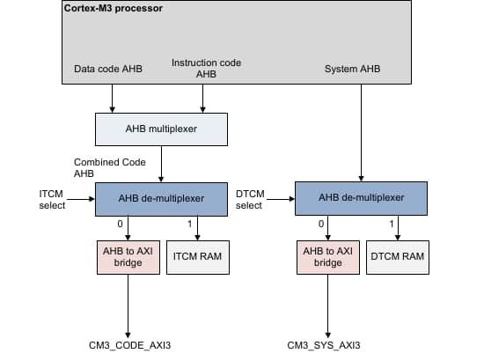
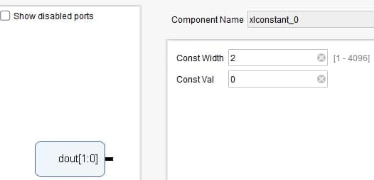
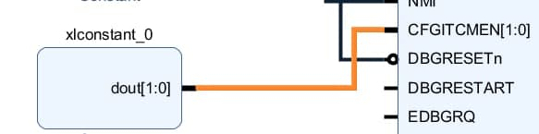
Exploring instruction fetch
We became interested in the idea of executing instruction not from the processor’s internernal memory (the ITCM), but from an external memory.
This can be performed by setting to '0' the CFGITMEN[0] signal.

Slide 5
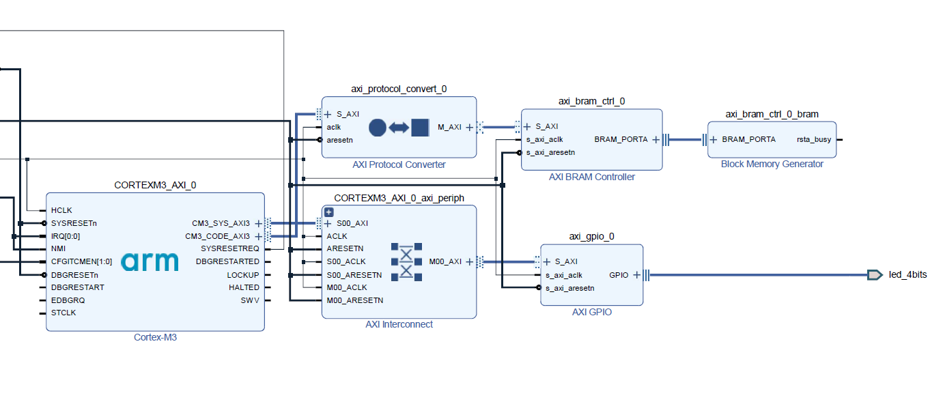
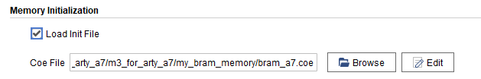
BRAM as instruction memory
The block memory generator module can be initialized with a .coe file.

Slide 6
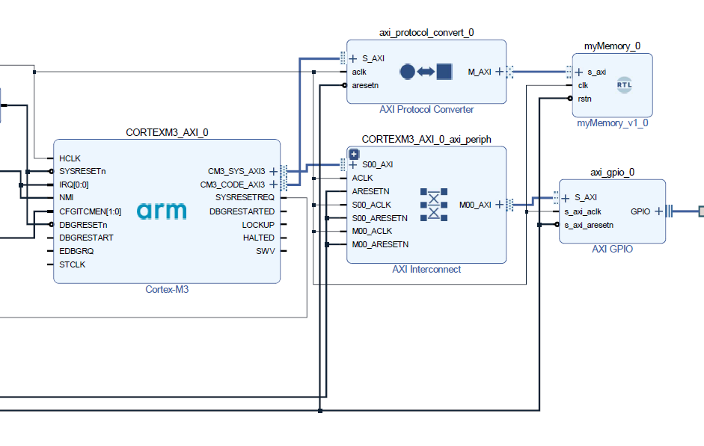
Our memory as instruction memory
We built a Verilog block where we instantiated a reg array to implement the memory itself.
We loaded it through the $readmemh instruction.

Slide 7
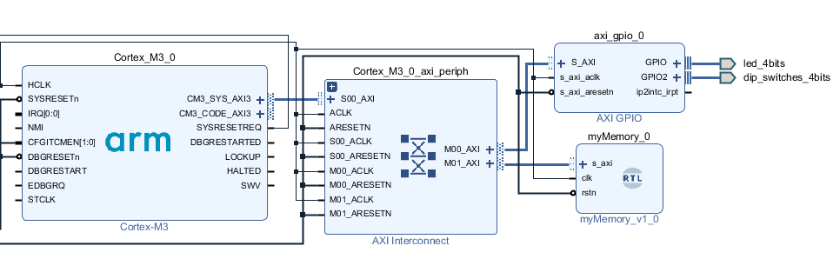
Testing our memory as data memory (1/2)

Slide 8
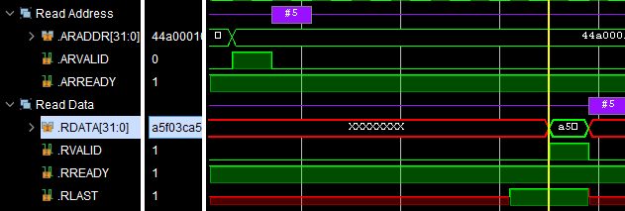
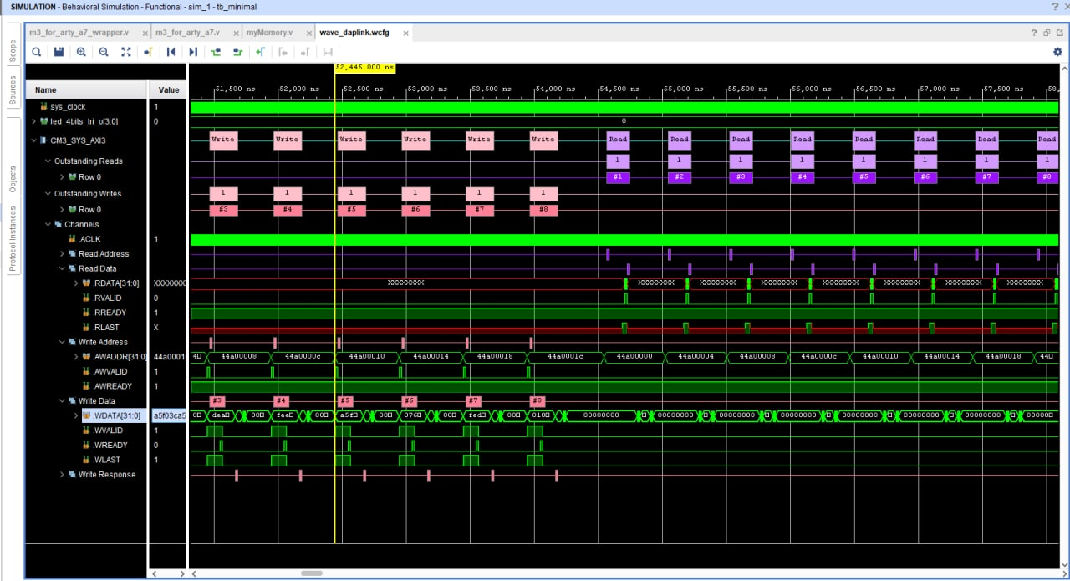
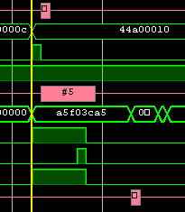
Testing our memory as data memory (2/2)

Slide 9
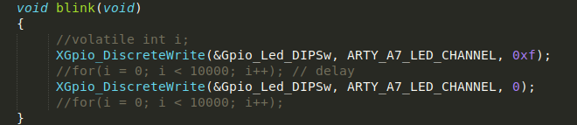
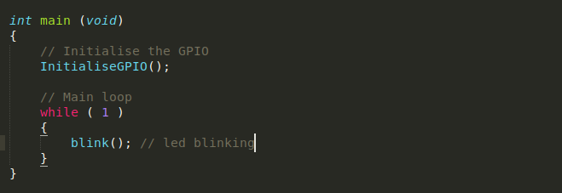
Our firmware
We decided to write a very simple application, namely an endless led blinking.

Slide 10
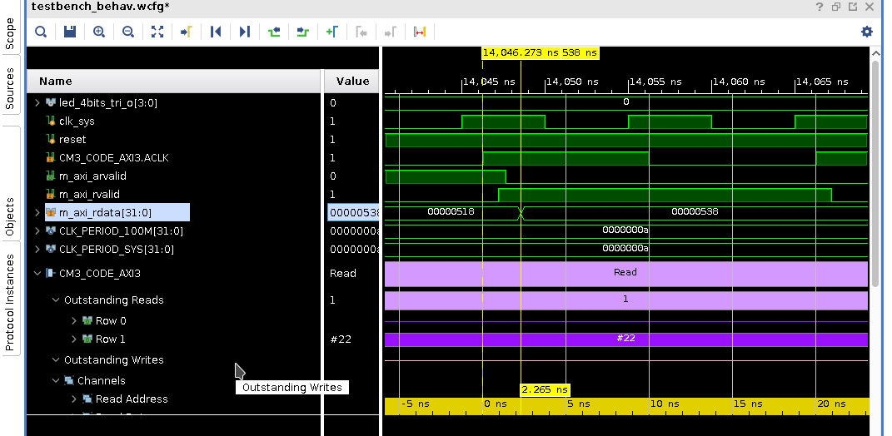
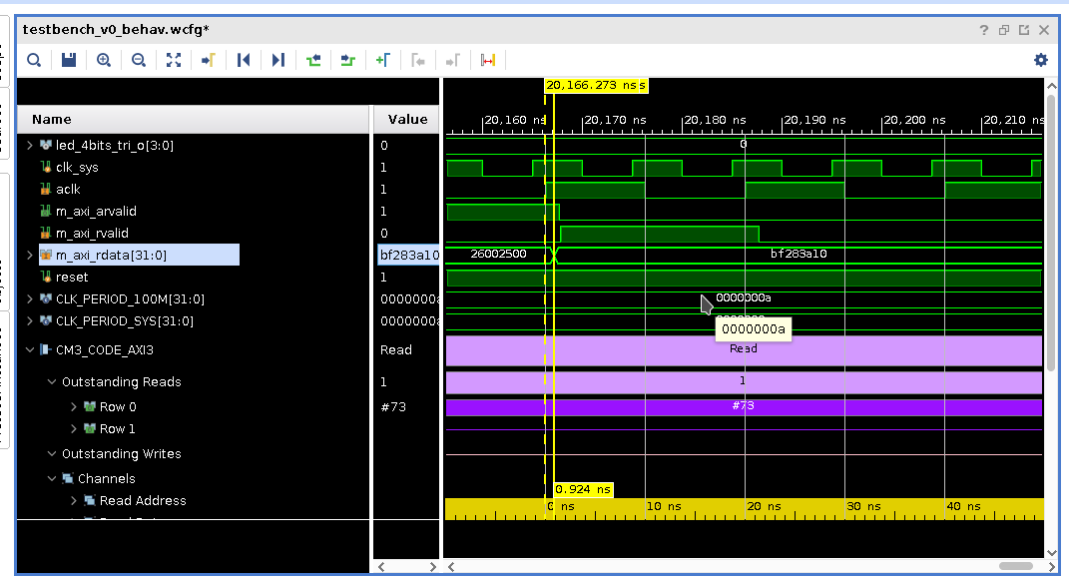
Timing Comparison: Post Synthesys
We are interested in the difference RDATA- CLK.
BRAM: 2,265 ns
Our Memory 0,94 ns

Slide 11
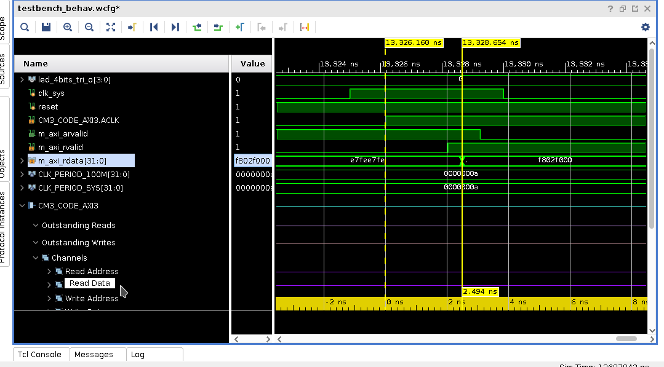
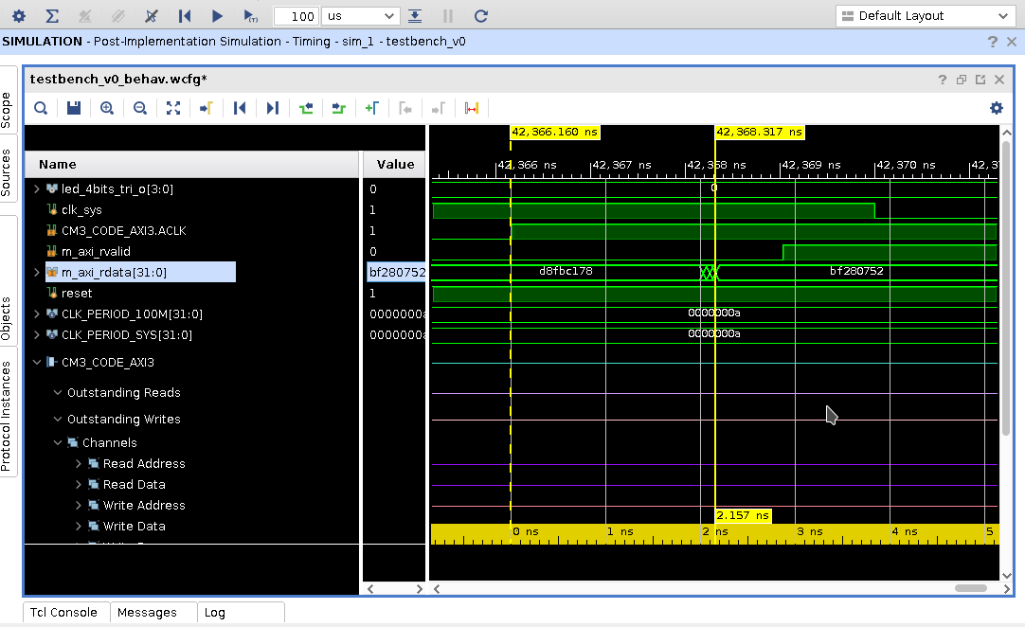
Timing Comparison: Post Implementation
We are interested in the difference RDATA- CLK.
BRAM : 2.5 ns
Our Memory: 2.16 ns

Slide 12
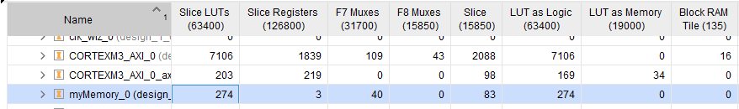
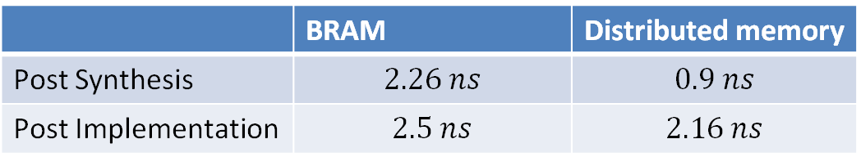
Conclusions (Memory latencies)
 | BRAM | Distributed memory
Post Synthesis | $$2.26 ns$$ | $$0.9 ns$$
Post Implementation | $$2.5 ns$$ | $$2.16 ns$$
The post-implementation Simulation gives a more realistic estimate of the memory latency!

Slide 13

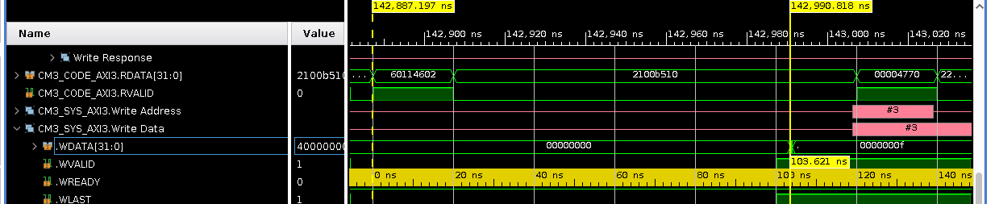
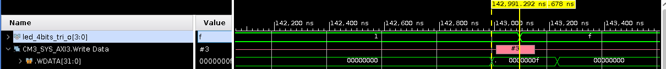
Disassebled code
60114602 is the exact instruction which writes on the memory address corresponding to the LEDs GPIO, making so the led effectively blinking.
103ns
100ns

Slide 14
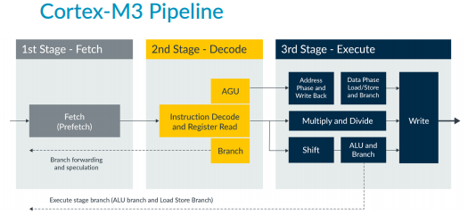
Conclusions (Disassembler)
103ns

Slide 15
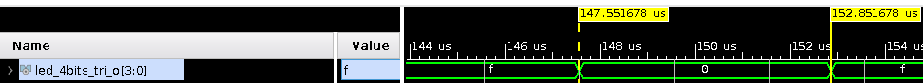
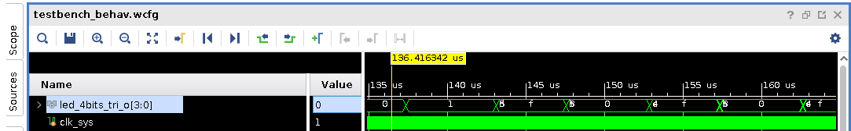


A peculiar behaviour: glitches
Post Synthesis
$$4,46μs$$
$$5,29μs$$
Post Implementation

Slide 16
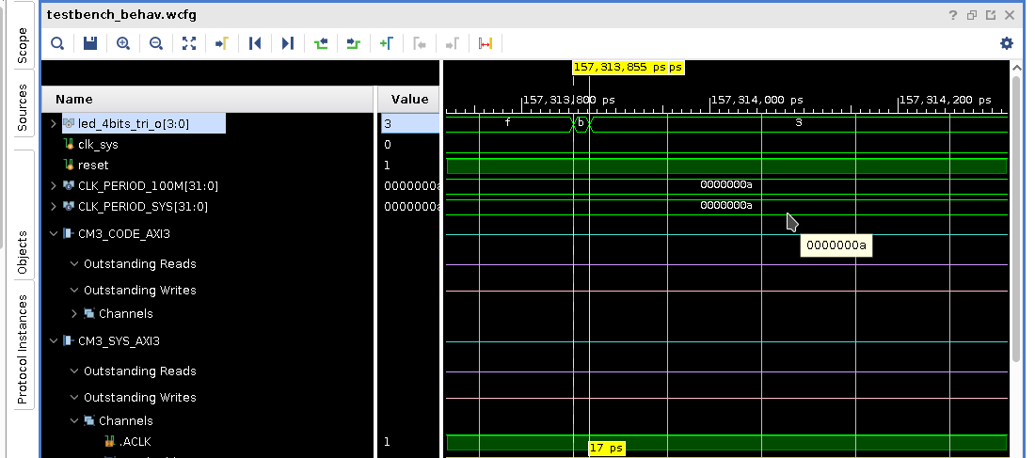
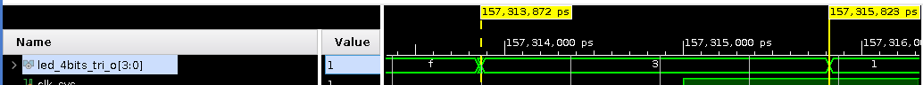
More in detail
17 ps
1,9ns
0.52ns

Slide 17
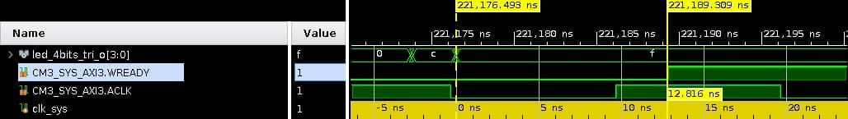
Dealing with the problem
We noticed that the WREADY signal is asserted by the slave well after the leds are stabilized on their steady state values, thus preventing the master from trying to perform any other transfer until the glitch has ended.

