Slide 1
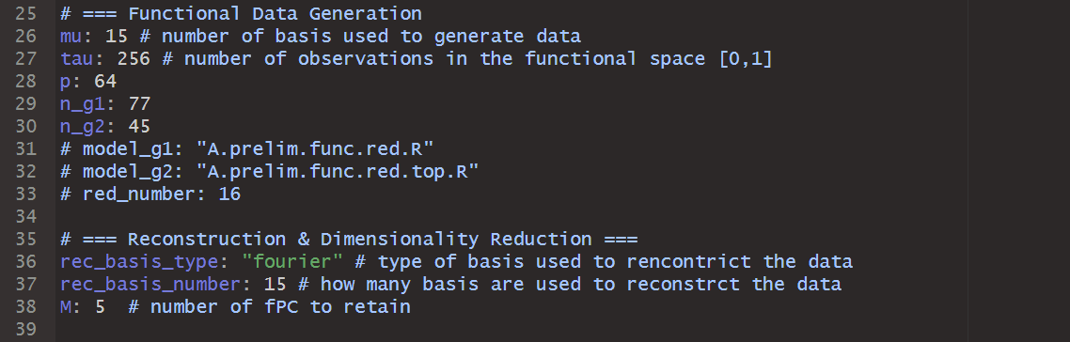
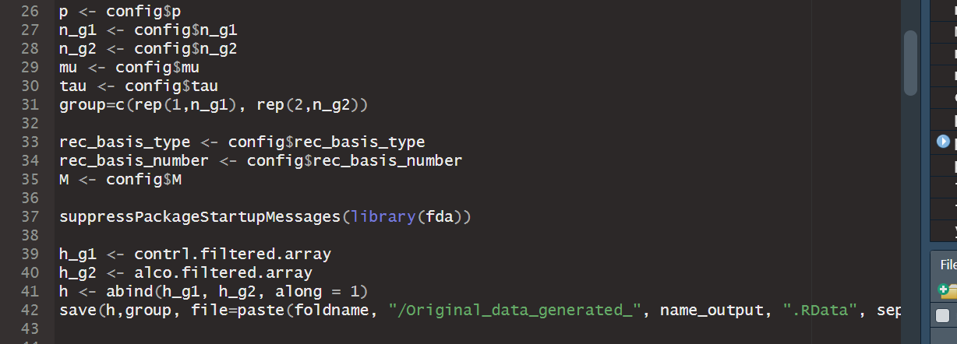
Generazione del dato:
Partendo da alco_filtered_Array.Rdata e control_filtered_array.Rdata in https://github.com/boxinz17/FuDGE/tree/master/EEG/generated_data
In EEG_dataset/config_template.yaml
In EEG_dataset/FPC_score.R

Slide 2
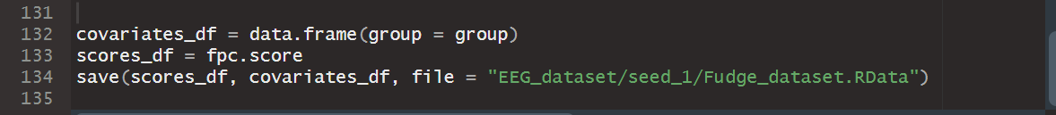
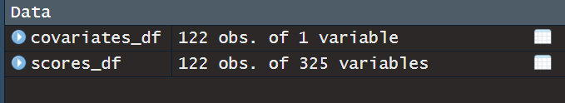
In EEG_dataset/Fudge_dataset.RData
Insert image of approximation

Slide 3
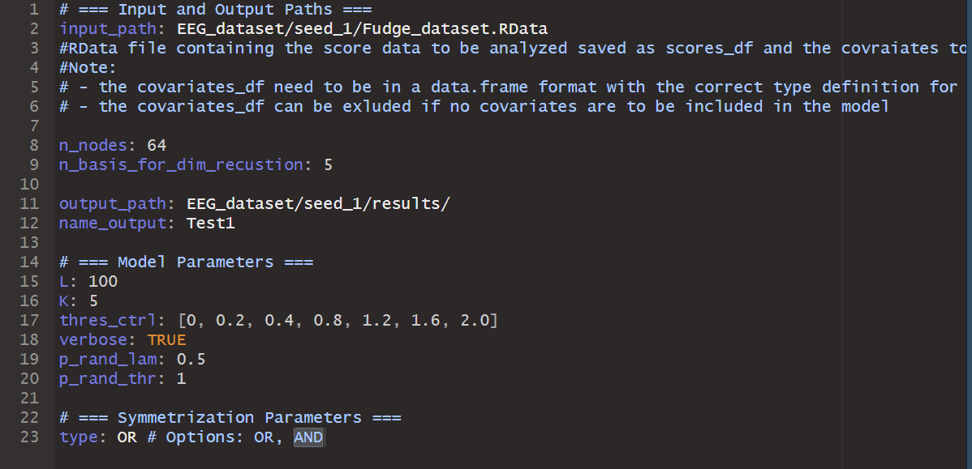
In EEG_dataset/config_file.yaml
Results in EEG_dataset/seed_1/results/

Slide 4
