Slide 1
Implementazione e specifiche home page Fitness Center
Alessio Calini (O46001993)
a.A 2020/2021

Slide 2
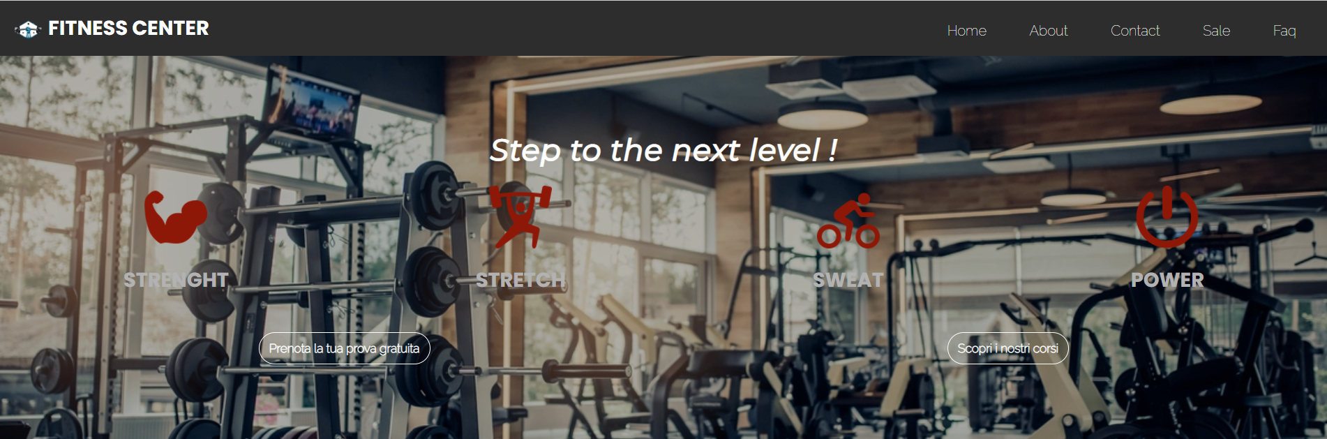
Header
100% dello schermo
700px

Slide 3

Nav
615,88px
313px
88px
48px
37px
50px
50px

Slide 4

h1
21,44px
72px
553,34px

Slide 5




div id=‘icon’
100% dello schermo
208,09px
167,54px
100px
208,09px
100px

Slide 6
h3
100% dello schermo
52px
273,44px
194,05px

Slide 7




div id=‘main’
77px
46,48px
100px

Slide 8


div id=‘details’
150px
100px
100px
543,05px

Slide 9
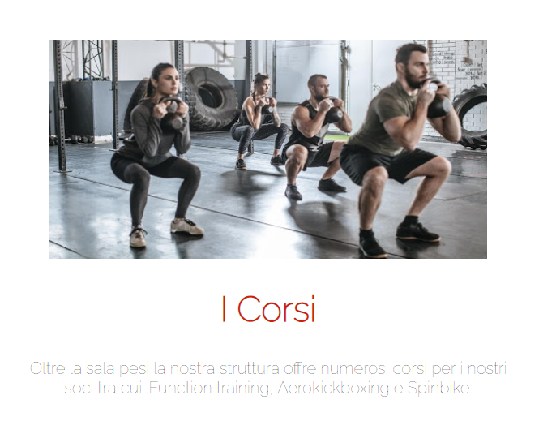


div
600px
300px
20px di padding
40px
40px

Slide 10

Footer
100% dello schermo
362,88px

Slide 11



footer
1394px
37,5px
75px
37,5px
75px
100,87px
100px
100px
16px

