Slide 1
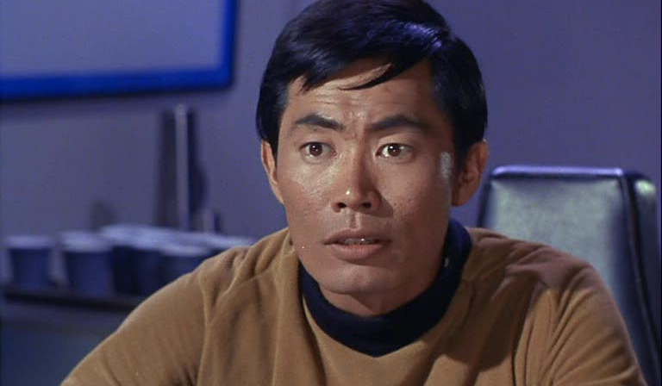
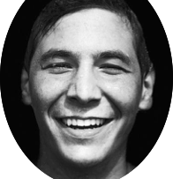


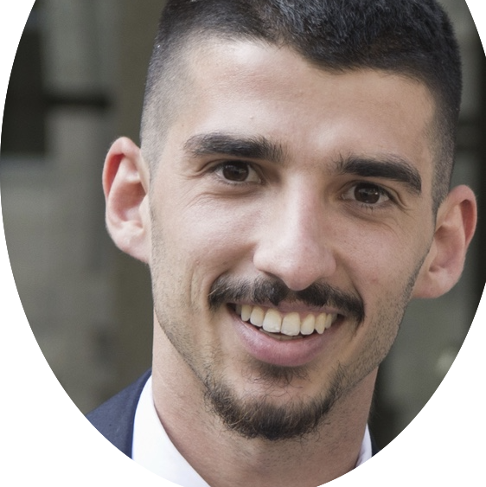

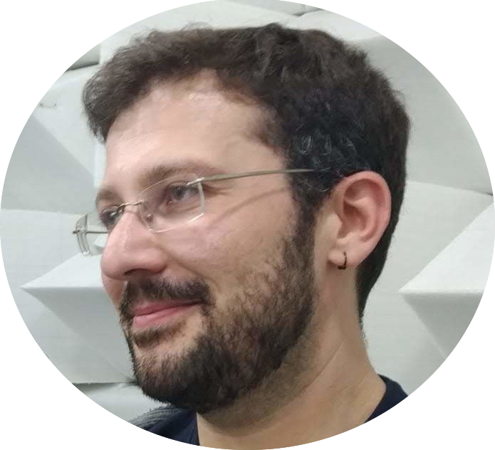
LE BIMBE DI SULU
Calling all radio enthusiasts (#2)

Slide 2
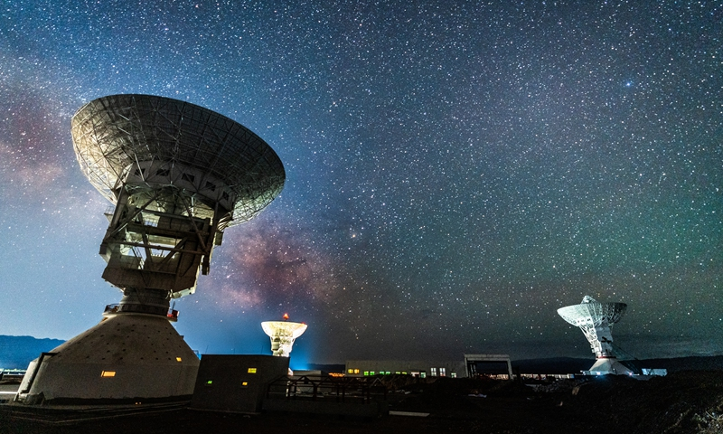

WHY
REDUCE THE COSTS OF COLLECTING DATA
UNIQUE PLACE FOR DATA. OPEN SCIENCE.
REDUCE THE PROCESSING TIME AND COSTS

Slide 3
Documentation
Data
Processing
Join the community
Downloads
My account
RADIOVERSE
LEARN ABOUT THE IONOSPHERE, ITS INTERACTION WITH ELECTROMAGNETIC WAVES AND ITS IMPACT ON HUMAN ACTIVITIES
HELP IN COLLECTING RADIO PROPAGATION DATA. SHARE YOUR HAM-RADIO KNOWLEDGE OR MOVE YOUR FIRST STEPS TO BECOME A RADIO AMATEUR
BECOME A DEVELOPER. HELP TO CREATE NEW PROCESSING ALGORITHMS TO RETRIEVE INFORMATION FROM RADIO SIGNAL AND TO MONITOR OUR IONOSPHERE
Contacts

Slide 4
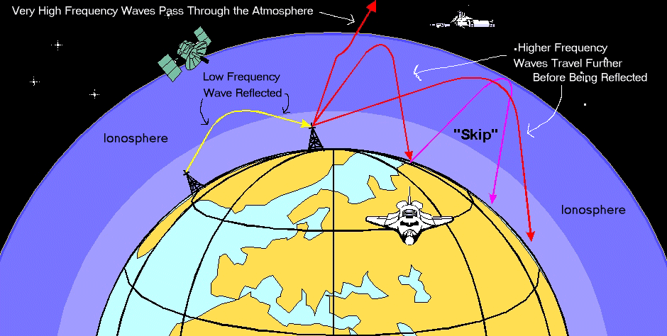
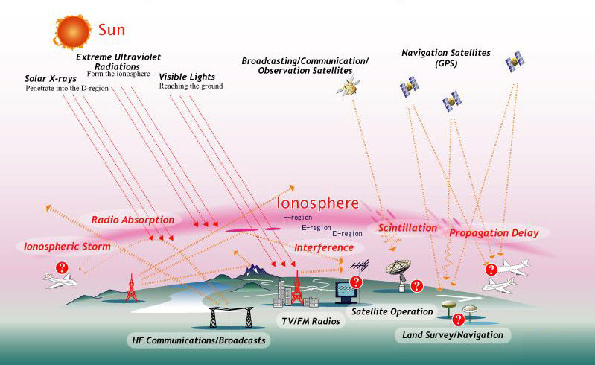
Documentation
Data
Processing
Join the community
Downloads
My account
WHAT IS THE IONOSPHERE
IONOSPHERE DENSITY FLUCTUATIONS
Layer of the atmosphere ionized by the incoming solar radiation
Modify the reflections of radio waves, disturbing telecommunications.
Used to propagate radio waves between far points thanks to reflection
Modify the propagation delay of signal coming from outside, like the ones from GPS.
RADIOVERSE
Contacts

Slide 5
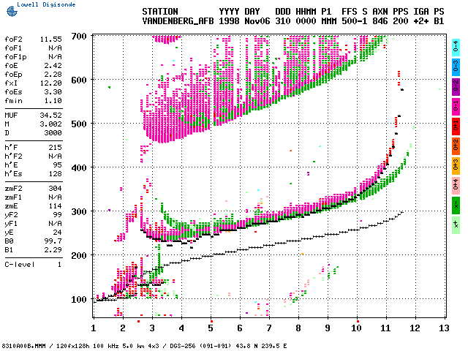
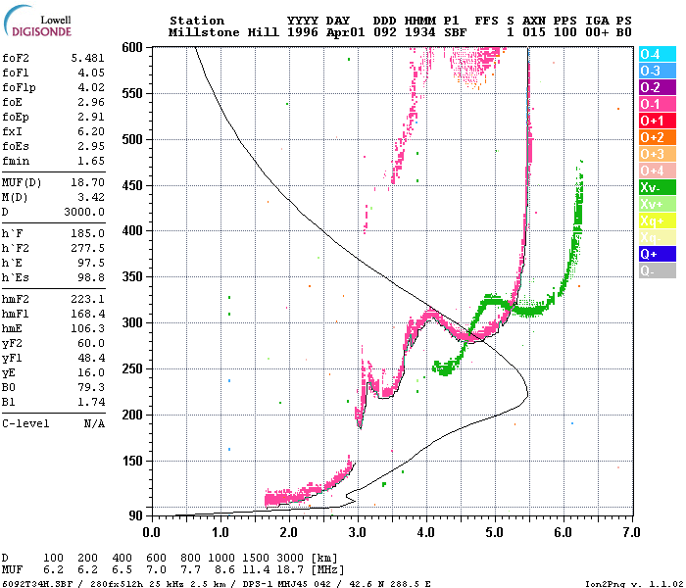
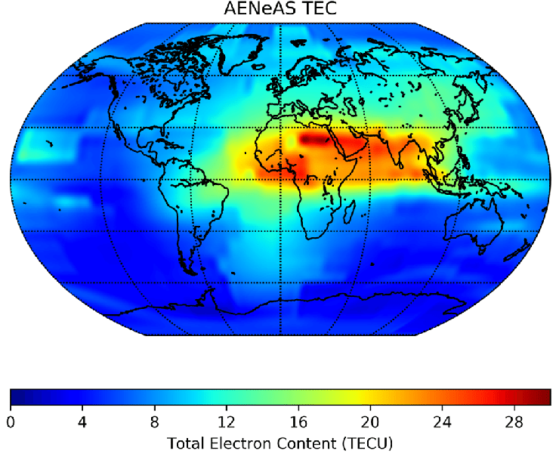
Documentation
Data
Processing
Join the community
Downloads
My account
FREQUENCY – DELAY POINTS
ELECTRON DENSITY
IONOSPHERE MAP
RADIOVERSE
Contacts

Slide 6
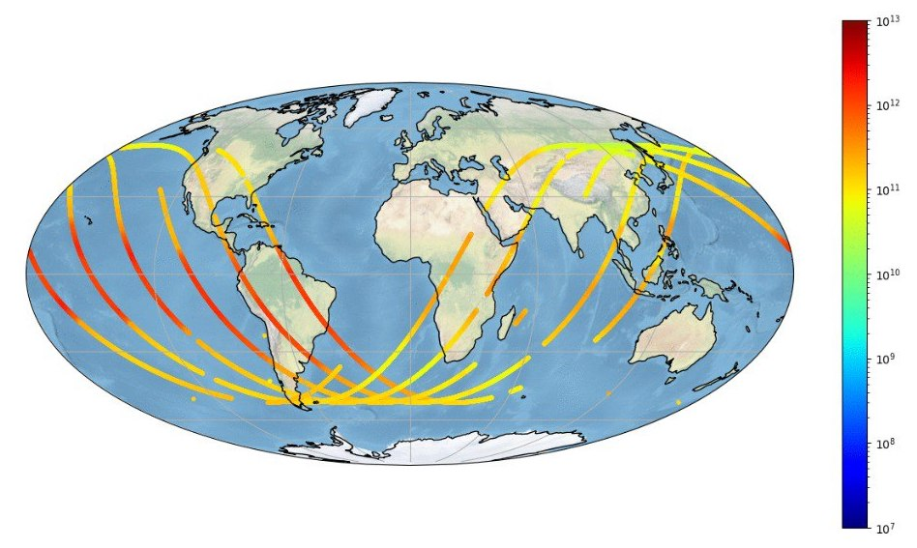
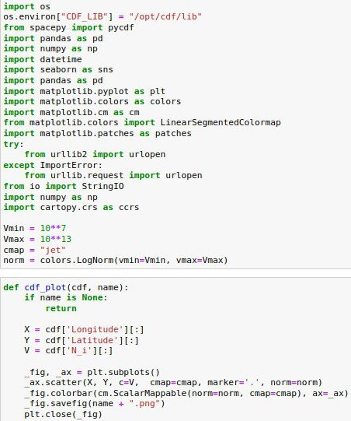
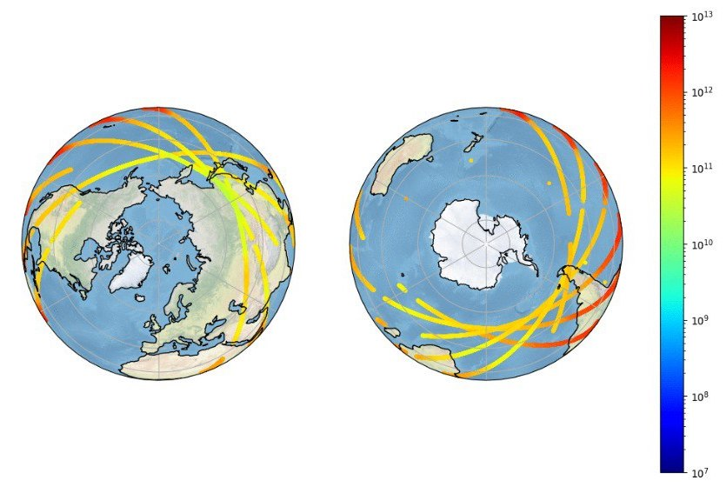
Documentation
Data
Processing
Join the community
Downloads
My account
ALGORITHMS
SOURCE CODE
EXAMPLE RESULTS
RAW DATA
FREQUENCY-DELAY COUPLES
DENSITY CURVES
TOTAL ELECTRON CONTENT (TEC)
RADIOVERSE
Contacts

Slide 7
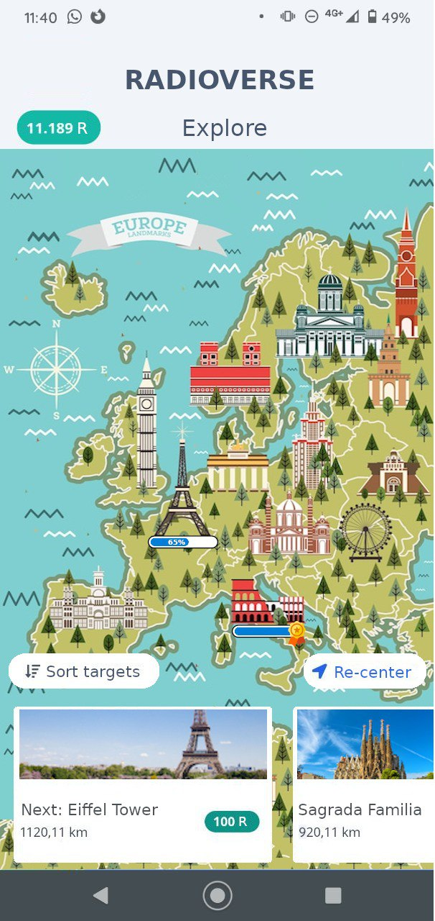
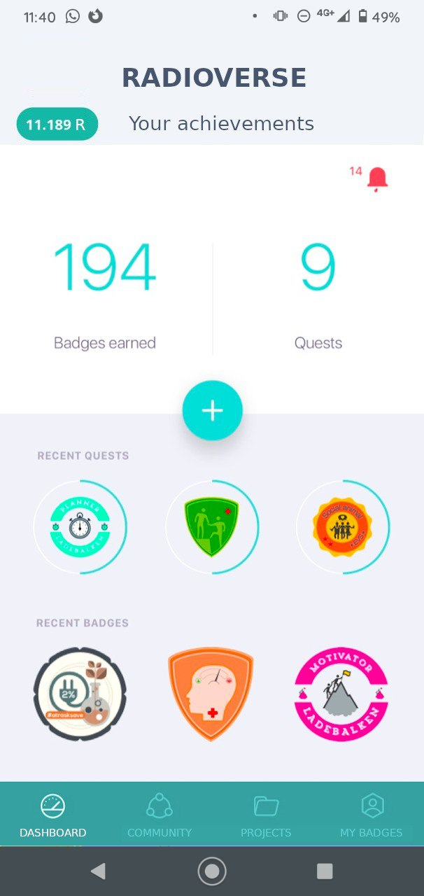
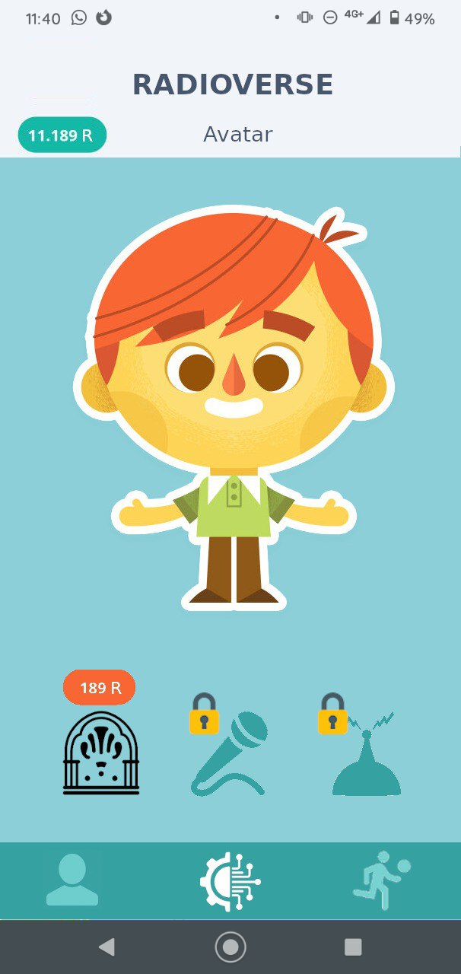
Documentation
Data
Processing
Join the community
Downloads
My account
PHONE APP
Gamification of the data collection
Radioverse: quests, battles, trades through proper radio transmission in the virtual word
Earn points and reputation
RADIOVERSE
Contacts

