Slide 1

Web-Inteligence Project
Group 7 :
Alessio De Angelis
Martin Hengstberger
Simon Stastny
Group 7, Web-Intelligence

Slide 2
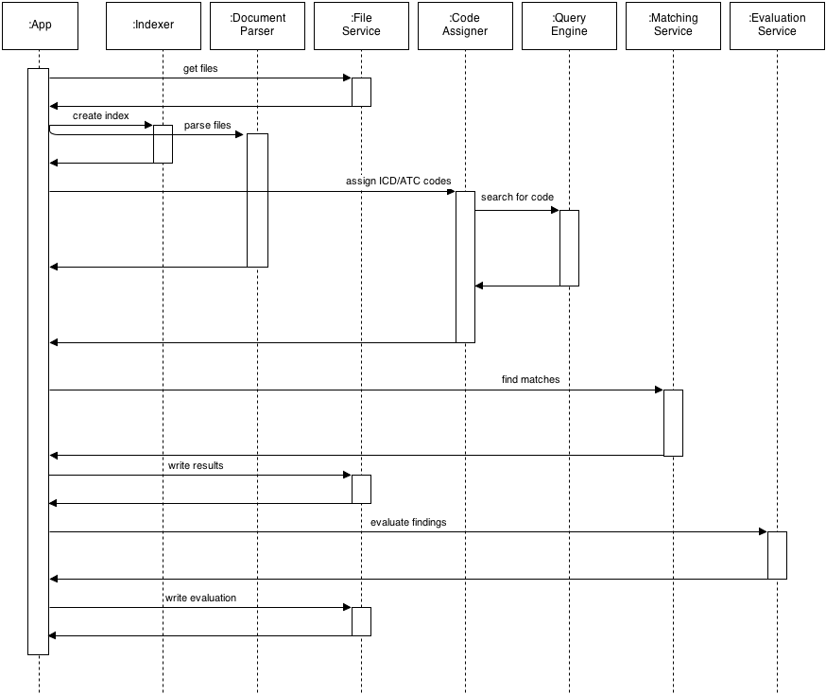
Lucene
Jena, tika, Sax

Slide 3
Classification
Information retrieval approach
Text is classified in ICT/ATC codes
Norwegian Analyser (stemming)
Index consists out of sentences (Lucene)

Slide 4
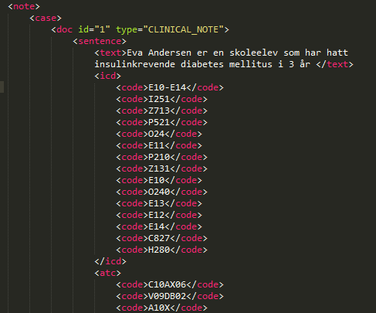
Results
Parallised Application
Serveral log files and intermediate result XMLs
Lots of unspecific results
Classifaction and ranking problems
Some parts remain unimplemented

Slide 5
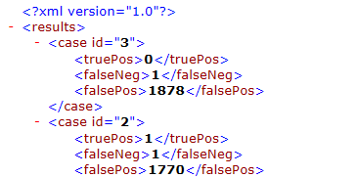
Evaluation
Automated comparison with the gold standard
Based on ICD/ATC codes
Output:

Slide 6
What we learned
How to use serveral tools for searching
There are powerful open source projects
Efficient parsing
Design of computational intensive application
Language specifics, sovle encoding issues
Searching/Finding the right thing is hard

