Slide 1

PolyPie
A polymeter and polyrhythm beat generator
Combined project between:
Advanced Coding Tools and Methodologies & Computer Music - Representations and Models.
Developed by Antonios Pappas, Mattia Lercari and Alessio Lampis 2019/2020
Notes:
Welcome everybody, good afternoon. This is going to be the presentation of Antonio’s, Mattia’s and my work during the last semester. Our project is called PolyPie and our aim was to create a different beat generator which allows to hear and visualize polyrhythms and polymeters.

Slide 2
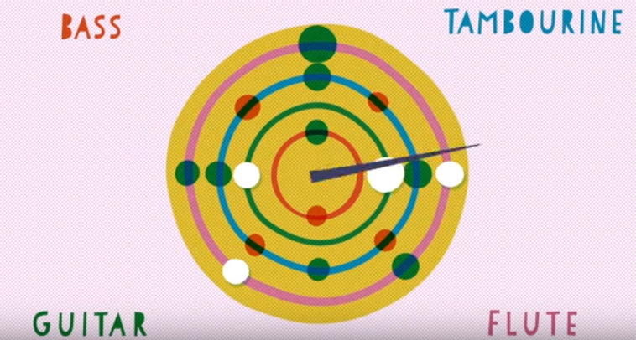
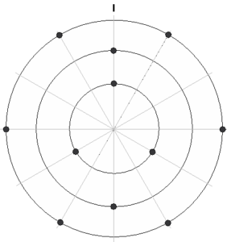
Idea
Notes:
We started from the idea of representing time in circular fashion. Our inspirations were the «polyrhythmic clock> by Jerry Leake (Berklee) and the well known rhythmic weel we have seen in lecture. This way gives a CLEAR visual clue on how we conceptualize polymetric and polyrhythmic structures. That’s because this kind of representation gives us a natural way of representing rhythmic loops, by slicing the circles in different ways. We named the sliced circles «Pies», as they resemble typical pie charts. In the typical western linear notation note heads represent pitch and duration of each note. In our representation slices of pies serve a similar function. Each pie superimposed is a different rhythm or meter with its own sound.

Slide 3
Developed with:
HTML
CSS (SCSS)
JAVASCRIPT (+Tone.js library)
Notes:
We used tone.js for sound and temporal SChEduling

Slide 4
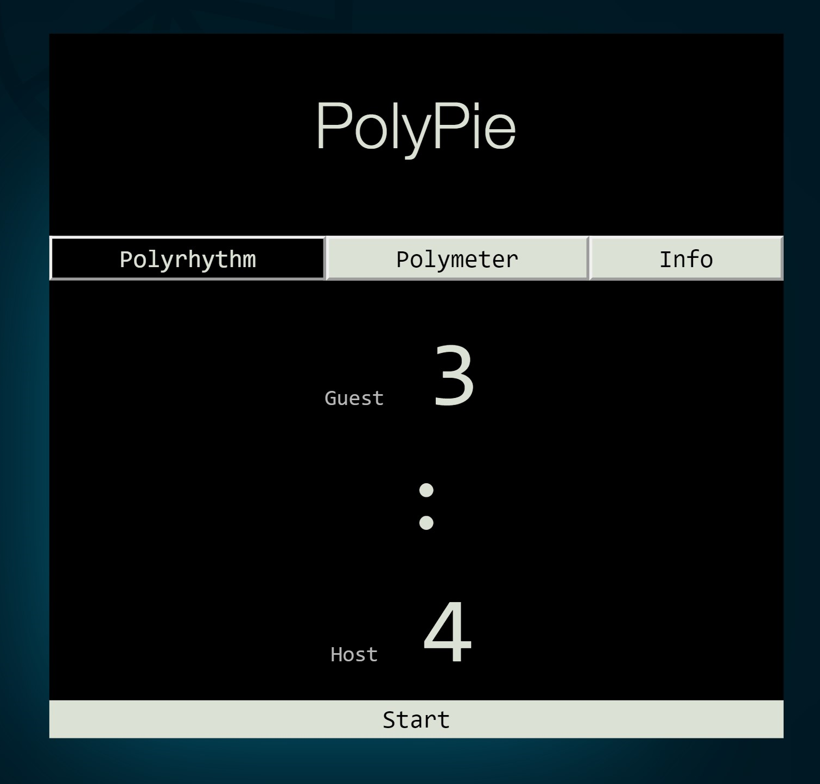
How it works
[true, false, false, … , false]
[true, false, false , … , false]
12

Slide 5
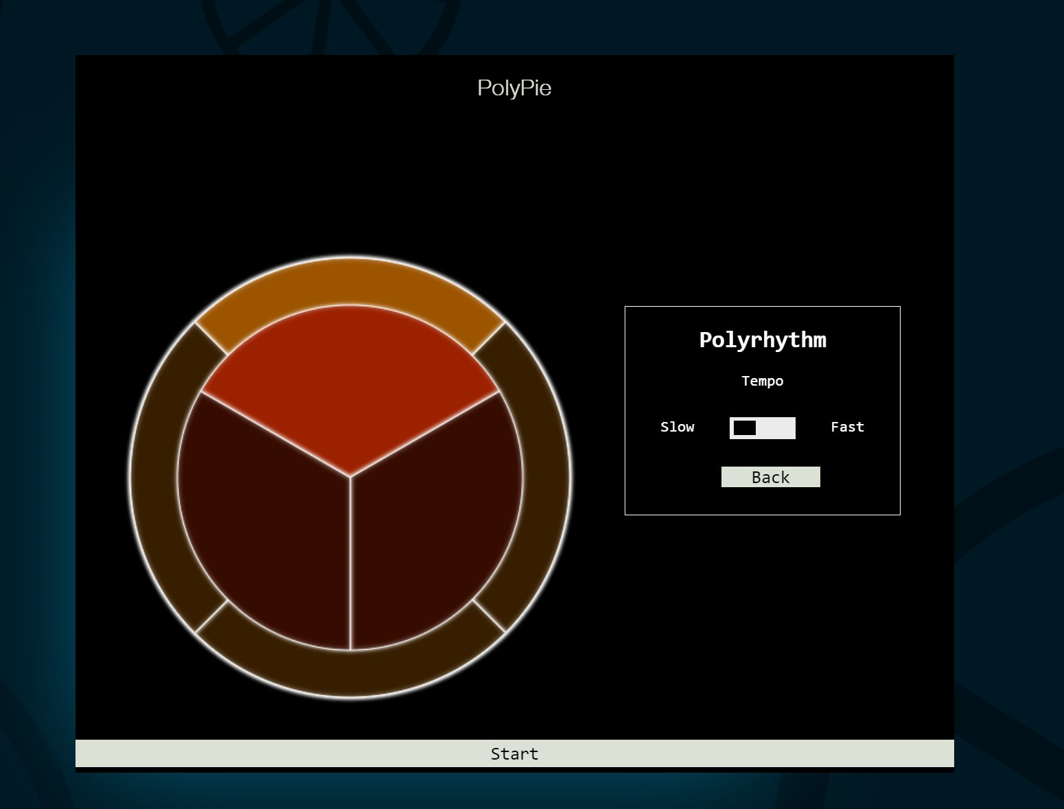
Polyrhythm result
Notes:
You can see and hear the different rhythms while the pies are rotating. The pies rotate indipendently one slice at the time (this represent the beat). Each pie has a different sound and when they play, the cursor flash with the color of the specific pie. When they play simultanieously the cursor blinks white and you can hear the full chord. By changing the speed, you’ll hear different notes and chords.

Slide 6
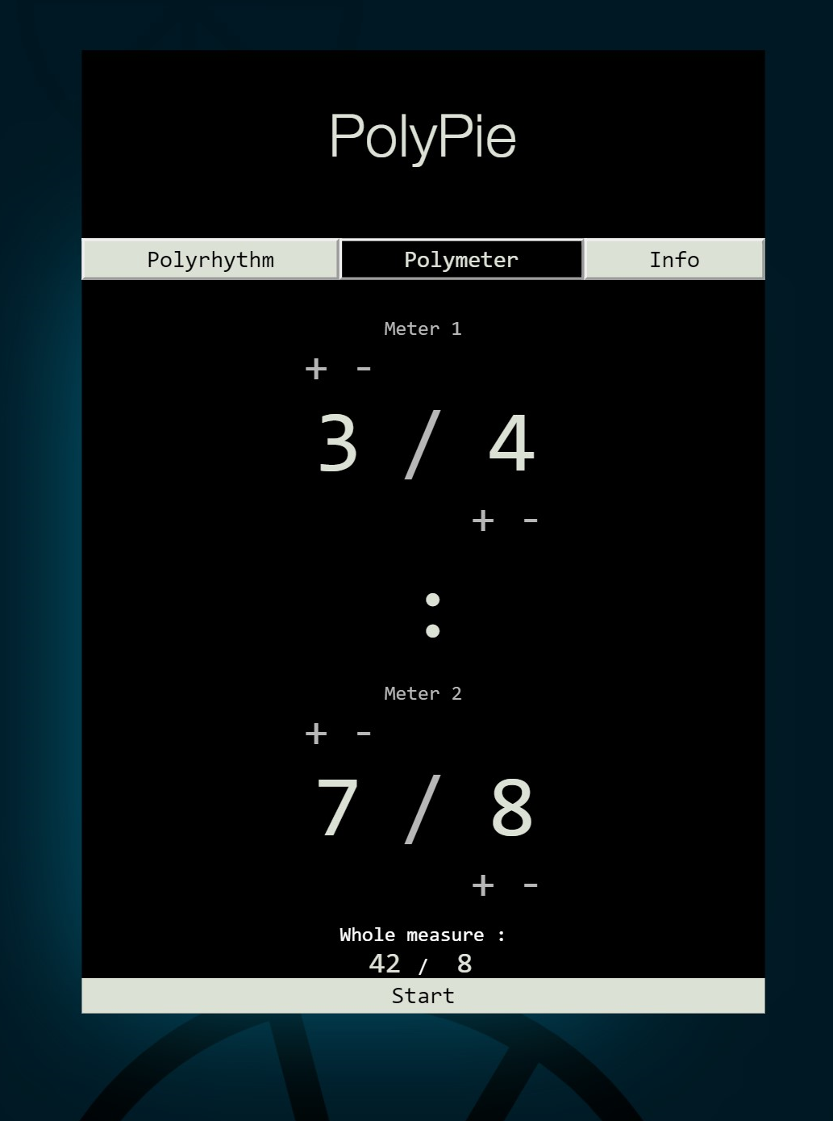
How it works
Meter 1 and
Meter 2 beats
Speed Ratio
2:1
Notes:
In the polymeter section, the inputs represent the two signatures of the meters we are going to play at the same time. The values of the denominators here give us the speed ratio between the two meters.

Slide 7
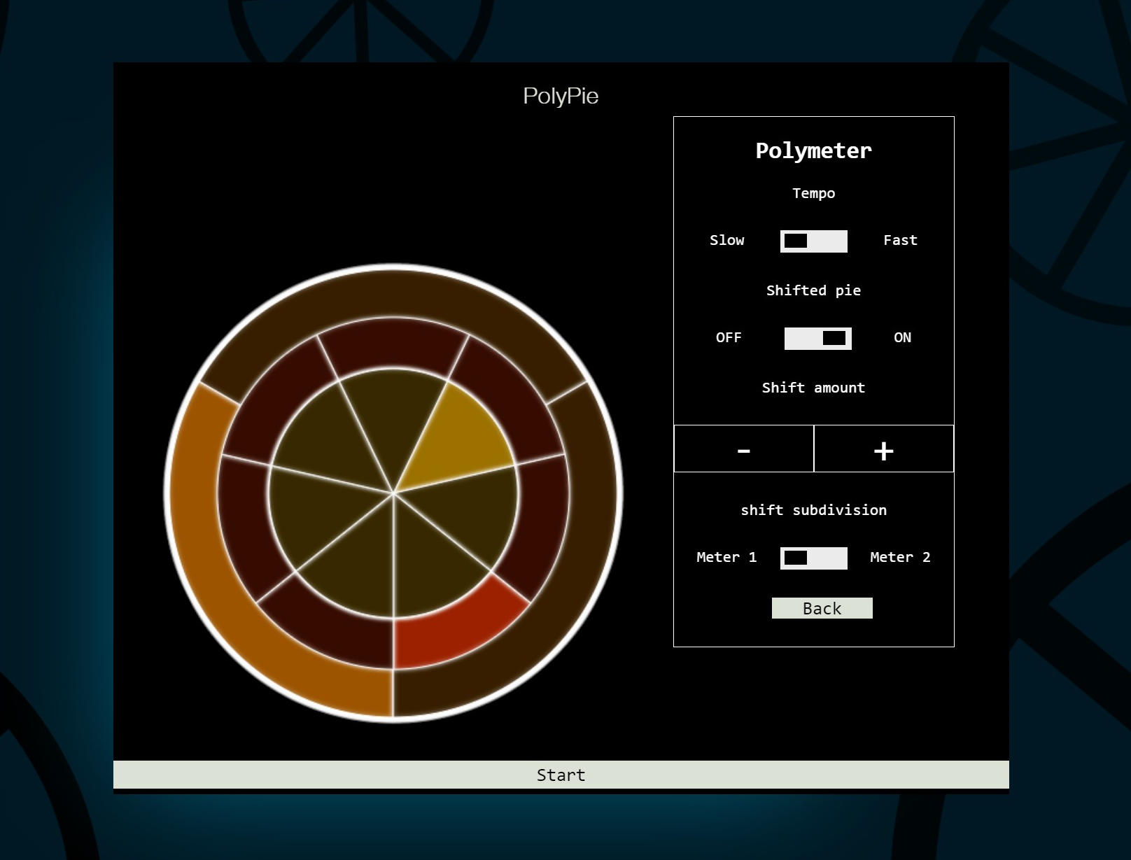
Polymeters
Notes:
The polymeter page works in a slightly different way: each pie represents one full measurer of the corresponding meter and, unlike in the previous section, we only play one note every loop. The two pies move in steps together (or, depending on the speed ratio, the slowest moves every 2 or 4 steps of the fastest). In this way, we can watch as the two meters go out of phase and when they finally cath up with eachother, they play a chord. The Tempo slider does the same thing as before.
We also have an additional feature: we can add a third pie that will initially be identical to the innermost one and will play the third of the chord. This pie can be shifted in respect to its «parent» with the + and - buttons, thus creating some more intricate pattern. It can also be toggled to the subdivision and speed of the outer pie with the «Shift subdivision» button.

Slide 8
Demo
clickme

