Slide 1

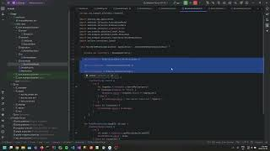
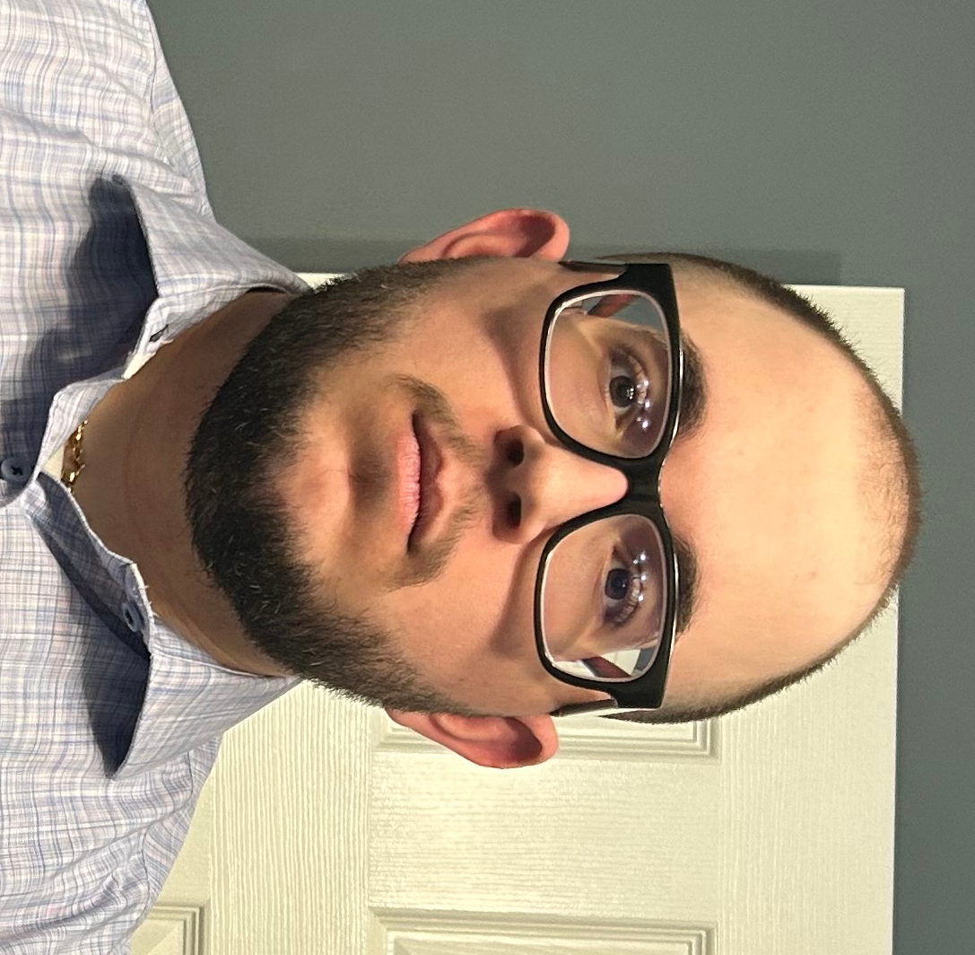
COMP 3025
OMDb Mobile App
Alessio Schiavi
200506861
COMP3025-25W-21399
25W Mobile and Pervasive Computing - 01
Assignment 2 - OMDb Mobile Application
Alternative URL: https://youtu.be/WJrN7AD4A4s

