Slide 1
IACV 2025/26 PROJECT
Synthetic IPPE-Square
Pose Estimation
Planar ambiguity and the geometry of pose uncertainty
Alessio Timofte · Anthony Iemmolo · Matteo Bianchi
Geometry and solver / Viewpoint analysis / Noise validation
Notes:
Presenter 1 | Suggested time: 40 seconds
Our project studies pose estimation from a square marker using only synthetic, known correspondences. We implemented the central geometry behind IPPE-square, validated it against OpenCV, and then investigated why some viewpoints make orientation difficult to estimate. The presentation follows the same progression as our submitted report. First we explain the camera model and the custom two-candidate solver. Then we examine how the candidates separate as the camera moves, and connect this to the reprojection Jacobian. Finally we test the predicted uncertainty with noisy simulations. Our central question is how much information four projected corners actually contain about the pose.
Sources: /Users/anthonymc/Desktop/IACV-25-26-project/docs/report/main.tex, title page and Section 1.
Figure panels, where present, reproduce the submitted report images without changing the plotted values.

Slide 2
01 GEOMETRY AND SOLVER
The project in one question
How reliably can four image corners
determine a square marker’s pose?
Known inputs
Estimated quantity
Controlled study
Four 3D corners
Their 2D projections
Camera intrinsics K
Pose: rotation R, position t
Six pose parameters
Two IPPE candidates
Exact geometry first
Then Gaussian noise
Known ground truth
Synthetic correspondences isolate the pose-estimation geometry
IACV 2025/26
02
Notes:
Presenter 1 | Suggested time: 55 seconds
The input is deliberately simple: we know the metric coordinates of four square corners and the intrinsic calibration of a pinhole camera. We choose a ground-truth pose and calculate the image coordinates directly. The unknowns supplied to the solver are the marker-to-camera rotation and translation, with six degrees of freedom. This controlled setup lets us separate geometric uncertainty from detector performance. There are no photographs, no marker detection, no distortion model, and no image-processing errors. The first experiment asks how easily the two IPPE hypotheses can be distinguished. The second asks how small corner perturbations propagate into pose uncertainty. These are related questions, but one concerns alternative hypotheses and the other local sensitivity.
Sources: /Users/anthonymc/Desktop/IACV-25-26-project/docs/report/main.tex, Section 1 and configuration.
Figure panels, where present, reproduce the submitted report images without changing the plotted values.

Slide 3
01 GEOMETRY AND SOLVER
Synthetic geometry and projection
Marker and camera
Canonical corner order
Square side L = 0.10 m, centred on Z = 0
640 × 480 image, fₓ = fᵧ = 800 px
Principal point (320, 240) px
Corner | X / L | Y / L
0 | −½ | +½
1 | +½ | +½
2 | +½ | −½
3 | −½ | −½
p = (X, Y, Z)ᵀ = R P + t
u = fₓ X / Z + cₓ
v = fᵧ Y / Z + cᵧ
Camera axes: X right, Y down, Z forward
Facing pose includes F = diag(1, −1, −1)
IACV 2025/26
03
Notes:
Presenter 1 | Suggested time: 75 seconds
The marker is a ten-centimetre square on its own Z-equals-zero plane. Its coordinates follow OpenCV’s exact IPPE-square order, shown in the table, and the image points keep the same correspondence order. We transform each marker point with P-camera equals R P plus t, then apply the perspective divide and intrinsics. The camera coordinate convention is right-handed: X right, Y down, Z forward. A subtle detail is that a front-facing marker is near a 180-degree rotation about X, not the identity. We therefore compose the configured Euler rotation with F, the diagonal matrix shown here. The code uses Euler angles only to specify a scene. Estimation and uncertainty calculations use rotation matrices and local rotation vectors.
Sources: /Users/anthonymc/Desktop/IACV-25-26-project/docs/report/main.tex, Sections 2.1–2.5; geometry/marker.py, geometry/camera.py, pipeline.py.
Figure panels, where present, reproduce the submitted report images without changing the plotted values.

Slide 4
01 GEOMETRY AND SOLVER
Custom IPPE-square solver
01
Normalize pixels
Apply K⁻¹ to remove the camera intrinsics.
02
Estimate the planar homography
DLT uses an 8 × 9 system built from four correspondences.
03
Recover two rotations
Evaluate H and its 2 × 2 derivative at the square centre.
04
Solve translations and rank
An 8 × 3 least-squares system per rotation, then pixel RMSE.
The custom solver returns both candidates without nonlinear refinement
IACV 2025/26
04
Notes:
Presenter 1 | Suggested time: 70 seconds
The solver has four stages. First, applying inverse K gives normalized image coordinates, so the camera calibration disappears from the geometric calculation. Since all object points are planar, the mapping is a homography. We estimate it with DLT and fix its scale so h33 equals one. IPPE uses the value and first derivative of this mapping at the square centre. Its rotation construction then produces two possible orientations. For each orientation we solve translation from the correspondence constraints, keeping two cross-product rows per corner. This is the same eight-by-three algebraic system used by the OpenCV reference. We reproject each candidate and sort by pixel RMSE. OpenCV does not participate in the custom solver; it is an external validation reference.
Sources: /Users/anthonymc/Desktop/IACV-25-26-project/docs/report/main.tex, Section 2.6; ippe_square.py.
Figure panels, where present, reproduce the submitted report images without changing the plotted values.

Slide 5
01 GEOMETRY AND SOLVER
Where the two candidates come from
Orthonormality leaves a sign ambiguity
b bᵀ = I − R₂×₂ᵀ R₂×₂
Both +b and −b satisfy the same constraint.
They produce the two IPPE rotation candidates.
‖b‖ = sin θ
At θ = 0°, b vanishes
and the candidates coincide.
θ is the angle between the marker normal and the line to the camera
IACV 2025/26
05
Notes:
Presenter 1 | Suggested time: 75 seconds
This equation is the source of the two hypotheses. After removing viewpoint alignment and scale, IPPE knows a two-by-two block of the rotation. Completing a valid rotation imposes orthonormality, which determines the outer product b b-transpose. That outer product is identical for b and minus b. The two choices lead to the two rotations, with the third column completed by a cross product. Geometrically, the length of b equals the sine of the viewing angle. At a head-on view, b is zero and the two candidates coincide. Away from that view, the normals tilt to opposite sides of the line of sight. This is an ambiguity of the local IPPE construction; the full perspective reprojection errors need not be equal.
Sources: /Users/anthonymc/Desktop/IACV-25-26-project/docs/report/main.tex, Section 2.6 and Section 3 discussion; docs/ippe_derivation.tex.
Figure panels, where present, reproduce the submitted report images without changing the plotted values.

Slide 6
01 GEOMETRY AND SOLVER
Noiseless validation against OpenCV
Baseline viewing angle: 17.26° t = (0.05, 0.02, 0.50) m
Solver / candidate | RMSE (px) | Rotation error | Translation error
Custom / 1 | 6.4 × 10⁻¹⁴ | ≈ 0° | 1.1 × 10⁻¹³ mm
OpenCV / 1 | 2.2 × 10⁻¹⁴ | ≈ 0° | 1.1 × 10⁻¹³ mm
Custom / 2 | 3.33825 | 34.521° | 3.101 mm
OpenCV / 2 | 3.33825 | 34.521° | 3.101 mm
Both candidate pairs agree to the reported precision
The project reports an OpenCV IPPE rotation-conversion failure near a 180° rotation.
The baseline is unaffected. The viewpoint experiments use the custom solver.
IACV 2025/26
06
Notes:
Presenter 1 | Suggested time: 65 seconds
The baseline is mildly oblique and both solvers receive exactly the same noiseless correspondences. The first candidate recovers the ground truth at numerical precision. The difference between the two tiny RMSE values has no meaningful interpretation: both are at the floating-point floor. More importantly, the second candidate also agrees between our implementation and OpenCV, including its translation. Its rotation is 34.52 degrees from the ground truth, exactly twice the baseline viewing angle. RMSE averages over eight scalar residuals, matching OpenCV’s convention. The submitted report also documents a reference-implementation limitation near a 180-degree rotation. That concerns the rotation-vector conversion observed in the project, not the baseline comparison. We now move from one validated scene to the entire viewpoint sweep.
Sources: /Users/anthonymc/Desktop/IACV-25-26-project/docs/report/main.tex, Section 2.7, Table 1 and reference-implementation limitation.
Figure panels, where present, reproduce the submitted report images without changing the plotted values.

Slide 7
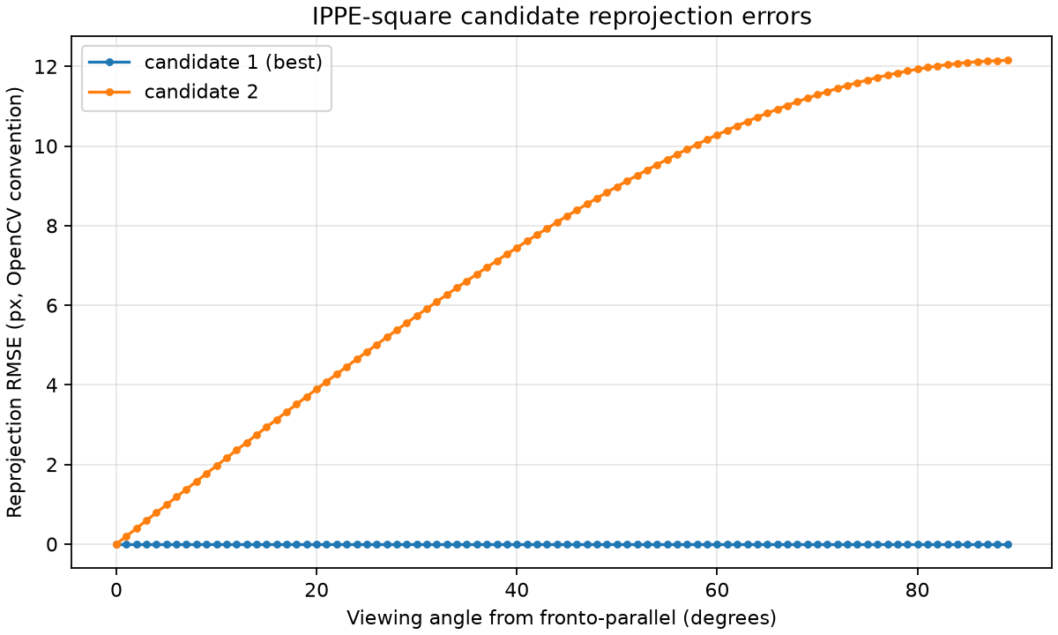
02 AMBIGUITY AND CONDITIONING
The mirror candidate separates as the view tilts
Noiseless camera arc
0° to 89°
One view per degree
Radius 0.50 m
Camera aims at centre
At 89°
12.153 px
Mirror-candidate RMSE
IACV 2025/26
07
Notes:
Presenter 2 | Suggested time: 65 seconds
For Experiment 1 we keep the marker fixed and move the camera along a front-facing arc, always pointing at the centre. Radius and azimuth are fixed, so viewing angle is the only variable. There are ninety samples from zero to eighty-nine degrees, and no noise. The blue line is the best candidate and remains essentially zero. The orange line is the second, mirror candidate. At zero degrees both hypotheses coincide. As the view becomes oblique the mirror increasingly disagrees with the exact image, reaching 12.153 pixels near edge-on. The curve flattens above about seventy-five degrees. These are raw IPPE hypotheses: refining both could make them converge to the same pose and would hide the effect this experiment measures.
Sources: /Users/anthonymc/Desktop/IACV-25-26-project/docs/report/main.tex, Section 3; docs/report/figures/exp1_sweep.png.
Figure panels, where present, reproduce the submitted report images without changing the plotted values.

Slide 8
02 AMBIGUITY AND CONDITIONING
Small image differences can hide large pose errors
Rotation separation = 2θ
Viewing angle | Mirror RMSE | Rotation separation
1° | 0.197 px | 2°
5° | 0.986 px | 10°
30° | 5.736 px | 60°
75° | 11.659 px | 150°
At 5°
The wrong orientation is
10° away, yet its corner
RMSE is below 1 pixel.
Separability depends on corner noise and the marker’s apparent size
IACV 2025/26
08
Notes:
Presenter 2 | Suggested time: 60 seconds
The table compares the ambiguity in image space and in pose space. Along our arc, the normals lie symmetrically on either side of the line of sight, with no extra relative spin. Their geodesic rotation separation is therefore twice the viewing angle. At five degrees the alternative pose is ten degrees away, but its reprojection RMSE is only 0.986 pixels. This is the practical problem: a pose can be substantially wrong while still producing a similar image. With half-pixel corner noise the distinction becomes fragile near head-on. That threshold depends on the focal length, marker size, distance, and noise level. The table is evidence for this configuration, rather than a universal angular rule for every marker and camera.
Sources: /Users/anthonymc/Desktop/IACV-25-26-project/docs/report/main.tex, Section 3, representative sweep table and discussion.
Figure panels, where present, reproduce the submitted report images without changing the plotted values.

Slide 9
02 AMBIGUITY AND CONDITIONING
The residual Jacobian: eight rows, six columns
δθ = (
δt
,
δt
,
δt
,
δω
,
δω
,
δω
)ᵀ
x
y
z
x
y
z
Four corners give eight scalar pixel residuals.
The pose has three translation and three rotation parameters.
Local rotation update
Chain rule for corner i
R′ = R exp([δω]×)
Jᵢ = Dᵢ [ I₃ −R[Pᵢ]× ]
Stacking four 2 × 6 blocks gives the full 8 × 6 Jacobian
IACV 2025/26
09
Notes:
Presenter 2 | Suggested time: 70 seconds
The second experiment asks about local sensitivity rather than the separation between two full hypotheses. We stack horizontal and vertical reprojection errors for each corner into an eight-dimensional residual. Translation is perturbed additively and rotation with a right-multiplied exponential. This expresses the rotation increment in the marker frame. Differentiating the transformed point gives the block I, minus R times the cross-product matrix of the marker point. Multiplication by the two-by-three pinhole derivative D gives two residual rows per corner. Four corners therefore produce an eight-by-six Jacobian. The submitted report verifies the derivative with independent centred finite differences. The principal point affects projection, but its additive constant disappears from these derivatives.
Sources: /Users/anthonymc/Desktop/IACV-25-26-project/docs/report/main.tex, Section 4.1; jacobian.py.
Figure panels, where present, reproduce the submitted report images without changing the plotted values.

Slide 10
02 AMBIGUITY AND CONDITIONING
Conditioning requires a stated parameter scale
Normalize translation by distance d = ‖t‖
Jₙ = J diag(d, d, d, 1, 1, 1)
The scaled parameters are dimensionless.
Equivalent images then give the same condition number.
Jₙ = U Σ Vᵀ
κ = σ₁ / σ₆
Small σ₆: weak response to pose motion
The vector v₆ identifies that motion
Large κ: uneven observability
Across the six pose directions
IACV 2025/26
10
Notes:
Presenter 2 | Suggested time: 70 seconds
A condition number only makes sense after specifying the units of the unknowns. In SI units, translation columns are pixels per metre while rotation columns are pixels per radian. Changing metres to millimetres changes the numerical conditioning even though the image stays identical. We therefore scale translation by the camera-to-marker distance d. The condition plots use this dimensionless parameterization. Singular value decomposition then identifies six directions in pose space. A small singular value means a pose displacement produces little image change. The smallest value measures the weakest response, and its right singular vector identifies the least observable motion. Kappa compares the strongest and weakest responses. Later, physical covariance matrices remain in metres and radians using the unscaled Jacobian.
Sources: /Users/anthonymc/Desktop/IACV-25-26-project/docs/report/main.tex, Sections 4.2–4.3; experiment2.py:run_conditioning_sweep.
Figure panels, where present, reproduce the submitted report images without changing the plotted values.

Slide 11
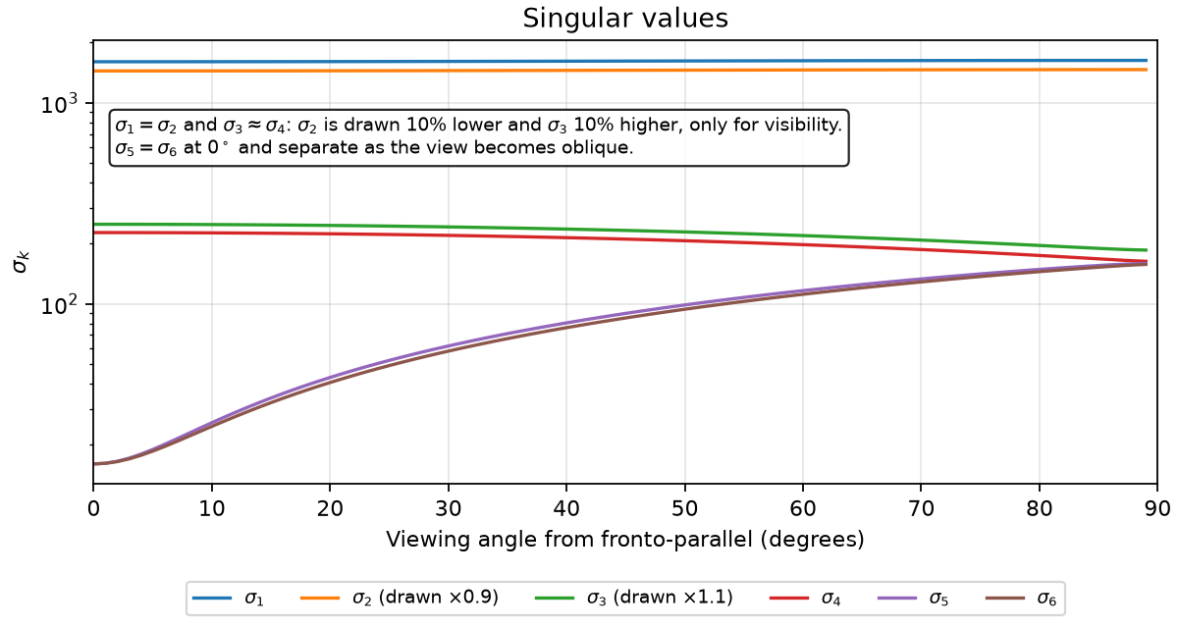
02 AMBIGUITY AND CONDITIONING
Out-of-plane tilt is weakly observed head-on
Three pairs
σ₁, σ₂
Sideways translation
σ₃, σ₄
Depth and plane spin
σ₅, σ₆
Out-of-plane tilt
Plot offsets for visibility: σ₂ × 0.9 and σ₃ × 1.1, as labelled in the report figure.
IACV 2025/26
11
Notes:
Presenter 2 | Suggested time: 65 seconds
This first panel shows all six singular values of the scaled Jacobian. Near the frontal configuration they form three pairs. Sideways translation moves all the corners together and gives the largest responses. Depth and in-plane rotation affect the apparent size or orientation of the square and form the middle pair. Out-of-plane tilts form the weakest pair. At head-on, a tilt can largely be compensated by a small sideways translation; only a weak keystone deformation remains. With increasing obliquity, tilt has a stronger image signature, so the two smallest singular values grow. The figure deliberately offsets sigma two and sigma three by ten percent for visibility. Those are drawing offsets only and do not alter the computed diagnostics.
Sources: /Users/anthonymc/Desktop/IACV-25-26-project/docs/report/main.tex, Sections 4.4–4.5; upper panel of docs/report/figures/exp2_conditioning.png.
Figure panels, where present, reproduce the submitted report images without changing the plotted values.

Slide 12
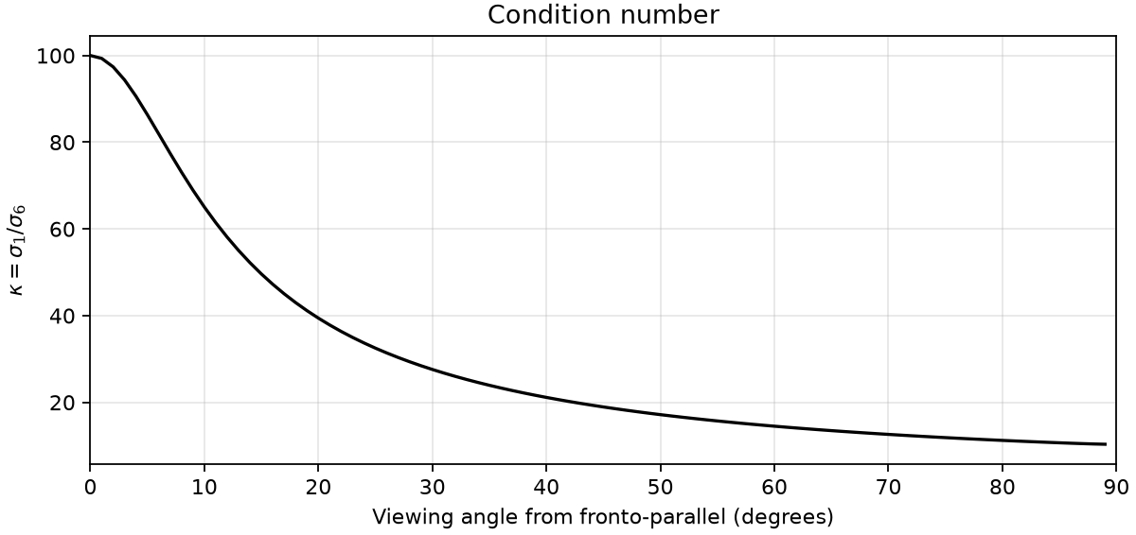
02 AMBIGUITY AND CONDITIONING
Moderate obliquity improves local conditioning
κ ≈ (d / h)²
Head-on, with h = L / 2
100
at 0°
27.6
at 30°
Doubling distance or halving marker size worsens head-on κ by about 4×
IACV 2025/26
12
Notes:
Presenter 2 | Suggested time: 70 seconds
The condition number falls quickly from about one hundred at a frontal view to about twenty-eight at thirty degrees. The leading-order frontal formula is distance divided by marker half-side, squared. Here the distance is half a metre and half-side five centimetres, giving one hundred. This also explains why a smaller or more distant marker is difficult: doubling distance multiplies the frontal condition number by about four. Most of the gain along this arc comes from the growth of the smallest singular values; the largest values change little. This is a local geometric result under exact correspondences. Near edge-on the marker becomes extremely narrow, so we should not interpret this curve as a recommendation for a real detector. Next we examine the weak direction and test the uncertainty prediction under noise.
Sources: /Users/anthonymc/Desktop/IACV-25-26-project/docs/report/main.tex, Sections 4.4–4.5; middle panel of docs/report/figures/exp2_conditioning.png.
Figure panels, where present, reproduce the submitted report images without changing the plotted values.

Slide 13
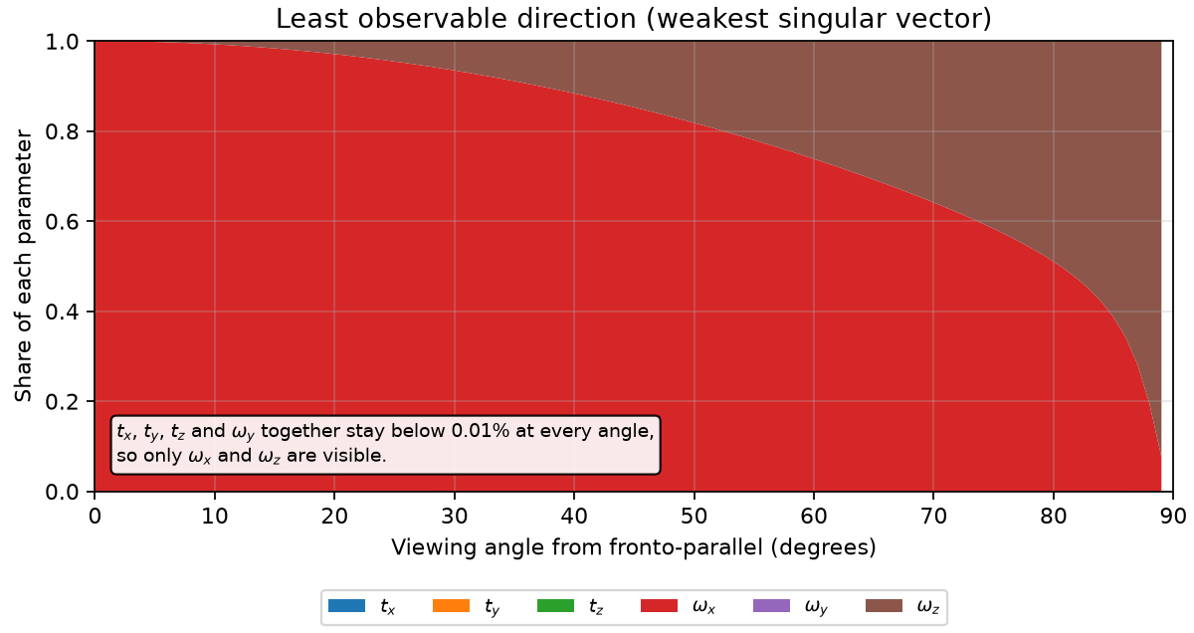
03 NOISE VALIDATION AND CONCLUSIONS
The weakest direction changes with viewpoint
Near head-on
Mostly ωₓ:
out-of-plane tilt
Near edge-on
More spin
in the marker plane
The coloured shares are squared components of the least observable singular vector v₆.
IACV 2025/26
13
Notes:
Presenter 3 | Suggested time: 60 seconds
The singular values tell us how weak the response is, while the right singular vectors tell us which motion is responsible. This panel decomposes the weakest direction into squared parameter components. For our fixed-azimuth arc it is dominated by rotation throughout. Near head-on the selected weak direction is almost entirely omega x, an out-of-plane tilt. As the view becomes more oblique, it contains more in-plane spin, omega z. Near edge-on, spin moves much of the corner motion along the line of sight, so it becomes difficult to observe. At exactly zero degrees the weakest two values coincide, meaning the two-dimensional weak subspace is the stable object, not a unique selected vector. We now ask whether noise produces scatter in the directions this analysis predicts.
Sources: /Users/anthonymc/Desktop/IACV-25-26-project/docs/report/main.tex, Section 4.5; lower panel of docs/report/figures/exp2_conditioning.png.
Figure panels, where present, reproduce the submitted report images without changing the plotted values.

Slide 14
03 NOISE VALIDATION AND CONCLUSIONS
Monte Carlo tests the least-squares prediction
Cov(δθ) ≈ σₚₓ² (JᵀJ)⁻¹
Simulation
Pose estimator
2,500 trials per angle
Independent Gaussian noise, σₚₓ = 0.5 px
Dense sampling near head-on
Start from both IPPE candidates
Refine both with Gauss–Newton
Keep the lower reprojection cost
Local covariance uses trials classified near the true pose.
Mirror flips are counted separately.
IACV 2025/26
14
Notes:
Presenter 3 | Suggested time: 75 seconds
The covariance expression describes the local least-squares estimator. To test it fairly, we cannot simply compare against unrefined IPPE. For each noisy trial we initialize Gauss–Newton from both IPPE hypotheses, refine each, and retain the lower reprojection cost. That refinement is intentional here, unlike the ambiguity sweep. The experiment uses twenty-five viewing angles from zero to eighty-five degrees, sampled densely near frontal views, with twenty-five hundred trials per angle and independent half-pixel Gaussian coordinate noise. Errors use translation differences and the logarithm of the relative rotation. We classify a mirror flip by which exact candidate is closer in rotation. Covariance statistics use only the trials classified near the true pose, while the flip frequency is reported separately. This distinction matters for interpreting the next figures.
Sources: /Users/anthonymc/Desktop/IACV-25-26-project/docs/report/main.tex, Section 4.6; experiment2.py:estimate_pose and run_monte_carlo.
Figure panels, where present, reproduce the submitted report images without changing the plotted values.

Slide 15
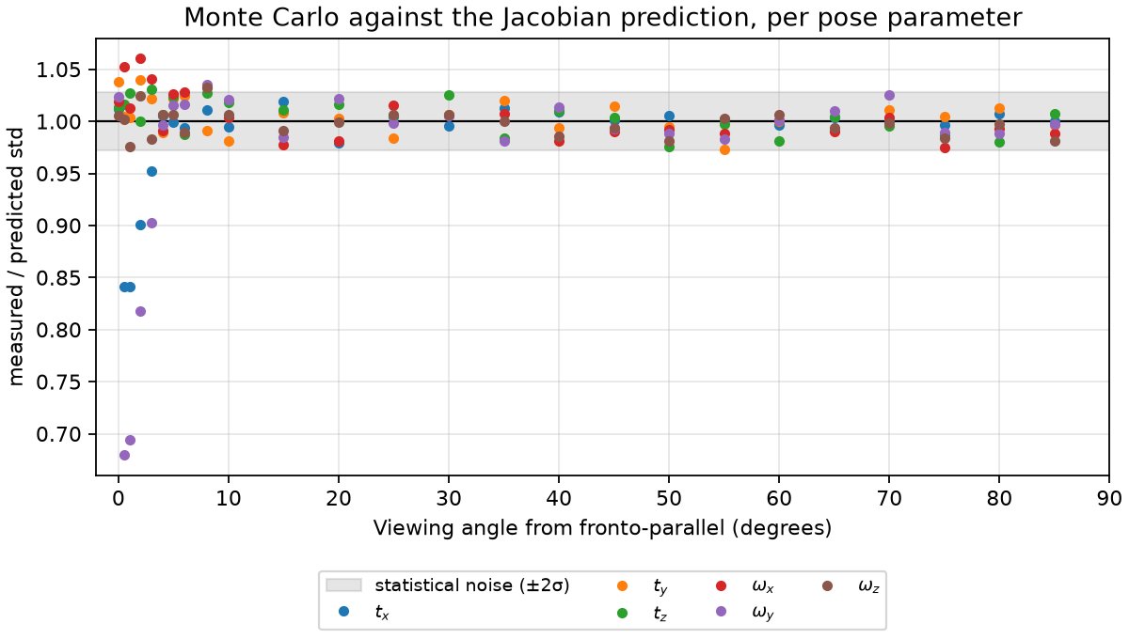
03 NOISE VALIDATION AND CONCLUSIONS
Local scatter follows the Jacobian prediction
Ratio = 1
Measured scatter
matches prediction
Near 0.5°–3°
True-pose selection
narrows ωᵧ and tₓ
scatter below prediction
Grey band: nominal sampling variability, about ±2.8% for 2,500 trials.
IACV 2025/26
15
Notes:
Presenter 3 | Suggested time: 70 seconds
Each point is the measured standard deviation divided by its Jacobian prediction for one pose parameter. A ratio of one means agreement. Across most viewpoints the ratios cluster close to one. The grey band shows the nominal sampling fluctuation for twenty-five hundred trials, about plus or minus 2.8 percent. The substantial deviations between half a degree and three degrees need a careful interpretation. In that interval mirror candidates lie inside the noise scale. Trials assigned to the mirror are excluded from these local statistics. That selection removes large omega-y errors and narrows the retained distribution, with the coupled x-translation following the same pattern. Ratios below one therefore do not mean that the data suddenly provide better orientation information. They expose the limit of interpreting one conditioned mode with a first-order covariance.
Sources: /Users/anthonymc/Desktop/IACV-25-26-project/docs/report/main.tex, Section 4.6, procedure and interpretation; upper panel of docs/report/figures/exp2_montecarlo.png.
Figure panels, where present, reproduce the submitted report images without changing the plotted values.

Slide 16
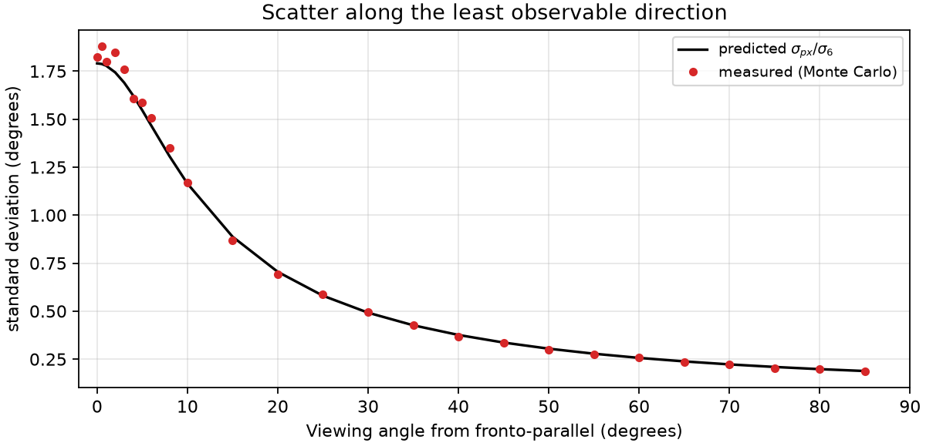
03 NOISE VALIDATION AND CONCLUSIONS
Scatter concentrates in the weakest direction
Predicted scatter
std(v₆) ≈ σₚₓ / σ₆
1.82°
measured at 0°
0.186°
measured at 85°
Black curve: Jacobian prediction. Red points: measured scatter from retained trials.
IACV 2025/26
16
Notes:
Presenter 3 | Suggested time: 60 seconds
Instead of looking at coordinate axes separately, we can project the pose errors onto the weakest singular direction. In the scaled coordinates, the predicted standard deviation along that direction is pixel-noise standard deviation divided by sigma six. The black prediction and red measurements track one another closely. The report gives about 1.824 degrees measured head-on compared with a prediction of 1.791 degrees, and 0.186 degrees measured at eighty-five degrees compared with 0.188 predicted. At thirty degrees the scatter is already about half a degree. This connects the conditioning analysis to an actual pose-error scale. The plot expresses the angular-equivalent magnitude in degrees because the weakest direction is overwhelmingly rotational. It still uses the same retained-trial convention as the preceding panel.
Sources: /Users/anthonymc/Desktop/IACV-25-26-project/docs/report/main.tex, Section 4.6 and Monte Carlo table; middle panel of docs/report/figures/exp2_montecarlo.png.
Figure panels, where present, reproduce the submitted report images without changing the plotted values.

Slide 17
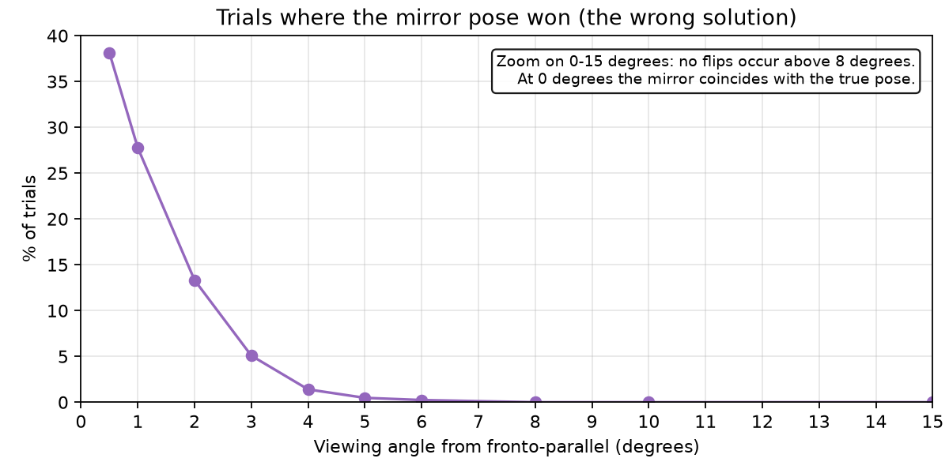
03 NOISE VALIDATION AND CONCLUSIONS
Noise can make the mirror pose the better fit
38%
mirror flips at 0.5°
953 of 2,500 trials
13%
mirror flips at 2°
333 of 2,500 trials
At 0° the candidates coincide. No flips occurred from 8° in this run
IACV 2025/26
17
Notes:
Presenter 3 | Suggested time: 65 seconds
This final panel reports the trials that the covariance plots leave out. At half a degree, the estimate is closer to the mirror rotation in 953 out of twenty-five hundred trials, about thirty-eight percent. At two degrees the rate falls to roughly thirteen percent, and by four degrees it is 1.4 percent. No flips occurred from eight degrees onward in the submitted simulation. These are empirical rates for this camera, marker, distance, and noise level. Exactly zero degrees is special: the two exact candidates coincide, so there is no separate mirror pose to count. The result joins the two experiments. A small reprojection gap means noisy observations can favor the alternative orientation, while one local covariance matrix cannot describe the uncertainty across both hypotheses.
Sources: /Users/anthonymc/Desktop/IACV-25-26-project/docs/report/main.tex, Section 4.6 and Monte Carlo table; lower panel of docs/report/figures/exp2_montecarlo.png.
Figure panels, where present, reproduce the submitted report images without changing the plotted values.

Slide 18
03 NOISE VALIDATION AND CONCLUSIONS
What the experiments establish
Solver validation
Both raw candidates match the OpenCV reference in the baseline scene.
Geometry controls uncertainty
Near-frontal views weakly constrain tilt and make the mirror hard to reject.
The local model has a clear boundary
The Jacobian predicts local scatter. Mirror selection needs a separate statistic.
Scope: ideal calibration, synthetic correspondences, one camera arc and a fixed noise model.
IACV 2025/26
18
Notes:
Presenter 3 | Suggested time: 65 seconds
We can draw three conclusions within the scope of this synthetic study. First, the custom homography-based solver reproduces both IPPE-square candidates in the reference baseline. Second, the uncertainty is strongly geometric. Looking straight at a marker gives a large, clear-looking square, but its out-of-plane tilt is weakly constrained. Moderate obliquity provides much stronger information about orientation. Third, the Jacobian successfully predicts local scatter, but does not by itself represent switching between mirror hypotheses. That is why we report the covariance and the mirror rate separately. Our evidence assumes known correspondences, exact calibration, a fixed camera arc, and independent Gaussian corner noise. It does not establish real detector performance near edge-on. The main lesson is to distinguish a small reprojection error from a reliably determined orientation. Thank you; we welcome questions.
Sources: /Users/anthonymc/Desktop/IACV-25-26-project/docs/report/main.tex, Section 4.7 and overall experiment assumptions.
Figure panels, where present, reproduce the submitted report images without changing the plotted values.

