Slide 1
Micro frontends
Amarandei Matei Alexandru
Zaharia Andrei Lucian

Slide 2
Table of Contents
01
02
03
04
What
How
Why
Who

Slide 3
01
What are Microfrontends?

Slide 4
What are Microfrontends?
- An extension of the Microservices paradigm, adapted for Front-End development
- Modern architectural approach for developing web applications
- Each module, or microfrontend, handles a specific aspect of the application
- Microfrontends can be independently deployed, tested, and scaled

Slide 5
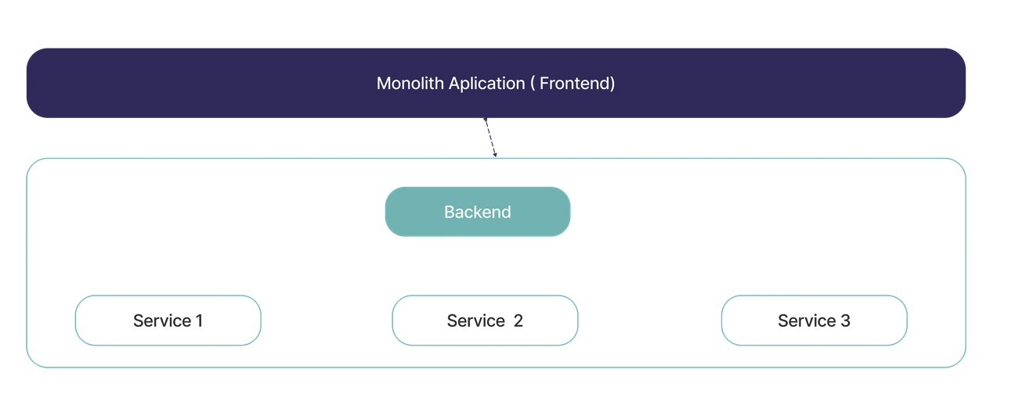
The Boomer Way 👴🏻

Slide 6
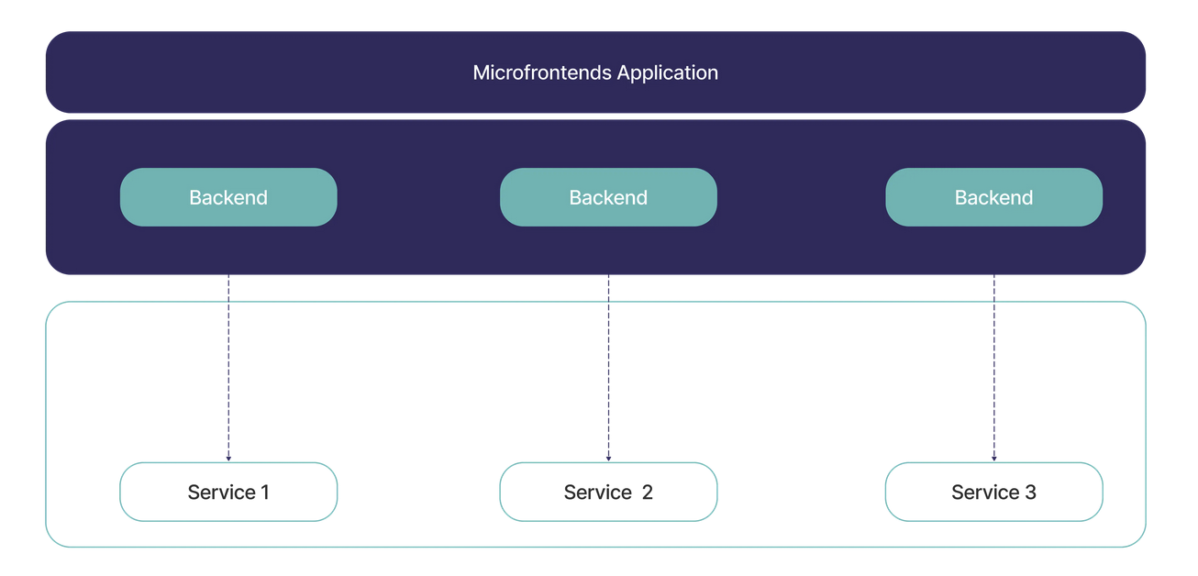
The Zoomer Way 👨🏻‍🎤

Slide 7
02
How do Microfrontends work?

Slide 8
How do Microfrontends work?
Small, independent modules
Seamless Integration
Each module focuses on a specific part of the user interface
Teams can develop and maintain these modules completely separately
Techniques like client-side routing and lazy-loading
Communication thorugh APIs or event-driven mechanisms

Slide 9
Steps
Define Modules
Develop and Containerize
Integrate in Main
Identify the different parts of your application that can be separated into microfrontend modules.
Integrate modules in their respective places.
Ensure communication.
Deploy.
For each module, create a separate codebase using the technology stack and framework that makes the most sense for that module.
Deploy.

Slide 10
Monorepos_
Multirepos_
Metarepos_
All Modules are in the same repository
All Modules are in separate repositories
A combination of the two

Slide 11

03
Why Microfrontends?

Slide 12
Benefits
Scalability
Speed
Technologies
Multiple teams can work simultaneously and do not impact one another
Aside from the speed of the app, the speed of development is greatly increased
Different technologies can be used for each module, depending on what is best
Maintainability
Iterability
Reusability
Since everything is separated, each module can be tested, updated or replaced as needed
If there are problems or rollbacks are needed, a different version for each module can be used
The same module can be referenced and used in multiple places or apps

Slide 13
Downsides
Complex Setup
Multiple deployment pipelines, routing configurations, and orchestration mechanisms
Payload
Size
Separate resources and dependencies for each module, potentially impacting load times
Security
Cross-origin issues, Data Isolation, Versioning Vulnerabilities, the need for robust communication and authentication mechanisms
Management Overhead
Tracking the progress of each module's development, ensuring consistent design and user, and orchestrating their seamless integration

Slide 14
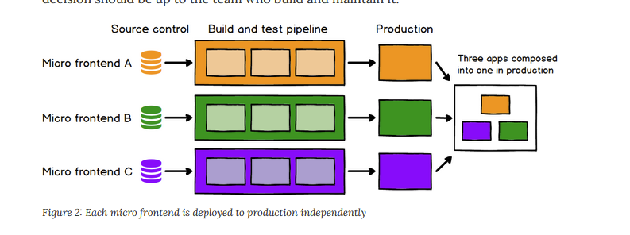
Simple Visual 🎨

Slide 15
04
Who is behind Microfrontends?

Slide 16

Single-Spa
2017

Slide 17

Module Federation
2020

Slide 18
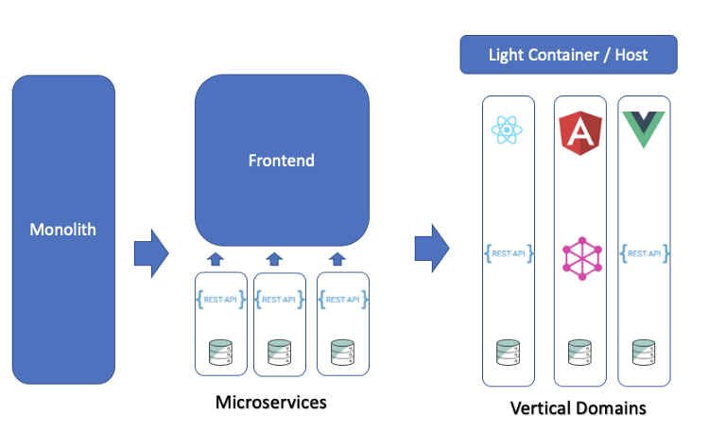
Evolution
2017-2023

Slide 19
Thanks!_
Demo Time

Slide 20
References_
Microfrontends
Single-Spa
ModuleFederation
https://micro-frontends.org/
https://single-spa.js.org/docs/microfrontends-concept/
https://webpack.js.org/concepts/module-federation/
Lit
Crash Course
Best Practices
https://lit.dev/
// courtesy of Prof. Dr. habil. Sabin-Corneliu Buraga
https://www.youtube.com/watch?v=S84MG1eIhaI&ab_channel=LaithAcademy
https://www.xenonstack.com/insights/micro-frontend-architecture

