Slide 1
Behavior Tree State Stack
Ryan Buehler and Alex Herrera
Notes:
Hello, today we’d like to discuss the Behavior Tree State Stack as a solution to address a common weakness in Behavior Trees.
[Ryan] I’m Ryan Buehler.
[Alex] And I’m Alex Herrera
As the job of the AI programmer is to create a compelling player experience,
[Next Slide]
creating more organic behavior is always a priority.

Slide 2

In life, tasks get interrupted
Notes:
In life, things get interrupted.
[Click]
In a totally relatable story, let’s say you’re cooking a complex meal with lots of ingredients, following the directions to the letter. Suddenly, you hear a knock at the door and you step away from the kitchen to go answer it. It’s your friendly neighbor, there to let you know you left your fuel tank on your helicopter pad. How embarrassing! You run to go take of it quickly and return to the kitchen, before you burn your noodles. Wouldn’t it be strange if you had to restart the whole cooking progress from the beginning?
Shifting from one behavior to another
[Next Slide]
is not so easy for agents running on behavior trees.

Slide 3
Behavior Trees are poor at interruptions
Why do Behavior Trees have this deficiency?
They’re meant to be traversed
There is no meta-level awareness of location within the tree
Trees, therefore, must always start at the root
Notes:
Behavior Trees, with all their strengths, are notoriously poor at interruptions.
[Click]
Why do they have this deficiency?
[Click]
First, they are easily traversable, but the nodes are self contained and affect the control flow as individuals. There is no overarching governance that keeps track of where the current logic is within the tree.
[Click]
Second, Because the nodes are meant to remain modular, they can not keep track of their location in the tree, as they might appear anywhere within the logic.
[Click]
Finally, because of these characteristics, there has yet to be a good way to return to a behavior mid-stream.
[Next Slide]
There are some possible mitigations to this issue.

Slide 4
You can try these workarounds
Behavior Trees can call other Behavior Trees
Hybridize FSMs with BTs
Implement jump logic throughout each tree
Our Solution:
Push the Behavior Tree state onto a stack
Notes:
These “workarounds” can solve the issue of navigating through Behavior Tree logic, however they each come with their own set of drawbacks.
[Click]
You can organize your Behavior Trees within a Parent Behavior Tree, which in turn could allow better control over the flow of the logic, but this comes with the downside that you must foresee the ways for it to be interrupted beforehand.
[Click]
You could try hybridize Finite-State Machines at the highest level, but again there is the same problem with predicting states.
[Click]
Finally, you can pepper your behavior trees with jump logic or interrupts, constantly checking blackboard values to navigate to the correct branch. This is tedious, difficult to pull off and likely to very difficult to debug, as it destructively breaks the flow of logic that makes Behavior Trees so powerful and easy to understand.
So, what then might be a better possible solution?
[Click]
Our solution is to push the current state of the behavior tree, freezing its logic and blackboard, and replacing it with a new behavior tree. At any point, the new behavior tree may be interrupted or completed and the old behavior tree’s state popped off the stack to return to the exact moment where it left off.
[Next Slide]
So what does this solution buy you?

Slide 5
BT State Stacks are an open-ended solution
Why is this useful?
No parent logic required
Can be executed infinitely
Notes:
Well, the largest benefit is that its an open-ended, generic solution.
[Click]
Why is that useful?
[Click]
No parent logic needs to be built into the behavior trees. You simply pause one behavior tree in exchange for another. This can potentially be used between any two behavior trees, although there are possible security issues to be wary of.
[Click]
Another nice thing about this solution is that it could be used ad infinitum as memory allows, as you can just keep pushing new behavior tree states to the stack as they get interrupted.
[Next Slide]
What are some cases where this system would be useful then?

Slide 6
It might be especially useful in
FPS – Breaking out of a non-combat behavior to respond to combat
RTS – Temporarily reallocating units to perform an interrupt behavior
RPG – NPCs can be performing their daily routine and break for interactions (good or bad) with the player
Notes:
There are potentially endless situations where this solution might be practical. Most of these will likely involve real-time games where Behavior Trees are common.
Some specific examples might include…
[Click]
FPS
[Click]
RTS
[Click]
And RPGs…
Behavior Tree Stacks are fairly simple to implement within the blueprint system
[Next Slide]
or behavior trees themselves in Unreal.

Slide 7
How does it work?
Unreal’s Behavior Trees
Blueprint Nodes
Reasonable Simulation Demo
Interrupt the Tree. Push the old tree
Injected a new tree
Pop the old tree state off the stack
Notes:
We utilized the Unreal Engine’s very popular and powerful Behavior Tree system to run our experiment. Our process for this demo is as follows:
Implemented the stack code underneath Unreal’s Behavior Tree system with blueprints for testing.
Created new blueprint nodes to push/pop the BT state. And, we created a new blueprint node to signify completion of the BT.
Created a simulation of a task with visually noticeable progress.
Interrupted the progress. Pushed the state onto the stack.
We injected a new, different Behavior Tree with no correlation to the previous.
And finally, we popped the old tree state off the stack to return to the previous behavior, right where we left off.
As stated earlier, there are potential dangers
[Next Slide]
involved with implementing Behavior Tree stacks.

Slide 8
What is the downside?
Might need to return to previous actor state
Must be careful about access
Notes:
So what considerations must be taken to implement this solution?
[Click]
Pushing an exact behavior tree state to the stack can be dangerous in many ways that must be accounted for. If the agent is performing a behavior and exacting a specific and direct action, they might return to continue an otherwise inaccessible action that their current state no longer allows. For example, if the agent is firing a stationary machine gun and the behavior tree state is captured at that moment, then the agent runs off to go bandage a wounded ally, the AI programmer must ensure that the agent returns “physically” to the gun before popping the state off the stack.
[Click]
Then, in the same example, the potential is there for the agent to activate the gun from an impossible range, assuming it had direct access to that functionality. So, it would also be up to the programmer to assure that the agent have appropriate checks to ensure they should have access to their logic.
[Next Slide]
In conclusion, Behavior Trees are a feasible tool to add to the AI programmer’s toolkit.

Slide 9
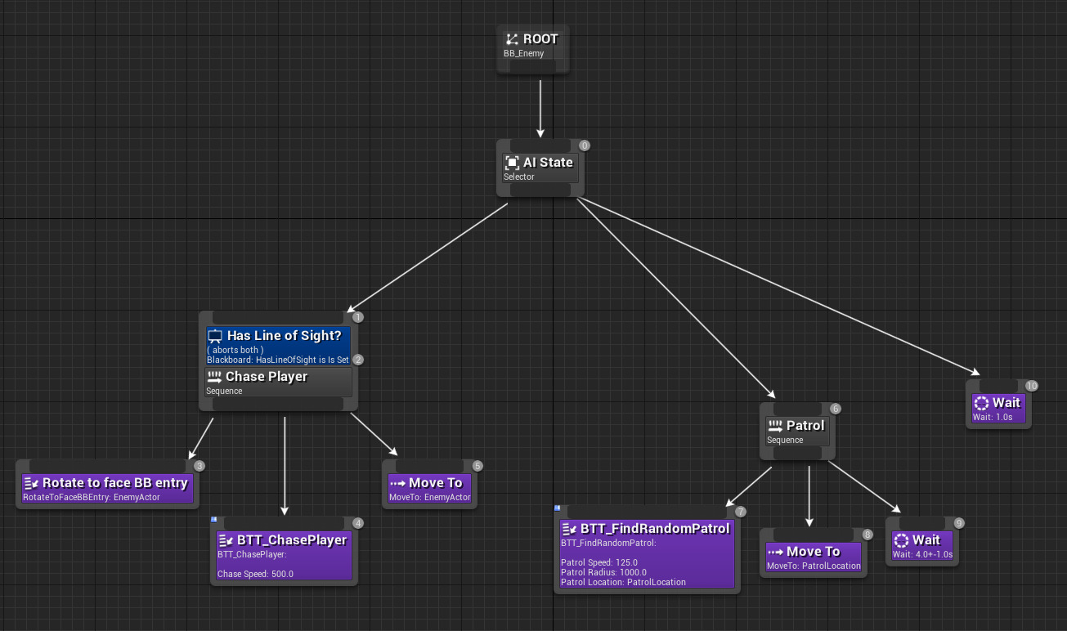
Behavior Tree Interrupts are feasible
Notes:
Interrupting a Behavior Tree is possible with the Behavior Tree Stack system. It allows for an open-ended way to pause a behavior, move on to another behavior and return to where it left off. It is an answer to one of the Behavior Tree system’s greatest struggles, but it also has its downsides to consider.

