Slide 1
Git Bash Tutorial
Presenter : Alex-CHUN-YU
Notes:
Git (飯桶、蠢蛋) Bash(猛打)
USE GITHUB BY GIT BASH
Git tool develop base on Linux kernel

Slide 2
Install GIT BASH
Window:
Google → Git Bash (https://git-for-windows.github.io/)
Notes:
Google search for this URL

Slide 3
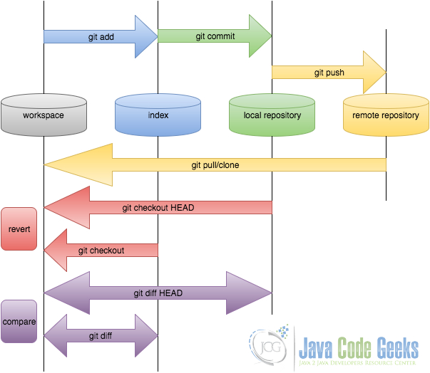

GIT FLOW GRAPHIC
寫信
放入信封
丟到郵筒
送到目的地
請求回信
Notes:
GitFlow

Slide 4
Linux Basic Command
pwd 、cd、ls、rm、mkdir、rmdir、vim
Notes:
pwd (show your path) cd(join or leave directory )
ls(show your file)
rm(remove file)
mkdir(create directory)
rmdir(remove directory)

Slide 5
git basic Command
Version:
git --version
Set Config Values:
git config --global user.name "Alex"
git config --global user.email "P76064538@mail.ncku.edu.tw"
git config –list
Need Help:
git config --help
git help config
Notes:
1.Tell Git who you are (local user)
2.Create a new local repository
3.Create illustrate file(README.md)

Slide 6
git basic Command
Our First Commit:
git add README.md
git reset README.md
git add -A
git reset
git status
git commit –m "commit message"
git push
git pull
Notes:
Git add <filename>(Add one or more files to staging(indexing)追蹤 )
Git reset <filename>(取消追蹤)
Git commit (commit message，可一次做很多事在commit)
Git push(提交上去)
git pull(更新程式)
git status(看狀態)

Slide 7
git basic Command
How to use branch?
git branch -a
git branch "branch_name"
git checkout "branch_name"
git branch -d love
git push -u origin love
git push origin --delete love
git merge "your branch"
git log
Notes:
Git branch –a (本地加遠端，已存在的branch，內定通常只有master)
Git branch (本地端branch)
Git branch “branch_name“(創建branch)
Git checkout “branch_name”(轉換branch)
Git merge “your branch“ in master
Git log(看歷史紀錄)
Git rm filename 假設刪除一個filename的話，不須add 直接 commit，並且它是必須存在在git中，不然也無法更新(ex:rm filename只會刪本地端，psuh也沒用)
Git rm –f file
git branch -d love 先刪本地端
git branch –D love 先刪遠端

Slide 8
小小實作練習

Slide 9
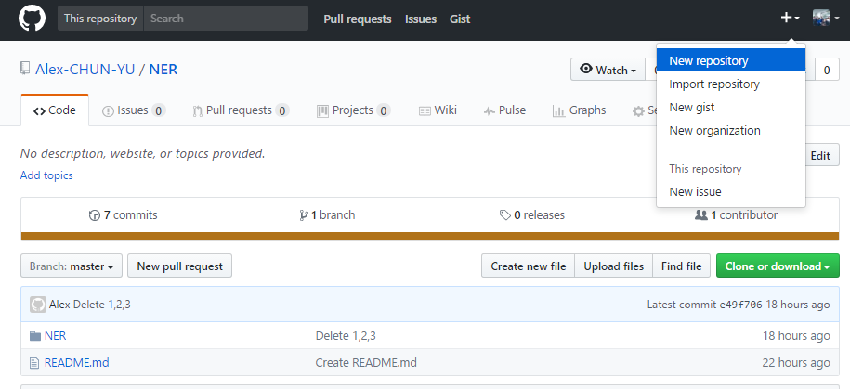
Github REPOSITORY TO LOCAL

Slide 10
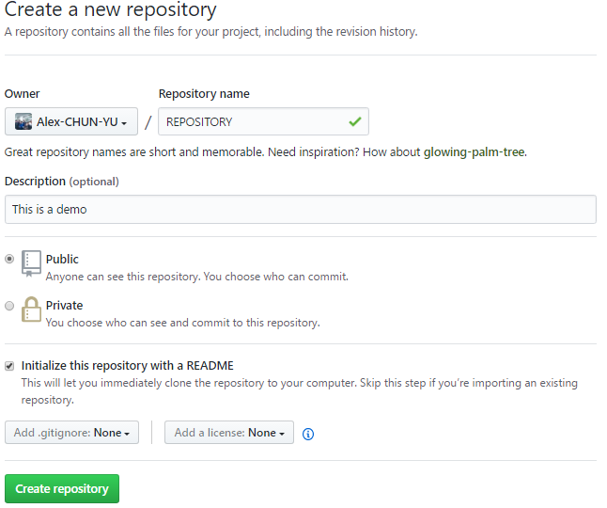
Github REPOSITORY TO LOCAL

Slide 11
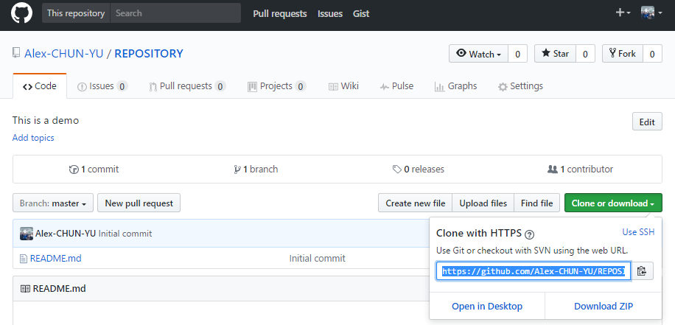
Github REPOSITORY TO LOCAL
Copy your HTTPS

Slide 12
Github REPOSITORY TO LOCAL
git clone https://github.com/ALEX-CHUN-YU/GitBash.git
git clone -b demo https://github.com/ALEX-CHUN-YU/GitBash.git
cd REPOSITORY
vim README.md (Touch README.md)
git add README.md
git commit –m "commit message"
git push
Notes:
Clone to your path，and then cd clone directory
如果要單獨開發一個branch 建議使用第2行

Slide 13
補充

Slide 14
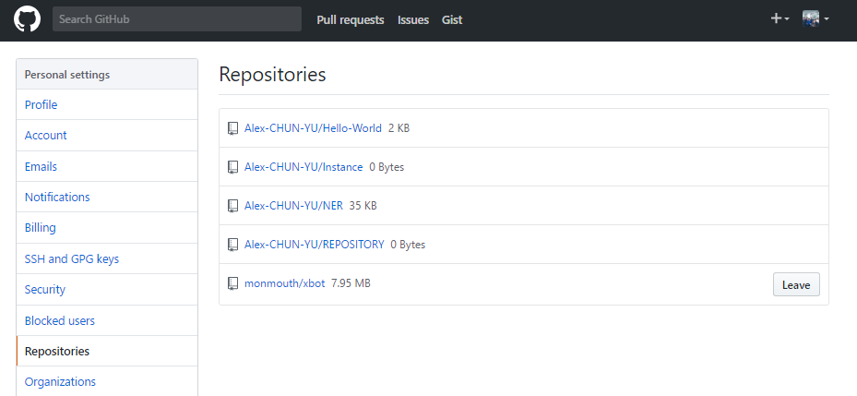
合作專案
Notes:
別人會開權限給你，你就可以clone 下來，一樣去做commit …..動作

Slide 15
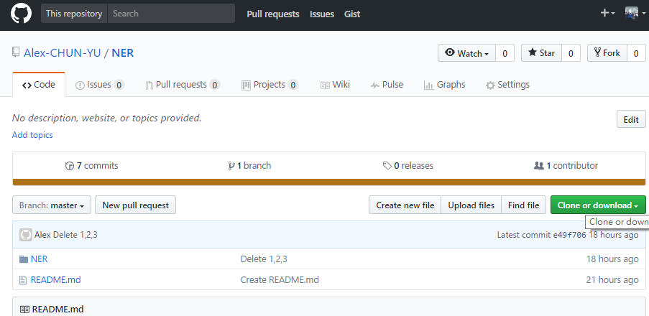
如何協作別人的專案
前往專案的 github 頁面，點選右上角的『 Fork 』按鈕，該專案就會出現在你帳號的專案庫裡面。
Notes:
複製別人的專案到你的github上面，如果你有編輯你會成為contributors

