Slide 1
Solving the Maze problem with ILP
Angelo Andreussi, Alex Della Schiava, Claudia Maußner

Slide 2
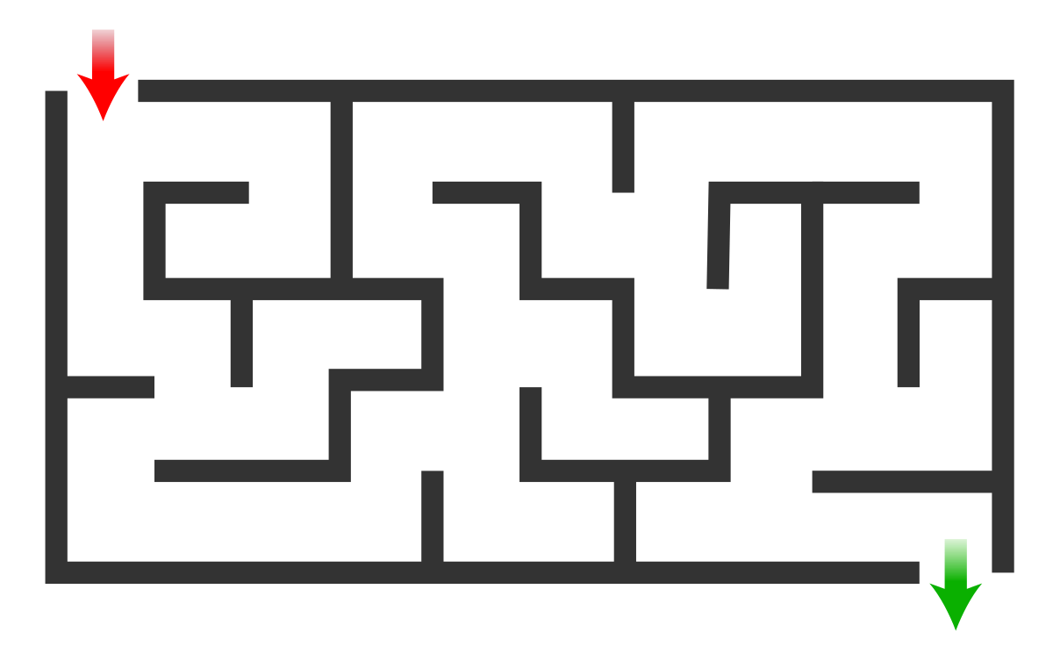
The Maze Problem
A fairly simple problem.
Find a path from point A to point B in a labyrinth-shaped map.
Can be solved with a huge variety of classical algorithms
An example of a Maze

Slide 3
Our tools
HYPER (Bratko, 1999): Based on Top-down search in the hypothesis space.
Metagol (Cropper, Muggleton, 2016): Based on meta-interpretative learning.
ILASP (Law, 2018): Inductive Logic Programming in the context of Answer Set Programs (ASP).

Slide 4
Our goals
Of course, solving the Maze problem.
In some cases, directly through ILP;
Otherwise, using the code learned through ILP.
Comparing HYPER, Metagol and ILASP.
Different systems produce different performances.
Not only, they can also lead to huge differences in the approach of the problem.
Further studying and analyzing these ILP techniques.

