Slide 1

Solving the Maze problem with ILP
Angelo Andreussi, Alex Della Schiava, Claudia Maußner

Slide 2
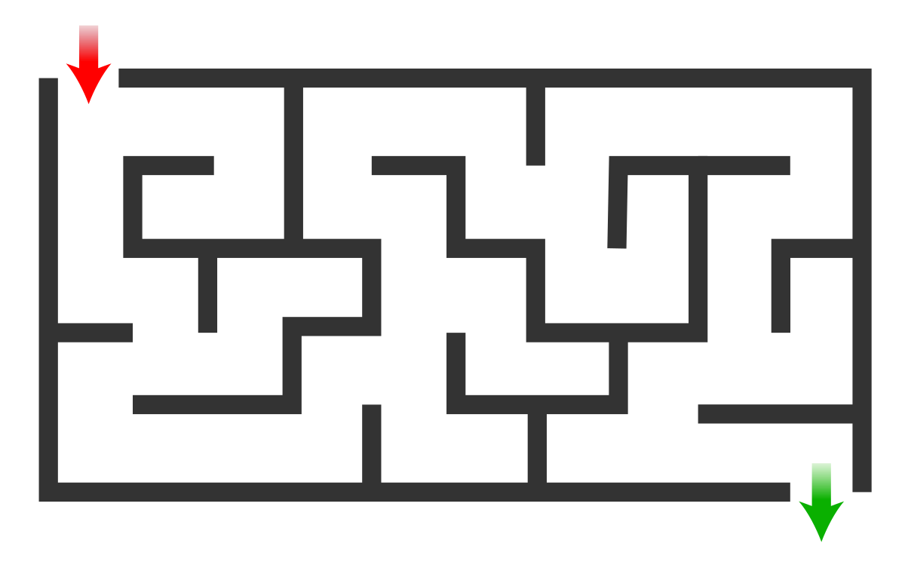
The Maze Problem
A fairly simple problem.
Find a path from point A to point B in a labyrinth-shaped map.
Can be solved with a huge variety of classical algorithms
An example of a Maze

Slide 3
The Maze
All three implementations use the same 5x5 maze (for some tests also a 7x7 maze has been used):
 |  | X=1 | X=2 | X=3 | X=4 | X=5
Y=1 |  | S
Y=2
Y=3
Y=4
Y=5 |  |  | G

Slide 4
Our tools
HYPER (Bratko, 1999): Based on Top-down search in the hypothesis space.
Metagol (Cropper, Muggleton, 2016): Based on meta-interpretative learning.
ILASP (Law, 2018): Inductive Logic Programming in the context of Answer Set Programs (ASP).

Slide 5
Our goals
Of course, solving the Maze problem.
In some cases, directly through ILP;
Otherwise, using the code learned through ILP.
Comparing HYPER, Metagol and ILASP.
Different systems produce different performances.
Not only, they can also lead to huge differences in the approach of the problem.
Further studying and analyzing these ILP techniques.

Slide 6
Hyper

Slide 7
Brief recap
Key components:
Background knowledge.
Replacing structured terms.
Start hypotheses.
Positive examples.
Negative examples.
Learning procedure:
Choose complete start hypotheses.
Refine the hypotheses by
Matching two variables of the same type
Adding a goal from background knowledge
Refining a variable to background terms

Slide 8
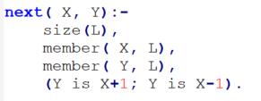
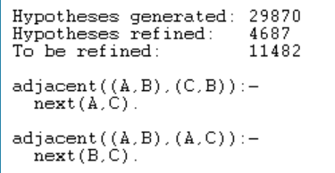
Learning adjacent cells
Goal: Learn adjacent cells, not considering obstacles. (Predicate adjacent/2).
Background Knowledge:
backliteral(next(X,Y),[X:integer],[Y:integer]).
Structured terms:
term(cell,(A,B),[A:integer,B:integer]).
Positive examples: 4
Negative examples: 3
Parameters:
max_proof_length(2).
max_clauses(2).
max_clause_length(3).

Slide 9
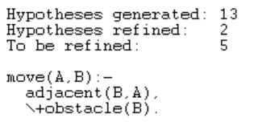
Learning to walk
Goal: Learn to move to an adjacent, legal cell (cell with no obstacle). (Predicate move/2).
Background Knowledge:
backliteral(obstacle(X),[X:cell],[]).
backliteral(\+(G),[X:cell], []):- G=obstacle(X).
backliteral(adjacent(X,Y),[X:cell,Y:cell],[]).
Structured terms: None.
Start hypothesis: start_clause([move(X,Y)]/[X:cell,Y:cell]).
Positive examples: 1
Negative examples: 1
Parameters:
max_proof_length(2).
max_clauses(2).
max_clause_length(3).
The number of hypotheses generated and refined is independent of the size of the grid and the grid!

Slide 10
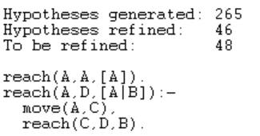
Learning to travel
Goal: Learn to move from two distant cells in the maze without going through illegal cells. (Predicate reach/3).
Background Knowledge:
backliteral(move(X,Y),[X:cell],[Y:cell]).
backliteral(reach(X,Y,L),[X:cell,L:list],[Y:cell]).
Structured terms:
term(list1,[X|L],[X:cell,L:list]).
term(list1,[X],[X:cell]).
Start hypothesis:
start_clause([reach(X,Y,L)]/[X:cell,Y:cell,L:list1]).
Positive examples: 3 / Negative examples: 5
Parameters:
max_proof_length(5).
max_clauses(2).
max_clause_length(3).

Slide 11
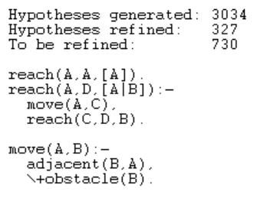
Combined Learning: walk & travel
Goal: Learn the two predicates move/2 and reach/3 at once.
Background Knowledge:
Same as before for both tasks.
Structured terms:
Same as before for both tasks.
Start hypothesis: Same as before for both tasks
start_clause([move(X,Y)]/[X:cell,Y:cell]).
start_clause([reach(X,Y,L)]/[X:cell,Y:cell,L:list1]).
Positive examples / Negative examples: Same as before
Parameters changed!:
max_proof_length(7).
max_clauses(4).
max_clause_length(3).

Slide 12
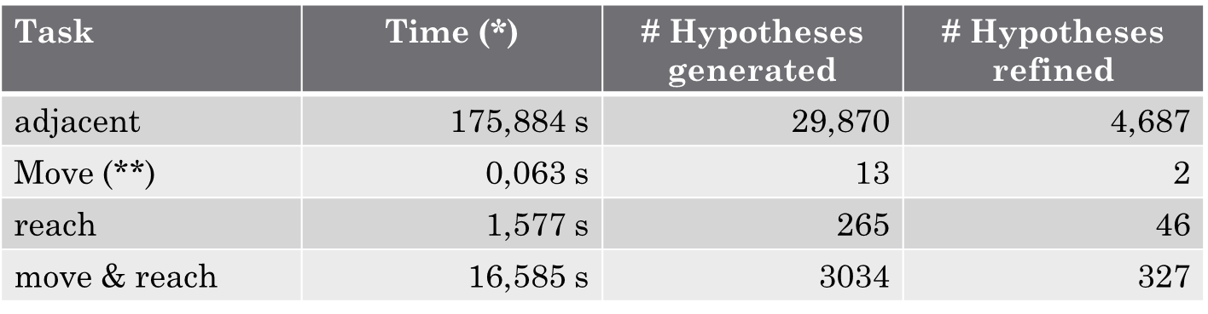
Performance of Hyper
(*) Mean values from 10 runs
(**) Independent of grid

Slide 13
Findings
Do not put too many examples! Start with 1- 2 examples and then add successively new ones as needed.
Do not forget about the parameter settings.
Start learning small steps / simple tasks.
It is more efficient to learn each action on its own then all at once (only one start_clause). With more than one start clause and many backliterals the task grows heavily.
Recursiveness simplifies the learning.

Slide 14
Metagol

Slide 15
Brief recap
Four key components:
Metarules. (Language Bias)
Background Knowledge.
Positive examples.
Negative examples.
Learning procedure:
Select a positive example to be proven.
Prove it through either the existing background knowledge or clauses previously induced.
(If step 2 did not work) Unify the example with the head of a metarule and repeat the process for each of the atoms in the body.
Once the hypothesis is complete, check its consistency. If negative examples are covered then backtrack.

Slide 16
Learning to walk
Goal: Learn to move to an adjacent, legal cell. (Predicate move/2).
Background Knowledge:
inc_x/2; dec_x/2; inc_y/2; dec_y/2;
legal_position/1: Checks whether a cell is in bounds and free from obstacles.
Metarules:
metarule(ident,[P,Q],[P,A,B],[[Q,A,B]]).
metarule(postcon,[P,Q,R],[P,A,B],[[Q,A,B],[R,B]]).
metarule(i_postcon,[P,Q,R],[P,A,B],[[R,B],[Q,A,B]]).
Positive examples:
One legal move for each direction (up, down, left, right).
Negative examples:
One illegal move for each direction.

Slide 17
The power of metarules
Using postcon:
move(A,B):-inc_x(A,B),legal_position(B).
move(A,B):-inc_y(A,B),legal_position(B).
move(A,B):-dec_x(A,B),legal_position(B).
move(A,B):-dec_y(A,B),legal_position(B).
Using i_postcon:
move(A,B):-legal_position(B),move_1(A,B).
move_1(A,B):-inc_x(A,B).
move_1(A,B):-inc_y(A,B).
move_1(A,B):-dec_x(A,B).
move_1(A,B):-dec_y(A,B).
Both metarules are able to learn the predicate adjacent/2 through predicate invention.
Although postcon is also able to offer a 4 clause solution.

Slide 18
The power of background knowledge
Slightly complicating things, legal_position/1 can be split up into its two conjunctions in_range/1 and is_free/1.
metarule([P,Q,R,S],[P,A,B],[[Q,A,B],[R,B],[S,B]]).
Result:
move(A,B):-inc_x(A,B),in_range(B),is_free(B).
move(A,B):-inc_y(A,B),in_range(B),is_free(B).
move(A,B):-dec_x(A,B),in_range(B),in_range(B).
move(A,B):-dec_y(A,B),in_range(B),is_free(B).

Slide 19
Results
postcon | i_postcon | double_postcon
0.047 seconds | 0.121 seconds | 0.156 seconds
(Timings are mean values from 10 runs).
This comparison highlights how adding both clauses or clauses’ length can impact performance.
Tradeoff: More expressive solutions and broader background knowledge lead to a larger search space.

Slide 20
Learning to travel
Goal: Learn to move from two distant cells in the Maze without going through illegal cells. (Predicate reach/2).
Background Knowledge:
move/2 (Learned from «learning_to_walk»).
Metarules:
metarule(recursion,[P,Q],[P,A,B],[[Q,A,C],[P,C,B]]).
metarule(ident,[P,Q],[P,A,B],[[Q,A,B]]).
Positive examples:
reach((1,1), (2,1)).
reach((1,1), (2,5)).
Negative examples:
NONE: Illegal behaviour is already forbidden by the background knowledge.
What if we remove this?

Slide 21
Learning to travel (from scratch)
Goal: Learn to move from two distant cells in the Maze without going through illegal cells. (Predicate reach/2).
Background Knowledge:
inc_x/2; dec_x/2; inc_y/2; dec_y/2;
legal_position/1.
Metarules:
metarule(ident,[P,Q],[P,A,B],[[Q,A,B]]).
metarule(ident2,[P,Q],[P,A,B,[A,B]],[[Q,A,B]]).
metarule(postcon,[P,Q,R],[P,A,B],[[R,B],[Q,A,B]]).
metarule(recursion,[P,Q,R],[P,A,B,[A|L1]],[[R,B],[Q,A,C],[R,C],[P,C,B,L1]]).
Positive examples:
4 examples representing a single step (one for each direction).
1 example representing a path which uses all 4 moves (reach((3,1),(4,5)))
Negative examples:
4 examples of single steps going out of bounds.
4 examples of single steps going into obstacles.

Slide 22
The result
reach(A,B,[A,B]):-reach_1(A,B).
reach_1(A,B):-legal_position(B),reach_2(A,B).
reach_2(A,B):-inc_x(A,B).
reach_2(A,B):-dec_y(A,B).
reach_2(A,B):-inc_y(A,B).
reach_2(A,B):-dec_x(A,B).
reach(A,B,[A|C]):-legal_position(B),reach_2(A,D),legal_position(D),reach(D,B,C).
Through predicate invention we are able to learn both move/2 and adjacent/2.
Is this really correct?

Slide 23
Other tasks
learn_to_win.pl: Solving the Maze problem directly through ILP. Gives a «sequence of predicates» to reach the goal cell from the starting cell.
racc.pl (not working): Learning the reach/3 predicate exploiting tail recursion (will be elaborated in the conclusions).

Slide 24
ILASP
Actually, ILASP version 3

Slide 25

Brief overview on ASP
ASP model is (roughly speaking) a set of rules that represent logics of a problem. The solver tries to find all interpretations (atoms wich are true) that satisfies rules, namely the Answer sets.
An example for the maze problem: write set of rules that specify legal moves on the grid in a logical manner and find out all answer sets: different set of moves (paths) from start to goal position.
Different types of rules in an ASP encoding:
Normal rule :
h :- b1, . . . , bn | where h is an atom and b1 . . . bn are literals…semantic similar to prolog.
Hard constraint :
:- b1, . . . , bn | if b1 . . . bn are satisfied by an interpretation, then it cannot be an answer set.
Choice rule :
l{h1; . . . ; hm}u :- b1, . . . , bn | l, u integers. If the body is satisfied then between l and u of the atoms h1...hm are satisfied

Slide 26
ILASP
The Inductive learning tool used in ASP is Ilasp.
It enables learning programs containing normal rules, choice rules and hard constraints, specifying (as always) background knowledge, search space and positive + negative examples.
Here it has been used for the maze problem, specifically to learn some normal rules that compose the ASP model wich solves the problem of path finding.

Slide 27
Learning to to move on adjacent cells
Goal: Learn the move on adjacent cells, not considering for now the obstacles. (Predicate next/2).
Something like: next((X,Y),(Z,K)) which holds if coordinates are near.
Background Knowledge:
succ predicate = predicate true for adjacent cells.
cell predicate = predicate true for coordinates on the grid.
Positive examples: shows that next holds for near cells on the grid
Negative examples: shows different contexts where next doesn’t hold: when 2 cells are distant, or when you exit from the grid, when cells are in the same diagonal.
mode bias: predicates «cell», «succ», and «next» on the head of the rules.

Slide 28
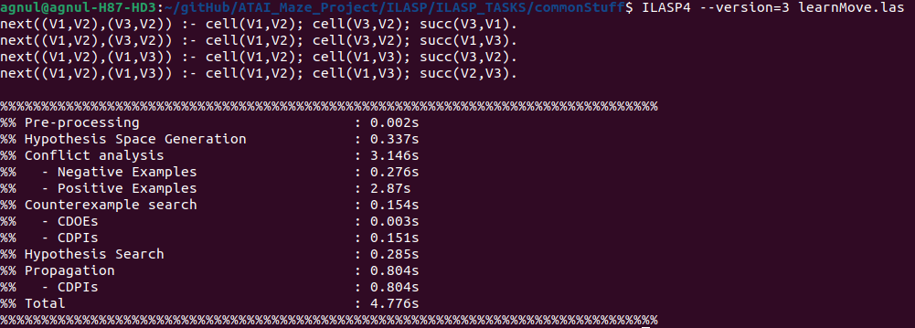
Output of ILASP task – next pred.
(VX,VY) are coordinates.
Equivalent to the “adjacent” predicate of my companions

Slide 29
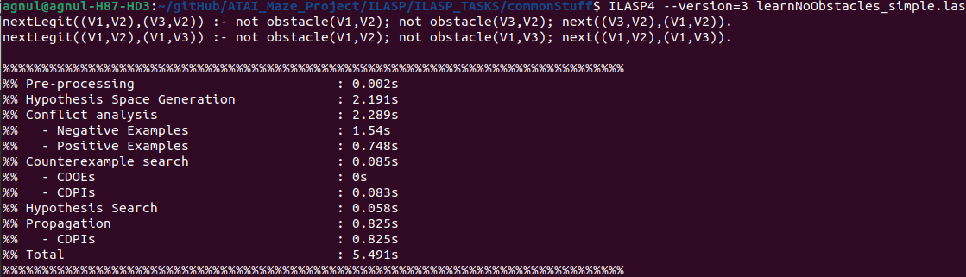
Output of ILASP task – nextLegit pred.
(VX,VY) are coordinates.
Equivalent to the “move” predicate of my companions

Slide 30
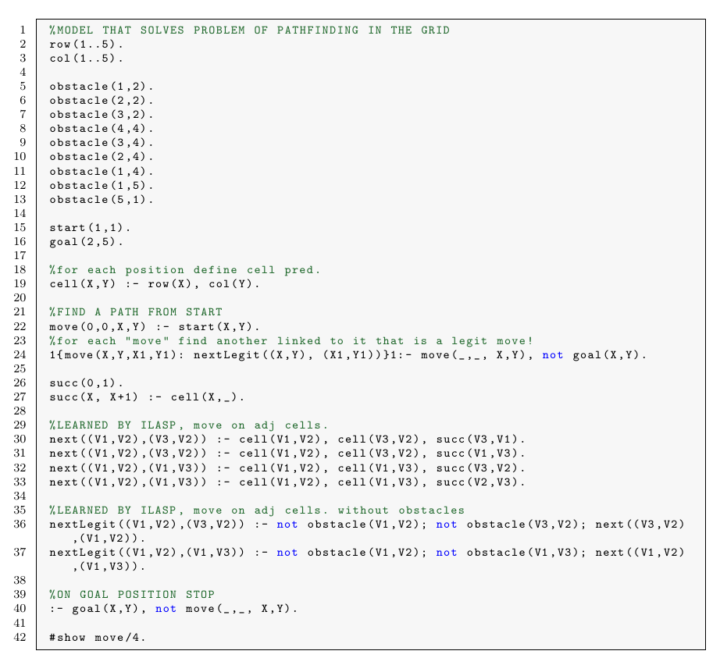
Combining what learned in an ASP model

Slide 31
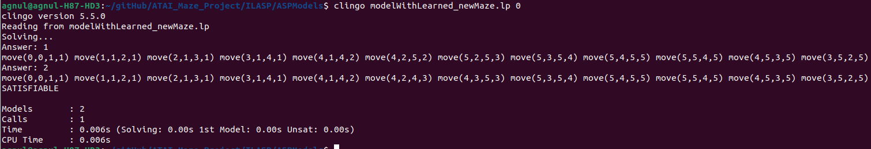
Execution of the solver on the model
paths found on our grid

Slide 32
Analysis on scalability of the tool
Work done in ILASP shows clearly a fact: time complexity doesn’t scale well with respect to search space dimension.
Trying to do the 2 previous tasks both on the same script was not feasible: the search space was too big, but actually the second task «just» got 1 more predicate (obstacle)!
ILASP got an option to show the search space of a task, by using the linux «wc» command it is possible to extract its dimension and later do an analysys of the relation time – search space dimension

Slide 33
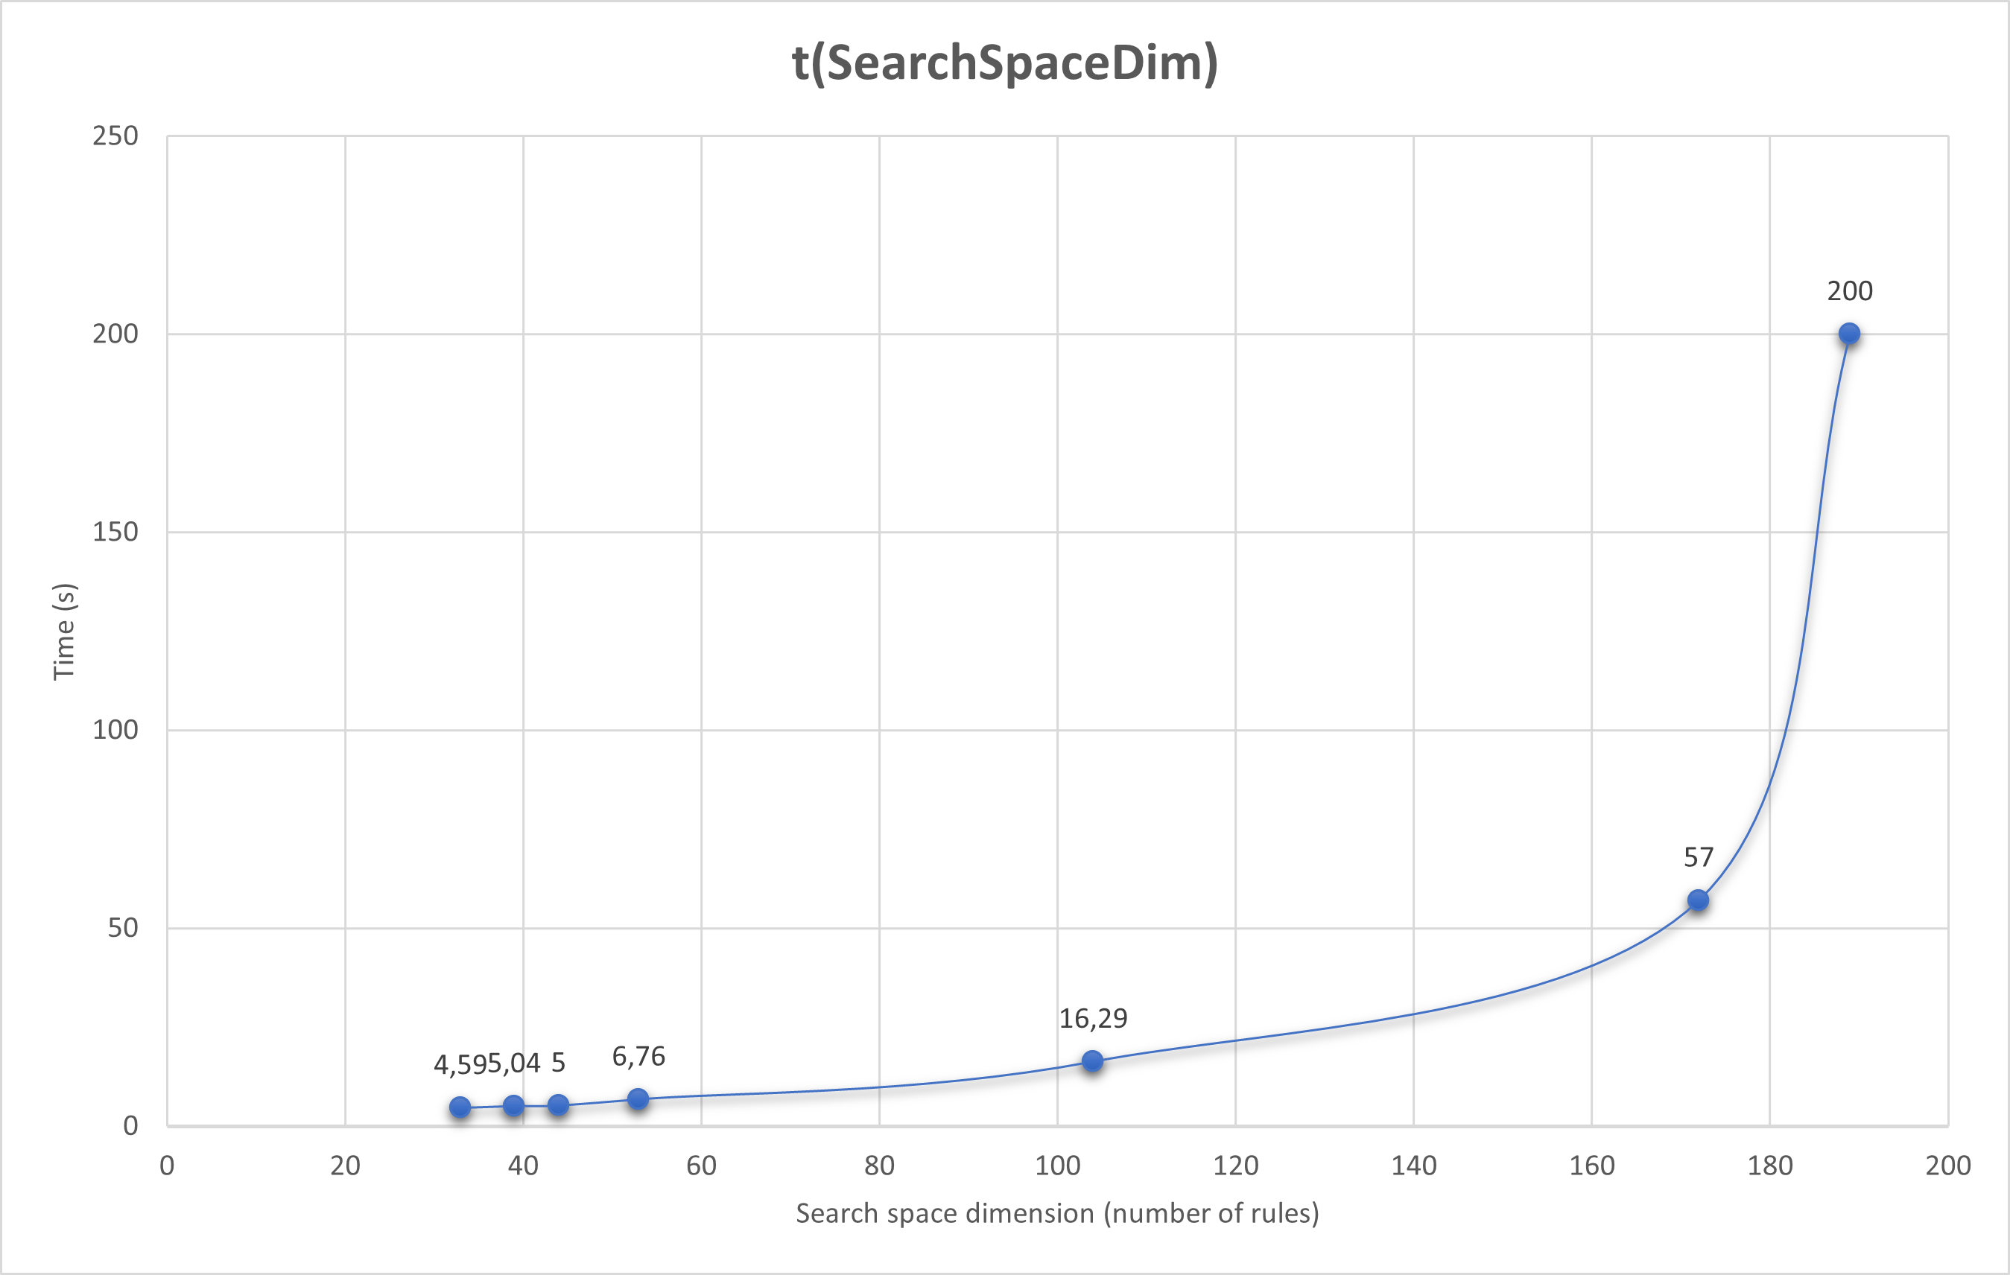
Performance analysis results
Evident exp. Trend ! This implies that it’s a good practice split a task in other tasks

Slide 34
Conclusions

Slide 35
Performance comparison
Task | HYPER | Metagol | ILASP
adjacent/2 | 175.884 | 0.056 | 4.767
move/2 | 0.063 | 0.047 | 5.343
reach/3 | 1.577 | 0.026 | NA
move/2 & reach/3 | 16.585 | 0.848 | NA
Timings were taken as averages of 10 runs (in seconds).
All the tools seem to prove that learning one task at a time is far more efficient than learning more tasks at once.
In metagol it was feasible to learn both adjacent/2 and move/2 on the same task but not on ILASP (computation times very high).
Grid dimensions considered did not impact time measurements.

Slide 36
Approach comparison
HYPER and Metagol seem to have quite a similar approach, though the latter seems far more efficient than the former.
The tradeoff for Metagol’s efficiency is related to the fact that it requires a far more precise initial idea of the result in order to use the correct metarules.
The more “problem oriented” approach of ASP and its expressiveness make the learning of some predicates trivial. Once learned the move predicate, further learnings weren’t necessary.

Slide 37
Bonus: is reach/3 correct?
Not quite!
This can lead to infinite loops in Prolog querying.
reach(A,B,[A,B]):-reach_1(A,B).
reach_1(A,B):-legal_position(B),reach_2(A,B).
reach_2(A,B):-inc_x(A,B).
reach_2(A,B):-dec_y(A,B).
reach_2(A,B):-inc_y(A,B).
reach_2(A,B):-dec_x(A,B).
reach(A,B,[A|C]):- legal_position(B),
reach_2(A,D),legal_position(D)
,reach(D,B,C).
This is caused by the (partly) declarative nature of Prolog
 |  | X=1 | X=2 | X=3 | X=4 | X=5
Y=1 |  | S
Y=2
Y=3
Y=4
Y=5 |  |  | G

Slide 38
Solution: Tail Recursion
This solution exploits tail recursion and accumulators in order to avoid loops.
non_member(C,Acc) checks whether the encountered node has already been visited before.
reach(A,B,L) :- reach_1(A,B,[A],L).
reach_1(A,A,L,L).
reach_1(A,B,Acc,L) :-
move(A,C),
non_member(C,Acc),
reach_1(C,B,[C|Acc],L).

