Slide 1
What LinkedIn Can do Extra?
Alex Dolia
7 Jan 2024

Slide 2
Contents
Who Entrepreneurs Looking For?
Content Based Recommendation System
Collaborative Filtering
Collaborative Filtering – Fixing Drawbacks
Collaborative Filtering – SVD Approach
Collaborative Filtering – Simple Python Code
Collaborative Filtering – Billion-scale Computations
My Ideas about What We Can Do Else:
New Ideas Part I – Analog of Shopping Basket
New Ideas Part II – Large Language Models
New Ideas Part III – Novelty Detection
New Ideas Part IV – Slide Weights
New Ideas Part V – Interpretability vs Explainability
New Ideas Part VI – Conversational Recommendation
New Ideas Part VII – Accountant, Extra Data Points
New Ideas Part VIII – Recent Trends
Metrics and Evaluation
Potential Risks and Possible Mitigation
Non Functional and Maintenance Requirements
Long-term Vision
Contact Details

Slide 3
Who Entrepreneurs Looking For?
Co-founders, someone like themselves who share the same passion about innovation and their product;
Partners who have some sell strategy;
Team, who will deliver vision on founders;
Potential customers;
Suppliers;
Competitors;
Accountant.
Entrepreneurs need information about market (market research) where all above parties come together.

Slide 4
Content Based Recommendation System
Content Based Recommendation System
The idea of content based methods is to try to build a model, based on the available “features”, that explain the observed user-item interactions.
If we manage to get such model, then, making new predictions for a user is pretty easy: we just need to look at the profile (age, sex, …) of this user and, based on this information, to determine relevant customers, blogs, news, or interest groups to suggest.
Content based methods suffer far less from the cold start problem than collaborative approaches (see slides below) : new users or items can be described by their characteristics (content) and so relevant suggestions can be done for these new entities.
Only new users or items with previously unseen features will logically suffer from this drawback, but once the system old enough, this has few to no chance to happen.

Slide 5
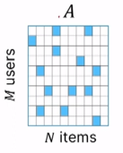
Collaborative Filtering
There are the two major paradigms of recommender systems : collaborative and content based methods.
Collaborative methods for recommender systems are methods that are based solely on the past interactions recorded between users and items in order to produce new recommendations. These interactions are stored in the so-called “user-item interactions matrix”.
Then, the main idea that rules collaborative methods is that these past user-item interactions are sufficient to detect similar users and/or similar items and make predictions based on these estimated proximities.
However, as it only consider past interactions to make recommendations, collaborative filtering suffer from the “cold start problem”: it is impossible to recommend anything to new users or to recommend a new item to any users and many users or items have too few interactions to be efficiently handled.

Slide 6
Collaborative Filtering – Fixing Drawbacks
This drawback can be addressed in different way:
Recommending random items to new users or new items to random users (random strategy);
Recommending popular items to new users or new items to most active users (maximum expectation strategy);
Recommending a set of various items to new users or a new item to a set of various users (exploratory strategy) or,
Finally, using a non collaborative method (e.g., content based recommendation) for the early life of the user or the item.

Slide 7
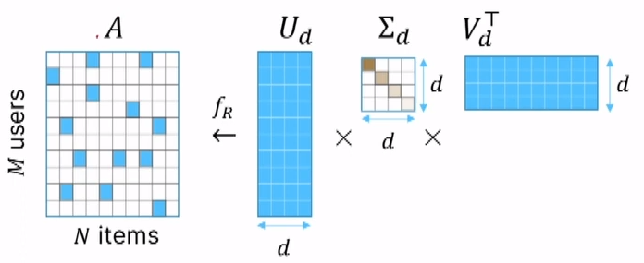
Collaborative Filtering – SVD Approach
The process of performing SVD on a user-item matrix can be broken down into three steps:
Decompose the user-item matrix into three matrices: U, S, and V.
Keep only the top k singular values and their corresponding vectors, this is useful in order to reduce the complexity and computational costs without losing too much information.
Multiply the matrices back together to obtain an approximation of the original user-item matrix.

Slide 8
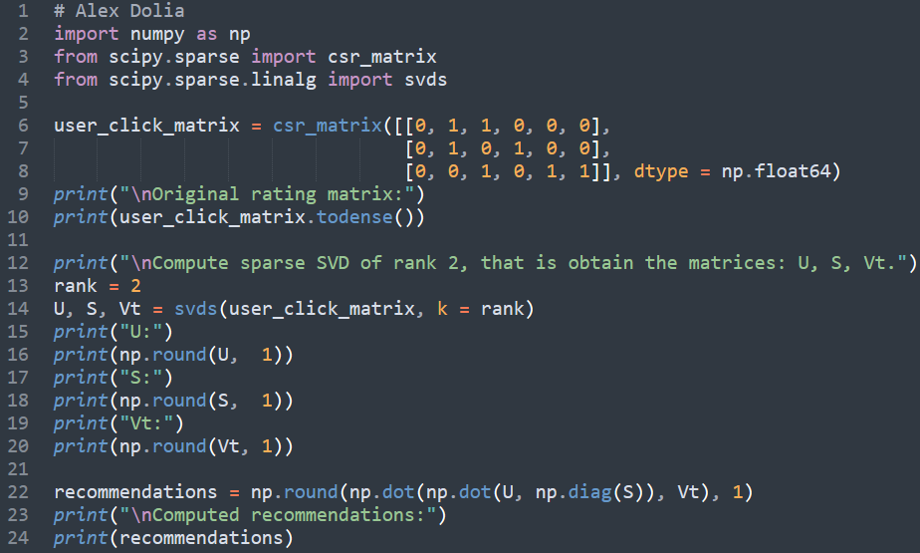
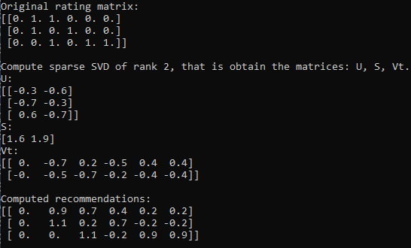
Collaborative Filtering – Simple Python Code
Every row of the rating matrix user_click_matrix (in the previous slide it is A) correspond to the customer and column to item (job, co-founder, etc recommendation) he is interested in. It is equal to 1 if the use click on the link and 0 if he did not click or have not seen it.
Optimization parameter is the rank of the matrix, in this example, the rank is equal to 2.

Slide 9
Collaborative Filtering – Billion-scale Computations
In practice, in distributed setups, randomised SVD is used.
Example:
Large-Scale Matrix Factorization on TPUs:
https://blog.research.google/2022/04/large-scale-matrix-factorization-on-tpus.html
Criteo:
https://github.com/criteo/Spark-RSVD
Facebook’s randomized SVD implementation:
https://research.facebook.com/blog/2014/9/fast-randomized-svd/

Slide 10
My Ideas about What We Can Do Else
.
New Ideas Part I – Analog of Shopping Basket
New Ideas Part II – Large Language Models
New Ideas Part III – Novelty Detection
New Ideas Part IV – Slide Weights New Ideas Part V – Interpretability vs Explainability
New Ideas Part VI – Conversational Recommendation
New Ideas Part VII – Accountant, Extra Data Points
New Ideas Part VII – Recent Trends

Slide 11
New Ideas Part I – Analog of Shopping Basket
From one side we use the search to find something and the results of our search could be used by recommendation systems;
From another side we have the recommendation and we might click on them or not. In this case, we kind of have selection of item and we select some of them;
Now the idea is the following:
We search some items (person, advertisement, blog and so on) or we create item (describe what we are looking for);
Then we add this item to basket;
If we need more then one item we go to the 1);
When we are happy with our basket we submit it and the recommendation system use it to make recommendation;
Recommendation system, for example, use classification approach if out item is similar to basket or not.
Note that, by default the basket contain automatic recommendation item but we can remove it. In this case, we can reduce spam and make the recommendation more targeting or tailed to the customers.
Maybe we need to have a button that allow easily switch from basket recommendation to automatic one.

Slide 12
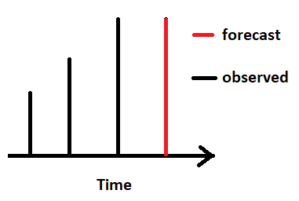
New Ideas Part II – Large Language Models
Recommendation based on the past interest and actions.
Just imagine you do time series and for the future prediction you use the previous value:
In this case we do not take into an account the trend in the previous values.
Sometimes when we talk about Entrepreneurs we usually use word Disruptive Innovation. In this case, we need to explore new areas, sometimes change rapidly the direction of company development.
In this case what we can do is extend our search to recommendation – we specifically describe the topic what we are interested in and our system listen all news, group, communication and trying to find something to what we are interested in. Therefore, we force our system to recommend something that is important to us. This problem can be solve using Large Language Model and we should not be constrained by our social network (for example, using Langchain for search over the internet).

Slide 13
New Ideas Part III – Novelty Detection
Scenario: we are given a number of candidates for the certain position and we drag their pictures left (not interested) or right (selected). Usually, this information can be used by collaborative filtering but it might be a bit noisy.
Based on selected people or news we can create the model that compute the novelty score. If the novelty score does not exceed the certain threshold it means the entrepreneurs is interested in the selection otherwise not.
Or entrepreneurs can select people and tell the recommendation system – find me the similar people without specifying specific skills.
See my paper about novelty detection theory: https://link.springer.com/chapter/10.1007/11871842_61

Slide 14
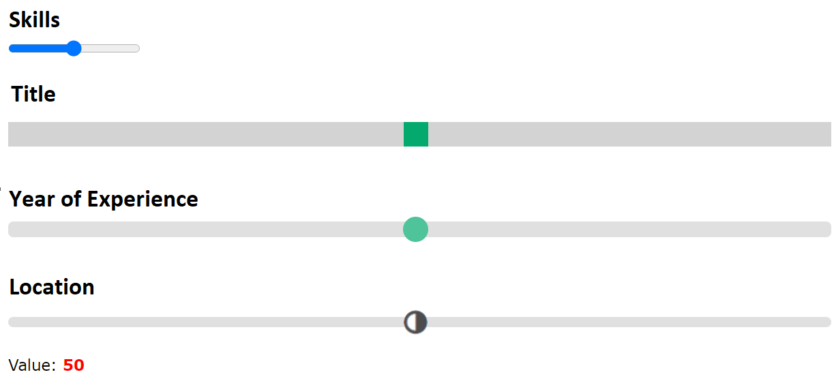
New Ideas Part IV – Slide Weights
At the moment we cannot control importance of the weights in the recommendation or search.
But we can have advanced search or recommendation. For example, we are looking for someone with 10 years experience or range of year experience. Or we are interested in Location to be close as possible to the job or we do not care about location.
We can control our selection using sliders.

Slide 15
New Ideas Part V – Interpretability vs Explainability
If we want to tune weights using range sliders we need to know why we get this or another recommendation. Using black box model sometimes make it hard.
Interpretability: refers to the ability to understand the decision-making process of an AI model. An interpretable model is transparent in its operation and provides information about the relationships between inputs and outputs. An interpretable algorithm can be explained clearly and understandably by a human being. Interpretability is therefore important to ensure that users can understand and trust artificial intelligence models.
Explainability: pertains to the ability to explain the decision-making process of an AI model in terms understandable to the end user. An explainable model provides a clear and intuitive explanation of the decisions made, enabling users to understand why the model produced a particular result. In other words, explainability focuses on why an algorithm made a specific decision and how that decision can be justified.
See the following paper: https://www.ijcai.org/proceedings/2020/0373.pdf

Slide 16
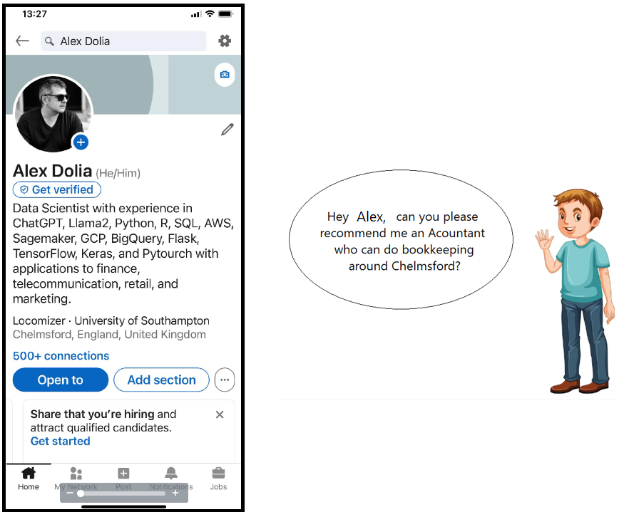
New Ideas Part VI – Conversational Recommendation
There’s one important industry executive at the RecSys conference told that interactive components account for 50% of the commercial success of a recommender.
Chatbot can be implemented using ChatGPT or Llama2 and Langchain using retrieval augmented generation approach.
See for example the course on chatbot with LLM
https://learn.deeplearning.ai/courses/langchain-chat-with-your-data
You can use speech recognition in Python
https://thepythoncode.com/article/using-speech-recognition-to-convert-speech-to-text-python?utm_content=cmp-true

Slide 17
New Ideas Part VII – Accountant, Extra Data Points
Accountants have qualification, certification, size of accounting firm, year of experience, target segment, and location.
Target segment can be small, average, or large company that are doing IT consultancy, social medial, finance services, marketing and so on. Accountants might interested in the company with particular funding stage: pre-seed funding stage, series A, B, C, D, Mezzanine funding and bridge loans, and finally, IPO.
Accountants might provide the following services:
Corporate Tax, Accounting, Book Cleanup, Bookkeeping, Business budgeting and forecasting, Business Plans, Consulting, Financial Planning, Financial Reporting, Financial Services, In-house CFO, IT Consulting, Payroll, Personal Tax, Self-assessment Returns, Small Business Tax, Startup Consulting, Tax Advice, Tax Consulting Services, Tax Preparation, Tax Services, Tax Setup.
Therefore above information can be used as data points or features for recommendation systems.

Slide 18
New Ideas Part VIII – Recent Trends
Multi-task learning (RecSys 2020 best paper)
Causality
Fairness and debiasing
Reinforcement Learning
Deep Learning for Sequential Recommendation
Conversational Recommenders, Critiquing

Slide 19
Metrics and Evaluation I
Technical metrics are hit rate, average time between clicks, coverage, diversity, churn, responsiveness, precision, and recall.
For example, if a recommendation is top n selection then we consider it as success and 0 otherwise. In this case we can use binary classification metrics as well.
In general, good technical metrics do not guarantee good business metrics. But the ultimate goal is to get uplift in business metrics compared with the baseline recommendation.
Business metrics: A/B Testing, N Bandit Testing, Customer Satisfaction and Customer Retention.

Slide 20



Metrics and Evaluation II
In recent years, most of the research work carried out in the field of recommender systems is partly evaluated using accuracy metrics coming from the information retrieval field such as precision (P@K) and recall (R@K) whose formulas are provided hereafter:
where n and m represent respectively the number of users and the number of items, the set of items i₁,i₂,…,iₖ are the items ranked from 1 to K, the value of hit is 1 if the recommended item iⱼ is relevant to user u, otherwise 0. Rel(u) represents the set of relevant items for user u in the test set.
The purpose of these evaluation metrics in the context of product recommendation is to identify the K most relevant items for a given user and to measure the quality of retrieving with precision relevant information. In the special case of recommending only one item to the user, as in Session Based recommender systems where we want to measure the correctness of the immediate next item, hitrate@K:

Slide 21
Potential Risks and Possible Mitigation
Potential Risks:
Lack of quality training data
Incorrect training data
Poor data quality
Introduction of implicit biases
Underfitting and Overfitting
Lack of computational resources
Mitigating potential risks:
Data needs to be of sufficient fidelity, quality, and breadth to accurately capture system behavior
Our training dataset size is optimized, and make sure use of a rigid data governance strategy
Bias has to be removed from interpretations
Create a Minimum Viable Product first and then try to improve late.
Risk of Social Media for Business:
Damage to Reputation
Security Breaches
Compliance violations
Legal Issues
Financial consequences
Steps to manage risk on social media:
Define your social media policy
Train your employees
Monitor your social media accounts
Respond promptly to negative feedback
Review and revise your policy on a regular basis

Slide 22
Non Functional and Maintenance Requirements
Non functional requirements:
Security requirements:
Encryption of internet traffic;
Authorization;
Role-based access control;
Audit of successful and unsuccessful connection request.
Requirements for maintenance:
Monitoring of infrastructure performance;
Monitoring of recommendation quality.
We need to monitor business metrics over time after deployment.
To be in the top of the game we need to follow recent advances in recommendation systems: blogs, papers, meetups, and conferences.
18th ACM Conference on Recommender Systems
Bari, Italy, 14–18 October 2024
https://recsys.acm.org/recsys24/

Slide 23
Long-term Vision
It is helpful to design surveys that target entrepreneurs and try to understand the following:
What entrepreneurs with different background, business type, and demographics really need in the searching or recommendation?
What they do not like in the current system like LinkedIn?
We get it even before designing the system and perform A/B testing after we design it.
It is difficult to provide exactly the same services in the same manner and get ahead of competition:
You need to provide something new.
The recommendation system should be proactive – not just use knowledge or data generated inside of the system but use, for example, retrieval augmented generation and search for information (new funding,
new job opportunities etc) on the entire internet. It can be done, for example using, LangChain agents.
Maybe we need to develop recommendation system for entrepreneurs in chatbot manner using Large Language model and make it even more easy – use the Human Voice for giving instructions to chatbot without necessity to press any button: “Hey Alex, could you please …”

Slide 24
Contact Details
email: alex.dolia.ra@gmail.com
phone: +44 77916 85009
LinkedIn: https://www.linkedin.com/in/alex-dolia-866b9958/
GitHub: https://github.com/Alex-Dolia/what_LinkedIn_can_do_extra
Scholar Google: https://scholar.google.com/citations?user=7OtH-7sAAAAJ&hl=en
Acknowledgement.
I would like to thank Dr. Alexei Polyakov for suggestions of Who Entrepreneurs Looking For and ideas about the accountant selection.
I also would like to thank my accountant Nick Pappel for his ideas about what points or keywords to use to get more targeted accountant recommendation.

