Slide 1

A Case Study in Human-AI Collaboration
Presenter: Alex Faulkner Test Automation Lead
AI-Powered Test Automation
Organisation: DigiBlu / Experience Travel Group
Date: November 2025
Mapping Complex Approval Workflows at Scale

Slide 2

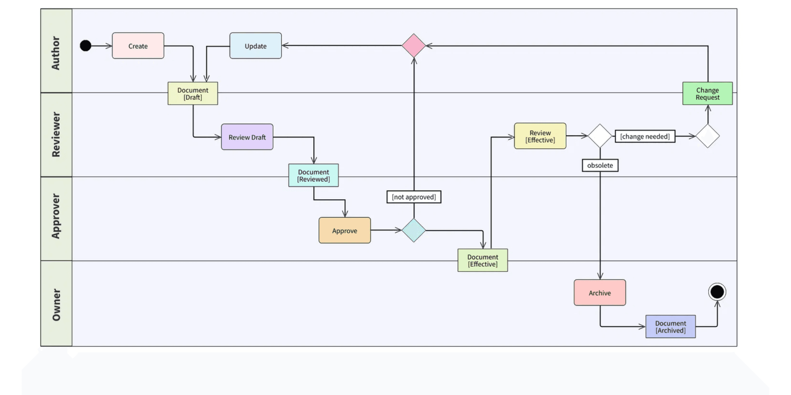
The Challenge: Testing Complex Payment Approval Workflows
6
Different payment types to test
61
Unique approval workflows with varying rules
276
Distinct rejection scenarios requiring testing
5
Business Risks if Testing Fails
Approval levels (PCM → RD → RCM → CFO → CEO)
Payment processing delays
●
Incorrect approvals or rejections
●
Compliance violations
●
Financial errors in regulated industry
Manual testing was:
●
Overwhelming, error-prone, and unmaintainable

Slide 3

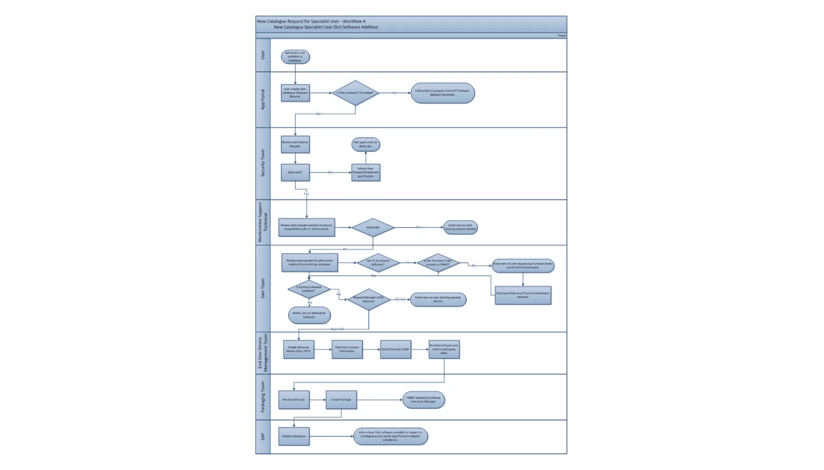
The Scale of Complexity: Why Traditional Testing Failed
The Numbers
61 unique approval workflows
276 rejection scenarios to test
4 raising locations
6 payment types
5 approval levels (maximum)
100+ page specification document
Human Limitations
Weeks to manually map scenarios
Impossible to track all permutations
⚠
High risk of missed edge cases
⚠
Documentation scattered & inconsistent
⚠
Key Problem
Changes require remapping everything
⚠
Each rejection routes differently based on:
Who rejected (Approver 1, 2, 3, 4, or 5)
→
When in the workflow
→
Business logic conditions (thresholds, rules)
→

Slide 4

The AI Solution - Mapping Phase: Using AI to Map Every Possible Path
1
2
3
Fed Claude AI the Requirements
AI Extracted All Patterns
AI Generated Comprehensive Scenarios
•
100+ page Solution Specification Document
•
Identified 61 unique workflow configurations
•
276 complete rejection flow scenarios
•
Excel files with approval logic (merged cells)
•
Mapped complex conditional logic
•
Happy paths (all approvers approve)
•
Business rules and conditions
•
Handled merged Excel cells (standard tools failed)
•
App 1+ rejection variations
•
Re-approval & multiple loops
Output: Dynamic Excel Workbook
5 Tabs: Quick Reference, Summary, Logic, Instructions, All Scenarios
Auto-Updating Formulas: Dynamic calculations for scenario tracking and validation
Color-Coded Scenarios
Green = Happy Path (all approvers approve)
Red = Delete (App 1 rejection = immediate deletion)
Yellow = Reject (App 2+ rejection = sent back to App 1)
Blue = Recovery (re-approval scenarios)
White = Complex (multiple rejection loops)

Slide 5

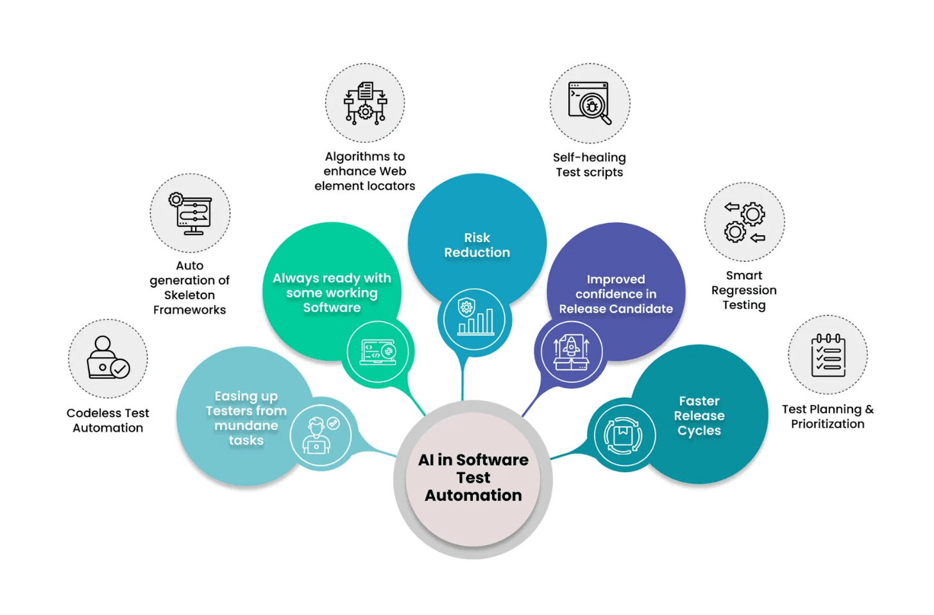
The AI Solution - Automation Phase: Turning Maps into Automated Tests
AI-Generated Test Automation
Advanced Features Implemented
~4.7K
Form field automation
Lines of production-quality Python code
100% coverage
→
112
PDF validation
Automated test cases created
Download & verify 11 fields per submission
→
Email approval integration
6/6
IMAP protocol support
Payment types supported
→
Screenshot capture
Evidence for every test
Modular, maintainable architecture
→
CSV reporting
Pass/fail indicators
→
Multi-environment support
Technology Stack
Dev & UAT compatibility
→
Python + Selenium + Playwright
◆
openpyxl, pandas, pdfplumber
3-tier error handling
◆
GitHub for version control
Robust failure management
◆
→

Slide 6

How We Implemented It: The Human + AI Collaboration Model
The success of this project came from a balanced partnership where humans and AI each contributed their unique strengths. Neither could have achieved this alone.
Humans Provided
AI Provided
Business context and domain knowledge
Pattern recognition across 61 workflows
Validation of logic and requirements
Rapid code generation (~4,700 lines)
Decision-making on priorities
Exhaustive scenario enumeration (276 scenarios)
Creative problem-solving for novel situations
Consistent documentation
Quality assurance of AI outputs
Debugging suggestions based on error patterns

Slide 7

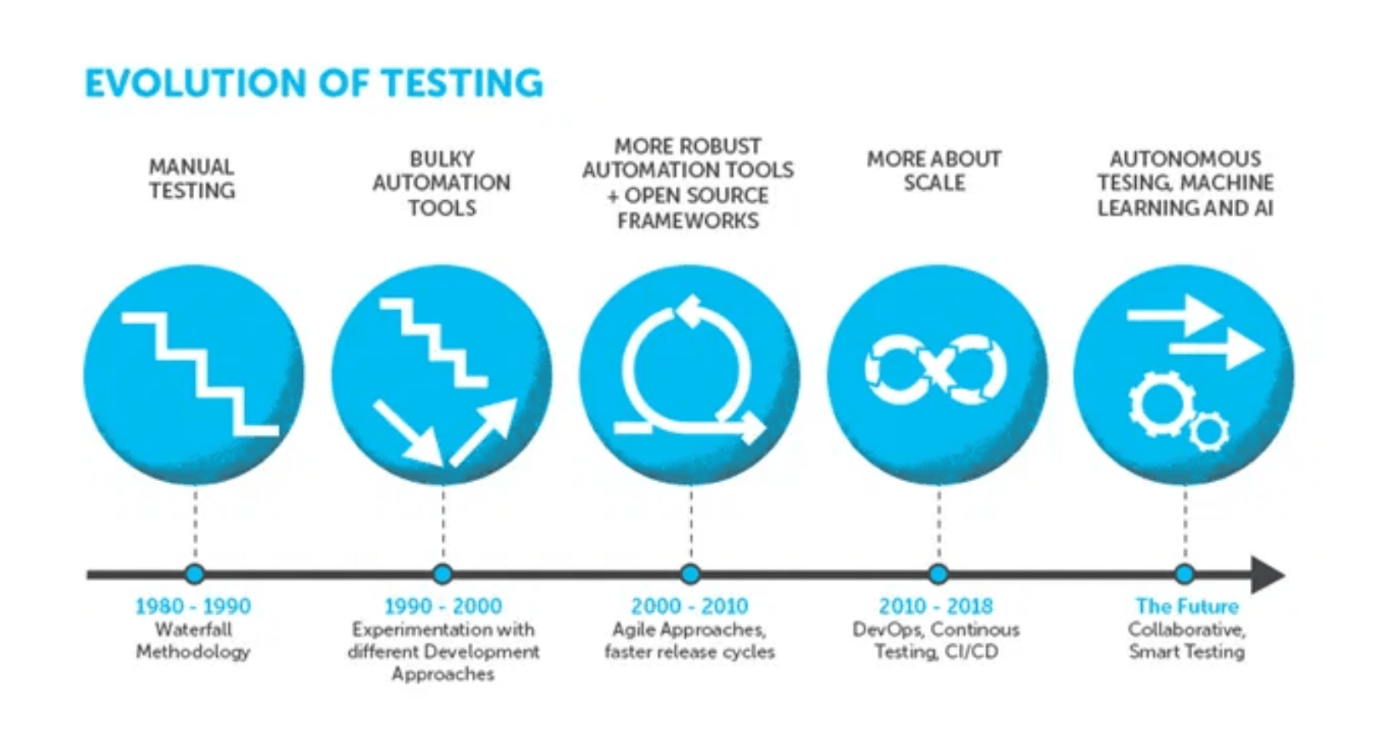
The Implementation Process: From Requirements to Delivery
1
Human uploads requirements
2
AI analyzes and proposes
Business requirements and specifications provided
AI reviews and suggests solutions
3
Human validates logic
4
AI generates code structure
Business logic verification and approval
Production-quality code generation
5
Iterate on debugging
6
Human validates outputs
Refinement and error resolution
Final quality assurance and approval
7
AI generates documentation
12
weeks from concept to 6 fully automated payment types
Comprehensive documentation created alongside code for sustainability and knowledge transfer

Slide 8

Real Example - AI Solving the Impossible: The Merged Cells Problem
The Challenge
Traditional Approach
AI Approach
Excel approval logic used merged cells for readability
Manual Solution:
AI Solution:
→
Manually unmerge every cell
✓
Identified merged cells issue
→
Re-enter data consistently
✓
Proposed openpyxl library
The Problem:
→
Verify accuracy across 100+ rows
✓
Detect all merged ranges
●
Standard Python (pandas) couldn't read merged cells
✓
Unmerge & fill cells
●
50+ workflows appeared blank
✓
Re-read complete data
⏱ Estimated Time:
●
Manual solution would take weeks
2-3 Weeks
⚡ Actual Time:
1 Day
2-3 Weeks
1 Day
✓ All 61 workflows correctly mapped ✓ No manual data entry required
Result:
vs
Traditional Manual Approach
AI-Assisted Solution

Slide 9

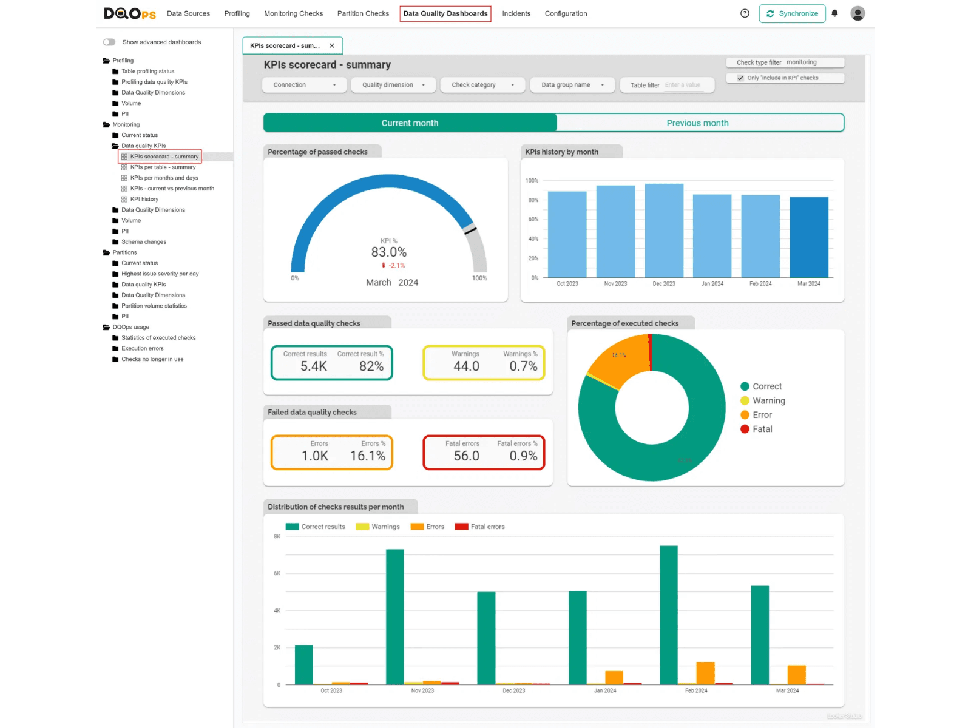
The Results - By The Numbers: Measurable Impact
Coverage Achieved
Time Savings
Quality Improvements
Modular architecture (15+ reusable functions)
✓
6/6 payment types automated (100%)
◆
Manual Testing
3-tier error handling strategy
◆
2-3 hours per payment type per cycle
Screenshot evidence for every test
✓
276/276 rejection scenarios mapped (100%)
◆
Comprehensive logging across all operations
◆
CSV reports with pass/fail indicators
61/61 approval workflows covered (100%)
◆
✓
Automated Testing
Multi-environment support (Dev/UAT)
◆
5-10 minutes per payment type
Production-ready code standards
◆
✓
~112 automated test cases created
Automated test data management
◆
Consistent naming conventions
◆
✓
~4,700+ lines of production code
Time Reduction
Self-documenting code structure
90-95%
◆
✓
11 PDF fields validated per submission
✓
100% form field coverage
Scenario Mapping
Weeks → 2-3 days with AI
Development Speed
60-70% faster with AI assistance

Slide 10
What Made This Work: Key Success Factors
1
Iterative Collaboration
2
AI as Force Multiplier
3
Breaking Down Complexity
4
Documentation First
Started small, learned continuously
Single developer achieved team-level output
Divided into manageable phases
Docs generated alongside code
Began with 1 payment type PoC
→
Week 1-2: Map workflows with AI
→
AI generated comprehensive docs
→
AI excellent at exhaustive scenario generation
Learned from each iteration
→
→
Week 3-4: Generate first test scripts
→
Made project transferable to others
→
AI spotted patterns humans missed
→
Week 5-8: Scale to all payment types
→
Reduced onboarding time significantly
Human essential for business logic validation
→
→
Continuous refinement improved quality
→
Week 9-10: Add advanced features
→
Future-proofed the solution
→
Combined strengths = better than either alone
→
Week 11-12: Documentation & handoff
→
60-70% faster development
→

Slide 11
Lessons Learned: What Worked, What Didn't
✓ What Worked Well
⚠ Challenges Overcome
💡 Key Insights
✓Breaking complex problems into smaller pieces
⚠AI initial code 70-80% correct (needed human refinement)
AI Accelerates, Humans Validate
60-70% faster development, but human oversight essential
✓Using AI to identify patterns across 61 workflows
⚠Dynamic form fields required smart waiting logic
Documentation is Critical
✓Generating code AND documentation together
AI-generated docs made project sustainable and
⚠Email authentication needed workarounds
transferable
✓Validating AI outputs against known scenarios
⚠PDF validation evolved through 3 approaches
Business Logic First
✓Iterative refinement improved accuracy
Understanding requirements deeply more important than
⚠Cross-environment behavior differences
coding speed
✓Test data separation (config.py pattern)
Continuous Improvement
⚠Selector changes required test maintenance
Each payment type built on lessons from previous ones
Think in Systems
AI helped structure as scalable system, not individual
scripts

Slide 12

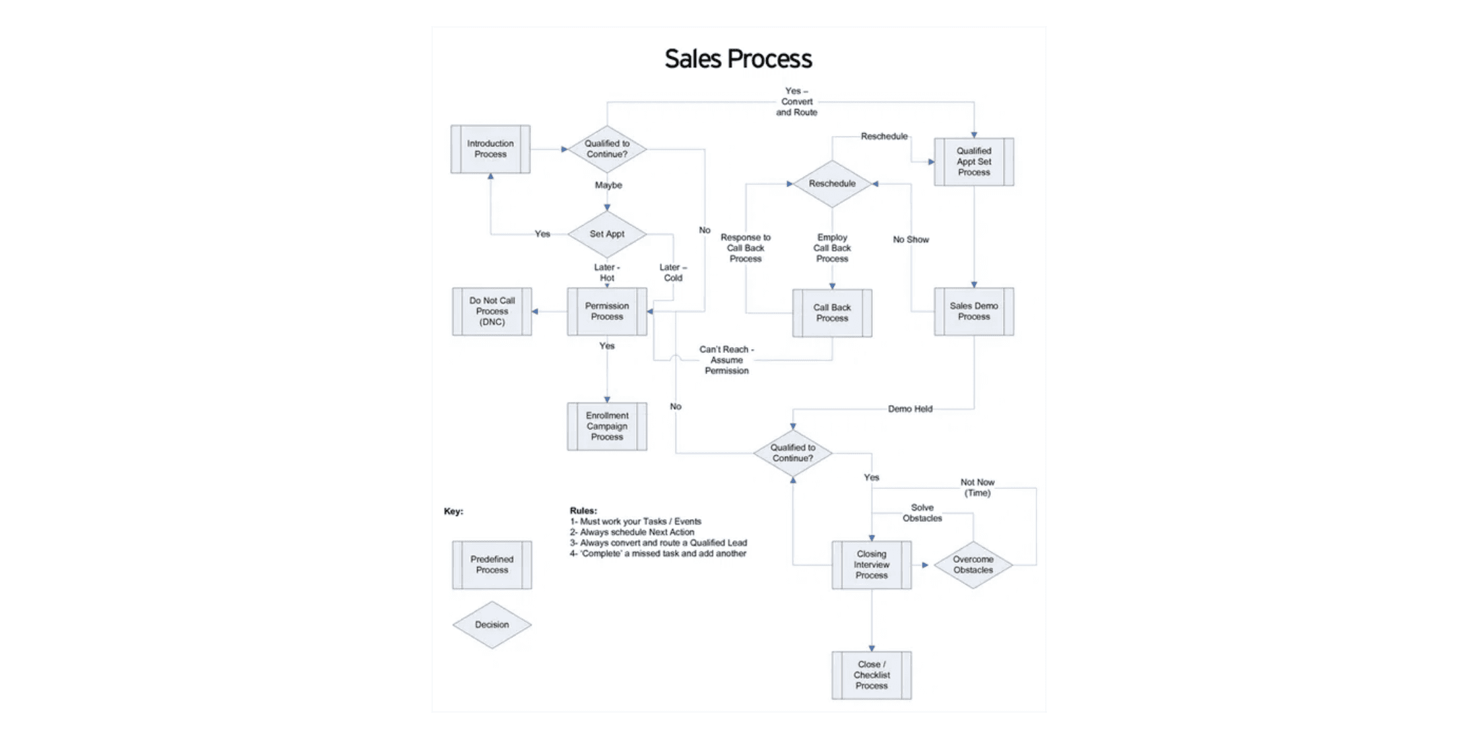
Beyond Testing - The Big Picture: Why This Matters & Where It Transfers
Healthcare
Financial Services
Patient journey workflows
→
Loan approval hierarchies
→
Treatment approval chains
→
Transaction risk workflows
→
Insurance authorization processes
→
Claims processing
→
E-commerce
Supply Chain
Order fulfillment routing
→
Procurement approvals
→
Return/refund approvals
→
Vendor selection processes
→
Inventory management decisions
→
Multi-stage quality checks
→
The Paradigm Shift
Traditional: Test automation lags months behind development
With AI: Test automation ready as fast as (or faster than) features
Result: Faster, safer deployments with comprehensive coverage
Core Transferable Principle
Use AI to map complex processes that humans struggle to visualize comprehensively

Slide 13

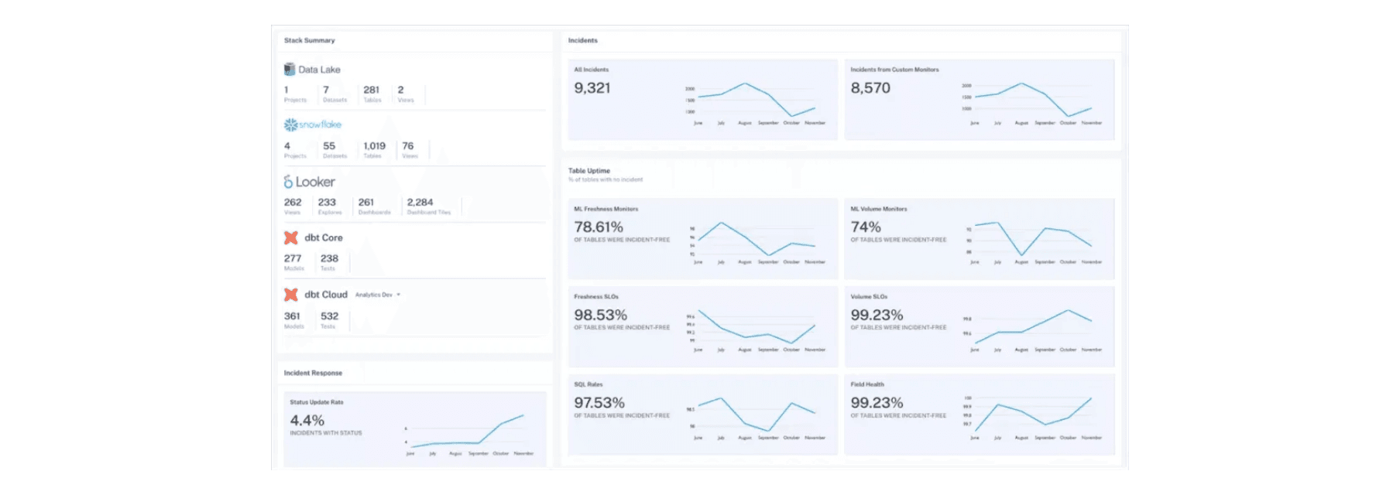
Closing & Key Takeaways
1
AI Democratizes Expertise
One person + AI can accomplish team-level work. No AI PhD required—just clear problem description and willingness to iterate.
2
Start with Understanding, Not Coding
Use AI to map the problem space first. Understanding business logic creates a solid foundation; coding becomes easier.
3
Iterate and Validate
What's Next for Us
AI accelerates execution; humans ensure correctness. Best results from continuous refinement and collaborative validation.
Expanding to additional form types in the system
→
AI-powered test data generation
→
Self-healing tests (auto-fix selector changes)
4
Think Transferably
→
Natural language test interface for business users
→
These patterns work across industries. Any complex approval or routing logic is a candidate for AI-assisted automation.
5
Documentation Matters
AI-generated docs ensure sustainability and transferability. Makes projects transferable beyond the original creator.
Call to Action
Questions?
Consider where complex processes exist in your work that could benefit from AI-assisted mapping and automation.

