Slide 1
Building Java Programs A Back to Basics Approach
CHAPTER 1
INTRODUCTION TO JAVA PROGRAMMING
Please download the PPT, and use Slide Show for a better viewing experience
Winnie Li

Slide 2
Topics will be covered
What is Computer Science?
What is Programming?
Basic Java Program (with println statements)
Structure
Identifier names
Syntax
Strings
Comments
Static Methods and Algorithms
Structured Version
Unstructured With Redundancy Version
Unstructured Without Redundancy Version

Slide 3
What is Computer Science?
Computers? Sciences? Programming?
Late lonely nights in front of computer? Or…
Computer Science (from Wikipedia)
The study of theoretical foundations of information and computation and their implementation and application in computer systems.
Algorithmic Thinking
Algorithm is… a step-by-step procedure for solving a problem or accomplishing some end especially by a computer
Many subfields
Graphics, Computer Vision
Artificial Intelligence
Scientific Computing
Robotics
Databases, Data Mining
User Interface
Natural Language Processing ...
Computer Engineering (CSE)
Overlap with CS and EE; emphasizes hardware

Slide 4
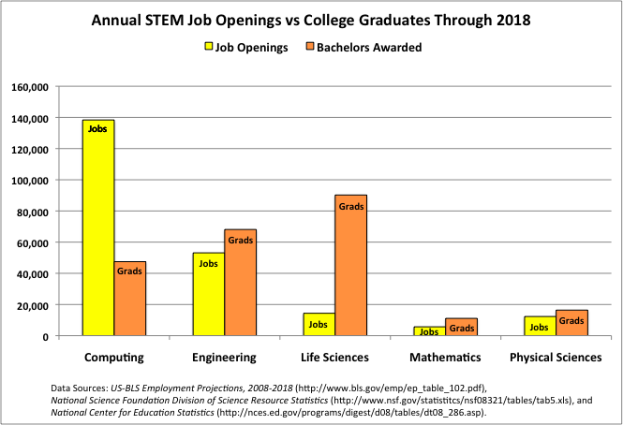
CS Job Market

Slide 5

What is programming?
program: A set of instructions to be carried out by a computer.
program execution: The act of carrying out the instructions contained in a program.
programming language: A systematic set of rules used to describe computations in a format that is editable by humans.
This textbook teaches programming in a language named Java.

Slide 6
Some modern languages
procedural languages: programs are a series of commands
Pascal (1970): designed for education
C (1972): low-level operating systems and device drivers
functional programming: functions map inputs to outputs
Lisp (1958) / Scheme (1975), ML (1973), Haskell (1990)
object-oriented languages: programs use interacting "objects"
Smalltalk (1980): first major object-oriented language
C++ (1985): "object-oriented" improvements to C
successful in industry; used to build major OSes such as Windows
Java (1995): designed for embedded systems, web apps/servers
Runs on many platforms (Windows, Mac, Linux, cell phones...)
The language taught in this textbook

Slide 7
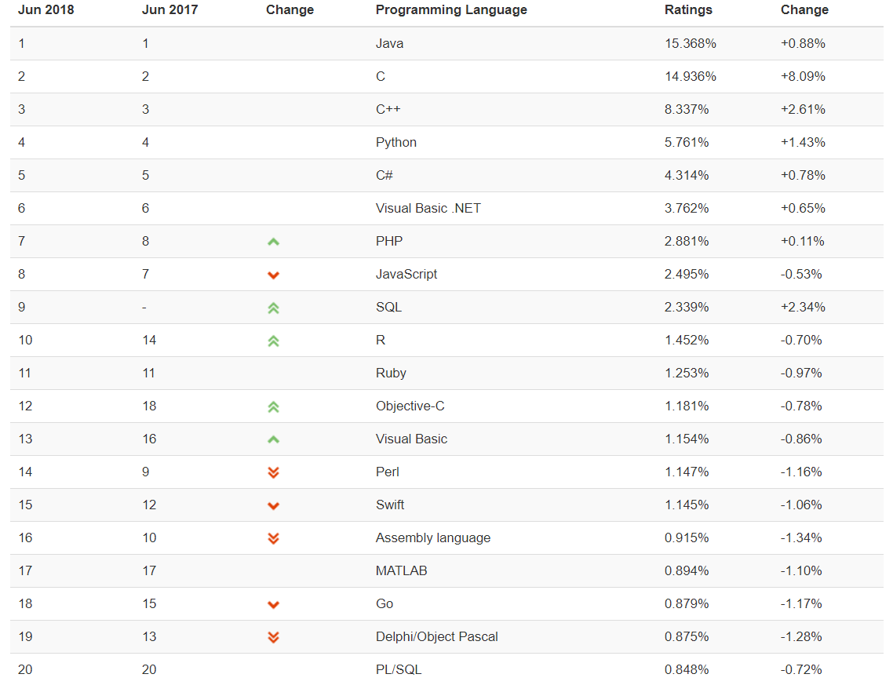
TIOBE Programming Community Index
Notes:
TIOBE Programming Community Index for June 2018.

Slide 8
Myths
CS/CSE majors spend lives in dark offices alone writing code
CS/CSE is only about lines and lines of details
CS/CSE is not creative
CS/CSE is only for people that want to work at large software companies
All the jobs moved to Bangalore
…
See more at: http://www.cs.washington.edu/whycse

Slide 9
Should you take this course?
NO
“I hate computers.”
“I don’t pay attention to details.”
Programming is fairly detail-oriented.
“I refuse to think logically.”
“I want to take an easy class.”
Hard for those who find difficulty in logical thinking and who don’t pay attention to details.

Slide 10
Should you take this course?
PROBABLY NOT
“I want free gourmet meals and to make lots of money by working for Google.”
“World of Warcraft rocks hardcore!”
“Everyone, look at my Facebook farm!”
“I’ve programmed before, so I can just coast through this for an easy A!“

Slide 11
Should you take this course?
YES
“I have to take this class.”
Is this the only reason? Are you pursuing the right major?
“I like to solve problems.”
“Computers and robots are going to take over the world. I want to befriend them so that my life will be spared.”

Slide 12
Basic Java programs with println statements
STRUCTURE
IDENTIFIER NAMES
SYNTAX
STRINGS
COMMENTS

Slide 13



Compile/run a Java program
Write it.
code or source code: The set of instructions in a program.
Compile it.
compile: Translate a program from one language to another.
byte code: The Java compiler converts your code into a format named byte code that runs on many computer types.
Run (execute) it.
output: The messages printed to the user by a program.
source code
byte code
output
compile
run

Slide 14
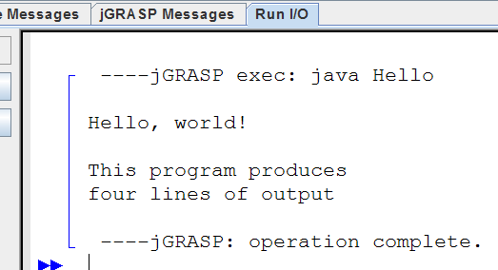
Example Java program
public class Hello {
public static void main(String[] args) {
System.out.println("Hello, world!");
System.out.println();
System.out.println("This program produces");
System.out.println("four lines of output");
}
}
Its output:
Hello, world!
This program produces
four lines of output
console: Text box into which the program's output is printed.

Slide 15
Structure of a Java program
class: a program
public class Name {
public static void main(String[] args) {
statement;
statement;
...
statement;
}
}
Every executable Java program consists of a class
that contains a method named main
that contains the statements (commands) to be executed.
method: a named group of statements
statement: a command to be executed

Slide 16
Names and identifiers
public class Hello {
public static void main(String[] args) {
System.out.println("Hello, world!");
…
You must give your program a name.
public class MyProgram {
Naming convention: Capitalize each word (e.g. MyClassName)
Your program's file must match exactly (MyProgram.java)
includes capitalization (Java is "case-sensitive")
identifier: A name given to an item in your program.
must start with a letter or _ or $
subsequent characters can be any of those or a number
legal: _myName TheCure ANSWER_IS_42 $bling$
illegal: me+u 49ers side-swipe Ph.D's
Why? __________________________________________

Slide 17
Keywords
public class Hello {
public static void main(String[] args) {
System.out.println("Hello, world!");
…
keyword: An identifier that you cannot use because it already has a reserved meaning in Java.
abstract default if private this
boolean do implements protected throw
break double import public throws
byte else instanceof return transient
case extends int short try
catch final interface static void
char finally long strictfp volatile
class float native super while
const for new switch
continue goto package synchronized
Notes:
Because Java is case-sensitive, you could technically use Class or cLaSs as identifiers, but this is very confusing and thus strongly discouraged.

Slide 18
System.out.println
public class Hello {
public static void main(String[] args) {
System.out.println("Hello, world!");
…
A statement that prints a line of output on the console.
pronounced "print-linn"
sometimes called a "println statement" for short
Two ways to use System.out.println :
System.out.println(“Your Message");
Prints the given message as output.
System.out.println();
Prints a blank line of output.

Slide 19
Syntax
public class Hello {
public static void main(String[] args) {
System.out.println("Hello, world!");
}
}
syntax: The set of legal structures and commands that can be used in a particular language.
Every basic Java statement ends with a semicolon ;
The contents of a class or method occur between { and }
syntax error (compiler error): A problem in the structure of a program that causes the compiler to fail.
Missing semicolon
Too many or too few { } braces
Illegal identifier for class name
Class and file names do not match… and many more

Slide 20
Syntax error example
1 public class Hello {
2 pooblic static void main(String[] args) {
3 System.owt.println("Hello, world!")_
4 }
5 }
Compiler output:
Hello.java:2: <identifier> expected
pooblic static void main(String[] args) {
^
Hello.java:3: ';' expected
}
^
2 errors
The compiler shows the line number where it found the error.
The error messages can be tough to understand!
Notes:
Computers are stupid, computers can’t read minds, computers don’t make mistakes. If the computer is NOT doing what you want, it’s because YOU made the mistake.

Slide 21
Strings
public class Hello {
public static void main(String[] args) {
System.out.println("Hello, world!");
…
string: A sequence of characters to be printed.
Starts and ends with a " quote " character.
The quotes do not appear in the output.
Examples:
"hello" "This is a string. It's fairly long!"
Restrictions:
May not span multiple lines.
"This is not a legal String."
May not contain a " character. "This is not a "legal" String either."

Slide 22
Escape sequences
escape sequence: A special sequence of characters used to represent certain special characters in a string.
\t tab character (Note: use FOUR spaces to represent)
\n new line character
\" quotation mark character
\\ backslash character
Example: System.out.println("\\hello\nhow\tare \"you\"?\\\\");
Output: \hello how are "you"?\\

Slide 23
Exercise 1
#1 - #5: What is the output of the following println statements?
1. System.out.println("a\tb\tc");
2. System.out.println("\\\\");
3. System.out.println("'");
4. System.out.println("\"\"\"");
5. System.out.println("C:/in\the downward spiral");
#6: Write a println statement to produce this output.
/ \ // \\ /// \\\

Slide 24
Fill in your answers…
Output of each println statement:
println statement to produce the line of output:

Slide 25
Exercise 2
What println statements will generate this output?
This program prints a
quote from the Gettysburg Address.
"Four score and seven years ago,
our 'fore fathers' brought forth on
this continent a new nation."
What println statements will generate this output?
A "quoted" String is
'much' better if you learn
the rules of "escape sequences."
Also, "" represents an empty String.
Don't forget: use \" instead of " !
'' is not the same as "

Slide 26
Fill in your answers…
println statements to generate the output:
println statements to generate the output:

Slide 27
Comments
comment: A note written in source code by the programmer to describe or clarify the code.
Comments are not executed when your program runs.
Syntax:
// comment text, on one line or, /* comment text; may span multiple lines */
Examples:
// This is a one-line comment.
/* This is a very long
multi-line comment. */

Slide 28
Using comments
Where to place comments:
at the top of each file (a "comment header")
at the start of every method (seen later)
to explain complex pieces of code
Comments are useful for:
Understanding larger, more complex programs.
Multiple programmers working together, who must understand each other's code.

Slide 29
Comments example
/* Maroon 5 Fan Student, CS 210, Winter 2012
This program prints lyrics about ... Moves Like Jagger */
public class MovesLikeJagger {
public static void main(String[] args) {
// first verse
System.out.println(“Just shoot for the stars");
System.out.println(“If it feels right");
System.out.println(“Then aim for my heart");
…
System.out.println();
// second verse
System.out.println(“Maybe it’s hard");
System.out.println(“When you feel like you’re broken and scarred");
System.out.println(“Nothing feels right");
…
System.out.println();
}
}

Slide 30
Static methods and algorithms
STATIC METHODS
ALGORITHMS
BAKE COOKIES EXAMPLE

Slide 31
Static methods
static method: A named group of statements.
denotes the structure of a program
eliminates redundancy by code reuse
procedural decomposition: dividing a problem into methods
Writing a static method is like adding a new command to Java.
class
method A
statement
statement
statement
method B
statement
statement
method C
statement
statement
statement

Slide 32
Using static methods
1. Design the algorithm.
Look at the structure, and which commands are repeated.
Decide what are the important overall tasks.
2. Declare (write down) the methods.
Arrange statements into groups and give each group a name.
3. Call (run) the methods.
The program's main method executes the other methods to perform the overall task.

Slide 33
Declaring a method
Gives your method a name so it can be executed
Syntax: public static void name() { statement; statement; ... statement; }
Example: public static void printClassSchedule() { System.out.println(“CS 210 Fundamentals of CS I"); System.out.println(“MW 10:30am to 12:20pm"); }

Slide 34
Calling a method
Executes the method's code
Syntax:
name();
You can call the same method many times if you like.
Example:
printClassSchedule();
Output:
CS 210 Fundamentals of CS I
MW 10:30am to 12:20pm

Slide 35
Program with static method
public class FreshPrince {
public static void main(String[] args) {
rap(); // Calling (running) the rap method
System.out.println();
rap(); // Calling the rap method again
}
// This method prints the lyrics to my favorite song.
public static void rap() {
System.out.println("Now this is the story all about how");
System.out.println("My life got flipped turned upside-down");
}
}
Output:
Now this is the story all about how
My life got flipped turned upside-down
Now this is the story all about how
My life got flipped turned upside-down

Slide 36
Methods calling methods
public class MethodsExample {
public static void main(String[] args) {
message1();
message2();
System.out.println("Done with main.");
}
public static void message1() {
System.out.println("This is message1.");
}
public static void message2() {
System.out.println("This is message2.");
message1();
System.out.println("Done with message2.");
}
}
Output:
This is message1.
This is message2.
This is message1.
Done with message2.
Done with main.

Slide 37
Control flow
play Slide Show for better displays
When a method is called, the program's execution...
"jumps" into that method, executing its statements, then
"jumps" back to the point where the method was called.
public class MethodsExample {
public static void main(String[] args) {
message1();
message2();
System.out.println("Done with main.");
}
...
}
public static void message1() {
System.out.println("This is message1.");
}
public static void message2() {
System.out.println("This is message2.");
message1();
System.out.println("Done with message2.");
}
public static void message1() {
System.out.println("This is message1.");
}

Slide 38

Algorithms
algorithm: A list of steps for solving a problem.
Example algorithm: "Bake sugar cookies"
Mix the dry ingredients.
Cream the butter and sugar.
Beat in the eggs.
Stir in the dry ingredients.
Set the oven temperature.
Set the timer.
Place the cookies into the oven.
Allow the cookies to bake.
Spread frosting and sprinkles onto the cookies.
...

Slide 39
Problems with algorithms
lack of structure: Many tiny steps; tough to remember.
redundancy: Consider making a double batch...
Mix the dry ingredients.
Cream the butter and sugar.
Beat in the eggs.
Stir in the dry ingredients.
Set the oven temperature.
Set the timer.
Place the first batch of cookies into the oven.
Allow the cookies to bake.
Set the timer.
Place the second batch of cookies into the oven.
Allow the cookies to bake.
Mix ingredients for frosting.
...

Slide 40
Structured algorithms
structured algorithm: Split into coherent tasks.
1 Make the cookie batter.
Mix the dry ingredients.
Cream the butter and sugar.
Beat in the eggs.
Stir in the dry ingredients.
2 Bake the cookies.
Set the oven temperature.
Set the timer.
Place the cookies into the oven.
Allow the cookies to bake.
3 Add frosting and sprinkles.
Mix the ingredients for the frosting.
Spread frosting and sprinkles onto the cookies.
...

Slide 41
Removing redundancy
A well-structured algorithm can describe repeated tasks with less redundancy.
1 Make the cookie batter.
Mix the dry ingredients.
...
2a Bake the cookies (first batch).
Set the oven temperature.
Set the timer.
...
2b Bake the cookies (second batch).
3 Decorate the cookies.
...

Slide 42
A program with redundancy
public class BakeCookies {
public static void main(String[] args) {
System.out.println("Mix the dry ingredients.");
System.out.println("Cream the butter and sugar.");
System.out.println("Beat in the eggs.");
System.out.println("Stir in the dry ingredients.");
System.out.println("Set the oven temperature.");
System.out.println("Set the timer.");
System.out.println("Place a batch of cookies into the oven.");
System.out.println("Allow the cookies to bake.");
System.out.println("Set the oven temperature.");
System.out.println("Set the timer.");
System.out.println("Place a batch of cookies into the oven.");
System.out.println("Allow the cookies to bake.");
System.out.println("Mix ingredients for frosting.");
System.out.println("Spread frosting and sprinkles.");
}
}

Slide 43
Design of an algorithm
// This program displays a delicious recipe for baking cookies.
public class BakeCookies2 {
public static void main(String[] args) {
// Step 1: Make the cake batter.
System.out.println("Mix the dry ingredients.");
System.out.println("Cream the butter and sugar.");
System.out.println("Beat in the eggs.");
System.out.println("Stir in the dry ingredients.");
// Step 2a: Bake cookies (first batch).
System.out.println("Set the oven temperature.");
System.out.println("Set the timer.");
System.out.println("Place a batch of cookies into the oven.");
System.out.println("Allow the cookies to bake.");
// Step 2b: Bake cookies (second batch).
System.out.println("Set the oven temperature.");
System.out.println("Set the timer.");
System.out.println("Place a batch of cookies into the oven.");
System.out.println("Allow the cookies to bake.");
// Step 3: Decorate the cookies.
System.out.println("Mix ingredients for frosting.");
System.out.println("Spread frosting and sprinkles.");
}
}

Slide 44
Final cookie program
// This program displays a delicious recipe for baking cookies.
public class BakeCookies3 {
public static void main(String[] args) {
makeBatter();
bake(); // 1st batch
bake(); // 2nd batch
decorate();
}
// Step 1: Make the cake batter.
public static void makeBatter() {
System.out.println("Mix the dry ingredients.");
System.out.println("Cream the butter and sugar.");
System.out.println("Beat in the eggs.");
System.out.println("Stir in the dry ingredients.");
}
// Step 2: Bake a batch of cookies.
public static void bake() {
System.out.println("Set the oven temperature.");
System.out.println("Set the timer.");
System.out.println("Place a batch of cookies into the oven.");
System.out.println("Allow the cookies to bake.");
}
// Step 3: Decorate the cookies.
public static void decorate() {
System.out.println("Mix ingredients for frosting.");
System.out.println("Spread frosting and sprinkles.");
}
}

Slide 45
Why methods part I?
Makes code easier to read by capturing the structure of the program
main should be a good summary of the program
public static void main(String[] args) {
}
Note: Longer code doesn’t
necessarily mean worse code
public static void main(String[] args) {
}
public static ... (...) {
}
public static ... (...) {
}

Slide 46
Why methods part II?
Eliminate redundancy
public static void main(String[] args) {
}
public static void main(String[] args) {
}
public static ... (...) {
}

Slide 47
When to use methods
Place statements into a static method if:
The statements are related structurally, and/or
The statements are repeated.
You should not create static methods for:
An individual println statement.
Only blank lines. (Put blank printlns in main.)
Unrelated or weakly related statements. (Consider splitting them into two smaller methods.)

Slide 48
Drawing complex figures with static methods
Unstructured version
structured with redundancy version
structured without redundancy version

Slide 49
Static methods question
Write a program to print these figures using methods.
______
/ \
/ \
\ /
\______/
\ /
\______/
+--------+
______
/ \
/ \
| STOP |
\ /
\______/
______
/ \
/ \
+--------+

Slide 50
Development strategy
______
/ \
/ \
\ /
\______/
\ /
\______/
+--------+
______
/ \
/ \
| STOP |
\ /
\______/
______
/ \
/ \
+--------+
First version (unstructured):
Create an empty program and main method.
Copy the expected output into it, surrounding each line with System.out.println syntax.
Run it to verify the output.

Slide 51
Program version 1
public class Figures1 {
public static void main(String[] args) {
System.out.println(" ______");
System.out.println(" / \\");
System.out.println("/ \\");
System.out.println("\\ /");
System.out.println(" \\______/");
System.out.println();
System.out.println("\\ /");
System.out.println(" \\______/");
System.out.println("+--------+");
System.out.println();
System.out.println(" ______");
System.out.println(" / \\");
System.out.println("/ \\");
System.out.println("| STOP |");
System.out.println("\\ /");
System.out.println(" \\______/");
System.out.println();
System.out.println(" ______");
System.out.println(" / \\");
System.out.println("/ \\");
System.out.println("+--------+");
}
}

Slide 52
Development strategy 2
______
/ \
/ \
\ /
\______/
\ /
\______/
+--------+
______
/ \
/ \
| STOP |
\ /
\______/
______
/ \
/ \
+--------+
Second version (structured, with redundancy):
Identify the structure of the output.
Divide the main method into static methods based on this structure.

Slide 53
Output structure
______
/ \
/ \
\ /
\______/
\ /
\______/
+--------+
______
/ \
/ \
| STOP |
\ /
\______/
______
/ \
/ \
+--------+
The structure of the output:
initial "egg" figure
second "teacup" figure
third "stop sign" figure
fourth "hat" figure
This structure can be represented by methods:
egg
teaCup
stopSign
hat

Slide 54
Program version 2
public class Figures2 {
public static void main(String[] args) {
egg();
teaCup();
stopSign();
hat();
}
public static void egg() {
System.out.println(" ______");
System.out.println(" / \\");
System.out.println("/ \\");
System.out.println("\\ /");
System.out.println(" \\______/");
System.out.println();
}
public static void teaCup() {
System.out.println("\\ /");
System.out.println(" \\______/");
System.out.println("+--------+");
System.out.println();
}
...

Slide 55
Program version 2, cont'd.
...
public static void stopSign() {
System.out.println(" ______");
System.out.println(" / \\");
System.out.println("/ \\");
System.out.println("| STOP |");
System.out.println("\\ /");
System.out.println(" \\______/");
System.out.println();
}
public static void hat() {
System.out.println(" ______");
System.out.println(" / \\");
System.out.println("/ \\");
System.out.println("+--------+");
}
}

Slide 56
Development strategy 3
______
/ \
/ \
\ /
\______/
\ /
\______/
+--------+
______
/ \
/ \
| STOP |
\ /
\______/
______
/ \
/ \
+--------+
Third version (structured, without redundancy):
Identify redundancy in the output, and create methods to eliminate as much as possible.
Add comments to the program.

Slide 57
Output redundancy
______
/ \
/ \
\ /
\______/
\ /
\______/
+--------+
______
/ \
/ \
| STOP |
\ /
\______/
______
/ \
/ \
+--------+
The redundancy in the output:
egg top: reused on stop sign, hat
egg bottom: reused on teacup, stop sign
divider line: used on teacup, hat
This redundancy can be fixed by methods:
eggTop
eggBottom
line

Slide 58
Program version 3
// Suzy Student, CSE 138, Spring 2094
// Prints several figures, with methods for structure and redundancy.
public class Figures3 {
public static void main(String[] args) {
egg();
teaCup();
stopSign();
hat();
}
// Draws the top half of an an egg figure.
public static void eggTop() {
System.out.println(" ______");
System.out.println(" / \\");
System.out.println("/ \\");
}
// Draws the bottom half of an egg figure.
public static void eggBottom() {
System.out.println("\\ /");
System.out.println(" \\______/");
}
// Draws a complete egg figure.
public static void egg() {
eggTop();
eggBottom();
System.out.println();
}
...

Slide 59
Program version 3, cont'd.
...
// Draws a teacup figure.
public static void teaCup() {
eggBottom();
line();
System.out.println();
}
// Draws a stop sign figure.
public static void stopSign() {
eggTop();
System.out.println("| STOP |");
eggBottom();
System.out.println();
}
// Draws a figure that looks sort of like a hat.
public static void hat() {
eggTop();
line();
}
// Draws a line of dashes.
public static void line() {
System.out.println("+--------+");
}
}

Slide 60

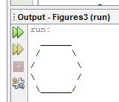
Program version 3 – Implementation Steps
Step 3: Repeat Step 2 as many times as needed. Make sure you implement ONE method at a time, keep checking the output, fixing bugs (if there are any), and move on…
Step 1: Put down the quarter, year, section #, change to YOUR name, and add a short summary (i.e., what is this program about)
Step 4: Add comments to each method and/or complicated code.
Step 2: Remove the default comments, and implement ONE method, run it and see if it works well.
This is the “default” program provided, you should modify this program and submit the final version
// CS 210
Spring 2013 Section OAS
play Slide Show for better displays
// Student Name
// Winnie Li
// Prints several figures, with methods for structure and redundancy.
public class Figures3 {
public static void main(String[] args) {
egg();
}
// TODO fill in your code to output the exact figure as specified in the problem
}
public static void egg() {
eggTop();
eggBottom();
System.out.println();
}
}
// Draws a complete egg figure.
// Draws the top half of an egg figure.
public static void eggTop() {
System.out.println(" ______");
System.out.println(" / \\");
System.out.println("/ \\");
}
public static void eggBottom() {
System.out.println("\\ /");
System.out.println(" \\______/");
}
// Draws the bottom half of an egg figure.
Continue

Slide 61
A word about style
Structure your code properly
Eliminate redundant code
Use spaces judiciously and consistently
Indent properly
Follow the naming conventions
Use comments to describe code behavior

Slide 62
Why style?
Programmers build on top of other’s code all the time.
You should NOT waste time deciphering what a method does.
You should spend time on thinking or coding.
You should NOT be wasting time looking for that missing closing brace.
So CODE WITH STYLE!

Slide 63
The End ☺
CHAPTER 1
INTRODUCTION TO JAVA PROGRAMMING
Winnie Li

