Slide 1
Building Java Programs A Back to Basics Approach
CHAPTER 4
CONDITIONAL EXECUTION
Please download the PPT, and use Slide Show for a better viewing experience
Winnie Li

Slide 2
Topics will be covered
The if/else statements
Logical Operators and Factoring
Cumulative Algorithms
Text Processing
System.out.printf

Slide 3
if/else Statements
IF STATEMENT
IF/ELSE STATEMENT
NESTED IF/ELSE STATEMENT
IF/ELSE/IF STATEMENT

Slide 4
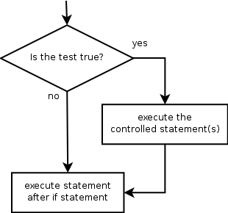
The if statement
Executes a block of statements only if a test is true
if (test) {
statement;
...
statement;
}
Example:
double gpa = console.nextDouble();
if (gpa >= 3.5) {
System.out.println("Application accepted.");
}

Slide 5
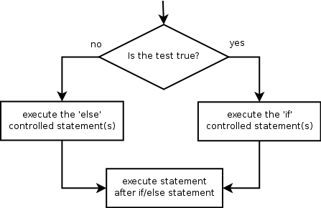
The if/else statement
Executes one block if a test is true, another if false
if (test) {
statement(s);
} else {
statement(s);
}
Example:
double gpa = console.nextDouble();
if (gpa >= 3.5) {
System.out.println("Welcome to Mars University!");
} else {
System.out.println("Application denied.");
}

Slide 6
Relational expressions
if statements and for loops both use logical tests.
for (int i = 1; i <= 10; i++) { ...
if (i <= 10) { ...
These are boolean expressions, will be taught in Ch. 5.
Tests use relational operators:
Operator | Meaning | Example | Value
== | equals | 1 + 1 == 2 | true
!= | does not equal | 3.2 != 2.5 | true
< | less than | 10 < 5 | false
> | greater than | 10 > 5 | true
<= | less than or equal to | 126 <= 100 | false
>= | greater than or equal to | 5.0 >= 5.0 | true

Slide 7
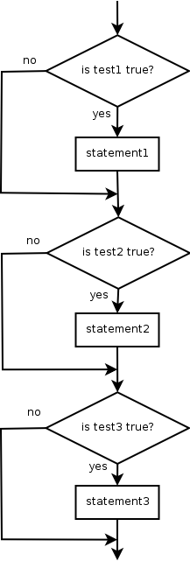
Misuse of if
What's wrong with the following code?
Scanner console = new Scanner(System.in);
System.out.print("What percentage did you earn? ");
int percent = console.nextInt();
if (percent >= 90) {
System.out.println("You got an A!");
}
if (percent >= 80) {
System.out.println("You got a B!");
}
if (percent >= 70) {
System.out.println("You got a C!");
}
if (percent >= 60) {
System.out.println("You got a D!");
}
if (percent < 60) {
System.out.println("You got an F!");
}
...

Slide 8
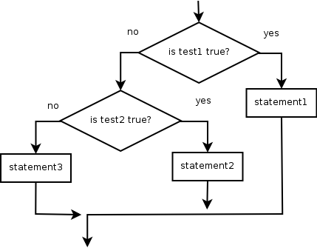
Nested if/else
Chooses between outcomes using many tests
if (test) {
statement(s);
} else if (test) {
statement(s);
} else {
statement(s);
}
Example:
if (x > 0) {
System.out.println("Positive");
} else if (x < 0) {
System.out.println("Negative");
} else {
System.out.println("Zero");
}

Slide 9
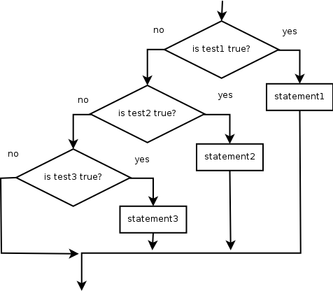
Nested if/else/if
If it ends with else, exactly one path must be taken.
If it ends with if, the code might not execute any path.
if (test) {
statement(s);
} else if (test) {
statement(s);
} else if (test) {
statement(s);
}
Example:
if (place == 1) {
System.out.println("Gold medal!");
} else if (place == 2) {
System.out.println("Silver medal!");
} else if (place == 3) {
System.out.println("Bronze medal.");
}

Slide 10
Nested if structures
exactly 1 path (mutually exclusive) if (test) { statement(s); } else if (test) { statement(s); } else { statement(s); } | 0 or 1 path (mutually exclusive) if (test) { statement(s); } else if (test) { statement(s); } else if (test) { statement(s); } | 0, 1, or many paths (independent tests; not exclusive) if (test) { statement(s); } if (test) { statement(s); } if (test) { statement(s); }

Slide 11
What is the output? 1
Scanner console = new Scanner(System.in);
System.out.print("What percentage did you earn? ");
int percent = console.nextInt();
if (percent >= 90) {
System.out.println("You got an A!");
}
if (percent >= 80) {
System.out.println("You got a B!");
}
if (percent >= 70) {
System.out.println("You got a C!");
}
if (percent >= 60) {
System.out.println("You got a D!");
}
if (percent < 60) {
System.out.println("You got an F!");
}
...
Input:
95
86
74
62
58
-12
Notes:
A B C D
B C D
C D
D
F

Slide 12
What is the output? 2
Scanner console = new Scanner(System.in);
System.out.print("What percentage did you earn? ");
int percent = console.nextInt();
if (percent >= 90) {
System.out.println("You got an A!");
}
else if (percent >= 80) {
System.out.println("You got a B!");
}
else if (percent >= 70) {
System.out.println("You got a C!");
}
else if (percent >= 60) {
System.out.println("You got a D!");
}
else {
System.out.println("You got an F!");
}
...
Input:
95
86
74
62
58
-12
Notes:
A
B
C
D
F

Slide 13
What is the output? 3
Scanner console = new Scanner(System.in);
System.out.print("What percentage did you earn? ");
int percent = console.nextInt();
if (percent >= 90) {
System.out.println("You got an A!");
}
else if (percent >= 80) {
System.out.println("You got a B!");
}
else if (percent >= 70) {
System.out.println("You got a C!");
}
else if (percent >= 60) {
System.out.println("You got a D!");
}
else if (percent > 0) {
System.out.println("You got an F!");
}
...
Input:
95
86
74
62
58
-12
Notes:
A
B
C
D
F
___

Slide 14
Which nested if/else?
(1) if/if/if (2) nested if/else (3) nested if/else/if
Whether a user is lower, middle, or upper-class based on income.
(2) nested if / else if / else
Whether you made the dean's list (GPA ≥ 3.8) or honor roll (3.5-3.8).
(3) nested if / else if
Whether a number is divisible by 2, 3, and/or 5.
(1) sequential if / if / if
Computing a grade of A, B, C, D, or F based on a percentage.
(2) nested if / else if / else if / else if / else

Slide 15
Loops with if/else
if/else statements can be used with loops or methods:
int evenSum = 0;
int oddSum = 0;
for (int i = 1; i <= 10; i++) {
if (i % 2 == 0) {
evenSum = evenSum + i;
} else {
oddSum = oddSum + i;
}
}
System.out.println("Even sum: " + evenSum);
System.out.println("Odd sum: " + oddSum);

Slide 16
The if/else hammer
Just because you learned a new construct does not mean that every new problem has to be solved using that construct!
int z = Math.max(x, y);
int z; if (x > y) { z = x; } else { z = y; }

Slide 17
Logical Operators and Factoring
LOGICAL OPERATORS
LOGICAL EXPRESSIONS
FACTORING
IF/ELSE AND RETURN

Slide 18
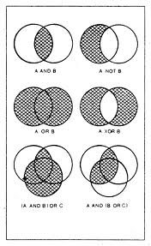
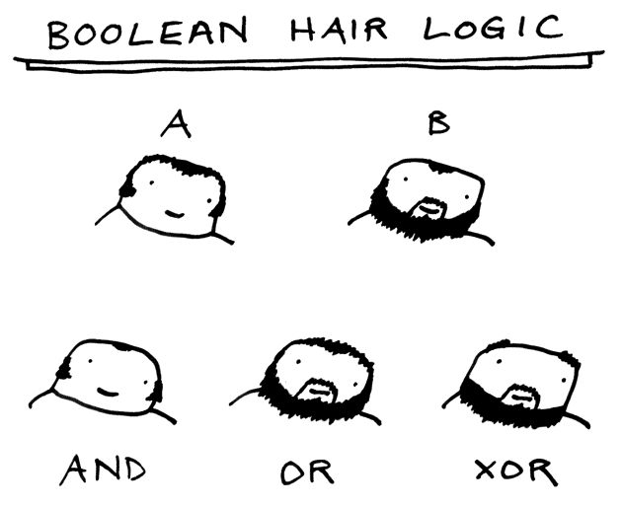
AND? OR? NOT?
?
?
?
?
?

Slide 19
Logical operators
Tests can be combined using logical operators:
"Truth tables" for each, used with logical values p and q:
Operator | Description | Example | Result
&& | and | (2 == 3) && (-1 < 5) | false
|| | or | (2 == 3) || (-1 < 5) | true
! | not | !(2 == 3) | true
p | q | p && q | p || q
true | true | true | true
true | false | false | true
false | true | false | true
false | false | false | false
p | !p
true | false
false | true

Slide 20
Evaluating logic expressions
Relational operators have lower precedence than math.
5 * 7 >= 3 + 5 * (7 - 1)
5 * 7 >= 3 + 5 * 6
35 >= 3 + 30
35 >= 33
true
Relational operators cannot be "chained" as in algebra.
2 <= x <= 10
true <= 10 (assume that x is 15)
error!
Instead, combine multiple tests with && or ||
2 <= x && x <= 10
true && false
false

Slide 21
Logical Exercises
#1 - #5: What is the result of each of the following expressions? True or False?
int x = 42;
int y = 17;
int z = 25;
1. y < x && y <= z
2. x % 2 == y % 2 || x % 2 == z % 2
3. x <= y + z && x >= y + z
4. !(x < y && x < z)
5. (x + y) % 2 == 0 || !((z - y) % 2 == 0)
Fun Question: Write a program that prompts for information about a person and uses it to decide whether to date them.

Slide 22
Factoring if/else code
factoring: Extracting common/redundant code.
Can reduce or eliminate redundancy from if/else code.
Example:
if (a == 1) {
System.out.println(a);
x = 3;
b = b + x;
} else if (a == 2) {
System.out.println(a);
x = 6;
y = y + 10;
b = b + x;
} else { // a == 3
System.out.println(a);
x = 9;
b = b + x;
}
System.out.println(a);
x = 3 * a;
if (a == 2) {
y = y + 10;
}
b = b + x;

Slide 23
The "dangling if" problem
What can be improved about the following code?
if (x < 0) {
System.out.println("x is negative");
} else if (x >= 0) {
System.out.println("x is non-negative");
}

Slide 24
if/else with return
// Returns the larger of the two given integers.
public static int max(int a, int b) {
if (a > b) {
return a;
} else {
return b;
}
}
Methods can return different values using if/else
Whichever path the code enters, it will return that value.
Returning a value causes a method to immediately exit.
All paths through the code must reach a return statement.

Slide 25
All paths must return
public static int max(int a, int b) {
if (a > b) {
return a;
}
// Error: not all paths return a value
}
The following also does not compile:
public static int max(int a, int b) {
if (a > b) {
return a;
} else if (b >= a) {
return b;
}
}
The compiler thinks if/else/if code might skip all paths, even though mathematically it must choose one or the other.
How can we fix it?

Slide 26
if/else, return question
Write a method quadrant that accepts a pair of real numbers x and y and returns the quadrant for that point:
Example: quadrant(-4.2, 17.3) returns 2
If the point falls directly on either axis, return 0.
y+
quadrant 2
quadrant 1
x-
x+
quadrant 3
quadrant 4
y-

Slide 27
if/else, return answer
public static int quadrant(double x, double y) {
if … {
return …;
}
…
}
public static int quadrant(double x, double y) {
if (x > 0 && y > 0) {
return 1;
} else if (x < 0 && y > 0) {
return 2;
} else if (x < 0 && y < 0) {
return 3;
} else if (x > 0 && y < 0) {
return 4;
} else { // at least one coordinate equals 0
return 0;
}
}

Slide 28
Cumulative Algorithms
Cumulative sum
Cumulative product
Receipt example

Slide 29
Adding many numbers
How would you find the sum of all integers from 1-1000?
// This may require a lot of typing
int sum = 1 + 2 + 3 + 4 + ... ;
System.out.println("The sum is " + sum);
What if we want the sum from 1 - 1,000,000? Or the sum up to any maximum?
How can we generalize the above code?

Slide 30
Cumulative sum loop
int sum = 0;
for (int i = 1; i <= 1000; i++) {
sum = sum + i;
}
System.out.println("The sum is " + sum);
cumulative sum: A variable that keeps a sum in progress and is updated repeatedly until summing is finished.
The sum in the above code is an attempt at a cumulative sum.
Cumulative sum variables must be declared outside the loops that update them, so that they will still exist after the loop.

Slide 31
Cumulative product
This cumulative idea can be used with other operators:
int product = 1;
for (int i = 1; i <= 20; i++) {
product = product * 2;
}
System.out.println("2 ^ 20 = " + product);
Any other way to achieve this?
How would we make the base and exponent adjustable?

Slide 32
Scanner and cumul. sum
We can do a cumulative sum of user input:
Scanner console = new Scanner(System.in);
int sum = 0;
for (int i = 1; i <= 100; i++) {
System.out.print("Type a number: ");
sum = sum + console.nextInt();
}
System.out.println("The sum is " + sum);

Slide 33
Cumulative sum question
Modify the Receipt program from Ch. 2.
Prompt for how many people, and each person's dinner cost.
Use static methods to structure the solution.
Example log of execution:
How many people ate? 4
Person #1: How much did your dinner cost? 20.00
Person #2: How much did your dinner cost? 15
Person #3: How much did your dinner cost? 30.0
Person #4: How much did your dinner cost? 10.00
Subtotal: $75.0
Tax: $6.0
Tip: $11.25
Total: $92.25

Slide 34
Cumulative sum answer
// This program enhances our Receipt program using a cumulative sum.
import java.util.*;
public class Receipt2 {
public static void main(String[] args) {
Scanner console = new Scanner(System.in);
double subtotal = meals(console);
results(subtotal);
}
// Prompts for number of people and returns total meal subtotal.
public static double meals(Scanner console) {
System.out.print("How many people ate? ");
int people = console.nextInt();
double subtotal = 0.0; // cumulative sum
for (int i = 1; i <= people; i++) {
System.out.print("Person #" + i +
": How much did your dinner cost? ");
double personCost = console.nextDouble();
subtotal = subtotal + personCost; // add to sum
}
return subtotal;
}
...

Slide 35
Cumulative answer, cont'd.
...
// Calculates total owed, assuming 8% tax and 15% tip
public static void results(double subtotal) {
double tax = subtotal * .08;
double tip = subtotal * .15;
double total = subtotal + tax + tip;
System.out.println("Subtotal: $" + subtotal);
System.out.println("Tax: $" + tax);
System.out.println("Tip: $" + tip);
System.out.println("Total: $" + total);
}
}

Slide 36
Strings
Indexes
String methods
Compare strings

Slide 37
Recall: Strings
string: An object storing a sequence of text characters.
Unlike most other objects, a String is not created with new.
String <name> = "<text>";
String <name> = <expression with String value>;
Examples: String name = “Winnie Li"; int x = 3; int y = 5; String point = "(" + x + ", " + y + ")";

Slide 38
Indexes
Characters of a string are numbered with 0-based indexes:
String name = "M. Mouse";
First character's index : 0
Last character's index : 1 less than the string's length
The individual characters are values of type char (seen later)
index | 0 | 1 | 2 | 3 | 4 | 5 | 6 | 7
character | M | . |  | M | o | u | s | e

Slide 39
String methods
These methods are called using the dot notation:
String popStarz = "Prince vs. Michael";
System.out.println(popStarz.length()); // 18
Method name | Description
indexOf(<string>) | index where the start of the given string appears in this string (-1 if not found)
length() | number of characters in this string
substring(<index1>, <index2>) or substring(<index1>) | the characters in this string from index1 (inclusive) to index2 (exclusive); if index2 is omitted, grabs until end of string
toLowerCase() | a new string with all lowercase letters
toUpperCase() | a new string with all uppercase letters

Slide 40
String method examples
// index 012345678901
String s1 = "Stuart Reges";
String s2 = "Marty Stepp";
System.out.println(s1.length()); // 12
System.out.println(s1.indexOf("e")); // 8
System.out.println(s1.substring(7, 10)); // "Reg"
String s3 = s2.substring(1, 7);
System.out.println(s3.toLowerCase()); // "arty s"
Given the following string:
// index 0123456789012345678901
String book = "Building Java Programs";
How would you extract the word "Java" ?
System.out.println(book.substring(9, 13));

Slide 41
Modifying strings
Methods like substring and toLowerCase build and return a new string, rather than modifying the current string.
String s = "Mumford & Sons";
s.toUpperCase();
System.out.println(s); // Mumford & Sons
To modify a variable's value, you must reassign it:
String s = "Mumford & Sons";
s = s.toUpperCase();
System.out.println(s); // MUMFORD & SONS

Slide 42
Strings as user input
Scanner's next method reads a word of input as a String.
Scanner console = new Scanner(System.in);
System.out.print("What is your name? ");
String name = console.next();
name = name.toUpperCase();
System.out.println(name + " has " + name.length() +
" letters and starts with " + name.substring(0, 1));
Output:
What is your name? Winnie
Winnie has 6 letters and starts with W
The nextLine method reads a line of input as a String.
System.out.print("What is your address? ");
String address = console.nextLine();

Slide 43
Comparing strings
Relational operators such as < and == fail on objects.
Scanner console = new Scanner(System.in);
System.out.print("What is your name? ");
String name = console.next();
if (name == "Barney") {
System.out.println("I love you, you love me,");
System.out.println("We're a happy family!");
}
This code will compile, but it will not print the song.
== compares objects by references (seen later), so it often gives false even when two Strings have the same letters.

Slide 44
The equals method
Objects are compared using a method named equals.
Scanner console = new Scanner(System.in);
System.out.print("What is your name? ");
String name = console.next();
if (name.equals("Barney")) {
System.out.println("I love you, you love me,");
System.out.println("We're a happy family!");
}
Technically this is a method that returns a value of type boolean, the type used in logical tests.

Slide 45
String test methods
String name = console.next();
if (name.startsWith("Prof")) { System.out.println("When are your office hours?"); } else if (name.equalsIgnoreCase("STUART")) { System.out.println("Let's talk about meta!"); }
Method | Description
equals(str) | whether two strings contain the same characters
equalsIgnoreCase(str) | whether two strings contain the same characters, ignoring upper vs. lower case
startsWith(str) | whether one contains other's characters at start
endsWith(str) | whether one contains other's characters at end
contains(str) | whether the given string is found within this one

Slide 46
Text Processing
Type char
Compare char value
Character methods

Slide 47
Type char
char : A primitive type representing single characters.
A String is stored internally as an array of char
String s = "Ali G.";
It is legal to have variables, parameters, returns of type char
surrounded with apostrophes: 'a' or '4' or '\n' or '\''
char letter = ‘L';
System.out.println(letter); // L
System.out.println(“Prof. “ + letter); // Prof. L
index | 0 | 1 | 2 | 3 | 4 | 5
value | 'A' | 'l' | 'i' | ' ' | 'G' | '.'

Slide 48
The charAt method
The chars in a String can be accessed using the charAt method.
accepts an int index parameter and returns the char at that index
String food = "cookie";
char firstLetter = food.charAt(0); // 'c'
System.out.println(firstLetter + " is for " + food);
You can use a for loop to print or examine each character.
String major = "CSE";
for (int i = 0; i < major.length(); i++) { // output:
char c = major.charAt(i); // C
System.out.println(c); // S
} // E

Slide 49
Comparing char values
You can compare chars with ==, !=, and other operators:
String word = console.next();
char last = word.charAt(word.length() - 1);
if (last == 's') {
System.out.println(word + " is plural.");
}
// prints the alphabet
for (char c = 'a'; c <= 'z'; c++) {
System.out.print(c);
}

Slide 50
char vs. int
Each char is mapped to an integer value internally
Called an ASCII value
'A' is 65 'B' is 66 ' ' is 32
'a' is 97 'b' is 98 '*' is 42
Mixing char and int causes automatic conversion to int.
'a' + 10 is 107, 'A' + 'A' is 130
To convert an int into the equivalent char, type-cast it.
(char) ('a' + 2) is 'c'

Slide 51
char vs. String
"h" is a String, but 'h' is a char (they are different)
A String is an object; it contains methods.
String s = "h";
s = s.toUpperCase(); // "H"
int len = s.length(); // 1
char first = s.charAt(0); // 'H'
A char is primitive; you can't call methods on it.
char c = 'h';
c = c.toUpperCase(); // ERROR
s = s.charAt(0).toUpperCase(); // ERROR
What is s + 1 ? What is c + 1 ?
What is s + s ? What is c + c ?
Notes:
51

Slide 52
Character methods
Method | Description
getUnmericValue(Ch) | converts a “numeric” character into number
isDigit(Ch) | whether or not a character is one of digits ‘0’ through ‘9’
isLetter(Ch) | whether or not a character is one of letters
isLowerCase(Ch) | whether or not a character is a lowercase letter
isUpperCase(Ch) | whether or not a character is a uppercase letter
toLowerCase(Ch) | converts a character into the lowercase version
toUpperCase(Ch) | converts a character into the uppercase version
Character.getNumericValue(‘6’) returns 6
Character.isDigit(‘C’) returns false
Character.isLowerCase(‘h’) returns true
Character.toUpperCase(‘e’) returns ‘E’

Slide 53
string and Character Methods Exercises
Assume that the following variables have been declared:
String a = “Ready, Set, Go!”;
String b = a.substring(5, 10);
char b1 = b.charAt(2);
Evaluate the following expressions:
#1. Character.isLowerCase(b1)
#2. Character.toLowerCase(b1)
#3. a.charAt(2 + a.indexOf(“e”))
#4. b + 5
#5. b1 + 5

Slide 54
Cumulative text algorithm examples
accepts a string and a char and returns the number of times the character occurs in the string.
int found = 0;
for (int i = 0; i < text.length(); i++) {
if (text.charAt(i) == ‘i’) {
found++;
} // “Winnie” returns 2
}
return found;
accepts a string and returns the same char in the reverse order.
String result = "";
for (int i = 0; i < phrase.length(); i++) { // “stressed”
result = text.charAt(i) + result; // returns
} // “desserts”
return result;

Slide 55
System.out.printf

Slide 56
Formatting text with printf
System.out.printf("format string", parameters);
A format string can contain placeholders to insert parameters:
%d integer
%f real number
%s string
NOTE: these placeholders are used instead of + concatenation
Example:
int x = 3;
int y = -17;
System.out.printf("x is %d and y is %d!\n", x, y);
// x is 3 and y is -17!
NOTE: printf does not drop to the next line unless you write \n

Slide 57
printf width
%Wd integer, W characters wide, right-aligned
%-Wd integer, W characters wide, left-aligned
%Wf real number, W characters wide, right-aligned
...
for (int i = 1; i <= 3; i++) {
for (int j = 1; j <= 10; j++) {
System.out.printf("%4d", (i * j));
}
System.out.println(); // to end the line
}
Output:
1 2 3 4 5 6 7 8 9 10
2 4 6 8 10 12 14 16 18 20
3 6 9 12 15 18 21 24 27 30

Slide 58
printf precision
%.Df real number, rounded to D digits after decimal
%W.Df real number, W chars wide, D digits after decimal
%-W.Df real number, W wide (left-align), D after decimal
double gpa = 3.253764;
System.out.printf("your GPA is %.1f\n", gpa);
System.out.printf("more precisely: %8.3f\n", gpa);
Output:
your GPA is 3.3
more precisely: 3.254
3
8

Slide 59
printf question
Modify our Receipt program to better format its output.
Display results in the format below, with $ and 2 digits after .
Example log of execution:
How many people ate? 4
Person #1: How much did your dinner cost? 20.00
Person #2: How much did your dinner cost? 15
Person #3: How much did your dinner cost? 25.0
Person #4: How much did your dinner cost? 10.00
Subtotal: $70.00
Tax: $5.60
Tip: $10.50
Total: $86.10

Slide 60
printf answer (partial)
...
// Calculates total owed, assuming 8% tax and 15% tip
public static void results(double subtotal) {
double tax = subtotal * .08;
double tip = subtotal * .15;
double total = subtotal + tax + tip;
// System.out.println("Subtotal: $" + subtotal);
// System.out.println("Tax: $" + tax);
// System.out.println("Tip: $" + tip);
// System.out.println("Total: $" + total);
System.out.printf("Subtotal: $%.2f\n", subtotal);
System.out.printf("Tax: $%.2f\n", tax);
System.out.printf("Tip: $%.2f\n", tip);
System.out.printf("Total: $%.2f\n", total);
}
}

Slide 61
The End ☺
CHAPTER 4
CONDITIONAL EXECUTION
Winnie Li

Slide 62
if/else, return question
Write a method countFactors that returns the number of factors of an integer.
countFactors(24) returns 8 because 1, 2, 3, 4, 6, 8, 12, and 24 are factors of 24.
Solution:
// Returns how many factors the given number has.
public static int countFactors(int number) {
int count = 0;
for (int i = 1; i <= number; i++) {
if (number % i == 0) {
count++; // i is a factor of number
}
}
return count;
}

Slide 63
Nested if/else example
Formula for body mass index (BMI):
Write a program that produces output like the following:
This program reads data for two people and
computes their body mass index (BMI).
Enter next person's information:
height (in inches)? 70.0
weight (in pounds)? 194.25
Enter next person's information:
height (in inches)? 62.5
weight (in pounds)? 130.5
Person 1 BMI = 27.868928571428572
overweight
Person 2 BMI = 23.485824
normal
Difference = 4.3831045714285715
BMI | Weight class
below 18.5 | underweight
18.5 - 24.9 | normal
25.0 - 29.9 | overweight
30.0 and up | obese
Notes:
// This program computes two people's body mass index (BMI) and
// compares them. The code uses parameters, returns, and Scanner.
import java.util.*; // so that I can use Scanner
public class BMI {
public static void main(String[] args) {
System.out.println("This program reads in data for two people and");
System.out.println("computes their body mass index (BMI)");
System.out.println();
// finish me!
}
}

Slide 64
Nested if/else answer
// This program computes two people's body mass index (BMI) and
// compares them. The code uses Scanner for input, and parameters/returns.
import java.util.*; // so that I can use Scanner
public class BMI {
public static void main(String[] args) {
introduction();
Scanner console = new Scanner(System.in);
double bmi1 = person(console);
double bmi2 = person(console);
// report overall results
report(1, bmi1);
report(2, bmi2);
System.out.println("Difference = " + Math.abs(bmi1 - bmi2));
}
// prints a welcome message explaining the program
public static void introduction() {
System.out.println("This program reads data for two people and");
System.out.println("computes their body mass index (BMI).");
System.out.println();
}
...

Slide 65
Nested if/else, cont'd.
// reads information for one person, computes their BMI, and returns it
public static double person(Scanner console) {
System.out.println("Enter next person's information:");
System.out.print("height (in inches)? ");
double height = console.nextDouble();
System.out.print("weight (in pounds)? ");
double weight = console.nextDouble();
System.out.println();
double bodyMass = bmi(height, weight);
return bodyMass;
}
// Computes/returns a person's BMI based on their height and weight.
public static double bmi(double height, double weight) {
return (weight * 703 / height / height);
}
// Outputs information about a person's BMI and weight status.
public static void report(int number, double bmi) {
System.out.println("Person " + number + " BMI = " + bmi);
if (bmi < 18.5) {
System.out.println("underweight");
} else if (bmi < 25) {
System.out.println("normal");
} else if (bmi < 30) {
System.out.println("overweight");
} else {
System.out.println("obese");
}
}
}
Notes:
How would we round the BMI numbers?

Slide 66
Scanners as parameters
If many methods need to read input, declare a Scanner in main and pass it to the other methods as a parameter.
public static void main(String[] args) {
Scanner console = new Scanner(System.in);
int sum = readSum3(console);
System.out.println("The sum is " + sum);
}
// Prompts for 3 numbers and returns their sum.
public static int readSum3(Scanner console) {
System.out.print("Type 3 numbers: ");
int num1 = console.nextInt();
int num2 = console.nextInt();
int num3 = console.nextInt();
return num1 + num2 + num3;
}

