Slide 1
Building Java Programs A Back to Basics Approach
CHAPTER 10
ArrayList
Please download the PPT, and use Slide Show for better viewing experience
Winnie Li

Slide 2
Topics will be covered
Basic ArrayLists Operations
ArrayList Searching Methods
Adding to and Removing from an ArrayList
Wrapper Classes
Using ArrayList

Slide 3
ArrayLists
reading: 10.1

Slide 4
Exercise
Write a program that reads a file and displays the words of that file as a list.
First display all words.
Then display them with all plurals (ending in "s") capitalized.
Then display them in reverse order.
Then display them with all plural words removed.
Should we solve this problem using an array?
Why or why not?

Slide 5
Naive solution
String[] allWords = new String[1000];
int wordCount = 0;
Scanner input = new Scanner(new File("data.txt"));
while (input.hasNext()) {
String word = input.next();
allWords[wordCount] = word;
wordCount++;
}
Problem: You don't know how many words the file will have.
Hard to create an array of the appropriate size.
Later parts of the problem are more difficult to solve.
Luckily, there are other ways to store data besides in an array.

Slide 6
Collections
collection: an object that stores data; a.k.a. "data structure"
the objects stored are called elements
some collections maintain an ordering; some allow duplicates
typical operations: add, remove, clear, contains (search), size
examples found in the Java class libraries:
ArrayList, LinkedList, HashMap, TreeSet, PriorityQueue
all collections are in the java.util package
import java.util.*;

Slide 7
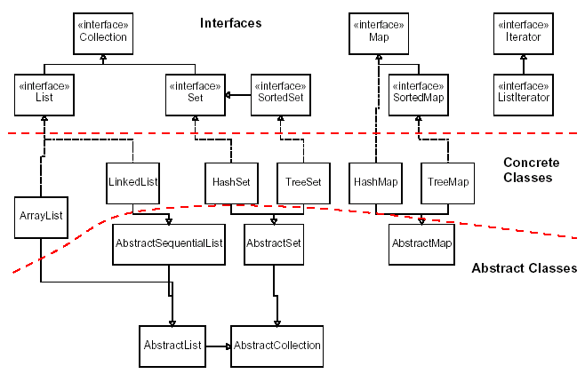
Java collections framework

Slide 8
Topics covered in Chapter 10 - 18
Array
ArrayList
HashSet
HashMap
(Key-Value in Data Science)
Recursion
Time Complexity
Searching Algorithm
Sorting Algorithm
Stack Operations
LinkedList
Binary Search Tree
Binary Tree
Priority Queue/Heap
Trie
Red-Black Tree
Hashing

Slide 9
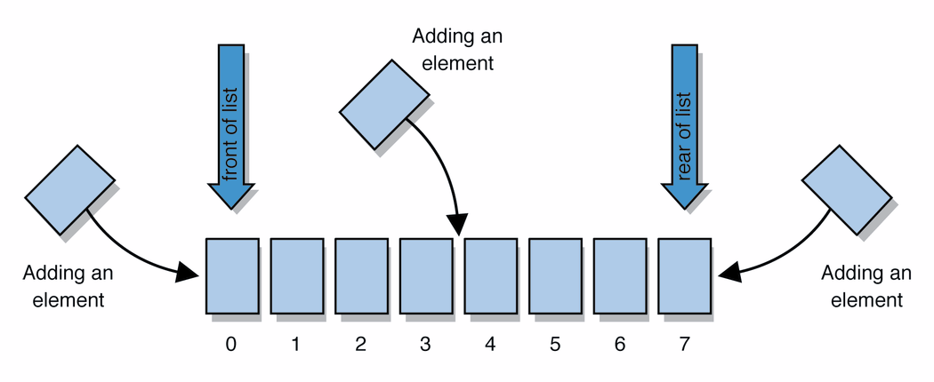
Lists
list: a collection storing an ordered sequence of elements
each element is accessible by a 0-based index
a list has a size (number of elements that have been added)
elements can be added to the front, back, or elsewhere
in Java, a list can be represented as an ArrayList object
Notes:
use jGRASP/DrJava Interactions window to create a list and add some elements, get them, check size

Slide 10
Idea of a list
Rather than creating an array of boxes, create an object that represents a "list" of items. (initially an empty list.)
[]
You can add items to the list.
The default behavior is to add to the end of the list.
[hello, ABC, goodbye, okay]
The list object keeps track of the element values that have been added to it, their order, indexes, and its total size.
Think of an "array list" as an automatically resizing array object.
Internally, the list is implemented using an array and a size field.

Slide 11
ArrayList methods 1
add(value) | appends value at end of list
add(index, value) | inserts given value just before the given index, shifting subsequent values to the right
clear() | removes all elements of the list
indexOf(value) | returns first index where given value is found in list (-1 if not found)
get(index) | returns the value at given index
remove(index) | removes/returns value at given index, shifting subsequent values to the left
set(index, value) | replaces value at given index with given value
size() | returns the number of elements in list
toString() | returns a string representation of the list such as "[3, 42, -7, 15]"

Slide 12
ArrayList methods 2
addAll(list) addAll(index, list) | adds all elements from the given list to this list (at the end of the list, or inserts them at the given index)
contains(value) | returns true if given value is found somewhere in this list
containsAll(list) | returns true if this list contains every element from given list
equals(list) | returns true if given other list contains the same elements
iterator() listIterator() | returns an object used to examine the contents of the list (seen later)
lastIndexOf(value) | returns last index value is found in list (-1 if not found)
remove(value) | finds and removes the given value from this list
removeAll(list) | removes any elements found in the given list from this list
retainAll(list) | removes any elements not found in given list from this list
subList(from, to) | returns the sub-portion of the list between indexes from (inclusive) and to (exclusive)
toArray() | returns the elements in this list as an array

Slide 13
Type Parameters (Generics)
ArrayList<Type> name = new ArrayList<Type>();
When constructing an ArrayList, you must specify the type of elements it will contain between < and >.
This is called a type parameter or a generic class.
Allows the same ArrayList class to store lists of different types.
ArrayList<String> names = new ArrayList<String>();
names.add("Marty Stepp");
names.add("Stuart Reges");

Slide 14
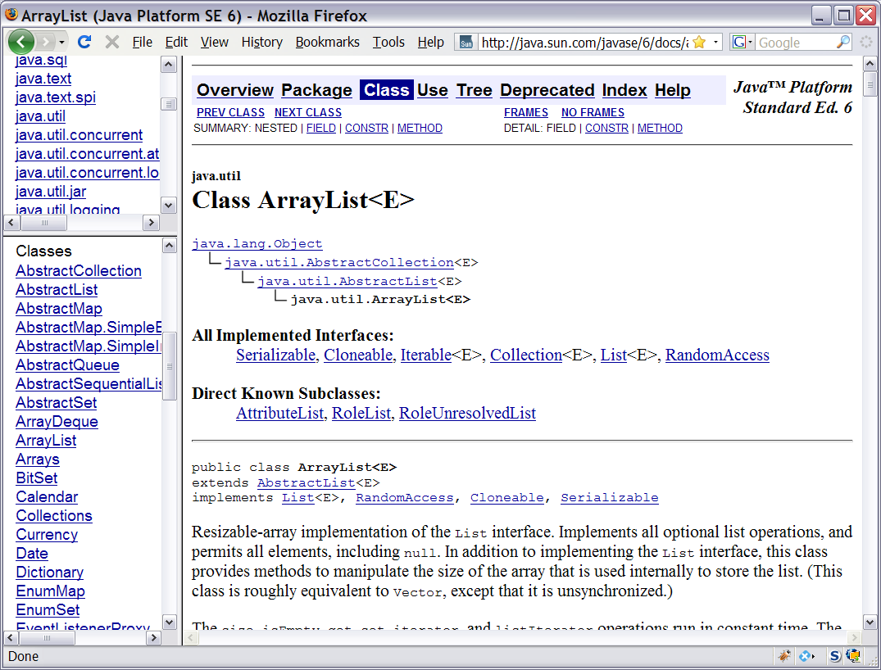
Learning about classes
The Java API Specification is a huge web page containing documentation about every Java class and its methods.
The link to the API Specs is on the course web site.

Slide 15
ArrayList vs. array
construction
String[] names = new String[5];
ArrayList<String> list = new ArrayList<String>();
storing a value
names[0] = "Jessica";
list.add("Jessica");
retrieving a value
String s = names[0];
String s = list.get(0);

Slide 16
ArrayList vs. array 2
doing something to each value that starts with "B"
for (int i = 0; i < names.length; i++) {
if (names[i].startsWith("B")) { ... }
}
for (int i = 0; i < list.size(); i++) {
if (list.get(i).startsWith("B")) { ... }
}
seeing whether the value "Benson" is found
for (int i = 0; i < names.length; i++) {
if (names[i].equals("Benson")) { ... }
}
if (list.contains("Benson")) { ... }

Slide 17
Exercise Revisited
Write a program that reads a file and displays the words of that file as a list.
First display all words.
Then display them in reverse order.
Then display them with all plurals (ending in "s") capitalized.
Then display them with all plural words removed.

Slide 18
Exercise solution (partial)
ArrayList<String> allWords = new ArrayList<String>();
Scanner input = new Scanner(new File("words.txt"));
while (input.hasNext()) {
String word = input.next();
allWords.add(word);
}
System.out.println(allWords);
// remove all plural words
for (int i = 0; i < allWords.size(); i++) {
String word = allWords.get(i);
if (word.endsWith("s")) {
allWords.remove(i);
i--;
}
}
// After removing the plural word
// index will be reduced by 1

Slide 19
ArrayList as parameter
public static void name(ArrayList<Type> name) {
Example:
// Removes all plural words from the given list.
public static void removePlural(ArrayList<String> list) {
for (int i = 0; i < list.size(); i++) {
String str = list.get(i);
if (str.endsWith("s")) {
list.remove(i);
i--;
}
}
}
You can also return a list:
public static ArrayList<Type> methodName(params)

Slide 20
ArrayList of primitives?
The type you specify when creating an ArrayList must be an object type; it cannot be a primitive type.
// illegal -- int cannot be a type parameter
ArrayList<int> list = new ArrayList<int>();
But we can still use ArrayList with primitive types by using special classes called wrapper classes in their place.
// creates a list of ints
ArrayList<Integer> list = new ArrayList<Integer>();

Slide 21
Wrapper classes
A wrapper is an object whose sole purpose is to hold a primitive value.
Once you construct the list, use it with primitives as normal:
ArrayList<Double> grades = new ArrayList<Double>();
grades.add(3.2);
grades.add(2.7);
...
double myGrade = grades.get(0);
Primitive Type | Wrapper Type
int | Integer
double | Double
char | Character
boolean | Boolean

Slide 22
Exercise
Write a program that reads a file full of numbers and displays all the numbers as a list, then:
Prints the average of the numbers.
Prints the highest and lowest number.
Filters out all of the even numbers (ones divisible by 2).

Slide 23
Exercise solution (partial)
ArrayList<Integer> numbers = new ArrayList<Integer>();
Scanner input = new Scanner(new File("numbers.txt"));
while (input.hasNextInt()) {
int n = input.nextInt();
numbers.add(n);
}
System.out.println(numbers);
filterEvens(numbers);
System.out.println(numbers);
...
// Removes all elements with even values from the given list.
public static void filterEvens(ArrayList<Integer> list) {
for (int i = list.size() - 1; i >= 0; i--) {
int n = list.get(i);
if (n % 2 == 0) {
list.remove(i);
}
}
}
// Searching from the end of the
// index would be easier –
// Once a value is removed, the
// size of the index reduces by 1
// we search the “next end element”
// until we reach to index 0

Slide 24
Other Exercises
Write a method reverse that reverses the order of the elements in an ArrayList of strings.
Write a method capitalizePlurals that accepts an ArrayList of strings and replaces every word ending with an "s" with its uppercased version.
Write a method removePlurals that accepts an ArrayList of strings and removes every word in the list ending with an "s", case-insensitively.

Slide 25
Out-of-bounds
Legal indexes are between 0 and the list's size() - 1.
Reading or writing any index outside this range will cause an IndexOutOfBoundsException.
ArrayList<String> names = new ArrayList<String>();
names.add("Marty"); names.add("Kevin");
names.add("Vicki"); names.add("Larry");
System.out.println(names.get(0)); // okay
System.out.println(names.get(3)); // okay
System.out.println(names.get(-1)); // exception
names.add(9, "Aimee"); // exception
index | 0 | 1 | 2 | 3
value | Marty | Kevin | Vicki | Larry

Slide 26
ArrayList "mystery"
ArrayList<Integer> list = new ArrayList<Integer>();
for (int i = 1; i <= 10; i++) {
list.add(10 * i); // [10, 20, 30, 40, ..., 100]
}
What is the output of the following code?
for (int i = 0; i < list.size(); i++) {
list.remove(i);
}
System.out.println(list);
Answer:
[20, 40, 60, 80, 100]

Slide 27


Step-by-step Workout
Please download the PPT, and use Slide Show for better viewing experience
for (int i = 0; i < list.size(); i++) {
list.remove(i);
}
System.out.println(list);
A[0]
A[1]
A[2]
A[3]
A[4]
A[5]
A[6]
A[7]
A[8]
A[9]
i = 0
10 | 20 | 30 | 40 | 50 | 60 | 70 | 80 | 90 | 100
20 | 30 | 40 | 50 | 60 | 70 | 80 | 90 | 100 | -
i = 1
20 | 30 | 40 | 50 | 60 | 70 | 80 | 90 | 100 | -
20 | 40 | 50 | 60 | 70 | 80 | 90 | 100 | - | -
i = 2 …
i = 5
20 | 40 | 60 | 80 | 100 | - | - | - | - | -

Slide 28
ArrayList "mystery" 2
ArrayList<Integer> list = new ArrayList<Integer>();
for (int i = 1; i <= 5; i++) {
list.add(2 * i); // [2, 4, 6, 8, 10]
}
What is the output of the following code?
int size = list.size();
for (int i = 0; i < size; i++) {
list.add(i, 42); // add 42 at index i
}
System.out.println(list);
Answer:
[42, 42, 42, 42, 42, 2, 4, 6, 8, 10]
Notes:
What happens if you get rid of the int size variable above and replace it with list.size() ? (infinite loop)

Slide 29
Step-by-step Workout
Please download the PPT, and use Slide Show for better viewing experience
for (int i = 0; i < size; i++) {
list.add(i, 42);
}
System.out.println(list);
A[0]
A[1]
A[2]
A[3]
A[4]
A[5]
A[6]
A[7]
A[8]
A[9]
2 | 4 | 6 | 8 | 10
i = 0
42 | 2 | 4 | 6 | 8 | 10
i = 1
42 | 42 | 2 | 4 | 6 | 8 | 10
i = 2, i = 3, i = 4…
i = 5
42 | 42 | 42 | 42 | 42 | 2 | 4 | 6 | 8 | 10

Slide 30
ArrayList as parameter
public static void name(ArrayList<Type> name) {
Example:
// Removes all plural words from the given list.
public static void removePlural(ArrayList<String> list) {
for (int i = 0; i < list.size(); i++) {
String str = list.get(i);
if (str.endsWith("s")) {
list.remove(i);
i--;
}
}
}
You can also return a list:
public static ArrayList<Type> methodName(params)
Notes:
Think of "ArrayList<Integer>" as just all being one atomic token representing the type.

Slide 31
Exercise
Write a method addStars that accepts an array list of strings as a parameter and places a * after each element.
Example: if an array list named list initially stores:
[the, quick, brown, fox]
Then the call of addStars(list); makes it store:
[the, *, quick, *, brown, *, fox, *]
Write a method removeStars that accepts an array list of strings, assuming that every other element is a *, and removes the stars (undoing what was done by addStars above).

Slide 32
Exercise solution
public static void addStars(ArrayList<String> list) {
for (int i = 1; i < list.size(); i += 2) {
list.add(i, "*");
}
}
public static void removeStars(ArrayList<String> list) {
for (int i = 1; i < list.size(); i++) {
list.remove(i);
}
}

Slide 33
Exercise
Write a method intersect that accepts two sorted array lists of integers as parameters and returns a new list that contains only the elements that are found in both lists.
Example: if lists named list1 and list2 initially store:
[1, 4, 8, 9, 11, 15, 17, 28, 41, 59]
[4, 7, 11, 17, 19, 20, 23, 28, 37, 59, 81]
Then the call of intersect(list1, list2) returns the list:
[4, 11, 17, 28, 59]

Slide 34
Other Exercises
Write a method reverse that reverses the order of the elements in an ArrayList of strings.
Write a method capitalizePlurals that accepts an ArrayList of strings and replaces every word ending with an "s" with its uppercased version.
Write a method removePlurals that accepts an ArrayList of strings and removes every word in the list ending with an "s", case-insensitively.

Slide 35
Objects storing collections
An object can have an array, list, or other collection as a field.
public class Course {
private double[] grades;
private ArrayList<String> studentNames;
public Course() {
grades = new double[4];
studentNames = new ArrayList<String>();
...
}
Now each object stores a collection of data inside it.

Slide 36
The End ☺
CHAPTER 10
ARRAYLIST
Winnie Li

Slide 37
The compareTo method
The standard way for a Java class to define a comparison function for its objects is to define a compareTo method.
Example: in the String class, there is a method:
public int compareTo(String other)
A call of A.compareTo(B) will return:
a value < 0 if A comes "before" B in the ordering,
a value > 0 if A comes "after" B in the ordering,
or 0 if A and B are considered "equal" in the ordering.

Slide 38
Using compareTo
compareTo can be used as a test in an if statement.
String a = "alice";
String b = "bob";
if (a.compareTo(b) < 0) { // true
...
}
Primitives | Objects
if (a < b) { ... | if (a.compareTo(b) < 0) { ...
if (a <= b) { ... | if (a.compareTo(b) <= 0) { ...
if (a == b) { ... | if (a.compareTo(b) == 0) { ...
if (a != b) { ... | if (a.compareTo(b) != 0) { ...
if (a >= b) { ... | if (a.compareTo(b) >= 0) { ...
if (a > b) { ... | if (a.compareTo(b) > 0) { ...

Slide 39
compareTo and collections
You can use an array or list of strings with Java's included binary search method because it calls compareTo internally.
String[] a = {"al", "bob", "cari", "dan", "mike"};
int index = Arrays.binarySearch(a, "dan"); // 3
Java's TreeSet/Map use compareTo internally for ordering.
Set<String> set = new TreeSet<String>();
for (String s : a) {
set.add(s);
}
System.out.println(s);
// [al, bob, cari, dan, mike]

Slide 40
Ordering our own types
We cannot binary search or make a TreeSet/Map of arbitrary types, because Java doesn't know how to order the elements.
The program compiles but crashes when we run it.
Set<HtmlTag> tags = new TreeSet<HtmlTag>();
tags.add(new HtmlTag("body", true));
tags.add(new HtmlTag("b", false));
...
Exception in thread "main" java.lang.ClassCastException
at java.util.TreeSet.add(TreeSet.java:238)

Slide 41
Comparable (10.2)
public interface Comparable<E> {
public int compareTo(E other);
}
A class can implement the Comparable interface to define a natural ordering function for its objects.
A call to your compareTo method should return:
a value < 0 if the other object comes "before" this one,
a value > 0 if the other object comes "after" this one,
or 0 if the other object is considered "equal" to this.
If you want multiple orderings, use a Comparator instead (see Ch. 13.1)

Slide 42
Comparable template
public class name implements Comparable<name> {
...
public int compareTo(name other) {
...
}
}

Slide 43
Comparable example
public class Point implements Comparable<Point> {
private int x;
private int y;
...
// sort by x and break ties by y
public int compareTo(Point other) {
if (x < other.x) {
return -1;
} else if (x > other.x) {
return 1;
} else if (y < other.y) {
return -1; // same x, smaller y
} else if (y > other.y) {
return 1; // same x, larger y
} else {
return 0; // same x and same y
}
}
}

Slide 44
compareTo tricks
subtraction trick - Subtracting related numeric values produces the right result for what you want compareTo to return:
// sort by x and break ties by y
public int compareTo(Point other) {
if (x != other.x) {
return x - other.x; // different x
} else {
return y - other.y; // same x; compare y
}
}
The idea:
if x > other.x, then x - other.x > 0
if x < other.x, then x - other.x < 0
if x == other.x, then x - other.x == 0
NOTE: This trick doesn't work for doubles (but see Math.signum)

Slide 45
compareTo tricks 2
delegation trick - If your object's fields are comparable (such as strings), use their compareTo results to help you:
// sort by employee name, e.g. "Jim" < "Susan"
public int compareTo(Employee other) {
return name.compareTo(other.getName());
}
toString trick - If your object's toString representation is related to the ordering, use that to help you:
// sort by date, e.g. "09/19" > "04/01"
public int compareTo(Date other) {
return toString().compareTo(other.toString());
}

Slide 46
Exercises
Make the HtmlTag class from HTML Validator comparable.
Compare tags by their elements, alphabetically by name.
For the same element, opening tags come before closing tags.
// <body><b></b><i><b></b><br/></i></body>
Set<HtmlTag> tags = new TreeSet<HtmlTag>();
tags.add(new HtmlTag("body", true)); // <body>
tags.add(new HtmlTag("b", true)); // <b>
tags.add(new HtmlTag("b", false)); // </b>
tags.add(new HtmlTag("i", true)); // <i>
tags.add(new HtmlTag("b", true)); // <b>
tags.add(new HtmlTag("b", false)); // </b>
tags.add(new HtmlTag("br")); // <br/>
tags.add(new HtmlTag("i", false)); // </i>
tags.add(new HtmlTag("body", false)); // </body>
System.out.println(tags);
// [<b>, </b>, <body>, </body>, <br/>, <i>, </i>]

Slide 47
Exercise solution
public class HtmlTag implements Comparable<HtmlTag> {
...
// Compares tags by their element ("body" before "head"),
// breaking ties with opening tags before closing tags.
// Returns < 0 for less, 0 for equal, > 0 for greater.
public int compareTo(HtmlTag other) {
int compare = element.compareTo(other.getElement());
if (compare != 0) {
// different tags; use String's compareTo result
return compare;
} else {
// same tag
if ((isOpenTag == other.isOpenTag()) {
return 0; // exactly the same kind of tag
} else if (other.isOpenTag()) {
return 1; // he=open, I=close; I am after
} else {
return -1; // I=open, he=close; I am before
}
}
}
}

