Slide 1
Building Java Programs A Back to Basics Approach
CHAPTER 11
JAVA Collections framework
Please download the PPT, and use Slide Show for better viewing experience
Winnie Li

Slide 2
Topics will be covered
Collections
Iterators
Set Concepts
Set Operations
Map Operations
Map Views

Slide 3
Question
List of people who have visited
Canada
Mexico
Canada or Mexico (either one)
Canada and Mexico (both)
Mexico but not Canada
Canada but not Mexico
…
What data structure would be more appropriate?
Array?
ArrayList?
Canada
Mexico
John
William
Susan
Jack
Jennifer
Sophia
Emma
Olivia
Ava
Tom
Lily
John
William
Susan
Jack
Jennifer
Sophia
Emma
Olivia
Isabella
Zoe

Slide 4
Step 1: Choose a Data Structure
Array
static String[] Mexico= new String[100]; static String[] Canada= new String[100];
ArrayList
ArrayList<String> Mexico = new ArrayList<>();
ArrayList<String> Canada = new ArrayList<>();
Which data structure is more suitable?

Slide 5
Step 2: Choose a Search Algorithm
List of people who have visited both Canada and Mexico
for (int i = 0; i < MexicoPeople-1; i++) { for (int j = 0; j < CanadaPeople-1; j++){ if( Mexico[i].equals(Canada[j])) { System.out.println(Mexico[i]); } }
}
Is there a better search algorithm?
Any data structure and algorithm can be applied
Ideally, we want to choose the most efficient one

Slide 6
Collections
reading: 11.1

Slide 7
Collections
Collection: an object that stores data; a.k.a. "data structure"
the objects stored are called elements
some collections maintain an ordering; some allow duplicates
typical operations: add, remove, clear, contains (search), size
examples found in the Java class libraries:
ArrayList, LinkedList, HashMap, TreeSet, PriorityQueue
Note: all collections are in the java.util package
import java.util.*;

Slide 8
Java Collections
Extends
Implements
Interface
class
Collection
Map
List
Queue
Set
HashTable
ArrayList
Deque
SortedSet
HashMap
LinkedList
ArrayDque
TreeSet
Linked HashMap
Vector
Priority Queue
HashSet
SortedMap
Linked HashSet
TreeMap

Slide 9
Sets
reading: 11.2

Slide 10
Sets
set: A collection of unique values (no duplicates allowed) that can perform the following operations efficiently:
add, remove, search (contains)
We don't think of a set as having indexes; we just add things to the set in general and don't worry about order
"the"
"of"
"if"
set.contains("to")
"to"
"down"
"from"
true
"by"
"she"
set.contains("be")
"you"
false
"in"
"why"
"him"
set

Slide 11
Java HashSet
Java HashSet class is used to create a collection that uses a hash table for storage
HashSet stores the elements by using a mechanism called hashing.
HashSet contains unique elements only.
HashSet allows null value.
HashSet doesn't maintain the insertion order. Here, elements are inserted on the basis of their hash code.
HashSet is the best approach for search operations.
We will learn hash table and hashing in Chapter 18.

Slide 12
Set methods
List<String> list = new ArrayList<String>();
...
Set<String> set = new HashSet<String>(list);
can construct an empty set, or one based on a given collection
add(value) | adds the given value to the set
contains(value) | returns true if the given value is found in this set
remove(value) | removes the given value from the set
clear() | removes all elements of the set
size() | returns the number of elements in list
isEmpty() | returns true if the set's size is 0
toString() | returns a string such as "[3, 42, -7, 15]"

Slide 13
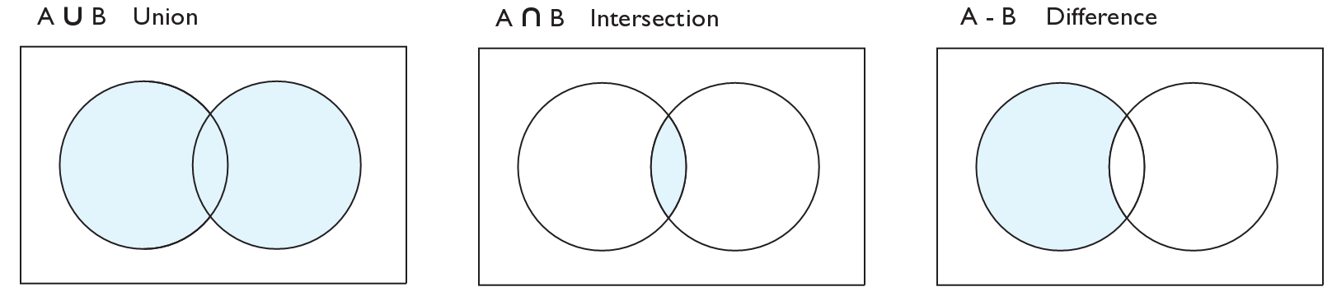
Set operations
addAll
retainAll
removeAll
addAll(collection) | adds all elements from the given collection to this set
containsAll(coll) | returns true if this set contains every element from given set
equals(set) | returns true if given other set contains the same elements
iterator() | returns an object used to examine set's contents (seen later)
removeAll(coll) | removes all elements in the given collection from this set
retainAll(coll) | removes elements not found in given collection from this set
toArray() | returns an array of the elements in this set

Slide 14
Example
College Clubs: Music, Baseball, STEM
music.addAll(baseball); baseball.addAll(stem); music.retainAll(baseball); baseball.removeAll(music); System.out.println(music); System.out.println(baseball); System.out.println(stem);
Output
[Kim, Emma, Olivia] //music
[Chris, Jane] //baseball
[Jane, Chris, Kim, Olivia] //stem
Music | Baseball | Stem
Brian | Emma | Chris
Emma | Olivia | Jane
Olivia | Kim | Olivia
 |  | Kim

Slide 15
Step-by-Step Workout
 | Music Brian, Emma, Olivia | Baseball Emma, Olivia, Kim | STEM Chris, Jane, Olivia, Kim
music.addAll(baseball);
baseball.addAll(stem);
music.retainAll(baseball);
baseball.removeAll(music);
System.out.println(music);
System.out.println(baseball);
System.out.println(stem);
Brian Emma Olivia
Emma Olivia Kim
Chris Jane
Olivia Kim
addAll => Union
Kim
Brian Emma Olivia
Kim
Emma Olivia Kim
Chris Jane
Olivia Kim
addAll => Union
Chris Jane
Emma Olivia Kim
Emma Olivia Kim
Chris Jane
Chris Jane
Olivia Kim
retainAll => Intersection
Emma Olivia Kim
Chris Jane
Chris Jane
Olivia Kim
removeAll => Difference
[Kim, Emma, Olivia]
[Chris, Jane]
[Jane, Chris,
Kim, Olivia]

Slide 16
Example Follow Up
The original set of music is modified after the operation
Music (before) | Music (after)
Brian | Brian
Emma | Emma
Olivia | Olivia
 | Kim
To copy a set (most common way)
Constructor
Use the constructor of a Set implementation:
Set<type> temp = new HashSet<>(music);
Set.clone
Set<type> temp = (Set<type>)music.clone();
For Example:
Constructor
HashSet<String> temp = new HashSet<>(music);
temp.addAll(baseball);
Cloning
HashSet<String> temp = new HashSet<>();
temp = (HashSet)music.clone();
temp.addAll(baseball)

Slide 17
Sets and ordering
HashSet: elements are stored in an unpredictable order
Set<String> names = new HashSet<String>();
names.add("Jake");
names.add("Robert");
names.add("Marisa");
names.add("Kasey");
System.out.println(names);
// [Kasey, Robert, Jake, Marisa]

Slide 18
Iterators
reading: 11.1

Slide 19
Examining sets (and maps ← coming later)
elements of Java Sets (and Maps) can't be accessed by index
must use a "for each" loop:
Set<Integer> scores = new HashSet<Integer>();
for (int score : scores) {
System.out.println("The score is " + score);
}
Problem: foreach is read-only; cannot modify set while looping
for (int score : scores) {
if (score < 60) {
// throws a ConcurrentModificationException
scores.remove(score);
}
}

Slide 20
Iterators
iterator: An object that allows a client to traverse the elements of any collection.
Remembers a position, and lets you:
get the element at that position
advance to the next position
remove the element at that position
index | 0 | 1 | 2 | 3 | 4 | 5 | 6 | 7 | 8 | 9
value | 3 | 8 | 9 | 7 | 5 | 12 | 0 | 0 | 0 | 0
size | 6
"the"
list
set
"to"
"we"
"from"
current element: 9
current index: 2
current element: "from"
next element: "the"
iterator
iterator

Slide 21
Iterator methods
Iterator interface in java.util
every collection has an iterator() method that returns an iterator over its elements
Set<String> set = new HashSet<String>();
...
Iterator<String> itr = set.iterator();
...
hasNext() | returns true if there are more elements to examine
next() | returns the next element from the collection (throws a NoSuchElementException if there are none left to examine)
remove() | removes the last value returned by next() (throws an IllegalStateException if you haven't called next() yet)

Slide 22
Iterator example 1
HashSet<String> hs = new HashSet<String>();
hs.add("one"); hs.add("two"); hs.add("three"); hs.add(“four"); hs.add("five");
Iterator hi = hs.iterator(); while(hi.hasNext()){ System.out.println(hi.next()); }
Output:
two
five
one
three
four
Note 1: HashSet does NOT maintain any order.

Slide 23
Iterator example 2
HashSet<String> hs = new HashSet<String>();
hs.add("one"); hs.add("two");
hs.add("two");
hs.add("two"); hs.add("three"); hs.add(“four"); hs.add("five");
hs.add(“five");
Iterator hi = hs.iterator(); while(hi.hasNext()){ System.out.println(hi.next()); }
Output:
two
five
one
three
four
Note 2: HashSet does NOT allow duplicate elements.

Slide 24
ArrayList VS HashSet
ArrayList<String> al = new ArrayList<String>();
al.add("one"); al.add("two");
al.add("two");
al.add("two"); al.add("three"); al.add(“four"); al.add("five");
al.add(“five");
for (int 1=0; i<al.size(); i++) { System.out.println(al.get(i)); }
HashSet<String> hs = new HashSet<String>();
hs.add("one"); hs.add("two");
hs.add("two");
hs.add("two"); hs.add("three"); hs.add(“four"); hs.add("five");
hs.add(“five");
Iterator hi = hs.iterator(); while(hi.hasNext()){ System.out.println(hi.next()); }
Output:
one
two
two
two
three
four
five
five
Output:
two
five
one
three
four
HashSet
Duplicate: No
Order: No
ArrayList
Duplicate: Yes
Order: Yes

Slide 25
HashSet – remove an element
HashSet<String> hs = new HashSet<>(); hs.add("A"); hs.add("B"); hs.add("C"); hs.add("D");
Iterator it = hs.iterator(); while (it.hasNext()) {
System.out.print(it.next()); } System.out.println(); // remove String s="C"; hs.remove(s);
System.out.println("after"); Iterator i = hs.iterator(); while (i.hasNext()) { System.out.print(i.next()); }
Output:
DABC
after
DBA

Slide 26
HashSet – sort elements
HashSet<String> hs = new HashSet<>(); hs.add("A"); hs.add("B"); hs.add("C"); hs.add("D");
// no sorting Iterator it = hs.iterator(); while (it.hasNext()) { System.out.print(it.next()); }
// sorting List myList = new ArrayList(hs); Collections.sort(myList); System.out.println("after"); Iterator i = myList.iterator(); while(i.hasNext()){ System.out.print(i.next()); }
Output:
DABC
after
ABCD

Slide 27
Recall Question
Canada
Mexico
List of people who have visited
Mexico or Canada
John
William
Susan
Jack
Jennifer
Sophia
Emma
Olivia
Ava
Tom
Lily
John
William
Susan
Jack
Jennifer
Sophia
Emma
Olivia
Isabella
Zoe
Use A.addAll(B)
HashSet<String> Mexico = new HashSet<>(); HashSet<String> Canada = new HashSet<>();
public void bothCountries(){ Mexico.addAll(Canada);
Iterator<String> m = Mexico.iterator(); while(m.hasNext()){ System.out.println(m.next()); } }

Slide 28
Recall Question
Canada
Mexico
List of people who have visited
Both Mexico and Canada
John
William
Susan
Jack
Jennifer
Sophia
Emma
Olivia
Ava
Tom
Lily
John
William
Susan
Jack
Jennifer
Sophia
Emma
Olivia
Isabella
Zoe
Use A.retainAll(B)
HashSet<String> Mexico = new HashSet<>(); HashSet<String> Canada = new HashSet<>();
public void bothCountries(){ Mexico.retainAll(Canada);
Iterator<String> m = Mexico.iterator(); while(m.hasNext()){ System.out.println(m.next()); } }

Slide 29
Recall Question
Compare Search Algorithms
Which one is more efficient?
Canada
Mexico
John
William
Susan
Jack
Jennifer
Sophia
Emma
Olivia
Ava
Tom
Lily
John
William
Susan
Jack
Jennifer
Sophia
Emma
Olivia
Isabella
Zoe
for (int i = 0; i < MexicoPeople-1; i++) { for (int j = 0; j < CanadaPeople-1; j++){ if( Mexico[i].equals(Canada[j])) { System.out.println(Mexico[i]); } }
}
vs
Mexico.retainAll(Canada);

Slide 30
Maps
reading: 11.3

Slide 31
Java Collections
Extends
Implements
Interface
class
Collection
Map
List
Queue
Set
HashTable
ArrayList
Deque
SortedSet
HashMap
LinkedList
ArrayDque
TreeSet
Linked HashMap
Vector
Priority Queue
HashSet
SortedMap
Linked HashSet
TreeMap

Slide 32
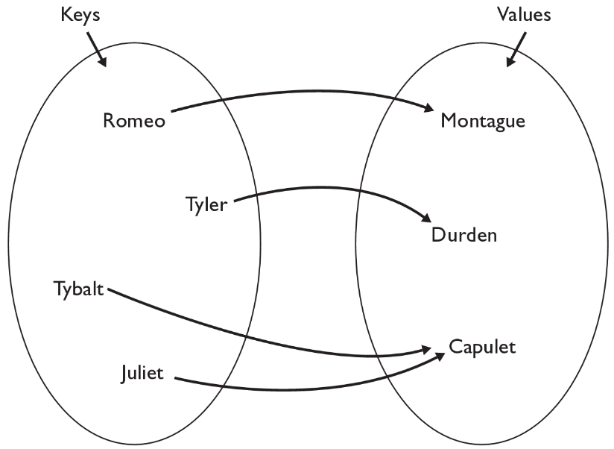
Map
map: Holds a set of unique keys and a collection of values, where each key is associated with one value.
a.k.a. "dictionary", "associative array", "hash“
Denoted as HashMap<Key, Value) or HashMap<K, V)
Basic syntax:
HashMap<String, Object> jashMap = new HashMap<>();
Basic map operations:
put(key, value ): Adds a mapping
from a key to a value.
get(key ): Retrieves the value
mapped to the key.
remove(key ): Removes the given
key and its mapped value.
myMap.get("Juliet") returns "Capulet"

Slide 33
Maps and tallying
a map can be thought of as generalization of a tallying array
the "index" (key) doesn't have to be an int
recall previous tallying examples from CSE 142
count digits: 22092310907
// (M)cCain, (O)bama, (I)ndependent
count votes: "MOOOOOOMMMMMOOOOOOMOMMIMOMMIMOMMIO"
index | 0 | 1 | 2 | 3 | 4 | 5 | 6 | 7 | 8 | 9
value | 3 | 1 | 3 | 0 | 0 | 0 | 0 | 1 | 0 | 2
"M"
14
key | "M" | "O" | "I"
value | 16 | 14 | 3
"O"
3
"I"
16
keys
values

Slide 34
Map methods
put(key, value) | adds a mapping from the given key to the given value; if the key already exists, replaces its value with the given one
get(key) | returns the value mapped to the given key (null if not found)
containsKey(key) | returns true if the map contains a mapping for the given key
remove(key) | removes any existing mapping for the given key
clear() | removes all key/value pairs from the map
size() | returns the number of key/value pairs in the map
isEmpty() | returns true if the map's size is 0
toString() | returns a string such as "{a=90, d=60, c=70}"
keySet() | returns a set of all keys in the map
values() | returns a collection of all values in the map
putAll(map) | adds all key/value pairs from the given map to this map
equals(map) | returns true if given map has the same mappings as this one

Slide 35
Using maps
A map allows you to get from one half of a pair to the other.
Remembers one piece of information about every index (key).
Later, we can supply only the key and get back the related value:
Allows us to ask: What is Winnie’s phone number?
// key value
put(“Winnie", “425-564-2825")
Map
get(“Winnie")
Map
“425-564-2825"

Slide 36
HashMap – add element
import java.util.*; public class MapDemo { public static void main(String[] args) {
HashMap<String, Integer> a = new HashMap<>();
a.put("one", 1); a.put("two", 2); a.put("three", 3); a.put("four", 4); // “four” is initially 4
a.put("four", 5); // “four” is now overridden to 5
System.out.println(a.get(“four")); System.out.println(a.get("one")); System.out.println(a.get("two")); System.out.println(a.get("three")); }
Output:
5
1
2
3
Note: “four” is initially 4, then it is overridden to 5.

Slide 37
HashMap – remove element
HashMap<Integer, String> hash_map = new HashMap<>();
// Mapping string values to int keys
hash_map.put(90, “A");
hash_map.put(80, “B");
hash_map.put(70, “C");
hash_map.put(60, “D");
// Displaying the HashMap
System.out.println("Initial Mappings are: " + hash_map);
// Removing the existing key mapping
String returned_value = (String)hash_map.remove(70);
// Verifying the returned value
System.out.println("Returned value is: "+ returned_value);
// Displaying the new map
System.out.println("New map is: "+ hash_map);
Output:
Initial Mappings are: {90=A, 80=B, 70=C, 60=D}
Returned value is: C
New map is: {90=A, 80=B, 60=D}
Note: to remove all items, use clear() method.

Slide 38
HashMap – size and iterate through elements
import java.util.*; public class iterateHashMap { public static void main(String[] args) { HashMap< String, String> hMap = new HashMap< String, String>(); hMap.put("1", "1st"); hMap.put("2", "2nd"); hMap.put("3", "3rd"); System.out.println(hMap.size());
Collection cl = hMap.values(); Iterator itr = cl.iterator(); while (itr.hasNext()) { System.out.println(itr.next()); } } }
Output:
3
3rd
2nd
1st
Note: HashMap uses hash, therefore it does NOT maintain any order.

Slide 39
ArrayList VS HashMap
public class student {
private String id;
private String name;
student (String id, String name){
this.id=id;
this.name=name;
}
public String getID() { return this.id;}
public String getName() { return this.name;}
}
HashMap<String, String> student = new HashMap<>();
student.put("1", "Kim");
student.put("2", "Eva");
String name=student.get("1");
System.out.println(name);
HashMap is the preferred data structure when implementing the type of problems similar to:
ArrayList<student> myArrayList = new ArrayList<>();
student s = new student("1","Kim");
myArrayList.add(s);
student s1 = new student("2","Eva");
myArrayList.add(s1);
for(student studentObject : myArrayList) {
if(studentObject.getID().equals("1"))
index=myArrayList.indexOf(studentObject);
}
System.out.println( myArrayList.get(index).getName());
ID
(Key)
Name
(Value)

Slide 40
When to use What
For each value there must be a key associated in HashMap
Keys are unique while values can be duplicate
HashMap should be used over ArrayList when there is no use of index and the data is need to be identified using key value pair.
In Arraylist: you have to access the elements with an index (int type)
In HashMap: you can access them by an index of another type (e.g., String)
HashMap takes one object and use that as a key (index) to another object (the value)
Good for you – if you have objects with unique IDs.
HashMap implementation uses the hash value of the key object to locate where it is stored, therefore there is no guarantee of the order of the values.

Slide 41
The End ☺
CHAPTER 11
JAVA Collections framework
Winnie Li

