Slide 1
Building Java Programs A Back to Basics Approach
CHAPTER 13
Searching and Sorting
Please download the PPT, and use Slide Show for better viewing experience
Winnie Li

Slide 2
Topics will be covered
What is Algorithm
Sequential Search
Binary Search
Recursive Binary Search
Time Complexity
Selection Sort
Merge Sort

Slide 3
What is Algorithm?

Slide 4
Algorithm
An algorithm is a procedure or formula for solving a problem, based on conducting a sequence of specified actions. A computer program can be viewed as an elaborate algorithm. In mathematics and computer science, an algorithm usually means a small procedure that solves a recurrent problem.
Algorithms are widely used throughout all areas of IT (information technology). A search engine algorithm, for example, takes search strings of keywords and operators as input, searches its associated database for relevant web pages, and returns results.

Slide 5
Which Algorithm is Better?
Sum of Odd Numbers
A
B
sumALL=0; sumEven=0; for (int i=1; i<=n; i++) { sumALL += i; } for (int i=1; i<=n; i++) { if (i%2 == 0){ sumEven += i; } }
sumOdd=sumALL-sumEven;
sumOdd=0; for (int i=1; i<=n; i++) { if (i%2 !== 0){ sumOdd += i; } }
Which one is better?
How do we determine if an algorithm is better than another?

Slide 6
Searching
reading: 13.1, 13.3

Slide 7
Sequential Search
sequential search: Locates a target value in an array/list by examining each element from start to finish.
How many elements will it need to examine?
Example: Searching the array below for the value 42:
Notice that the array is sorted. Could we take advantage of this?
index | 0 | 1 | 2 | 3 | 4 | 5 | 6 | 7 | 8 | 9 | 10 | 11 | 12 | 13 | 14 | 15 | 16
value | -4 | 2 | 7 | 10 | 15 | 20 | 22 | 25 | 30 | 36 | 42 | 50 | 56 | 68 | 85 | 92 | 103
i
Please download the PPT, and use Slide Show for better viewing experience

Slide 8
Binary Search
binary search: Locates a target value in a sorted array/list by successively eliminating half of the array from consideration.
How many elements will it need to examine?
Example: Searching the array below for the value 42:
index | 0 | 1 | 2 | 3 | 4 | 5 | 6 | 7 | 8 | 9 | 10 | 11 | 12 | 13 | 14 | 15 | 16
value | -4 | 2 | 7 | 10 | 15 | 20 | 22 | 25 | 30 | 36 | 42 | 50 | 56 | 68 | 85 | 92 | 103
min
mid
max
Please download the PPT, and use Slide Show for better viewing experience

Slide 9
The Arrays Class
Class Arrays in java.util has many useful array methods:
Syntax: Arrays.methodName(parameters)
Method name | Description
binarySearch(array, value) | returns the index of the given value in a sorted array (or < 0 if not found)
binarySearch(array, minIndex, maxIndex, value) | returns index of given value in a sorted array between indexes min /max - 1 (< 0 if not found)
copyOf(array, length) | returns a new resized copy of an array
equals(array1, array2) | returns true if the two arrays contain same elements in the same order
fill(array, value) | sets every element to the given value
sort(array) | arranges the elements into sorted order
toString(array) | returns a string representing the array, such as "[10, 30, -25, 17]"

Slide 10
Arrays.binarySearch
// searches an entire sorted array for a given value
// returns its index if found; a negative number if not found
// Precondition: array is sorted
Arrays.binarySearch(array, value)
// searches given portion of a sorted array for a given value
// examines minIndex (inclusive) through maxIndex (exclusive)
// returns its index if found; a negative number if not found
// Precondition: array is sorted
Arrays.binarySearch(array, minIndex, maxIndex, value)
The binarySearch method in the Arrays class searches an array very efficiently if the array is sorted.
You can search the entire array, or just a range of indexes (useful for "unfilled" arrays such as the one in ArrayIntList)
If the array is not sorted, you may need to sort it first

Slide 11
Using binarySearch
// index 0 1 2 3 4 5 6 7 8 9 10 11 12 13 14 15
int[] a = {-4, 2, 7, 9, 15, 19, 25, 28, 30, 36, 42, 50, 56, 68, 85, 92};
int index = Arrays.binarySearch(a, 0, 16, 42); // index1 is 10
int index2 = Arrays.binarySearch(a, 0, 16, 21); // index2 is -7
binarySearch returns the index where the value is found
if the value is not found, binarySearch returns:
-(insertionPoint + 1)
where insertionPoint is the index where the element would have been, if it had been in the array in sorted order.
To insert the value into the array, negate insertionPoint + 1
int indexToInsert21 = -(index2 + 1); // 6

Slide 12
Binary Search Code
// Returns the index of an occurrence of target in a,
// or a negative number if the target is not found.
// Precondition: elements of a are in sorted order
public static int binarySearch(int[] a, int target) {
int min = 0;
int max = a.length - 1;
while (min <= max) {
int mid = (min + max) / 2;
if (a[mid] < target) {
min = mid + 1;
} else if (a[mid] > target) {
max = mid - 1;
} else {
return mid; // target found
}
}
return -(min + 1); // target not found
}

Slide 13
Recursive Binary Search
Write a recursive binarySearch method.
If the target value is not found, return its negative insertion point.
int index = binarySearch(data, 42); // 10
int index2 = binarySearch(data, 66); // -14
index | 0 | 1 | 2 | 3 | 4 | 5 | 6 | 7 | 8 | 9 | 10 | 11 | 12 | 13 | 14 | 15 | 16
value | -4 | 2 | 7 | 10 | 15 | 20 | 22 | 25 | 30 | 36 | 42 | 50 | 56 | 68 | 85 | 92 | 103

Slide 14
Exercise solution
// Returns the index of an occurrence of the given value in
// the given array, or a negative number if not found.
// Precondition: elements of a are in sorted order
public static int binarySearch(int[] a, int target) {
return binarySearch(a, target, 0, a.length - 1);
}
// Recursive helper to implement search behavior.
private static int binarySearch(int[] a, int target,
int min, int max) {
if (min > max) {
return -1; // target not found
} else {
int mid = (min + max) / 2;
if (a[mid] < target) { // too small; go right
return binarySearch(a, target, mid + 1, max);
} else if (a[mid] > target) { // too large; go left
return binarySearch(a, target, min, mid - 1);
} else {
return mid; // target found; a[mid] == target
}
}
}

Slide 15
Binary search and objects
Can we binarySearch an array of Strings?
Operators like < and > do not work with String objects.
But we do think of strings as having an alphabetical ordering.
natural ordering: Rules governing the relative placement of all values of a given type.
comparison function: Code that, when given two values A and B of a given type, decides their relative ordering:
A < B, A == B, A > B

Slide 16
The compareTo Method
The standard way for a Java class to define a comparison function for its objects is to define a compareTo method.
Example: in the String class, there is a method:
public int compareTo(String other)
A call of A.compareTo(B) will return:
a value < 0 if A comes "before" B in the ordering,
a value > 0 if A comes "after" B in the ordering,
or 0 if A and B are considered "equal" in the ordering.

Slide 17
Program Complexity
reading: 13.2

Slide 18
Time Complexity
Time complexity is the computational complexity that describes the amount of time it takes to run an algorithm.
Time complexity is commonly estimated by counting the number of elementary operations performed by the algorithm, supposing that each elementary operation takes a fixed amount of time to perform.
Time complexity is commonly expressed using big O notation, typically O(n), O(n²), O(log n), O(nlog n).

Slide 19
Runtime Efficiency
efficiency: A measure of the use of computing resources by code.
can be relative to speed (time), memory (space), etc.
most commonly refers to run time
Assume the following:
Any single Java statement takes the same amount of time to run.
A method call's runtime is measured by the total of the statements inside the method's body.
A loop's runtime, if the loop repeats N times, is N times the runtime of the statements in its body.

Slide 20
General Runtime Calculation 1
statement1;
statement2;
statement3;
for (int i = 1; i <= N; i++) {
statement4;
}
for (int i = 1; i <= N; i++) {
statement5;
statement6;
statement7;
}
Remove Constant Values: Run time O(n)
3
N
4N + 3
3N

Slide 21
General Runtime Calculation 2
for (int i = 1; i <= N; i++) {
for (int j = 1; j <= N; j++) {
statement1;
}
}
for (int i = 1; i <= N; i++) {
statement2;
statement3;
statement4;
statement5;
}
Remove Constant Values: Run time O(n²)
N²
N² + 4N
4N

Slide 22
Example 1
System.out.println(“hello world”);
“hello world” will be printed once, so time complexity is constant.
Run time: O(1)
for (int i= 0; i<n; i++){
System.out.println(“hello world”);
}
“hello world” will be printed n times, so time complexity is constant.
Run time: O(n)

Slide 23
Example 2
Please download the PPT, and use Slide Show for better viewing experience
Example
 | Execution time
void ex2(int n) {
int count = 0; | 1
int i; | 1
for (int i = 0; i < n; i++) | n+1
count++; | n
}
Total Execution Time: 1 + 1 + (n + 1) + n = 2n + 3
X
X
Run time: O(n)
Remove All Constant Values

Slide 24
Example 3
Please download the PPT, and use Slide Show for better viewing experience
Example
 | Execution time
void ex3(int n) {
int count = 0; | 1
int i; | 1
for (int i = 0; i < n; i+=2) | (n/2)+1
count++; | n/2
}
Total Execution Time: 1 + 1 + (n/2 + 1) + n/2 = n + 3
X
Run time: O(n)
Remove All Constant Values

Slide 25

Example 4
for (int i=0; i<n; i++) {
System.out.println(i);
}
for (int i=0; i<n/2; i++) {
System.out.println(i);
}
for (int i=0; i<n; i++){
for (int j=0; j<n; j++) {
System.out.println(i/j);}
}
Example
n
O(n)
0.5n
O(n)
Remove all constant values
n*n

Slide 26
Example 5
public static void m4(int n) {
for (int i=0; i<n; i++) {
System.out.println(n * 10); }
for (int j=n-1; j>=0; j--) {
System.out.println(j / 10); }
}
public static void m5(int n) {
for (int i=0; i<15; i++) {
for (int j=0; j<n; j++) {
System.out.println(j);
}
}
}
Example
n + n = 2n
O(n)
Remove all constant values
15 x n = 15n
O(n)
Remove all constant values

Slide 27
Algorithm Growth Rates
We measure runtime in proportion to the input data size, N.
growth rate: Change in runtime as N changes.
Say an algorithm runs 0.4N³ + 25N² + 8N + 17 statements.
Consider the runtime when N is extremely large .
We ignore constants like 25 because they are tiny next to N.
The highest-order term (N³) dominates the overall runtime.
We say that this algorithm runs "on the order of" N³.
or O(N³) for short (read as "Big-Oh of N cubed")

Slide 28
Complexity Classes
complexity class: A category of algorithm efficiency based on the algorithm's relationship to the input size N.
Class | Big-Oh | If you double N, ... | Example
constant | O(1) | unchanged | 10ms
logarithmic | O(log₂ N) | increases slightly | 175ms
linear | O(N) | doubles | 3.2 sec
log-linear | O(N log₂ N) | slightly more than doubles | 6 sec
quadratic | O(N²) | quadruples | 1 min 42 sec
cubic | O(N³) | multiplies by 8 | 55 min
... | ... | ... | ...
exponential | O(2^{N}) | multiplies drastically | 5 * 10⁶¹ years

Slide 29
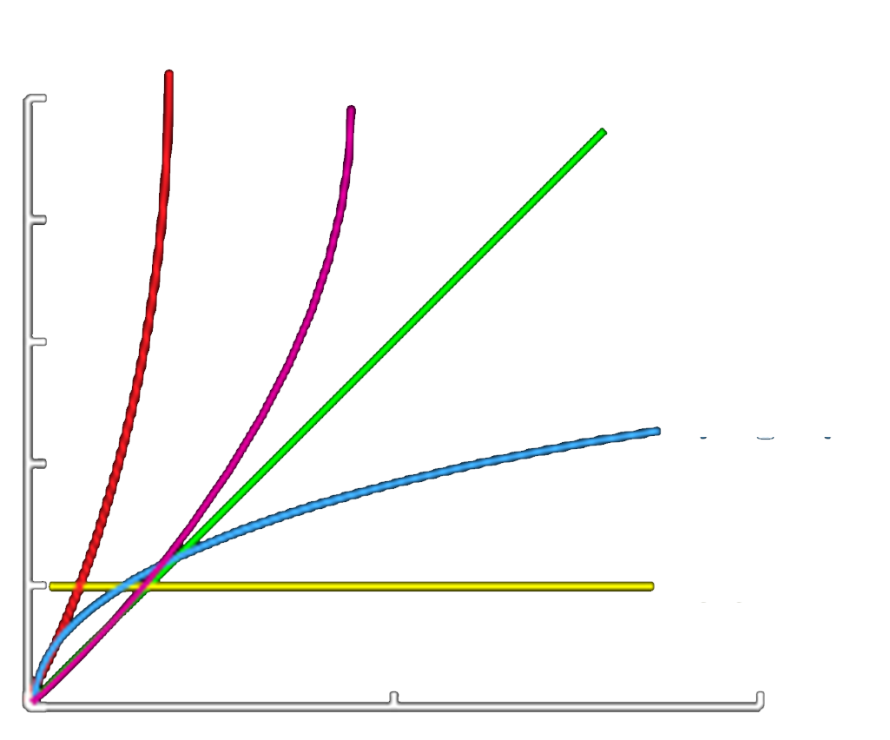












Compare Big O Functions
$$O(n^{2})$$
$$O(n\log{ n})$$
$$running time$$
$$O(n)$$
$$O\left(n^{2}\right)\sim$$
worst
$$O(n\log{ n})$$
bad
$$O(n)$$
fair
$$O(\log{ n})$$
$$O(\log{ n})$$
good
$$O(1)$$
best
$$O(1)$$
$$input size n$$

Slide 30
Collection Efficiency
Efficiency of various operations on different collections:
Method | ArrayList | SortedIntList | Stack | Queue
add (or push) | O(1) | O(N) | O(1) | O(1)
add(index, value) | O(N) |  | - | -
indexOf | O(N) | O(?) | - | -
get | O(1) | O(1) | - | -
remove | O(N) | O(N) | O(1) | O(1)
set | O(1) | O(1) | - | -
size | O(1) | O(1) | O(1) | O(1)
Method | ArrayList | SortedIntList | Stack | Queue
add (or push)
add(index, value) |  |  | - | -
indexOf
get |  |  | - | -
remove
set |  |  | - | -
size

Slide 31
Search Algorithm
reading: 13.1, 13,3

Slide 32
Example – Sequential Search
Find a value (for example, 38) from the following list
//Easy Algorithm
int id=38;
for (int i=0; i < n; i++) {
if (myArray[i] == id){
found;
break;
}
}
Best Case Runs 1 time (if id=23, we find it at the first index)
Worst Case Runs n times (id=72, we find it at the last index)
BigO takes the worst case. Run time of this algorithm: O(1)
index | 0 | 1 | 2 | 3 | 4 | 5 | 6 | 7 | 8 | 9
value | 23 | 5 | 12 | 8 | 16 | 2 | 56 | 38 | 91 | 72

Slide 33
Binary Search
binary search successively eliminates half of the elements.
Algorithm: Examine the middle element of the array.
If it is too big, eliminate the right half of the array and repeat.
If it is too small, eliminate the left half of the array and repeat.
Else it is the value we're searching for, so stop.
Which indexes does the algorithm examine to find value 23?
What is the runtime complexity class of binary search?
index | 0 | 1 | 2 | 3 | 4 | 5 | 6 | 7 | 8 | 9
value | 23 | 5 | 12 | 8 | 16 | 2 | 56 | 38 | 91 | 72

Slide 34
Example – Binary Search
Please download the PPT, and use Slide Show for better viewing experience
Sort the data in Ascending Order:
Assume we want search for id=23
Raw Data | 23 | 5 | 12 | 8 | 16 | 2 | 56 | 38 | 91 | 72
Sorted Data | 2 | 5 | 8 | 12 | 16 | 23 | 38 | 56 | 72 | 91
Check with mid (2/n): 2 5 8 12 16 23 38 56 72 91
23 > 16
→ 23 is in the right side
→ remove all left side (logically)
Check with mid (2/n): 2 5 8 12 16 23 38 56 72 91
23 < 56
→ 23 is in the left side
→ remove all right side (logically)
Check with mid (2/n): 2 5 8 12 16 23 38 56 72 91
23 = 23
→ id is found

Slide 35
Binary Search Runtime
For an array of size N, it eliminates ½ until 1 element remains.
N, N/2, N/4, N/8, ..., 4, 2, 1
How many divisions does it take?
Think of it from the other direction:
How many times do I have to multiply by 2 to reach N?
1, 2, 4, 8, ..., N/4, N/2, N
Call this number of multiplications "x".
2^{x} = N
x = log₂ N
Binary search is in the logarithmic complexity class.

Slide 36
Sequential Search Vs. Binary Search
Compare the two algorithms
Sequential Search
Run time O(n)
index | 0 | 1 | 2 | 3 | 4 | 5 | 6 | 7 | 8 | 9
value | 23 | 5 | 12 | 8 | 16 | 2 | 56 | 38 | 91 | 72
Binary Search: Runtime O(log n)
Raw Data | 23 | 5 | 12 | 8 | 16 | 2 | 56 | 38 | 91 | 72
Sorted Data | 2 | 5 | 8 | 12 | 16 | 23 | 38 | 56 | 72 | 91
2/n: 23>16 | 2 | 5 | 8 | 12 | 16 | 23 | 38 | 56 | 72 | 91
2/n: 23<56 | 2 | 5 | 8 | 12 | 16 | 23 | 38 | 56 | 72 | 91
2/n: 23=23 | 2 | 5 | 8 | 12 | 16 | 23 | 38 | 56 | 72 | 91
O(log n) < O(n) Binary Search is better.

Slide 37
More Example
int pow(int m, int n) {
int ret = 1;
int k = m;
int i = n;
while (i > 0) {
if (i % 2 == 1) ret *= k;
k *= k;
i /= 2;
}
return ret;
}
int pow(int m, int n) {
int ret = 1;
for (int i = 0; i < n; i++) {
ret *= m;
}
return ret;
}
Run time O(log n)
Run time O(n)

Slide 38
Sorting
reading: 13.3, 13.4

Slide 39
Sorting
sorting: Rearranging the values in an array or collection into a specific order (usually into their "natural ordering").
one of the fundamental problems in computer science
can be solved in many ways:
there are many sorting algorithms
some are faster/slower than others
some use more/less memory than others
some work better with specific kinds of data
some can utilize multiple computers / processors, ...
comparison-based sorting : determining order by comparing pairs of elements:
<, >, compareTo, …

Slide 40
Sorting Methods in Java
The Arrays and Collections classes in java.util have a static method sort that sorts the elements of an array/list
String[] words = {"foo", "bar", "baz", "ball"};
Arrays.sort(words);
System.out.println(Arrays.toString(words));
// [ball, bar, baz, foo]
List<String> words2 = new ArrayList<String>();
for (String word : words) {
words2.add(word);
}
Collections.sort(words2);
System.out.println(words2);
// [ball, bar, baz, foo]

Slide 41
Collections Class
Method name | Description
binarySearch(list, value) | returns the index of the given value in a sorted list (< 0 if not found)
copy(listTo, listFrom) | copies listFrom's elements to listTo
emptyList(), emptyMap(), emptySet() | returns a read-only collection of the given type that has no elements
fill(list, value) | sets every element in the list to have the given value
max(collection), min(collection) | returns largest/smallest element
replaceAll(list, old, new) | replaces an element value with another
reverse(list) | reverses the order of a list's elements
shuffle(list) | arranges elements into a random order
sort(list) | arranges elements into ascending order

Slide 42
Sorting Algorithms
bogo sort: shuffle and pray
bubble sort: swap adjacent pairs that are out of order
selection sort: look for the smallest element, move to front
insertion sort: build an increasingly large sorted front portion
merge sort: recursively divide the array in half and sort it
heap sort: place the values into a sorted tree structure
quick sort: recursively partition array based on a middle value
other specialized sorting algorithms:
bucket sort: cluster elements into smaller groups, sort them
radix sort: sort integers by last digit, then 2nd to last, then ...
...

Slide 43
Selection Sort
selection sort: Orders a list of values by repeatedly putting the smallest or largest unplaced value into its final position.
The algorithm:
Look through the list to find the smallest value.
Swap it so that it is at index 0.
Look through the list to find the second-smallest value.
Swap it so that it is at index 1.
...
Repeat until all values are in their proper places.

Slide 44
Selection Sort Example
Please download the PPT, and use Slide Show for better viewing experience
Initial array:
After 1st, 2nd, and 3rd passes:
index | 0 | 1 | 2 | 3 | 4 | 5 | 6 | 7 | 8 | 9 | 10 | 11 | 12 | 13 | 14 | 15 | 16
value | 22 | 18 | 12 | -4 | 27 | 30 | 36 | 50 | 7 | 68 | 91 | 56 | 2 | 85 | 42 | 98 | 25
index | 0 | 1 | 2 | 3 | 4 | 5 | 6 | 7 | 8 | 9 | 10 | 11 | 12 | 13 | 14 | 15 | 16
value | -4 | 18 | 12 | 22 | 27 | 30 | 36 | 50 | 7 | 68 | 91 | 56 | 2 | 85 | 42 | 98 | 25
index | 0 | 1 | 2 | 3 | 4 | 5 | 6 | 7 | 8 | 9 | 10 | 11 | 12 | 13 | 14 | 15 | 16
value | -4 | 2 | 12 | 22 | 27 | 30 | 36 | 50 | 7 | 68 | 91 | 56 | 18 | 85 | 42 | 98 | 25
index | 0 | 1 | 2 | 3 | 4 | 5 | 6 | 7 | 8 | 9 | 10 | 11 | 12 | 13 | 14 | 15 | 16
value | -4 | 2 | 7 | 22 | 27 | 30 | 36 | 50 | 12 | 68 | 91 | 56 | 18 | 85 | 42 | 98 | 25

Slide 45
Selection Sort Code
// Rearranges the elements of a into sorted order using
// the selection sort algorithm.
public static void selectionSort(int[] a) {
for (int i = 0; i < a.length - 1; i++) {
// find index of smallest remaining value
int min = i;
for (int j = i + 1; j < a.length; j++) {
if (a[j] < a[min]) {
min = j;
}
}
// swap smallest value its proper place, a[i]
swap(a, i, min);
}
}

Slide 46
Selection Sort (Animation)
Please download the PPT, and use Slide Show for better viewing experience
Run time O(n²)

Slide 47
Merge sort
merge sort: Repeatedly divides the data in half, sorts each half, and combines the sorted halves into a sorted whole.
The algorithm:
Divide the list into two roughly equal halves.
Sort the left half.
Sort the right half.
Merge the two sorted halves into one sorted list.
Often implemented recursively.
An example of a "divide and conquer" algorithm.
Invented by John von Neumann in 1945

Slide 48
Merge Sort Example
Please download the PPT, and use Slide Show for better viewing experience
index | 0 | 1 | 2 | 3 | 4 | 5 | 6 | 7
value | 22 | 18 | 12 | -4 | 58 | 7 | 31 | 42
split
22 | 18 | 12 | -4
58 | 7 | 31 | 42
split
split
22 | 18
12 | -4
58 | 7
31 | 42
split
split
split
split
22
18
12
-4
58
7
31
42
merge
merge
merge
merge
18 | 22
-4 | 12
7 | 58
31 | 42
merge
merge
-4 | 12 | 18 | 22
7 | 31 | 42 | 58
merge
-4 | 7 | 12 | 18 | 22 | 31 | 42 | 58

Slide 49
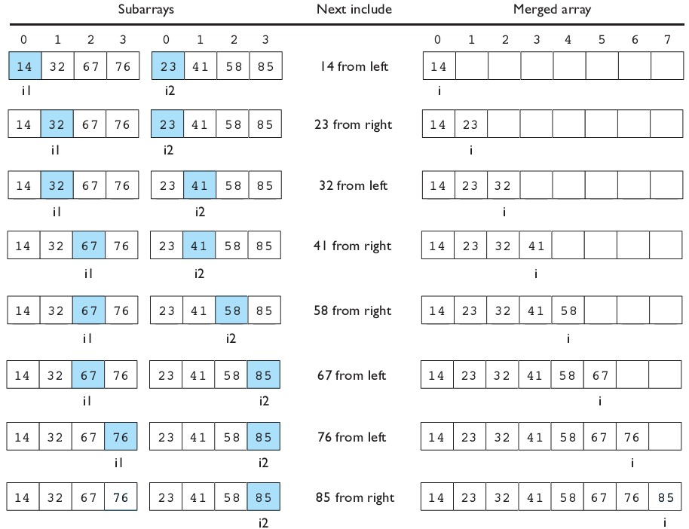
Merging Sorted Halves

Slide 50
Merge Halves Code
// Merges the left/right elements into a sorted result.
// Precondition: left/right are sorted
public static void merge(int[] result, int[] left,
int[] right) {
int i1 = 0; // index into left array
int i2 = 0; // index into right array
for (int i = 0; i < result.length; i++) {
if (i2 >= right.length ||
(i1 < left.length && left[i1] <= right[i2])) {
result[i] = left[i1]; // take from left
i1++;
} else {
result[i] = right[i2]; // take from right
i2++;
}
}
}

Slide 51
Merge Sort Code
// Rearranges the elements of a into sorted order using
// the merge sort algorithm.
public static void mergeSort(int[] a) {
// split array into two halves
int[] left = Arrays.copyOfRange(a, 0, a.length/2);
int[] right = Arrays.copyOfRange(a, a.length/2, a.length);
// sort the two halves
...
// merge the sorted halves into a sorted whole
merge(a, left, right);
}

Slide 52
Merge Sort Code 2
// Rearranges the elements of a into sorted order using
// the merge sort algorithm (recursive).
public static void mergeSort(int[] a) {
if (a.length >= 2) {
// split array into two halves
int[] left = Arrays.copyOfRange(a, 0, a.length/2);
int[] right = Arrays.copyOfRange(a, a.length/2, a.length);
// sort the two halves
mergeSort(left);
mergeSort(right);
// merge the sorted halves into a sorted whole
merge(a, left, right);
}
}

Slide 53
Merge Sort (Animation)
Please download the PPT, and use Slide Show for better viewing experience
Run time O(nlogn)

Slide 54
The End ☺
CHAPTER 13
SEARCHING and SORTING
Winnie Li

Slide 55
Range Algorithm 1
What complexity class is this algorithm? Can it be improved?
// returns the range of values in the given array;
// the difference between elements furthest apart
// example: range({17, 29, 11, 4, 20, 8}) is 25
public static int range(int[] numbers) {
int maxDiff = 0; // look at each pair of values
for (int i = 0; i < numbers.length; i++) {
for (int j = 0; j < numbers.length; j++) {
int diff = Math.abs(numbers[j] – numbers[i]);
if (diff > maxDiff) {
maxDiff = diff;
}
}
}
return diff;
}

Slide 56
Range Algorithm 2
The algorithm is O(N²). A slightly better version:
// returns the range of values in the given array;
// the difference between elements furthest apart
// example: range({17, 29, 11, 4, 20, 8}) is 25
public static int range(int[] numbers) {
int maxDiff = 0; // look at each pair of values
for (int i = 0; i < numbers.length; i++) {
for (int j = i + 1; j < numbers.length; j++) {
int diff = Math.abs(numbers[j] – numbers[i]);
if (diff > maxDiff) {
maxDiff = diff;
}
}
}
return diff;
}

Slide 57
Range Algorithm 3
This final version is O(N). It runs MUCH faster:
// returns the range of values in the given array;
// example: range({17, 29, 11, 4, 20, 8}) is 25
public static int range(int[] numbers) {
int max = numbers[0]; // find max/min values
int min = max;
for (int i = 1; i < numbers.length; i++) {
if (numbers[i] < min) {
min = numbers[i];
}
if (numbers[i] > max) {
max = numbers[i];
}
}
return max - min;
}

Slide 58
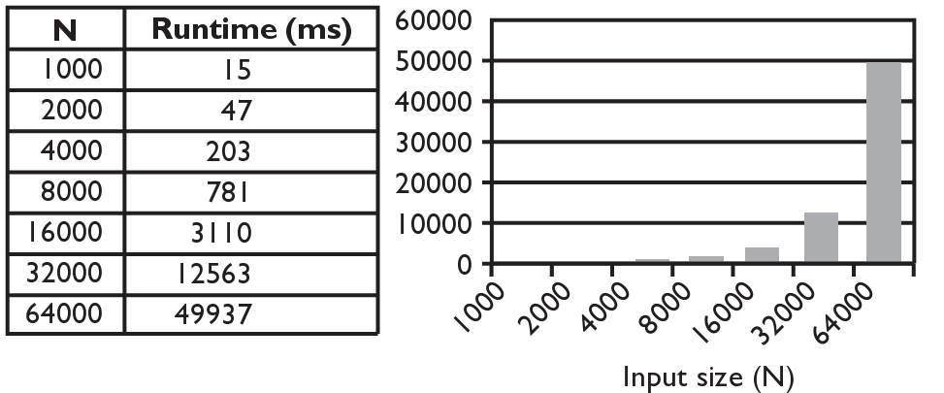
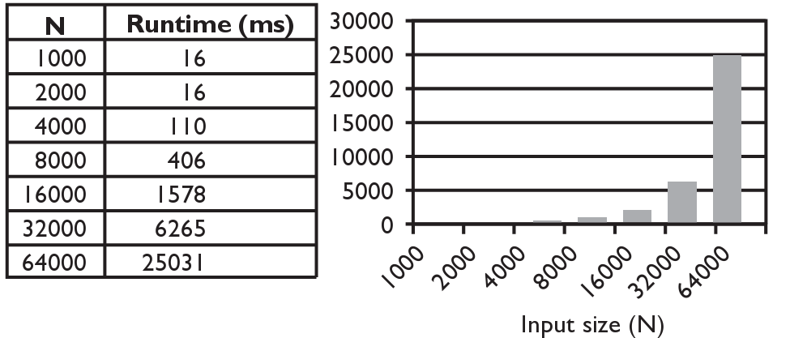
Runtime of First 2 Versions
Version 1:
Version 2:

Slide 59
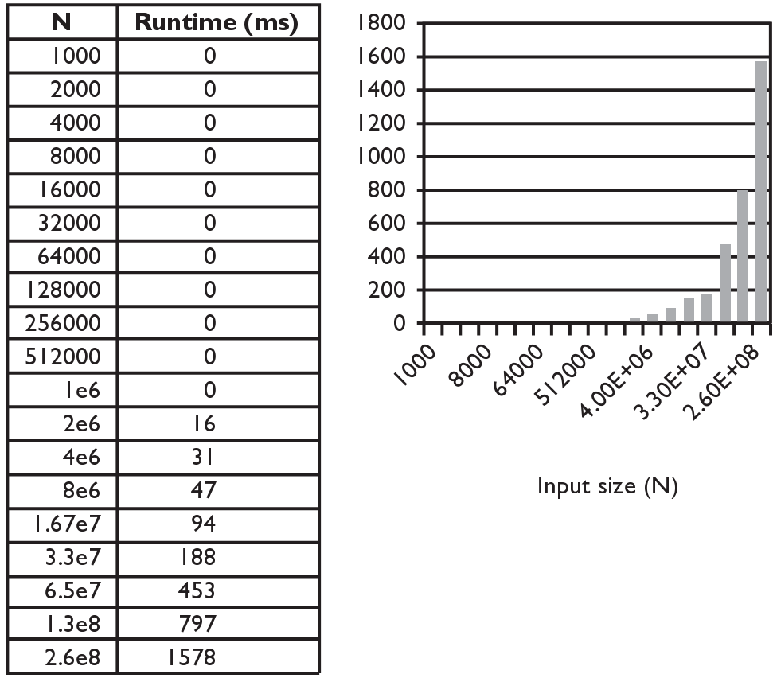
Runtime of the Third Version
Version 3:

Slide 60
Bogo sort
bogo sort: Orders a list of values by repetitively shuffling them and checking if they are sorted.
name comes from the word "bogus"
The algorithm:
Scan the list, seeing if it is sorted. If so, stop.
Else, shuffle the values in the list and repeat.
This sorting algorithm (obviously) has terrible performance!
What is its runtime?

Slide 61
Bogo sort code
// Places the elements of a into sorted order.
public static void bogoSort(int[] a) {
while (!isSorted(a)) {
shuffle(a);
}
}
// Returns true if a's elements are in sorted order.
public static boolean isSorted(int[] a) {
for (int i = 0; i < a.length - 1; i++) {
if (a[i] > a[i + 1]) {
return false;
}
}
return true;
}

Slide 62
Bogo sort code, cont'd.
// Shuffles an array of ints by randomly swapping each
// element with an element ahead of it in the array.
public static void shuffle(int[] a) {
for (int i = 0; i < a.length - 1; i++) {
// pick a random index in [i+1, a.length-1]
int range = a.length - 1 - (i + 1) + 1;
int j = (int) (Math.random() * range + (i + 1));
swap(a, i, j);
}
}
// Swaps a[i] with a[j].
public static void swap(int[] a, int i, int j) {
if (i != j) {
int temp = a[i];
a[i] = a[j];
a[j] = temp;
}
}

Slide 63
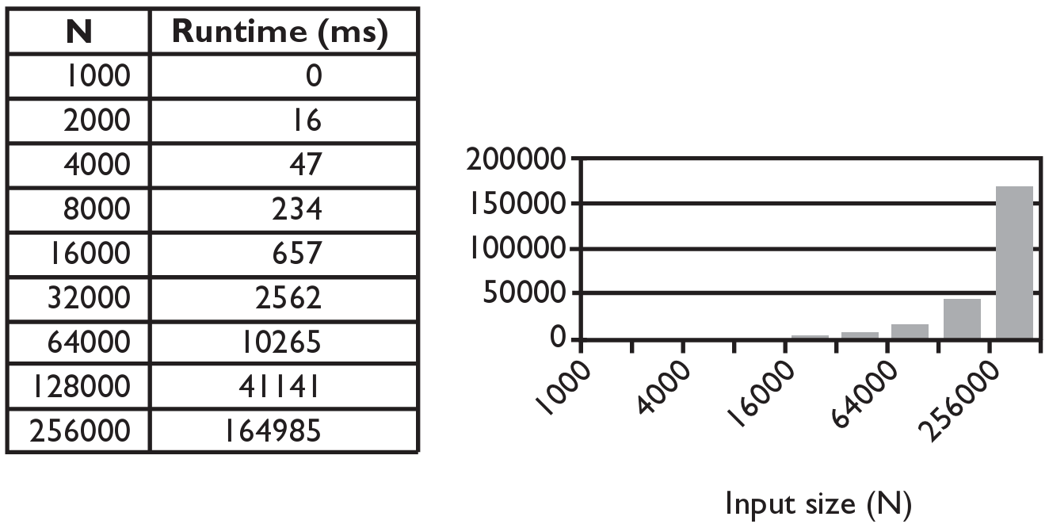
Selection Sort Runtime
What is the complexity class (Big-Oh) of selection sort?

Slide 64
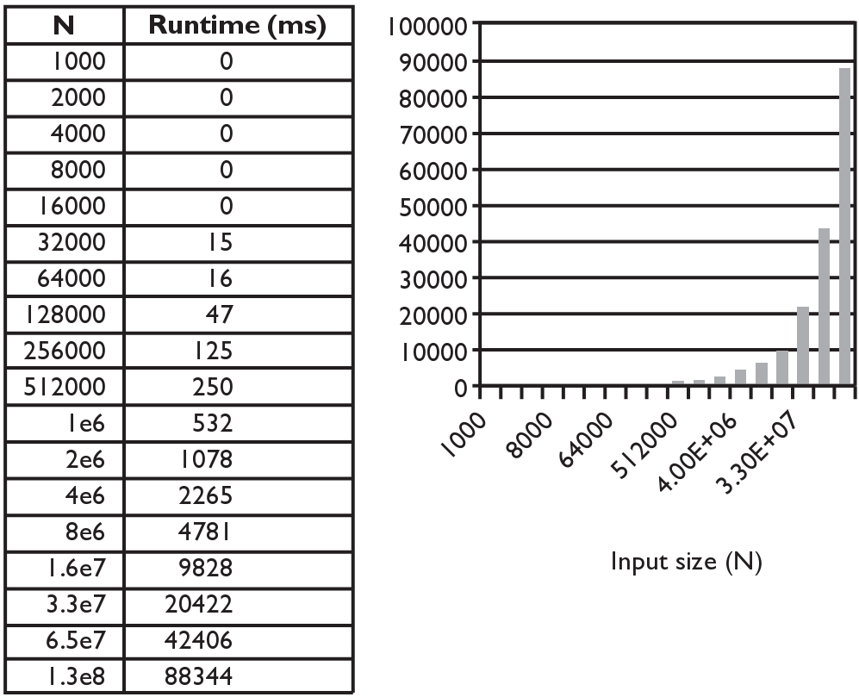
Merge Sort Runtime
What is the complexity class (Big-Oh) of merge sort?

Slide 65
Similar algorithms
index | 0 | 1 | 2 | 3 | 4 | 5 | 6 | 7 | 8 | 9 | 10 | 11 | 12 | 13 | 14 | 15 | 16
value | 22 | 18 | 12 | -4 | 27 | 30 | 36 | 50 | 7 | 68 | 91 | 56 | 2 | 85 | 42 | 98 | 25
bubble sort: Make repeated passes, swapping adjacent values
slower than selection sort (has to do more swaps)
insertion sort: Shift each element into a sorted sub-array
faster than selection sort (examines fewer values)
index | 0 | 1 | 2 | 3 | 4 | 5 | 6 | 7 | 8 | 9 | 10 | 11 | 12 | 13 | 14 | 15 | 16
value | 18 | 12 | -4 | 22 | 27 | 30 | 36 | 7 | 50 | 68 | 56 | 2 | 85 | 42 | 91 | 25 | 98
22
50
91
98
index | 0 | 1 | 2 | 3 | 4 | 5 | 6 | 7 | 8 | 9 | 10 | 11 | 12 | 13 | 14 | 15 | 16
value | -4 | 12 | 18 | 22 | 27 | 30 | 36 | 50 | 7 | 68 | 91 | 56 | 2 | 85 | 42 | 98 | 25
sorted sub-array (indexes 0-7)
7
Notes:
A lot of 143 students implement a kind of insertion sort on their SortedIntList add operation.

