Slide 1
Building Java Programs A Back to Basics Approach
CHAPTER 14
Stacks and queues
Please download the PPT, and use Slide Show for better viewing experience
Winnie Li

Slide 2
Topics will be covered
Introduction
Stack Concepts
Stack Operations
Queue Concepts
Queue Operations
Expression Evaluator
Expression Evaluation and Syntax Parsing
Infix to Postfix Expression
Postfix Expression Evaluation

Slide 3
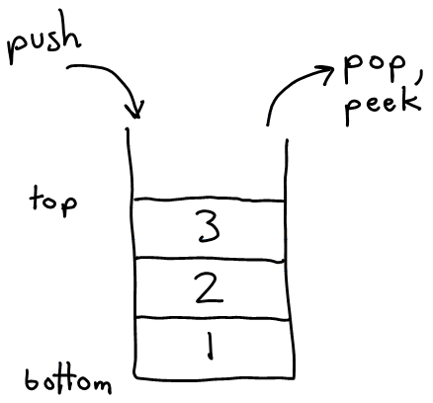
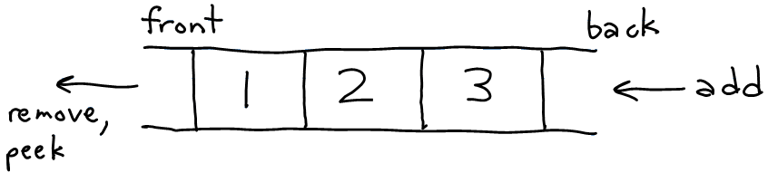
Stacks and Queues
Sometimes it is good to have a collection that is less powerful, but is optimized to perform certain operations very quickly.
Today we will examine two specialty collections:
stack: Retrieves elements in the reverse of the order they were added.
queue: Retrieves elements in the same order they were added.
queue
stack

Slide 4
Stacks
reading: 14.1, 14.2

Slide 5
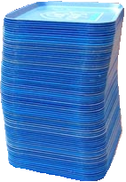
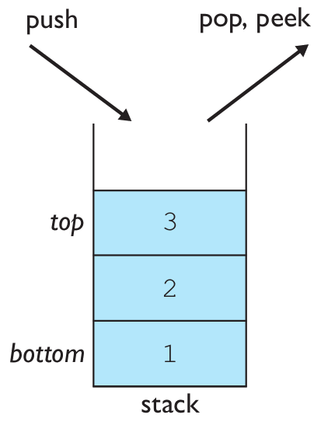
Stacks
stack: A collection based on the principle of adding elements and retrieving them in the opposite order.
Last-In, First-Out ("LIFO")
The elements are stored in order of insertion, but we do not think of them as having indexes.
The client can only add/remove/examine the last element added (the "top").
Access is restricted to the most recently inserted item
basic stack operations:
push: Add an element to the top of the stack.
pop: Remove the top element of the stack.
peek: Examine the top element of the stack.
Notes:
analogy: trays of food at the sizzler

Slide 6
Stacks in Computer Science
Programming languages and compilers:
method calls are placed onto a stack (call=push, return=pop)
compilers use stacks to evaluate expressions
Matching up related pairs of things:
find out whether a string is a palindrome
examine a file to see if its braces { } and other operators match
convert "infix" expressions to "postfix" or "prefix"
Sophisticated algorithms:
searching through a maze with "backtracking"
many programs use an "undo stack" of previous operations
method3 | return var local vars parameters
method2 | return var local vars parameters
method1 | return var local vars parameters

Slide 7
Stacks Application
The Developer may use the stack in the following (not limited to) cases:
Expression evaluation and syntax parsing
Finding the correct path in a maze using backtracking
Runtime memory management
Recursion function
…

Slide 8
Stack Operation -- PUSH
Please download the PPT, and use Slide Show for better viewing experience
Push C
C
← Top of Stack
Push B
B
← Top of Stack
A
← Top of Stack
Push A
Stack

Slide 9
Stack Operation -- POP
Please download the PPT, and use Slide Show for better viewing experience
Pop
C
Pop
B
← Top of Stack
Pop
A
← Top of Stack
Stack

Slide 10
Stacks Exercise 1
Consider the following stack sequence
Explain the stack operations in term of PUSH, POP and pointer changes:
PUSH(88) POP(88) POP(17)
17
39
6
88
17
39
6
17
39
6
39
6
PUSH
(88)
POP
(88)
Stack Pointer
POP
(17)

Slide 11
Stacks Exercise 2
Given the output stream A,B,C,D,E,F Write down the sequence of operations (Push for stack and Pop for unstack) which would produce the sequence C,B,D,E,F,A
PUSH A
PUSH B
PUSH C
POP C
POP B
PUSH D
POP D
PUSH E
POP E
PUSH F
POP F
POP A
Make sure to draw the stack, and include push/pop action with stack pointer

Slide 12
Class Stack
Stack<Integer> s = new Stack<Integer>();
s.push(42);
s.push(-3);
s.push(17); // bottom [42, -3, 17] top
System.out.println(s.pop()); // 17
Stack has other methods, but we forbid you to use them.
Stack<E>() | constructs a new stack with elements of type E
push(value) | places given value on top of stack
pop() | removes top value from stack and returns it; throws EmptyStackException if stack is empty
peek() | returns top value from stack without removing it; throws EmptyStackException if stack is empty
size() | returns number of elements in stack
isEmpty() | returns true if stack has no elements

Slide 13
Stack Limitations/Idioms
Remember: You cannot loop over a stack in the usual way.
Stack<Integer> s = new Stack<Integer>();
...
for (int i = 0; i < s.size(); i++) {
do something with s.get(i);
}
Instead, you must pull contents out of the stack to view them.
common idiom: Removing each element until the stack is empty.
while (!s.isEmpty()) {
do something with s.pop();
}

Slide 14
Exercise
Consider an input file of exam scores in reverse ABC order:
Yeilding Janet 87
White Steven 84
Todd Kim 52
Tashev Sylvia 95
...
Write code to print the exam scores in ABC order using a stack.
What if we want to further process the exams after printing?
Notes:
notion of looping over a collection while modifying it
notion of not destroying a stack while examining it (write 1st version that destroys stack, 2nd version puts it back)

Slide 15
What Happened to My Stack?
Suppose we're asked to write a method max that accepts a Stack of integers and returns the largest integer in the stack.
The following solution is seemingly correct:
// Precondition: s.size() > 0
public static void max(Stack<Integer> s) {
int maxValue = s.pop();
while (!s.isEmpty()) {
int next = s.pop();
maxValue = Math.max(maxValue, next);
}
return maxValue;
}
The algorithm is correct, but what is wrong with the code?

Slide 16
What Happened to My Stack?
The code destroys the stack in figuring out its answer.
To fix this, you must save and restore the stack's contents:
public static void max(Stack<Integer> s) {
Stack<Integer> backup = new Stack<Integer>();
int maxValue = s.pop();
backup.push(maxValue);
while (!s.isEmpty()) {
int next = s.pop();
backup.push(next);
maxValue = Math.max(maxValue, next);
}
while (!backup.isEmpty()) {
s.push(backup.pop());
}
return maxValue;
}

Slide 17
Queues
reading: 14.1, 14.2

Slide 18
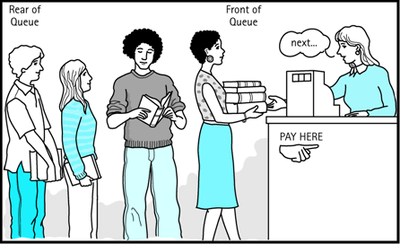
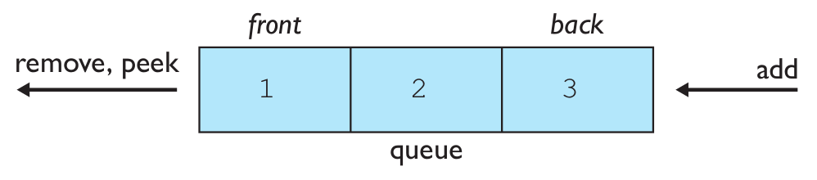
Queues
queue: Retrieves elements in the order they were added.
First-In, First-Out ("FIFO")
Elements are stored in order of insertion but don't have indexes.
Client can only add to the end of the queue, and can only examine/remove the front of the queue.
Insertion at back (rear)
Remove at front
basic queue operations:
add (enqueue): Add an element to the back.
remove (dequeue): Remove the front element.
peek: Examine the front element.
/rear
Notes:
analogy: trays of food at the sizzler

Slide 19
Queues in Computer Science
Operating systems:
queue of print jobs to send to the printer
queue of programs / processes to be run
queue of network data packets to send
Programming:
modeling a line of customers or clients
storing a queue of computations to be performed in order
Real world examples:
people on an escalator or waiting in a line
cars at a gas station (or on an assembly line)

Slide 20
Queues Applications
Queue data structure can be implemented in two ways:
Using Array
Using LinkedList
When a queue is implemented using array, that queue can organize only limited number of elements.
When a queue is implemented using linked list, that queue can organize unlimited number of elements.

Slide 21
Queue Operation Example
Queue after inserting 15, 25, 30, 35, and 40
back / rear
15 | 25 | 30 | 35 | 40
front

Slide 22
Programming with Queues
Queue<Integer> q = new LinkedList<Integer>();
q.add(42);
q.add(-3);
q.add(17); // front [42, -3, 17] back
System.out.println(q.remove()); // 42
IMPORTANT: When constructing a queue you must use a new LinkedList object instead of a new Queue object.
This has to do with a topic we'll discuss later called interfaces.
add(value) | places given value at back of queue
remove() | removes value from front of queue and returns it; throws a NoSuchElementException if queue is empty
peek() | returns front value from queue without removing it; returns null if queue is empty
size() | returns number of elements in queue
isEmpty() | returns true if queue has no elements

Slide 23
Queue Idioms
As with stacks, must pull contents out of queue to view them.
while (!q.isEmpty()) {
do something with q.remove();
}
another idiom: Examining each element exactly once.
int size = q.size();
for (int i = 0; i < size; i++) {
do something with q.remove();
(including possibly re-adding it to the queue)
}
Why do we need the size variable?
Notes:
examining each element once is like

Slide 24
Mixing Stacks and Queues
We often mix stacks and queues to achieve certain effects.
Example: Reverse the order of the elements of a queue.
Queue<Integer> q = new LinkedList<Integer>();
q.add(1);
q.add(2);
q.add(3); // [1, 2, 3]
Stack<Integer> s = new Stack<Integer>();
while (!q.isEmpty()) { // Q -> S
s.push(q.remove());
}
while (!s.isEmpty()) { // S -> Q
q.add(s.pop());
}
System.out.println(q); // [3, 2, 1]

Slide 25
Expression Evaluation and Syntax Parsing
reading: 14.4

Slide 26
Computer Calculation
How does the compute calculate this? 1 + 3 * (2 – 1)
Expression Evaluation and Syntax Parsing
Infix to Postfix Expression
Postfix Expression Evaluation
Step 1
Step 2
Step 3
( 5 + 3 ) * ( 8 - 2 )
5 3 + 8 2 - *
48

Slide 27
Expression Evaluation and Syntax Parsing
{ 1 + 3 * ( 2 – 1 ) }
If token == { || (
PUSH
If token == } || )
POP
{ (
) }
PUSH
POP
Stack
Please download the PPT, and use Slide Show for better viewing experience

Slide 28
Expression Evaluation and Syntax Parsing
{ 1 + 3 * ( 2 – 1 ) }
{1+3*(2–1)}
{
{1+3*(2–1)}
{1+3*(2–1)}
{1+3*(2–1)}
(
PUSH
PUSH
POP
POP
( )
Paired
(No Error)
{ }
Paired
(No Error)
( }
If Unmatched
(Error)
Stack
Please download the PPT, and use Slide Show for better viewing experience

Slide 29
Infix to Postfix Expression
reading: 14.4

Slide 30
Infix Expression and Postfix Expression
Infix expressions are readable and solvable by humans
Infix Expression: ( 5 + 3 ) * ( 8 – 2 )
Postfix Expression: 5 3 + 8 2 - *
Computer cannot differentiate the operators and parenthesis easily, that’s why postfix conversion is needed.

Slide 31
Infix to Postfix Conversion (by human)
D = A + B * C
Step 1: The operators in the given Infix Expression: = + *
Step 2: The order of operators according to their preference: *+=
Step 3: Convert the first operator *: D = A + B C *
Step 4: Convert the next operator +: D = A B C * +
Step 5: Convert the next operator =: D A B C * + =
Finally, given Infix Expression is converted into
Postfix Expression as follows: D A B C * + =

Slide 32
Infix to Postfix Expression
To convert Infix Expression into Postfix Expression using Stack data structure:
1: Read all the symbols one by one from left to right in the given Infix Expression.
2. If the reading symbols is operand, then directly print it to the result (Output).
3. If the reading symbol is left parenthesis “(”, then PUSH it to the Stack
4. If the reading symbol is right parenthesis “)”, then POP all the contents of stack until respective left parenthesis is popped and print each popped symbol to the result.
5. If the reading symbol is operator (+-*/etc.), then PUSH it to the Stack. However, first pop the operators which are already on the stack that have higher or equal precedence than current operator and print them to the result.

Slide 33
Example
Please download the PPT, and use Slide Show for better viewing experience
(A + B) * (C – D)
Reading Char Stack Postfix Expression
(
PUSH (
empty
(
A
NO operation
(A is operand)
A
(

Slide 34
Example
Please download the PPT, and use Slide Show for better viewing experience
(A + B) * (C – D)
Reading Char Stack Postfix Expression
+
+ has lower priority than (
PUSH +
A
+
(
B
NO operation
(B is operand)
B
+
A
(

Slide 35
Example
Please download the PPT, and use Slide Show for better viewing experience
(A + B) * (C – D)
Reading Char Stack Postfix Expression
POP all elements until we reach (
POP +
POP (
)
AB
)
+
Discard
(
NO operation
(A is operand)
AB+
*
*
(

Slide 36
Example
Please download the PPT, and use Slide Show for better viewing experience
(A + B) * (C – D)
Reading Char Stack Postfix Expression
(
PUSH (
AB+
(
*
C
NO operation
(C is operand)
C
(
AB+
*

Slide 37
Example
Please download the PPT, and use Slide Show for better viewing experience
(A + B) * (C – D)
Reading Char Stack Postfix Expression
-
- has lower priority than (
PUSH -
-
AB+C
(
*
NO operation
(D is operand)
-
D
D
(
AB+C
*

Slide 38
Example
Please download the PPT, and use Slide Show for better viewing experience
(A + B) * (C – D)
Reading Char Stack Postfix Expression
POP all elements until we reach (
POP -
POP (
)
)
-
AB+CD
(
Discard
*
POP all elements until stack becomes empty
POP *
AB+CD-
The FINAL
Postfix Expression
*

Slide 39
Exercise
Infix to Postfix Expression: 1 – 2 * 3 + 1
String post = “”
post = post + 1
PUSH -
post = post + 2
PUSH *
post = post + 3
(read + )
POP * (post = post + *)
POP – (post = post + -)
PUSH +
Post = post + 1
POP + (post = post + +)
post = 1 2 3 * - 1 +
Make sure to draw the stack (as shown in the previous example

Slide 40
Postfix Expression Evaluation
reading: 14.4

Slide 41
Postfix Expression Evaluation
A postfix expression is a collection of operators and operands in which the operator is placed after the operands. That means, in a postfix expression the operator follows the operands.
Operand 1 Operand 2 Operator
A B +

Slide 42
Evaluation of Postfix Expression
A postfix expression can be evaluated using the Stack data structure using the following steps:
Step 1: Read all the symbols one by one from left to right in the given Postfix Expression
Step 2: If the reading symbol is operand, then PUSH it to the Stack.
Step 3: If the reading symbol is operator (+-*/ etc.), then perform TWO POP operations and store the two popped operands in two different variables (operand1 and operand2). Then perform reading symbol operation using operand1 and operand2 and PUSH result back to the stack.
Step 4: Finally perform a POP operation and display the popped value as the final result.

Slide 43
Example
Please download the PPT, and use Slide Show for better viewing experience
Infix: ( 5 + 3 ) * ( 8 – 2) Postfix: 5 3 + 8 2 - *
Reading Char Stack Postfix Expression
5
PUSH 5
empty
5
empty
3
PUSH 3
3
5

Slide 44
Example
Please download the PPT, and use Slide Show for better viewing experience
Infix: ( 5 + 3 ) * ( 8 – 2) Postfix: 5 3 + 8 2 - *
Reading Char Stack Postfix Expression
+
POP 3
+ =
8
POP 5
3
5
value1 = pop()
value2 = pop()
result = value2 + value1
PUSH 8
push(result)

Slide 45
Example
Please download the PPT, and use Slide Show for better viewing experience
Infix: ( 5 + 3 ) * ( 8 – 2) Postfix: 5 3 + 8 2 - *
Reading Char Stack Postfix Expression
8
PUSH 8
empty
8
8
PUSH 2
empty
2
2
8
8

Slide 46
Example
Please download the PPT, and use Slide Show for better viewing experience
Infix: ( 5 + 3 ) * ( 8 – 2) Postfix: 5 3 + 8 2 - *
Reading Char Stack Postfix Expression
- =
6
-
POP 2
2
POP 8
8
8
value1 = pop()
value2 = pop()
result = value2 - value1
push(result)
6
8

Slide 47
Example
Please download the PPT, and use Slide Show for better viewing experience
Infix: ( 5 + 3 ) * ( 8 – 2) Postfix: 5 3 + 8 2 - *
Reading Char Stack Postfix Expression
*
POP 6
* =
48
POP 8
6
8
value1 = pop()
value2 = pop()
result = value2 * value1
No More Input
POP 48
push(result)
48
result = pop
Final Result

Slide 48
Postfix Algorithm
The algorithm: Use a stack
When you see an operand, push it onto the stack.
When you see an operator:
pop the last two operands off of the stack.
apply the operator to them.
push the result onto the stack.
When you're done, the one remaining stack element is the result.
"5 2 4 * + 7 -"
5
5
2
2
5
4
4
2
5
*
8
5
+
13
7
7
13
-
6

Slide 49
Postfix Algorithm
// Evaluates the given prefix expression and returns its result.
// Precondition: string represents a legal postfix expression
public static int postfixEvaluate(String expression) {
Stack<Integer> s = new Stack<Integer>();
Scanner input = new Scanner(expression);
while (input.hasNext()) {
if (input.hasNextInt()) { // an operand (integer)
s.push(input.nextInt());
} else { // an operator
String operator = input.next();
int operand2 = s.pop();
int operand1 = s.pop();
if (operator.equals("+")) {
s.push(operand1 + operand2);
} else if (operator.equals("-")) {
s.push(operand1 - operand2);
} else if (operator.equals("*")) {
s.push(operand1 * operand2);
} else {
s.push(operand1 / operand2);
}
}
}
return s.pop();
}

Slide 50
The End ☺
CHAPTER 14
STACKS and QUEUES
Winnie Li

