Slide 1
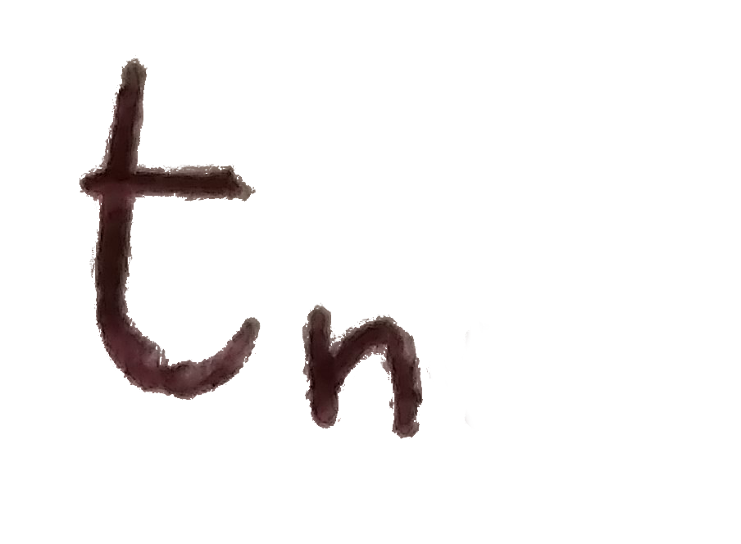
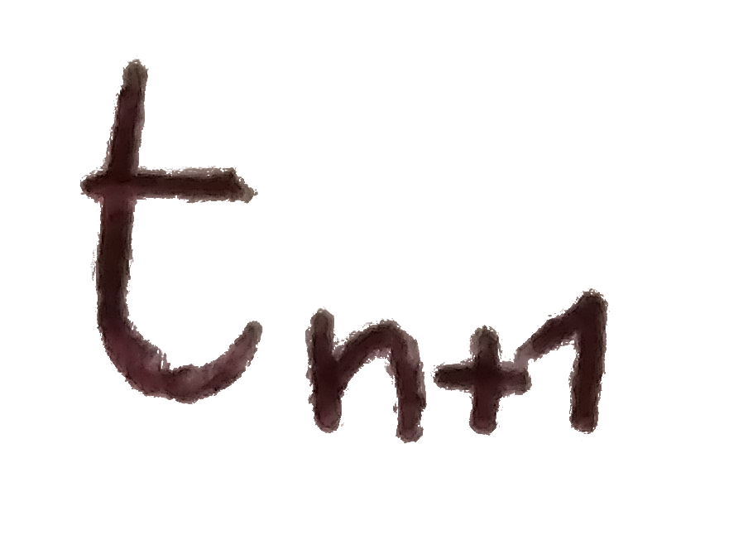


Model steps
(at each time step)
Niche space
Species evolution possibilities
0
1
For (species in all species){
if (species speciates){
test if daughter sp. establish
}else{
test if species goes extinct
}
}
One species, two traits
These possibilities are dependent on establishment and extinction probabilities, which are different depending on the interaction type
Niche value
0
1
Interaction range
0
1
Interactions
Interactions number
Means interacts with

