Slide 1
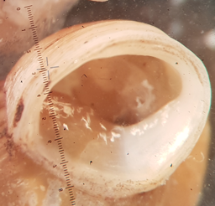
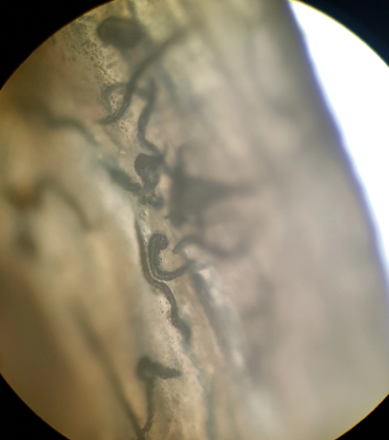
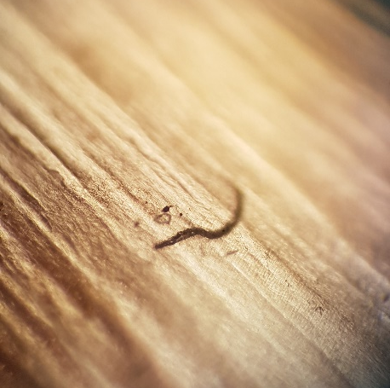
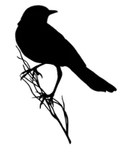
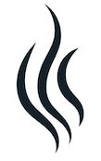
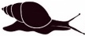
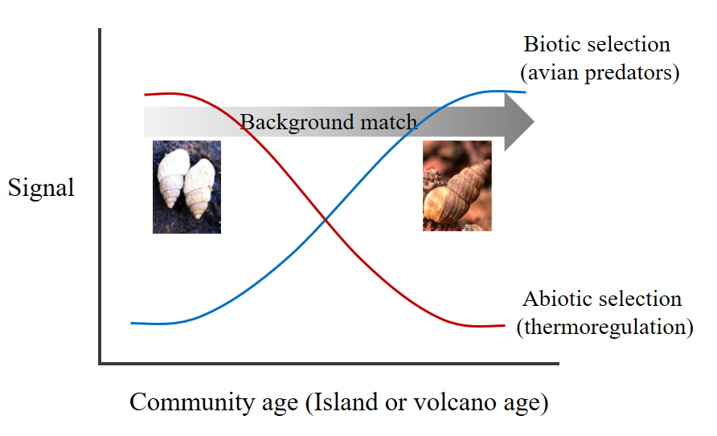
habitat
vegetation zone
arboreal
terrestrial
arid
humid
(2)
(4)
(5)
(7)
(3)
(6)
(8)
(1)
brightness
load
(13)
(9)
(10)
(12)
(11)
island age
island area

Slide 2
Habitat
Vegetation zone
Arboreal
Terrestrial
Arid
Humid
(2)
(3)
(4)
(5)
(6)
(7)
(1)
(8)
Brightness
Nematode load
(13)
(9)
(12)
(10)
(11)
Island age
Island area

Slide 3
Sept 2024
habitat
vegetation zone
arboreal
terrestrial
arid
humid
(2)
(4)
(5)
(7)
(3)
(6)
(8)
(1)
brightness
diversity
(13)
(9)
(10)
(12)
(11)
island age
island area

Slide 4
Outdated – June 2024
habitat
vegetation zone
arboreal
terrestrial
arid
humid
(2)
(4)
(5)
(7)
(3)
(6)
(8)
Higher sun exposure*~
Escape soil nematodes*
Depends on foraging activities and sun exposure~
Higher contact with soil nematodes*
Higher sun exposure*~
Unsuitable for nematodes*
Higher foraging activities and sun exposure~
Suitable habitat for nematodes*
Evolution towards darker colors to match background and escape predatory birds~
Coevolution may change encapsulation capacity^
Zero net effect^
Higher diversity and abundance of nematodes with area*
No clue
*General literature
~Kraemer et al. 2019
^own hypothesis
(1)
brightness
load
(13)
(9)
(10)
(12)
(11)
island age
island area
> Selection (and therefore brightness) on species in particular communities is similar, while selection pressure among islands differs (Kraemer et al. 2019)

