Slide 1
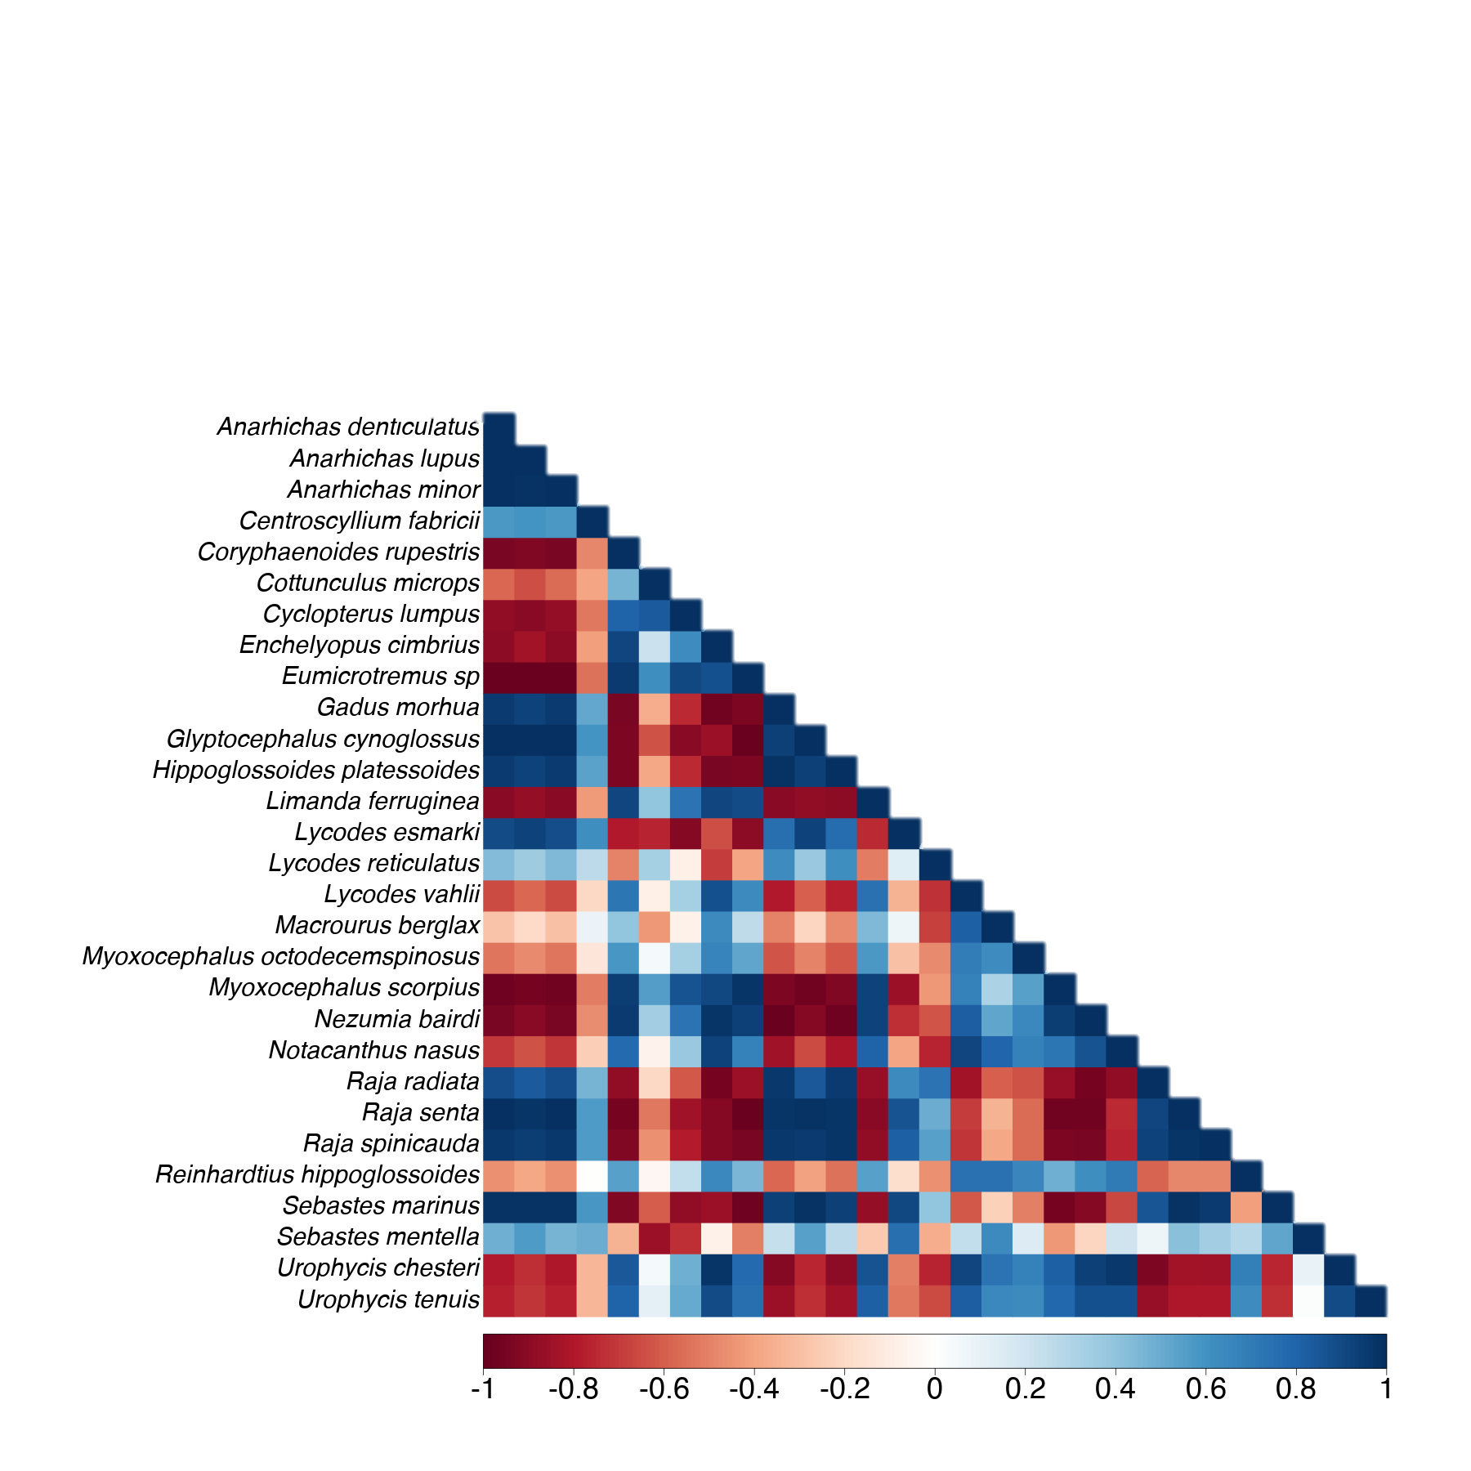
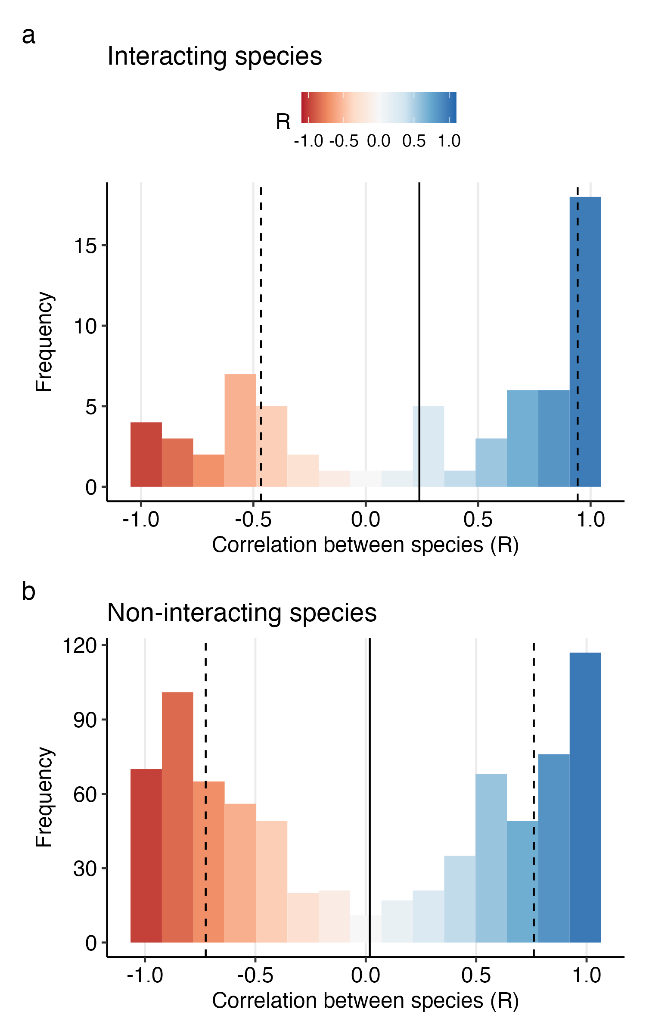
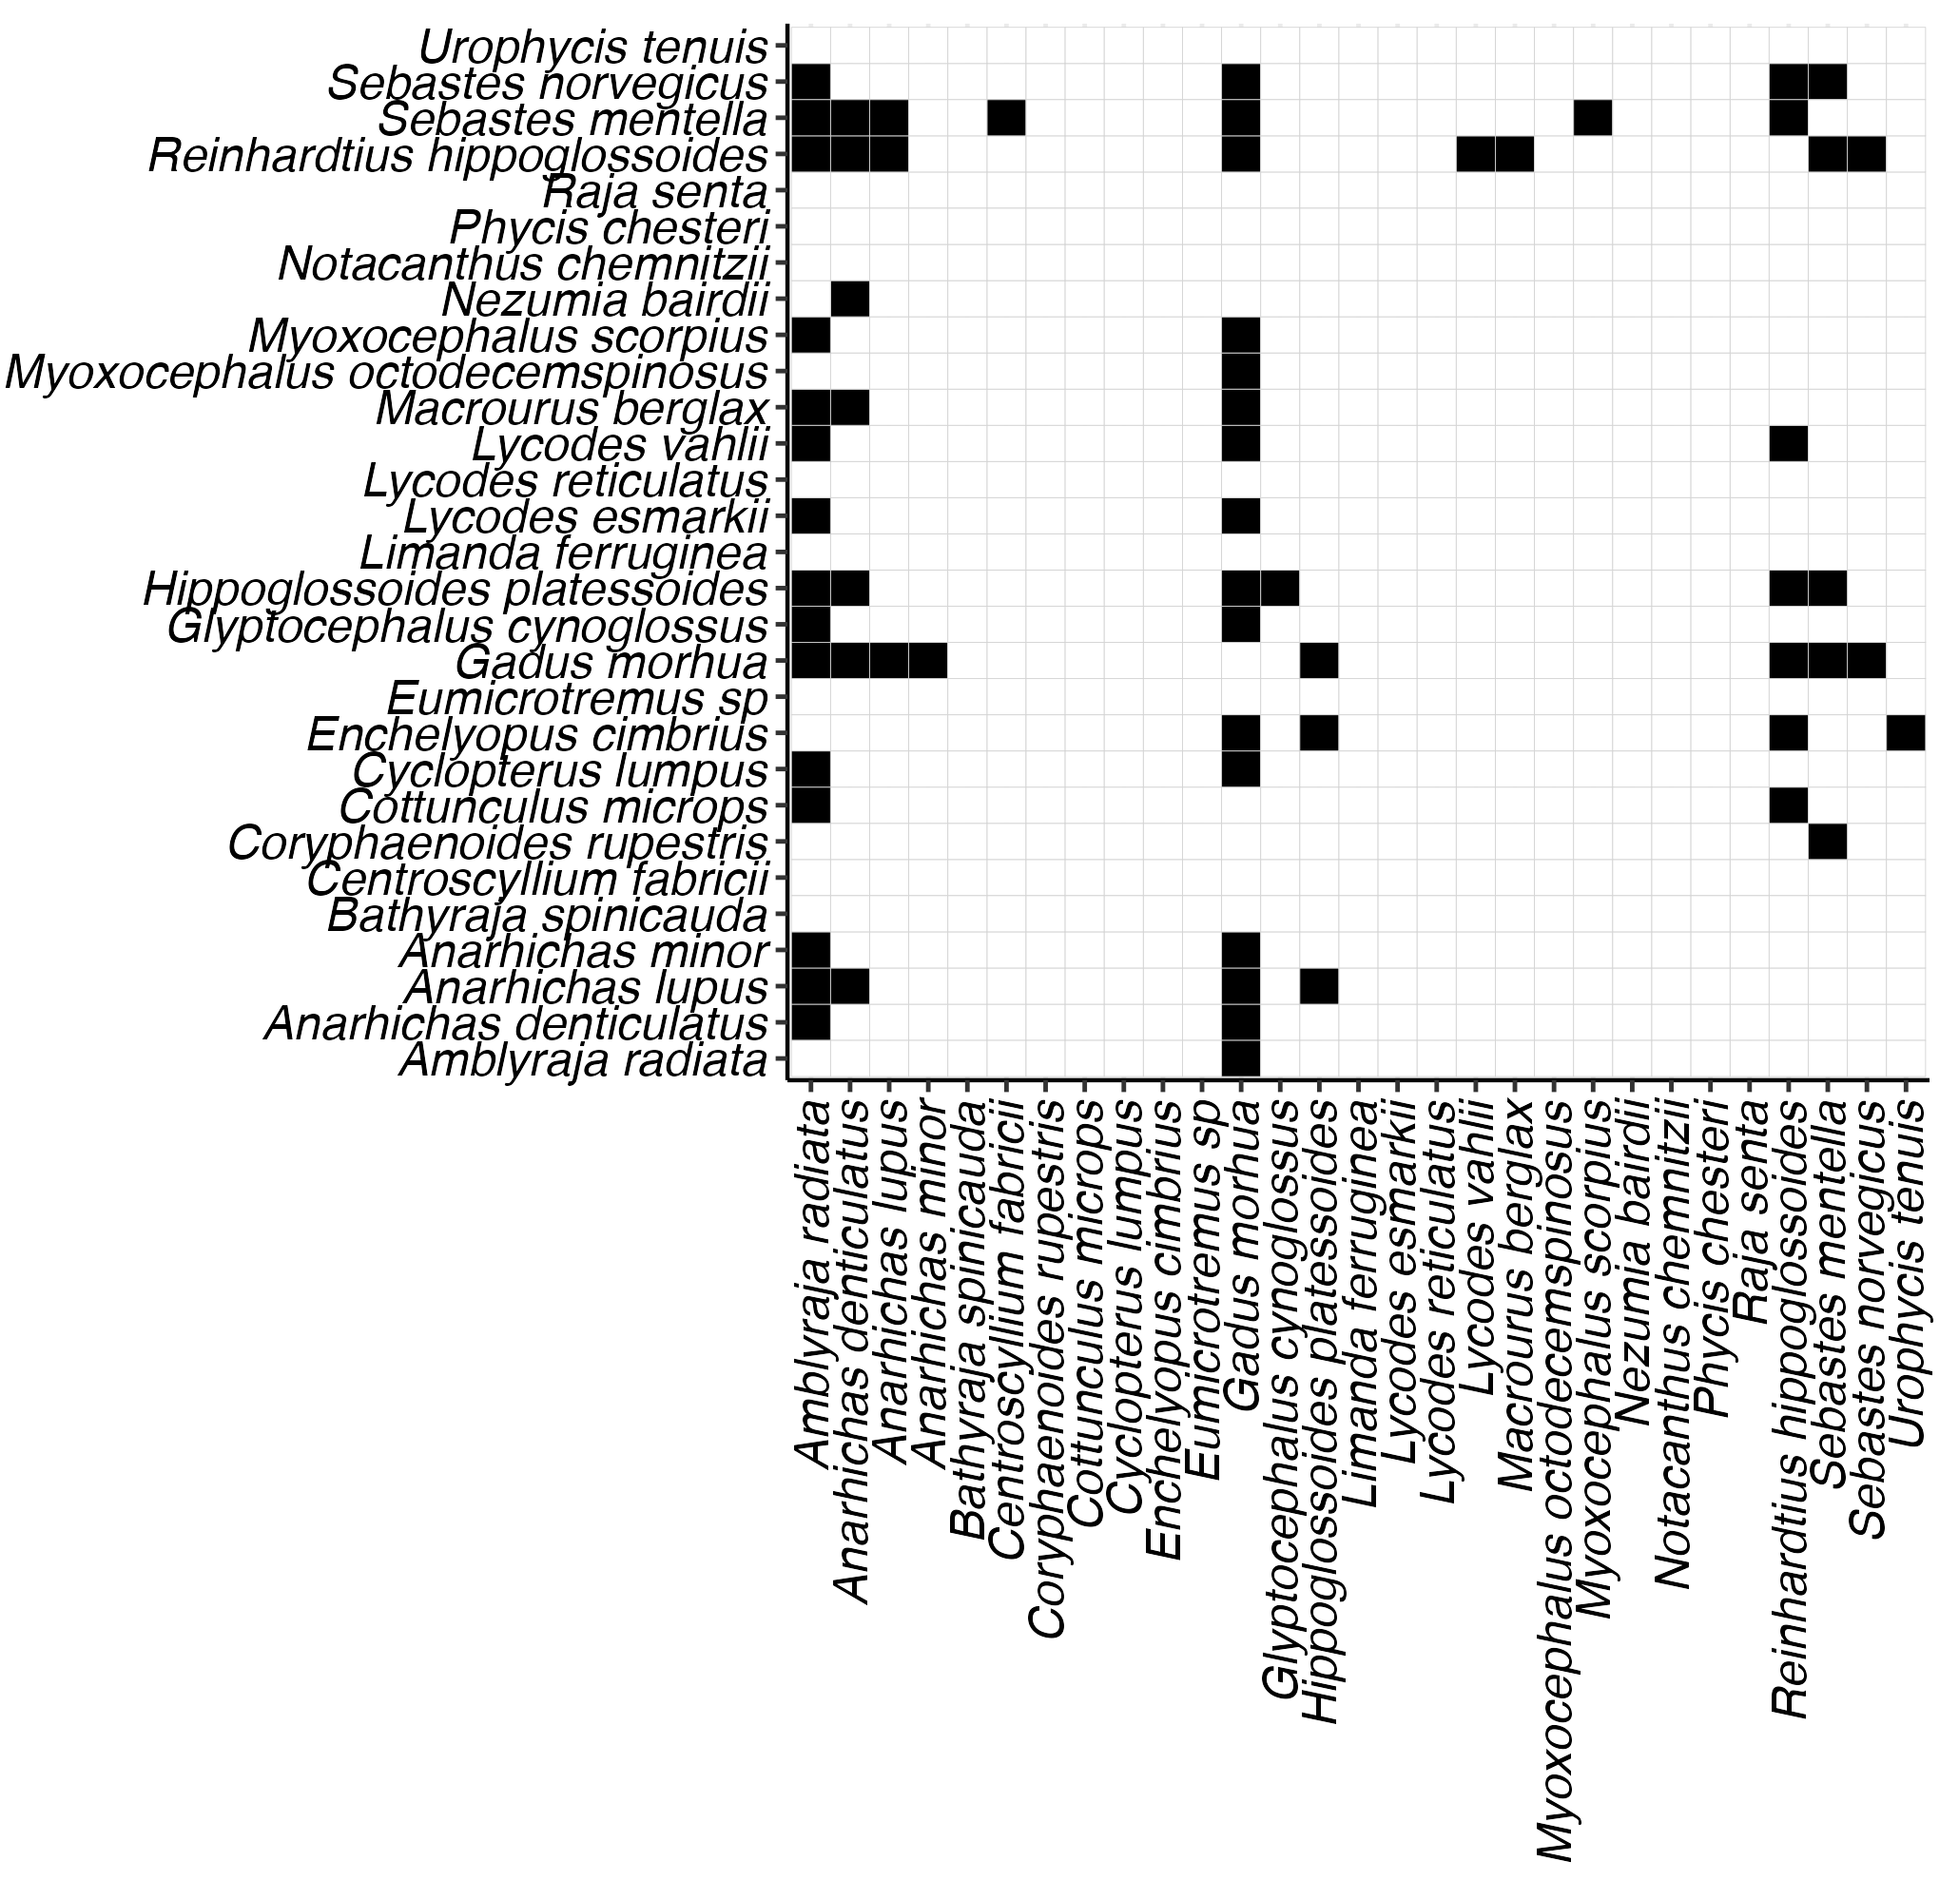
C matrix Temporal co-responses
Ecological Network Coherence (ENC)
Interacting species
A matrix
Food web
Non-interacting species

