Slide 1
Sigma API Services – ETL for RDBMS and NoSQL data stores
Sigma API Services is a platform-neutral tool that facilitates data transfer between two different databases,
It provides an easy-to-configure, easy-to-operate WebService wrapper that helps do CRUD operations.
The wiring between these services is done by a Time-based Scheduler that comes part of the suite.
The API Service supports flexible mapping between the fields belonging to the source and destination.
Unlimited no of configurations can be created and managed at both ends to support full-blown data transfer between systems like
ERP Vs CRM
ERP Vs Retail Sales
Vendor Management Systems Vs Reporting Software
Consolidation of data for Analytics

Slide 2
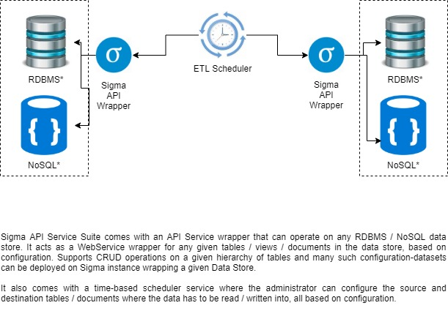
Sigma API Services - Introduction

Slide 3
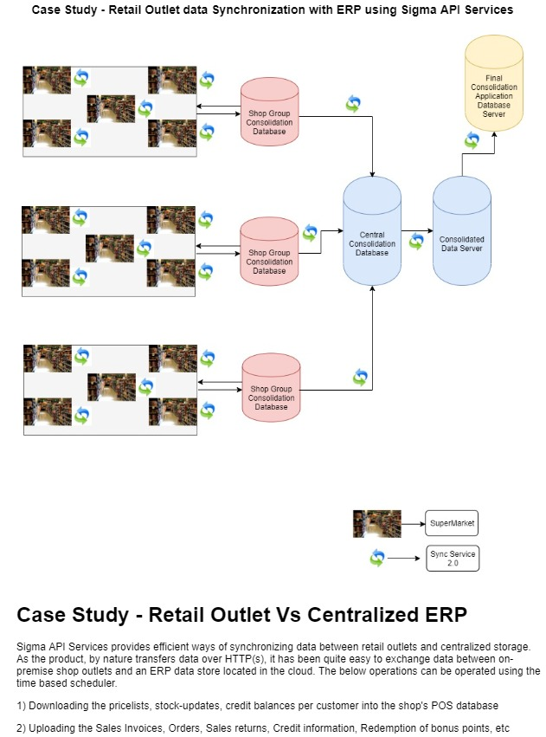
Sigma API Services – Case Study

Slide 4

Sigma API Services – Addon Features with Case Study (Instant Notification)
Scenario#1
Invoice transaction created in ERP. Item stock got updated for a couple of locations. At the same time, in a retail outlet, stock value for the same set of items are showing a different value. Currently there is no way to do an instant update (or pulling) of latest stock values for a given item.
Scenario#2
A customer does a purchase in a retail outlet and his loyalty points get increased after a couple of invoices being paid by him. The invoice gets transferred to the centralized ERP environment and gets posted there. His loyalty points are incremented in the ERP database. The customer, after this purchase, moves around for a while and later he reaches out to another retail outlet of the same enterprise and does a purchase. He wants to redeem his loyalty points in this invoice. However, he is unable to do so, as the loyalty points he gained in the previous purchase wasn’t posted in the POS system of the new location, as the sync happens only on Close Of Business, which means, the loyalty points in the POS system in the second retail outlet are 1 day old.
To address these two concerns, the Instant Notification & Broadcast feature gives a helping hand, to have a multi-cast enabled message queueing system in place, which will propagate the changes done in centralized ERP environment back to the retail outlet subsystems (POS) in different locations.

Slide 5
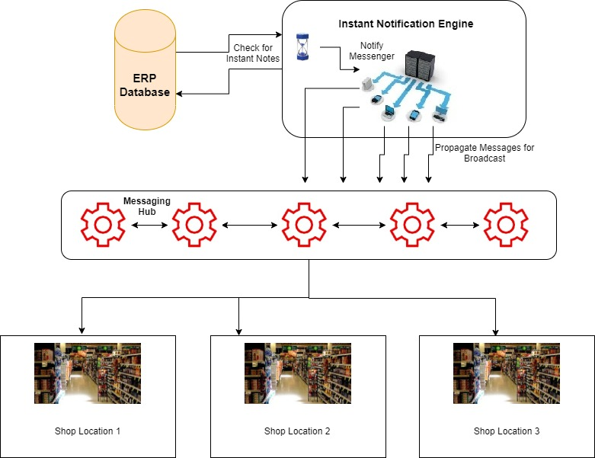
Sigma API Services – Addon Features with Case Study (Instant Notification)

Slide 6
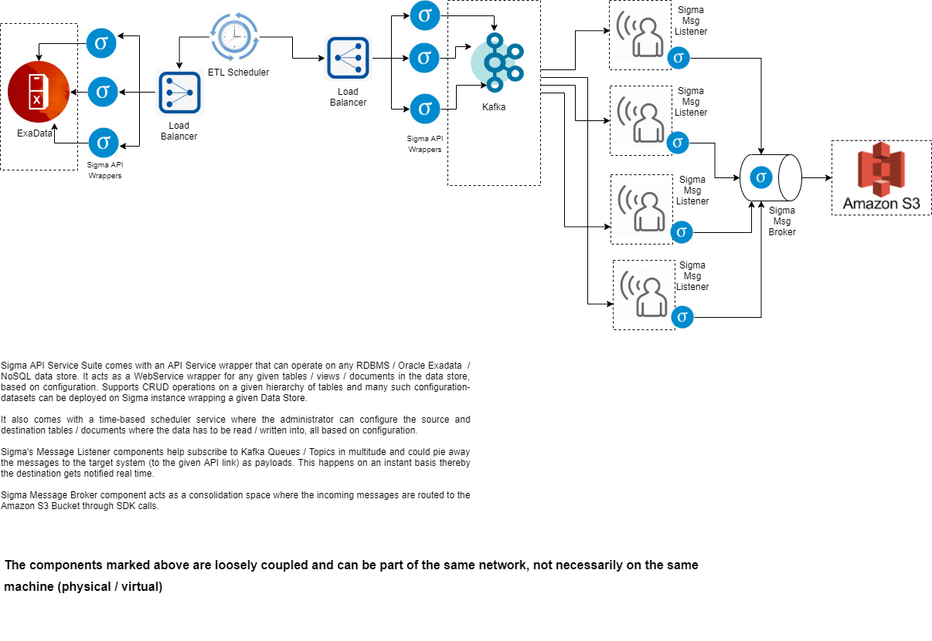
Sigma API Services – Exadata Integration with Amazon S3 - Typical Deployment Strategy

Slide 7
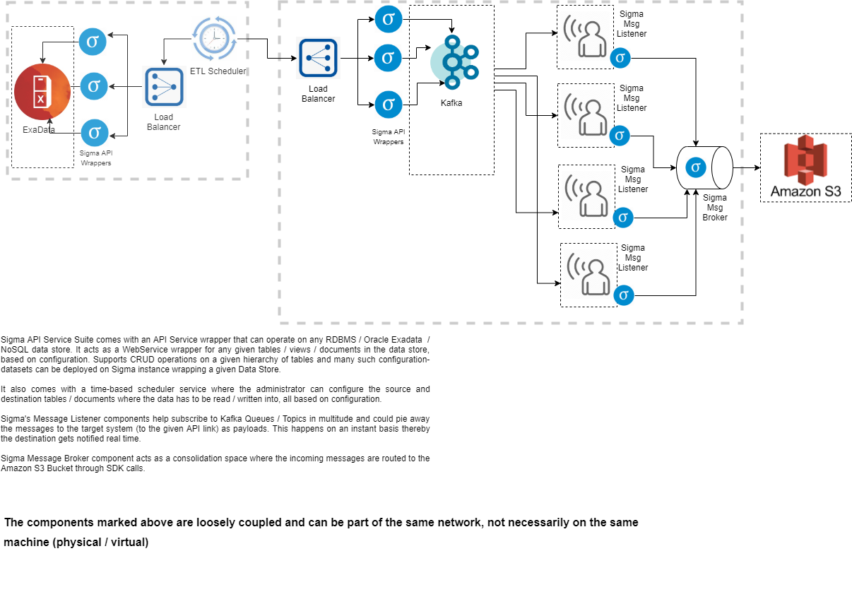
Sigma API Services – Exadata Integration with Amazon S3 - Recommended Deployment Architecture

Slide 8
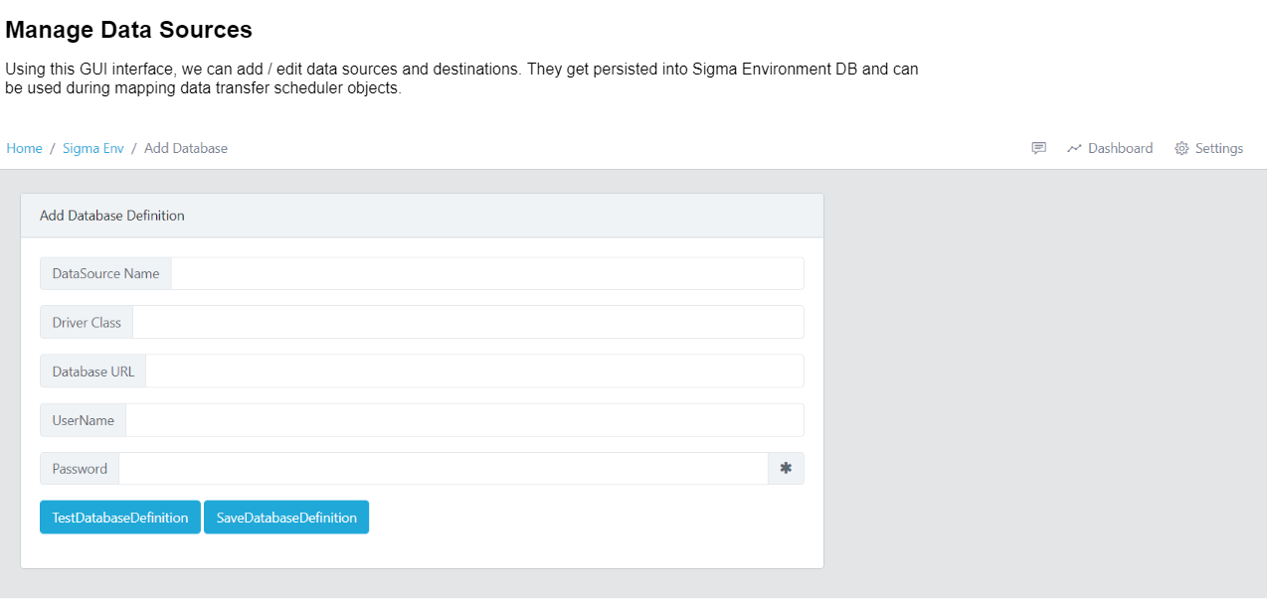

Slide 9
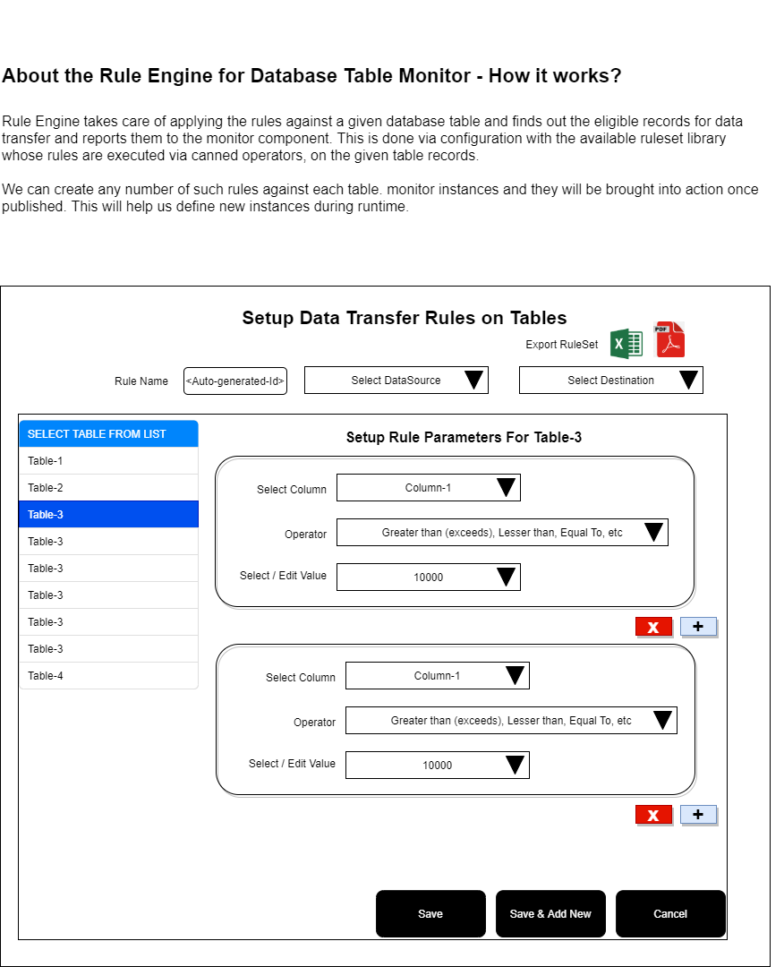

Slide 10
Advantages of Sigma API Suite
Ability to scale horizontally, for handling peak loads (with auto-shrink capability)
Data packet size controlled via configuration.
Centralized monitoring, live tracking of data transfer via Administrative GUI, on the scheduled ETL operations
Flexibility in configuration of data transfer components.

Slide 11

Thank You

