Slide 1
October 2023
Introduction to C++:
Workshop Two
Dr. Alexander Hill
a.d.hill@liverpool.ac.uk

Slide 2
Recap
#include <iostream>
using namespace std;
int main() { int first_number, second_number, sum;
cout << "Enter two integers: ";
cin >> first_number >> second_number;
// sum of two numbers in stored in variable sumOfTwoNumbers
sum = first_number + second_number;
// prints sum
cout << first_number << " + " << second_number << " = " << sum << "\n";
return 0; }
Notes:
Recap different aspects of this code

Slide 3
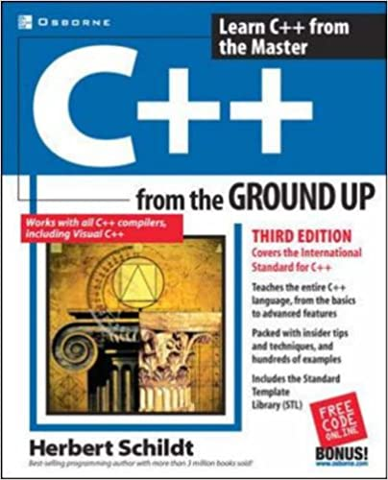
Resources
alex-hill94.github.io/#WS2
C++ from the ground up, Herbert Schildt (Roughly Chapters 2-5)
Online compiler: https://www.programiz.com/cpp-programming/online-compiler/
https://www.w3schools.com/cpp/cpp_variables.asp

Slide 4
Aim of Workshop Two
Variables and data types
Functions
For-loops
Arrays and vectors

Slide 5
Follow along on your laptop
Copy the text on the Powerpoint into your IDE (find slides on my site)
Compile and run to assert that you get the same results
#include <iostream>
using namespace std;
int main() {
string a = "Interactive lessons are superior!";
cout << a << endl;
return 0;
}
(base) alexhill at Alexs-Air in ~/Documents/UOL/Teaching/C++_Workshops/Workshops/WS2
$ g++ -o run test.cpp
(base) alexhill at Alexs-Air in ~/Documents/UOL/Teaching/C++_Workshops/Workshops/WS2
$ ./run
Interactive lessons are superior!
Notes:
Highlight that the executable is called ‘run’

Slide 6
VARIABLES
Different data types
Type conversion
Precision and limits
Simple exercises and operations list

Slide 7
Variables
A variable is a container for data
A named location in memory space
Variables are assigned values, which may be changed at any time
In C++, you must tell the compiler what data type to expect for a variable

Slide 8
Variables
#include <iostream>
using namespace std;
int main() {
int a = 10;
int b;
b = 11;
cout << a << " " << b;
return 0; }
Variables may be assigned values straight away or later in the code

Slide 9
Data Types
Name | Description
int | Stores integers without decimals (e.g. 0, 1, 2…)
double | Stores floating point numbers without decimals (e.g. 1.21)
char | Stores single characters, which are loaded using single quotations ('a’,’b’)
string | Stores text, loaded using double quotations (“Hello”)
bool | Stores Boolean values: true, false
float | Stores floating point numbers without decimals (e.g. 1.21F)
others | There are more data types, and you can create your own
Notes:
Reference that there are more data types than are shown here

Slide 10
Doubles and Floats
Floats | Doubles
Size: 4 bytes | Size: 8 bytes
7 decimal places | 15 decimal places
17.0F | 17.0
Used occasionally to speed up processes | Used most of the time
Notes:
Why do we need the F after? Otherwise the compiler will read the value as a double and do a type conversion, which may lead to data loss

Slide 11
Compiling Data Types
The compiler will try to convert the value inputted to the chosen data type
If there’s an apparent discrepancy, warnings can arise
(base) alexhill at Alexs-Air in ~/Documents/UOL/Teaching/C++_Workshops/Workshops/WS2
$ g++ -o run test.cpp
test.cpp:5:10: warning: implicit conversion from 'double' to 'int' changes value from 1.5 to 1 [-Wliteral-conversion]
int a = 1.5;
~ ^~~
1 warning generated.
(base) alexhill at Alexs-Air in ~/Documents/UOL/Teaching/C++_Workshops/Workshops/WS2
$ ./run
1
#include <iostream>
using namespace std;
int main() {
int a = 1.5;
cout << a << endl;
return 0;
}

Slide 12
Compiling Data Types
Sometimes there will be no warnings, or unintended consequences – so be careful!
#include <iostream>
using namespace std;
int main() {
char a = 1;
cout << a << endl;
a = '%'
cout << a << endl;
return 0;
}
(base) alexhill at Alexs-Air in ~/Documents/UOL/Teaching/C++_Workshops/Workshops/WS2
$ g++ -o run test.cpp
(base) alexhill at Alexs-Air in ~/Documents/UOL/Teaching/C++_Workshops/Workshops/WS2
$ ./run
%
‘End line’ function

Slide 13
Type Conversion
Variables can have their data type changed implicitly or explicitly
An example of implicit conversion: here the double value is automatically converted to int
#include <iostream>
using namespace std;
int main() {
// assigning a double value to num_double
double num_double = 9.1;
// declaroing an int variable
int num_int;
// implicit conversion
// assigning double value to a int variable
num_int = num_double;
cout << "num_double = " << num_double << endl;
cout << "num_int = " << num_int << endl;
return 0;
}
$ ./run
num_double = 9.1
num_int = 9

Slide 14
Type Conversion
Variables can have their data type changed implicitly or explicitly
An example of explicit conversion: here the double value is automatically converted to in
#include <iostream>
using namespace std;
int main() {
double num_double = 9.1;
int num_int;
// explicit conversion
num_int = int(num_double);
cout << "num_double = " << num_double << endl;
cout << "num_int = " << num_int << endl;
return 0;
}
$ ./run
num_double = 9.1
num_int = 9

Slide 15
Type Conversion
Note that what we’re doing here is converting a value, not the data type in memory
#include <iostream>
using namespace std;
int main() {
double num_double = 9.1;
double num_int;
int num_int1;
// explicit conversion
num_int = int(num_double);
num_int1 = int(num_double);
cout << "num_double = " << num_double << endl;
cout << typeid(num_double).name() << endl;
cout << "num_int = " << num_int << endl;
cout << typeid(num_int).name() << endl;
cout << "num_int1 = " << num_int1 << endl;
cout << typeid(num_int1).name() << endl;
return 0;
}
$ ./run
num_double = 9.1
d
num_int = 9
d
num_int1 = 9
i

Slide 16
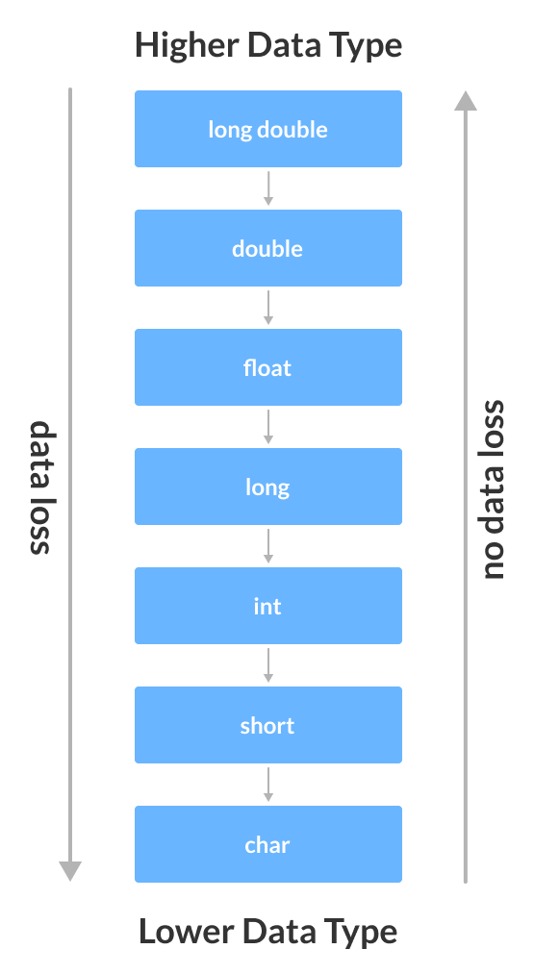
Credit:
www.programiz.com/cpp-programming/type-conversion

Slide 17
Precision: Double
There is an inbuilt precision for cout
#include <iostream>
using namespace std;
int main() {
double a = 1.123456789;
cout << a << endl;
return 0;
}
$ ./run
1.12346

Slide 18
Precision: Double
You can set the precision of cout that you need using the setprecision function
#include <iostream>
#include <iomanip>
using namespace std;
int main() {
double a = 1.123456789;
cout << setprecision(10);
cout << a << endl;
return 0;
}
$ ./run
1.123456789

Slide 19
Precision: Double
Note that if you set the precision beyond the capacity of the data type, you get (deterministic) junk after a certain point
#include <iostream>
#include <iomanip>
using namespace std;
int main() {
double a = 1.1234567891234567891234;
cout << setprecision(20);
cout << a << endl;
return 0;
}
$ ./run
1.1234567891234568116
Notes:
Rounding errors

Slide 20
Limits
The data types have a max and min value depending on the number of bits they use in memory
For int, this is 2147483647
$ g++ -o run test.cpp
test.cpp:5:13: warning: implicit conversion from 'long' to 'int' changes value from 2147483648 to -2147483648 [-Wconstant-conversion]
int b = 2147483648;
~ ^~~~~~~~~~
1 warning generated.
(base) alexhill at Alexs-Air in ~/Documents/UOL/Teaching/C++_Workshops/Workshops/WS2
$ ./run
2147483647
-2147483648
#include <iostream>
using namespace std;
int main() {
int a = 2147483647;
int b = 2147483648;
cout << a << endl;
cout << b << endl;
}
Notes:
Why does it become negative?

Slide 21
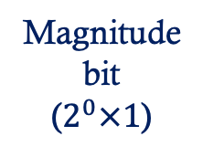


Limits
For int (32 bits) this is 2147483647
01111111111111111111111111111111
Sign bit (0 = +ve)
Magnitude bit ($2^{0}×1$)
($2^{1}×1$)
($2^{30}×1$)

Slide 22
Limits
If you need extra decimal places, you can use data types like long int, which uses more bits
https://learn.microsoft.com/en-us/cpp/c-language/cpp-integer-limits?view=msvc-170
#include <iostream>
using namespace std;
int main() {
int a = 2147483647;
long int b = 2147483648;
cout << a << endl;
cout << b << endl;
}
$ g++ -o run test.cpp
(base) alexhill at Alexs-Air in ~/Documents/UOL/Teaching/C++_Workshops/Workshops/WS2
$ ./run
2147483647
2147483648

Slide 23
Limits
You can check how many bytes (eight bits per byte) a data type uses with the sizeof() function
#include <iostream>
using namespace std;
int main() {
cout << "int:" << sizeof(int) << endl;
cout << "float:" << sizeof(float) << endl;
cout << "double:" << sizeof(double) << endl;
cout << "long int:" << sizeof(long int) << endl;
}
$ ./run
int:4
float:4
double:8
long int:8
Notes:
Bytes vs bits

Slide 24
Boolean
The Relational operators in C++ are the same as they are in Python (==, !=)
To check the value of a variable, you must first create a Boolean variable
1 = true, 0 = false
You can force cout to return ‘true’ and ‘false’ using cout << boolalpha
#include <iostream>
using namespace std;
int main() {
int a = 10;
bool b;
bool c;
b = a == 10;
c = a == 11;
cout << b << endl;
cout << c << endl;
}
$ ./run
1
0

Slide 25
Operators
The arithmetic operators in C++ are very close to those in Python (+, -, /, *, %)
Others (like logical operators {&&, ||, !}) are a bit different
See https://www.programiz.com/cpp-programming/operators for a more complete list

Slide 26
FUNCTIONS
Explore how functions are created in programmes

Slide 27
Functions
Functions are the building blocks of C++ programmes
A good practice is one function doing only one job
C++ does not allow nested functions*, however one function can call another
You can call your function anything except main(), which is reserved for the programme execution
*https://stackoverflow.com/questions/4324763/can-we-have-functions-inside-functions-in-c

Slide 28
Functions
#include <iostream>
using namespace std;
void myfunc(){
cout << ”Baby don’t hurt me" << endl;
};
void myfunc2(){
cout << ”Don’t hurt me" << endl;
};
int main() {
cout << ”What is love?" << endl;
myfunc(); // Call myfunc
myfunc2(); // Call myfunc2
cout << ”No more" << endl;
return 0;
}
void is a null data type, used here as the function returns nothing
Code is executed through
main
myfunc() calls the function we’ve created
Notes:
Functions are not run immediately, they are saved for later use

Slide 29
Functions
Function declaration
void myfunc(){
cout << ”Baby don’t hurt me" << endl;
};
Function definition
Notes:
C++ functions are split into two parts, the definition and the declaration

Slide 30
Functions: Declaration after main
#include <iostream>
using namespace std;
int main() {
cout << ”What is love?" << endl;
myfunc(); // Call myfunc
cout << ”No more" << endl;
return 0;
}
void myfunc(){
cout << ”Baby don’t hurt me" << endl;
};
$ g++ -o output test.cpp
test.cpp:6:1: error: use of undeclared identifier 'myfunc'
myfunc(); // Call myfunc
^
1 error generated.

Slide 31
Functions: Splitting the Declaration and the Definition
#include <iostream>
using namespace std;
void myfunc(); // 'Prototype'
int main() {
cout << ”What is love?" << endl;
myfunc(); // Call myfunc
cout << ”No more" << endl;
return 0;
}
void myfunc(){
cout << ”Baby don’t hurt me" << endl;
};
You can declare a function before its definition. The compiler needs to know what data type will be returned and what inputs it will take before it’s first called
Notes:
This is good practice

Slide 32
Knock-knock jokes
Knock-knock!
Who’s there?
Cash.
Cash who?
No thanks, I prefer almonds.

Slide 33
Challenge One:
#include <iostream>
using namespace std;
void myfunc(); // 'Prototype'
int main() {
cout << "Inside main" << endl;
myfunc(); // Call myfunc
cout << "Back inside" << endl;
return 0;
}
void myfunc(){
cout << "Inside myfunc" << endl;
};
I would like you to tell a knock-knock joke using multiple functions.
The main() function should prompt the user to write “Who’s there?” and “XXXXX who?” into the terminal, while the other functions should tell the other parts of the joke
You’ll need to use ‘cin’ for this (note that entering two words separated by a space will be taken as two inputs)
Best/worst joke wins! Send your scripts to my email address or post on the slack channel
a.d.hill@liverpool.ac.uk

Slide 34
#include <iostream>
using namespace std;
void knock(); // 'Prototype'
void setup();
void punchline();
int main() {
string who, there;
string blank_who;
knock();
cin >> who >> there;
setup(); // Call myfunc
cin >> blank_who;
punchline(); // Call myfunc
return 0;
}
void knock(){
cout << "Knock knock" << endl;
};
void setup(){
cout << "Beets" << endl;
};
void punchline(){
cout << "Beets me!" << endl;
};

Slide 35
Functions: Arguments
int: my function mul has integer arguments
int: my function mul will return an integer
#include <iostream>
using namespace std;
int mul(int val_one, int val_two);
int main() {
int a;
a = mul(1, 4);
cout << a << endl;
return 0;
}
int mul(int val_one, int val_two){
return val_one * val_two;
}

Slide 36
Challenge Two:
I would like you to compute the below equation using two functions called ‘add’ and ‘divide’
(12.12 + 7.01) / (6.352 + 23.4)
No arithmetic operators in main()!
If you can do this quickly, write a code that computes:
y = mx^2 + c
For x specified in the terminal, and m and c defined in the script (#include <cmath> // Need this for pow())
#include <iostream>
#include <cmath> // Need this for pow()
using namespace std;
int mul(int val_one, int val_two);
int main() {
int a;
a = mul(1, 4);
cout << a << endl;
return 0;
}
int mul(int val_one, int val_two){
return val_one * val_two;
}

Slide 37
#include <iostream>
#include <cmath> // Need this for pow()
using namespace std;
double add(double val_one, double val_two);
double divide(double val_one, double val_two);
int main() {
double a = 12.12;
double b = 7.01;
double c = 6.352;
double d = 23.4;
double ans;
ans = divide(add(a, b) , add(c, d) );
cout << ans << endl;
return 0;
}
double add(double val_one, double val_two){
return val_one + val_two;
}
double divide(double val_one, double val_two){
return val_one/val_two;
}

Slide 38
FOR LOOPS
Explore the syntax of conditional and ranged for loops

Slide 39
Conditional For Loops
Introducing for loops in C++
condition
Update (optional)
#include <iostream>
using namespace std;
int main() {
for (int i = 1; i <= 5; ++i) {
cout << i << " ";
}
return 0;
}
initialization
Block of code within loop

Slide 40
Challenge Three:
#include <iostream>
using namespace std;
int main() {
int num, sum;
sum = 0;
cout << "Enter a positive integer: ";
cin >> num;
for (int i = 1; i <= num; ++i) {
sum += i;
}
cout << "Sum = " << sum << endl;
return 0;
}
This code computes the sum of numbers up to num
Can you adapt this to compute the mean of numbers up to num?

Slide 41
#include <iostream>
using namespace std;
int main() {
double num, sum;
double mean;
sum = 0;
cout << "Enter a positive integer: ";
cin >> num;
for (int i = 1; i <= num; ++i) {
sum += i;
cout << i << " " << sum << endl;
}
cout << "Sum = " << sum << endl;
cout << "Num = " << num << endl;
mean = sum/num;
cout << "Mean = " << mean << endl;
return 0;
}
It is necessary to initialize num and sum as float objects to ensure this calculation is float/float
(base) alexhill at Alexs-Air in ~/Documents/UOL/Teaching/C++_Workshops/Workshops/WS2
$ ./run
Enter a positive integer: 14
1 1
2 3
3 6
4 10
5 15
6 21
7 28
8 36
9 45
10 55
11 66
12 78
13 91
14 105
Sum = 105
Num = 14
Mean = 7.5

Slide 42
Ranged For Loop (New For C++11)
#include <iostream>
using namespace std;
int main() {
int num_array[] = {1, 2, 3, 4, 5, 6, 7, 8, 9, 10};
for (int n : num_array) {
cout << n << " ";
}
return 0;
}
Array object

Slide 43
Ranged For Loop
Disable warnings with this argument
#include <iostream>
using namespace std;
int main() {
int num_array[] = {1, 2, 3, 4, 5, 6, 7, 8, 9, 10};
for (int n : num_array) {
cout << n << " ";
}
return 0;
}
$ g++ -std=c++11 -o run test.cpp
(base) alexhill at Alexs-Air in ~/Documents/UOL/Teaching/C++_Workshops/Workshops/WS2
$ ./run
1 2 3 4 5 6 7 8 9 10 (base) alexhill at Alexs-Air in ~/Documents/UOL/Teaching/C++_Workshops/Workshops/WS2

Slide 44
ARRAYS AND VECTORS
Explore the difference between arrays and vectors
Combine all we’ve learned today to create some more complex programmes

Slide 45
Arrays
A one-dimensional array is a list of related variables
int num_array[10] = {1, 2, 3, 4, 5, 6, 7, 8, 9, 10};
Type
Variable name
Size (reserves this many ints in memory)
Values

Slide 46
Array Indexing
#include <iostream>
using namespace std;
int main() {
int my_array[7];
int j;
for(j = 0; j < 7; j++)
{
my_array[j] = j;
cout << my_array[j] << endl;
}
return 0;
}
Arrays consist of contiguous memory locations, the lowest address is the first element etc.
Elements are indexed similarly to Python (e.g. my_array[0])

Slide 47
Array Indexing
#include <iostream>
using namespace std;
int main() {
int crash[10], i;
for(i = 0; i < 100; i++)
{
crash[i] = i;
cout << crash[i] << endl;
}
return 0;
}
Warning, there are no boundary checks
Here the loop iterates 100 times, even though crash is only 10 elements long!
This will cause important information to be overwritten

Slide 48
Vectors
Vectors are like arrays, but can grow dynamically
#include <vector>
…
vector<int> my_vector; // initialise vector
Call vector object
Name of vector
Data type

Slide 49
Vector Initialisation
#include <iostream>
#include <vector>
int main() {
// initialiser list
vector<int> vector1 = {1, 2, 3, 4, 5};
// uniform initialisation
vector<int> vector2{6, 7, 8, 9, 10};
// method 3
vector<int> vector3(5, 12);
for (int i: vector3)
std::cout << i << ' ';
return 0;
}
vector1 and vector2 are intialised with set values
vector3 creates an array of length five, consisting of repeating twelves
You can’t print out a full vector, you need to loop over all the elements

Slide 50
Vector Manipulation
vector<int> v1 = {1, 2, 3, 4, 5};
// add the integers 6 and 7 to the vector
v1.push_back(6);
v1.push_back(7);
// remove the last element
v1.pop_back();
// change elements at indexes 1 and 4
v1.at(1) = 9;
v1.at(4) = 7;
// access vector elements
v1.at(0);
// or
v1[0];
// However, the at() function
// is preferred over [] because
// at() throws an exception
// whenever the vector is out of
// bound, while [] gives a garbage value.
For other vector functions, see:
https://www.programiz.com/cpp-programming/vectors

Slide 51
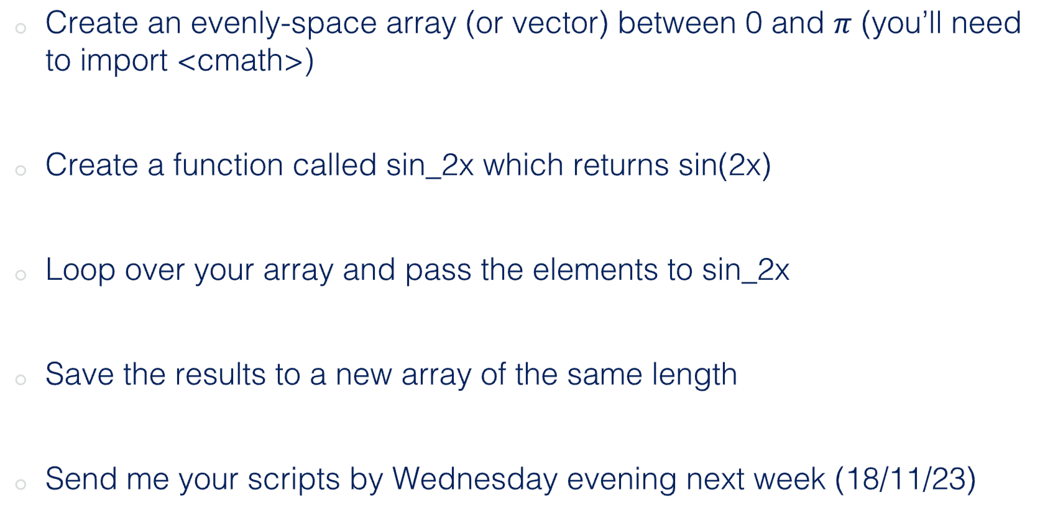
Challenge Four (Homework)
Create an evenly-space array (or vector) between 0 and $π$ (you’ll need to import <cmath>)
Create a function called sin_2x which returns sin(2x)
Loop over your array and pass the elements to sin_2x
Save the results to a new array of the same length
Send me your scripts by Wednesday evening next week (18/11/23)

Slide 52
Next Week
Passing vectors into functions (pointers)
Plotting data
Introduction to Monte Carlo methods

Slide 53
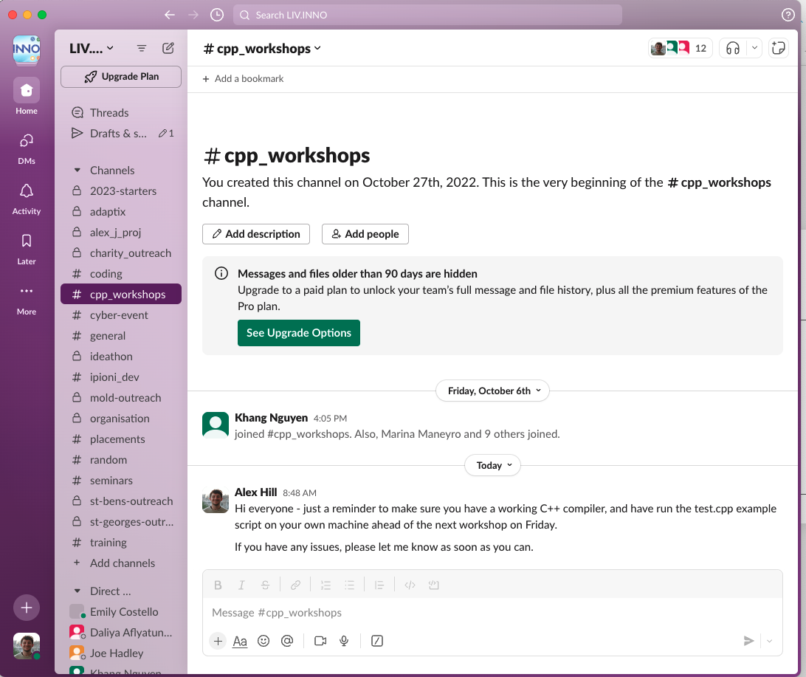
Thanks!
Any questions in the Slack Channel, or message me privately

