Slide 1
October 2024
Introduction to C++:
Workshop Three
Dr. Alexander Hill
a.d.hill@liverpool.ac.uk

Slide 2
Last Week
Variables and data types
Functions
For loops
Arrays and vectors

Slide 3
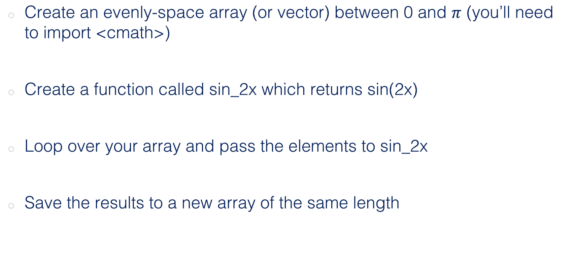
Challenge Four (Homework)
Create an evenly-space array (or vector) between 0 and $π$ (you’ll need to import <cmath>)
Create a function called sin_2x which returns sin(2x)
Loop over your array and pass the elements to sin_2x
Save the results to a new array of the same length

Slide 4
#include <cmath>
--||-- int main() {
int double start = 0;
double end = M_PI;
double step = M_PI/4;
// Create the evenly spaced array between 0 and pi
vector<double> x_values;
for (double x = start; x <= end; x +=step) {
x_values.push_back(x);
}
// Print the evenly spaced array just to check
cout << "Evenly spaced array between 0 and pi in fractions of pi:" << endl;
for (double x : x_values) {
cout << x << " ";
}
cout << endl;
cout << endl;
// Array to store results of sin(2x)
vector<double> sin_values;
for (double x : x_values) {
sin_values.push_back(sin_2x(x));
}
--||--
Nice use of the for loop
Jak
Evenly spaced array between 0 and pi in fractions of pi:
0 0.785398 1.5708 2.35619 3.14159
sin(2(0.0000)) = 0.0000
sin(2(0.7854)) = 1.0000
sin(2(1.5708)) = 0.0000
sin(2(2.3562)) = -1.0000
sin(2(3.1416)) = -0.0000

Slide 5
#include <iostream>
#include <cmath>
#include <vector>
using namespace std;
double sin_2x(double theta);
int main() {
vector<double> angles = {0, M_PI/4, M_PI/2, 3*(M_PI/4), M_PI};
cout << "Angles and sin(2x) values:\n";
cout << '\n';
for (double x: angles) {
cout << "Angle: " << x << '\n';
cout << "sin(2x): " << sin_2x(2*x) << '\n';
cout << '\n';
}
return 0;
}
double sin_2x(double theta){
return sin(2*theta);
}
Works nicely, but maybe not so easily adaptable
Liam
$ ./run
Angles and sin(2x) values:
Angle: 0
sin(2x): 0
Angle: 0.785398
sin(2x): 1.22465e-16
Angle: 1.5708
sin(2x): -2.44929e-16
Angle: 2.35619
sin(2x): 3.67394e-16
Angle: 3.14159
sin(2x): -4.89859e-16
Not an array, just printing the values

Slide 6
#include <iostream>
#include <cmath>
#include <vector>
using namespace std;
double sin_2x(double a){
return sin(2*a);
} int main() {
vector<double> PiVector = {};
vector<double> Sin2piVector = {};
for (double i = 0; i <= 10; ++i) {
PiVector.push_back((i/10)*M_PI);
}
for (int i = 0; i <= (PiVector.size() - 1); ++i) {
Sin2piVector.push_back(sin_2x(PiVector.at(i)));
}
for (int i = 0; i <= (PiVector.size() - 1); ++i) {
cout << "Pi = " << PiVector.at(i)<< " : Sin2Pi = " << Sin2piVector.at(i) << endl; } return 0;
}
Better practice to avoid repetition if possible, i.e. int n = 10
Good use of vector functions
$ ./run
Pi = 0 : Sin2Pi = 0
Pi = 0.314159 : Sin2Pi = 0.587785
Pi = 0.628319 : Sin2Pi = 0.951057
Pi = 0.942478 : Sin2Pi = 0.951057
Pi = 1.25664 : Sin2Pi = 0.587785
Pi = 1.5708 : Sin2Pi = 1.22465e-16
Pi = 1.88496 : Sin2Pi = -0.587785
Pi = 2.19911 : Sin2Pi = -0.951057
Pi = 2.51327 : Sin2Pi = -0.951057
Pi = 2.82743 : Sin2Pi = -0.587785
Pi = 3.14159 : Sin2Pi = -2.44929e-16
Rosie

Slide 7
Salma
#include <iostream>
#include <cmath>
#include <vector>
double sin2x(double x);
int a,i ;
double pi;
int main() {
a = 10;
pi = M_PI;
std:: vector<double> values(a);
for(i=0; i<a;i++){
values[i] = i*pi /(a-1);
}
std:: vector<double>op(a);
for (i=0; i<a;i++){
op[i] = sin2x(values[i]);
}
for(int i=0; i<a;i++){
std::cout <<"x :"<<values[i]<<" // sin(2x) = "<< op[i] <<std::endl;
}
return 0;
}
double sin2x(double x ){
return sin(2*x);
}
Declaration outside main!
std:: needed here as vector is defined within the std namespace
$ ./run
x :0 // sin(2x) = 0
x :0.349066 // sin(2x) = 0.642788
x :0.698132 // sin(2x) = 0.984808
x :1.0472 // sin(2x) = 0.866025
x :1.39626 // sin(2x) = 0.34202
x :1.74533 // sin(2x) = -0.34202
x :2.0944 // sin(2x) = -0.866025
x :2.44346 // sin(2x) = -0.984808
x :2.79253 // sin(2x) = -0.642788
x :3.14159 // sin(2x) = -2.44929e-16

Slide 8
#include <iostream>
#include <vector>
#include <cmath>
using namespace std;
vector<double> starting_vect(int num_of_vals);
vector<double> pi_vect(vector<double>starting_vector);
vector<double> sin_vect(vector<double>pi_vector);
int select_vals();
void print_vals(vector<double> sin_vector);
int main() {
int num_of_vals = select_vals();
vector<double> v1 = starting_vect(num_of_vals);
vector<double> v2 = pi_vect(v1);
vector<double> v3 = sin_vect(v2);
print_vals(v1);
print_vals(v2);
print_vals(v3);
cout << endl;
return 0;
}
// More below
Archie
$ ./run
enter number of sin values: 4
values for starting_vect: 4 3 2 1
values for pi_vect: 0.785398 1.0472 1.5708 3.14159
values for sin2x: 1 0.866025 1.22465e-16 -2.44929e-16
Really nice use of main()

Slide 9
Archie
vector<double> starting_vect(int num_of_vals) {
vector<double> vector1;
for (int i = 0; i < num_of_vals; i++) {
vector1.push_back(num_of_vals - i);
}
return vector1;
}
vector<double> pi_vect(vector<double>starting_vector){
vector<double> pi_vector;
for(double k: starting_vector){
pi_vector.push_back(M_PI/k);
}
return pi_vector;
}
$ ./run
enter number of sin values: 4
values for starting_vect: 4 3 2 1
values for pi_vect: 0.785398 1.0472 1.5708 3.14159
values for sin2x: 1 0.866025 1.22465e-16 -2.44929e-16
pi_vector not evenly space spaced, goes pi/4, pi/3, pi/2, pi/1 etc

Slide 10
#include <iostream>
#include <vector>
#include <cmath>
using namespace std;
double sin_2x(double z)
{
const double t = 1e-10;
double y;
y = sin(z);
if(abs(y)<t) y=0.0;
return y;
}
int main()
{
double theta, x[13], d[13], ans[13];
for(int i=0;i<13;i++)
{
x[i]=(i*M_PI/6);
theta=2*x[i];
d[i]=(theta*180/M_PI);//converting to degree
ans[i]=sin_2x(theta);
cout<<"The value of sin("<<d[i]<<"') = "<<ans[i]<<endl;
}
return 0;
}
Shirsendu
Good use of const, setting sensitivity limit manually
Personally would have sin_2x(double x). Also – you are import 2x really, which is potentially confusing
13 and 6 work, but not adaptable and open to human error
$ ./run
The value of sin(0') = 0
The value of sin(60') = 0.866025
The value of sin(120') = 0.866025
The value of sin(180') = 0
The value of sin(240') = -0.866025
The value of sin(300') = -0.866025
The value of sin(360') = 0
The value of sin(420') = 0.866025
The value of sin(480') = 0.866025
The value of sin(540') = 0
The value of sin(600') = -0.866025
The value of sin(660') = -0.866025
The value of sin(720') = 0

Slide 11
// Online C++ compiler to run C++ program online
#include <iostream>
#include <iomanip>
using namespace std;
#include <cmath>
#include <vector>
// PART 1: To generate a evenly space vector between 0 to PI
double sin_2(double ang);
int main() {
const double PI = 3.141592653589793;
double x,h, thetao, theta;
int n=10; // Total entries between 0 to PI
thetao=0; // Inital angle in radian
h=PI/n; // step size
vector<double>angle={};
vector<double>sin_2x={};
cout << "Anlges"<<'\n';
for (int i=0; i<n+1; i++) {
angle. push_back(thetao);
cout << setprecision(3);
cout<< angle[i] << '\n'; // display vector elements
theta=thetao+h;
thetao=theta;
}
// Part 2: Generate a function which calculate Sin2x and save entries in a new vector
cout << "Sin2x"<< '\n';
for ( int j=0;j<n+1; j++){
sin_2x. push_back(sin_2(angle[j]));
cout << setprecision(3);
cout <<sin_2x[j] << '\n';
}
return 0;
}
double sin_2(double ang) {
return 2*cos(ang)*sin(ang);
}
$ ./run
Anlges
0
0.314
0.628
0.942
1.26
1.57
1.88
2.2
2.51
2.83
3.14
Sin2x
0
0.588
0.951
0.951
0.588
1.22e-16
-0.588
-0.951
-0.951
-0.588
-2.45e-16
Good use of const, but cleaner to use the M_PI in built into <cmath>
Shaoib

Slide 12
#include <iostream>
#include <vector>
#include <cmath>
using namespace std;
std::vector<double> input_vector() {
vector<double> x = {0,1,2,3,4,5,6,7,8};
double inc =M_PI/8;
vector<double> theta(x.size());
for (size_t i = 0; i < x.size(); ++i) {
theta[i] = x[i] * inc;
}
return theta;
}
double sin2x(double theta) { return sin(2*theta); }
int main()
{
std::vector<double> theta = input_vector();
std::vector<double> output(theta.size());
for (size_t i = 0; i < theta.size(); ++i) {
output[i] = sin2x(theta[i]);
if (std::abs(output[i]) < 1e-10) {
output[i] = 0;
}
}
for (size_t i = 0; i < output.size(); ++i) {
cout << output[i] << endl;
}
return 0;
}
$ ./run
0
0.707107
1
0.707107
0
-0.707107
-1
-0.707107
0
Good use of size function to set size of output
Naomi

Slide 13
#include <cmath>
#include <iostream>
#include <vector>
using namespace std;
double sin_2x(double x) {
return sin(2 * x);
}
int main() {
int num_steps = 100;
double step = M_PI / (num_steps-1);
vector<double> x_array(num_steps);
vector<double> y_array(num_steps);
for (int i = 0; i < num_steps; ++i) {
x_array.at(i) = 0.0 + (i * step);
};
for (int i = 0; i < num_steps; ++i) {
y_array.at(i) = sin_2x(x_array.at(i));
};
return 0;
}
$ ./run
0
0.785398
1.5708
2.35619
3.14159
0
1
1.22465e-16
-1
-2.44929e-16
Nice code overall, could be a couple of lines shorter if you only ran one for loop
John

Slide 14
#include <iostream>
#include <cmath>
#include <vector>
using namespace std;
double sin2x(double theta);
int main() {
double k = 5;
vector<double> v1(k, M_PI);
vector<double> v2 = {};
for (int i = 0; i <= k-1; ++i)
{
v1.at(i) = i * (1.0/(k-1.0)) * v1.at(i);
v2.push_back( sin2x(v1.at(i)) );
}
for (int i = 0; i <= k-1; ++i)
cout << "Theta = " << v1.at(i) << ", sin(2theta) = " << v2.at(i) << endl;
return 0;
}
double sin2x(double theta)
{
return sin(2.0 * theta);
}
Alex H
$ ./run
Theta = 0, sin(2theta) = 0
Theta = 0.785398, sin(2theta) = 1
Theta = 1.5708, sin(2theta) = 1.22465e-16
Theta = 2.35619, sin(2theta) = -1
Theta = 3.14159, sin(2theta) = -2.44929e-16

Slide 15
Takeaways
Use vectors if possible to stop bound issues
Consider generalising your code early in the process

Slide 16
Hang on…
Why is sin(2pi) not exactly 0?
M_PI = 3.141592653589793, not exactly pi!

Slide 17
#include <iostream>
#include <cmath>
#include <vector>
#include <iomanip>
using namespace std;
int main() {
float pi_float = M_PI;
double pi_double = M_PI;
float sin_2_pi_float = sin(2*pi_float);
double sin_2_pi_double = sin(2*pi_double);
cout << "pi_float = " << pi_float << ", sin(2.pi_float) = " << sin_2_pi_float << endl;
cout << "pi_double = " << pi_double << ", sin(2.pi_double) = " << sin_2_pi_double << endl;
cout << setprecision(16);
cout << "pi_float = " << pi_float << ", sin(2.pi_float) = " << sin_2_pi_float << endl;
cout << "pi_double = " << pi_double << ", sin(2.pi_double) = " << sin_2_pi_double << endl;
return 0;
}
$ ./output
pi_float = 3.14159, sin(2.pi_float) = 1.74846e-07
pi_double = 3.14159, sin(2.pi_double) = -2.44929e-16
pi_float = 3.141592741012573, sin(2.pi_float) = 1.748455531469517e-07
pi_double = 3.141592653589793, sin(2.pi_double) = -2.449293598294706e-16

Slide 18
Aim of Workshop Three
Passing vectors into functions (pointers)
Plotting data (really this time)

Slide 19
Resources
alex-hill94.github.io/#WS3
https://www.programiz.com/cpp-programming/online-compiler/?ref=1a2efafc
https://www.geeksforgeeks.org/pointers-and-references-in-c/
https://www.w3schools.com/cpp/cpp_pointers.asp
https://youtu.be/LfaMVlDaQ24?t=32542 – Harvard CS50 (Memory)

Slide 20
POINTERS
References, memory addresses and pointers
Returning multiple values from functions
Passing arrays into functions
Passing vectors into functions

Slide 21

Memory Address
C++ allows us to manipulate the computer’s memory, which can make code writing and performance more efficient

Slide 22
Memory Address
The ampersand (&) can be used to get the memory address of a variable
This is usually in the form of a hexadecimal
#include <iostream>
using namespace std;
int main() {
int height = 10; // height variable
cout << "height = " << height << '\n';
cout << "height address = " << &height << '\n';
return 0;
}
$ ./run
height = 10
height address = 0x16bd133d8

Slide 23
References
You can create a ‘reference variable’ to an existing variable using the ampersand, &
This is effectively an alias to an already existing variable
#include <iostream>
using namespace std;
int main() {
int height = 10; // height variable
int &ref = height; // first reference to height
int ref1 = height; // second reference to height
height = 9;
cout << "height = " << height << '\n';
cout << "ref = " << ref << '\n';
cout << "ref1 = " << ref1 << '\n';
return 0;
}
$ ./run
height = 9
ref = 9
ref1 = 10

Slide 24
References
#include <iostream>
using namespace std;
int main() {
int height = 10; // height variable
int &ref = height; // reference to height
int copy = height; // copy of height
height = 9;
cout << "height = " << height << '\n';
cout << "&height = " << &height << '\n';
cout << "ref = " << ref << '\n';
cout << "&ref = " << &ref << '\n';
cout << "copy = " << copy << '\n';
return 0;
}
The placement of & is important for your chosen purpose
$ ./output
height = 9
&height = 0x16d98b3d8
ref = 9
&ref = 0x16d98b3d8
copy = 10

Slide 25
Pointers
We can create a variable that saves the memory address of another variable, known as a pointer
These require the use of an asterisk, *
#include <iostream>
using namespace std;
int main() {
int height; // height variable
height = 10;
int* pointer = &height;
cout << "height address = " << &height << '\n';
cout << "pointer = " << pointer << '\n';
cout << "height = " << height << '\n';
return 0;
}
$ ./run
height address = 0x16dd6f3d8
pointer = 0x16dd6f3d8
height = 10

Slide 26
Pointers
#include <iostream>
using namespace std;
int main() {
int height; // height variable
height = 10;
int* pointer1 = &height;
int * pointer2 = &height;
int *pointer3 = &height;
cout << "height address = " << &height << '\n';
cout << "pointer1 = " << pointer1 << '\n';
cout << "pointer2 = " << pointer2 << '\n';
cout << "pointer3 = " << pointer3 << '\n';
cout << "height = " << height << '\n';
return 0;
}
You can place the asterisk anywhere, but the convention is int* pointer1
$ ./output
height address = 0x16b4d33d8
pointer1 = 0x16b4d33d8
pointer2 = 0x16b4d33d8
pointer3 = 0x16b4d33d8
height = 10

Slide 27
Pointers
Make sure the data type of the pointer matches the variable!
#include <iostream>
using namespace std;
int main() {
int height = 10; // height variable
int* pointer = &height;
string name = "Alex";
int* name_ptr = &name;
cout << "height = " << height << ", height address = " << pointer << '\n’;
cout << "name = " << name << ", name address = " << name_ptr << '\n';
return 0;
}
$ g++ -o output test.cpp
test.cpp:8:6: error: cannot initialize a variable of type 'int *' with an rvalue of type 'std::string *' (aka 'basic_string<char> *')
int* name_ptr = &name;
^ ~~~~~
1 error generated.

Slide 28
Deferencing
We can get the value of the variable that the pointer is pointing at using * again
#include <iostream>
using namespace std;
int main() {
int height = 10; // height variable
int* pointer = &height;
cout << "variable = " << height << endl;
cout << "address = " << pointer << endl;
cout << "address value = " << *pointer << endl;
return 0;
}
$ ./run
variable = 10
address = 0x16dd0f3d8
address value = 10

Slide 29
Modifying variables with pointers
#include <iostream>
using namespace std;
int main() {
int height = 10; // height variable
int* pointer = &height;
cout << "variable = " << height << endl;
cout << "address = " << pointer << endl;
cout << "address value = " << *pointer << endl;
cout << endl;
*pointer = 12;
cout << "variable = " << height << endl;
cout << "address = " << pointer << endl;
cout << "address value = " << *pointer << endl;
return 0;
}
$ ./run
variable = 10
address = 0x16d8433d8
address value = 10
variable = 12
address = 0x16d8433d8
address value = 12

Slide 30
Arrays as Pointers
#include <iostream>
using namespace std;
int main()
{
int arr[] = { 1, 2, 3, 4, 5, 6, 7, 8 };
cout << "arr = " << arr << "\n";
cout << "arr[0] = " << arr[0] << "\n";
return 0;
}
}
$ ./output
arr = 0x16b2ab3b0
arr[0] = 1

Slide 31
Arrays as Pointers
#include <iostream>
using namespace std;
int main()
{
int a = 1;
int* b = &a;
cout << "a = " << a << "\n";
cout << "b = " << b << "\n";
cout << "b[0] = " << b[0] << "\n";
cout << "b[1] = " << b[1] << "\n";
cout << "b[2] = " << b[2] << "\n";
cout << "&b[0] = " << &b[0] << "\n";
cout << "&b[1] = " << &b[1] << "\n";
return 0;
}
$ ./output
a = 1
b = 0x16f6d33d8
b[0] = 1
b[1] = 0
b[2] = 1869428016
&b[0] = 0x16f6d33d8
&b[1] = 0x16f6d33dc

Slide 32
Challenge Five: a few minutes with pointers
Initialise five variables of type: int, float, double, char, and string
Create pointer variables of these variables
Use the pointers to modify the values of the initial variables
Print the values of the variables and their addresses

Slide 33
Functions and pointers

Slide 34
Pythonic Approach
#include <iostream>
using namespace std;
#include <tuple>
tuple <int, int> swap_my_nums(int x, int y)
{
int z = x;
x = y;
y = z;
return make_tuple(x, y);
}
int main() {
int orig_first_number = 10;
int orig_second_number = 20;
int new_first_number;
int new_second_number;
cout << "Before swap: " << "\n";
cout << orig_first_number << " " << orig_second_number << "\n";
// Call the function, which will change the values of first_number and second_number
tie(new_first_number, new_second_number) = swap_my_nums(orig_first_number, orig_second_number);
cout << "After swap: " << "\n";
cout << new_first_number << " " << new_second_number << "\n";
return 0;
}
swap_my_nums returns two values
$ ./run
Before swap:
10 20
After swap:
20 10

Slide 35
Passing by Reference
#include <iostream>
using namespace std;
void swap_my_nums(int &x, int &y) {
int z = x;
x = y;
y = z;
}
int main() {
int first_number = 10;
int second_number = 20;
cout << "Before swap: " << "\n";
cout << first_number << " " << second_number << "\n";
// Call the function, which will change the values of first_number and second_number
swap_my_nums(first_number, second_number);
cout << "After swap: " << "\n";
cout << first_number << " " << second_number << "\n";
return 0;
}
The function does not make a copy of x and y, it passes the actual variables themselves
$ ./run
Before swap:
10 20
After swap:
20 10

Slide 36
Passing by pointers
#include <iostream>
using namespace std;
void swap_my_nums(int* x, int* y) {
int z = *x;
cout << "x = " << x << endl;
cout << "y = " << y << endl;
cout << "*x = " << *x << endl;
cout << "*y = " << *y << endl;
*x = *y;
*y = z;
}
int main() {
int first_number = 10;
int second_number = 20;
cout << "Before swap: " << "\n";
cout << first_number << " " << second_number << "\n";
// Call the function, which will change the values of first_number and second_number
swap_my_nums(&first_number, &second_number);
cout << "After swap: " << "\n";
cout << first_number << " " << second_number << "\n";
return 0;
}
Tells the compiler to expect a pointer to an int variable
$ ./output
Before swap:
10 20
x = 0x16b79f3d8
y = 0x16b79f3d4
*x = 10
*y = 20
After swap:
20 10
Grabs the value at the address the pointer points to
Passes in the memory address

Slide 37
Passing arrays into functions
#include <iostream>
#include <cmath>
using namespace std;
void func(int* a, int* b, int N)
{
int i;
for (i = 0; i < N; i++)
b[i] = a[i] * 2;
}
int main()
{
int arr[] = { 1, 2, 3, 4, 5, 6, 7, 8 };
int arr1[8];
int n = sizeof(arr) / sizeof(arr[0]);
int n1 = sizeof(arr1) / sizeof(arr1[0]);
assert(n==n1);
printf("all good");
func(arr, arr1, n);
for (int i = 0; i < n; i++)
cout << "\n" << arr1[i];
return 0;
}
$ ./run
all good
2
4
6
8
10
12
14

Slide 38
‘Decay’ of arrays in functions
void func(int* a, int* b)
{
cout << "a = " << a << endl;
cout << "sizeof(a) = " << sizeof(a) << endl;
cout << "sizeof(a[0]) = " << sizeof(a[0]) << endl;
int N = sizeof(a);
for (int i = 0; i < N; i++)
b[i] = a[i] * 2;
}
int main()
{
int arr[] = { 1, 2, 3, 4, 5, 6, 7, 8 };
int arr1[8];
int n = sizeof(arr) / sizeof(arr[0]);
int n1 = sizeof(arr1) / sizeof(arr1[0]);
cout << "arr = " << arr << endl;
cout << "sizeof(arr) = " << sizeof(arr) << endl;
cout << "sizeof(arr[0]) = " << sizeof(arr[0]) << endl;
func(arr, arr1);
return 0;}
When an array is passed into a function, it effectively becomes a pointer to the first element in the array only, so you have to pass in the array length as a variable into the function ahead of time
$ ./output
arr = 0x16d8f73b0
sizeof(arr) = 32
sizeof(arr[0]) = 4
a = 0x16d8f73b0
sizeof(a) = 8
sizeof(a[0]) = 4

Slide 39
Passing arrays into functions
#include <iostream>
#include <cmath>
using namespace std;
void func(int* a, int N)
{
int i;
for (i = 0; i < N; i++)
++a[i];
}
int main()
{
int arr[] = { 1, 2, 3, 4, 5, 6, 7, 8 };
int n = sizeof(arr) / sizeof(arr[0]);
cout << "Array size inside main() is " << n;
func(arr, n);
int i;
for (i = 0; i < n; i++)
cout << "\n" << arr[i];
return 0;
}
$ ./run
Array size inside main() is 8
2
3
4
5
6
7
8
9

Slide 40
Challenge Six
Create an array called x, with values -5 to 5 in main()
Pass the array to a function called quad, which computes the square of all the values in the array, and save the values to another array called y
Loop over all x and y and check that things have worked right
Use pointers to minimise the length of your script

Slide 41
#include <cmath>
#include <iostream>
using namespace std;
void quad(int* a, int* b , int N)
{
int i;
for (i = 0; i < N; i++)
b[i] = pow(a[i], 2);
}
int main()
{
int x[] = { -5, -4, -3, -2, -1, 0, 1, 2, 3, 4, 5};
int n = sizeof(x) / sizeof(x[0]);
int y[n];
quad(x, y, n);
int i;
for (i = 0; i < n1; i++)
{ cout << x[i] << "^2 = " << y[i] << "\n" ;
}
return 0;
}
$ ./run
-5^2 = 25
-4^2 = 16
-3^2 = 9
-2^2 = 4
-1^2 = 1
0^2 = 0
1^2 = 1
2^2 = 4
3^2 = 9
4^2 = 16
5^2 = 25

Slide 42
Passing vectors into functions
#include <iostream>
#include <vector>
using namespace std;
// The vect here is a copy of vect in main()
void func(vector<int> vect)
{ vect.push_back(3); }
int main()
{
vector<int> vect;
vect.push_back(1);
vect.push_back(2);
func(vect);
// vect remains unchanged after function
// call
for (int i = 0; i < vect.size(); i++)
cout << vect[i] << ”\n";
return 0;
}
You can pass a full vector into a function, but a full copy is made, which may take a lot of time to work with
As the function works with the copy of vect, no change is made to vect in main()
$ ./run
1
2

Slide 43
Passing vectors into functions
#include <iostream>
#include <vector>
using namespace std;
// The vect here is the same as the vect in main()
void func(vector<int>& vect)
{ vect.push_back(3); }
int main()
{
vector<int> vect;
vect.push_back(1);
vect.push_back(2);
func(vect);
// vect remains unchanged after function
// call
for (int i = 0; i < vect.size(); i++)
cout << vect[i] << ”\n";
return 0;
}
Making vect a reference stops a copy being made
Changes made in func() now changes the original vect in memory
If we add const in front of vector, vect can no longer be changed by func
$ ./run
1
2
3

Slide 44
Challenge four revisited

Slide 45
#include <iostream>
#include <vector>
#include <cmath>
using namespace std;
void sin2x(const vector<double>& input, vector<double>& output) {
int n = input.size();
for (int i = 0; i < n; ++i)
output.push_back(sin(2 * input.at(i)));
}
int main(){
int k;
cout << "Provide n_vals: \n";
cin >> k;
vector<double> thetas(k);
vector<double> ans;
for (int i = 0; i < k; ++i)
{
thetas.at(i) = i * (1./(k-1)) * M_PI;
}
sin2x(thetas, ans);
for (double j: thetas){
cout << "Theta = " << j << "\n";
}
for (double j: ans){
cout << "sin(2theta) = " << j << "\n";
}
return 0;
}
$ ./output
Provide n_vals:
10
Theta = 0
Theta = 0.349066
Theta = 0.698132
Theta = 1.0472
Theta = 1.39626
Theta = 1.74533
Theta = 2.0944
Theta = 2.44346
Theta = 2.79253
Theta = 3.14159
sin(2theta) = 0
sin(2theta) = 0.642788
sin(2theta) = 0.984808
sin(2theta) = 0.866025
sin(2theta) = 0.34202
sin(2theta) = -0.34202
sin(2theta) = -0.866025
sin(2theta) = -0.984808
sin(2theta) = -0.642788
sin(2theta) = -2.44929e-16

Slide 46
PLOTTING DATA
Reading/writing data basics
Combining C++ with Python

Slide 47
Reading/writing data
C++ provides some basic classes for reading/writing data
#include <ofstream> // : Stream class to write on files
#include <ifstream> // : Stream class to read from files
#include <fstream> // : Stream class to both read and write from/to files.
ofstream myfile;
myfile.open ("example.txt");
myfile << "Writing this to a file.\n";
myfile.close();

Slide 48
Reading/writing data example
#include <iostream>
#include <cmath>
#include <vector>
#include <fstream>
using namespace std;
int main()
{
int k;
cout << "Input n_vals:";
cin >> k;
vector<double> thetas(k);
vector<double> ans;
for (int i = 0; i < k; ++i)
{
thetas.at(i) = i * (1./(k-1)) * M_PI;
}
for (int i = 0; i < k; ++i)
{
ans.push_back(sin(2. * thetas.at(i)));
}

Slide 49
Reading/writing data
ofstream myfile;
myfile.open ("data.txt");
myfile << "Theta = " << "\n";
for (double j: thetas)
{if (j != thetas.back()){myfile << j << ", " << "\n";}
else{myfile << j << "\n";}}
myfile << ""<< "\n" << "\n";
myfile << "Ans = " << "\n";
for (double j: ans)
{if (j != ans.back()){myfile << j << ", " << "\n";}
else{myfile << j << "\n";}}
myfile << "" << "\n"; myfile.close();
return 0;
}

Slide 50
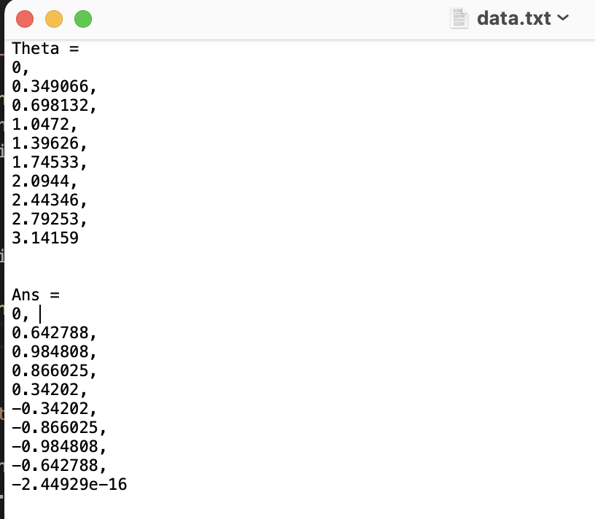
Reading/writing data

Slide 51
Reading/writing data
ofstream myfile;
myfile.open ("data.py");
myfile << "import numpy as np" << "\n” << "\n"; myfile << "theta = np.array((" << "\n";
for (double j: thetas){
if (j != thetas.back()){
myfile << j << ", " << "\n";
}
else{
myfile << j << "\n";
}
}
myfile << "))"<< "\n" << "\n";
myfile << "ans = np.array((" << "\n";
for (double j: ans){
if (j != ans.back()){
myfile << j << ", " << "\n";
}
else{
myfile << j << "\n";}
}
myfile << "))" << "\n";
myfile.close();
return 0;
}
Alternatively, save to a python script…
Create a plotting code plot.py
import matplotlib.pyplot as plt
from data import *
plt.figure()
plt.plot(theta, ans)
plt.show()

Slide 52
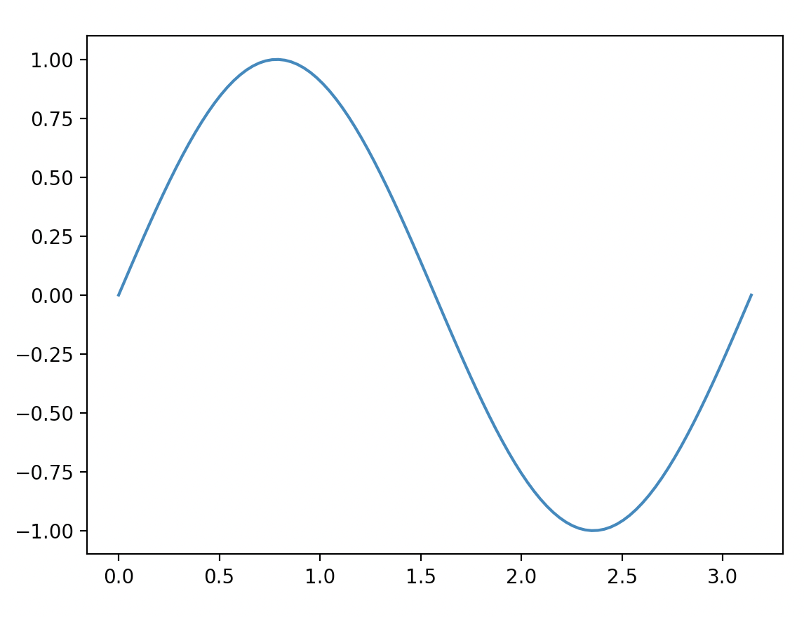
Reading/writing data
Running this in the command line…
$ g++ -std=c++11 -o run lesson_script.cpp
(base) alexhill at Alexs-MacBook-Air in ~/Documents/UOL/Teaching/C++_Workshops/Workshops/WS3/scripts
$ ./run
Input n_vals:100
(base) alexhill at Alexs-MacBook-Air in ~/Documents/UOL/Teaching/C++_Workshops/Workshops/WS3/scripts
$ ipython plot.py &

Slide 53
Caveats
This isn’t the most efficient way of saving data, we want to work with binary files for that
This requires the use of python

Slide 54
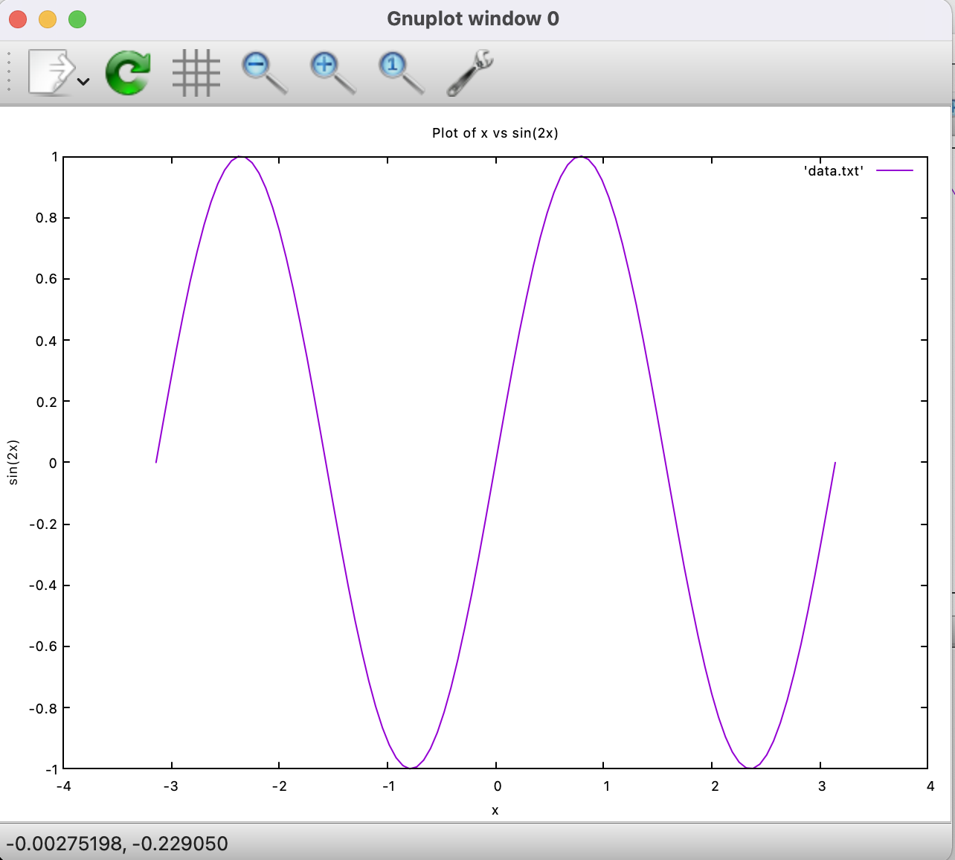
Reading/writing data
std::vector<double> x_values(num_points);
std::vector<double> y_values(num_points);
// Generate x values and compute y = sin(2 * x)
for (int i = 0; i < num_points; ++i) {
x_values[i] = x_min + i * step;
y_values[i] = sin(2 * x_values[i]);
}
// Save to a file for gnuplot
std::ofstream outfile("data.txt");
for (int i = 0; i < num_points; ++i) {
outfile << x_values[i] << " " << y_values[i] << "\n";
}
outfile.close();
// Plotting with gnuplot
std::ofstream gp("plot.gp");
gp << "set title 'Plot of x vs sin(2x)'\n";
gp << "set xlabel 'x'\n";
gp << "set ylabel 'sin(2x)'\n";
gp << "plot 'data.txt' with lines\n";
gp << "pause -1\n";
gp.close();
// Run gnuplot script
system("gnuplot -persist plot.gp");
return 0;
}

Slide 55
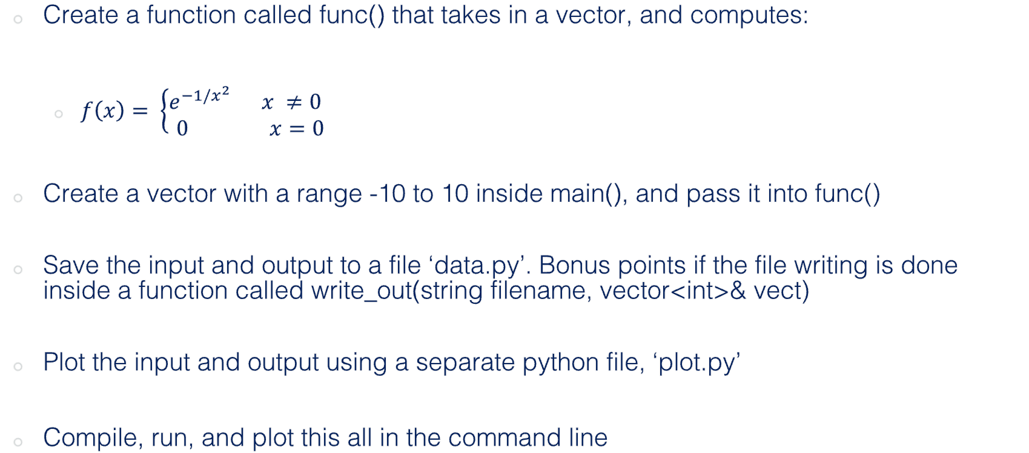
Challenge Seven: combining what we’ve learned today (const, &, *) (Homework)
Create a function called func() that takes in a vector, and computes:
$f\left(x\right)= \left\{\begin{aligned}e^{−1/x^{2}} x ≠0 \\ 0 x=0\end{aligned} \right.$
Create a vector with a range -10 to 10 inside main(), and pass it into func()
Save the input and output to a file ‘data.py’. Bonus points if the file writing is done inside a function called write_out(string filename, vector<int>& vect)
Plot the input and output using a separate python file, ‘plot.py’
Compile, run, and plot this all in the command line

Slide 56
Monte Carlo Methods
Generating random numbers in C++
Basics of Monte Carlo methods

Slide 57
#include<iostream>
#include<cstdlib>
using namespace std;
int main(){
// Providing a seed value
srand(time(NULL));
// Loop to get 5 random numbers
for(int i=1; i<=5; i++){
// Retrieve a random number between 100 and 200
// Offset = 100
// Range = 101
int random = 100 + (rand() % 101);
// Print the random number
cout<<random<<endl;
}
return 0;
}
Seed for random number generator
Outputs current calendar time
Modulo: returns the remainder
Returns an integer between 1 and RAND_MAX

Slide 58
Monte Carlo Basics
Monte Carlo methods are a class of computational algorithms that use random sampling to obtain results
They are often when precise, analytic solutions are impossible
MC methods are widely used in mathematics and physics
General idea is to approximate things using samples, e.g. integration, expectations of probabilities

Slide 59
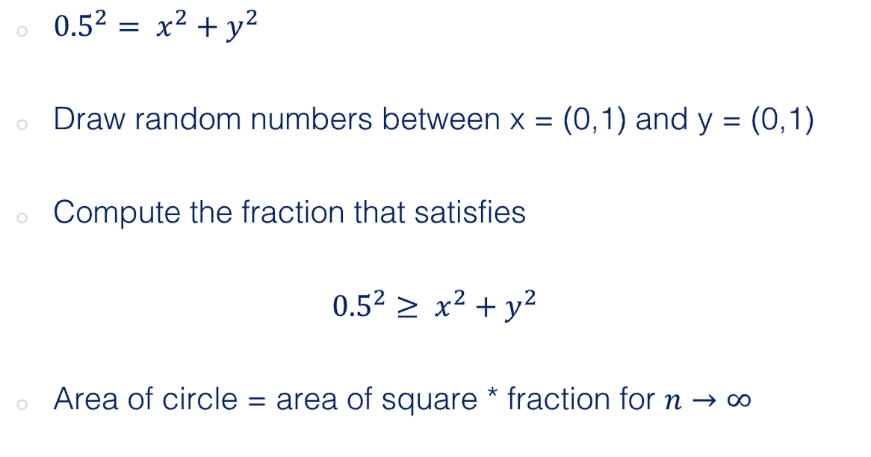
Example: area of a circle
1
${0.5}^{2}= x^{2}+y^{2}$
Draw random numbers between x = (0,1) and y = (0,1)
Compute the fraction that satisfies
$${0.5}^{2}≥ x^{2}+y^{2}$$
Area of circle = area of square * fraction for $n→∞$
y
0
1
x

Slide 60
Thanks!

