Slide 1
Introduction to C++
Dr. Alex Hill
a.d.hill@liverpool.ac.uk
October 2022

Slide 2
Last week…
Variables and data types
Functions
For loops
Arrays and vectors

Slide 3
Resources
alex-hill94.github.io/#WS3
https://www.programiz.com/cpp-programming/online-compiler/?ref=1a2efafc
https://www.geeksforgeeks.org/c-plus-plus/?ref=shm
https://www.w3schools.com/cpp/default.asp

Slide 4
AIM of workshop three
Passing vectors into functions (pointers)
Plotting data (really this time)
Introduction to Monte Carlo methods (if there’s time)

Slide 5
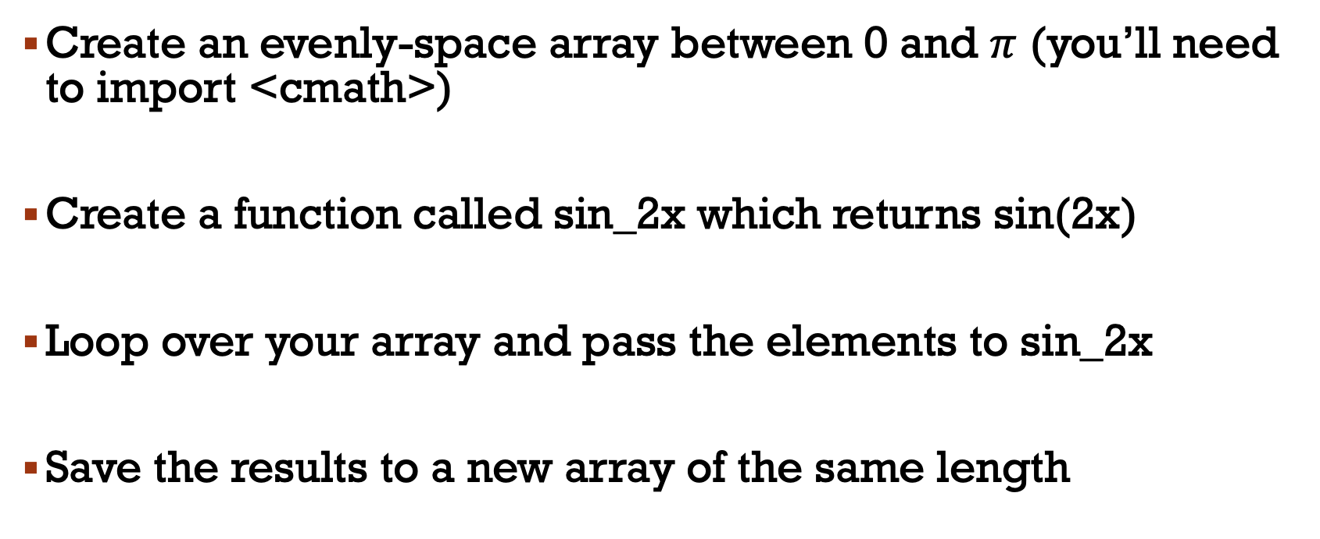
Challenge four RECAP
Create an evenly-space array between 0 and $π$ (you’ll need to import <cmath>)
Create a function called sin_2x which returns sin(2x)
Loop over your array and pass the elements to sin_2x
Save the results to a new array of the same length

Slide 6
Challenge Four answers
#include <cmath>
#include <iostream>
using namespace std;
double sin_2x(double val);
int main(){
double arr[]={0,0.25,0.5,0.75,1};
int len;
len=sizeof(arr)/sizeof(double);
double ans[len];
for(int i=0; i<len;++i){
ans[i]=sin_2x(arr[i]);
}
for(double n : ans){
cout << n<<'\n';
}
return 0;
}
double sin_2x(double val){
return sin(2*val);
}
Alex J
* M_PI
$ ./run
0
0.479426
0.841471
0.997495
0.909297

Slide 7
Challenge Four answers
#include <cmath>
#include <iostream>
using namespace std;
double sin_2x(double val);
int main(){
double arr[]={0,0.25,0.5,0.75,1};
int len;
len=sizeof(arr)/sizeof(double);
double ans[len];
for(int i=0; i<len;++i){
ans[i]=sin_2x(arr[i]);
}
for(double n : ans){
cout << n<<'\n';
}
return 0;
}
double sin_2x(double val){
return sin(2*val);
}
len=sizeof(arr)/sizeof(*arr);
Gives length of array (n_bytes_array/n_bytes_element)
This doesn’t work for vectors!

Slide 8
Challenge Four answers
Ali
#include <iostream>
#include <cmath>
using namespace std;
double sin_2x(double val_one);
int main() {
double angle[6] = {0,0.628,1.256,1.884,2.512,3.14};
double results[6];
int i;
for(i = 0; i < 7; i++) results[i]=sin_2x(angle[i]);
for(i = 0; i < 7; i++) cout << results[i] << ' ';
return 0;
}
double sin_2x(double val_one){
return sin(val_one*2);
}
Only two d.p., enough precision?
$ ./run
0 0.950859 0.588816 -0.586238 -0.951841 -0.0031853 -0.781322
0,1,2,3,4,5,6 = length 7

Slide 9
Challenge Four answers
Katie
#include <iostream>
#include <cmath>
#include <vector>
#define _USE_MATH_DEFINES
using namespace std;
int main() {
cout << "j array: " << endl;
int i;
float pi = M_PI;
int range = 10;
float j;
int getArrayLength = sizeof(j) / sizeof(int); //number of elements/length of array/vector:
//vector<double>my_array;
float my_array[20];
float new_array[20];
for (i = 0; i < range+1; i++)
{
j = i * (pi/range);
my_array[i] = j;
cout << "original array " << my_array[i] << endl;
new_array[i] = sin(2 * j);
}
for (i=0; i <range +1; i++)
{
cout << "new array" << new_array[i] << endl;
}
return 0;
}
Results in 10 elements being junk in this array
$ ./run
Theta = 0$ ./run
j array:
original array 0
original array 0.314159
original array 0.628319
original array 0.942478
original array 1.25664
original array 1.5708
original array 1.88496
original array 2.19911
original array 2.51327
original array 2.82743
original array 3.14159
new array0
new array0.587785
new array0.951057
new array0.951056
new array0.587785
new array-8.74228e-08
new array-0.587785
new array-0.951056
new array-0.951056
new array-0.587785
new array1.74846e-07

Slide 10
Challenge Four answers
#include <iostream>
#include <cmath>
#include <vector>
using namespace std;
double sin_2x(double val1);
int main(){
vector <double> v1 = {};
int j;
double a;
double array1[5] = {0, (M_PI_4), (M_PI_2), (3*(M_PI_4)), (M_PI)};
for(j = 0; j < 5; j++)
{
a = array1[j];
cout << sin_2x(a) << endl;
v1.push_back(a);
}
for (int i:v1)
{cout << i << ' ';}
return 0;
}
double sin_2x(double val1){
return (sin(2*val1));
}
Lauryn
int i returns 0, 0, 1, 2, 3
$ ./run
0
1
1.22465e-16
-1
-2.44929e-16
0 0 1 2 3

Slide 11
// Program calculates sin(2x) for an array of x values from 0 to pi
// Importing required packages
#include <iostream>
#include <cmath>
using namespace std;
// Function Prototypes
double sin_2x(double x);
int main()
{
// Declaring Variables
int nStep;
cout << "\n\nSin(2x) Calculator!! \nPlease input the number of steps: ";
cin >> nStep;
double pi = atan(1) * 4;
double step = pi / nStep;
double x_array[nStep];
double sin_array[nStep];
// Filling and printing x array
cout << "\nx_array: ";
for(int i = 0; i <= nStep; i++)
{
x_array[i] = step * i;
cout << step * i << " ";
}
// Looping over array to calculate sin(2x) and printing
cout << "\n\nsin(2x) array ";
for(int i = 0; i <= nStep; i++)
{
sin_array[i] = sin_2x(x_array[i]);
cout << sin_array[i] << " ";
}
cout << "\n\n";
return 0;
}
double sin_2x(double x)
{
return sin(2 * x);
}
Tom
$ ./run
Sin(2x) Calculator!!
Please input the number of steps: 10
x_array: 0 0.314159 0.628319 0.942478 1.25664 1.5708 1.88496 2.19911 2.51327 2.82743 3.14159
sin(2x) array 0 0.587785 0.951057 0.951057 0.587785 1.22465e-16 -0.587785 -0.951057 -0.951057 -0.587785 -2.44929e-16

Slide 12
#include <iostream>
#include <cmath>
double sin2x(double x);
double sin2x(double x)
{
//From trigonometric equivalences: sin2x = 2*sinx*cosx
return 2*sin(x)*cos(x);
}
int main()
{
//Create evenly spaced array of doubles containing 20 elements within 0 and pi
int size_array{20};
double input_array[size_array]{};
//Assign elements to input array
double step{M_PI/(size_array-1)};
for (int it{0}; it<20; ++it){
input_array[it] = step*it;
//Check that elements are actually equally spaced between 0 and pi
std::cout<<"Input Array element "<<it<<": "<<input_array[it]<<std::endl;
}
std::cout<<"============================================"<<std::endl;
//Create output array
double output_array[size_array]{};
//Assign elements to output array
for (int it{0}; it<20; ++it){
output_array[it] = sin2x(input_array[it]);
//View results
std::cout<<"Output Array element "<<it<<": "<<output_array[it]<<std::endl;
}
return 0;
}
$ ./run
Input Array element 0: 0
Input Array element 1: 0.165347
Input Array element 2: 0.330694
Input Array element 3: 0.496041
Input Array element 4: 0.661388
Input Array element 5: 0.826735
Input Array element 6: 0.992082
Input Array element 7: 1.15743
Input Array element 8: 1.32278
Input Array element 9: 1.48812
Input Array element 10: 1.65347
Input Array element 11: 1.81882
Input Array element 12: 1.98416
Input Array element 13: 2.14951
Input Array element 14: 2.31486
Input Array element 15: 2.4802
Input Array element 16: 2.64555
Input Array element 17: 2.8109
Input Array element 18: 2.97625
Input Array element 19: 3.14159
============================================
Output Array element 0: 0
Output Array element 1: 0.324699
Output Array element 2: 0.614213
Output Array element 3: 0.837166
Output Array element 4: 0.9694
Output Array element 5: 0.996584
Output Array element 6: 0.915773
Output Array element 7: 0.735724
Output Array element 8: 0.475947
Output Array element 9: 0.164595
Output Array element 10: -0.164595
Output Array element 11: -0.475947
Output Array element 12: -0.735724
Output Array element 13: -0.915773
Output Array element 14: -0.996584
Output Array element 15: -0.9694
Output Array element 16: -0.837166
Output Array element 17: -0.614213
Output Array element 18: -0.324699
Output Array element 19: -2.44929e-16
Andrea

Slide 13
#include <iostream>
#include <cmath>
#include <vector>
using namespace std;
double sin2x(double theta);
int main() {
double k = 5;
vector<double> v1(k, M_PI);
vector<double> v2 = {};
for (int i = 0; i <= k-1; ++i)
{
v1.at(i) = i * (1.0/(k-1.0)) * v1.at(i);
v2.push_back( sin2x(v1.at(i)) );
}
for (int i = 0; i <= k-1; ++i)
cout << "Theta = " << v1.at(i) << ", sin(2theta) = " << v2.at(i) << endl;
return 0;
}
double sin2x(double theta)
{
return sin(2.0 * theta);
}
Alex H
$ ./run
Theta = 0, sin(2theta) = 0
Theta = 0.785398, sin(2theta) = 1
Theta = 1.5708, sin(2theta) = 1.22465e-16
Theta = 2.35619, sin(2theta) = -1
Theta = 3.14159, sin(2theta) = -2.44929e-16

Slide 14
Hang on…
Why is sin(2pi) not exactly 0?
M_PI = 3.141592653589793, not exactly pi!

Slide 15
Takeaways
Use vectors if possible to stop bound issues
Mind your ints and doubles!

Slide 16

Pointers
References, memory addresses and pointers
Returning multiple values from functions
Passing arrays into functions
Passing vectors into functions

Slide 17
references
You can create a ‘reference variable’ to an existing variable using the ampersand, &
This is effectively an alias to an already existing variable
#include <iostream>
using namespace std;
int main() {
int height = 10; // height variable
int &ref = height; // first reference to height
int ref1 = height; // second reference to height
height = 9;
cout << "height = " << height << '\n';
cout << "ref = " << ref << '\n';
cout << "ref1 = " << ref1 << '\n';
return 0;
}
$ ./run
height = 9
ref = 9
ref1 = 10

Slide 18
Memory address
The ampersand (&) can be used to get the memory address of a variable
This is usually in the form of a hexadecimal
#include <iostream>
using namespace std;
int main() {
int height = 10; // height variable
cout << "height = " << height << '\n';
cout << "height address = " << &height << '\n';
return 0;
}
$ ./run
height = 10
height address = 0x16bd133d8

Slide 19

Memory address
Why do we care?
C++ allows us to manipulate the computer’s memory, which can make code writing and performance more efficient

Slide 20
pointers
We can create a variable that saves the memory address of another variable, known as a pointer
These require the use of an asterisk
#include <iostream>
using namespace std;
int main() {
int height; // height variable
height = 10;
int* pointer = &height;
cout << "height address = " << &height << '\n';
cout << "pointer = " << pointer << '\n';
cout << "height = " << height << '\n';
return 0;
}
$ ./run
height address = 0x16dd6f3d8
pointer = 0x16dd6f3d8
height = 10

Slide 21
pointers
Make sure the data type matches the pointer!
#include <iostream>
using namespace std;
int main() {
int height = 10; // height variable
int* pointer = &height;
string name = "Alex";
string* name_ptr = &name;
cout << "height = " << height << ", height address = " << pointer << '\n’;
cout << "name = " << name << ", name address = " << name_ptr << '\n';
return 0;
}
$ ./run
height = 10, height address = 0x16d27f3d8
name = Alex, name address = 0x16d27f3b8

Slide 22
Dereferencing
We can get the value of the variable that the pointer is pointing at using * again
#include <iostream>
using namespace std;
int main() {
int height = 10; // height variable
int* pointer = &height;
cout << "variable = " << height << endl;
cout << "address = " << pointer << endl;
cout << "address value = " << *pointer << endl;
return 0;
}
$ ./run
variable = 10
address = 0x16dd0f3d8
address value = 10

Slide 23
Modifying variables with pointers
#include <iostream>
using namespace std;
int main() {
int height = 10; // height variable
int* pointer = &height;
cout << "variable = " << height << endl;
cout << "address = " << pointer << endl;
cout << "address value = " << *pointer << endl;
*pointer = 12;
cout << "variable = " << height << endl;
cout << "address = " << pointer << endl;
cout << "address value = " << *pointer << endl;
return 0;
}
$ ./run
variable = 10
address = 0x16d8433d8
address value = 10
variable = 12
address = 0x16d8433d8
address value = 12

Slide 24
Challenge five: a few minutes with pointers
Initialise five variables of type: int, float, double, char, and string
Create pointer variables of these variables
Use the pointers to modify the values of the initial variables
Print the values of the variables and their addresses

Slide 25
Aside: Multiple values from functions

Slide 26
Pythonic approach
#include <iostream>
using namespace std;
#include <tuple>
tuple <int, int> swap_my_nums(int x, int y)
{
int z = x;
x = y;
y = z;
return make_tuple(x, y);
}
int main() {
int orig_first_number = 10;
int orig_second_number = 20;
int new_first_number;
int new_second_number;
cout << "Before swap: " << "\n";
cout << orig_first_number << " " << orig_second_number << "\n";
// Call the function, which will change the values of first_number and second_number
tie(new_first_number, new_second_number) = swap_my_nums(orig_first_number, orig_second_number);
cout << "After swap: " << "\n";
cout << new_first_number << " " << new_second_number << "\n";
return 0;
}
swap_my_nums returns two values
$ ./run
Before swap:
10 20
After swap:
20 10

Slide 27
Passing by reference
#include <iostream>
using namespace std;
void swap_my_nums(int &x, int &y) {
int z = x;
x = y;
y = z;
}
int main() {
int first_number = 10;
int second_number = 20;
cout << "Before swap: " << "\n";
cout << first_number << " " << second_number << "\n";
// Call the function, which will change the values of first_number and second_number
swap_my_nums(first_number, second_number);
cout << "After swap: " << "\n";
cout << first_number << " " << second_number << "\n";
return 0;
}
$ ./run
Before swap:
10 20
After swap:
20 10

Slide 28
Passing by pointers
#include <iostream>
using namespace std;
void swap_my_nums(int x, int y, int* x_n, int* y_n) {
int z = x;
x = y;
y = z;
*x_n = x;
*y_n = y;
}
int main() {
int first_number = 10;
int second_number = 20;
int first_number_new;
int second_number_new;
cout << "Before swap: " << "\n";
cout << first_number << " " << second_number << "\n";
// Call the function, which will change the values of first_number and second_number
swap_my_nums(first_number, second_number, &first_number_new, &second_number_new);
cout << "After swap: " << "\n";
cout << first_number_new << " " << second_number_new << "\n";
return 0;
}
Tells the compiler to expect a pointer to an int variable
Grabs the value at the address the pointer points to
$ ./run
Before swap:
10 20
After swap:
20 10

Slide 29
Passing arrays into functions
// Now for something more complicated...
#include <iostream>
#include <cmath>
using namespace std;
void func(int* a, int N, int* b)
{
int i;
for (i = 0; i < N; i++)
b[i] = a[i] * 2;
}
int main()
{
int arr[] = { 1, 2, 3, 4, 5, 6, 7, 8 };
int arr1[8];
int n = sizeof(arr) / sizeof(arr[0]);
int n1 = sizeof(arr1) / sizeof(arr1[0]);
assert(n==n1);
printf("all good");
func(arr, n, arr1);
int i;
for (i = 0; i < n; i++)
cout << "\n" << arr1[i];
return 0;
}
$ ./run
all good
2
4
6
8
10
12
14

Slide 30
Passing arrays into functions
When arrays are passed into functions, they are treated as pointers
// CPP Program to demonstrate passing
// an array to a function is always treated
// as a pointer
#include <iostream>
using namespace std;
// Note that arr[] for fun is
// just a pointer even if square
// brackets are used
void func(int arr)
{
int n = sizeof(*arr) / sizeof(arr[0]);
cout << "\nArray size inside fun() is " << n << endl;
}
// Driver Code
int main()
{
int arr[] = { 1, 2, 3, 4, 5, 6, 7, 8 };
cout << "arr = " << arr << "\n";
int n = sizeof(arr) / sizeof(arr[0]);
cout << "Array size inside main() is " << n;
func(arr);
return 0;
}
$ ./run
arr = 0x16d3373b0
Array size inside main() is 8
Array size inside fun() is 1
These shouldn’t disagree ideally
We need to pass the length of the array in as an argument so that we can loop over it

Slide 31
Passing arrays into functions
// CPP Program to demonstrate passing
// an array to a function is always treated
// as a pointer
#include <iostream>
#include <cmath>
using namespace std;
// Note that arr[] for fun is
// just a pointer even if square
// brackets are used
void func(int* a, int N)
{
int i;
for (i = 0; i < N; i++)
++a[i];
}
int main()
{
int arr[] = { 1, 2, 3, 4, 5, 6, 7, 8 };
int n = sizeof(arr) / sizeof(arr[0]);
cout << "Array size inside main() is " << n;
func(arr, n);
int i;
for (i = 0; i < n; i++)
cout << "\n" << arr[i];
return 0;
}
$ ./run
Array size inside main() is 8
2
3
4
5
6
7
8
9

Slide 32
Challenge five
Create an array called x, with values -5 to 5 in main()
Pass the array to a function called quad, which computes the square of all the values in the array, and save the values to another array called y
Loop over all x and y and check that things have worked right
Use pointers to minimise the length of your script

Slide 33
Challenge five
#include <cmath>
#include <iostream>
using namespace std;
void quad(int* a, int N, int* b)
{
int i;
for (i = 0; i < N; i++)
b[i] = pow(a[i], 2);
}
int main()
{
int x[] = { -5, -4, -3, -2, -1, 0, 1, 2, 3, 4, 5};
int n = sizeof(x) / sizeof(x[0]);
int y[n];
quad(x, n, y);
int i;
for (i = 0; i < n1; i++)
{ cout << x[i] << "^2 = " << y[i] << "\n" ;
}
return 0;
}
$ ./run
-5^2 = 25
-4^2 = 16
-3^2 = 9
-2^2 = 4
-1^2 = 1
0^2 = 0
1^2 = 1
2^2 = 4
3^2 = 9
4^2 = 16
5^2 = 25

Slide 34
Passing vectors into functions
// C++ program to demonstrate that when vectors
// are passed to functions without &, a copy is
// created.
#include <iostream>
#include <vector>
using namespace std;
// The vect here is a copy of vect in main()
void func(vector<int> vect)
{ vect.push_back(3); }
int main()
{
vector<int> vect;
vect.push_back(1);
vect.push_back(2);
func(vect);
// vect remains unchanged after function
// call
for (int i = 0; i < vect.size(); i++)
cout << vect[i] << ”\n";
return 0;
}
You can pass a full vector into a function, but a full copy is made, which may take a lot of time to work with
As the function works with the copy of vect, no change is made to vect in main()
$ ./run
1
2

Slide 35
Passing vectors into functions
// C++ program to demonstrate that when vectors
// are passed to functions without &, a copy is
// created.
#include <iostream>
#include <vector>
using namespace std;
// The vect here is a copy of vect in main()
void func(vector<int>& vect)
{ vect.push_back(3); }
int main()
{
vector<int> vect;
vect.push_back(1);
vect.push_back(2);
func(vect);
// vect remains unchanged after function
// call
for (int i = 0; i < vect.size(); i++)
cout << vect[i] << ”\n";
return 0;
}
Making vect a reference stops a copy being made
Changes made in func() now changes the original vect in memory
If we add const in front of vector, vect can no longer be changed by func
$ ./run
1
2
3

Slide 36
Challenge four revisited

Slide 37
#include <iostream>
#include <vector>
#include <cmath>
using namespace std;
void sin2x(const vector<double>& input, vector<double>& output)
{
int n = input.size();
for (int i = 0; i < n; ++i)
output.push_back(sin(2 * input.at(i)));
}
int main()
{
int k;
cout << "Provide n_vals: \n";
cin >> k;
vector<double> thetas(k);
vector<double> ans;
for (int i = 0; i < k; ++i)
{
thetas.at(i) = i * (1./(k-1)) * M_PI;
}
sin2x(thetas, ans);
for (double j: thetas){
cout << "Theta = " << j << "\n";
}
for (double j: ans){
cout << "sin(2theta) = " << j << "\n";
}
return 0;
}

Slide 38
Plotting data
Reading/writing data basics
Combining C++ with Python

Slide 39
Reading/writing data
C++ provides some basic classes for reading/writing data
#include <ofstream> // : Stream class to write on files
#include <ifstream> // : Stream class to read from files
#include <fstream> // : Stream class to both read and write from/to files.
ofstream myfile;
myfile.open ("example.txt");
myfile << "Writing this to a file.\n";
myfile.close();

Slide 40
Reading/writing data example
#include <iostream>
#include <cmath>
#include <vector>
#include <fstream>
using namespace std;
int main()
{
int k;
cout << "Input n_vals:";
cin >> k;
vector<double> thetas(k);
vector<double> ans;
for (int i = 0; i < k; ++i)
{
thetas.at(i) = i * (1./(k-1)) * M_PI;
}
for (int i = 0; i < k; ++i)
{
ans.push_back(sin(2. * thetas.at(i)));
}

Slide 41
Reading/writing data
ofstream myfile;
myfile.open ("data.txt");
myfile << "Theta = " << "\n";
for (double j: thetas)
{if (j != thetas.back()){myfile << j << ", " << "\n";}
else{myfile << j << "\n";}}
myfile << ""<< "\n" << "\n";
myfile << "Ans = " << "\n";
for (double j: ans)
{if (j != ans.back()){myfile << j << ", " << "\n";}
else{myfile << j << "\n";}}
myfile << "" << "\n"; myfile.close();
return 0;
}
#include <iostream>
#include <cmath>
#include <vector>
#include <fstream>
using namespace std;
int main()
{
int k = 10;
vector<double> thetas(k);
vector<double> ans;
for (int i = 0; i < k; ++i)
{
thetas.at(i) = i * (1./(k-1)) * M_PI;
}
for (int i = 0; i < k; ++i)
{
ans.push_back(sin(2. * thetas.at(i)));
}

Slide 42
Reading/writing data
ofstream myfile;
myfile.open ("data.py");
myfile << "import numpy as np" << "\n” << "\n"; myfile << "theta = np.array((" << "\n";
for (double j: thetas){
if (j != thetas.back()){
myfile << j << ", " << "\n";
}
else{
myfile << j << "\n";
}
}
myfile << "))"<< "\n" << "\n";
myfile << "ans = np.array((" << "\n";
for (double j: ans){
if (j != ans.back()){
myfile << j << ", " << "\n";
}
else{
myfile << j << "\n";}
}
myfile << "))" << "\n";
myfile.close();
return 0;
}
Alternatively, save to a python script…
Create a plotting code plot.py
import matplotlib.pyplot as plt
from data import *
plt.figure()
plt.plot(theta, ans)
plt.show()

Slide 43
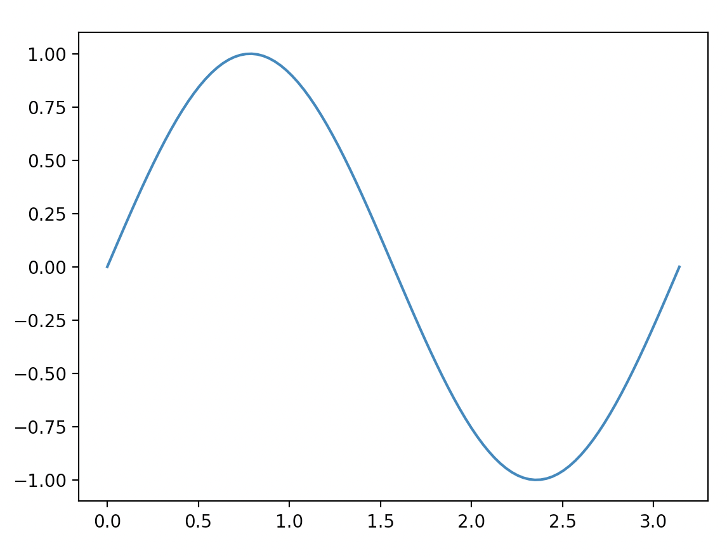
Reading/writing data
Running this in the command line…
$ g++ -std=c++11 -o run lesson_script.cpp
(base) alexhill at Alexs-MacBook-Air in ~/Documents/UOL/Teaching/C++_Workshops/Workshops/WS3/scripts
$ ./run
Input n_vals:100
(base) alexhill at Alexs-MacBook-Air in ~/Documents/UOL/Teaching/C++_Workshops/Workshops/WS3/scripts
$ ipython plot.py &

Slide 44
Caveats
This isn’t the most efficient way of saving data, we want to work with binary files for that
This requires the use of python
We’ll return to optimal ways of saving and plotting data in a future class

Slide 45
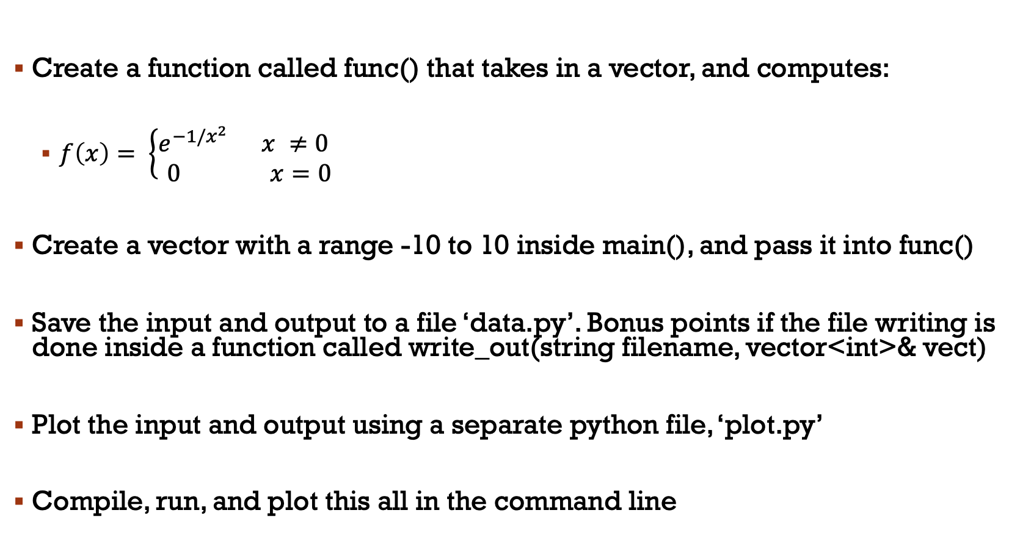
Challenge six: combining what we’ve learned today
Create a function called func() that takes in a vector, and computes:
$f\left(x\right)= \left\{\begin{aligned}e^{−1/x^{2}} x ≠0 \\ 0 x=0\end{aligned} \right.$
Create a vector with a range -10 to 10 inside main(), and pass it into func()
Save the input and output to a file ‘data.py’. Bonus points if the file writing is done inside a function called write_out(string filename, vector<int>& vect)
Plot the input and output using a separate python file, ‘plot.py’
Compile, run, and plot this all in the command line

Slide 46
Monte carlo methods
Generating random numbers in C++
Basics of Monte Carlo methods

Slide 47
#include<iostream>
#include<cstdlib>
using namespace std;
int main(){
// Providing a seed value
srand(time(NULL));
// Loop to get 5 random numbers
for(int i=1; i<=5; i++){
// Retrieve a random number between 100 and 200
// Offset = 100
// Range = 101
int random = 100 + (rand() % 101);
// Print the random number
cout<<random<<endl;
}
return 0;
}
Seed for random number generator
Outputs current calendar time
Modulo: returns the remainder
Returns an integer between 1 and RAND_MAX

Slide 48
Monte carlo basics
Monte Carlo methods are a class of computational algorithms that use random sampling to obtain results
They are often when precise, analytic solutions are impossible
MC methods are widely used in mathematics and physics
General idea is to approximate things using samples, e.g. integration, expectations of probabilities

Slide 49
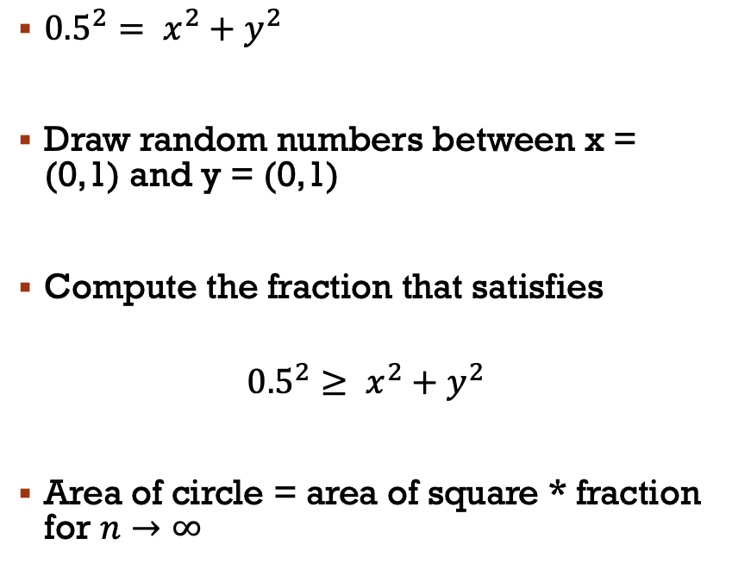
Example: Area of a circle
1
${0.5}^{2}= x^{2}+y^{2}$
Draw random numbers between x = (0,1) and y = (0,1)
Compute the fraction that satisfies
$${0.5}^{2}≥ x^{2}+y^{2}$$
Area of circle = area of square * fraction for $n→∞$
y
0
1
x

Slide 50
Monte carlo history
1930s: Fermi did Monte Carlo approximations by hand to estimate the outcomes of experiments
1940s: von Neumann was working with computers
Ulam, Fermi and von Neumann work at Los Alamos on the atomic bomb
1946: Ulam playing solitaire wants to get the prob of the perfect hand
Use an approximate method, sample deals from the deck, how many perfect hands?
Ulam works with von Neumann to run simulations on computers
Approximate solutions to problems that are difficult to compute analytically
Why Monte Carlo? Ulam had an uncle who liked the Monte Carlo casino in Monaco

Slide 51
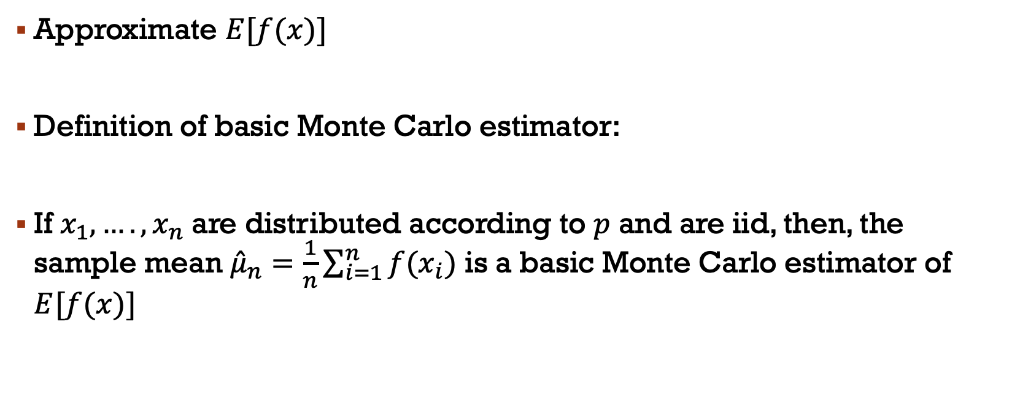
Monte Carlo: expectations
Approximate $E[f(x)]$
Definition of basic Monte Carlo estimator:
If $x_{1},…., x_{n}$ are distributed according to $p$ and are iid, then, the sample mean ${\hat{μ}}_{n}=\frac{1}{n}\sum_{i=1}^{n}{f(x_{i})}$ is a basic Monte Carlo estimator of $E[f(x)]$

Slide 52
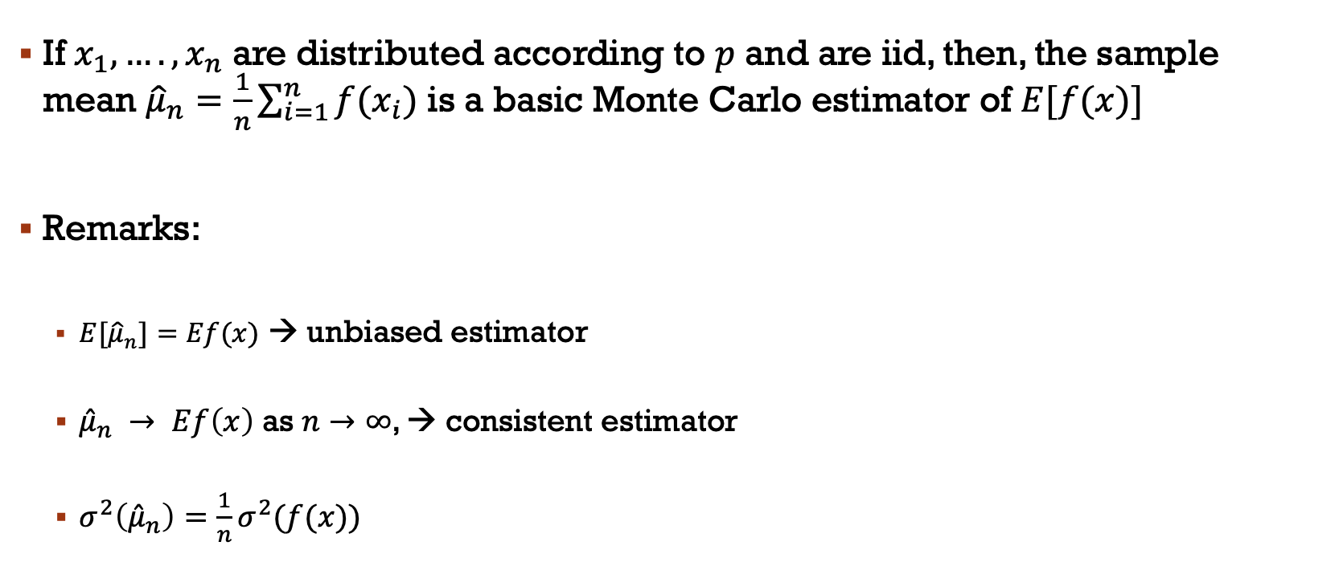
Monte Carlo: expectations
If $x_{1},…., x_{n}$ are distributed according to $p$ and are iid, then, the sample mean ${\hat{μ}}_{n}=\frac{1}{n}\sum_{i=1}^{n}{f(x_{i})}$ is a basic Monte Carlo estimator of $E[f(x)]$
Remarks:
${E[\hat{μ}}_{n}]=Ef(x)$ → unbiased estimator
${\hat{μ}}_{n} → Ef\left(x\right)$ as $n→∞$, → consistent estimator
$σ^{2}\left({\hat{μ}}_{n}\right)=\frac{1}{n}σ^{2}(f(x))$

Slide 53
Thanks!

