Slide 1
Introduction to C++
Dr. Alex Hill
a.d.hill@liverpool.ac.uk
October 2022

Slide 2
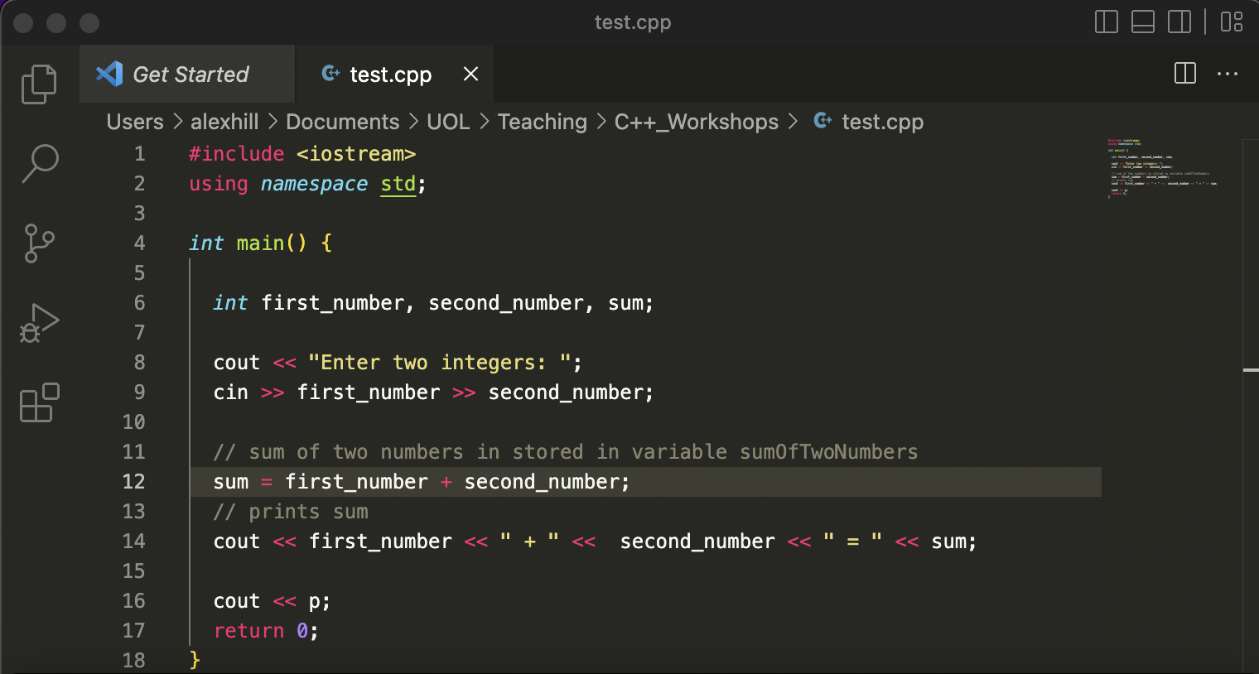
REcap

Slide 3
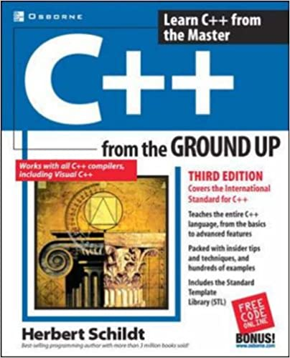
Resources
alex-hill94.github.io/#WS2
C++ from the ground up (roughly chapter two to five)
https://www.w3schools.com/cpp/cpp_variables.asp
https://www.programiz.com/cpp-programming/online-compiler/?ref=1a2efafc

Slide 4
AIM of workshop Two
Variables and data types
Functions
For loops
Arrays and vectors

Slide 5
Follow along on your laptop
Copy the text on the Powerpoint into your IDE
Compile and run to assert that you get the same results
#include <iostream>
using namespace std;
int main() {
string a = "Interactive lessons are superior!";
cout << a << endl;
return 0;
}
(base) alexhill at Alexs-Air in ~/Documents/UOL/Teaching/C++_Workshops/Workshops/WS2
$ g++ -o run test.cpp
(base) alexhill at Alexs-Air in ~/Documents/UOL/Teaching/C++_Workshops/Workshops/WS2
$ ./run
Interactive lessons are superior!

Slide 6
Variables
Different data types
Type conversion
Precision and limits
Simple examples and operations list

Slide 7
Variables
A variable is a location in memory space which may be named
Variables are assigned values, which may be changed at any time
In C++, you must tell the compiler what data type to expect for a variable

Slide 8
Variables
#include <iostream>
using namespace std;
int main() {
int a = 10;
int b;
b = 11;
cout << a << " " << b;
return 0;
}
Variables may be assigned values straight away, or later in the code

Slide 9
Data types
Name | Description
int | Stores integers without decimals (e.g. 0, 1, 2…)
double | Stores floating point numbers without decimals (e.g. 1.21)
char | Stores single characters, which are loaded using single quotations ('a’,’b’)
string | Stores text, loaded using double quotations (“Hello”)
bool | Stores Boolean values: true, false
float | Stores floating point numbers without decimals (e.g. 1.21F)
others | There are more data types, and you can create your own

Slide 10
Doubles and floats
Floats | Doubles
Size: 4 bytes | Size: 8 bytes
7 decimal places | 15 decimal places
17.0F | 17.0
Used occasionally to speed up processes | Used most of the time

Slide 11
Compiling Data types
The compiler will try to convert the value inputted to the chosen data type
If there’s an apparent discrepancy, warnings can be arise
(base) alexhill at Alexs-Air in ~/Documents/UOL/Teaching/C++_Workshops/Workshops/WS2
$ g++ -o run test.cpp
test.cpp:5:10: warning: implicit conversion from 'double' to 'int' changes value from 1.5 to 1 [-Wliteral-conversion]
int a = 1.5;
~ ^~~
1 warning generated.
(base) alexhill at Alexs-Air in ~/Documents/UOL/Teaching/C++_Workshops/Workshops/WS2
$ ./run
1
#include <iostream>
using namespace std;
int main() {
int a = 1.5;
cout << a << endl;
return 0;
}

Slide 12
Compiling Data types
Sometimes there will be no warnings, or unintended consequences
Be careful!
#include <iostream>
using namespace std;
int main() {
char a = 1;
cout << a << endl;
a = '%'
cout << a << endl;
return 0;
}
(base) alexhill at Alexs-Air in ~/Documents/UOL/Teaching/C++_Workshops/Workshops/WS2
$ g++ -o run test.cpp
(base) alexhill at Alexs-Air in ~/Documents/UOL/Teaching/C++_Workshops/Workshops/WS2
$ ./run
%

Slide 13
Type conversion
Variables can have their data type changed implicitly or explicitly
An example of implicit conversion: the double value is automatically converted to int
#include <iostream>
using namespace std;
int main() {
// assigning a double value to num_double
double num_double = 9.1;
// declaroing an int variable
int num_int;
// implicit conversion
// assigning double value to a int variable
num_int = num_double;
cout << "num_double = " << num_double << endl;
cout << "num_int = " << num_int << endl;
return 0;
}
$ ./run
num_double = 9.1
num_int = 9

Slide 14
Type conversion
Variables can have their data type changed implicitly or explicitly
An example of explicit conversion: the double value is automatically converted to int
#include <iostream>
using namespace std;
int main() {
double num_double = 9.1;
int num_int;
// explicit conversion
num_int = int(num_double);
cout << "num_double = " << num_double << endl;
cout << "num_int = " << num_int << endl;
return 0;
}
$ ./run
num_double = 9.1
num_int = 9

Slide 15
Type conversion
Note that what we’re doing here is converting a value, not the data type identifier in memory
#include <iostream>
using namespace std;
int main() {
double num_double = 9.1;
double num_int;
int num_int1;
// explicit conversion
num_int = int(num_double);
num_int1 = int(num_double);
cout << "num_double = " << num_double << endl;
cout << typeid(num_double).name() << endl;
cout << "num_int = " << num_int << endl;
cout << typeid(num_int).name() << endl;
cout << "num_int1 = " << num_int1 << endl;
cout << typeid(num_int1).name() << endl;
return 0;
}
$ ./run
num_double = 9.1
d
num_int = 9
d
num_int1 = 9
i

Slide 16
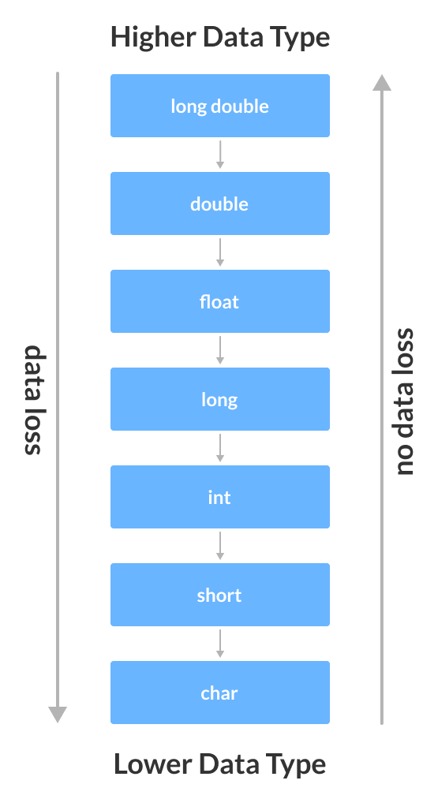
Credit:
www.programiz.com/cpp-programming/type-conversion

Slide 17
Precision: double
There is an inbuilt precision for cout
#include <iostream>
using namespace std;
int main() {
double a = 1.123456789;
cout << a << endl;
return 0;
}
$ ./run
1.12346
(base) alexhill at Alexs-Air in ~/Documents/UOL/Teaching/C++_Workshops/Workshops/WS2
$

Slide 18
Precision: double
You can set the precision of cout that you need using the setprecision function
#include <iostream>
#include <iomanip>
using namespace std;
int main() {
double a = 1.123456789;
cout << setprecision(10);
cout << a << endl;
return 0;
}
$ ./run
1.123456789

Slide 19
Precision: double
Note that if you set the precision beyond the capacity of the data type, you get (deterministic) junk after a certain point
#include <iostream>
#include <iomanip>
using namespace std;
int main() {
double a = 1.1234567891234567891234;
cout << setprecision(20);
cout << a << endl;
return 0;
}
$ ./run
1.1234567891234568116

Slide 20
limits
The data types have a max and min value depending on the number of bits they use in memory
For int, this is 2147483647
$ g++ -o run test.cpp
test.cpp:5:13: warning: implicit conversion from 'long' to 'int' changes value from 2147483648 to -2147483648 [-Wconstant-conversion]
int b = 2147483648;
~ ^~~~~~~~~~
1 warning generated.
(base) alexhill at Alexs-Air in ~/Documents/UOL/Teaching/C++_Workshops/Workshops/WS2
$ ./run
2147483647
-2147483648
#include <iostream>
using namespace std;
int main() {
int a = 2147483647;
int b = 2147483648;
cout << a << endl;
cout << b << endl;
}

Slide 21
limits
If you need extra decimal places, you can use data types like long int, which uses more bits
https://learn.microsoft.com/en-us/cpp/c-language/cpp-integer-limits?view=msvc-170
#include <iostream>
using namespace std;
int main() {
int a = 2147483647;
long int b = 2147483648;
cout << a << endl;
cout << b << endl;
}
$ g++ -o run test.cpp
(base) alexhill at Alexs-Air in ~/Documents/UOL/Teaching/C++_Workshops/Workshops/WS2
$ ./run
2147483647
2147483648

Slide 22
limits
You can check how many bits a data type uses with the sizeof() function
#include <iostream>
using namespace std;
int main() {
cout << "int:" << sizeof(int) << endl;
cout << "float:" << sizeof(float) << endl;
cout << "double:" << sizeof(double) << endl;
cout << "long int:" << sizeof(long int) << endl;
}
$ ./run
int:4
float:4
double:8
long int:8

Slide 23
Simple Boolean example
The Relational operators in C++ are the same as they are in Python (==, !=)
To check the value of a variable, you must first create a Boolean variable
1 = true, 0 = false
You can force cout to return ‘true’ and ‘false’ using cout << boolalpha
#include <iostream>
using namespace std;
int main() {
int a = 10;
bool b;
bool c;
b = a == 10;
c = a == 11;
cout << b << endl;
cout << c << endl;
}
$ ./run
1
0

Slide 24
operators
The arithmetic operators in C++ are very close to those in Python (+, -, /, *, %)
Others (like logical operators) are a bit different
See https://www.programiz.com/cpp-programming/operators for a more complete list

Slide 25

Functions
Functions
Explore how functions are created in programmes

Slide 26
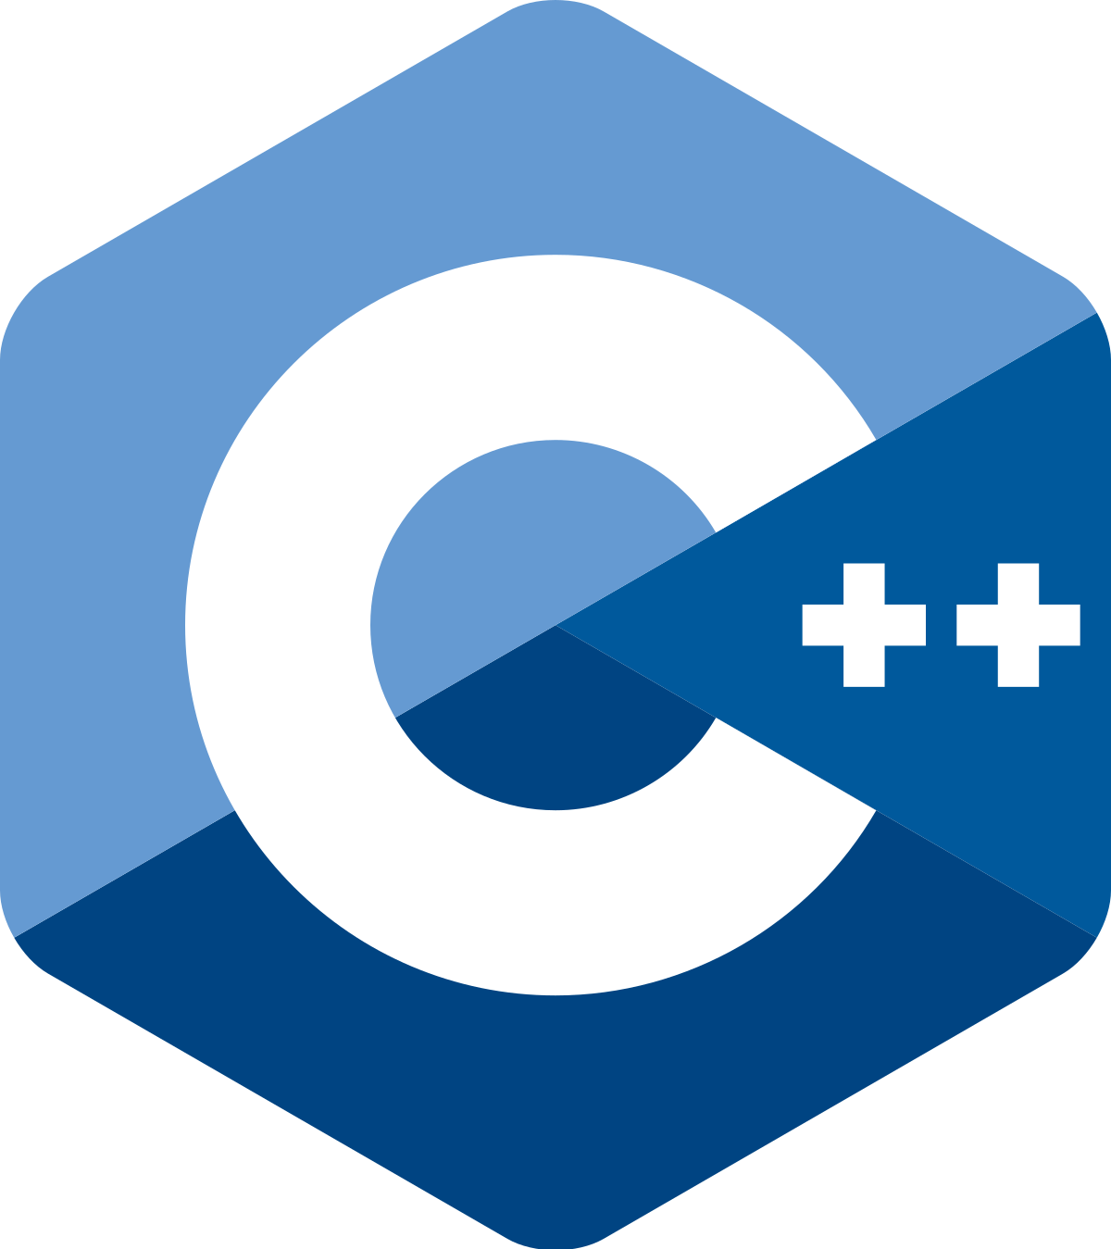
Functions
Functions are the building blocks of C++ programmes
A good point to aim for is each function doing only one thing
C++ does not allow nested functions, however one function can call another
You can call your function anything except main(), which is reserved for the programme execution

Slide 27
Functions
'Prototype’ here indicates that the function needs to be declared prior to its definition. The compiler needs to know what data type will be returned and what inputs it will take before it’s first called
void is a null data type, used here as the function returns nothing
#include <iostream>
using namespace std;
void myfunc(); // 'Prototype'
int main() {
cout << ”What is love?" << endl;
myfunc(); // Call myfunc
cout << ”No more" << endl;
return 0;
}
void myfunc(){
cout << ”Baby don’t hurt me" << endl;
};

Slide 28
Challenge One:
#include <iostream>
using namespace std;
void myfunc(); // 'Prototype'
int main() {
cout << "Inside main" << endl;
myfunc(); // Call myfunc
cout << "Back inside" << endl;
return 0;
}
void myfunc(){
cout << "Inside myfunc" << endl;
};
I would like you to tell a knock-knock joke using multiple functions.
The main() function should prompt the user to write “Who’s there?” and “XXXXX who?” into the terminal, while the other functions should tell the other parts of the joke
Best/worst joke wins! Send your scripts to my email address.
a.d.hill@liverpool.ac.uk

Slide 29
#include <iostream>
using namespace std;
void knock(); // 'Prototype'
void setup();
void punchline();
int main() {
string who, there;
string blank_who;
knock();
cin >> who >> there;
setup(); // Call myfunc
cin >> blank_who;
punchline(); // Call myfunc
return 0;
}
void knock(){
cout << "Knock knock" << endl;
};
void setup(){
cout << "Beets" << endl;
};
void punchline(){
cout << "Beets me!" << endl;
};

Slide 30
functions
int as my function mul has integer arguments
int as my function mul will return an integer
#include <iostream>
using namespace std;
int mul(int val_one, int val_two);
int main() {
int a;
a = mul(1, 4);
cout << a << endl;
return 0;
}
int mul(int val_one, int val_two){
return val_one * val_two;
}

Slide 31
Challenge two:
#include <iostream>
#include <cmath> // Need this for pow()
using namespace std;
int mul(int val_one, int val_two);
int main() {
int a;
a = mul(1, 4);
cout << a << endl;
return 0;
}
int mul(int val_one, int val_two){
return val_one * val_two;
}
I would like you to compute the below equation using two functions called ‘add’ and ‘divide’
(12.12 + 7.01) / (6.352 + 23.4)
No arithmetic operators in main()!
If you can do this quickly, write a code that computes:
y = mx^2 + c
For x specified in the terminal, and m and c defined in the script (#include <cmath> // Need this for pow())

Slide 32
#include <iostream>
#include <cmath> // Need this for pow()
using namespace std;
double add(double val_one, double val_two);
double divide(double val_one, double val_two);
int main() {
double a = 12.12;
double b = 7.01;
double c = 6.352;
double d = 23.4;
double ans;
ans = divide(add(a, b) , add(c, d) );
cout << ans << endl;
return 0;
}
double add(double val_one, double val_two){
return val_one + val_two;
}
double divide(double val_one, double val_two){
return val_one/val_two;
}

Slide 33
Functions
For loops
Explore the syntax of conditional and ranged for loops

Slide 34
Conditional for loops
Introducing for loops in C++
condition
Update (optional)
#include <iostream>
using namespace std;
int main() {
for (int i = 1; i <= 5; ++i) {
cout << i << " ";
}
return 0;
}
initialization
Block of code within loop

Slide 35
Challenge three:
#include <iostream>
using namespace std;
int main() {
int num, sum;
sum = 0;
cout << "Enter a positive integer: ";
cin >> num;
for (int i = 1; i <= num; ++i) {
sum += i;
}
cout << "Sum = " << sum << endl;
return 0;
}
This code computes the sum of numbers up to num
Can you adapt this to compute the mean of numbers up to num?

Slide 36
#include <iostream>
using namespace std;
int main() {
double num, sum;
double mean;
sum = 0;
cout << "Enter a positive integer: ";
cin >> num;
for (int i = 1; i <= num; ++i) {
sum += i;
cout << i << " " << sum << endl;
}
cout << "Sum = " << sum << endl;
cout << "Num = " << num << endl;
mean = sum/num;
cout << "Mean = " << mean << endl;
return 0;
}
It is necessary to initialize num and sum as float objects to ensure this calculation is float/float
(base) alexhill at Alexs-Air in ~/Documents/UOL/Teaching/C++_Workshops/Workshops/WS2
$ ./run
Enter a positive integer: 14
1 1
2 3
3 6
4 10
5 15
6 21
7 28
8 36
9 45
10 55
11 66
12 78
13 91
14 105
Sum = 105
Num = 14
Mean = 7.5

Slide 37
Ranged For loop: new for C++11
Array object
#include <iostream>
using namespace std;
int main() {
int num_array[] = {1, 2, 3, 4, 5, 6, 7, 8, 9, 10};
for (int n : num_array) {
cout << n << " ";
}
return 0;
}

Slide 38
Ranged For loop
Disable warnings with this argumet
#include <iostream>
using namespace std;
int main() {
int num_array[] = {1, 2, 3, 4, 5, 6, 7, 8, 9, 10};
for (int n : num_array) {
cout << n << " ";
}
return 0;
}
$ g++ -std=c++11 -o run test.cpp
(base) alexhill at Alexs-Air in ~/Documents/UOL/Teaching/C++_Workshops/Workshops/WS2
$ ./run
1 2 3 4 5 6 7 8 9 10 (base) alexhill at Alexs-Air in ~/Documents/UOL/Teaching/C++_Workshops/Workshops/WS2

Slide 39
Functions
Arrays and vectors
Explore the difference between arrays and vectors
Combine all we’ve learned today to create some more complex programmes

Slide 40
arrays
A one-dimensional array is a list of related variables
int num_array[10] = {1, 2, 3, 4, 5, 6, 7, 8, 9, 10};
Type
Variable name
Size (reserves this many ints in memory)
Values

Slide 41
Array indexing
#include <iostream>
using namespace std;
int main() {
int my_array[7];
int j;
for(j = 0; j < 7; j++)
{
my_array[j] = j;
cout << my_array[j] << endl;
}
return 0;
}
Arrays consist of contiguous memory locations, the lowest address is the first element etc.
Elements are indexed similarly to Python (e.g. my_array[0])
Warning, there’s no

Slide 42
Array indexing
#include <iostream>
using namespace std;
int main() {
int crash[10], i;
for(i = 0; i < 100; i++)
{
crash[i] = i;
cout << crash[i] << endl;
}
return 0;
}
Warning, there are no boundary checks
Here the loop iterates 100 times, even though crash is only 10 elements long!
This will cause important information to be overwritten

Slide 43
vectors
Vectors are like arrays, but can grow dynamically
#include <vector>
…
vector<int> my_vector; // initialise vector
Call vector object
Name of vector
Data type

Slide 44
Vector initialisation
#include <iostream>
#include <vector>
using namespace std;
int main() {
// initialiser list
vector<int> vector1 = {1, 2, 3, 4, 5};
// uniform initialisation
vector<int> vector2{6, 7, 8, 9, 10};
// method 3
vector<int> vector3(5, 12);
for (int i: vector3)
std::cout << i << ' ';
return 0;
}
vector1 and vector1 are intialised with set values
vector3 creates an array of length five, consisting of repeating twelves
You can’t print out a full vector, you need to loop over all the elements

Slide 45
Vector manipulation
vector<int> vector1 = {1, 2, 3, 4, 5};
// add the integers 6 and 7 to the vector
vector.push_back(6);
vector.push_back(7);
// remove the last element
num.pop_back(7);
// change elements at indexes 1 and 4
num.at(1) = 9;
num.at(4) = 7;
// access vector elements
vector.at(0);
// or
vector[0];
// However, the at() function
// is preferred over [] because
// at() throws an exception
// whenever the vector is out of
// bound, while [] gives a garbage value.
For other vector functions, see:
https://www.programiz.com/cpp-programming/vectors

Slide 46
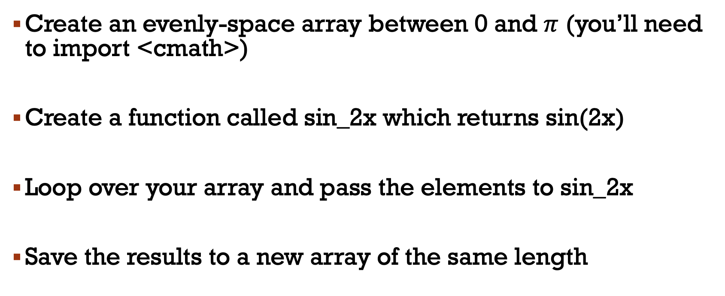
Challenge four
Create an evenly-space array between 0 and $π$ (you’ll need to import <cmath>)
Create a function called sin_2x which returns sin(2x)
Loop over your array and pass the elements to sin_2x
Save the results to a new array of the same length

Slide 47
Next week
Passing vectors into functions (pointers)
Plotting data (really this time)
Introduction to Monte Carlo methods

Slide 48
Thanks!

