Slide 1
Introduction to C++
Dr. Alex Hill
a.d.hill@liverpool.ac.uk
November 2022

Slide 2
Last week…
Classes
Monte Carlo Basics
Random Number Generation

Slide 3
Resources
alex-hill94.github.io/#Proj for project description and a potentially useful C++ script
Previous lecture slides for details on random numbers, classes, functions, etc.
https://cplusplus.com/reference/random

Slide 4

Your project

Slide 5
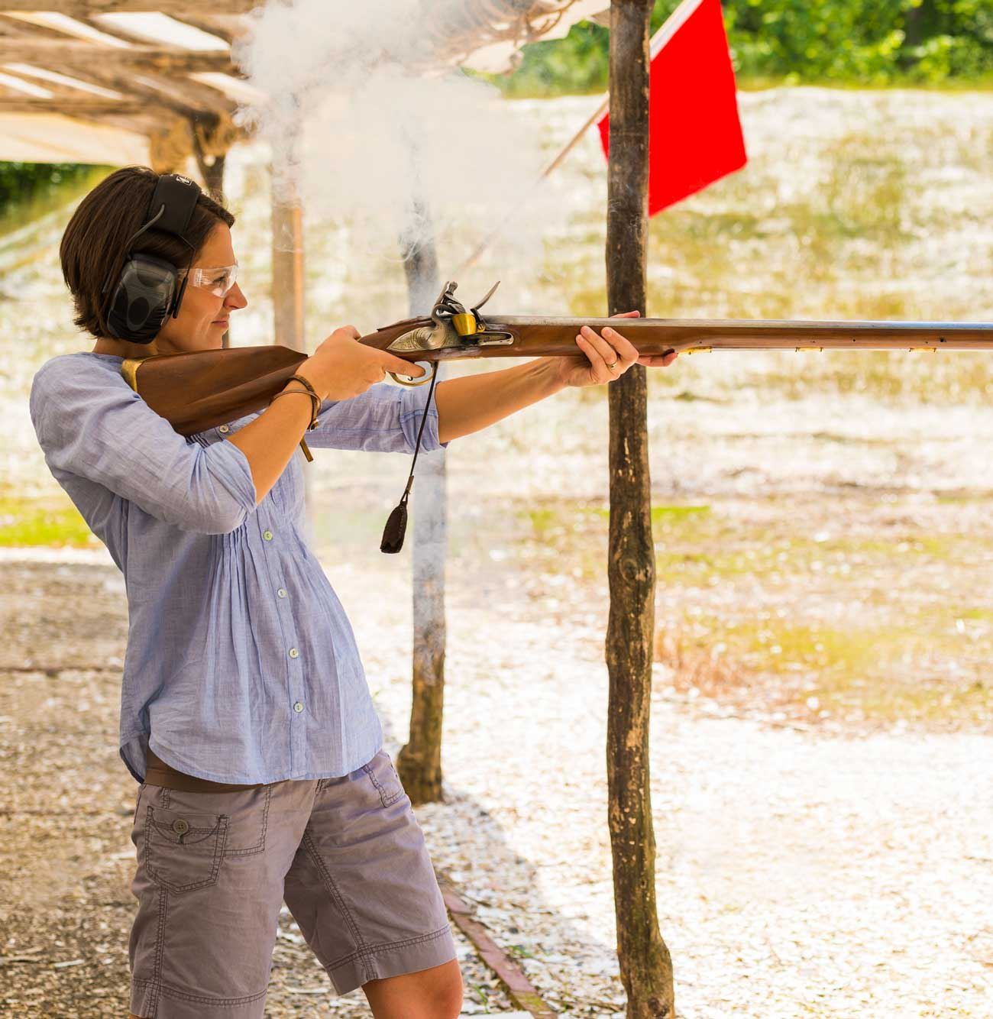
Project description
Context: ballistics in the 1800s
Aim: determine the accuracy of various weapons at a given distance

Slide 6
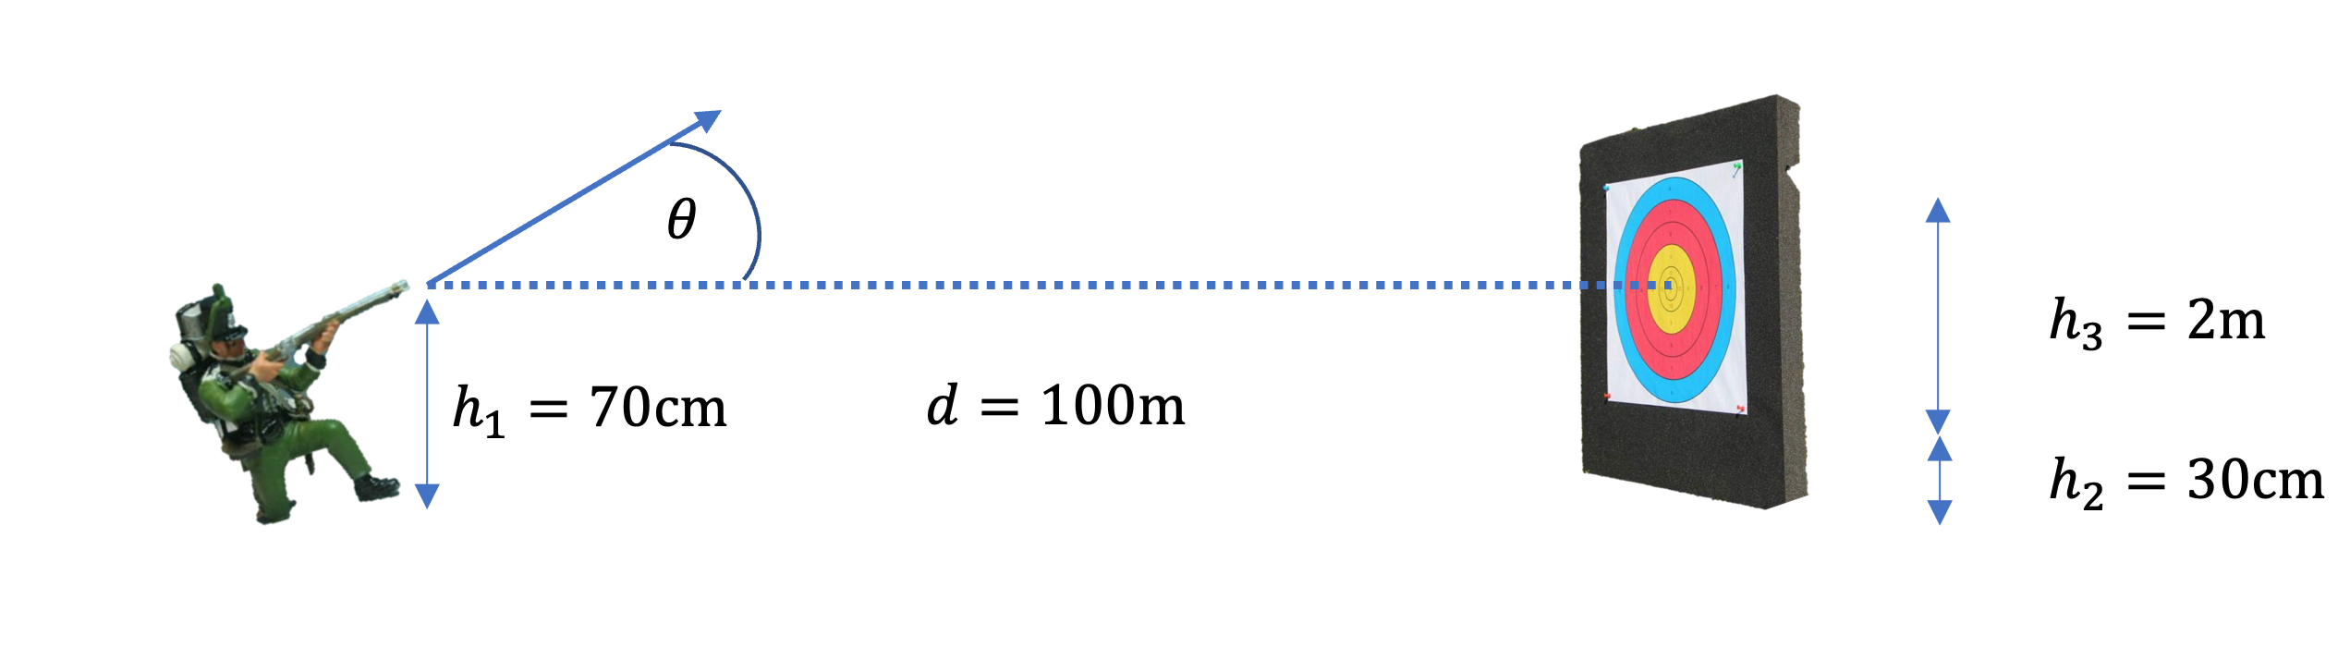
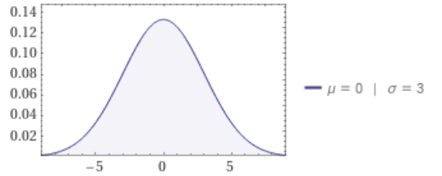

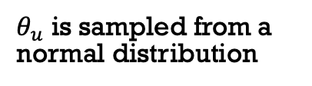
Project description
$$θ=θ_{c}+θ_{u}$$
$θ_{u}$ is sampled from a normal distribution

Slide 7
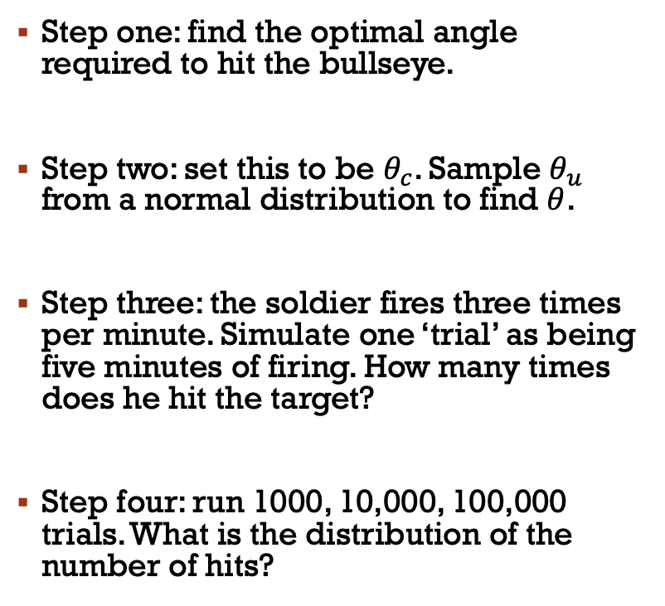

Project description
Step one: find the optimal angle required to hit the bullseye.
Step two: set this to be $θ_{c}$. Sample $θ_{u}$ from a normal distribution to find $θ$.
Step three: the soldier fires three times per minute. Simulate one ‘trial’ as being five minutes of firing. How many times does he hit the target?
Step four: run 1000, 10,000, 100,000 trials. What is the distribution of the number of hits?
$$θ=θ_{c}+θ_{u}$$

Slide 8
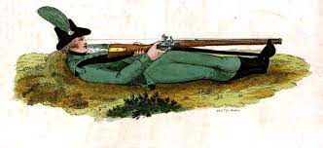
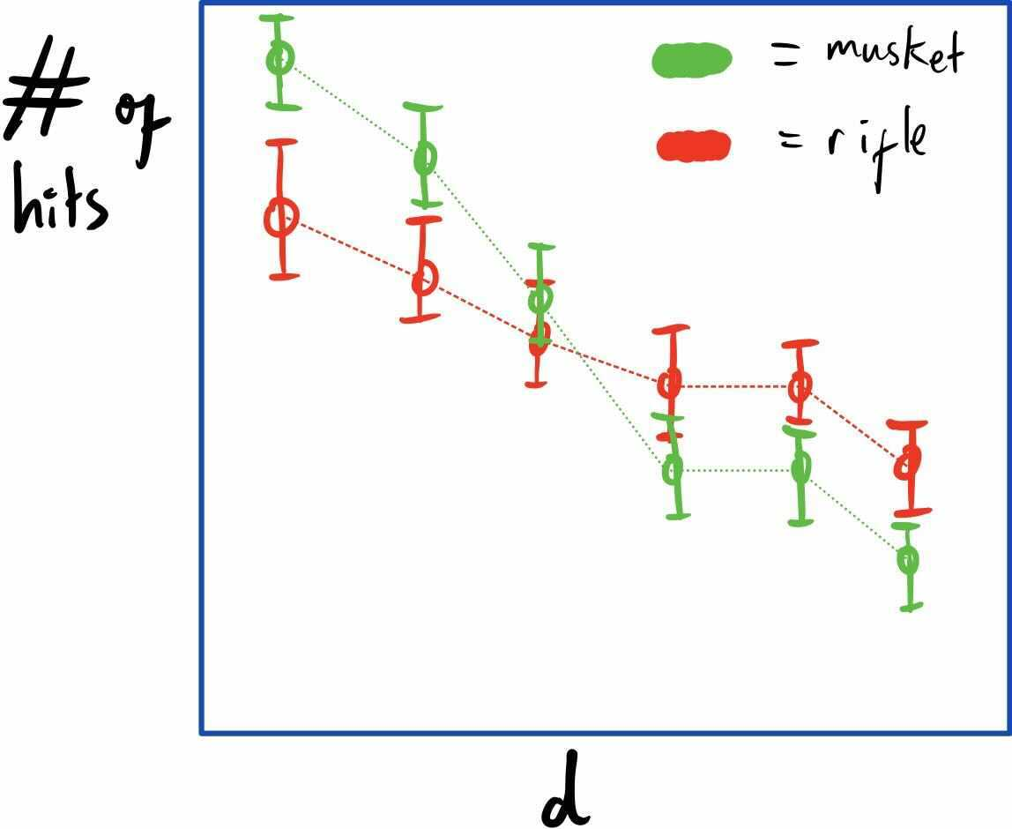
Project description
Step five: compare the performance of a rifle vs a musket at 100m (details on the main document)
Step six: run the experiment for muskets and rifles at various distances. At what distance does it become better to use one over the other?

Slide 9
Tips
DRY – don’t repeat yourself!
Generalise things as much as possible, and consider where it would be useful to use classes
Plan your approach before you start coding
Communicate via Slack, or book study rooms in the teaching hub (502)

Slide 10
teams
Alex J
Andrew
Lauryn
Robert
Ryan
Ali
Andrea
Jonah
Katie
Tom
Short presentation on the 29th of November
Focus on your coding approach as much as the results

Slide 11
Thanks!

