Slide 1
October 2023
Introduction to C++:
Workshop Three
Dr. Alexander Hill
a.d.hill@liverpool.ac.uk

Slide 2
Last Week
Variables and data types
Functions
For loops
Arrays and vectors

Slide 3
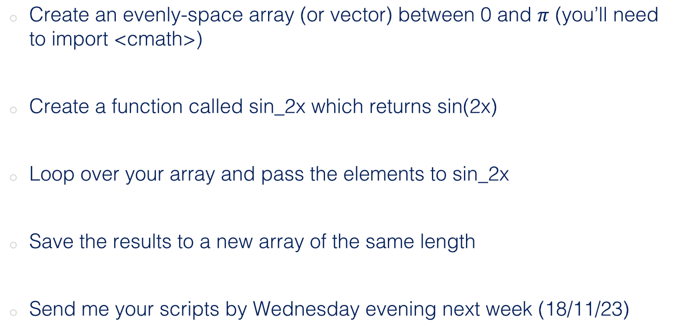
Challenge Four (Homework)
Create an evenly-space array (or vector) between 0 and $π$ (you’ll need to import <cmath>)
Create a function called sin_2x which returns sin(2x)
Loop over your array and pass the elements to sin_2x
Save the results to a new array of the same length
Send me your scripts by Wednesday evening next week (18/11/23)

Slide 4
#include <iostream>
#include <cmath>
using namespace std;
double sin_2x(double x){
return sin(2*x);
}
int main() {
int points=100;
double pi=3.14159265358979;
int j;
double array[points+1];
double seno[points+1];
for(j = 0; j <= points; j++)
{
array[j] = pi/points*j;
}
for(j = 0; j <= points; j++)
{
seno[j] = sin_2x(array[j]);
cout << j << " " << seno[j] << " " << endl;
}
return 0;
}
Works, but nicer to import it as a constant
Ana
$ g++ -o output ana.cpp
(base) alexhill at Alexs-MacBook-Air-2 in ~/Documents/UOL/LIVINNO/Teaching/C++_Workshops/2023/WS3/scripts
$ ./output
0 0
1 0.0627905
2 0.125333
3 0.187381
4 0.24869
5 0.309017
6 0.368125
7 0.425779
8 0.481754
9 0.535827
10 0.587785
11 0.637424
…

Slide 5
#include <iostream>
#include <vector>
#include <cmath>
using namespace std;
double sin_2x(double x) { //function delcaration; expects one arg of type double called x
return sin(2 * x); //function definition; uses sin function from cmath
}
int main() {
const double pi = M_PI; //uses pi constant from cmath
const int numPoints = 9; //number of steps
double step = pi / (numPoints - 1); //calculates step size
double values[numPoints]; //array to store evenly spaced points between 0-pi
double results[numPoints]; //new array to store results of sin_2x
for (int i = 0; i < numPoints; ++i) { //loop
values[i] = i * step; //fills values with points between 0-pi
results[i] = sin_2x(values[i]); //calculate sin(2x) and stores it in results
//prints outcome
cout <<"sin(2 * " << values[i] << ") = " << results[i] << endl;
}
return 0;}
cmath import: M_PI
const
$ g++ -o output emily.cpp
(base) alexhill at Alexs-MacBook-Air-2 in ~/Documents/UOL/LIVINNO/Teaching/C++_Workshops/2023/WS3/scripts
$ ./output
sin(2 * 0) = 0
sin(2 * 0.392699) = 0.707107
sin(2 * 0.785398) = 1
sin(2 * 1.1781) = 0.707107
sin(2 * 1.5708) = 1.22465e-16
sin(2 * 1.9635) = -0.707107
sin(2 * 2.35619) = -1
sin(2 * 2.74889) = -0.707107
sin(2 * 3.14159) = -2.44929e-16
Emily

Slide 6
#include <iostream>
#include <vector>
#include <cmath>
using namespace std;
double sin_2x(double x) { //function delcaration; expects one arg of type double called x
return sin(2 * x); //function definition; uses sin function from cmath
}
int main() {
const double pi = M_PI; //uses pi constant from cmath
pi = 5;
const int numPoints = 9; //number of steps
double step = pi / (numPoints - 1); //calculates step size
double values[numPoints]; //array to store evenly spaced points between 0-pi
double results[numPoints]; //new array to store results of sin_2x
for (int i = 0; i < numPoints; ++i) { //loop
values[i] = i * step; //fills values with points between 0-pi
results[i] = sin_2x(values[i]); //calculate sin(2x) and stores it in results
//prints outcome
cout <<"sin(2 * " << values[i] << ") = " << results[i] << endl;
}
return 0;}
$ g++ -o output emily.cpp
emily.cpp:10:8: error: cannot assign to variable 'pi' with const-qualified type 'const double'
pi = 5;
~~ ^
emily.cpp:9:18: note: variable 'pi' declared const here
const double pi = M_PI; //uses pi constant from cmath
~~~~~~~~~~~~~^~~~~~~~~
1 error generated.
Emily

Slide 7
#include <iostream>
#include <vector>
#include <cmath> // Need this for pi (M_PI), sin()
using namespace std;
double sin_2x(double x_val); // sin(2x) declaration
int main() {
// evenly-spaced vector between 0 and pi
int no_space;
cout << "Enter any integer - this is for spacing of vector: ";
cin >> no_space;
//pi div. increment
double pi_div = M_PI / no_space;
// empty vectors first
vector<double> vect_pi_eve;
vector<double> vect_sin2x;
// push_back loop adding into vector
for (int i = 0; i <= no_space; i++){
vect_pi_eve.push_back(i*pi_div);
}
Don’t need std here
Khang
// print vect_pi_eve
for (double i: vect_pi_eve)
std::cout << i << ' ';
// passing elements to sin(2x) function
for (int i = 0; i <= no_space; i++){
vect_sin2x.push_back(sin_2x(vect_pi_eve.at(i)));
}
// print vect_sin2x
for (double i: vect_sin2x)
std::cout << i << ' ';
return 0;
}
//------------------------
//sin(2x) function
double sin_2x(double x_val){
return sin(2*x_val);
};

Slide 8
$ g++ -std=c++11 -o output khang.cpp
(base) alexhill at Alexs-MacBook-Air-2 in ~/Documents/UOL/LIVINNO/Teaching/C++_Workshops/2023/WS3/scripts
$ ./output
Enter any integer - this is for spacing of vector: 6
0 0.523599 1.0472 1.5708 2.0944 2.61799 3.14159 0 0.866025 0.866025 1.22465e-16 -0.866025 -0.866025 -2.44929e-16 (base) alexhill at Alexs-MacBook-Air-2 in ~/Documents/UOL/LIVINNO/Teaching/C++_Workshops/2023/WS3/scripts
// print vect_sin2x
for (double i: vect_pi_eve)
std::cout << i << endl;
for (double i: vect_sin2x)
std::cout << i << endl;

Slide 9
Luke
double sin2x(double a){
return sin(2 * a);
}
int main() {
int n = 8;
vector<double> x_array(n);
vector<double> y_array(n);
for (int i=0; i<n-1; i++){
x_array[i] = M_PI * i / n;
}
for (int i=0; i<n-1; i++){
double b = sin2x(x_array[i]);
y_array[i] = b;
}
$ g++ -std=c++11 -o output luke.cpp
(base) alexhill at Alexs-MacBook-Air-2 in ~/Documents/UOL/LIVINNO/Teaching/C++_Workshops/2023/WS3/scripts
$ ./output
X values
0
0.392699
0.785398
1.1781
1.5708
1.9635
2.35619
0
Sin 2X values
0
0.707107
1
0.707107
1.22465e-16
-0.707107
-1
0
We aren’t going to the edge of the array here

Slide 10
Sam
#include <cmath>
double sin2x(double x);
int main() {
int num_points = 10;
double values_between_zero_and_pi[num_points];
double sin_values[num_points];
double step = M_PI / (num_points - 1);
for (int i = 0; i < num_points; i++) {
values_between_zero_and_pi[i] = i * step;
sin_values[i] = sin2x(values_between_zero_and_pi[i]);
// std::cout << values_between_zero_and_pi[i] << std::endl;
std::cout << sin_values[i] << "\t";
}
std::cout << std::endl;
return 0;
}
double sin2x(double x) {
return sin(2 * x);
}
$ g++ -std=c++11 -o output sam.cpp
sam.cpp:12:14: error: no member named 'cout' in namespace 'std'
std::cout << sin_values[i] << "\t";
~~~~~^
sam.cpp:14:10: error: no member named 'cout' in namespace 'std'
std::cout << std::endl;
~~~~~^
sam.cpp:14:23: error: no member named 'endl' in namespace 'std'
std::cout << std::endl;
~~~~~^
3 errors generated.

Slide 11
Sam
#include <cmath>
double sin2x(double x);
int main() {
int num_points = 10;
double values_between_zero_and_pi[num_points];
double sin_values[num_points];
double step = M_PI / (num_points - 1);
for (int i = 0; i < num_points; i++) {
values_between_zero_and_pi[i] = i * step;
sin_values[i] = sin2x(values_between_zero_and_pi[i]);
// std::cout << values_between_zero_and_pi[i] << std::endl;
std::cout << sin_values[i] << "\t";
}
std::cout << std::endl;
return 0;
}
double sin2x(double x) {
return sin(2 * x);
}
$ ./output
0 0.642788 0.984808 0.866025 0.34202 -0.34202 -0.866025 -0.984808 -0.642788 -2.44929e-16
Consider some easier to read formatting, e.g. line breaks and associated string

Slide 12
#include <iostream>
#include <cmath>
using namespace std;
// Function that just returns sin(2x)
double sin_2x(double x) {
return sin(2 * x);
}
int main() {
// Set total number of array elements
int arrayLength;
cout << "Set array length: ";
cin >> arrayLength;
// Declare pi array and sin array
double piArray[arrayLength];
double sinArray[arrayLength];
// Print to terminal
cout << "Pi Array: ";
// For loop to build pi array and print to terminal:
for (int n = 0; n < arrayLength; n++) {
piArray[n] = M_PI * n / (arrayLength - 1);
cout << piArray[n] << " ";
}
cout << endl << "Sin Array: ";
// For loop to call the sin_2x function and print to terminal:
for (int n = 0; n < arrayLength; n++) {
sinArray[n] = sin_2x(piArray[n]);
cout << sinArray[n] << " ";
}
return 0;
}
Joe
$ g++ -std=c++11 -o output Joe\ Hadley\ Workshop\ 2\ Homework.cpp
(base) alexhill at Alexs-MacBook-Air-2 in ~/Documents/UOL/LIVINNO/Teaching/C++_Workshops/2023/WS3/scripts
$ ./output
Set array length: 10
Pi Array: 0 0.349066 0.698132 1.0472 1.39626 1.74533 2.0944 2.44346 2.79253 3.14159
Sin Array: 0 0.642788 0.984808 0.866025 0.34202 -0.34202 -0.866025 -0.984808 -0.642788 -2.44929e-16 (base) alexhill at Alexs-MacBook-Air-2 in ~/Documents/UOL/LIVINNO/Teaching/C++_Workshops/2023/WS3/scripts

Slide 13
#include <iostream>
#include <cmath>
#include <stdexcept>
using namespace std;
// Function to make a pi array, generalised for any start and end values
double* linspace(int arrayLength, bool printResult = false, double startValue = 0, double endValue = M_PI) {
if (printResult){
cout << "Array: " << " ";
}
// Throw exception if m < 2
if (arrayLength < 2) {
throw invalid_argument("Array must have at least 2 elements");
}
// Allocate memory for new array of length m
double* interpArray = new double[arrayLength];
// Iterate through the elements of new array giving equally m spaced values between start and end values, inclusive
for (int n = 0; n < arrayLength; n++) {
interpArray[n] = startValue + (endValue-startValue) * n / (arrayLength - 1);
// Print results if desired - default is no
if (printResult) {
cout << interpArray[n] << " ";
}
}
if (printResult) {
cout << endl;
}
return interpArray;
}
// Function to return sin(2x)
double sin_2x(double x) {
return sin(2 * x);
}
//
Joe
// Overloaded function to deal with a whole vector
double* sin_2x(double* inputArray, int length, bool printResult = false) {
double* sinArray = new double[length];
if (printResult){
cout << "Sin Array: " << " ";
}
for (int n = 0; n < length; n++) {
// Call double version of function - is this good practice?
sinArray[n] = sin_2x(inputArray[n]);
// Print results if desired - default is no
if (printResult){
cout << sinArray[n] << " ";
}
}
return sinArray;
}
int main() {
// Set total number of array elements
int arrayLength;
cout << "Set array length: ";
cin >> arrayLength;
// Allocate memory for arrays
double* piArray;
double* sinArray;
// Throws exception if m < 2
try {
// Use linspace function to generate array, using default values, and print to terminal
piArray = linspace(arrayLength, true);
// Exception
} catch (invalid_argument& e) {
cerr << e.what() << endl;
return -1;
}
// Let sin_2x function deal with whole array and print to terminal
sinArray = sin_2x(piArray, arrayLength, true);
// Deallocate memory for arrays
delete[] piArray;
delete[] sinArray;
return 0;
}
Use of pointers and creation of python-like functions 👍

Slide 14
#include <cmath>
#include <vector>
#include <algorithm>
#include <iostream>
using namespace std;
double sin_2x(double x);
int main(){
int n = 10;
vector<double> v1(n), v2(n);
// fill with values between 0 and pi
double d = M_PI/(n-1);
std::generate(v1.begin(),v1.end(), [i=0, &d]() mutable {return d*i++;});
std::cout << "x = ";
for (double j: v1) {
std::cout << j << ", ";
}
std::cout << endl;
std::generate(v2.begin(),v2.end(), [i=-1, &v1]() mutable {i++; return sin_2x(v1.at(i));});
std::cout << "sin(2x) = ";
for (double j: v2) {
std::cout << j << ", ";
}
std::cout << endl;
return 0;
}
double sin_2x(double x){
auto sin2x = sin(2*x);
return sin2x;}
$ g++ -std=c++14 -o output marina.cpp
(base) alexhill at Alexs-MacBook-Air-2 in ~/Documents/UOL/LIVINNO/Teaching/C++_Workshops/2023/WS3/scripts
$ ./output
x = 0, 0.349066, 0.698132, 1.0472, 1.39626, 1.74533, 2.0944, 2.44346, 2.79253, 3.14159,
sin(2x) = 0, 0.642788, 0.984808, 0.866025, 0.34202, -0.34202, -0.866025, -0.984808, -0.642788, -2.44929e-16,
Marina
Nice split declaration and definition

Slide 15
#include <iostream>
#include <vector>
#include <math.h>
using namespace std;
vector<float> sin_2x(vector<float> vec){
vector<float> vec_2x;
for (float x : vec)
{
vec_2x.push_back(sin(2 * x));
}
return vec_2x;
};
int main()
{ vector<float> vect;
// generate value between 0 ~ pi
float stride = 0.1;
for (float i = 0; i < M_PI; i += stride)
{
vect.push_back(i);
}
// call sin_2x to change the value in the vector and return into a new vector
vector<float> vect_2x = sin_2x(vect);
for (float x : vect_2x)
cout << x << "\n";
return 0;
}
$ g++ -std=c++11 -o output qiyuan.cpp
(base) alexhill at Alexs-MacBook-Air-2 in ~/Documents/UOL/LIVINNO/Teaching/C++_Workshops/2023/WS3/scripts
$ ./output
0
0.198669
0.389418
0.564642
0.717356
0.841471
0.932039
0.98545
0.999574
0.973848
0.909297
0.808496
0.675463
0.515501
0.334988
0.14112
-0.0583747
-0.255542
-0.442521
-0.611858
-0.756803
-0.871576
-0.951602
-0.993691
-0.996165
-0.958924
-0.883455
-0.772765
-0.631267
-0.464603
-0.279417
-0.083091
Qiyuan
You’re not getting quite up to pi with this array

Slide 16
#include <iostream>
#include <cmath>
using namespace std;
int main() {
double num_array[5] = {0, M_PI_4 , M_PI_2 , 3*M_PI_4 , M_PI};
double result[5];
double sin_2x;
int n;
for (int i=0; i<5; i++){
//cout << num_array[i] << endl;
sin_2x = sin(2*num_array[i]);
result[i]= sin_2x;
cout << "sin(2x)=" << result[i]<< endl;
}
return 0;
}
Sinead
$ g++ -std=c++11 -o output sinead.cpp
(base) alexhill at Alexs-MacBook-Air-2 in ~/Documents/UOL/LIVINNO/Teaching/C++_Workshops/2023/WS3/scripts
$ ./output
sin(2x)=0
sin(2x)=1
sin(2x)=1.22465e-16
sin(2x)=-1
sin(2x)=-2.44929e-16
Consider generalising this

Slide 17
#define _USE_MATH_DEFINES
#include <cmath>
#include <iostream>
#include <vector>
using namespace std;
float sin_2x(float val_x);
int main() {
int vector_size;
cout << "Enter the desired length of the array/vector: ";
cin >> vector_size;
float step_size;
step_size = M_PI / (vector_size-1);
vector<float> vector1{0};
cout << "Evenly spaced vector between 0 and pi " << endl;
cout << 0 << " " << vector1.at(0) << endl;
Sakrican
for(int i=1; i <= vector_size-1 ; ++i) {
vector1.push_back(step_size*i);
cout << i << " " << vector1.at(i) << endl;
}
vector<float> vector_sin2x{0};
cout << "The vector and the sin2x values " << endl;
cout << 0 << " " << vector1.at(0) << " " << vector_sin2x.at(0) << endl;
for(int i=1; i <= vector_size-1 ; ++i) {
vector_sin2x.push_back(sin_2x(vector1.at(i)));
cout << i << " " << vector1.at(i) << " " << vector_sin2x.at(i) << endl;
}
return 0;
}
float sin_2x(float val_x){
float val_2x;
val_2x = 2*val_x;
return sin(val_2x);
}
Not always needed (depends on compiler)

Slide 18
Sakrican
$ g++ -std=c++11 -o output sakrican.cpp
(base) alexhill at Alexs-MacBook-Air-2 in ~/Documents/UOL/LIVINNO/Teaching/C++_Workshops/2023/WS3/scripts
$ ./output
Enter the desired length of the array/vector: 10
Evenly spaced vector between 0 and pi
0 0
1 0.349066
2 0.698132
3 1.0472
4 1.39626
5 1.74533
6 2.0944
7 2.44346
8 2.79253
9 3.14159
The vector and the sin2x values
0 0 0
1 0.349066 0.642788
2 0.698132 0.984808
3 1.0472 0.866025
4 1.39626 0.34202
5 1.74533 -0.34202
6 2.0944 -0.866025
7 2.44346 -0.984808
8 2.79253 -0.642788
9 3.14159 -3.01992e-07

Slide 19
#include<iostream>
using namespace std;
#define _USE_MATH_DEFINES
#include<math.h>
#include<vector>
float sin_2x(float arg);
int main() {
int n_p;
float range_l=0, range_h=M_PI;
cout << "Lower Limit" << range_l << endl;
// cin >> range_l;
cout << "Upper Limit" << range_h << endl;
// cin >> range_h;
cout << "Number of Data Points" << " ";
cin >> n_p;
vector<float> argument(n_p, 0);
vector<float> sin_values(n_p, 0);
cout << "x" << "\t\t" << "Sin(2x)" << endl;
cout << "-----------------------------------------" << endl;
for (int i = 0; i < n_p; ++i) {
argument[i]= range_l+i*((range_h-range_l)/(n_p-1));
sin_values[i] = sin_2x(argument[i]);
cout << argument[i] << "\t\t" << sin_values[i] << endl;
}
return 0;
}
float sin_2x(float arg) {
return sin(2*arg);}
$ g++ -std=c++11 -o output rupesh.cpp
(base) alexhill at Alexs-MacBook-Air-2 in ~/Documents/UOL/LIVINNO/Teaching/C++_Workshops/2023/WS3/scripts
$ ./output
Lower Limit0
Upper Limit3.14159
Number of Data Points 10
x Sin(2x)
-----------------------------------------
0 0
0.349066 0.642788
0.698132 0.984808
1.0472 0.866025
1.39626 0.34202
1.74533 -0.34202
2.0944 -0.866025
2.44346 -0.984808
2.79253 -0.642787
3.14159 1.74846e-07
Rupesh

Slide 20
#include <iostream>
#include <cmath>
#include <vector>
using namespace std;
double sin2x(double theta);
int main() {
double k = 5;
vector<double> v1(k, M_PI);
vector<double> v2 = {};
for (int i = 0; i <= k-1; ++i)
{
v1.at(i) = i * (1.0/(k-1.0)) * v1.at(i);
v2.push_back( sin2x(v1.at(i)) );
}
for (int i = 0; i <= k-1; ++i)
cout << "Theta = " << v1.at(i) << ", sin(2theta) = " << v2.at(i) << endl;
return 0;
}
double sin2x(double theta)
{
return sin(2.0 * theta);
}
Alex H
$ ./run
Theta = 0, sin(2theta) = 0
Theta = 0.785398, sin(2theta) = 1
Theta = 1.5708, sin(2theta) = 1.22465e-16
Theta = 2.35619, sin(2theta) = -1
Theta = 3.14159, sin(2theta) = -2.44929e-16

Slide 21
Takeaways
Use vectors if possible to stop bound issues
Consider generalising your code early in the process

Slide 22
Hang on…
Why is sin(2pi) not exactly 0?
M_PI = 3.141592653589793, not exactly pi!

Slide 23
#include <iostream>
#include <cmath>
#include <vector>
#include <iomanip>
using namespace std;
int main() {
float pi_float = M_PI;
double pi_double = M_PI;
float sin_2_pi_float = sin(2*pi_float);
double sin_2_pi_double = sin(2*pi_double);
cout << "pi_float = " << pi_float << ", sin(2.pi_float) = " << sin_2_pi_float << endl;
cout << "pi_double = " << pi_double << ", sin(2.pi_double) = " << sin_2_pi_double << endl;
cout << setprecision(16);
cout << "pi_float = " << pi_float << ", sin(2.pi_float) = " << sin_2_pi_float << endl;
cout << "pi_double = " << pi_double << ", sin(2.pi_double) = " << sin_2_pi_double << endl;
return 0;
}
$ ./output
pi_float = 3.14159, sin(2.pi_float) = 1.74846e-07
pi_double = 3.14159, sin(2.pi_double) = -2.44929e-16
pi_float = 3.141592741012573, sin(2.pi_float) = 1.748455531469517e-07
pi_double = 3.141592653589793, sin(2.pi_double) = -2.449293598294706e-16

Slide 24
Aim of Workshop Three
Passing vectors into functions (pointers)
Plotting data (really this time)

Slide 25
Resources
alex-hill94.github.io/#WS3
https://www.programiz.com/cpp-programming/online-compiler/?ref=1a2efafc
https://www.geeksforgeeks.org/pointers-and-references-in-c/
https://www.w3schools.com/cpp/cpp_pointers.asp

Slide 26
POINTERS
References, memory addresses and pointers
Returning multiple values from functions
Passing arrays into functions
Passing vectors into functions

Slide 27
Memory Address
The ampersand (&) can be used to get the memory address of a variable
This is usually in the form of a hexadecimal
#include <iostream>
using namespace std;
int main() {
int height = 10; // height variable
cout << "height = " << height << '\n';
cout << "height address = " << &height << '\n';
return 0;
}
$ ./run
height = 10
height address = 0x16bd133d8

Slide 28
References
You can create a ‘reference variable’ to an existing variable using the ampersand, &
This is effectively an alias to an already existing variable
#include <iostream>
using namespace std;
int main() {
int height = 10; // height variable
int &ref = height; // first reference to height
int ref1 = height; // second reference to height
height = 9;
cout << "height = " << height << '\n';
cout << "ref = " << ref << '\n';
cout << "ref1 = " << ref1 << '\n';
return 0;
}
$ ./run
height = 9
ref = 9
ref1 = 10

Slide 29
References
#include <iostream>
using namespace std;
int main() {
int height = 10; // height variable
int &ref = height; // reference to height
int copy = height; // copy of height
height = 9;
cout << "height = " << height << '\n';
cout << "&height = " << &height << '\n';
cout << "ref = " << ref << '\n';
cout << "&ref = " << &ref << '\n';
cout << "copy = " << copy << '\n';
return 0;
}
The placement of & is important for your chosen purpose
$ ./output
height = 9
&height = 0x16d98b3d8
ref = 9
&ref = 0x16d98b3d8
copy = 10

Slide 30

Memory address
Why do we care?
C++ allows us to manipulate the computer’s memory, which can make code writing and performance more efficient

Slide 31
Pointers
We can create a variable that saves the memory address of another variable, known as a pointer
These require the use of an asterisk, *
#include <iostream>
using namespace std;
int main() {
int height; // height variable
height = 10;
int* pointer = &height;
cout << "height address = " << &height << '\n';
cout << "pointer = " << pointer << '\n';
cout << "height = " << height << '\n';
return 0;
}
$ ./run
height address = 0x16dd6f3d8
pointer = 0x16dd6f3d8
height = 10

Slide 32
Pointers
#include <iostream>
using namespace std;
int main() {
int height; // height variable
height = 10;
int* pointer1 = &height;
int * pointer2 = &height;
int *pointer3 = &height;
cout << "height address = " << &height << '\n';
cout << "pointer1 = " << pointer1 << '\n';
cout << "pointer2 = " << pointer2 << '\n';
cout << "pointer3 = " << pointer3 << '\n';
cout << "height = " << height << '\n';
return 0;
}
You can place the asterisk anywhere, but the convention is int* pointer1
$ ./output
height address = 0x16b4d33d8
pointer1 = 0x16b4d33d8
pointer2 = 0x16b4d33d8
pointer3 = 0x16b4d33d8
height = 10

Slide 33
Pointers
Make sure the data type of the pointer matches the variable!
#include <iostream>
using namespace std;
int main() {
int height = 10; // height variable
int* pointer = &height;
string name = "Alex";
int* name_ptr = &name;
cout << "height = " << height << ", height address = " << pointer << '\n’;
cout << "name = " << name << ", name address = " << name_ptr << '\n';
return 0;
}
$ g++ -o output test.cpp
test.cpp:8:6: error: cannot initialize a variable of type 'int *' with an rvalue of type 'std::string *' (aka 'basic_string<char> *')
int* name_ptr = &name;
^ ~~~~~
1 error generated.

Slide 34
Deferencing
We can get the value of the variable that the pointer is pointing at using * again
#include <iostream>
using namespace std;
int main() {
int height = 10; // height variable
int* pointer = &height;
cout << "variable = " << height << endl;
cout << "address = " << pointer << endl;
cout << "address value = " << *pointer << endl;
return 0;
}
$ ./run
variable = 10
address = 0x16dd0f3d8
address value = 10

Slide 35
Modifying variables with pointers
#include <iostream>
using namespace std;
int main() {
int height = 10; // height variable
int* pointer = &height;
cout << "variable = " << height << endl;
cout << "address = " << pointer << endl;
cout << "address value = " << *pointer << endl;
*pointer = 12;
cout << "variable = " << height << endl;
cout << "address = " << pointer << endl;
cout << "address value = " << *pointer << endl;
return 0;
}
$ ./run
variable = 10
address = 0x16d8433d8
address value = 10
variable = 12
address = 0x16d8433d8
address value = 12

Slide 36
Arrays as Pointers
#include <iostream>
using namespace std;
int main()
{
int arr[] = { 1, 2, 3, 4, 5, 6, 7, 8 };
cout << "arr = " << arr << "\n";
cout << "arr[0] = " << arr[0] << "\n";
return 0;
}
$ ./output
arr = 0x16b2ab3b0
arr[0] = 1

Slide 37
Arrays as Pointers
#include <iostream>
using namespace std;
int main()
{
int a = 1;
int* b = &a;
cout << "a = " << a << "\n";
cout << "b = " << b << "\n";
cout << "b[0] = " << b[0] << "\n";
cout << "b[1] = " << b[1] << "\n";
cout << "b[2] = " << b[2] << "\n";
cout << "&b[0] = " << &b[0] << "\n";
cout << "&b[1] = " << &b[1] << "\n";
return 0;
}
$ ./output
a = 1
b = 0x16f6d33d8
b[0] = 1
b[1] = 0
b[2] = 1869428016
&b[0] = 0x16f6d33d8
&b[1] = 0x16f6d33dc

Slide 38
Challenge five: a few minutes with pointers
Initialise five variables of type: int, float, double, char, and string
Create pointer variables of these variables
Use the pointers to modify the values of the initial variables
Print the values of the variables and their addresses

Slide 39
Functions and pointers

Slide 40
Pythonic Approach
#include <iostream>
using namespace std;
#include <tuple>
tuple <int, int> swap_my_nums(int x, int y)
{
int z = x;
x = y;
y = z;
return make_tuple(x, y);
}
int main() {
int orig_first_number = 10;
int orig_second_number = 20;
int new_first_number;
int new_second_number;
cout << "Before swap: " << "\n";
cout << orig_first_number << " " << orig_second_number << "\n";
// Call the function, which will change the values of first_number and second_number
tie(new_first_number, new_second_number) = swap_my_nums(orig_first_number, orig_second_number);
cout << "After swap: " << "\n";
cout << new_first_number << " " << new_second_number << "\n";
return 0;
}
swap_my_nums returns two values
$ ./run
Before swap:
10 20
After swap:
20 10

Slide 41
Passing by Reference
#include <iostream>
using namespace std;
void swap_my_nums(int &x, int &y) {
int z = x;
x = y;
y = z;
}
int main() {
int first_number = 10;
int second_number = 20;
cout << "Before swap: " << "\n";
cout << first_number << " " << second_number << "\n";
// Call the function, which will change the values of first_number and second_number
swap_my_nums(first_number, second_number);
cout << "After swap: " << "\n";
cout << first_number << " " << second_number << "\n";
return 0;
}
The function does not make a copy of x and y, it passes the actual variables themselves
$ ./run
Before swap:
10 20
After swap:
20 10

Slide 42
Passing by pointers
#include <iostream>
using namespace std;
void swap_my_nums(int* x, int* y) {
int z = *x;
cout << "x = " << x << endl;
cout << "y = " << y << endl;
cout << "*x = " << *x << endl;
cout << "*y = " << *y << endl;
*x = *y;
*y = z;
}
int main() {
int first_number = 10;
int second_number = 20;
cout << "Before swap: " << "\n";
cout << first_number << " " << second_number << "\n";
// Call the function, which will change the values of first_number and second_number
swap_my_nums(&first_number, &second_number);
cout << "After swap: " << "\n";
cout << first_number << " " << second_number << "\n";
return 0;
}
Tells the compiler to expect a pointer to an int variable
$ ./output
Before swap:
10 20
x = 0x16b79f3d8
y = 0x16b79f3d4
*x = 10
*y = 20
After swap:
20 10
Grabs the value at the address the pointer points to
Passes in the memory address

Slide 43
Passing arrays into functions
#include <iostream>
#include <cmath>
using namespace std;
void func(int* a, int* b, int N)
{
int i;
for (i = 0; i < N; i++)
b[i] = a[i] * 2;
}
int main()
{
int arr[] = { 1, 2, 3, 4, 5, 6, 7, 8 };
int arr1[8];
int n = sizeof(arr) / sizeof(arr[0]);
int n1 = sizeof(arr1) / sizeof(arr1[0]);
assert(n==n1);
printf("all good");
func(arr, arr1, n);
for (int i = 0; i < n; i++)
cout << "\n" << arr1[i];
return 0;
}
$ ./run
all good
2
4
6
8
10
12
14

Slide 44
‘Decay’ of arrays in functions
void func(int* a, int* b)
{
cout << "a = " << a << endl;
cout << "sizeof(a) = " << sizeof(a) << endl;
cout << "sizeof(a[0]) = " << sizeof(a[0]) << endl;
int N = sizeof(a);
for (int i = 0; i < N; i++)
b[i] = a[i] * 2;
}
int main()
{
int arr[] = { 1, 2, 3, 4, 5, 6, 7, 8 };
int arr1[8];
int n = sizeof(arr) / sizeof(arr[0]);
int n1 = sizeof(arr1) / sizeof(arr1[0]);
cout << "arr = " << arr << endl;
cout << "sizeof(arr) = " << sizeof(arr) << endl;
cout << "sizeof(arr[0]) = " << sizeof(arr[0]) << endl;
func(arr, arr1);
return 0;}
When an array is passed into a function, it effectively becomes a pointer to the first element in the array only, so you have to pass in the array length as a variable into the function ahead of time
$ ./output
arr = 0x16d8f73b0
sizeof(arr) = 32
sizeof(arr[0]) = 4
all good
a = 0x16d8f73b0
sizeof(a) = 8
sizeof(a[0]) = 4

Slide 45
Passing arrays into functions
// CPP Program to demonstrate passing
// an array to a function is always treated
// as a pointer
#include <iostream>
#include <cmath>
using namespace std;
// Note that arr[] for fun is
// just a pointer even if square
// brackets are used
void func(int* a, int N)
{
int i;
for (i = 0; i < N; i++)
++a[i];
}
int main()
{
int arr[] = { 1, 2, 3, 4, 5, 6, 7, 8 };
int n = sizeof(arr) / sizeof(arr[0]);
cout << "Array size inside main() is " << n;
func(arr, n);
int i;
for (i = 0; i < n; i++)
cout << "\n" << arr[i];
return 0;
}
$ ./run
Array size inside main() is 8
2
3
4
5
6
7
8
9

Slide 46
Challenge Five
Create an array called x, with values -5 to 5 in main()
Pass the array to a function called quad, which computes the square of all the values in the array, and save the values to another array called y
Loop over all x and y and check that things have worked right
Use pointers to minimise the length of your script

Slide 47
Challenge Five
#include <cmath>
#include <iostream>
using namespace std;
void quad(int* a, int* b , int N)
{
int i;
for (i = 0; i < N; i++)
b[i] = pow(a[i], 2);
}
int main()
{
int x[] = { -5, -4, -3, -2, -1, 0, 1, 2, 3, 4, 5};
int n = sizeof(x) / sizeof(x[0]);
int y[n];
quad(x, y, n);
int i;
for (i = 0; i < n1; i++)
{ cout << x[i] << "^2 = " << y[i] << "\n" ;
}
return 0;
}
$ ./run
-5^2 = 25
-4^2 = 16
-3^2 = 9
-2^2 = 4
-1^2 = 1
0^2 = 0
1^2 = 1
2^2 = 4
3^2 = 9
4^2 = 16
5^2 = 25

Slide 48
Passing vectors into functions
#include <iostream>
#include <vector>
using namespace std;
// The vect here is a copy of vect in main()
void func(vector<int> vect)
{ vect.push_back(3); }
int main()
{
vector<int> vect;
vect.push_back(1);
vect.push_back(2);
func(vect);
// vect remains unchanged after function
// call
for (int i = 0; i < vect.size(); i++)
cout << vect[i] << ”\n";
return 0;
}
You can pass a full vector into a function, but a full copy is made, which may take a lot of time to work with
As the function works with the copy of vect, no change is made to vect in main()
$ ./run
1
2

Slide 49
Passing vectors into functions
#include <iostream>
#include <vector>
using namespace std;
// The vect here is the same as the vect in main()
void func(vector<int>& vect)
{ vect.push_back(3); }
int main()
{
vector<int> vect;
vect.push_back(1);
vect.push_back(2);
func(vect);
// vect remains unchanged after function
// call
for (int i = 0; i < vect.size(); i++)
cout << vect[i] << ”\n";
return 0;
}
Making vect a reference stops a copy being made
Changes made in func() now changes the original vect in memory
If we add const in front of vector, vect can no longer be changed by func
$ ./run
1
2
3

Slide 50
Challenge four revisited

Slide 51
#include <iostream>
#include <vector>
#include <cmath>
using namespace std;
void sin2x(const vector<double>& input, vector<double>& output) {
int n = input.size();
for (int i = 0; i < n; ++i)
output.push_back(sin(2 * input.at(i)));
}
int main(){
int k;
cout << "Provide n_vals: \n";
cin >> k;
vector<double> thetas(k);
vector<double> ans;
for (int i = 0; i < k; ++i)
{
thetas.at(i) = i * (1./(k-1)) * M_PI;
}
sin2x(thetas, ans);
for (double j: thetas){
cout << "Theta = " << j << "\n";
}
for (double j: ans){
cout << "sin(2theta) = " << j << "\n";
}
return 0;
}
$ ./output
Provide n_vals:
10
Theta = 0
Theta = 0.349066
Theta = 0.698132
Theta = 1.0472
Theta = 1.39626
Theta = 1.74533
Theta = 2.0944
Theta = 2.44346
Theta = 2.79253
Theta = 3.14159
sin(2theta) = 0
sin(2theta) = 0.642788
sin(2theta) = 0.984808
sin(2theta) = 0.866025
sin(2theta) = 0.34202
sin(2theta) = -0.34202
sin(2theta) = -0.866025
sin(2theta) = -0.984808
sin(2theta) = -0.642788
sin(2theta) = -2.44929e-16

Slide 52
PLOTTING DATA
Reading/writing data basics
Combining C++ with Python

Slide 53
Reading/writing data
C++ provides some basic classes for reading/writing data
#include <ofstream> // : Stream class to write on files
#include <ifstream> // : Stream class to read from files
#include <fstream> // : Stream class to both read and write from/to files.
ofstream myfile;
myfile.open ("example.txt");
myfile << "Writing this to a file.\n";
myfile.close();

Slide 54
Reading/writing data example
#include <iostream>
#include <cmath>
#include <vector>
#include <fstream>
using namespace std;
int main()
{
int k;
cout << "Input n_vals:";
cin >> k;
vector<double> thetas(k);
vector<double> ans;
for (int i = 0; i < k; ++i)
{
thetas.at(i) = i * (1./(k-1)) * M_PI;
}
for (int i = 0; i < k; ++i)
{
ans.push_back(sin(2. * thetas.at(i)));
}

Slide 55
Reading/writing data
ofstream myfile;
myfile.open ("data.txt");
myfile << "Theta = " << "\n";
for (double j: thetas)
{if (j != thetas.back()){myfile << j << ", " << "\n";}
else{myfile << j << "\n";}}
myfile << ""<< "\n" << "\n";
myfile << "Ans = " << "\n";
for (double j: ans)
{if (j != ans.back()){myfile << j << ", " << "\n";}
else{myfile << j << "\n";}}
myfile << "" << "\n"; myfile.close();
return 0;
}

Slide 56
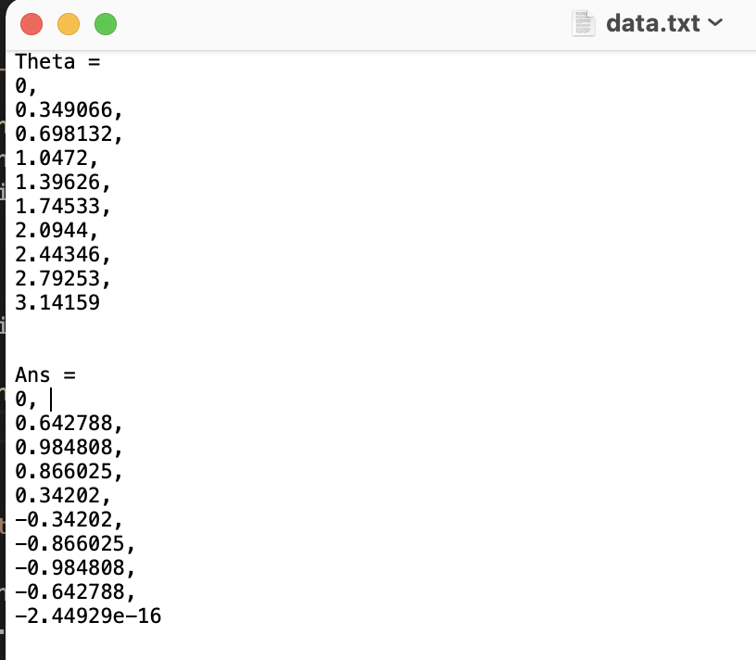
Reading/writing data

Slide 57
Reading/writing data
ofstream myfile;
myfile.open ("data.py");
myfile << "import numpy as np" << "\n” << "\n"; myfile << "theta = np.array((" << "\n";
for (double j: thetas){
if (j != thetas.back()){
myfile << j << ", " << "\n";
}
else{
myfile << j << "\n";
}
}
myfile << "))"<< "\n" << "\n";
myfile << "ans = np.array((" << "\n";
for (double j: ans){
if (j != ans.back()){
myfile << j << ", " << "\n";
}
else{
myfile << j << "\n";}
}
myfile << "))" << "\n";
myfile.close();
return 0;
}
Alternatively, save to a python script…
Create a plotting code plot.py
import matplotlib.pyplot as plt
from data import *
plt.figure()
plt.plot(theta, ans)
plt.show()

Slide 58
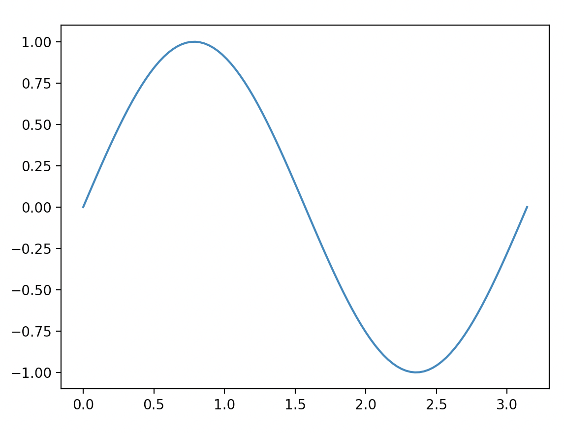
Reading/writing data
Running this in the command line…
$ g++ -std=c++11 -o run lesson_script.cpp
(base) alexhill at Alexs-MacBook-Air in ~/Documents/UOL/Teaching/C++_Workshops/Workshops/WS3/scripts
$ ./run
Input n_vals:100
(base) alexhill at Alexs-MacBook-Air in ~/Documents/UOL/Teaching/C++_Workshops/Workshops/WS3/scripts
$ ipython plot.py &

Slide 59
Caveats
This isn’t the most efficient way of saving data, we want to work with binary files for that
This requires the use of python

Slide 60
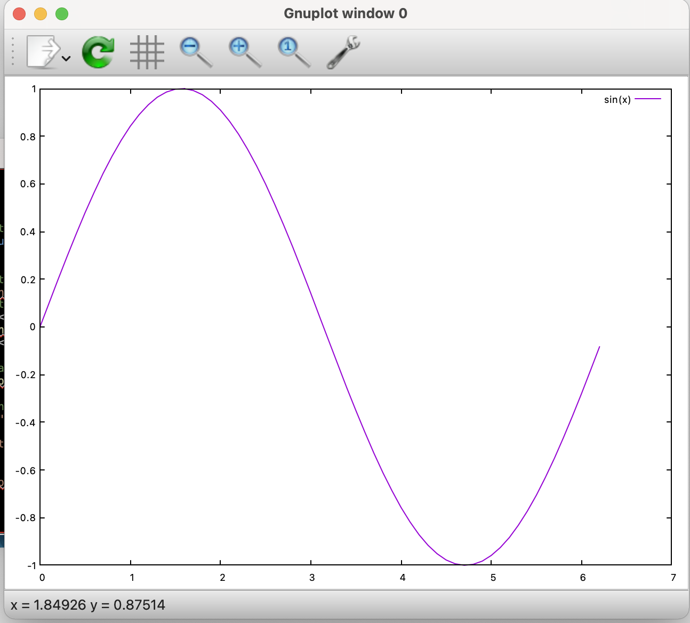
Reading/writing data
#include <iostream>
#include <fstream>
#include <cmath>
using namespace std; // Function to generate sin(x) for a given x value
double sinFunction(double x) {
return sin(x);} int main() {
// Create a file to store the data for the plot
ofstream dataFile("sin_data.txt"); // Generate data points for sin(x) and write them to the file
for (double x = 0; x <= 2 * M_PI; x += 0.1) {
double y = sinFunction(x);
dataFile << x << " " << y << "\n";} dataFile.close(); // Use Gnuplot to create a plot
FILE *gnuplotPipe = popen("gnuplot -persist", "w");
if (gnuplotPipe) {
// Plot sin(x) from the data file
fprintf(gnuplotPipe, "plot 'sin_data.txt' with lines title 'sin(x)'\n");
fflush(gnuplotPipe);
cout << "Press Enter to exit..." << endl;
cin.get();
pclose(gnuplotPipe);} else {
cerr << "Error: Gnuplot not found. Please install Gnuplot to run this script." << endl;}
return 0;}

Slide 61
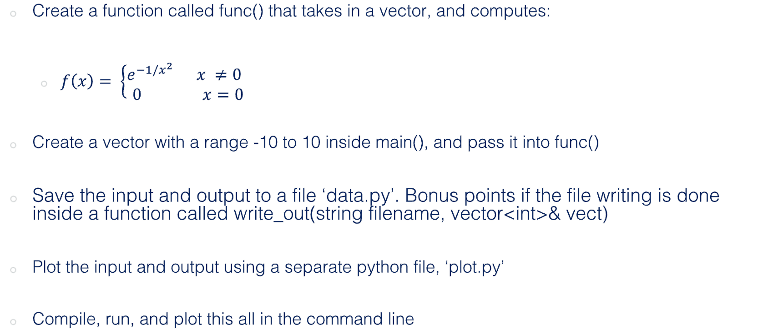
Challenge six: combining what we’ve learned today (const, &, *)
Create a function called func() that takes in a vector, and computes:
$f\left(x\right)= \left\{\begin{aligned}e^{−1/x^{2}} x ≠0 \\ 0 x=0\end{aligned} \right.$
Create a vector with a range -10 to 10 inside main(), and pass it into func()
Save the input and output to a file ‘data.py’. Bonus points if the file writing is done inside a function called write_out(string filename, vector<int>& vect)
Plot the input and output using a separate python file, ‘plot.py’
Compile, run, and plot this all in the command line

Slide 62
Monte Carlo Methods
Generating random numbers in C++
Basics of Monte Carlo methods

Slide 63
#include<iostream>
#include<cstdlib>
using namespace std;
int main(){
// Providing a seed value
srand(time(NULL));
// Loop to get 5 random numbers
for(int i=1; i<=5; i++){
// Retrieve a random number between 100 and 200
// Offset = 100
// Range = 101
int random = 100 + (rand() % 101);
// Print the random number
cout<<random<<endl;
}
return 0;
}
Seed for random number generator
Outputs current calendar time
Modulo: returns the remainder
Returns an integer between 1 and RAND_MAX

Slide 64
Monte Carlo Basics
Monte Carlo methods are a class of computational algorithms that use random sampling to obtain results
They are often when precise, analytic solutions are impossible
MC methods are widely used in mathematics and physics
General idea is to approximate things using samples, e.g. integration, expectations of probabilities

Slide 65
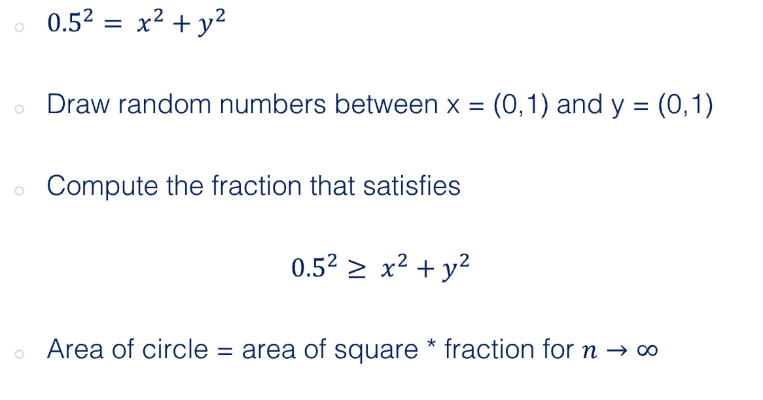
Example: area of a circle
1
${0.5}^{2}= x^{2}+y^{2}$
Draw random numbers between x = (0,1) and y = (0,1)
Compute the fraction that satisfies
$${0.5}^{2}≥ x^{2}+y^{2}$$
Area of circle = area of square * fraction for $n→∞$
y
0
1
x

Slide 66
Thanks!

