Slide 1
Programs/Bruker/prog/docu/English/topspin/html/en-US/789654027.html

Slide 2
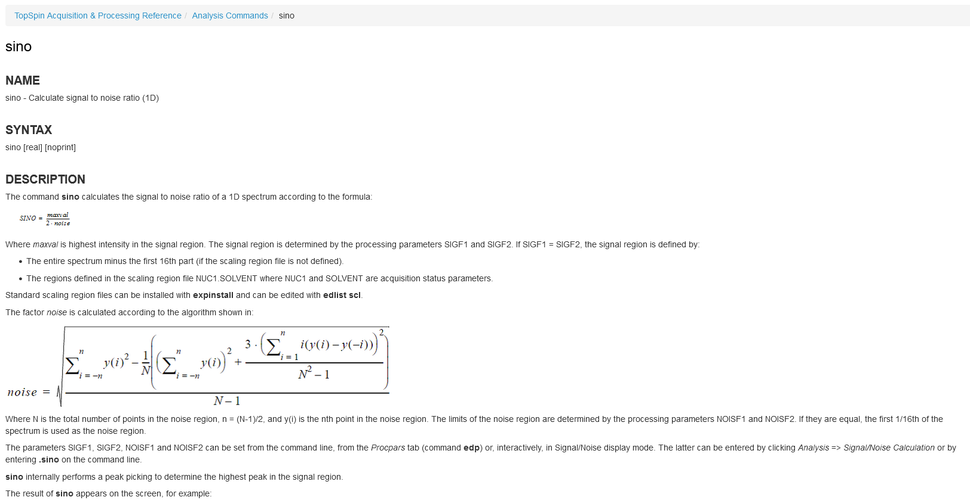

Slide 3
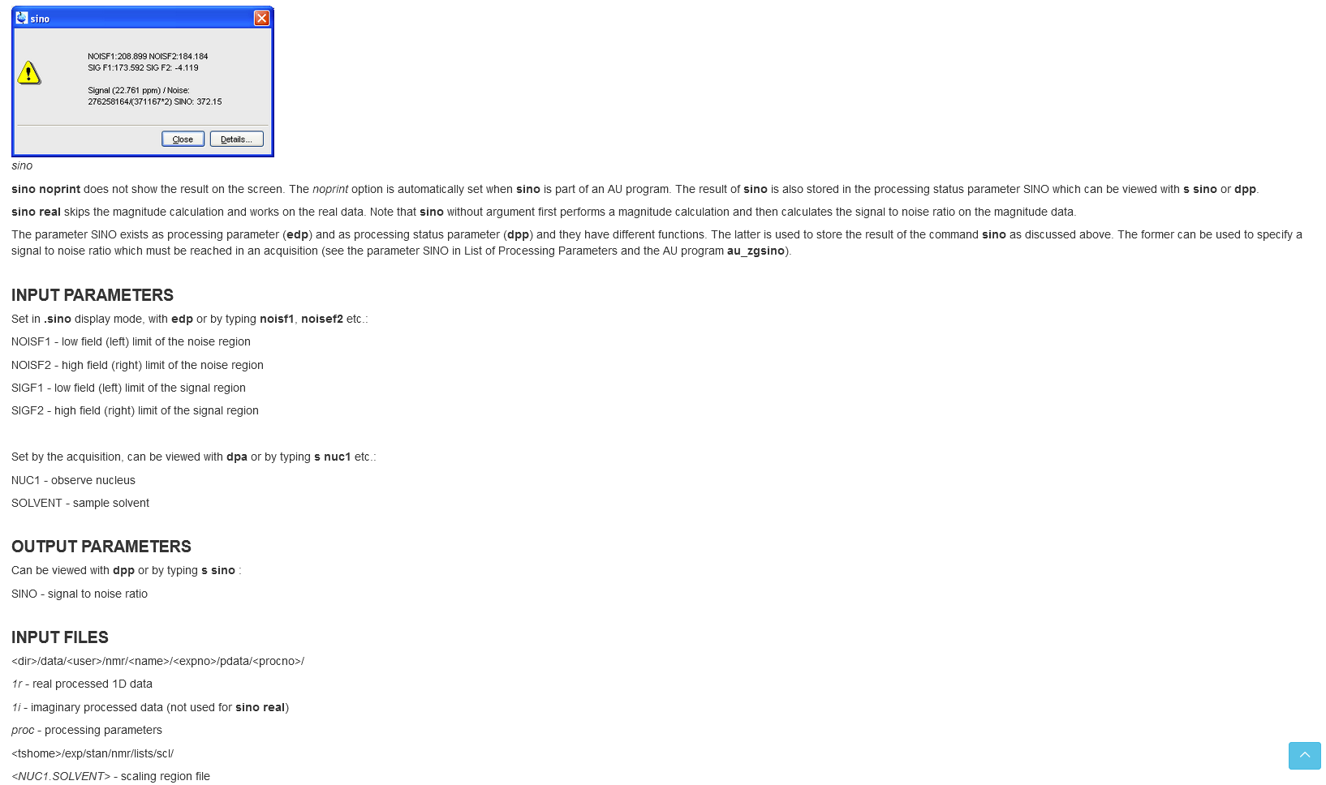

Slide 4
