Slide 1
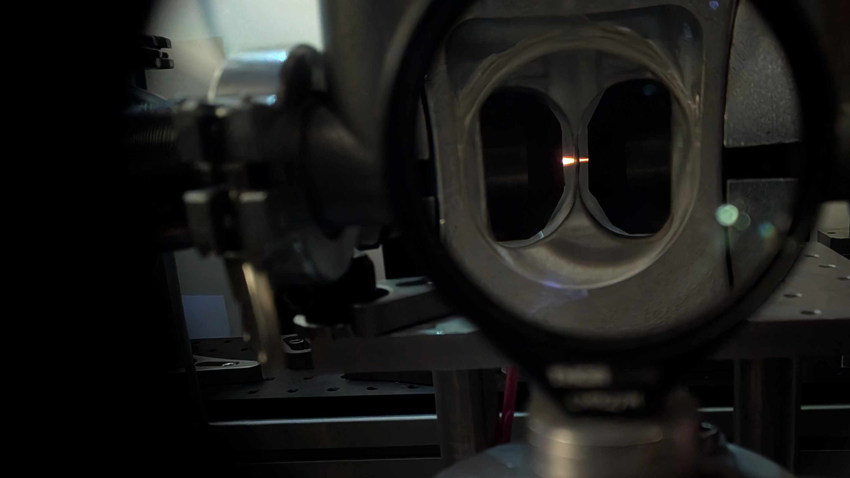
Challenge — Surrogate Models
A laser-plasma accelerator,
PALLAS simulation data
AISSAI Hackathon 2026 · Les Domaines de Gaston · 12 October 2026
Mykyta Lenivenko — IJCLab, Université Paris-Saclay / CNRS-IN2P3
Challenge supervisor: Hyag Guler – IJCLab
The PALLAS gas cell during a shot — the orange streak is the plasma
AISSAI Hackathon 2026 · Surrogate Models (PALLAS) · M. Lenivenko
Notes:
0:30. Adnan's lecture showed why surrogates exist in general. This talk is the specific machine, the data, and what we want the two teams to find out.

Slide 2
The challenge in one sentence
Replace an hours-long plasma simulation by a millisecond model — and measure honestly what that model gives up.
1
2
3
4
The machine
The simulation
The challenge
The data
laser-plasma acceleration, and PALLAS
exact, but hours per answer. A surrogate answers in milliseconds
three questions, the objective ladder, what a strong result looks like
the knobs, the outputs, the pack, the bars already set, and the traps
Notes:
0:30.

Slide 3
Laser-plasma accleration
1
Notes:
Part one: the machine.

Slide 4
A particle accelerator a few millimetres long
gas cell, helium + nitrogen — a few mm
laser in
trapped electrons
bunch out
tens–hundreds of MeV
plasma wave (the bubble)
laser pulse
Conventional: metres of radio-frequency cavities, up to ~100 MV/m.
Laser-plasma: a laser pulse in a gas cell drives a plasma wave - its field is ~1000× stronger.
Millimetres instead of meters. Electrons leave at tens to hundreds of MeV.
Esarey, Schroeder, Leemans, Rev. Mod. Phys. 81, 1229 (2009)
Notes:
1:30. Keep it to the picture. Schematic: the laser enters from the left, drives the plasma wave (the bubble) inside the gas cell, the trapped electrons ride at the back of the bubble, and the bunch leaves on the right at tens to hundreds of MeV.

Slide 5
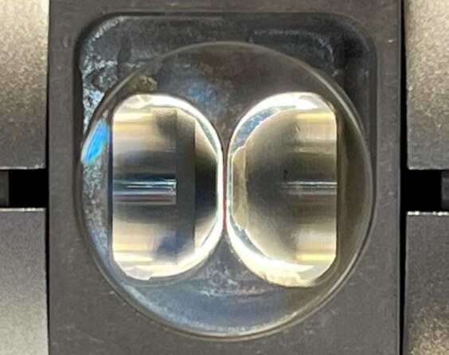
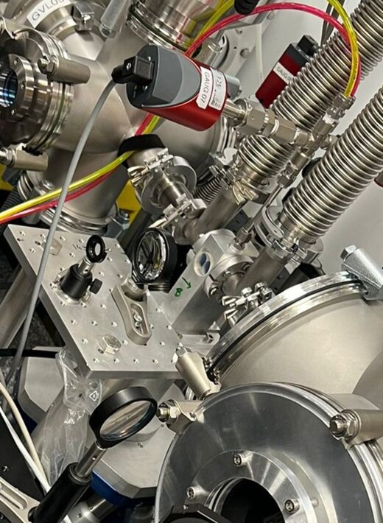
PALLAS at IJCLab: helium, nitrogen, and a shot in the cell
PALLAS (IJCLab, Orsay): a laser-plasma accelerator.
Gas: helium + nitrogen. Nitrogen's inner electrons are freed only at the laser peak — inside the wave, where they are trapped (ionisation injection).
Laser: ≈1J on target, ≈40fs length, ≈20μm spot size. Requires self-focussing in plasma to reach required intensity for inner shell ionization.
The PALLAS gas cell (left) and its interaction chamber (right)
Notes:
The only mechanism they need: ionisation injection — the nitrogen inner shell is ionised late, at the right place to be trapped.

Slide 6
The simulation, and its price
2
Notes:
Part two: the simulation, and its price.

Slide 7
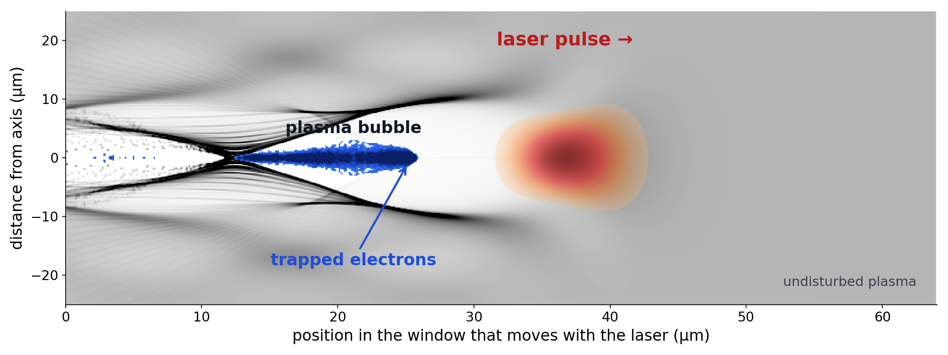
Particle-in-cell: Maxwell's equations on a grid, particles in between
1 · Fields on a grid
solve Maxwell's equations for E and B on every cell
2 · Interpolate
read E and B at each macro-particle
repeat every time step
4 · Deposit
charge and current from the particles back onto the grid
3 · Push
move each macro-particle with the Lorentz force, F = q(E + v × B)
About 2 mm into the gas: laser (red), the bubble behind it, trapped nitrogen electrons (blue).
Smilei (Derouillat et al. 2018): cylindrical grid, laser as an envelope — two approximations that make it affordable.
Exact for every sample, no noise, no calibration — but hours per simulation: the cost is cells × macro-particles × time steps.
Notes:
2:00. The point: the map from knobs to bunch is known exactly, but each point costs a cluster job.
Step 1, fields on a grid: the electric and magnetic fields live on the cells of a mesh, and Maxwell's equations are advanced one time step on every cell.
Step 2, interpolate: each macro-particle sits between grid points, so the fields are read off the grid at its position.
Step 3, push: every macro-particle is moved by the Lorentz force, F = q(E + v × B), for one time step.
Step 4, deposit: the moved particles carry charge and current, which are spread back onto the grid as the source for the next field solve.
Picture: one simulation of the kind in the data pack, about 2 mm into the gas: the laser (red) pushes plasma electrons aside and leaves a bubble behind it; nitrogen electrons freed inside the bubble are trapped (blue) and accelerated.
Smilei is the code (Derouillat et al. 2018); the data pack uses its cylindrical grid and the laser-envelope approximation, which is what makes thousands of runs affordable.

Slide 8
The envelope approximation: follow the pulse's amplitude, not its oscillations
Full wave — the code resolves every oscillation of the laser field, at the laser wavelength of 0.8 µm. The grid must be much finer than that.
Envelope — the code follows only the slowly varying amplitude (the cyan curve) and lets the plasma feel its averaged push. The grid only needs to resolve the plasma wave.
Cylindrical grid — the fields are stored on (r, z) with a few azimuthal modes instead of a full 3D box.
The price: where the laser spectrum changes strongly — very high density, strong depletion — the envelope picture degrades. That is why the density extrapolation on Thursday is also a probe of the simulations.
Notes:
The 34× between the two Smilei rows on the next slide is this: the envelope grid follows the plasma wavelength, the full-wave grid follows the laser wavelength. The envelope also has its own ionisation model, computed from the averaged field. Smilei: Derouillat et al. 2018; the envelope model in Smilei: Massimo et al. 2019, J. Comput. Phys.

Slide 9
Hours per answer
One configuration from the data pack on the Adastra cluster:
≈ 250
code | cores × hours | core-hours | simulated
Smilei, envelope (the data pack) | 192 × 1.3 | ≈ 250 | 7.0 mm
Smilei, full laser wave | 1,536 × 5.6 | ≈ 8,500 | 4.3 mm
core-hours for one training sample, the cheap envelope model
34× cheaper than the full wave on CPUs — and it still goes further
Full laser wave on one GPU (FBPIC, ionisation included, one NVIDIA A6000): 14.7 GPU-hours for 4.3 mm — a different configuration, same kind of physics.
Even the envelope model is a quarter of a thousand core-hours for one training sample.
Notes:
0:45. The table is the honest price of one training sample: even the cheap envelope run is a quarter of a thousand core-hours. On a GPU the full-wave code needs most of a day for one configuration. The envelope model is 34× cheaper than the full wave on CPUs and still goes further.

Slide 10
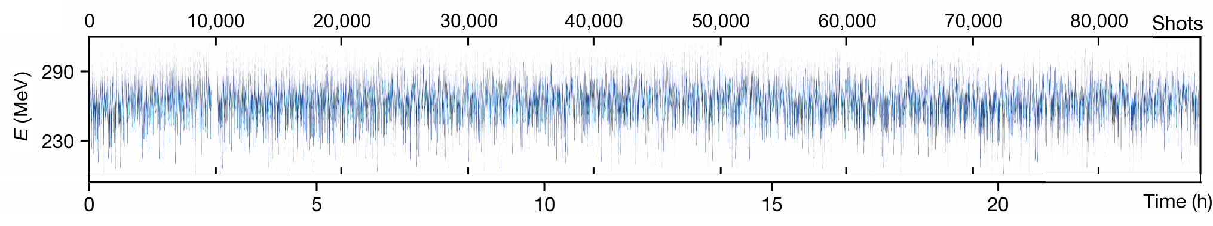
A surrogate answers in milliseconds
One laser-plasma accelerator, one shot per second for 24 hours: the electron energy jumps from shot to shot. To correct the machine you need an answer before the next shot — a simulation takes hours, a trained surrogate one in milliseconds. Scanning, optimising or inverting the machine needs thousands of such answers.
Electron spectrum of every shot, more than 80,000 shots over 24 h, LUX at DESY. From F. Brogren et al., Phys. Rev. Accel. Beams 28, 101302 (2025), Fig. 3(b), x-ray panel omitted, CC BY 4.0.
Notes:
0:45. Do not re-sell surrogates; they saw Adnan's speed chart. The spectra: the machine jitters, so a controller needs an answer every shot. Scanning, optimising or inverting the machine needs thousands of such answers.

Slide 11
The challenge
3
Notes:
Part three: the challenge.

Slide 12
Three questions for the week
A single R² does not tell you whether to trust a surrogate on a real machine. Three things do:
1
2
3
Does physics in the model help?
How many simulations does it need?
Does it still work outside its training range?
A network can learn everything from the simulations, or be given what physics already knows — e.g. a formula for the energy gain as an extra input.
We tried the textbook formula: it explains little. Which physics does help is open.
Each training sample costs hours on a cluster.
A model that is good after 300 simulations is far more useful than one that needs 3,000.
The test set holds densities above any in the training set, and positions along the accelerator you never saw.
A surrogate is worth most exactly where nobody has simulated yet.
Notes:
2:00. These are the organisers' three questions. The physics point: our own attempt with the textbook energy-gain law along the profile did not explain most of the variation — the optional objective "Find the physics that helps" has that negative result. Full wording of question one: a network can learn everything from the simulations, or you can give it what physics already knows — for example, a formula for the energy gain as an extra input. We tried the textbook formula: it explains little of the difference between simulations. Which physics does help is open.

Slide 13
The objectives — Easy and Medium
beam = the eight beam columns (E_med_MeV, dE_mad, q_end, i_peak, n_emit_x, sigma_z, sigma_y, div_rms) · settings A = p_1, a_0, c_N2 · settings B = P_max, cN2_max, L_inj, dip_frac · x_of is a known input in both campaigns
Easy
Medium
Inverse A — the kickoff notebook
beam + x_of → settings A (p_1, a_0, c_N2)
Bar: mean R² 0.9100, our reference (in review); your test file is noise-free, so easier.
Trajectory — beat the internal reference
settings B + z_mm → the six trajectory quantities
Bar: emulator_inplasma, in-plasma mean R² 0.8960 (energy 0.9633, energy spread 0.8092 the lowest), scored on the same hidden 357.
Direct B — the machine read forwards
settings B → E_med_MeV, dE_mad, q_end
Bar: the notebook's linear baseline, about 0.94 / 0.26 / 0.81 — energy spread is where the room is.
Inverse B — Campaign B read backwards
beam + x_of → settings B
Bar: a linear model, mean R² 0.6480 — P_max 0.8665, cN2_max 0.8400, L_inj 0.7987, dip_frac 0.0869; the room is in dip_frac.
Warm-up, not scored — Campaign A forwards
p_1, a_0, c_N2, x_of → E_med_MeV, dE_mad, q_end
Kane et al. 2026: R² 0.99 / 0.96 / 0.99 / 0.95 (neural network); not a bar for Campaign B.
Moments at the planes
settings B + plane_mm → 6 centroids, 6 widths, q_tot_pC
No bar: build an architecture that learns these at all; train on group = all only (the hidden truth is all).
Trajectory — beat a linear baseline
settings B + z_mm → E_MeV, q_pC, dE_pct, emit_um, div_mrad, sigz_um
Bar: your own linear fit on a held-out split.
Suggested pace: Mon Easy 1 · Tue Easy 2–4 + Medium 1 · Wed am Medium 2 · Thu Medium 3 + Hard · Fri 08:30 presentations
Notes:
2:00. Everyone climbs the same ladder, so teams are compared on the same tasks. Friday is presentations only, so the ladder ends Thursday. Keep the last hour of Thursday for slides.
The schedule is a suggestion: the Easy bars will probably fall much faster than a day each — move on as soon as you beat them.
Easy trajectory task: your submission is then scored by the organisers on the hidden test (test_trajectory.parquet); the pack quotes no linear number, so fit the linear model yourself.
Particles take long to train. Each simulation holds about 20,000 particles; the loss compares clouds of 2,000 particles × 6 coordinates and is backpropagated through all of them, so every step is slow. If you aim for them, start a run early.

Slide 14
The objectives — Hard and optional
beam = the eight beam columns (E_med_MeV, dE_mad, q_end, i_peak, n_emit_x, sigma_z, sigma_y, div_rms) · settings A = p_1, a_0, c_N2 · settings B = P_max, cN2_max, L_inj, dip_frac · x_of is a known input in both campaigns
Hard
Optional, if any time left
Out of distribution in density
train below P_max 6,528.6 Pa (2,277 configs) → predict test_trajectory.parquet
The result is the gap between the 221 hidden configurations inside the trained range and the 136 above it. Extrapolation, not harder interpolation: an honestly measured large gap answers the question.
Unseen positions
train on 11 planes → predict the 9 held-out planes
Interpolation inside 2.0–7.0 mm; 3.5 mm and 5.0 mm sit in the widest gaps.
Data-budget curve
100, 300, 1,000 and all 2,855 configs → four files
Reported: the number of configurations at which mean R² first reaches 0.90. How you pick them is part of the task.
Particles, not moments
settings B + plane_mm → a cloud of (zeta_um, y_um, z_um, ux, uy, uz)
Score: sliced Wasserstein distance, perfect ≈ 1, lower is better. References on 100 test configurations: a Gaussian from the true mean and covariance 2.13; copying the nearest training simulation 4.26.
Find the physics that helps
settings B + z_mm (+ anything derived) → E_MeV
Beat gradient boosting at 100 and 300 configurations (0.820 ± 0.016 and 0.908 ± 0.008) with a physics ingredient, and say why it works. Beam loading is the first place to look.
Suggested pace: Mon Easy 1 · Tue Easy 2–4 + Medium 1 · Wed am Medium 2 · Thu Medium 3 + Hard · Fri 08:30 presentations
Notes:
2:00. Everyone climbs the same ladder, so teams are compared on the same tasks. Friday is presentations only, so the ladder ends Thursday. Keep the last hour of Thursday for slides.
The schedule is a suggestion: the Easy bars will probably fall much faster than a day each — move on as soon as you beat them.
Easy trajectory task: your submission is then scored by the organisers on the hidden test (test_trajectory.parquet); the pack quotes no linear number, so fit the linear model yourself.
Particles take long to train. Each simulation holds about 20,000 particles; the loss compares clouds of 2,000 particles × 6 coordinates and is backpropagated through all of them, so every step is slow. If you aim for them, start a run early.

Slide 15
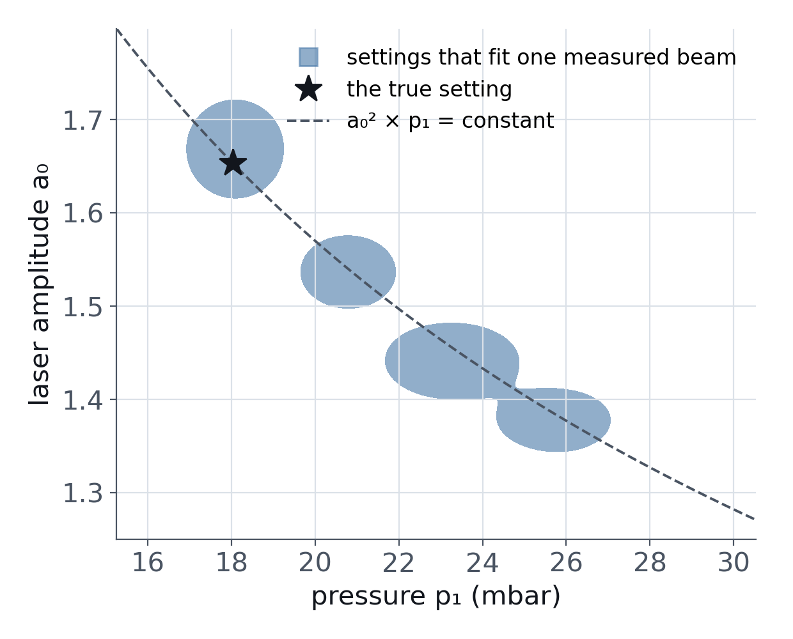
Backwards is not unique
Backwards: from the measured beam, recover the settings that made it. Done so far for Campaign A only.
But different settings make the same beam: every point on the curve gives the same output — stronger laser with lower pressure, or weaker laser with higher pressure (a_0² p_1 ≈ constant).
For about 63 % of beams our model finds two separate sets of settings that both fit.
The honest answer is a list of likely settings with probabilities — and the test is whether those probabilities are right.
Notes:
2:00. Inverse model: in review. Say so.

Slide 16
What would make a strong result
1
Beat the internal references, then explain them: pick a target, ask your model which knob moves it most, and check that the physics agrees.
2
One model, two scores: inside the training range and above it. The size of that gap is the result.
3
The density extrapolation matters twice. The pack was simulated with an envelope solver, least trustworthy at high density — a surrogate that extrapolates there also probes where the simulations themselves stop being reliable.
4
A data-budget curve: the score at 100, 300, 1,000 (proposed) and all simulations.
5
Inverse problem: a list of likely settings with probabilities, and evidence that those probabilities are right.
Ranking and hand-in: GRADING.md in the challenge repository. The jury decides.
Notes:
1:30. These are what would make the result useful to us — not the jury's criteria. Ranking and hand-in: GRADING.md in the challenge repository. The jury decides.

Slide 17
The data and the bars
4
Notes:
Part four: the data and the bars.

Slide 18
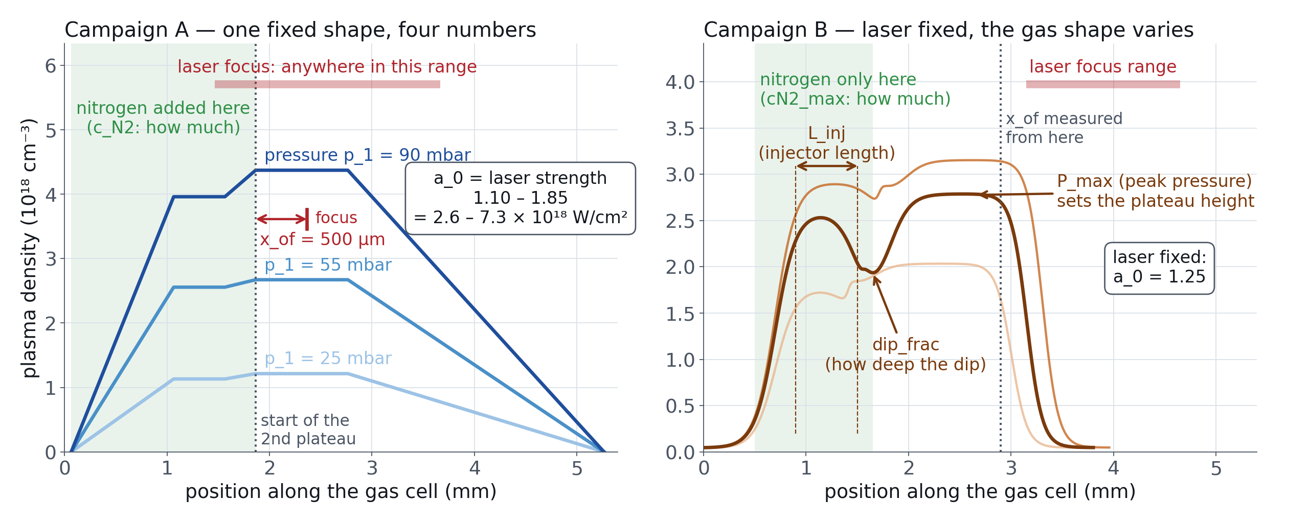
The operator's knobs
In: Campaign A — p_1 pressure · c_N2 nitrogen · a_0 laser strength · x_of focus. Campaign B — P_max · cN2_max · L_inj · dip_frac · x_of.
Notes:
1:30. Two campaigns, two knob sets — that is why they are two files. Energy spread dE_mad is a fraction, not a percent. Ranges: Campaign A p_1 10–100 mbar, c_N2 0.002–0.12, a_0 1.10–1.85; Campaign B a_0 fixed at 1.25, P_max 4–7 kPa, cN2_max 0.05–0.25, L_inj 0.4–0.8 mm, dip_frac 0.1–0.5.

Slide 19
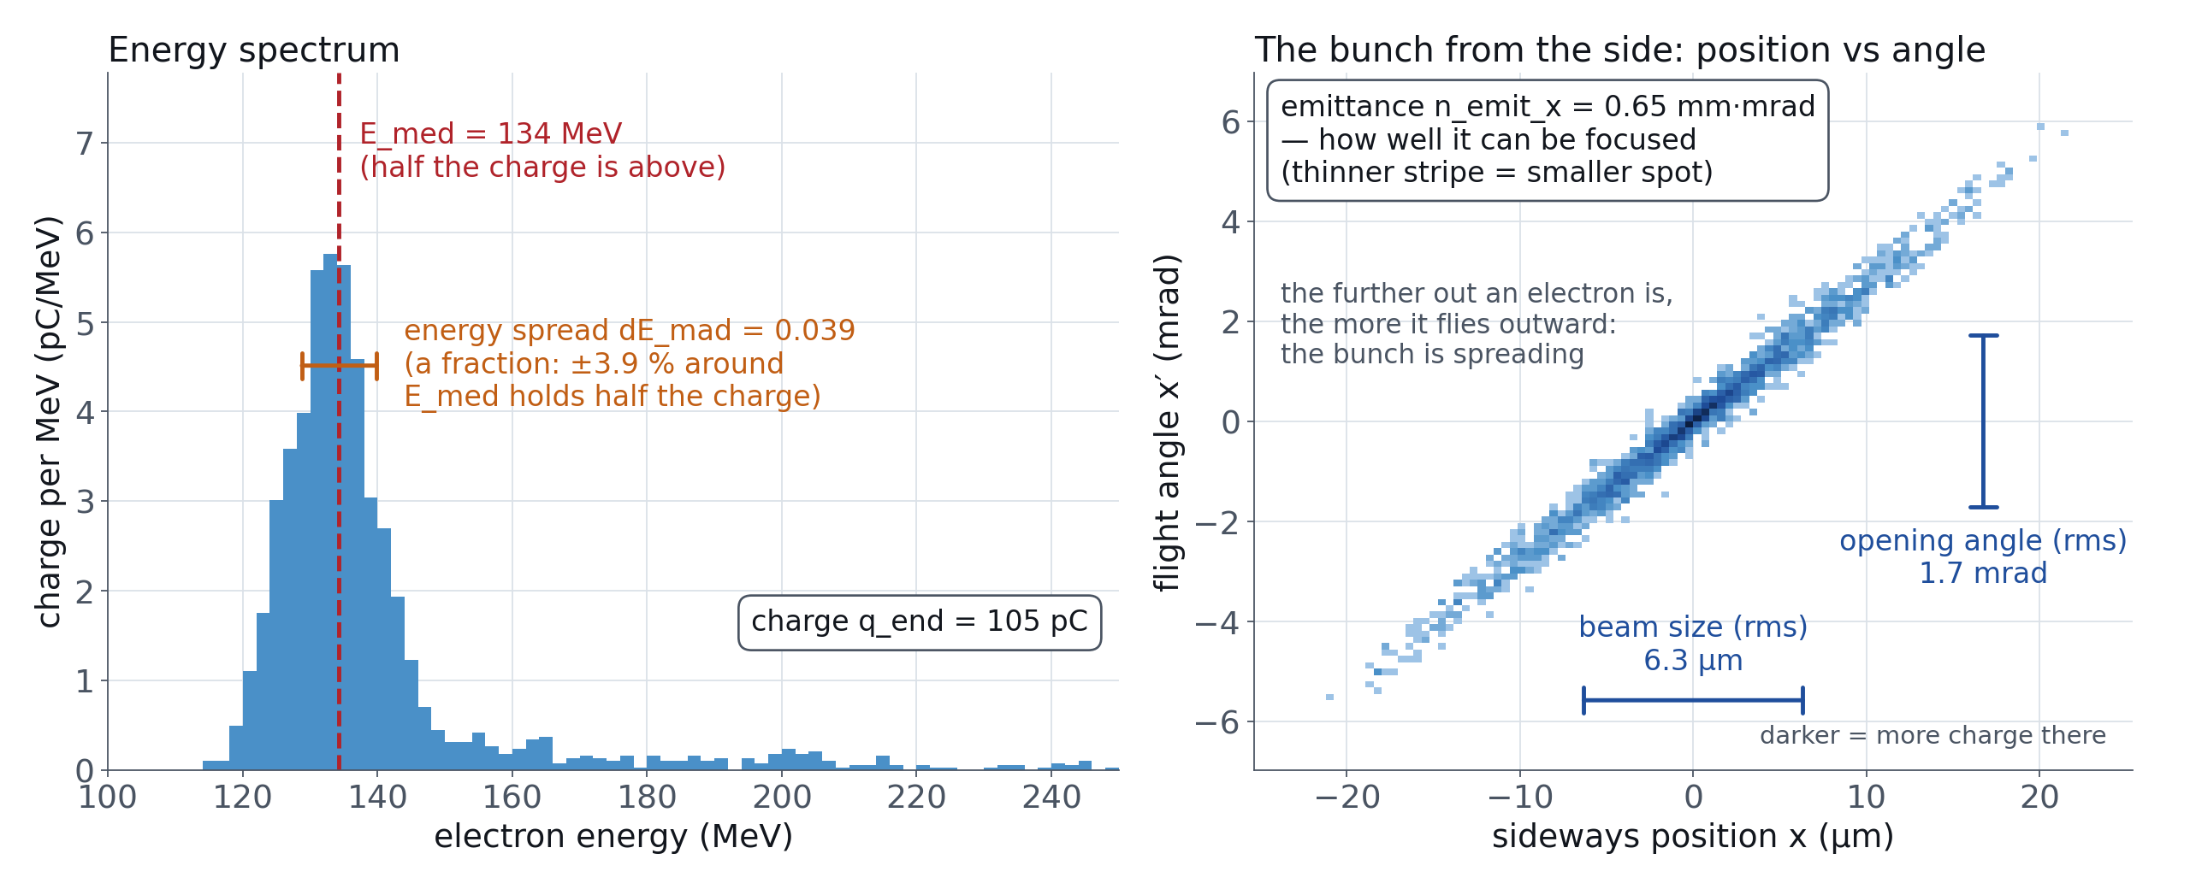
What comes out: one electron bunch
Out — one electron bunch: median energy E_med · energy spread dE_mad (fraction) · charge q_end · emittance n_emit · divergence div_rms · length sigma_z · peak current i_peak.
Notes:
1:00. One Campaign B simulation at the end of the accelerator. Left: the energy spectrum — median energy, spread (a fraction), charge. Right: each dot is where an electron is and where it is heading; a thin stripe means a small emittance, so the bunch can be focused to a small spot.

Slide 20
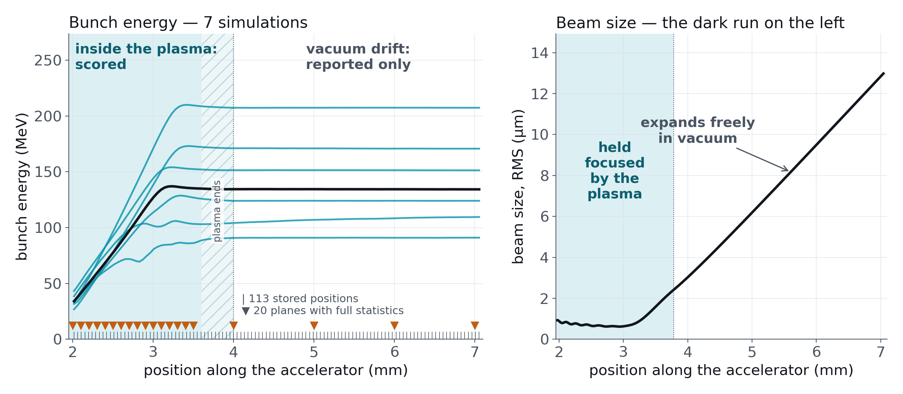
Following the bunch along the accelerator
Inside the plasma the bunch gains energy and is held focused. After the plasma ends it coasts in vacuum and spreads out.
Only the plasma part is scored.
Every Campaign B simulation stores the bunch at 113 positions, its full statistics at 20 planes, and up to 2,000 electrons per plane.
Notes:
1:30. The beam starts to grow a little before the shaded plasma end: the gas density is already falling there. Drift is reported, not ranked.

Slide 21
The data pack
Campaign A — 13,073 simulations (random + uniform scan), end-of-accelerator bunch
Campaign B — 5,286 public simulations, 2,882 with a bunch (≥ 3 pC):
curves at 113 positions
6×6 moments at 20 planes
particle clouds (5.3 GB first, 54 GB full)
Hidden test sets — answers not in the pack:
714 Campaign B and 2,446 Campaign A simulations
357 configurations for the forward, trajectory and inverse-B tasks
136 of them above the trained density range
Units: MeV, coulombs, pascals, µm — see DATA_CARD.md.
Notes:
1:30. One row = one simulation = one config id, everywhere except the moments table (sim_id string).

Slide 22
What has already been done
Campaign A, forwards — published
Kane et al., MLST 7, 030502 (2026): settings → beam at the end, a neural network. R² 0.99 energy · 0.96 energy spread · 0.99 charge · 0.95 emittance. Your warm-up, not scored.
Campaign A, backwards — in review
Our model, beam → settings: mean R² 0.910. Even a perfect model could reach only 0.991, because different settings give the same beam.
Campaign B — a quick reference, not a tuned result
We only reused the Campaign A approach on the new data. Nobody has worked on Campaign B properly yet.
Forwards, beam at the end: R² 0.974 energy · 0.804 spread · 0.942 charge.
Along the accelerator, inside the plasma: mean R² 0.896.
Backwards: only a linear model, mean R² 0.648 — it cannot recover the dip depth at all.
Energy spread and Campaign B backwards are where the room is.
Every number is in the pack: pack_reference.json → scores.
Notes:
1:30. Kane is the only published number; the inverse is in review — say so. Campaign B numbers are ours, internal, trained on our own split: stretch targets, not bars. The Campaign B reference reused the Campaign A approach on the new data; notebooks 2 and 3, shared by the organisers, contain it.

Slide 23
Getting started: the first hour
1
2
3
Get the repository and the data
Run the kickoff notebook
Physics track
Challenge repository github.com/aghribi/artifact-hackathon-2026, folder challenges/surrogate-models; the data pack should be on IDRIS already.
kickoff_notebook.ipynb fits a linear baseline, scores it with the organisers' score_submission from pallas_score.py on a held-out split, and writes submission_inverse.csv — so you see how the score is computed before you submit.
PHYSICS.md and physics_formulas.py: the density profile from the knobs for both campaigns, the laser parameters, and seven textbook formulas as functions.
Where things are: README.md · objectives.md · data/README.md · GRADING.md · pallas_score.py · kickoff_notebook.ipynb · PHYSICS.md
Hand-in and ranking: GRADING.md. The jury decides.
Notes:
1:30. The pitfalls (dE_mad is a fraction, trajectories ranked in-plasma only, the test leans to high density) are in the repository; do not read them out.

Slide 24
Thank you
Questions?
Mykyta Lenivenko — IJCLab · mykyta.lenivenko@ijclab.in2p3.fr
G. Kane et al., Mach. Learn.: Sci. Technol. 7, 030502 (2026)
P. Drobniak et al., Phys. Rev. Accel. Beams 26, 091302 (2023)
J. Derouillat et al., Comput. Phys. Commun. 222, 351 (2018) — Smilei
E. Esarey, C. B. Schroeder, W. P. Leemans, Rev. Mod. Phys. 81, 1229 (2009)
A. Döpp et al., High Power Laser Sci. Eng. 11, e55 (2023)
F. Brogren et al., Phys. Rev. Accel. Beams 28, 101302 (2025)
The PALLAS gas cell during a shot — the orange streak is the plasma
AISSAI Hackathon 2026 · Surrogate Models (PALLAS) · M. Lenivenko
Notes:
0:30, then 10 min questions.

