Slide 1

Predictive Models on Continuous and Discrete Weather Data
A study of New York state between the years of 2015 to 2020 focused on temperature and weather type.
ALEKSANDAR KAMENEV
SAISATHVIK KAMPATI
LAKSHMI BHAVANI CHEEKALA
RITHVIK SUBRAMANYA

Slide 2
Introduction
Weather analysis, in particular temperature and weather type, have been the focus of many fruitful studies. Global warming is a well discussed issue. A myriad of opinions have been expressed on the topic. While the majority of research provides strong evidence chronicling the effect and its theorized causes, consensus on the matter is not yet unanimous.
In our work we aim to build predictive models to estimate average temperature values. We showcase a linear and a random forest regression models. As well as a time series model and a random forest classifier to estimate weather type.
While the time frame of this study is rather narrow compared to the large body of research in the field, it is our belief that it’s sufficient to produce meaningful observations.

Slide 3
Problem Definition
To successfully predict average temperature values without any temperature metric present in the dataset.
To successfully predict future temperature behaviour based on past data.
To classify weather type with high accuracy.

Slide 4
Data Source
Dataset 1:
The data used for this study was sourced from the National Centers for Environmental Information.
A full data dictionary provided by the source can be found here. A short version relevant to our work is present in the project’s notebook.
Dataset 2:
The data used for this study was sourced from the National Centers for Environmental Information.

Slide 5
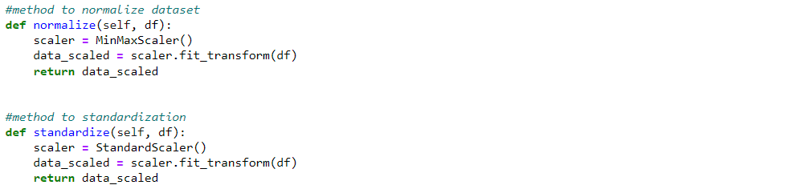
Standardization & Normalization

Slide 6
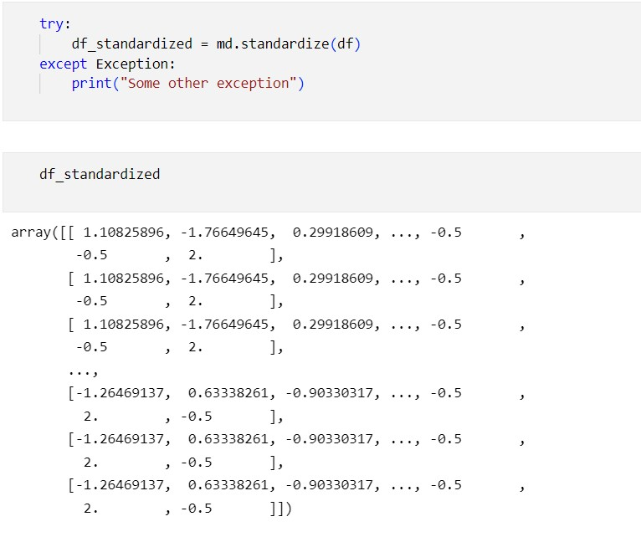
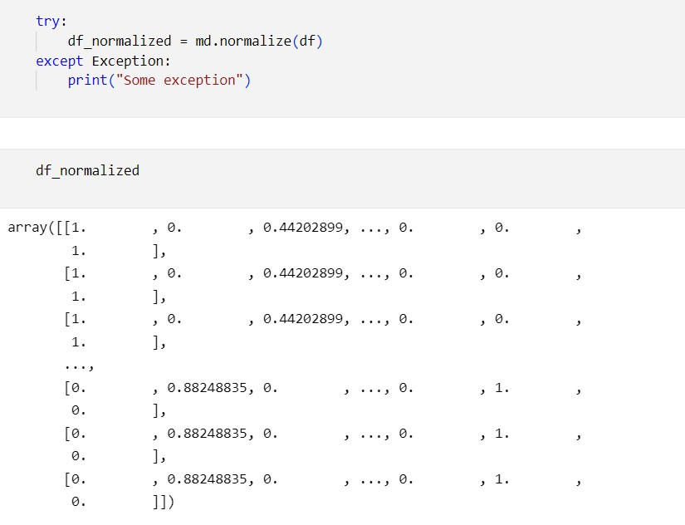
Standardization & Normalization

Slide 7
LINEAR REGRESSION
We have performed Linear regression to predict Temperature.
We have used a pipeline to streamline our workflow.
We have predicted it using different combination of features.
We got different type of results every time.

Slide 8
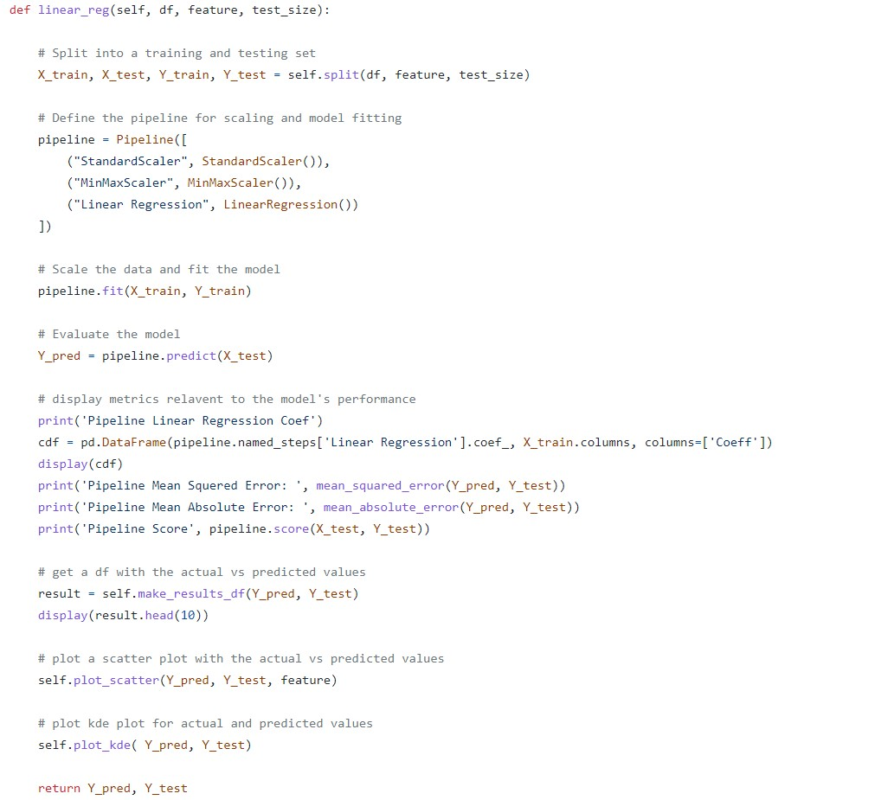
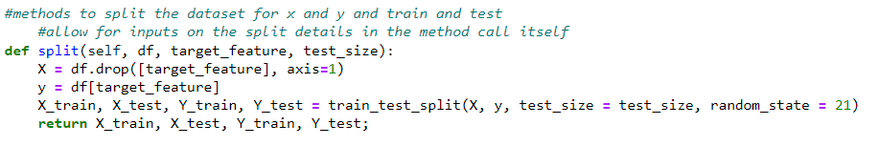

Slide 9
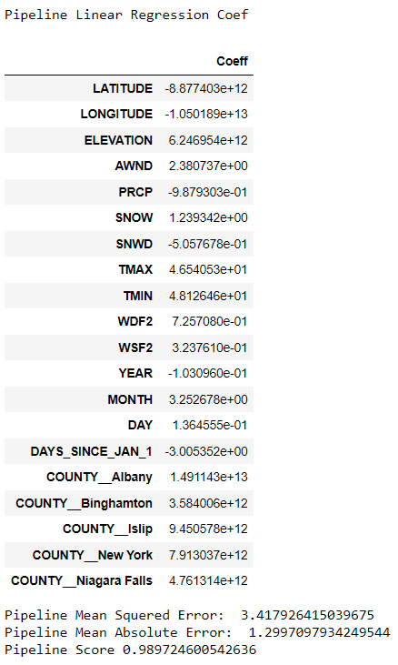
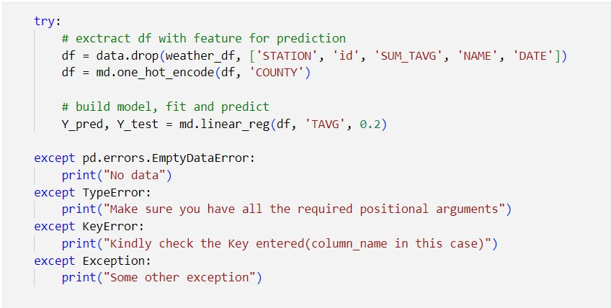
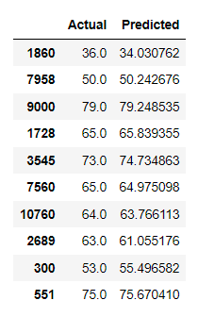
Avg Temperature – with TMIN and TMAX

Slide 10
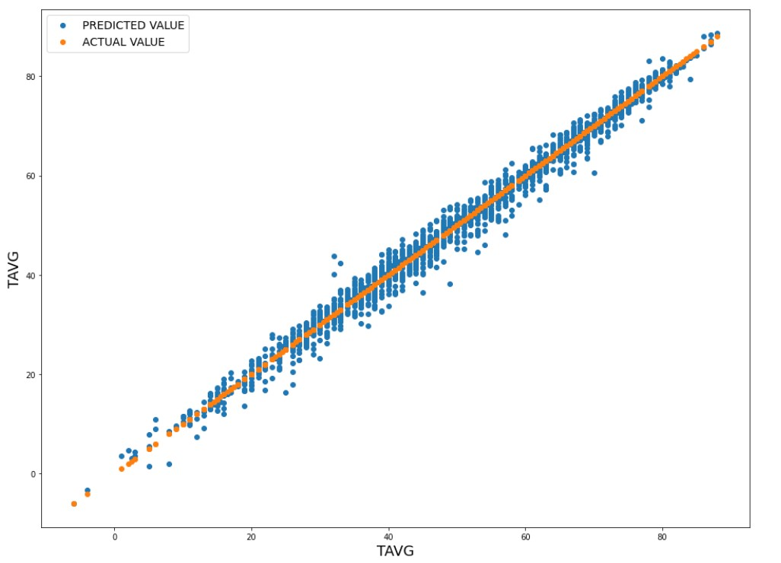
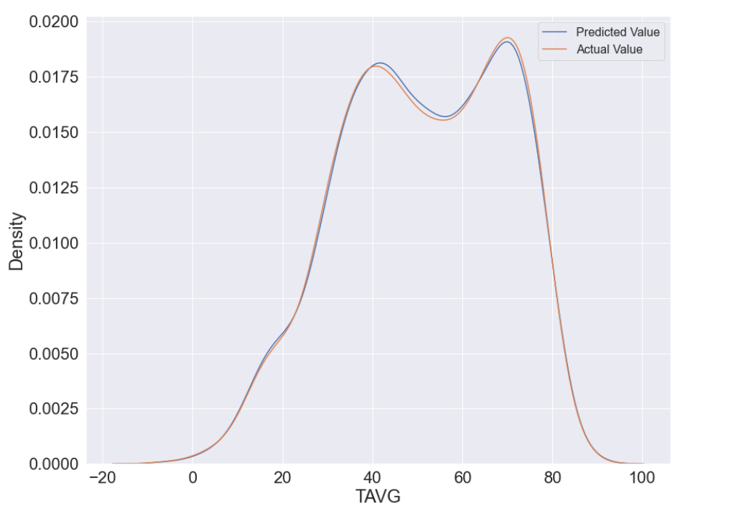
Avg Temperature – with TMIN and TMAX

Slide 11
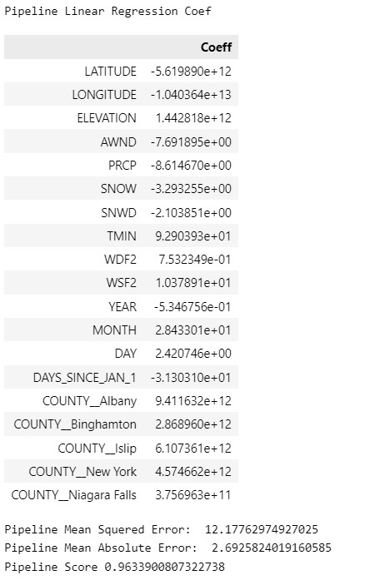
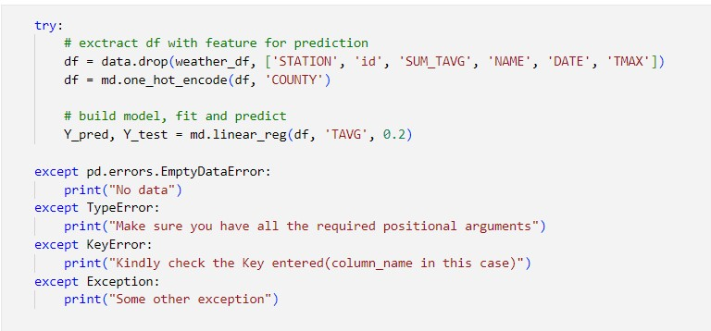
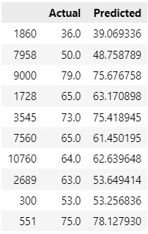
Avg Temperature – With TMIN

Slide 12
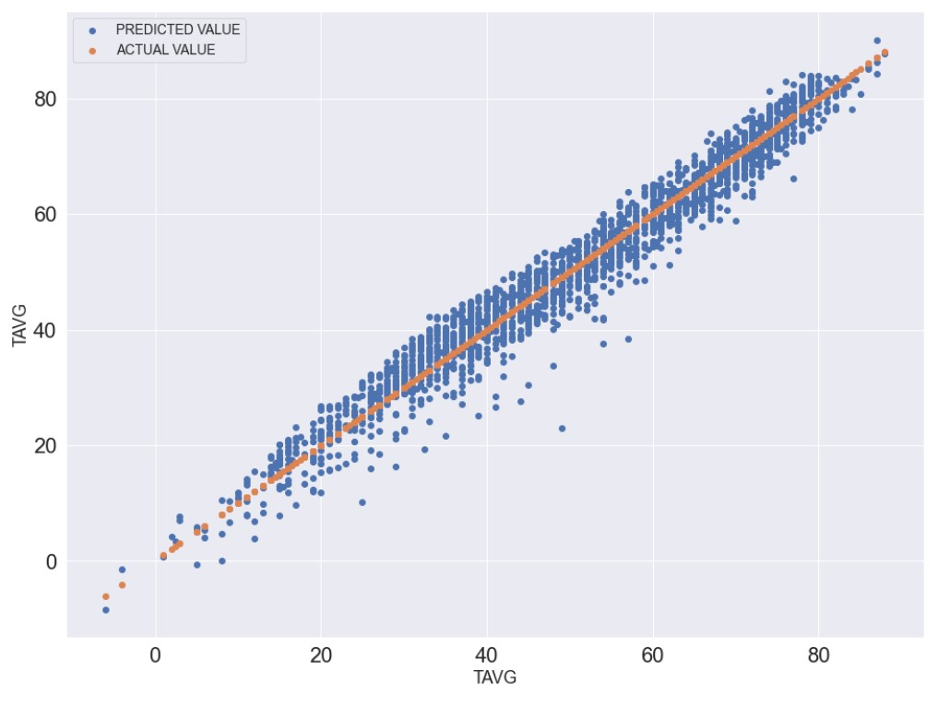
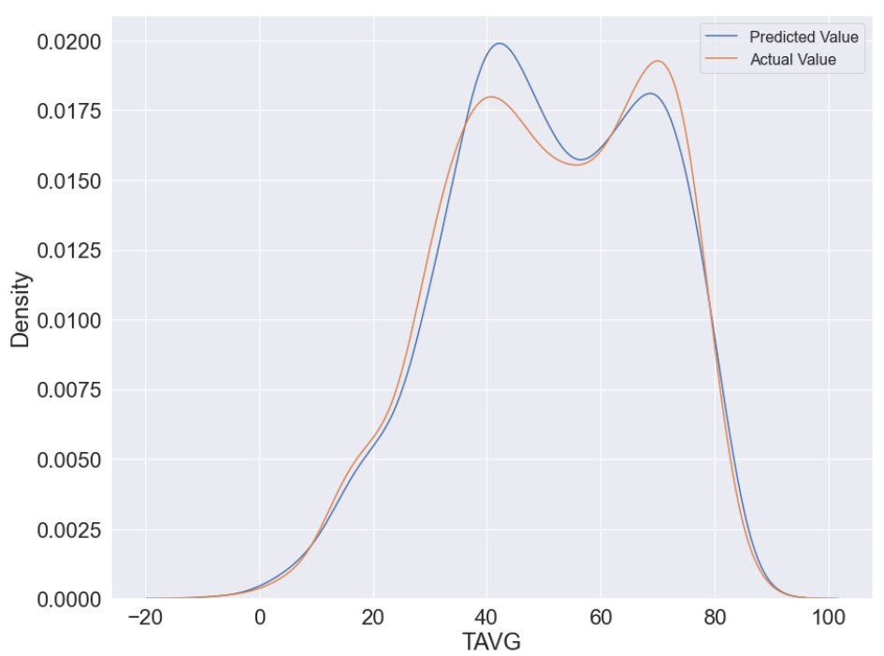
Avg Temperature – With TMIN

Slide 13
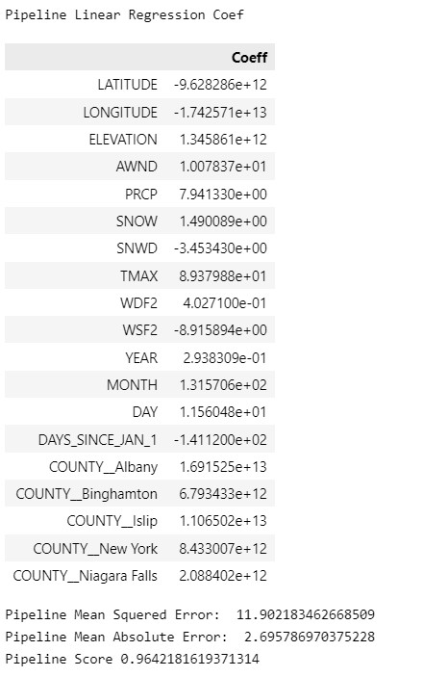
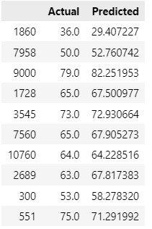
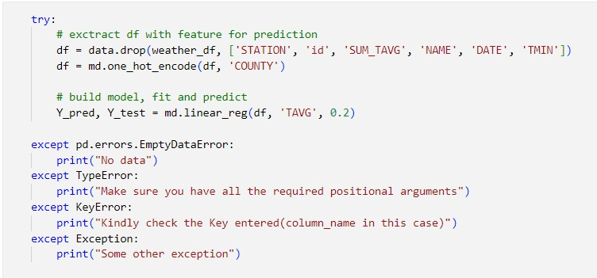
With TMAX

Slide 14
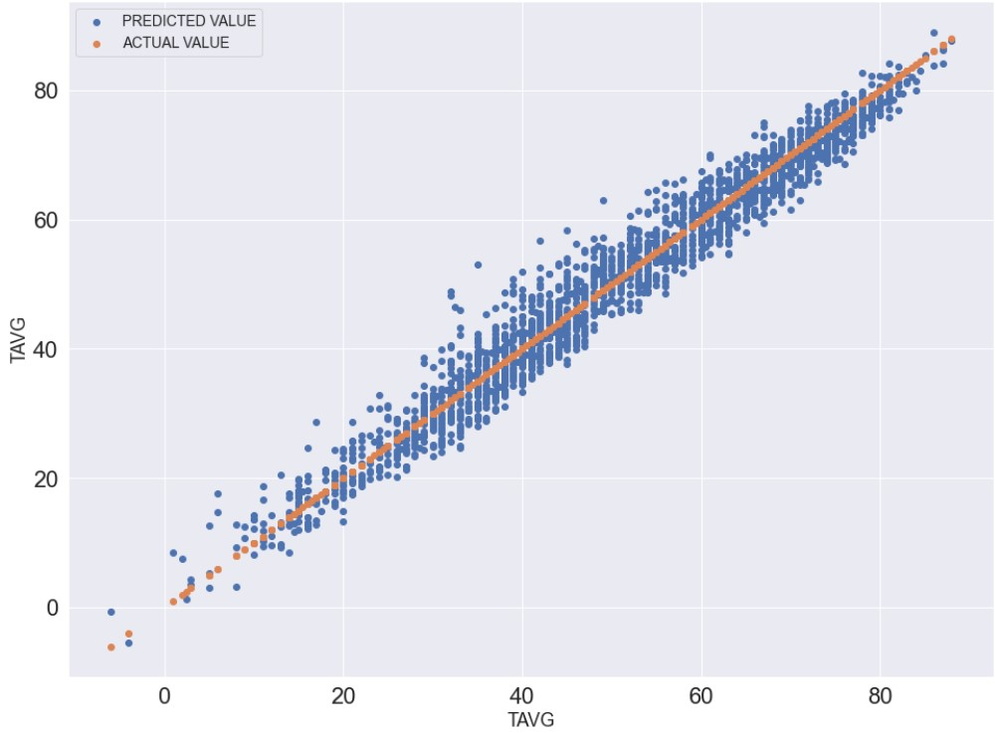
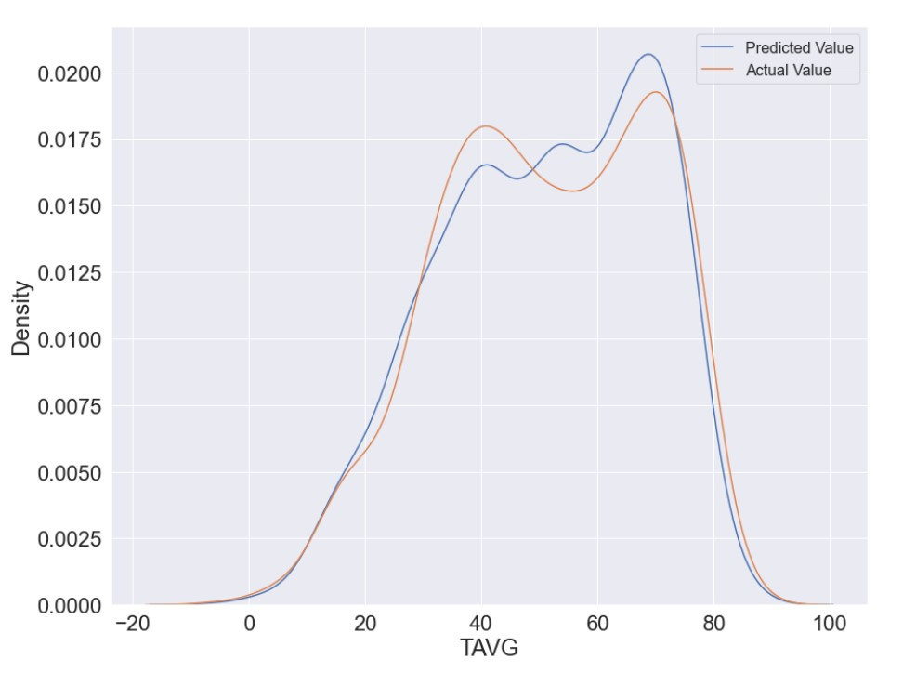
With TMAX

Slide 15
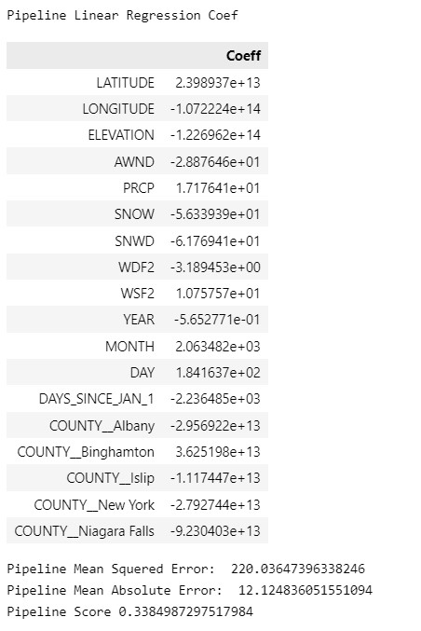
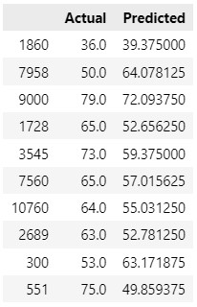
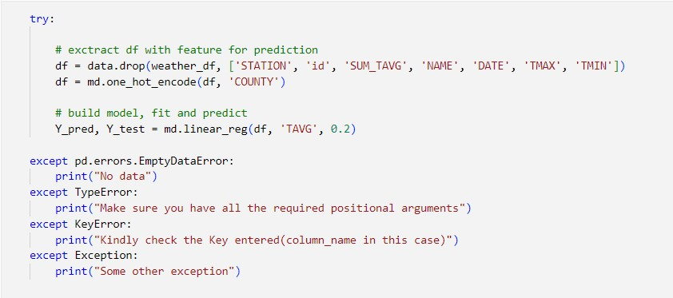
Without TMIN and TMAX

Slide 16
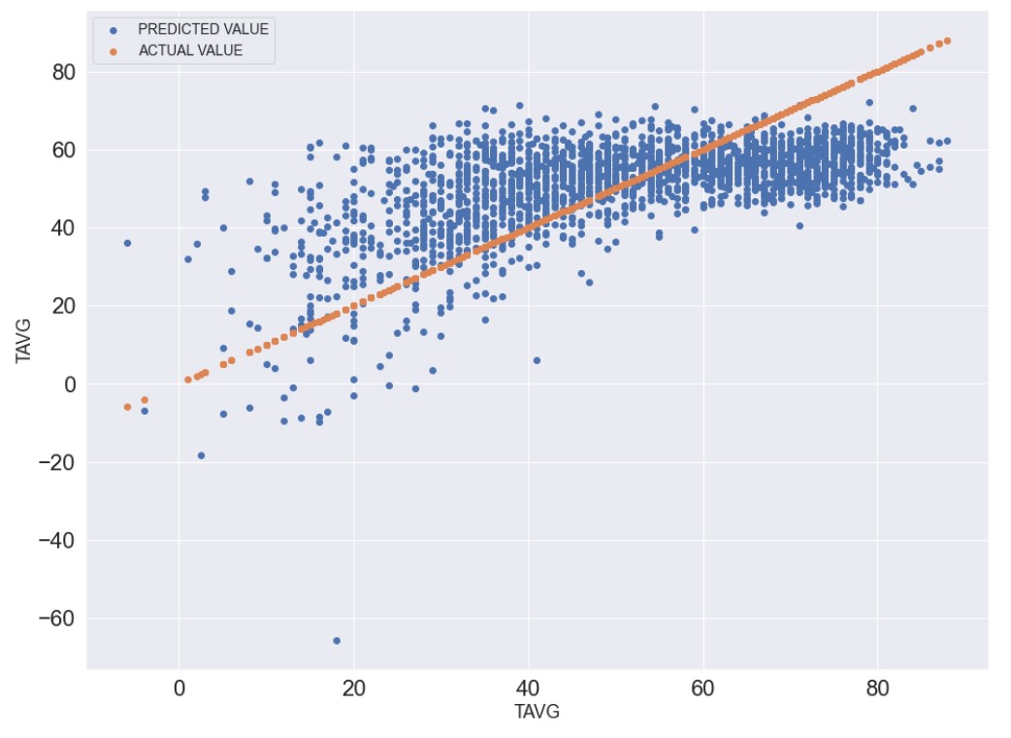
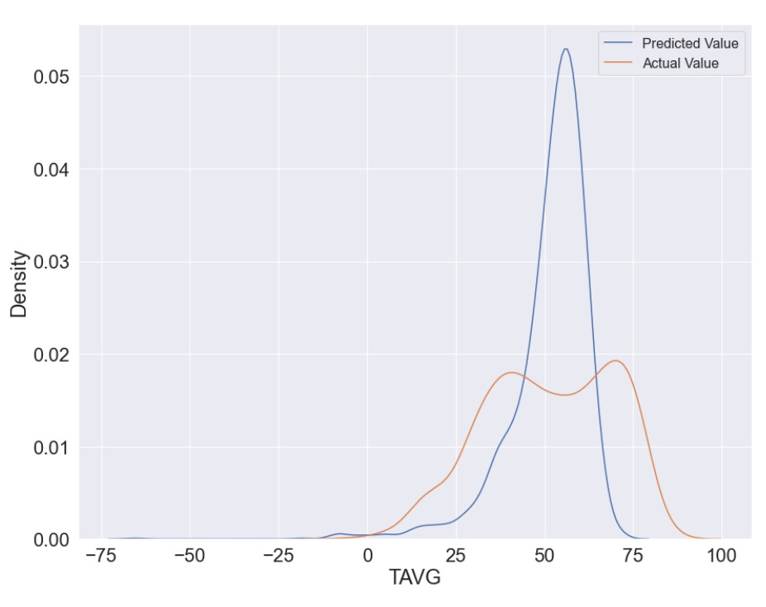
Without TMIN and TMAX

Slide 17
RANDOM FOREST
We have performed Random Forest Regression to predict Temperature.
We have predicted it using different combination of features.
We got different type of results every time.
In addition to what we have done in Linear regression we have used Hyperparameter tuning here to get better results.
As expected Random Forest performed better than Linear Regression when combined with HyperParameter tuning.

Slide 18
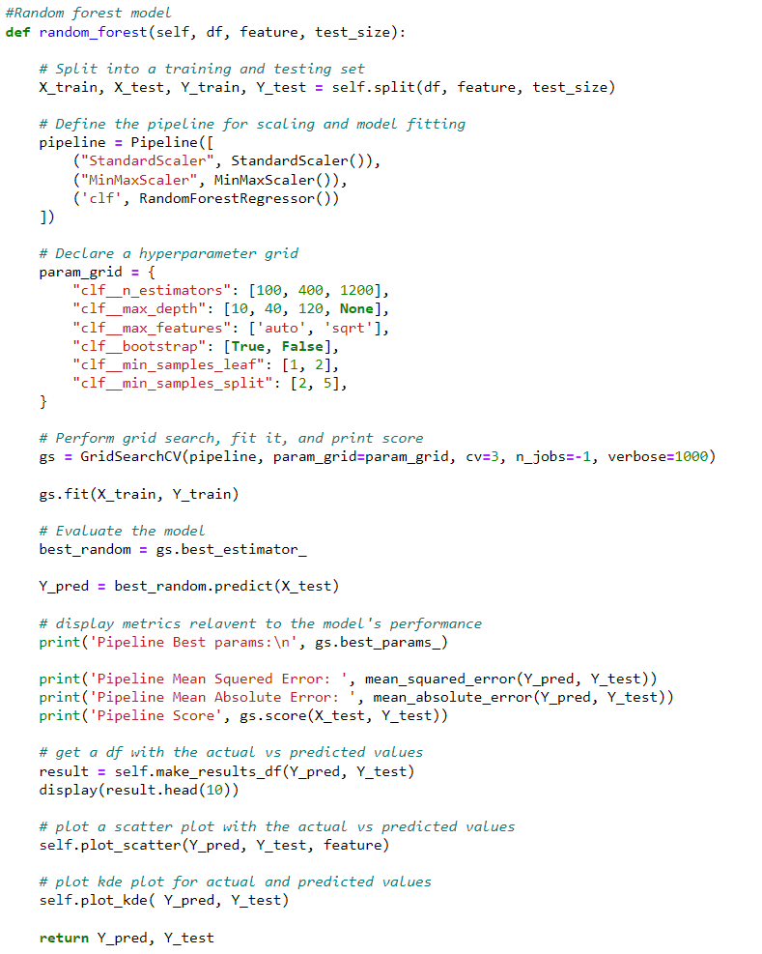
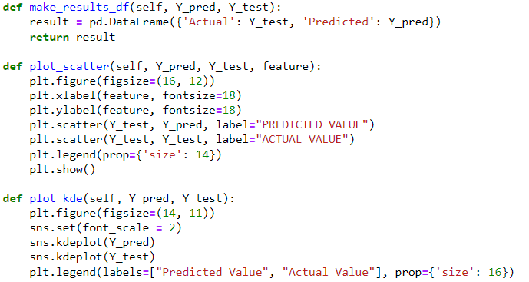

Slide 19
Hyperparameter Tuning
n_estimators = number of trees in the forest
max_features = max number of features considered for splitting a node
max_depth = max number of levels in each decision tree
min_samples_split = min number of data points placed in a node before the node is split
min_samples_leaf = min number of data points allowed in a leaf node
bootstrap = method for sampling data points (with or without replacement)

Slide 20
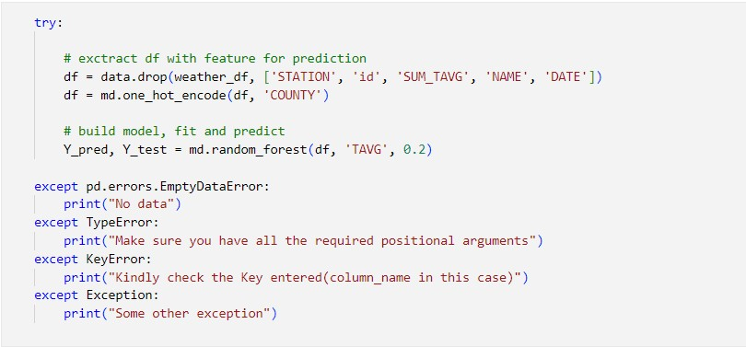
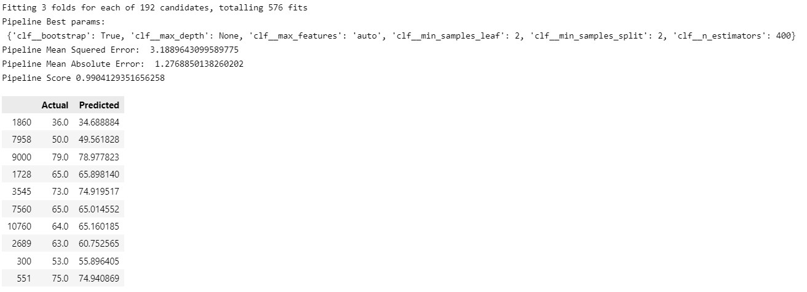
With TMIN AND TMAX

Slide 21
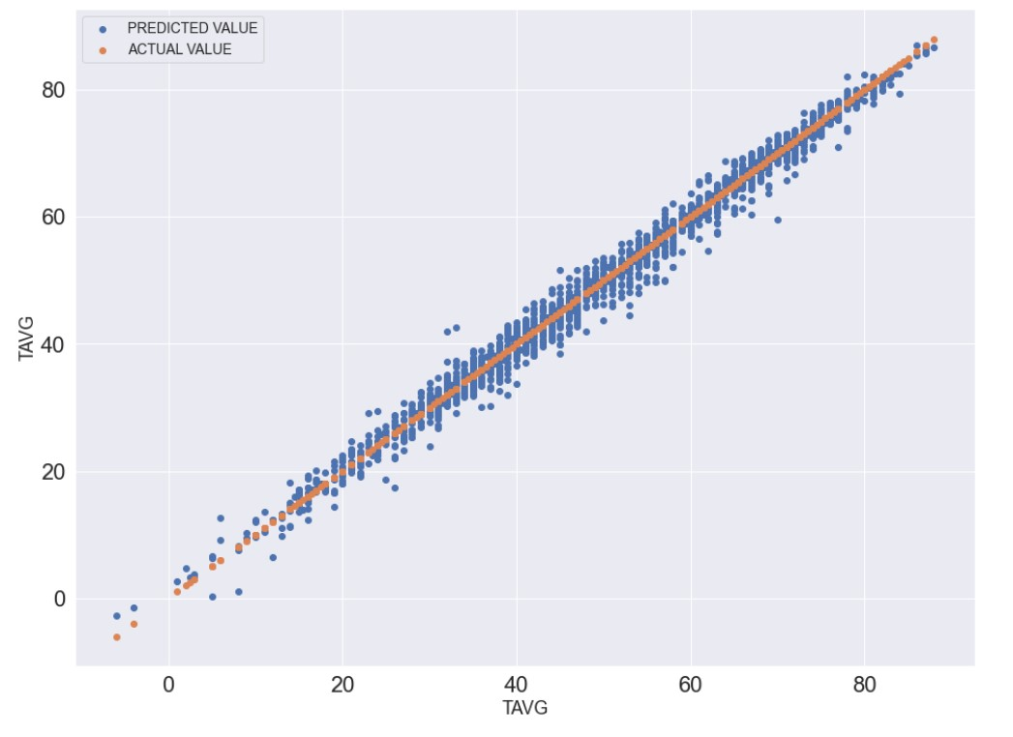
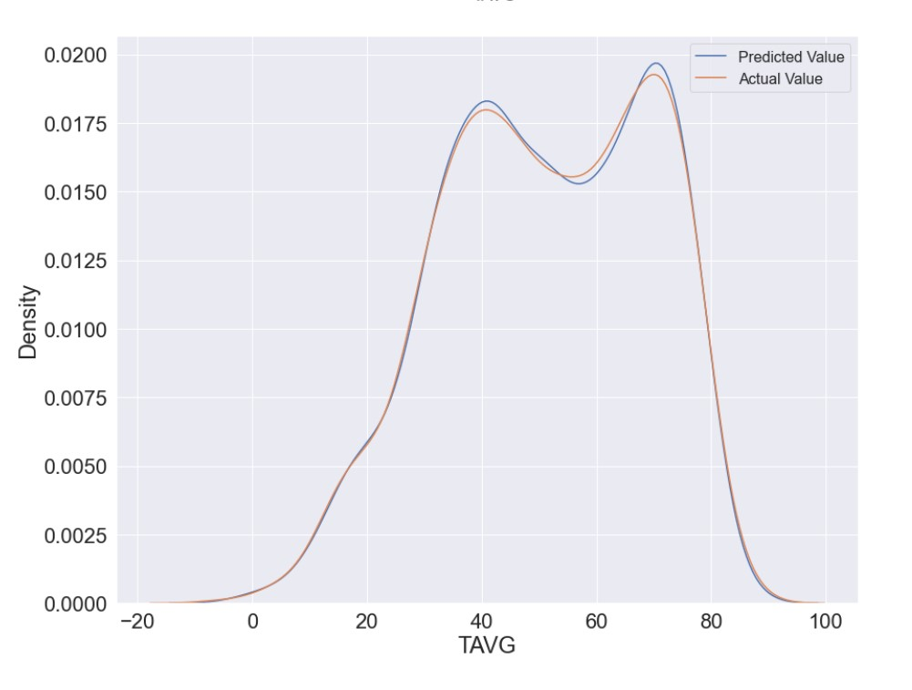
With TMIN AND TMAX

Slide 22
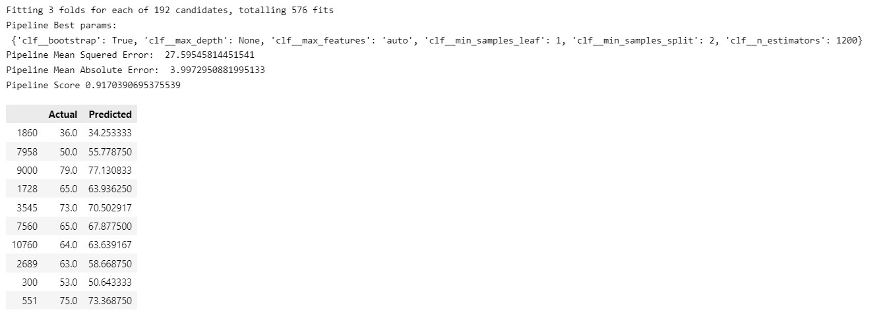
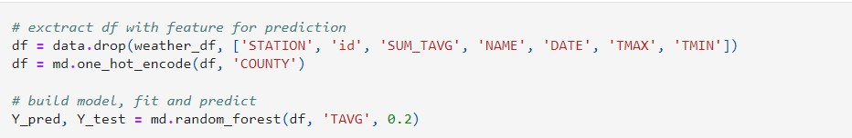
Without TMIN AND TMAX

Slide 23
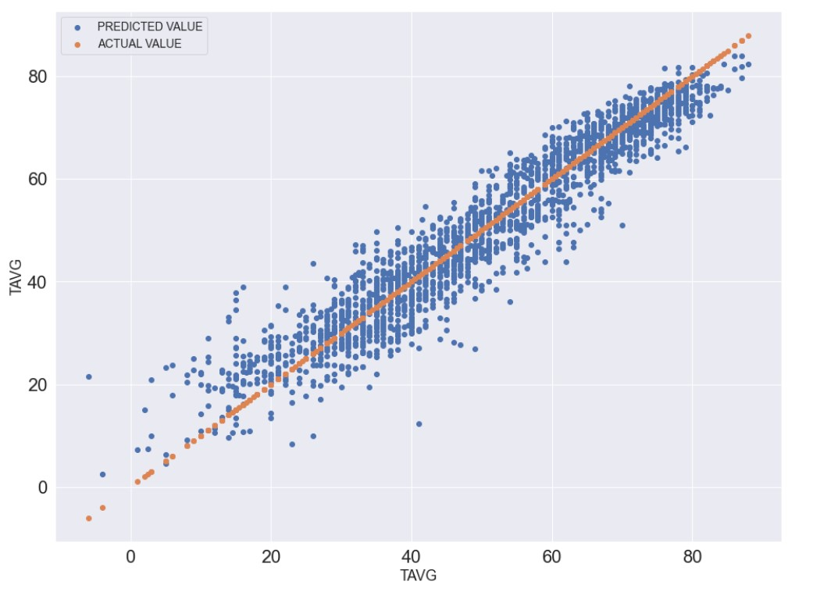
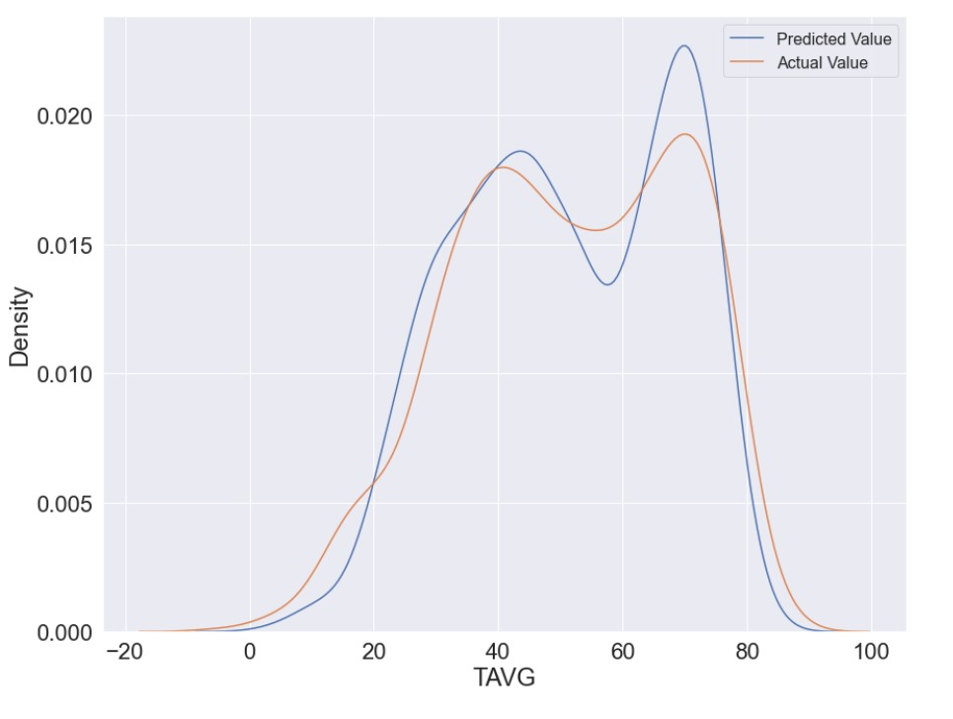
Without TMIN AND TMAX

Slide 24
TIME SERIES ANALYSIS
We have performed Time Series Analysis to predict the future values.
We have taken 2015 to 2019 data as our train data and 2020 as test data and tried to predict 2020 values.
We did it without Performing HyperParameter tuning and with HyperParameter tuning.
The results were better when we use HyperParameter tuning.

Slide 25
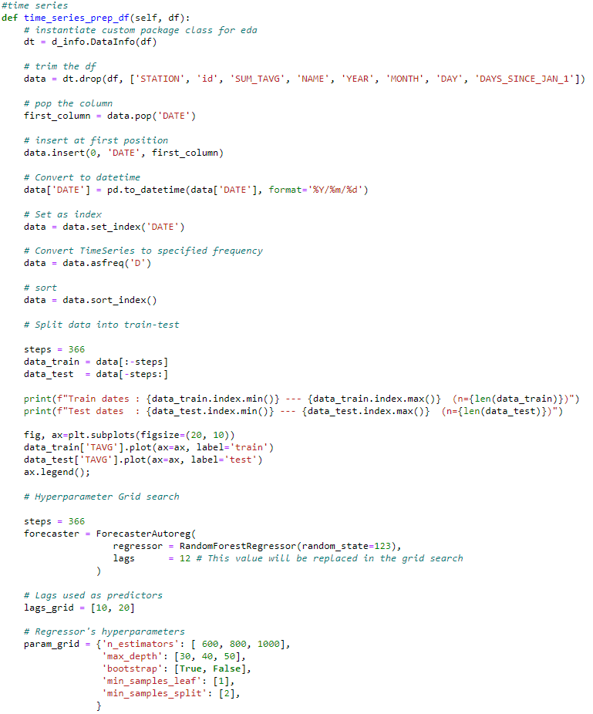
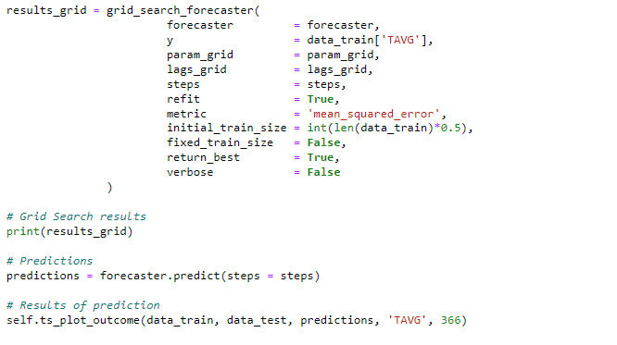
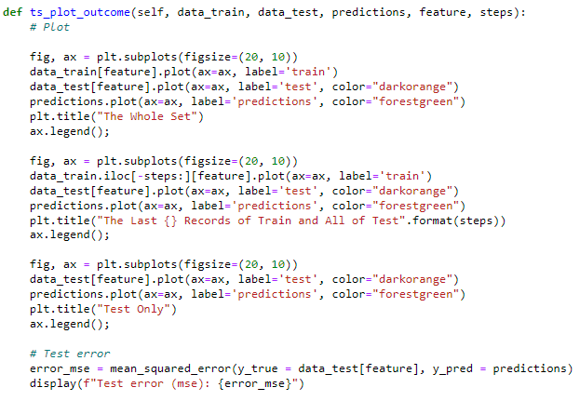

Slide 26
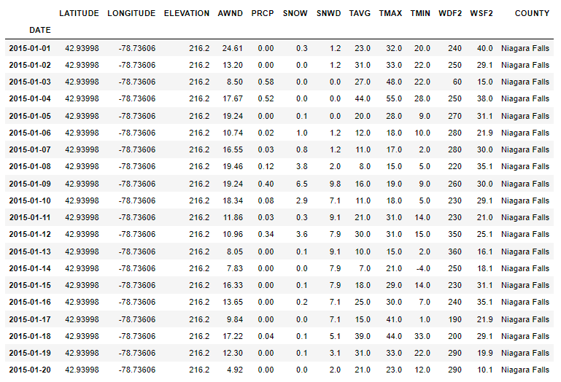
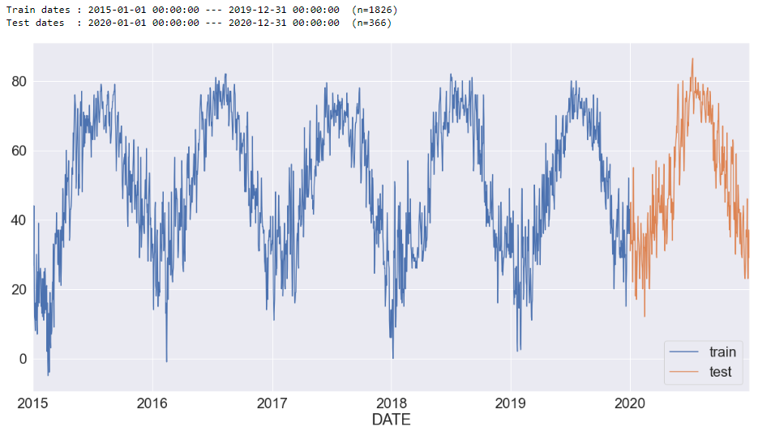
The Dataset

Slide 27
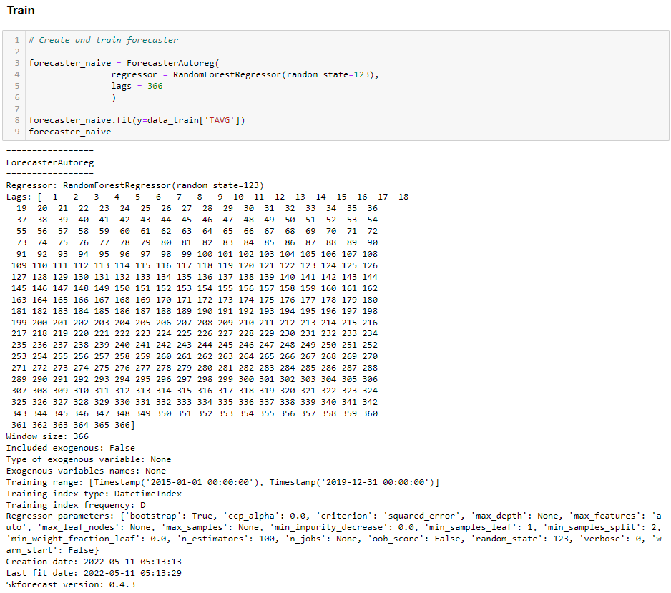
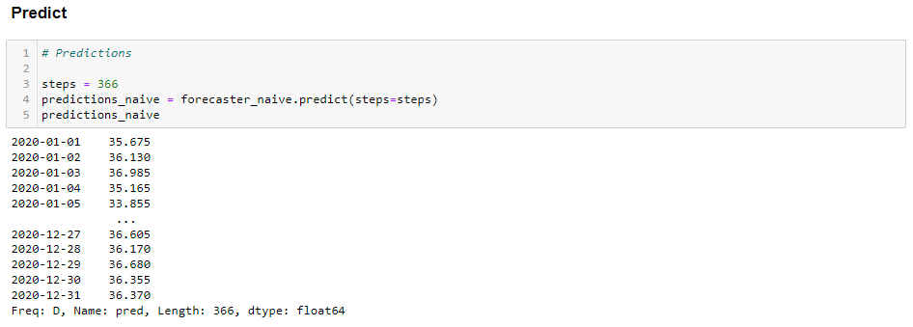
Base Model

Slide 28
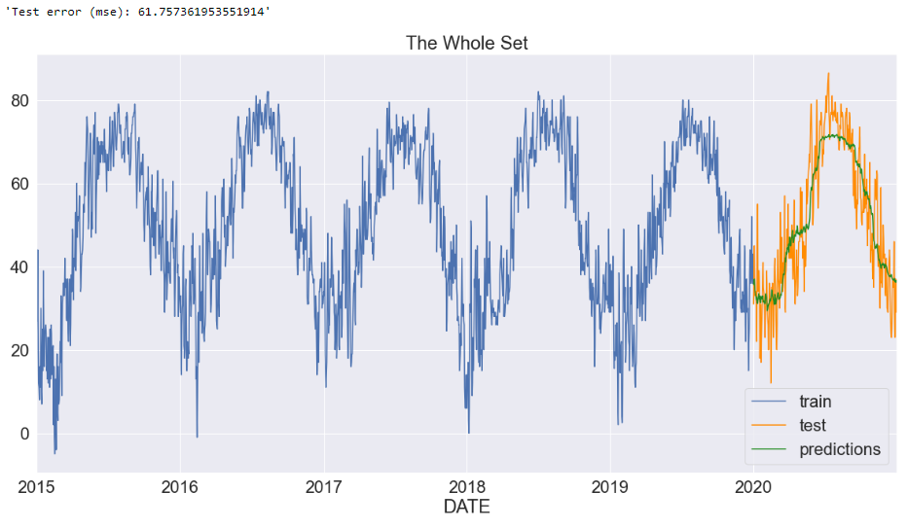
Base Model Result

Slide 29
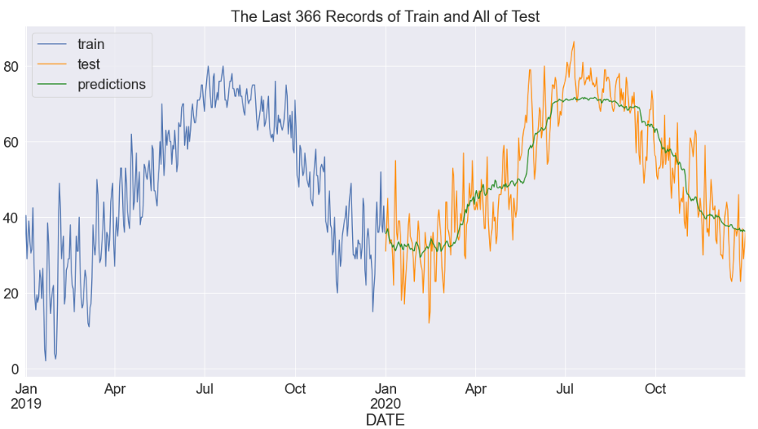
Base Model Result

Slide 30
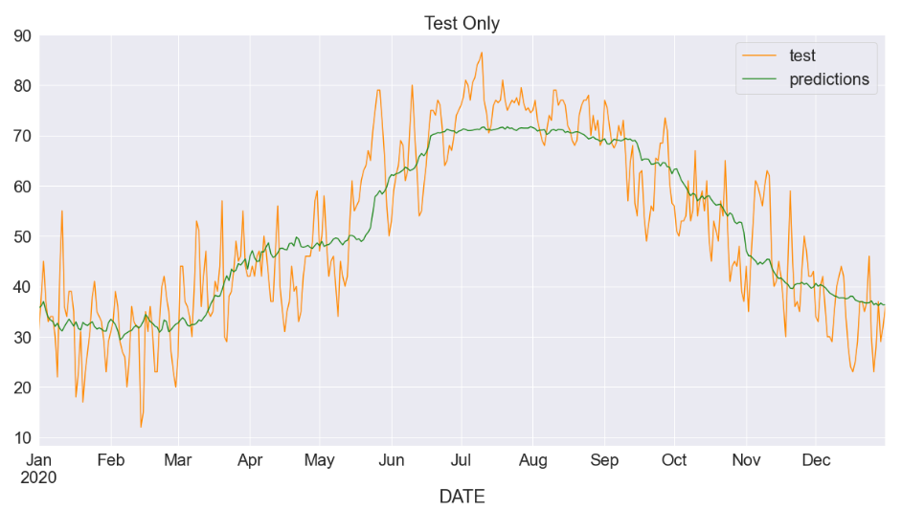
Base Model Result

Slide 31
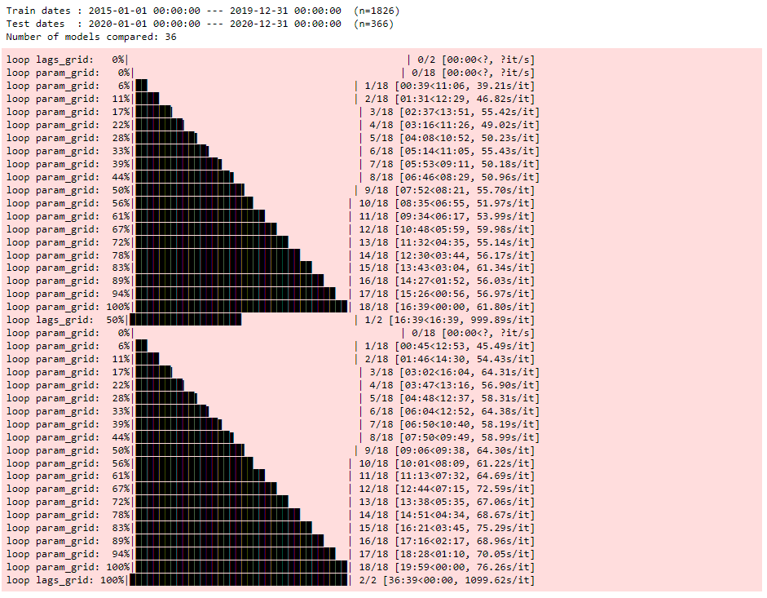
Final Model with hyperparameter tuning

Slide 32
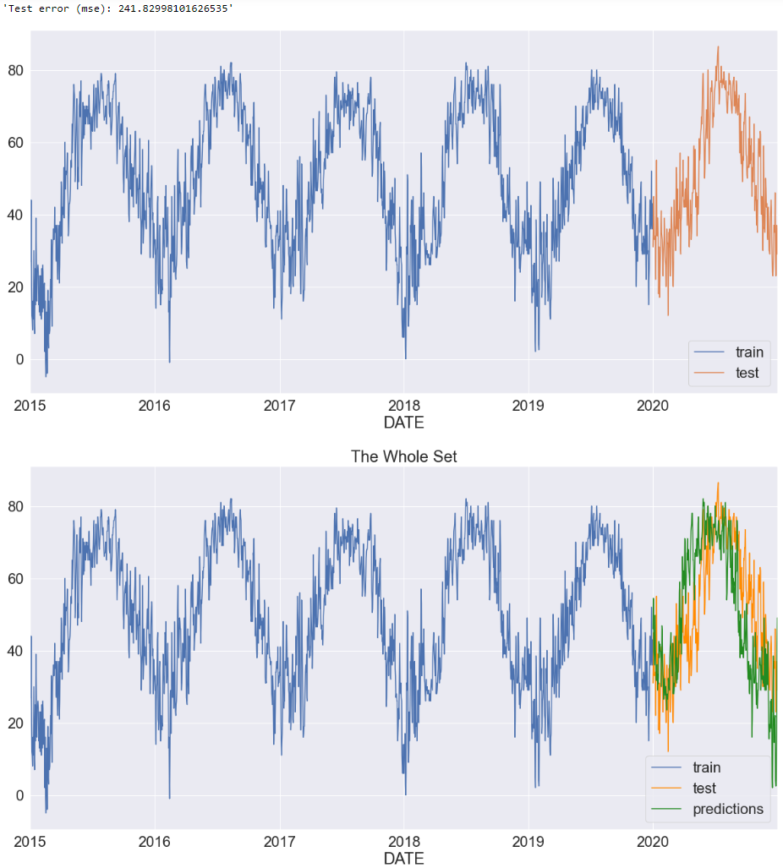
Final Model Result

Slide 33
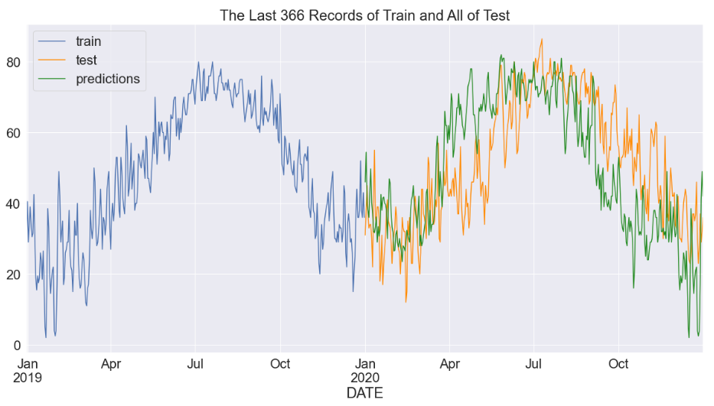
Final Model Result

Slide 34
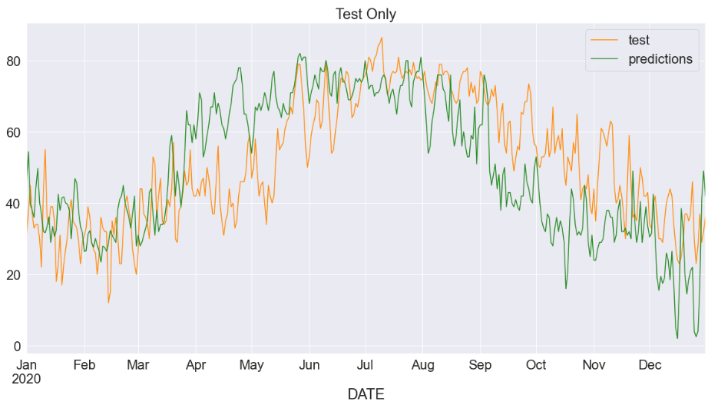
Base Model Result

Slide 35
Classifier
We have used classifiers to perform classification of weather type based on atmospheric data recorded during 2020 at the JFK airport.
The data includes the altimeter reading, dew point temperature, precipitation, pressure change, relative humidity, sea level pressure, visibility, wind direction, and more.
The classifiers used were K-nearest neighbor, Logistic regression, RandomForestClassifier, and Gaussian Naive Bayes.
The best classifier was the RandomForestClassifier.

Slide 36
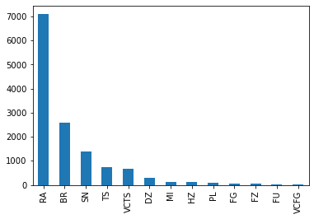
Weather Type Breakdown
PL = Ice Pellets
RA = Rain
BR = Mist
DZ = Drizzle
SN = Snow
HZ = Haze
FZ = Freezing
MI = Mild
FG = Fog
TS = Thunderstorm
VCTS = Thunderstorm in Vicinity
FU = Smoke
VCFG = Fog in Vicinity
Notes:
Rain is the most common with 7087 instances.
Fog in vicinity is the least common with 4 instances.

Slide 37

Heatmap
Thunderstorms have a significant correlation with Dew Point temperature and Wet Bulb temperature.
Mist has a significant positive correlation with Altimeter setting and Sea Level pressure.
Snow has a significant negative correlation with Dew Point temperature and Wet Bulb temperature.

Slide 38


K-nearest neighbors (k=3)
Notes:
K-nearest neighbors works by plotting each row as a data point in an n-dimensional graph, where n is the number of parameters for each data point. With k=3, the weather types of the 3 nearest data points are considered for each test point to classify it. The score for this model was 0.704.

Slide 39


K-nearest neighbors (k=5)
Notes:
This is the same classification method as in the previous slide, but using 5 nearest neighbors instead of 3. The score for this model is 0.658.

Slide 40


K-nearest neighbors (k=7)
Notes:
This is the same classification method as in the previous slide, but using 7 nearest neighbors instead of 5. The score for this model is 0.650. The recall for k=5 and k=7 were lower than that for k=3. This might be because there are small clusters of weather, but not all weather is clustered together, leading to higher k values including other, incorrect weather types.

Slide 41


Naive Bayes
Notes:
The score for this model is 0.445, which ends up being worse than the k-nearest neighbors.

Slide 42


Logistic Regression
Notes:
The score for this model is 0.497, which is better than the Naive Bayes model, but still worse than the k-nearest neighbors.

Slide 43


Random Forest
Notes:
The score for this model is 0.943. This model performed the best out of all the attempted models. Not only is the precision high, the recall is high, meaning that there are not a lot of false positives. In the future, hyperparameter tuning can be used to improve the recall of this model.

Slide 44
Ending Remarks
As expected providing TMAX and TMIN yields exceptionally high scores for the the different models but what is more interesting is the still very high score of random forest regression on TAVG prediction without TMAX or TMIN in the independent variables.
Using HyperParameter tuning helps increase the accuracy of the predictions.
The Results from Time Series Analysis suggest that the temperature is increasing consequently and provides evidence for global warming.
For classification, random forest performed the best with our dataset.

Slide 45
Future Work
Future studies may include use of time series models on diverse weather datasets from around the globe to showcase expected values and actual values to provide meaningful evidence of or against global warming.
Future work may include deployment of models for public use.
Future work on the classification may include dataset augmentation to increase the number of observations of certain weather types, and using hyperparameter tuning to increase recall of the models.

Slide 46
References
R. Mantri, K. R. Raghavendra, H. Puri, J. Chaudhary and K. Bingi, "Weather Prediction and Classification Using Neural Networks and k-Nearest Neighbors," 2021 8th International Conference on Smart Computing and Communications (ICSCC), 2021, pp. 263-268, doi: 10.1109/ICSCC51209.2021.9528115.
G. V. Sajan and P. Kumar, "Forecasting and Analysis of Train Delays and Impact of Weather Data using Machine Learning," 2021 12th International Conference on Computing Communication and Networking Technologies (ICCCNT), 2021, pp. 1-8, doi: 10.1109/ICCCNT51525.2021.9580176.
S. Raksha, J. S. Graceline, J. Anbarasi, M. Prasanna and S. Kamaleshkumar, "Weather Forecasting Framework for Time Series Data using Intelligent Learning Models," 2021 5th International Conference on Electrical, Electronics, Communication, Computer Technologies and Optimization Techniques (ICEECCOT), 2021, pp. 783-787, doi: 10.1109/ICEECCOT52851.2021.9707971.
Prathyusha, Zakiya, Savya, Tejaswi, N. Alex and S. C C, "A Method for Weather Forecasting Using Machine Learning," 2021 5th Conference on Information and Communication Technology (CICT), 2021, pp. 1-6, doi: 10.1109/CICT53865.2020.9672403.

Slide 47
THANK YOU
ANY QUESTIONS?

