Slide 1
JavaScript
Lecture. Event Handling.

Slide 2
Lesson Plan
JSON
HTTP
AJAX
CORS

Slide 3
JSON
JavaScript Object Notation
What is it?

Slide 4
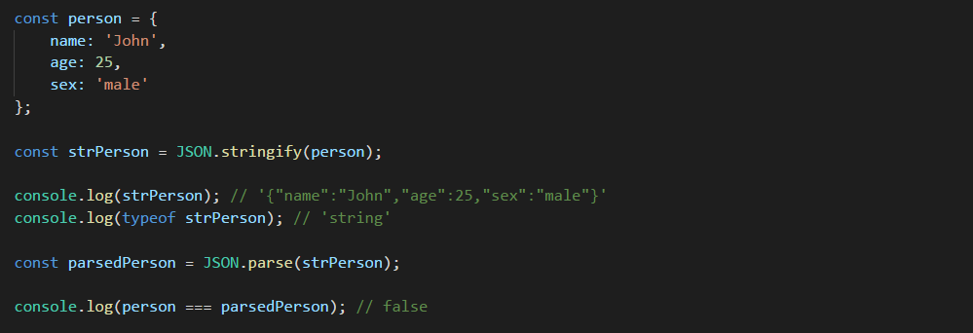
JSON

Slide 5
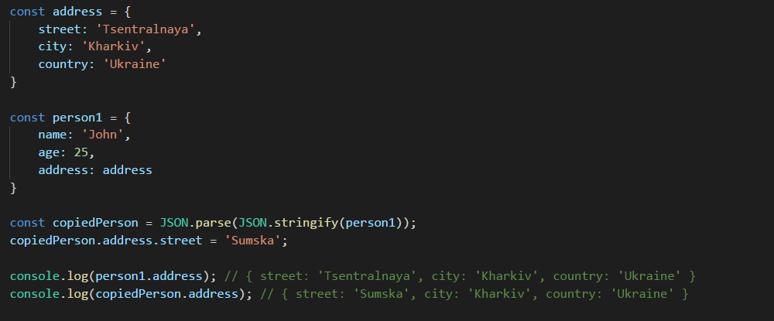
JSON
Deep copy with JSON

Slide 6
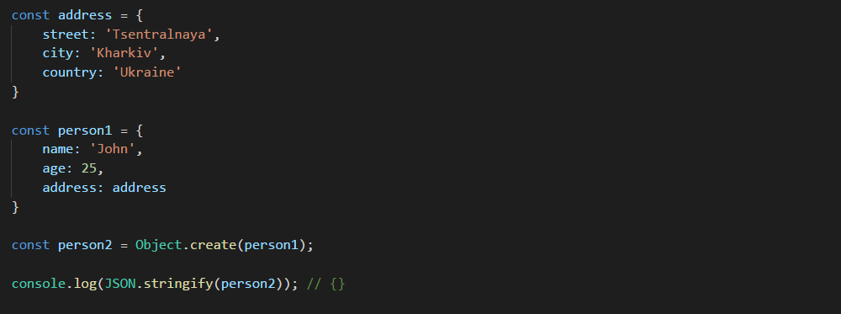
JSON
JSON.stringify doesn’t copy prototypes

Slide 7

HTTP
Hypertext Transfer Protocol

Slide 8
HTTP
Widespread methods
GET | Requests a representation of the specified resource. Requests using GET should only retrieve data and should have no other effect.
POST | Requests that the server accept the entity enclosed in the request.
PUT | Requests that the enclosed entity be stored under the supplied URI. If the URI refers to an already existing resource, it is modified; if the URI does not point to an existing resource, then the server can create the resource with that URI
PATCH | Applies partial modifications to a resource
DELETE | Deletes the specified resource.
OPTIONS | Returns the HTTP methods that the server supports for the specified URL.

Slide 9
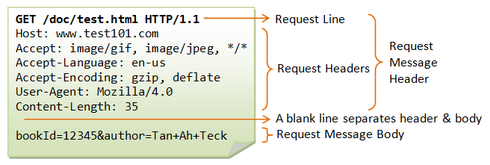
HTTP
Request structure

Slide 10
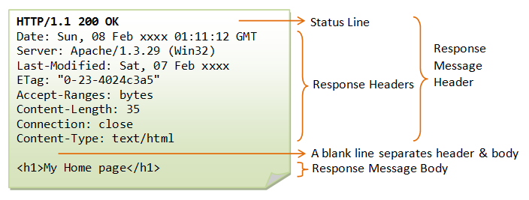
HTTP
Response structure

Slide 11

HTTP
Safe methods
HEAD, GET, OPTIONS and TRACE are safe

Slide 12
AJAX
Asynchronous JavaScript and XML
What is it?

Slide 13
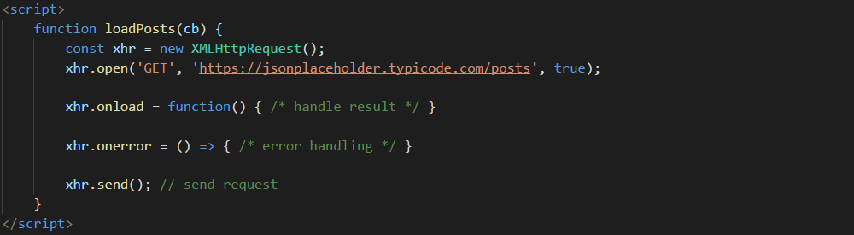
XMLHttpRequest
Simple xhr request example

Slide 14
XMLHttpRequest
Hooks
abort | The abort event is fired when the loading of a resource has been aborted.
error | The error event is fired when an error occurred.
timeout | The timeout event is fired when Progression is terminated due to preset time expiring.
readystatechange | The readystatechange event is fired when the readyState attribute of a document has changed.

Slide 15
XMLHttpRequest
Hooks
load | The load event is fired when a resource and its dependent resources have finished loading.
loadstart | The loadstart event is fired when progress has begun on the loading of a resource.
loadend | The loadend event is fired when progress has stopped on the loading of a resource
progress | The progress event is fired to indicate that an operation is in progress.

Slide 16
XMLHttpRequest
Methods
open() | Initializes a request. This method is to be used from JavaScript code.
send() | Sends the request. If the request is asynchronous (which is the default), this method returns as soon as the request is sent.
abort() | Aborts the request if it has already been sent.
setRequestHeader() | Sets the value of an HTTP request header.
getResponseHeader() | Returns the string containing the text of the specified header, or null if either the response has not yet been received or the header doesn't exist in the response.
getAllResponseHeaders() | Returns all the response headers, separated by CRLF, as a string, or null if no response has been received.

Slide 17
XMLHttpRequest
Login form example

Slide 18
XMLHttpRequest
File upload example

Slide 19
Form Data
append() | Appends a new value onto an existing key inside a FormData object, or adds the key if it does not already exist.
delete() | Deletes a key/value pair from a FormData object.
get() | Returns the first value associated with a given key from within a FormData object.
set() | Sets a new value for an existing key inside a FormData object, or adds the key/value if it does not already exist.
has() | Returns a boolean stating whether a FormData object contains a certain key/value pair.

Slide 20
CRUD
Create | PUT / POST | write
Read (Retrieve) | GET | read / take
Update (Modify) | PUT / POST / PATCH | write
Delete (Destroy) | DELETE | dispose

Slide 21
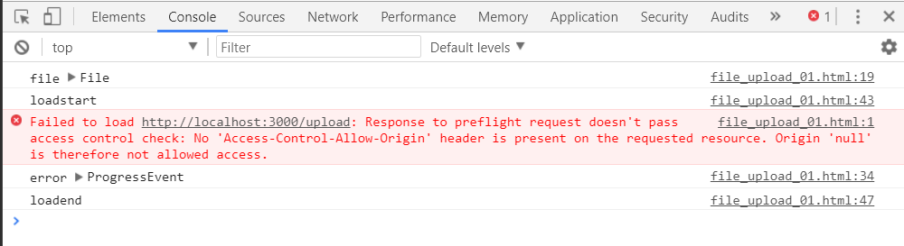
CORS

